Slide 1
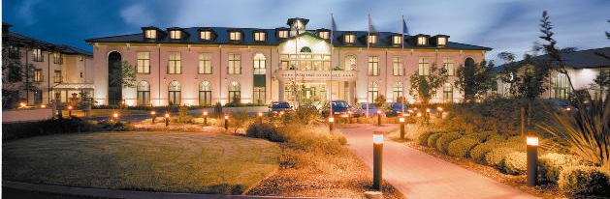

Vale Of Glamorgan Resort
By Chloe Speirs
(2000729)
https://www.walestouristsonline.co.uk/cardiff/hotels/The_Vale_Resort_WPKTRHP8.html

Slide 2
Risks
Venue to either Liverpool or Bayern Munich football team
Fire
Ensure that all guests are escorted from the hotel rapidly and safely as per the evacuation procedures
Ensure that evacuation procedures are located visibly throughout the hotel to ensure that it is easily visible to all guests and employees
Evacuation maps along with allocated safety points to be located within all rooms
Previous fire safety system testing
All hotel staff & security to be aware of the evacuation and fire procedures and plans in place
Ensure staff are familiarized with their designated responsibilities
Overcrowding
Ensure that ques are in place as all times, especially during peak/ busy times
Only guests with a hotel booking to be allowed access to hotel, no walk ins should be allowed to gain access during this time
On door security at all entrances of hotel always
Put extra security in place throughout the hotel
Crowd control barriers in place
Terror Attack
Accurate and full luggage checkage on arrival
Be Vigilant- Security/ employees on constant watch for suspicious Behaviour- High usage of CCTV surveillance
Approved counter terrorism plan in action
All unusual Behaviour to be reported immediately and to the correct responder/ management group
Prior stewards and staff briefings
Contact and Inform Police Anti-Terrorism Hotline immediately if guests or staff have any fears or suspicions
Hooliganism
Improved Security
Segregation of Fans- Keeping the opposed fans away from home team fans
Alcohol Restrictions

Slide 3
References
Wales Tourists. (2023). The Vale Resort Hotel. Available at; https://www.walestouristsonline.co.uk/cardiff/hotels/The_Vale_Resort_WPKTRHP8.html. (Accessed on; 02/04/2023)
Aulakh, A. (2019) Strategies to Combat Hooliganism and Poor Behaviour by Spectators. Available at; https://getrevising.co.uk/diagrams/strategies-to-combat-hooliganism-and-poor. (Accessed on; 22/04/2023)
BBC News. (2016) Five Ways to Stop Football Hooliganism. Available at; https://www.bbc.co.uk/news/magazine-36516017. (Accessed on; 23/04/2023)
Setupmyhotel. (2023) Fire Emergency Plan and Procedure- Hotel. Available at; https://setupmyhotel.com/train-my-hotel-staff/securityandloss/722-hotel-fire-emergency-plan-and-procedures.html?utm_content=cmp-true. (Accessed on; 23/04/2023)
Red Cross. (2023) How to Prepare in Case of a Terror Attack. Available at; https://www.redcross.org.uk/get-help/prepare-for-emergencies/how-to-prepare-in-case-of-a-terrorist-attack. (Accessed on; 23/04/2023)

