Slide 1
Supplier relationship management (SRM)
Session:2

Slide 2
Introduction
Supplier relationship management (SRM) is the core procurement process that focuses on everything that happens after the strategic sourcing process. SRM focuses on the programmatic management of ongoing supplier relationships over time. Whereas strategic sourcing ends with a contract, SRM uses that as its starting point. SRM has a longer time horizon than strategic sourcing and is focused on driving continuous improvements jointly with the most important suppliers. In this topic, the rationale for focusing on supplier relationships is introduced and a basic framework for SRM is offered. Challenges in implementing SRM and new opportunity areas in supplier relationships are discussed.

Slide 3
Why focus on supplier relationships?
The strategic sourcing process is the process that leads to the development of relationships with suppliers, negotiated and contracted terms and conditions for the operational ordering process. SRM has everything to do with what happens after the contract is signed and the sourcing process is completed. This contract is used in the ordering cycle to place orders against and work together operationally on a day-to-day basis. For the most important suppliers, companies may choose to develop an ongoing relationship focus and a proactive approach to managing that relationship for continuing value creation. Arguably, SRM is the transition from ‘money in the sky’ in a sourcing strategy to ‘money on the table’ at the end of a sourcing process and actual ‘money in the pocket’ or realized benefits in a working relationship.

Slide 4
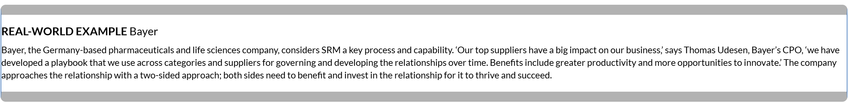

Slide 5
For procurement, not engaging in SRM leads to the risk of:
the business thinking procurement only negotiates the deal but is ‘missing in action’ when something goes wrong, or the contract needs to be executed and implemented
contracted savings and benefits ‘leaking away’ and never being ‘cashed’
suppliers consider procurement less credible because it is not involved in the actual business allocation but only in asking for preferential terms
narrowing procurement’s scope to negotiations, not doing business together and limiting its focus to the ‘deal’, not the collaboration.

Slide 6
In addition to avoiding those risks, there are additional benefits of focusing on relationships, as both parties can focus on continuous improvement efforts and openly share challenges and strategies with each other.
In turn, this can lead to productivity gains, risk reduction, ongoing savings and potentially process improvements and innovative opportunities that may go far beyond the initial contract agreed to at the end of the strategic sourcing process.

Slide 7
The difference between strategic sourcing and SRM
To help understand the uniqueness of SRM, Table 4.1 lists differences between the three core procurement processes.
Whereas the time horizon of a transaction in the ordering cycle is days/week for placing an order/receiving a good/paying the invoice, a strategic sourcing project can easily take months. SRM has an even longer time horizon, spanning the duration of the relations over the years.
Whereas strategic sourcing projects have a beginning and end, SRM has an ongoing programmatic focus on ensuring performance to contract and continuous improvement beyond that.
Whereas the supplier contract may mark the end of the strategic sourcing project, it marks the beginning point of SRM, focusing on the relationship post contracting.

Slide 8
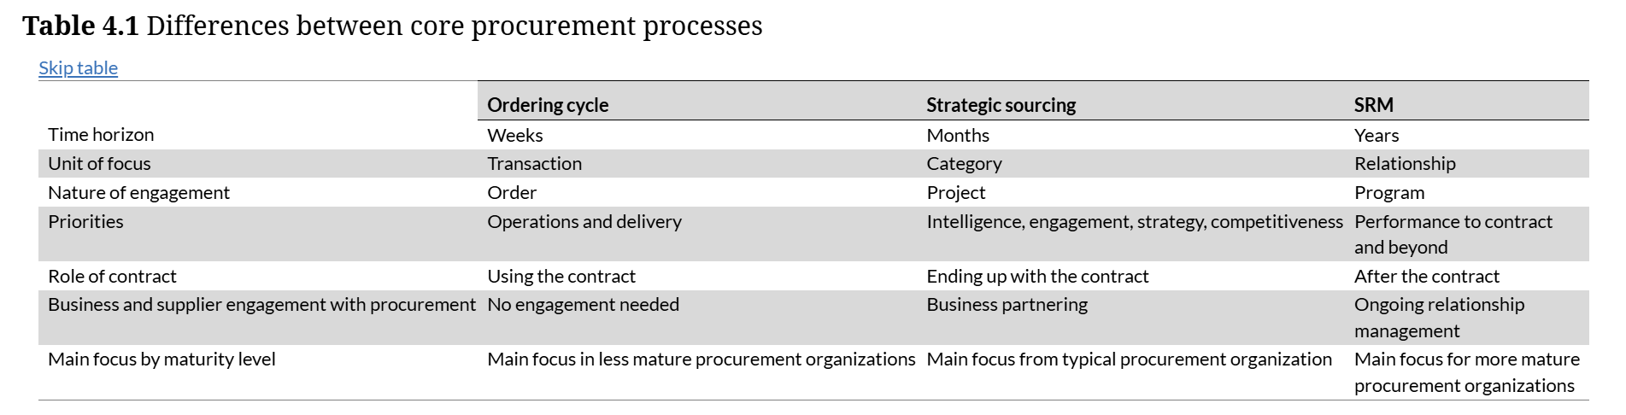

Slide 9
The difference between strategic sourcing and SRM
The topic of alignment plays different roles across the core processes. Whereas not much alignment is needed for processing transactions in the ordering cycle, business partnering with executive and cross-functional peers is critical; it is their spend, their business needs and specifications.
For SRM this engagement extends over time, to the relationship time horizon, requiring the engagement of executives to sponsor relationships and participate in top-to-top meetings, and of cross-functional team members to provide supplier feedback and engage in continuous improvement efforts.

Slide 10
The difference between strategic sourcing and SRM
A final key difference between the three core processes is the focus by procurement maturity level (see Table 1.1). If a procurement organization spends most of its time and resourcing in the ordering cycle it is a less mature organization that has room to mature into a greater focus on strategic sourcing.
The Webhelp organization was like that until the CFO started investing in procurement to run sourcing events across markets and by category of spend. Nowadays most professional procurement organizations major in this focus but aspire to mature to the level where they spend more time on SRM.

Slide 11
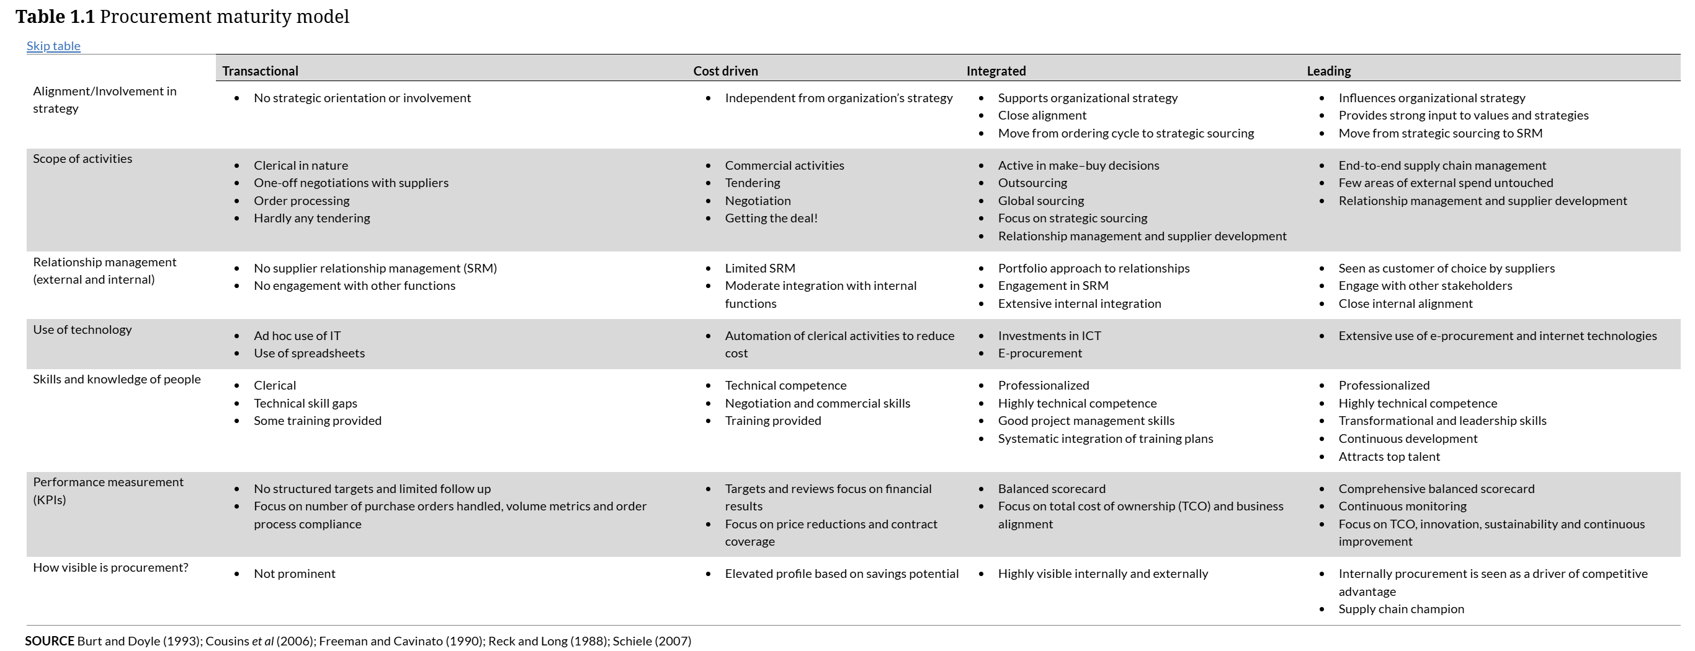

Slide 12
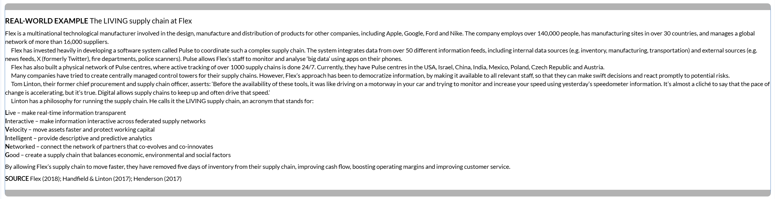

Slide 13
The difference between strategic sourcing and SRM
SRM requires sufficient sourcing capability for procurement to qualify as a business partner at the relationship level and it requires sufficient category coverage with sourcing to have strategically selected and contracted suppliers in place to consider for SRM. Hence SRM focus is more advanced. But this does not mean strategic sourcing will end; markets evolve, contracts expire, business needs change.
All of these are reasons why sourcing strategies need to be revisited over time.

Slide 14
SAME page framework for structuring SRM
Figure 4.1 shows four basic steps involved in implementing SRM:
Select suppliers to drive relationship efforts.
Align organizations, contact points and relationship governance.
Measure performance with a scorecard exchange.
Exchange improvement opportunities and efforts.

Slide 15
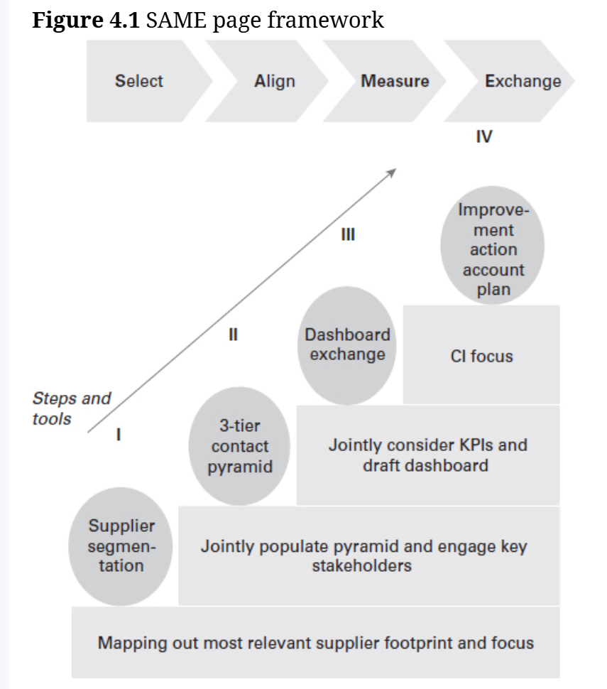

Slide 16
Select: segmenting the supply base
Key to SRM is the reality that the resource intensity and the exclusiveness of collaboration means there are only a few suppliers with whom true collaboration can be established. Not only because of demands on the supplier and limited capacity on the procurement side, but also because the majority of suppliers will be preferred or contracted suppliers at best.

Slide 17
Select: segmenting the supply base
There are many approaches to supplier segmentation, but organizations often rely on Kraljic’s matrix. In the strategic segment, there is a financial relevance and a risk need to drive for long-term and close relationships, while the routine segment does not warrant a lot of attention and hands-on involvement, as there is little risk and small financial benefit to be had. The leverage segment is the segment in which good-old negotiations and driving competitiveness in the market is the default approach; there are multiple suppliers and little risk of switching while there is a sizeable financial impact. Bottleneck suppliers may be smaller in financial impact but critical for supply; the focus here will be on ensuring supply rather than driving financial benefits. Key to supplier segmentation is to focus most resources and efforts on key suppliers and less on others – it is very much a prioritization scheme, just like any customer segmentation is.

Slide 18
Kraljic Matrix
Kraljic procurement positioning, or the Kraljic Matrix, is a strategic tool that classifies purchases into four quadrants based on profit impact and supply risk to develop tailored procurement strategies. Items are categorized as Strategic, Leverage, Bottleneck, or Non-Critical (Routine), guiding how a company should manage its suppliers and mitigate risks to optimize costs and ensure supply security.
The Two Dimensions
Profit Impact: This refers to the importance of the purchase to the company's profitability and bottom line.
Supply Risk: This describes the complexity or difficulty of the supply market, considering factors like supplier availability, monopoly situations, and technological innovation.

Slide 19
The Four Quadrants
Strategic Items: These are items with high profit impact and high supply risk. They require close collaboration and long-term, strategic relationships with suppliers to ensure a stable supply.
Leverage Items: These have a high profit impact but a low supply risk. With numerous available suppliers, procurement can use its purchasing power to negotiate favorable prices, terms, and conditions.
Bottleneck Items: These items present a high supply risk but have a low profit impact. Strategies focus on securing a reliable supply and minimizing dependence on few or single suppliers.
Non-Critical (Routine) Items: These have both low profit impact and low supply risk. The goal is to streamline these transactions through automated processes, reducing administrative costs and effort.

Slide 20
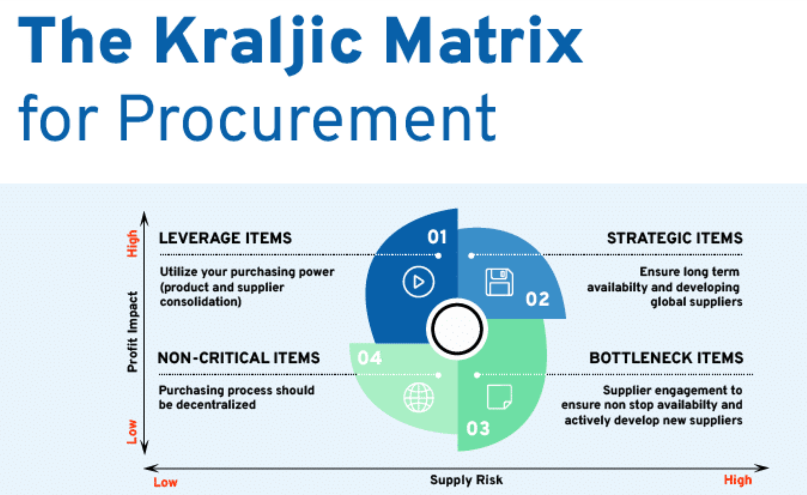

Slide 21
Select: segmenting the supply base
In that spirit, what Figure 4.2 introduces as sails of the windmill is the customer segmentation that a supplier might use, and it contrasts these with the procurement segmentation to explore what position procurement finds itself in.
For example, being seen as a strategic customer by a strategic supplier (far top right) introduces a good match and opportunity to develop a long-term partnership. If, however, a supplier you consider as strategic sees you as a customer that needs to be streamlined, for example not a very attractive account where they do not want to focus too many resources, you are in a risky position with that supplier. The approach here might be to seek and attract competitors. Equally so, if on the top left, you see suppliers as leverage and you are looking at them to drive competition. In contrast, suppliers see you as a strategic account, and you are in a good position as they will not likely turn you away and will work very hard in a competitive setting.

Slide 22
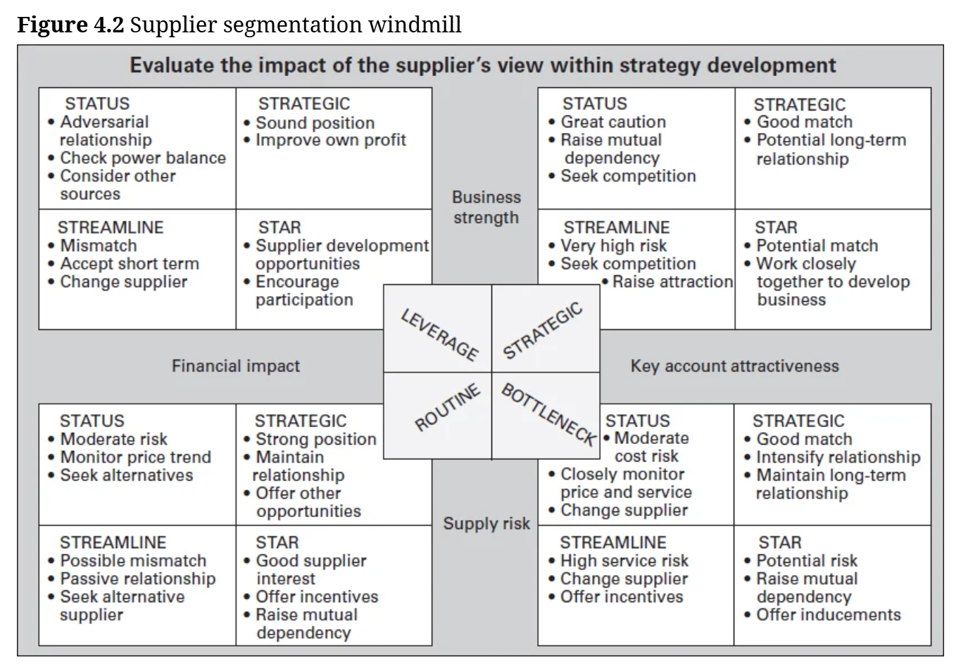

Slide 23
Align: contact pyramid
Some strategic and well-embedded suppliers have many connections with their customer organization on multiple levels and in multiple business areas.
Key to streamlining relationship efforts is to leverage on these connections and to provide structure, sponsorship and ownership to the engagement.

Slide 24
Align: contact pyramid
Typically, the two sides of therelationship will specify operational, relationship and sponsorshiplevels of contacts, in which the operational interactions can be day-to-day and about normal business transactions.
The relationship levelinteraction may be on a business period by business period timeframe involving relationship and account management from bothsides.
And the top level could be bringing together senior leaders,who sponsor and oversee the relationship, less frequently.

Slide 25
Measure: supplier dashboard
A supplier dashboard is used to measure and track suppliers’ performance in the eyes of users in the business and against the agreements reached with procurement. As such, it is very much a barometer of progress and performance and a basis for discussion about improvement opportunities.

Slide 26
Measure: supplier dashboard
Rules of thumb for good dashboards include:
Do not overcomplicate the metrics and the size of the dashboard; this just burdens the supplier without contributing to the main purpose of the dashboard.
The most important role of the dashboard is to serve as a basis for discussion.
The dashboard should be two-sided to truly reflect the relationship.
Focus KPIs on improvement areas and relationship priorities and do so consistently over time.
Inform KPIs with supplier selection criteria and sourcing strategy to avoid inconsistency across procurement processes (e.g. we select on different criteria than we evaluate on).

Slide 27
Measure: supplier dashboard
In addition to driving discussion about improvement opportunities, dashboards can be used to:
showcase progress and joint wins
engage business leaders and stakeholders in the relationship in a nuanced way (not biased by the most recent interactions)
create a road map for the relationship in the periods to come
allocate business volumes based upon progress and relative performance
inform updates and adjustments to sourcing strategies.

Slide 28
Exchange: improvement plans
Joint investment and innovation efforts represent a hallmark of achievement in SRM – this is when the two organizations really connect and engage deeply together. Improvement actions may initially be focused on more operational areas in the early days of the relationship. Over time they move to new areas of collaboration and investments identified at the relationship level and sponsors at the top level of the relationship pyramid.
Suppliers may also become collaborators in risk management. It is feasible to discuss risk drivers and levers in the relationship and the supply chain, and to jointly develop scenarios and mitigation approaches to reduce and respond to risks. Risk metrics may become part of the scorecard, and supplier and buyer can team up to monitor for possible risks, including supply disruptions, quality issues or logistics challenges.

Slide 29
Exchange: improvement plans
The benefit of including suppliers in risk management efforts is that it can enrich the risk heatmap typically used to categorize risk approaches. Figure 4.3 shows an example of such a heatmap plotting risks by likelihood of occurrence and size of impact. The map can be used to design risk management approaches. The three sections of the map are risks in the top right that urgently change strategy, in the centre requiring the development of a plan for mitigation and monitor risks, and the bottom left with tolerable risks. Suppliers can not only be part of more robust mitigation planning, they may also identify additional risks to be added to the heatmap and be able to identify upstream risk occurrences before they materialize for their customers.

Slide 30
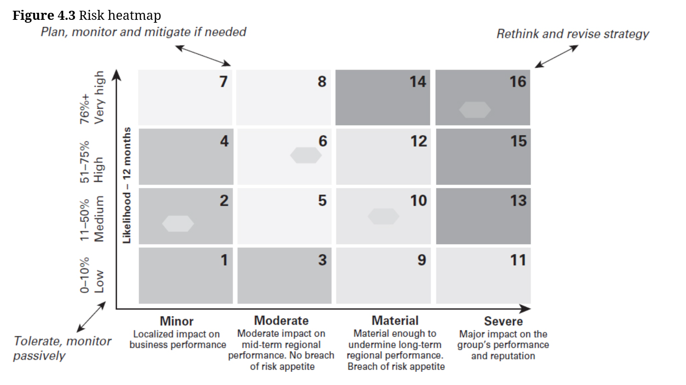

Slide 31
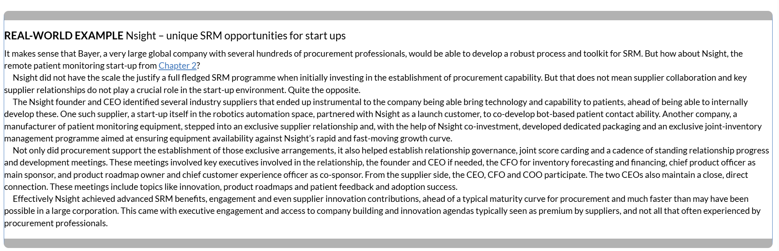

Slide 32
Exchange: improvement plans
The supplier contract closed at the end of the sourcing process provides the basis for ongoing relationship management and, as such, is a linking pin between the two processes. As such, how a supplier is contracted, reflecting the sourcing strategy that led to the contract, impacts how a supplier will be approached in SRM. In other words, the sourcing strategy travels through the process for a while, all the way into SRM.

Slide 33
Figure 4.4 further illustrates the interrelation between sourcing strategy selection, supplier segmentation and risk heatmapping. When selecting a price-centric sourcing strategy on the left of the diamond, the selected supplier(s) will fall into the leverage supplier segment: low risk and high impact on financial results, triggering a focus on competitive bidding to drive savings. If, however, a value-centric strategy is selected from the right side of the diamond, this will likely lead to strategic suppliers, where we focus on much more than price alone, or it provides a way to cope with a supplier bottleneck. In those markets, buyers will focus less on price (left side of the sourcing diamond) and more on ensuring supply, something that can be ensured with value-centric strategies from the right side of the diamond. Routine suppliers are not worthy of prioritisation for strategic sourcing and, as a result, will likely not have been selected using a sourcing strategy.

Slide 34
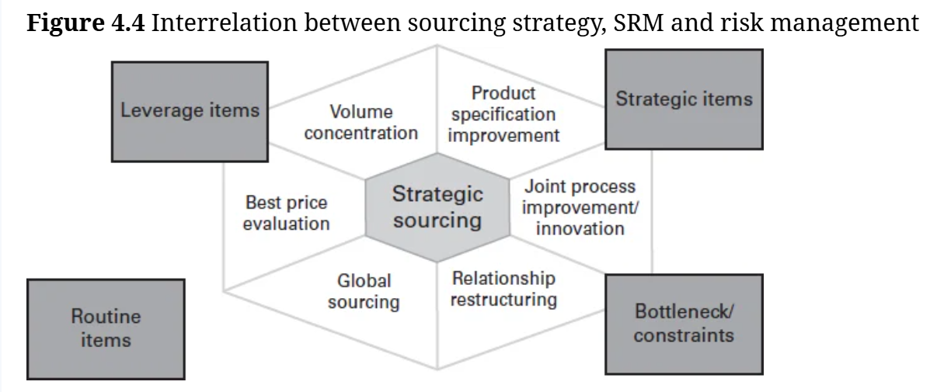

Slide 35
The overlap with the risk heatmap is that tolerable risks (bottom left of the heatmap) are those involving routine suppliers, and selected sourcing strategies on the left side of the diamond (for example tolerating longer shipping lines allowing for low-cost country sourcing). On the opposite, for risks facing strategic suppliers a strategy change is a worthy focus (top right of the heatmap) using value-driven sourcing strategies.

Slide 36
Challenges in implementing SRM
There are several critical challenges in implementing SRM, which help explain why many procurement executives plan to and would like to be more active in SRM than they are today. These challenges are as follows:
It is hard to make the case for devoting time and resources in SRM against the track record of savings from focusing on sourcing.
Engaging the business in SRM is critical, yet can be difficult to structure in a sustainable manner.
Doing SRM well requires a different skill set for procurement staff than traditional procurement and strategic sourcing.

Slide 37
Making the case
Many procurement organizations justify investment (in procurement leaders, team development and technologies) and the need for the business to engage with procurement based upon the financial benefits of strategic sourcing. Simply put, procurement can be self-funding with the savings it can generate, provided business alignment and sufficient calibre and capacity of staff. While sourcing leads to the contracting of (better) terms and commercial conditions, SRM is about bringing in those contracted returns during the usage period of those contracts. Arguably this takes more time and is a more ongoing effort. Yet pitching for the resources to do so can be challenging; most of the measurable benefits have already been claimed in a business case for sourcing. Yet without SRM, these benefits might never be capitalized upon.

Slide 38
Additionally, it is difficult to turn the economic benefits of having relationship managers into hard cash, such as negotiated savings. Yet the business might have come to expect hard ROI from procurement on the back of its strategic sourcing track record. On top of that, business leaders and peers will have multiple connections with suppliers already in place. This might lead them to challenge the need for procurement to involve itself in those relationships.

Slide 39
Some strong arguments that procurement leaders use in favour of SRM include:
avoid benefits leak past the contracting stage, for example seeing the agreement through
risk and dependence on critical suppliers justify resources and ongoing commitment
there are many things you cannot put in the contract, such as premium access to supplier resources and innovations
increased credibility and reliability as a customer of choice with suppliers.

Slide 40
Gaining business support and participation
Just as in strategic sourcing, business engagement is a critical success factor in SRM. Populating the relationship and governance pyramid with business contacts is critical to enable a close tie to operations, users and budget holders. It enables a real-life SRM conversation and makes the path to actioning outcomes shorter. However, when requesting business participation in an SRM programme, business leaders often push back using the argument that they already have supplier connections and conversations and can get the supplier in the room if there is an issue.

Slide 41
While this is true, experience shows that procurement can add some things to this connection, including:
coherent processes, calendars, governance structures and dashboards to provide consistency and rhythm to the conversations that otherwise are often infrequent, informal and not tied to improvement actions
clear roles and responsibilities in relationship management and the opportunity to deliver bad messages that business leaders often like to stay away from to ‘keep the relationship intact’
an enterprise perspective to the relationship rather than the (by definition) partial view of individual business leaders.

Slide 42
Different behaviours and skill sets
Managing relationships is different from negotiating terms and conditions. Needless to say, the ability to effectively implement SRM is critically dependent on adding to the skill set of the procurement department. Procurement managers and buyers have traditionally played hard ball: their job has been to secure better deals from suppliers. But what if suppliers are a gateway to innovation, quality and sustainability? And what if old-school procurement practices are standing in the way of tapping into the wisdom of suppliers?

Slide 43
SRM requires three key things:
Centring supplier engagement around customer market opportunities, stewarding supplier contributions ‘front of the house’ to new revenue and market differentiation rather than just focusing upstream on the supplier deal only.
Being transparent about where we need help from suppliers, where there are new business opportunities and facilitating access to users in the organization, as opposed to creating speed bumps to existing spend in the negotiations process.
Broadening the definition of success to include multiple elements of value, rather than just a narrow focus on price, and actively selling and marketing this story.

Slide 44
Three examples help illustrate this change:
Vodafone, the telecommunications multinational, takes supplier relations all the way into its marketing to consumers. The company has focused supplier relationships and engagements around the voice of its customers. It awards suppliers annually for their contribution to innovating new market propositions. A recent advertising campaign featured a supplier-developed service feature that transfers information from one mobile phone to the next while in the store as a reason for switching to Vodafone. The focus of procurement has moved from the back of the supply chain to ‘front of house’.
P&G offers an excellent example of openness in buyer behaviour and recently published its procurement sustainability scorecard in an effort to articulate where it seeks and needs supplier help. In the process, the company created transparency into what procurement’s objectives are, where it stands today and where it’s heading – obviously a break with the old tactic of blowing smoke into a negotiations process to gain the upper hand.
Unilever invites suppliers into innovation summits. At these events, procurement provides opportunities for suppliers to pitch innovations to business and R&D leaders. Procurement also markets the event and stewards suppliers with the Unilever board, leading to most board members attending the events and sponsoring projects.

Slide 45
These examples show how SRM is less about traditional buying that focuses upstream on deals, reduces transparency and introduces speed bumps to create leverage for price-driven negotiations. Instead, it is about focusing on customer value and moving from the back of the house to the front room. It is about being transparent about where help is needed, moving from playing poker to showing your cards.
As this next case study from Mars shows, part of the key change is to start listening to suppliers, measuring their feedback and addressing this consistently, to capture negotiated benefits and drive for premium access. This is an obvious shift from traditional strategic sourcing behaviour focused on telling suppliers what it takes to qualify and negotiating them into procurement’s mould.

Slide 46
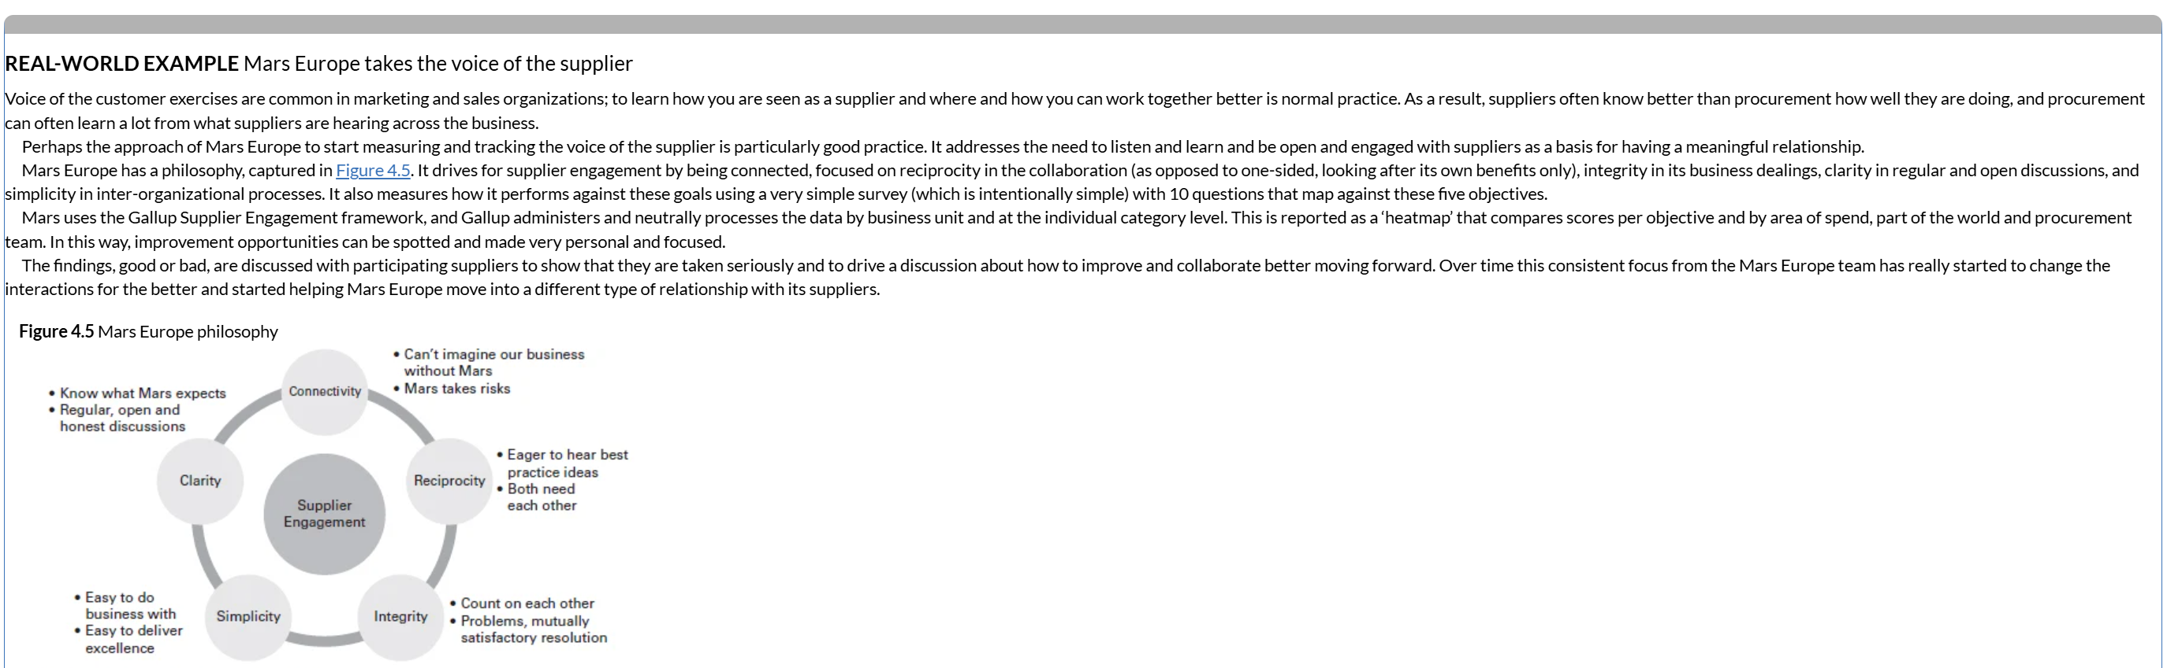

Slide 47
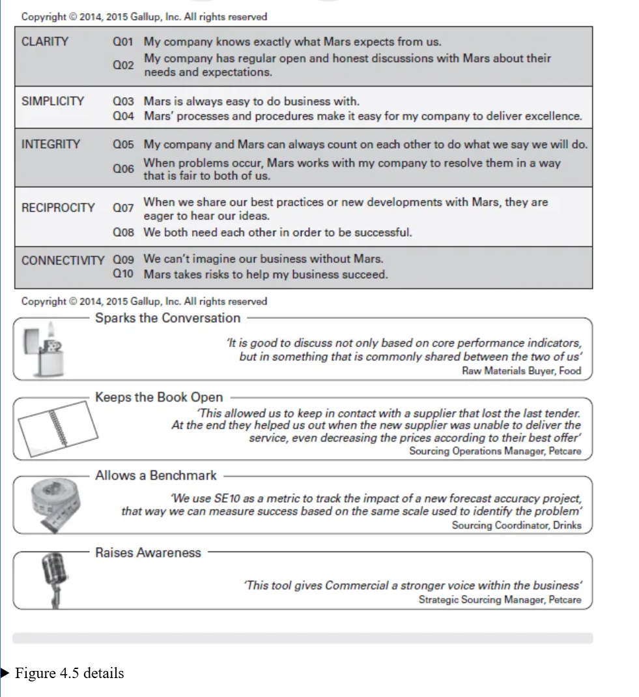

Slide 48
Making the change
While SRM is often talked about, one of the keys to future success in procurement will be to progress the wider roll-out and application of SRM in procurement.
To assist in planning and plotting the change, Figure 4.6 offers a possible change programme for implementing SRM.

Slide 49
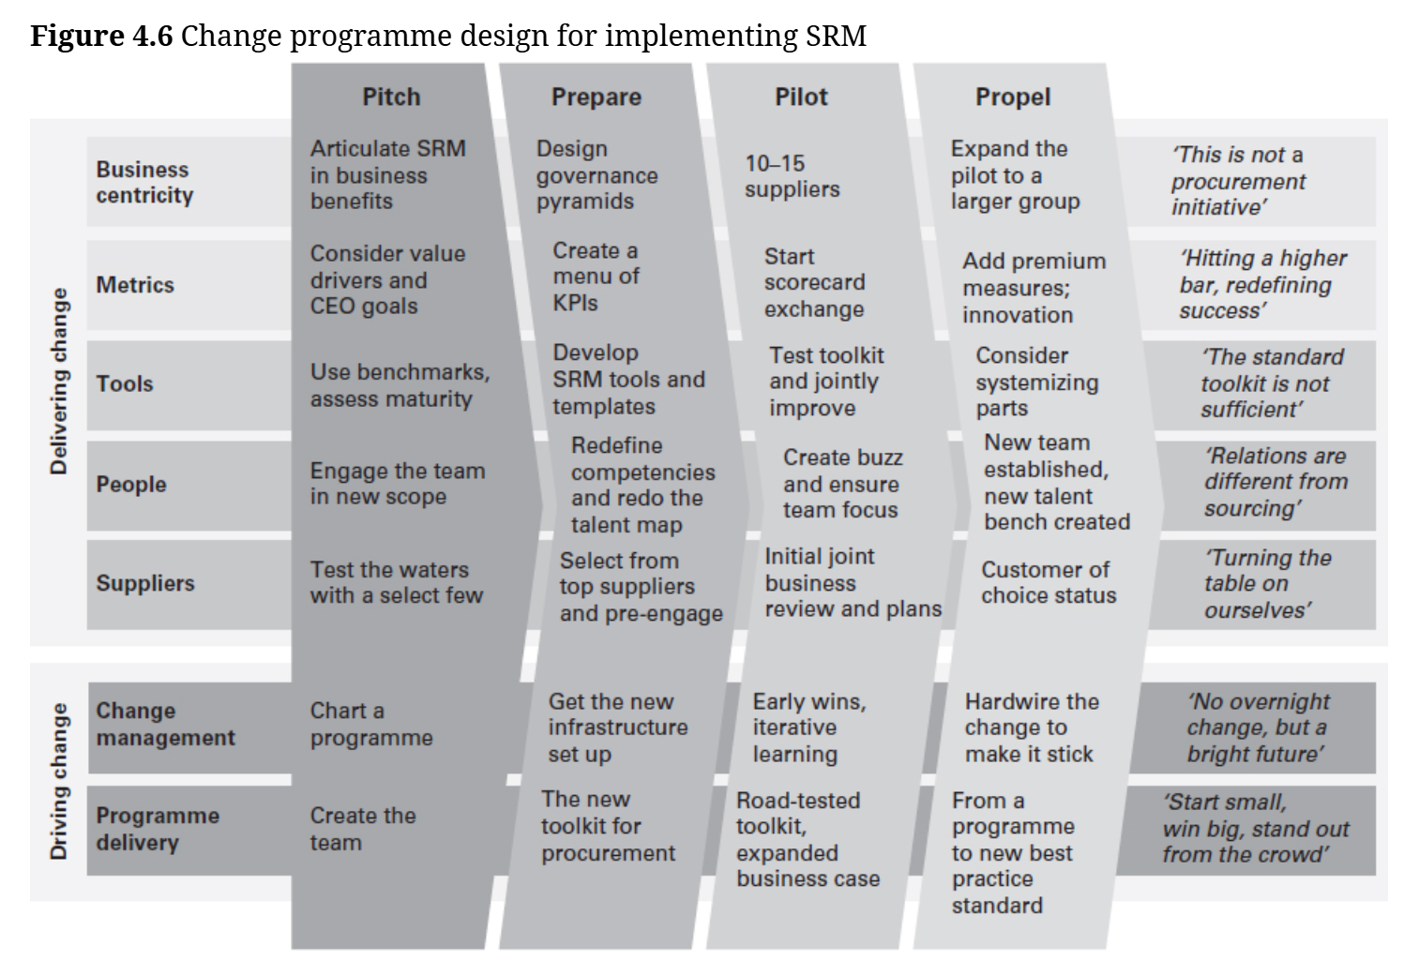

Slide 50
The top five horizontal bars in the diagram represent areas that need to change in order to implement SRM, which are:
business centric for it to succeed and be of sufficient value
supported by changes in metrics
enabled by tools
impacting people in the procurement team to change the ways of working
focused on engaging suppliers differently

Slide 51
From a change management perspective, suggestions are offered in the bottom two horizontal bars. The statements on the far right of the figure illustrate how stakeholders should be thinking about an SRM programme for the change aspects to be positioned well in the areas listed. These can serve as a litmus test: ‘Are we thinking and talking about this programme in the right way?’

Slide 52
The vertical bars represent the four likely stages in the development and roll-out of an SRM programme. They start with pitching the programme by articulating SRM in business benefits, engaging the procurement team and testing receptiveness of a few suppliers for such a programme. In the preparation stage, the toolkit is developed or rounded out as a basis for the programme, including the design of governance pyramids with the business, and scorecards. Profiles of roles in the programme are developed to enable a change in ways of working, and the selection of suppliers to pilot the programme with is finalized. The pilot can contain 10–15 suppliers to collaborate with to put the tools into action and test it, to show early wins and identify areas of improvement. In the propel stage, these can then be rolled out to a larger group of suppliers over time, and a customer of choice status can be targeted.

Slide 53
Summary and conclusions
Supplier relationship management is gaining focus and attention in strategic procurement, and this makes sense. SRM helps avoid negotiated benefits leaking away; it helps companies get to continuous improvement opportunities and ensures procurement can help see through a negotiated result. Key elements of implementing SRM are: segmenting suppliers and selecting key relationships to invest in establishing a contact pyramid to align contacts between the two firms establishing a dashboard to measure performance engaging in improvement planning on an ongoing basis. Barriers to change to be cleared for successful SRM include the need to make the case for SRM, gaining business support and engagement in the supplier relationships, and changing skills and behaviours of procurement teams.

Slide 54
With the ‘SAME page framework’ in place, the business engaged and the teamcapabilities developed, procurement puts itself in a perfect position to broaden itsimpact and expand the value it adds to the company and the supply chain. In reality, thiswill be easier said than done, and today SRM is talked about more than it is practised. Yetthe path forward is clear – supplier relations and the active engagement of procurementin them is the gateway to bigger value and business benefits.

