Slide 1
Communications Principles
Professor Ian Wells

Slide 2
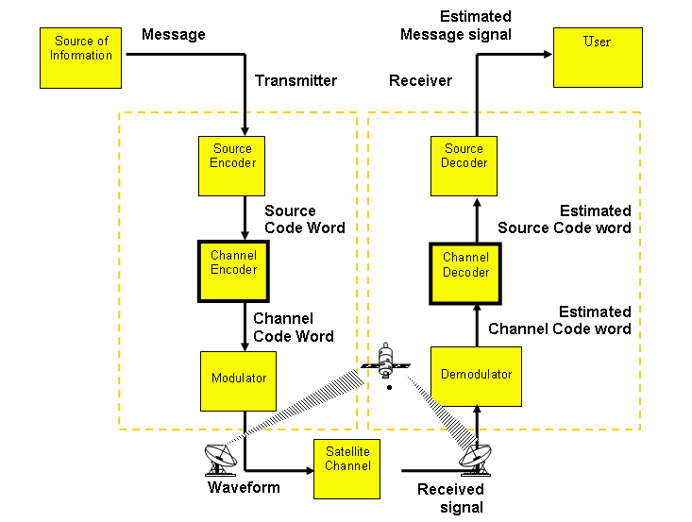
Communication System Block Diagram from http://www3.rad.com/networks/2002/errors/intro.htm

Slide 3
The Source Encoder
The Source Encoder performs such functions as variable length encoding of the digital message where required, which is concerned with the reduction of code word length for characters having a relatively high probability of transmission such as the vowel ‘e’.
This technique is sometimes referred to as data compression and is based for example on the works of Fano and Huffman.

Slide 4
The Channel Encoder
The Channel Encoder is concerned with the generation of error detection and correction codes.

Slide 5
The Modulator
The Modulator produces the signal waveforms that make the encoded messages suitable for transmission through the communications channel which involves for example, generation of A.S.K, F.S.K and P.S.K signal waveforms. The waveforms referred to above are generated by a modem.
The functions of demodulation (using a modem), channel and source decoding are performed by the receiver. Should the source and destination messages be in analogue form, then analogue to digital and digital to analogue converters are necessary.

Slide 6
The Channel
The Channel may be characterised by;
Bandwidth
Noise
Attenuation
Delay

Slide 7
System Types
A communications system may be digital either by the nature of the information (also known as data) which is passed into it, or in the nature of the signals which are transmitted. If either of these is digital then for our purposes it is considered to be a digital communications system.

Slide 8
Digital Modulation
We will focus on the 3 categories of digital modulation:
  Amplitude Shift Keying (ASK)
  Frequency Shift Keying (FSK)
  Phase Shift Keying (PSK)

Slide 9
The Sinusoid
A huge number of natural signals are either sinusoids or are composed of sinusoids.
It is represented mathematically as:
v(t) = Acos(2πf₀t + θ); -∞<t<+ ∞
= Acos(ϖ₀t + θ);
Where:
A = Amplitude
ϖ₀ ₌ angular frequency (radians per second)
f₀ = frequency (Hertz)
θ =phase (radians)
(NOTE: θ = “theta” and; ϖ = omega)

Slide 10
The Sinusoid
0 π/2 π 3π/2 2π Radians
0 90 180 270 360 Degrees
Notes:
Matlab code:
fs=1000;
t=0:1/fs:0.1;
v=cos(2*pi*10*t);
v1=cos(2*pi*10*t+2*pi/1.5);
plot(t,v,t,v1)
xlabel('Time (seconds)')
ylabel('Amplitude (Volts)')

Slide 11
Equations of the Sine Wave
The equations that relates the velocity (v), and wavelength, λ (lamda), the period, T and the frequency, f is:

Slide 12
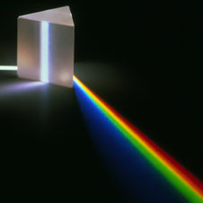
The Spectrum
The visible spectrum
Refraction from a prism
White light can be split up using a prism to form a spectrum. The light waves are refracted as they enter and leave the prism.

Slide 13

The Spectrum
The shorter the wavelength of the light, the more it is refracted.
As a result, red light is refracted the least and violet light is refracted the most, causing the coloured light to spread out to form a spectrum.

Slide 14
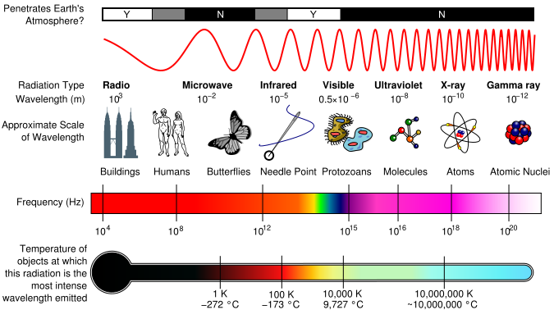
Electromagnetic Spectrum

Slide 15
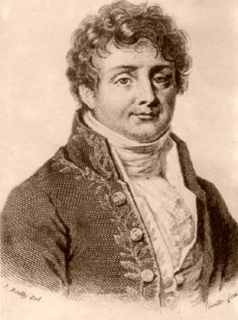
The Fourier Transform
The Fourier Transform is used in the continuous world to move from the 'Time Domain' into the 'Frequency Domain'.

Slide 16
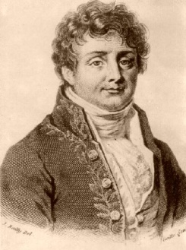
Spectrum of a Sinusoid
A typical spectrum of a sinusoid is shown below (this is its Fourier Transform):
Its frequency is 100Hz

Slide 17
The Delta Function
This is a special, function represented as below:
1
Relative Amplitude
0
Frequency (Hz)

Slide 18
Shifted and scaled
Delta functions can be scaled and shifted
3
Relative Amplitude
0
4
k

Slide 19
Representation of the Spectrum
The spectrum is represented as a pair of shifted delta (δ) functions. This is the spectrum of cos(2πf_{c}t)
0.5
Relative Amplitude
-fc
0
fc
Frequency (Hz)

Slide 20
Systems and Transforms
x(t)
Convolve
y(t)=h(t)*x(t)
IFT
Input
LTIV System
(we know h(t) or H(f)
Output
FT
X(f)
Y(f)=H(f).X(f)
Multiply

Slide 21
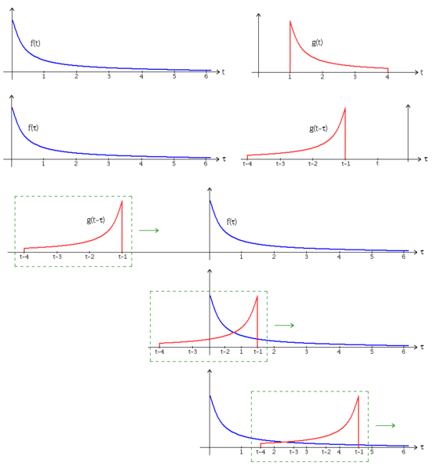
A Visual explanation of convolution

Slide 22
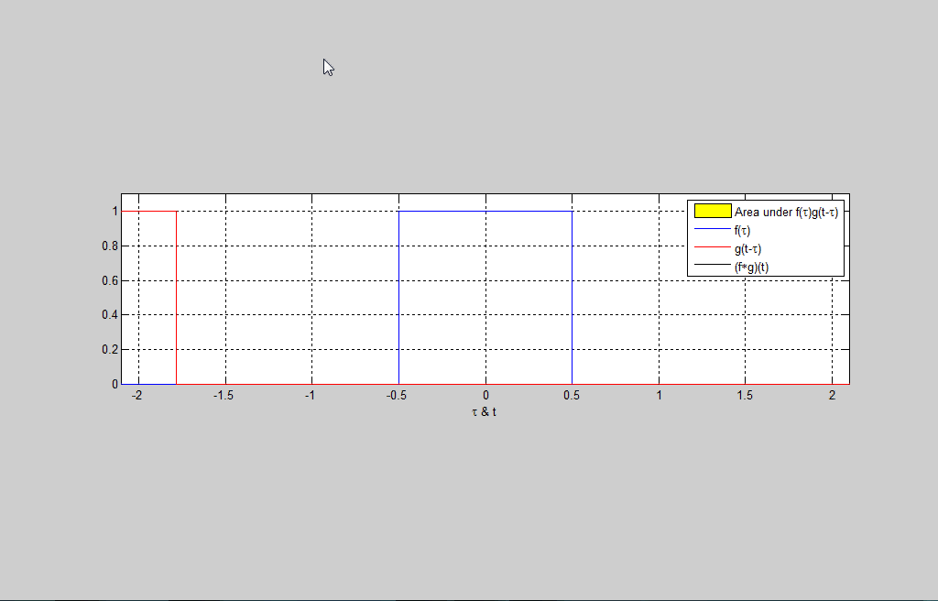
Rectangular Function convolution animation

Slide 23
Signal and channel types
Signals can either be:
  baseband
  bandpass
and similarly channels can be:
  baseband
  bandpass

Slide 24
Baseband Signals
A baseband signal is one where its spectrum is centred around 0Hz known as the DC (Direct Current) value
Relative Amplitude
1
0
Frequency (Hz)

Slide 25
Bandpass Signals
These are where the spectrum is centred around a different frequency (fc) other than DC
Relative Amplitude
1
fc
0
fc
Frequency (Hz)

Slide 26
Baseband channels
A baseband channel is where the channel only allows frequencies through which are baseband signals.
Channel response – low pass filter
Relative Amplitude
1
0
Frequency (Hz)

Slide 27
Baseband channels
Baseband channel with bandpass signal – the signal is filtered and will not pass thought the channel
Channel response – low pass filter
Relative Amplitude
1
0
Frequency (Hz)

Slide 28
Bandpass Channels
Bandpass channels will allow bandpass signals to pass if their centre frequency is inside the range of the channel.
Channel response high pass filter
Relative Amplitude
1
fc
0
fc
Frequency (Hz)

Slide 29
Bandpass Channel example
The telephone system is a bandpass channel whereas speech is baseband.
The effect is that the low frequency parts of speech are removed and only frequencies from 300Hz to 3200Hs are allowed through.

Slide 30
Frequency translation
Most signals are baseband and unfortunately most channels (especially radio channels) are bandpass.
Frequency translation is a process of moving a signal from baseband to bandpass

Slide 31
Frequency translation
Imagine that we have a baseband signal and that we multiply the signal by a sinusoid
We want to see the effect of this in the frequency domain
We know that multiplication in the time domain is ‘convolution’ in the frequency domain.

Slide 32
convolution with a delta function
Convolution with a delta function re-centres the function at the point of the delta function.
Consequently, convolution of two delta functions with our baseband signal gives the following

Slide 33
1
Relative Amplitude
Frequency (Hz)
0.5
fc
0
fc
0.5
fc
0
fc

Slide 34
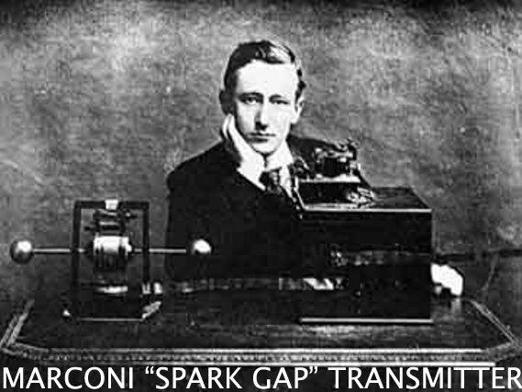
convolution with a delta function
So we have achieved the moving of a baseband signal into a bandpass channel
This was achieved by multiplication of our signal by a sinusoid – this process was called heterodyning in the early days of radio but is now known as modulation

Slide 35
Mathematically
In the time domain
In the frequency domain

Slide 36
Digital Modulation
The digital data is used to modulate one or more of the parameters of the carrier wave,
There are three parameters of the carrier wave to vary and therefore three basic types of digital modulation:
  Amplitude Shift Keying (ASK)
  Frequency Shift Keying (FSK), and
  Phase Shift Keying (PSK).

Slide 37
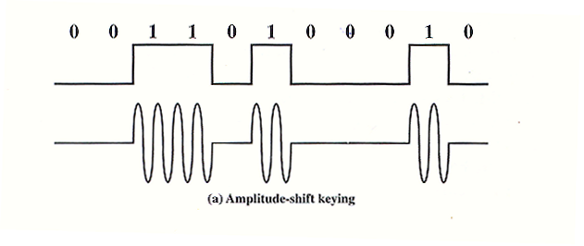
Amplitude Shift Keying (ASK)
In amplitude shift keying, the carrier wave amplitude is changed between discrete levels (usually two) in accordance with the digital data.

Slide 38
Ask modulator
Either use a conventional modulator
Or a simple switch
x(t)
y(t)
A_{c}cos(2πf_{c}t)
1
Modulated Signal
Oscillator, fc
0
data

Slide 39
Ask demodulator
This is done by multiplying the received signal by a copy of the carrier and low pass filtering the result (Why the low pass filter?)
Received signal
Low Pass Filter
Demodulated signal
A_{c}cos(2πf_{c}t)

Slide 40
ASK Example
The digital data to be transmitted is the binary number 00110100010.
Two amplitudes are used to directly represent the data, either 0 or 1. In this case, the modulation is called binary amplitude shift keying (BASK) or On Off Keying (OOK).
The signal is divided into eleven pulses of equal duration which represent the bits in the digital data.
The resulting signal is;

Slide 41
Uses of ASK
ASK is susceptible to sudden gain changes and is a rather inefficient modulation technique. On voice grade lines it is typically only used up to 1200bps.
The ASK technique is used to transmit digital data over optical fibre. For LED transmitters the preceding equation is valid. That is one signal element is represented by a light pulse while the other element is represented by the absence of light.
Laser transmitters normally have fixed “bias” current that causes the device to emit a low light level. This low level represents one signal element, while a higher amplitude light wave represents another.

Slide 42
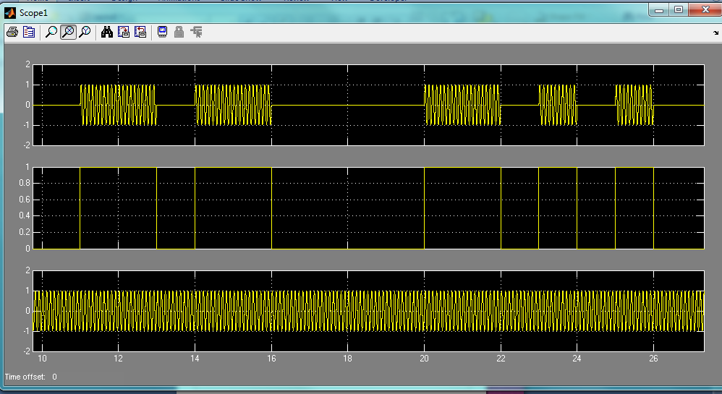
ASK Simulation

Slide 43
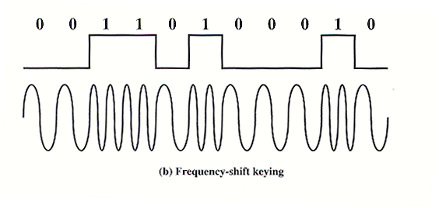
Frequency shift keying (FSK)
In frequency shift keying, the carrier frequency is changed between discrete values.
If only two frequencies are used then this will be called BFSK, for binary frequency shift keying.

Slide 44
FSK Mathematically
The FSK signal mathematically is;
Where f₁ and f₂ are typically offset from the carrier frequency fc by an equal but opposite amount.

Slide 45
FSK modulator
1
Oscillator, f1
Modulated Signal
Oscillator, f2
0
data

Slide 46
FSK demodulator
+
Received signal
Low Pass Filter
Sampler/ regenerator
A_{c}cos(2πf₁t)
-
A_{c}cos(2πf₀t)

Slide 47
Example fsk for voice
Example of the use of FSK for full-duplex operation over a voice grade line.:
The figure is a specification for the Bell System 108 series modems.
Recall that a voice grade line will pass frequencies in the range 300 to 3400 Hz, and that full duplex means that signals are transmitted in both directions at the same time.
To achieve full duplex this bandwidth is split

Slide 48
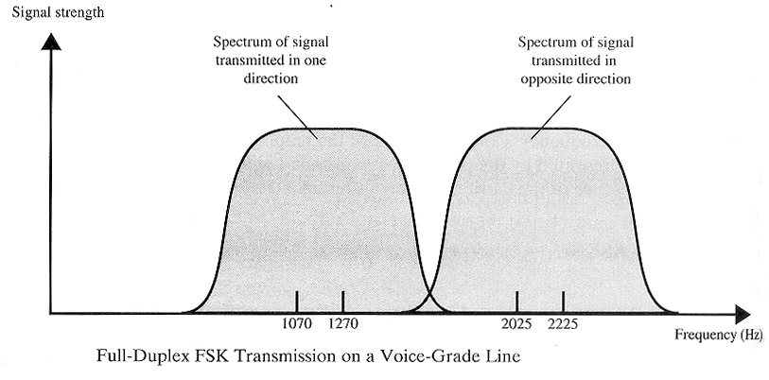
Example fsk for voice
In one direction, the frequencies used to represent 1 and 0 are centred on 1170 Hz, with a shift of 100Hz on either side. The effect of alternating between those two frequencies is to produce a signal whose spectrum is indicated as the shaded area on the left

Slide 49
Example fsk for voice
Similarly for the other direction the modem uses frequencies shifted 100Hz to each side of a centre frequency of 2125 Hz.
This signal is indicated by the shaded area on the right.
Note that there is little overlap and thus little interference.

Slide 50
Example fsk for voice
FSK is less susceptible to error than ASK.
On voice grade lines, it is typically used up to 1200 bps.
It is also commonly used for high-frequency (3 – 300 MHz) radio transmission.

Slide 51
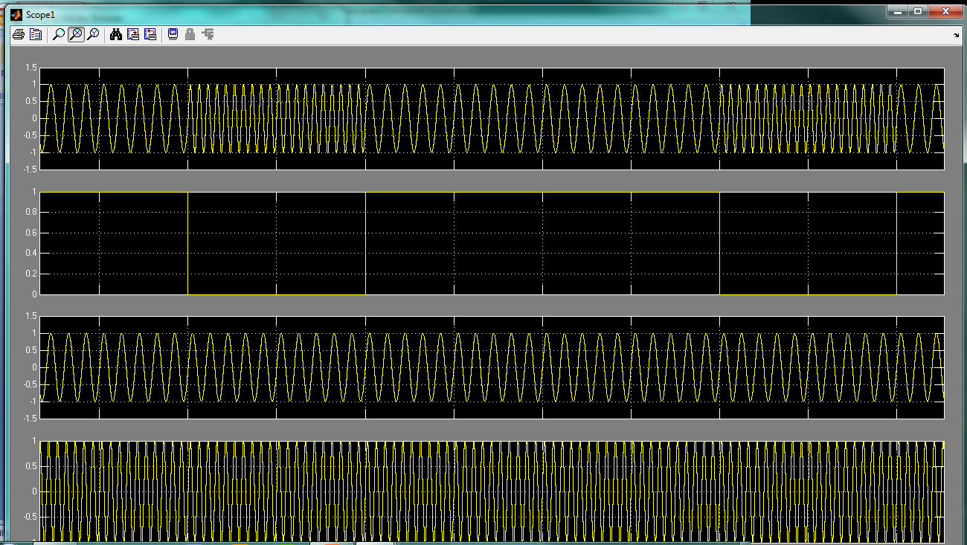
FSK Simulation

Slide 52
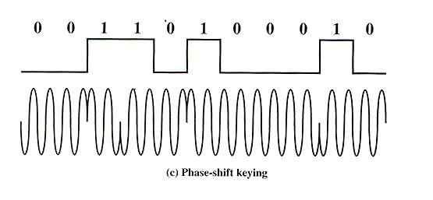
Phase shift keying (PSK)
The phase of the carrier wave at the beginning of the pulse is changed between discrete values.

Slide 53
Binary psk
Where one phase represents a binary 0 (e.g. 0⁰) and another represents a binary 1 (e.g. 180⁰ or π radians) then this type of PSK is known as Binary PSK (BPSK)

Slide 54
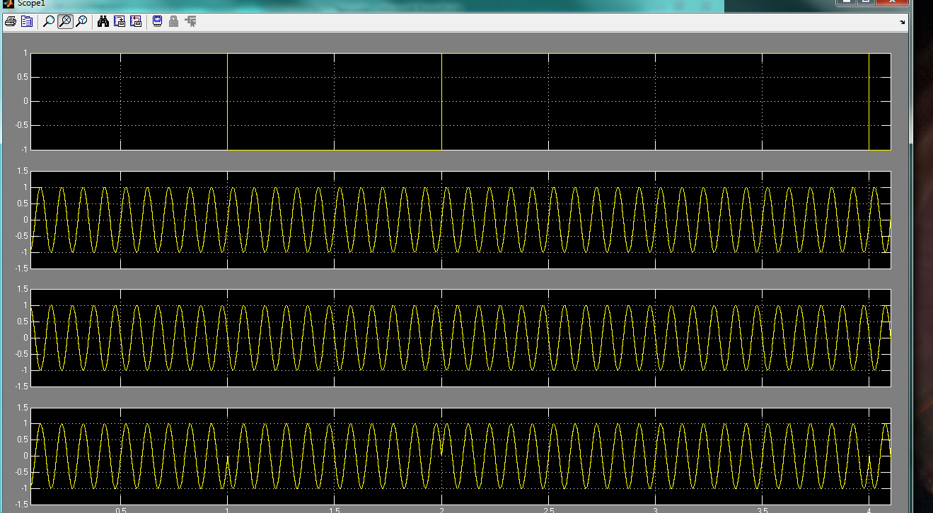
BPSK Simulation

Slide 55
PSK modulator
The half wavelength delay produces phase changes of π in the modulated signal
Half wavelength delay
1
Modulated Signal
Oscillator, fc
0
data

Slide 56
PSK demodulator
A PSK signal is either:
Or
In any time interval, and so its demodulation can be done by detecting its sign in each time interval.
This is equivalent to detecting phase

Slide 57
PSK demodulator
Received signal
Low Pass Filter
Sampler/ regenerator
A_{c}cos(2πf_{c}t)
Reference signal
The reference signal must be in phase with the original carrier

