Slide 1
BMSW4009
Effective Team Working and Communication
Week 2
October 2025
Muhammad Cassamo and Melanie Squire

Slide 2
Today we will…
Recap from last week
Relationships continued (PAC model)
The difference between groups and teams
Tuckman’s theory
Creating your presentation groups

Slide 3
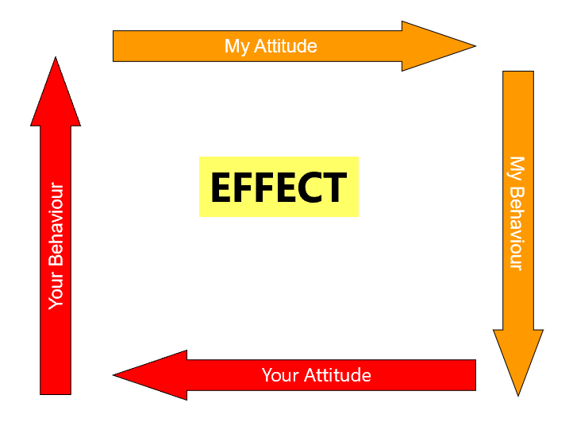
Recap of Week 1
We are all different and keep changing
The importance of relationships and trust
Valuing and promoting difference (Gestalt/Dialectical Tension)
Betari’s Box

Slide 4
What have you been thinking about?
What did you recognise about yourself in relationships?
What situations have you noticed yourself focusing more on relationships?
What do you agree/disagree with?
Notes:
Invite the students to split into pairs – find someone they don’t know/know less well.
Spend 9-10 minutes reflecting on their learning over the last 7 days focusing on relationships and their importance: particularly to achieving tasks.
Debrief for 8-9 minutes drawing out key themes; clarify and help people to better understand the concepts/approaches as appropriate.

Slide 5
Relationships:
I am OK You are OK HEALTHY No blame: focuses on issues | I am OK You are not OK ONE UP Blame others
I am not OK You are OK ONE DOWN Blame self | I am not OK You are not OK HOPELESS Blame everyone
The OK Corral
Ernst (1971)
Notes:
Highlight that effective relationships and teamwork is based on trying to create “I’m ok, you’re ok”.
Talk through the model briefly.
Highlight that a basic human instinct is to power play, and recognising but moving on from this is essential for teams. The crucial word to draw out here is that when you here people being blamed, you’re not going to get effective relationships and teamwork.

Slide 6
What issues can affect relationship building?
Culture - organisational & personal
Confidentiality
Social skills
Communication
Formality & informality
Trust – the big one!
Notes:
1. Communication Barriers
Effective communication is the cornerstone of any strong relationship. Barriers such as language differences, poor listening skills, and non-verbal communication misinterpretations can hinder understanding and trust.
2. Trust Issues
Building trust takes time and effort. Past experiences of betrayal or disappointment can make individuals wary of opening up or trusting others, which can impede the development of new relationships.
3. Different Values and Beliefs
Conflicts can arise when individuals hold different values, beliefs, or worldviews. These differences can be challenging to navigate and can lead to misunderstandings or disagreements that strain relationships.
4. Time Constraints
Building and maintaining relationships requires time. Busy schedules and prior commitments can limit the time available for developing new relationships or strengthening existing ones.
5. Personality Clashes
Differing personalities can lead to conflicts. For example, an introverted person might struggle to connect with someone who is extremely extroverted, which can create discomfort and misunderstanding.
6. Fear of Rejection
The fear of being rejected can prevent individuals from reaching out and making connections. This fear can stem from low self-esteem, previous rejections, or anxiety, making it hard to initiate or deepen relationships.
7. Technological Interference
While technology can facilitate connections, excessive use can also create a barrier. Reliance on digital communication can lead to a lack of deep, face-to-face interactions, which are crucial for building emotional bonds.
8. Cultural Differences
In a multicultural setting, cultural misunderstandings can occur. Differences in social norms, communication styles, and traditions can lead to misinterpretations and conflicts.
9. Lack of Empathy
Empathy involves understanding and sharing the feelings of another. A lack of empathy can make it difficult to form emotional connections or to respond appropriately to others' needs and feelings.
10. Environmental Stress
External pressures such as work stress, financial problems, or family issues can affect one's emotional availability and capacity to engage in relationships. Stress can make individuals irritable, withdrawn, or overly dependent, which can strain interactions with others.

Slide 7
PAC Model
Parent/Adult/Child
Parent: Represents a state of authority, adopting attitudes copied from parents or authority figures.
Adult: Represents a state of rationality and objectivity, dealing with current reality and reasoning.
Child: Represents a state of reaction, driven by emotions and past experiences.

Slide 8
Understanding Behaviour
Recognising which state we are in can help us understand our own responses and behaviours in team settings.
Impact on Others:
Different states can affect interactions with team members and outcomes in communication.
Practical Use:
How would we apply this knowledge to improve communication and collaboration within teams.
Notes:
Understanding Behaviour:
Note: Understanding which 'state' an individual is operating from can clarify motivations and reactions within the team.
Example: If a team member reacts defensively to feedback, recognizing this as a 'Child' state reaction can guide others in responding more supportively rather than critically.
Impact on Others:
Note: Interactions between different states can either foster or hinder communication and team dynamics.
Example:
Parent to Child: A team leader in the 'Parent' state giving orders might trigger rebellious or compliant behaviors from team members in the 'Child' state.
Adult to Adult: Encouraging an 'Adult' to 'Adult' interaction promotes rational and objective discussions, ideal for problem-solving and collaboration.
Practical Use:
Note: Awareness of these states can lead to more effective communication strategies and conflict resolution within teams.
Example 1: In meetings, if a team member consistently speaks from the 'Parent' state, it might create resentment or passivity in others. Training in recognizing these states can help the team encourage more 'Adult' state dialogue, fostering a more inclusive and productive environment.
Example 2: During conflict, a team member may slip into a 'Child' state, reacting emotionally. Recognizing this, other members can shift their approach by engaging from their 'Adult' state, focusing on facts and logic to help de-escalate the situation.

Slide 9
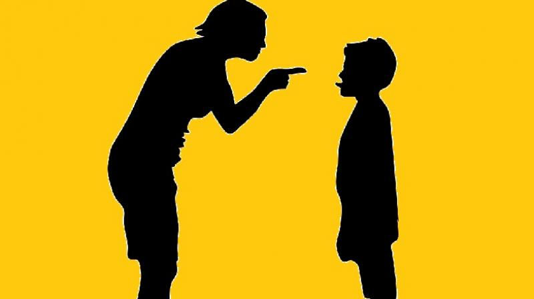


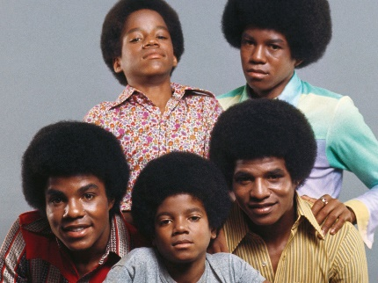
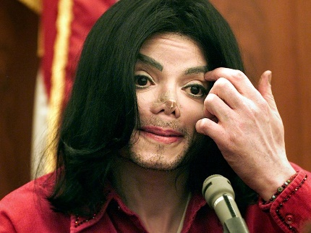

People – what state to choose?
Controlling
Nurturing
Parent
Adult
Transactional Analysis – the Games We Play
Berne (1958)
Child
Adapted: Compliant vs Rebellious
Free Child
Notes:
Explain the model:
The research points to us being in one of these states at any given point, and that we move between them very easily. It also points to us having a preference.
There are upsides and downsides of all of these states.
There are 3 main states (Parent, Adult, Child)
There are sub states to Parent and Child – the controlling parent (telling) and nurturing (doing things for others); the child state has the adapted child (responding to the parent) which can be both compliant and rebellious (Michael Jackson’s life story is a good example here) and the free child (creative, pushing boundaries)

Slide 10



The consequences?
Positive | Negative
Firmness, control, clarity, accountability | Bossy, overbearing, disabling & disengaging
Caring, loving, kind generous | “Rescuers need victims”; disable people doing things for themselves
Logical, rational, problem-solving, balance conflict | Boring, pedantic, limited use of feelings/values
Polite, courteous, accepting, amenable | Sit quietly, can’t say “no”; or aggressive, rebellious (or both)
Friendliness, fun, creative, honest, use emotions | Immature, childish, over emotional
Controlling
Parent
Nurturing
Parent
Functional Adult
Adapted Child
Free
Child
Notes:
Talk through the upsides and downsides:
e.g. if a fire officer tells you to get out of the building, it’s probably not a moment to sit down and chat; BUT if you are told what to do (and don't make decisions for yourself) you will become an adapted child.
We can play in all the states and there are consequences of being in one state too much or too little. Our individual behaviours in each state are most likely to have been learnt from childhood, but recognising these, gives us a chance to choose the best state and behaviours.

Slide 11

How do we build relationships with others?
Parent
Adult
Child
Notes:
Highlight the most likely response depending on the state that you pick.
Telling someone what to do ultimately gets 2 answers back: a child-like response (compliance or resistance) or a returned parental response (I’m more right than you)...this can rapidly slip into childlike behaviors from both people.
Treating each other as adults and with equal respect releases potential and ensures that both parties are “ok”; (NB positional power is often a barrier to this)

Slide 12

What is the difference between a team and a group?
Notes:
. Purpose and Goals
Groups: Typically formed with individuals assembled together without a common performance goal. Their objectives might be to share information or make decisions collectively but independently.
Teams: Formed specifically to achieve shared goals or complete tasks together. Teams have a strong, defined purpose and collective performance goals where members are mutually accountable.
2. Structure and Roles
Groups: Members may have similar or overlapping roles within the group's structure. Leadership might be less defined, with one or more members acting as facilitators.
Teams: Typically features clearly defined roles for each team member based on their strengths and job functions. Teams often have a designated leader, and the structure is designed to optimize performance towards the team's objectives.
3. Interdependence
Groups: Members operate more independently, with less reliance on others within the group to carry out tasks. Group performance might be the sum of each member's individual contributions.
Teams: High interdependence among members who need to work closely and coordinate their efforts to achieve the team’s objectives. Success is contingent on collaboration and the collective performance.
4. Accountability
Groups: Accountability is generally individual. Each member is responsible for their contributions or decisions within the group setting.
Teams: Emphasizes both individual and mutual accountability. The entire team shares responsibility for outcomes, successes, and failures.
5. Cohesion and Identity
Groups: Cohesion may vary, and the sense of identity is often tied more to the group's purpose than to each other. Personal bonds may be less pronounced.
Teams: Strong sense of identity and cohesion, often developing a unique team culture. Emotional bonds and loyalty to the team can enhance performance and motivation.
6. Outcome and Performance Measurement
Groups: Performance is often measured individually. Even in a group setting, the outcomes can be traced back to individual efforts.
Teams: Performance is measured based on the team’s collective output. The success of the team reflects the integrated efforts of all members.
7. Communication Dynamics
Groups: Communication may be more formal and structured around agendas, minutes, and scheduled discussions.
Teams: Communication tends to be more open and ongoing, with a focus on frequent, informal interactions that are crucial for coordination and building trust.
8. Decision-Making
Groups: Decision-making might be more democratic or might follow a majority rule, without needing to reach a consensus.
Teams: Decision-making often requires consensus and collective agreement, reflecting the collaborative nature of the team.

Slide 13
Is a Jury a Group or a Team?
Purpose and Goals
Structure and Roles
Interdependence
Accountability
Outcome and Performance Measurement
Decision-Making
Thus, while a jury starts as a group of individuals assembled from the public, it functions as a team due to its purpose, the need for collaboration and consensus, collective accountability, and the structured process it must follow to reach a legal verdict.
Notes:
ASK THE GROUP THE TITLE QUESTION
Purpose and Goals
A jury is formed with the specific purpose of deliberating on evidence and reaching a verdict in a legal case.
Structure and Roles
functioning as a unit towards a common goal under a structured legal process mirrors team dynamics.
Interdependence
Jurors must work closely together, discussing and analysing case details to reach a unanimous or majority decision.
Accountability
Accountability in a jury is primarily collective. While individual jurors are responsible for their participation and decision-making, the final verdict is a result of the jury’s decision.
Outcome and Performance Measurement
The performance of a jury is evaluated based on the collective outcome—the verdict.
Decision-Making
Team-Like: Decision-making within a jury requires consensus or near-consensus depending on the legal system. This need to reach a collective agreement before delivering a verdict is a key characteristic of team-based decision-making.

Slide 14

Notes:
The original Tuckman theory, detailing the stages of group development, was published in 1965 by Bruce Tuckman. It described four key phases: Forming, Storming, Norming, and Performing. In 1977, Tuckman and Mary Ann Jensen added a fifth stage, called Adjourning.
Team performance theory
Professor in Philosophical, Psychological, and Comparative Studies Ohio State University
Tuckman, Bruce W. (1965) 'Developmental sequence in small groups', Psychological Bulletin, 63, 384-399. Tuckman, Bruce W. (1972) Conducting Educational Research, New York: Harcourt Brace Jovanovich. Fifth edition 1999 by Wadsworth. Tuckman, Bruce W. (1979) Evaluating Instructional Programs, Boston: Allyn & Bacon

Slide 15
Tuckman’s Theory
Forming
Storming
Performing
Norming
Adjourning
Notes:
The original Tuckman theory, detailing the stages of group development, was published in 1965 by Bruce Tuckman. It described four key phases: Forming, Storming, Norming, and Performing. In 1977, Tuckman and Mary Ann Jensen added a fifth stage, called Adjourning.
Team performance theory
Professor in Philosophical, Psychological, and Comparative Studies Ohio State University
Tuckman, Bruce W. (1965) 'Developmental sequence in small groups', Psychological Bulletin, 63, 384-399. Tuckman, Bruce W. (1972) Conducting Educational Research, New York: Harcourt Brace Jovanovich. Fifth edition 1999 by Wadsworth. Tuckman, Bruce W. (1979) Evaluating Instructional Programs, Boston: Allyn & Bacon

Slide 16
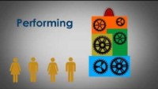

Slide 17
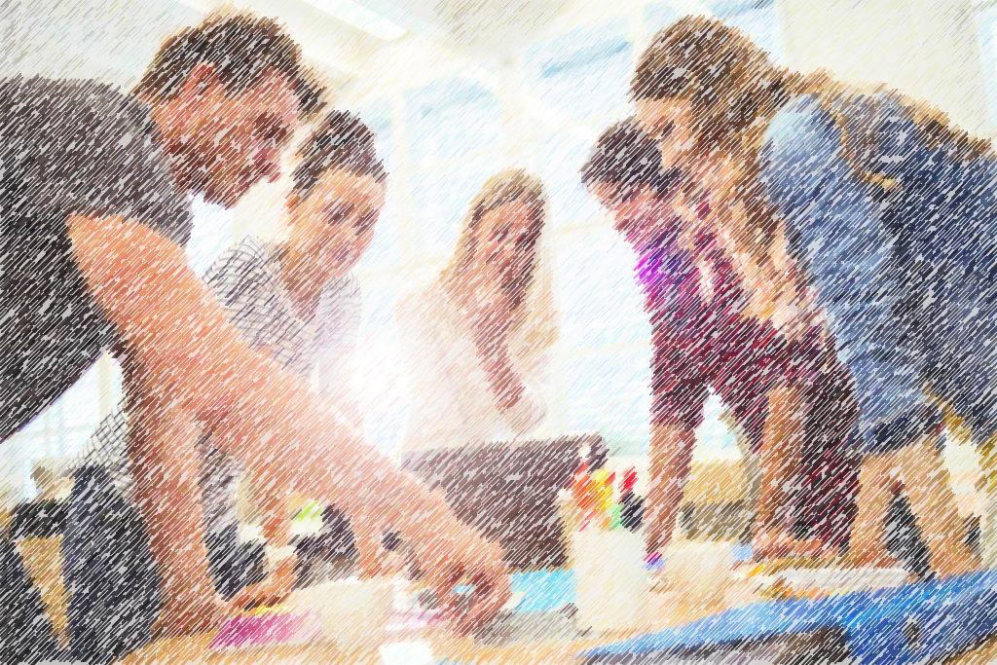
1. Forming
  Team members meet
  Relationships have not formed
  People are “weighing” each other
  People wonder what is expected of them
  Communications will be formal & brief
  Introductions are important
  Outgoing characters may dominate
  There is a need for formal leadership
Notes:
Consideration is given to hierarchical structure/ leadership/ individual roles and responsibilities
Characteristics
During the forming stage team members will be getting to know each other. There is likely to be quiet, uncommunicative phases until each member knows the team. Team members will be watching and listening to others and the leader. Members will offer guarded information about themselves.
Behaviours
Members will present themselves.
Try to understand and relate to the team goal.
The team will try to define and explore the team goal.
Try to set out steps to achieve the goal.
Try to fit themselves into a role in the team.
Leader’s actions
Use ‘ice breakers’ to help the team to get to know each other.
Set out a management vision for the team.
Explain and make clear the dimensions and limitations within which the team must work: time, budget, and so on.
Move the team onto the storming stage at the correct time.

Slide 18

2. Storming
  Team members are competing for position
  Conflict occurs whilst sorting out roles and responsibilities
  Team members may resist the task at an emotional level
Notes:
Characteristics
Once a team has gotten to know each other, you can expect there to be some stormy times as being polite and reserved gives way to real feelings and emotions. Control and personal influences on who is in control and what needs to be done must be argued out. Disagreements will occur and will need to be resolved.
Behaviours
Team members start to reveal their true selves, for better or worse.
Team members start to be impatient and frustrated with the progress the team is making.
Team members ‘tread on each other’s toes’ and they defend their positions or leave.
There will be general feelings of instability and mutiny.
Leader’s actions
Accept that the storming stage is vital to the team’s success.
Do not be put off or intimidated by the instability and aggression of this phase.
Remind the group that this stage is a natural point in the development of the group.
Manage the tensions and aggressions and turn them into positive actions.
Surface and address the conflicts – the team cannot move on until this is done.
Know the point to move the team on to the norming stage.

Slide 19

3. Norming
  Co-operation develops
  The team’s “norms” are developed
  Conflicts are settled
  Views are exchanged
Notes:
Characteristics
When the team has resolved the conflicts from the storming stage they will move on to agree the normal standards and expectations of being a group member. The focus of the team moves from conflict to performance. In the best teams genuine reflection takes place and the team performance is reviewed and improved until it is sufficient to complete the task.
Behaviours
The rules of membership and performance that may have been overlooked in the conflict of the previous stage are now taken very seriously.
There will be a move from ideas generation to planning and decision-making.
There will be limited discussion and much more action.
Subgroups, both formal and informal, may be formed to progress towards the final goal more quickly.
There will be very little explicit conflict; there may however be some tacit (behind-the-scenes) conflict.
Leader’s actions
As leader you must keep the team focused on the task and its timely completion.
Control the team and ensure they are following the agreed plans to completion.
Control the amount of informal subgrouping that may occur.
Watch out for and control tacit conflict (a spillover from the storming stage).
Control and relieve stress and pressure; act as the team ‘lubricant’.
Inject some humour and fun.

Slide 20
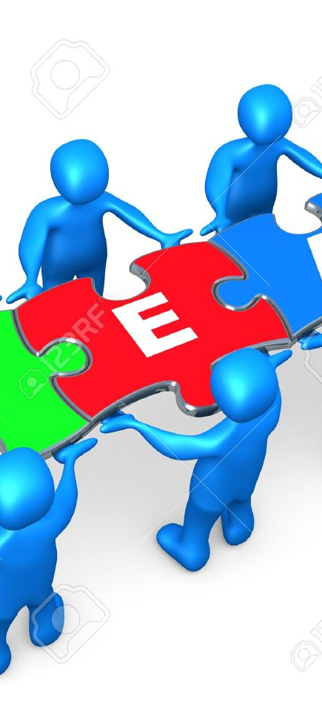
4. Performing
  Teamwork is achieved
  Roles are flexible and fully supported
  Solutions are found and implemented
  Excellence is achieved in standards of working
  External leadership is minimised as team self-manages
Notes:
Characteristics
This is the achievement stage and is characterised by action and completion. The norming stage will have set milestones to complete the task; these will be achieved and performance evaluated. Successful teams will now be adaptable, performance-driven and task-centred. The team is likely to be proactive and not require motivation or management. The team will viciously support each other and will aggressively attack any outside person that criticises the team.
Behaviours
Productive and output-driven, there will be very little unnecessary communication.
The team will be cohesive and stick together.
The team will be proactive and fast to respond to problems.
The team will respond to criticism from within the team but be intolerant of criticism from outside of the team.
Leader’s actions
Watch out for teams running out of control and in the wrong or inappropriate directions.
Reassert the output standards required and monitor team performance against the required standards.
Devise praise methods and rewards as milestones are met.
Relax and let the team perform without intervention from leadership; monitor and do not interfere – you will be treated as an outsider if you criticise.

Slide 21

5. Adjourning (or Mourning)
  Bittersweet sense of accomplishment
  Reluctance to say good-bye
  Many personal relationships formed
Notes:
This phase is sometimes called ‘Mourning’, as there is a feeling of loss, and things may never be like this again.
Characteristics
The team’s reason for existing is gradually achieved and this can leave a vacuum that is hard to fill. Team members will gradually drift away and spend less time on this team’s tasks. They may already have started to be involved in other teams.
Behaviours
elation at the success of achievement and then a sense of deflation as the challenge has disappeared
a sense of loss as the tight cohesive social group is gradually disbanded
divided loyalties as team members move on to other teams
relief at being free of a dysfunctional team
Leader’s actions
Manage the finishing post so that the team finishes with a ‘big bang’.
Maintain the cohesive nature of the team until the end.
Arrange reward, praise systems and a final ‘wake’ – actively mourn the end of the team.
Manage and trap the organisational learning that the team has created.
Arrange network structures after the death of the team.

Slide 22
QUIZ TIME
Get into teams and give yourselves a team name.
Appoint a scribe!
For each of the following scenarios, state which stage you think the team are at.
Don’t shout your answers out as we will go through the answers as a class after all 5 scenarios.

Slide 23
Scenario 1 – The Project Team
In a project team, two members argued over who should lead the creative direction, causing tension and confusion among others.
Forming
Storming
Performing
Norming
Adjourning

Slide 24
Scenario 2 – The Event Planning Team
After months of planning and executing a successful company conference, the Event Planning team held a final meeting to wrap up their work. They reviewed what went well and what could be improved for future events. The team members shared their appreciation for each other's efforts and celebrated their success with a small farewell gathering.
Forming
Storming
Performing
Norming
Adjourning

Slide 25
Scenario 3 – The Research Team
After initial conflicts and role negotiations, the research team reached a phase where members understood and accepted each other’s strengths and working styles. They established clear roles—Anna managed data collection, Brian focused on analysis, and Carla coordinated meetings. Team members communicated openly, gave constructive feedback, and supported one another.
Forming
Storming
Performing
Norming
Adjourning

Slide 26
Scenario 4 – The Product Team
The New Product Development team met for the first time to discuss their goals and timelines. Members were polite and cautious, focusing on introductions and learning about each other's backgrounds. Everyone was eager but uncertain about their roles and how the team would function.
Forming
Storming
Performing
Norming
Adjourning

Slide 27
Scenario 5 – The Software Team
After months of working together, the software development team had reached a high level of trust and collaboration. Roles were clear, but flexible, with team members stepping up as needed to solve problems and support each other. Communication was open and constructive, allowing them to quickly resolve issues. The team was focused on delivering high-quality features on time and continuously improving their processes.
Forming
Storming
Performing
Norming
Adjourning

Slide 28
Pros and cons
Pros
Clear framework
Helps to anticipate challenges/conflict
Supports team building
Allows leaders to adjust their style
Improves insights to increase team performance
Cons
Oversimplifies reality
Ignores individual differences
Less applicable for ongoing teams

Slide 29
How can you apply the model?
Think about the teams you are part of (in university, work, socially) which stage are you in?
Consider this and how you can help the team work towards the next stage.
When working on your presentations, take note of how the team moves through each stage and utilise this within both tasks.
Notes:
Teams are dynamic entities; they are driven by the people and personalities within them. You will experience wide variations of teamworking in the workplace; your aim should be to learn from each experience, however weird, painful or enjoyable that experience may be. Learning logs and developmental diaries can be a very useful way of reflecting and making sense of your involvement with teams.

Slide 30
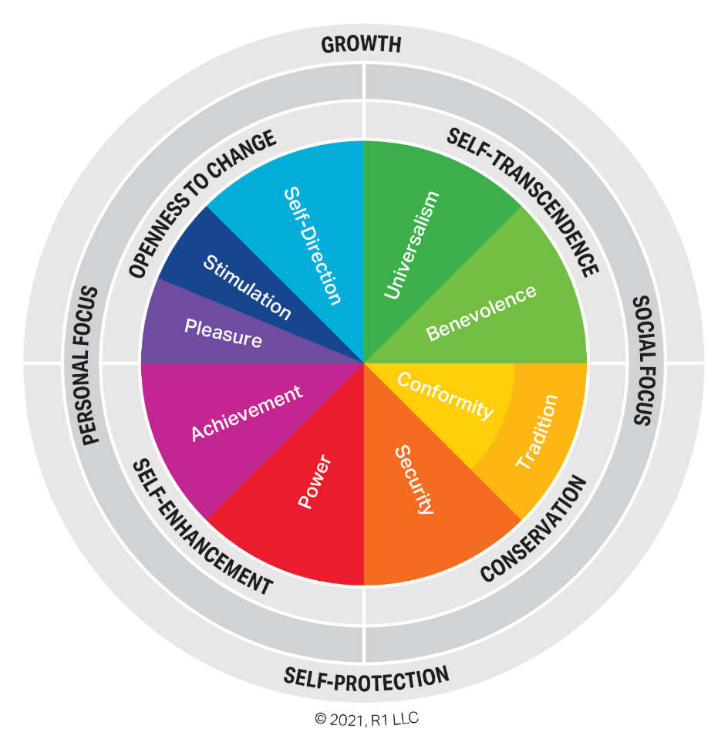
Individual exercise: Personal Values
From the coloured “cheeses”, work out your list of values in order

Slide 31

Looking back and learning
Review the effects and learn from this experience.
Emphasis should be on the first step to understanding ourselves and the people around us than immediate solutions to problems and situations
Try to look at yourself and how you interact with people this week
See if you notice anything different

