Slide 1

Strategic Management for Business – LCLM 6001
Week 8 :
International and Global Strategy.
Internalisation Strategies and Modes of Entry.
Critical Success Factors.

Slide 2

Last Week….
We examined…..
Technological trends fall within three broad areas of business activities:
Managing relationships,
Managing capital and assets, and;
Leveraging information in new ways.
Other technological advancement and their applications in businesses.

Slide 3
This Week….
We will do the following…..
International and Global Strategy.
Internalisation Strategies and Modes of Entry.
Critical Success Factors.

Slide 4
International and Global Strategy
Global strategy encompasses high coordination of wide-ranging activities detached geographically in many countries around the world.
While International strategy refers to a series of options for operating outside an organisation’s country of origin.

Slide 5
International and Global Strategy
International strategy is a strategy by which a firm sells its goods or services outside its domestic market.
A major reason for deploying international strategy is in order to access potentially new opportunities existing in the international market (i.e. international diversification).

Slide 6
International and Global Strategy
Furthermore, internationalisation permits for firms to secure much needed resources.
Other drivers include consumer universal product demand as well as the emergence of large-scale markets in the emerging economies.

Slide 7

International Strategies
Internationalisation is traditionally considered as a sequential process whereby companies gradually increase their commitment to newly entered markets, accumulating knowledge and increasing their capabilities along the way.

Slide 8








International and Global Strategy
Examples are:

Slide 9
Internationalisation Drivers
Market drivers
  Similar customer needs (e.g. credit cards).
  Global customers (e.g. car components).
  Transferable marketing (e.g. Coca-Cola).
Cost drivers
  Scale economies (e.g. R&D in aircraft manufacturing).
  Country-specific differences (e.g. clothing: manufacturing in Bangladesh/design in Paris).
  Favourable logistics (e.g. low cost of transporting microchips).

Slide 10
Internationalisation Drivers
Government Drivers
  Trade policies (e.g. reduction of trade barriers in the EU; WTO policies).
  The liberalisation and adoption of free markets.
  Technical standardisation (e.g. in electronics).
Competitive Drivers
  Interdependence (e.g. global coordination between subsidiaries in different countries).
  Global competitors (e.g. rivals may use profits to cross subsidise aggressive moves).

Slide 11
Benefits of International Strategies
Volberda et al (2011) identify four basic benefits firms may derive from pursuing international strategy:
Increased market size: firms have opportunity to expand size of their potential market beyond limited growth opportunity offered by domestic market.
  e.g. Coca-Cola’s third largest market by volume is China and it is growing faster than the home market.
  India’s market moved from 19th to 6th between 2006 and 2014.
Greater returns on Investment: As market size is crucial in earning return on investments, firms are primarily motivated to internationalize in order to generate above average returns.

Slide 12
Benefits of International Strategies
Economies of Scale and Learning: Economies of scale are possible through standardisation of products across country borders.
  Firms may also be able to exploit core competencies in international markets through resource- and knowledge sharing.
Location advantages: Firms benefit from possibility of positioning facilities in attractive locations, which may offer access to cheaper labour, energy and other natural resources
  This is however influenced by costs of production, transportation requirements and needs of intended customers.

Slide 13
International Strategies with Porter’s Diamond Model
Also known as the Diamond Model, is a framework developed by Michael E. Porter to analyze the competitive advantage of nations or regions in certain industries. It explains why some industries within particular nations are more competitive internationally than others. The model identifies four key factors that contribute to national competitive advantage:
Factor Conditions: These are the basic inputs required for competition, such as natural resources, climate, location, workforce skills, and infrastructure. Nations or regions with advantageous factor conditions are more likely to develop competitive industries.
Demand Conditions: This refers to the nature and size of the home market demand for an industry’s products or services. A strong, sophisticated domestic market drives firms to innovate and improve quality, giving them an edge in international markets.

Slide 14
International Strategies with Porter’s Diamond Model
3. Related and Supporting Industries: The presence of related industries that are internationally competitive can enhance the competitive advantage of a particular industry. Suppliers and related industries provide critical support through innovation and shared technology.
4. Firm Strategy, Structure, and Rivalry: The conditions in the home market determine how companies are created, organized, and managed, as well as the nature of domestic rivalry. Intense domestic competition forces firms to be more efficient, innovative, and proactive in improving their competitiveness.

Slide 15
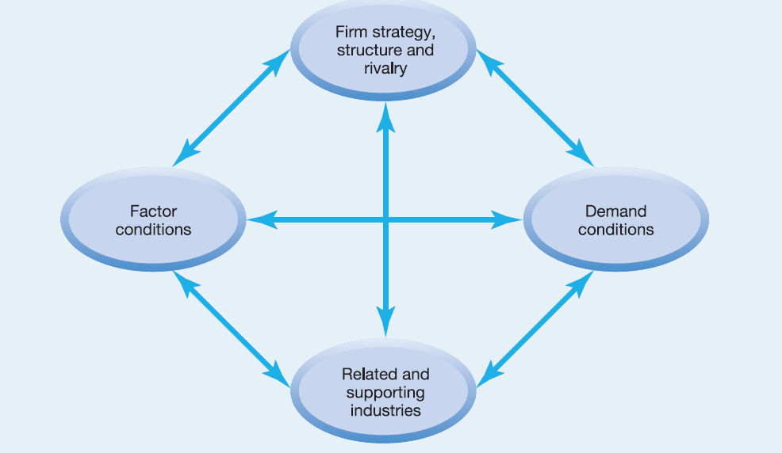
International Strategies with Porter’s Diamond Model

Slide 16

International Strategies with Porter’s Diamond Model

Slide 17
International Strategies with Porter’s Diamond Model
Factor Conditions: refers to factors of production – inputs needed to compete such as: labour, land, natural resources, capital, infrastructure etc
Basic: Natural resources Climate
Advanced : Infrastructure , Skilled Experts , Capital
Where a country has advanced (e.g. communication systems, highly educated workforce) and specialized (e.g. industry-specific skilled personnel) factors, there is likely to be strong home-country competition.
Such factors may develop where countries lack basic factors e.g. South Korea lack abundant natural resources but offer strong work ethics, engineers & systems of large firms to create expertise in manufacturing.

Slide 18
International Strategies with Porter’s Diamond Model
Demand Conditions: Characterised by the nature and size of buyers’ needs in the home market.
  A larger local demand than in foreign markets result in national advantage as discerning domestic customers drive quality & innovation.
  e.g. Japanese high expectation of electrical and electronics equipment
Related and Supporting Industries: Emphasis is on the key role of industry clusters in developing national advantage
  That is, the existence of competitive local supporting industries can be a basis for national advantage in a particular industry
  e.g. Italy as leader in the shoe industry – well established leather processing, and design services industries.

Slide 19
International Strategies with Porter’s Diamond Model
Firm Strategy, Structure and Rivalry: These vary among firms across domestic markets and particularly, domestic rivalry is a major factor that drives innovation. For example:
Germany has an excellent technical training system that places a strong emphasis on continuous product and process improvements.
Japan has unusual cooperative and competitive systems that facilitate cross-functional management of complex assembly operations.
The level of competition in the US among computer manufacturers and software producers has significantly contributed to the development of the industries.

Slide 20
International Strategies with The CAGE Framework
Cultural distance – differences in language, ethnicity, religion and social norms.
Administrative and political distance – compatibility of administrative, political or legal traditions.
Geographic distance – not just miles but also aspects such as size, sea-access and the quality of communications.
Economic/wealth distance – wealth and income differences.

Slide 21
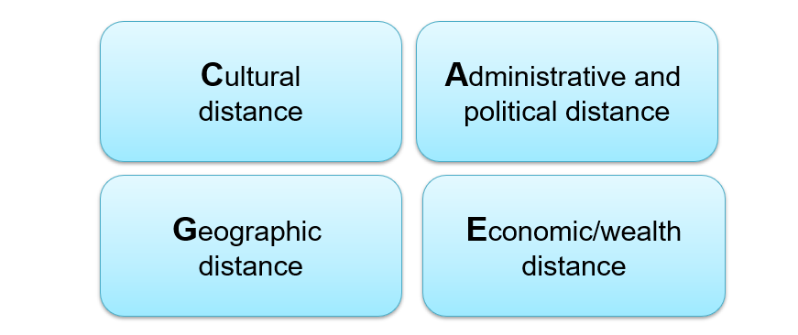
International Strategies with The CAGE Framework
The CAGE Framework

Slide 22
International Strategies with The CAGE Framework
The CAGE Framework Explained:
https://youtube.com/watch?v=-831oe9GEkM&si=EnSIkaIECMiOmarE

Slide 23
International Strategies: Modes of Entry
This strategy of staged international expansion means that firms begin by using entry modes such as licensing and exporting that allow them to acquire local knowledge whilst minimising the exposure of their assets.

Slide 24
International Strategies: Modes of Entry
Licensing: An arrangement that allows one party to purchase the rights to manufacture and sell another firm’s products within a host country or set of countries.
The Licensor is paid a royalty on each unit produced or sold, and the licensee takes the risks as well as makes monetary investments for production.
Licensing however requires a reliable legal environment where contract will not be abused.
Comparatively, licensing is possibly the least costly option but also offers low returns.

Slide 25
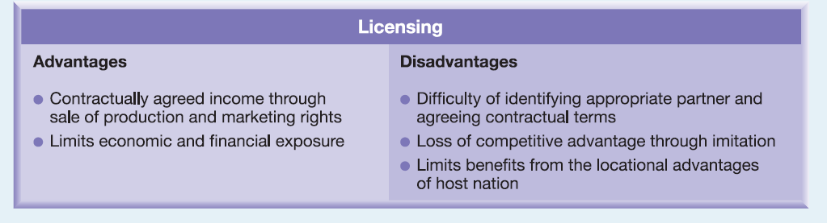
International Strategies: Modes of Entry
Licensing:

Slide 26
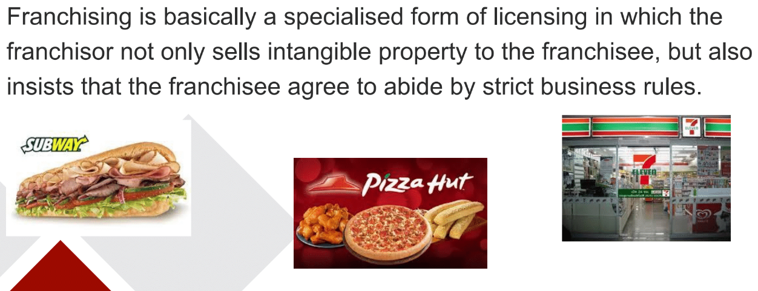
International Strategies: Modes of Entry
Franchising a form of Licensing:

Slide 27
International Strategies: Modes of Entry
Exporting: International trade where goods/services are shipped from one party (exporter) in one country to another country or countries
Exporting is suitable where home-based competitive advantage is large and products/services are easily transported
Usually based on contractual arrangements but could be costly due to transportation costs and tariffs on incoming goods.
Also, exporters have less control over product marketing and distribution.

Slide 28
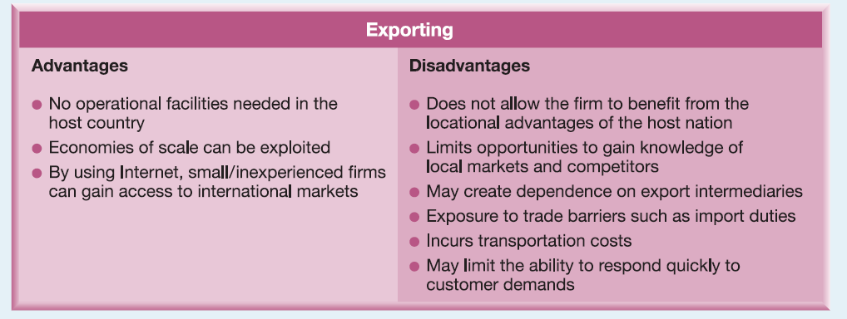
International Strategies: Modes of Entry
Exporting:

Slide 29
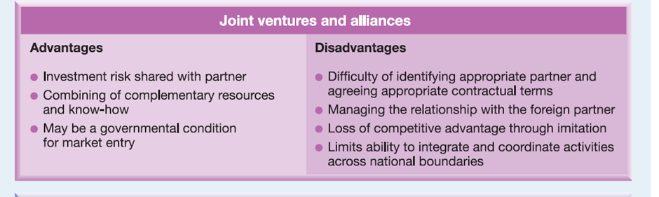
International Strategies: Modes of Entry
Joint Ventures and Alliances:

Slide 30
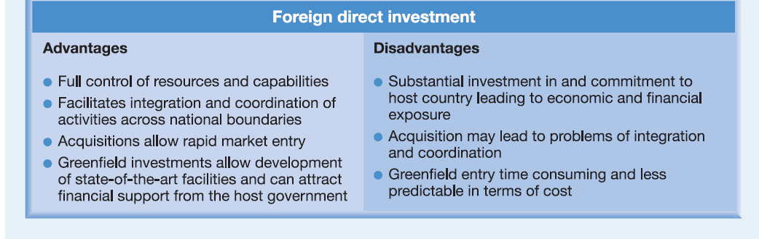
International Strategies: Modes of Entry
Foreign Direct Investment:

Slide 31
International Strategies: Modes of Entry
Wholly-owned subsidiary:
A new wholly-owned subsidiary is also referred to as a Greenfield venture Firms start new venture in foreign countries by constructing new operational facilities from the ground up.
Often very costly, time consuming, and highly risky.
But allows for maximum control and potential for above-average returns.
Useful where competitive advantage does not depend on local partners.

Slide 32

International Strategies: Modes of Entry
French Cakes in UK Market !

Slide 33

What’s Next?
Break Time!
Let’s go for cuppa!

Slide 34
Session 2
Critical Success Factors (CSFs)

Slide 35
Critical Success Factors (CSFs)
Critical success factors (CSFs) are those product features
that are particularly valued by a group of customers and, therefore, where the organisation must excel to outperform competition.

Slide 36
Critical Success Factors (CSFs)
The extent to which the offerings of different providers address the factors valued by customers can be visualised by creating a strategy canvas.

Slide 37
Critical Success Factors (CSFs)
The canvas is a simple but useful way of comparing competitors’
positions in a market and potential in different segments.
The next slide relates to one segment of the electrical engineering industry i.e., company-based buyers of electrical engineering equipment, and it illustrates the following – see next slide:

Slide 38
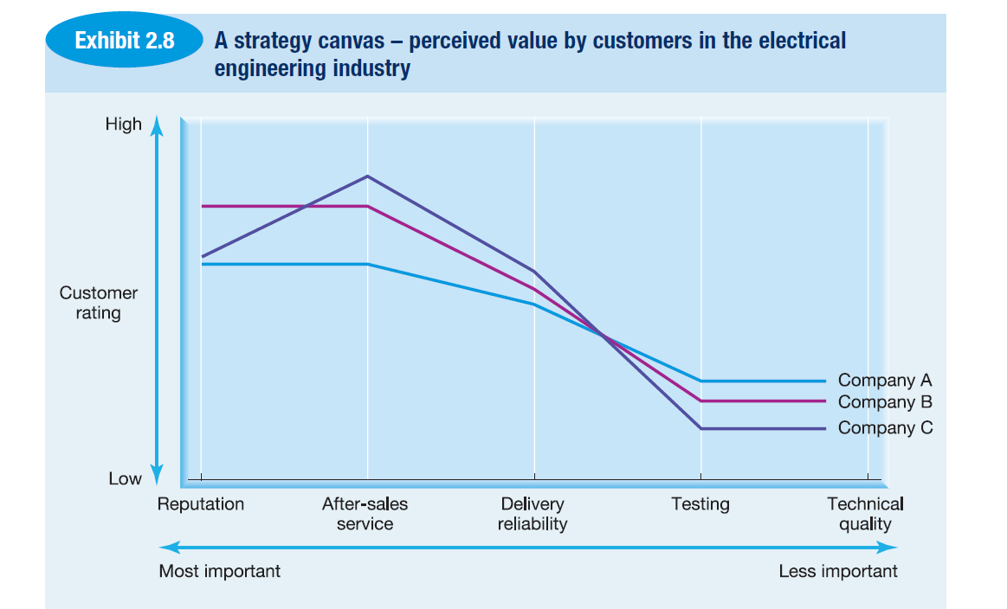
Critical Success Factors (CSFs)
The electrical engineering industry – company-based buyers of electrical engineering equipment:

Slide 39
Critical Success Factors (CSFs)
Five critical success factors are identified in Exhibit 2.8 as particularly important to customers on average (in rank order, the producer’s reputation, aftersales service, delivery reliability, testing facilities and technical quality).
They are the factors which would determine which provider was preferred, given similar prices.

Slide 40
Critical Success Factors (CSFs)
As shown on the exhibit 2.8 …..
Three competitor profiles are drawn on the canvas against these factors. It is clear that the particular strengths that company A possesses are not the factors most valued by the average customer, whereas company B’s strengths appear to have a better match.
But nobody is doing particularly well with regard to testing and technical quality.

Slide 41
Critical Success Factors (CSFs)
Segment choice is the next issue. Company A could try to improve on the most highly valued factors. But companies B and C are already strong there, and their customers are highly satisfied.
An alternative for company A is to focus on a particular market segment, those for whom testing and quality happen to be much more important than for the average customer.

Slide 42
Critical Success Factors (CSFs)
There is less competition there and greater room for improvement.
This segment might be relatively small, but targeting this specifically could be much more profitable than tackling companies B and C head on in their areas of strength.
Company A might focus on raising its profile at the right-hand end of the canvas.

Slide 43
Critical Success Factors (CSFs)
The key messages from this example are that it is important to see value through the eyes of the customer and to be clear about relative strengths within each company.

Slide 44

Summary of Today’s Lecture
Today we examined…….
International and Global Strategy.
Internalisation Strategies and Modes of Entry.
Critical Success Factors.

Slide 45
Next Week
Academic Interview Part 1

Slide 46
References
Johnson, G., Whittington, R., Scholes, K., Angwin, D. and Regnér, P. (2017), Exploring strategy, Pearson, London.
Lynch, R. (2021), Strategic Management, 7th ed., Pearson.
Truested (2019). How Threadless Gives Every Customer A Voice and Style, available @: https://truested.com/story/threadless, (Accessed 30/08/2024).

