Slide 1
International Business Communications
Module code: LCBB6001
Lecturer : Dr Laila Maazouz
Student : Elena-Mihaela Bucur 2133670

Slide 2

Cultural Differences Between the UK and Germany

Slide 3

Anglo American
A British Multinational Corporation has been selected for the presentation which has business in a number of countries. Among the several continents in which Anglo American has sizable worldwide activities are Oceania, Africa, Asia, and South America.

Slide 4
Organisational Overview
The company began its operations back in 1917 during the World War 1. Anglo American has grown and diversified into many agricultural and industrial products during the past century as it has extended its operations worldwide.

Slide 5
Cultural Comparisons - Similarities
Masculinity Orientation
Because of their shared values of hard work, aggressiveness, and success, both cultures rank masculinity highly. It appears that there is a common cultural emphasis on doing well and having success.
Work Ethic
People in the United Kingdom and Germany are known to be very hardworking and committed to their jobs. Hard work, determination, and efficiency in completing tasks are highly valued by them.
Power Orientation
Germany has a larger power gap and is more likely to favour well-established hierarchies, although both nations show a moderate to low tolerance for power imbalances when compared to other culture.

Slide 6
Cultural Comparisons - Differences
Long term Orientation
Whereas the United Kingdom values short-term realism and gradual advancement above long-term strategy, Germany has a strategic, long-term orientation towards future planning, order, and savings.
Individualism vs Collectivism
The German emphasises group agreement, hierarchy, and in-group loyalty, in contrast to the British emphasis on individual aims, independence, and assertiveness.
Work Life Balance
The British are more prepared to give up leisure time in order to meet work obligations, whereas the Germans value work-life separation more.

Slide 7
Communication Differences
The German way of communicating is more roundabout and collaborative; they like to hear out opposing arguments before settling on a course of action. The British have a reputation for being forthright and unfiltered.
Subordinates use formal language and adhere to tight etiquette while interacting with superiors, reflecting the German focus on hierarchy. The cultural norm in the United Kingdom, on the other hand, promotes transparency and closeness amongst employees at all levels of seniority.
Managers in the UK could think Germans aren't proactive enough if they don't debate things head-on, which is highly encouraged there.

Slide 8
Negotiations Patterns
#1
#2
#3
British people are more likely to be forthright in their stance with modest concessions, whereas Germans prefer an iterative consensus approach through non-binding talks seeking mutually accepted solutions.
In contrast to the British emphasis on speeding up agreements, the Germans value relationship-building above rapid successes in talks.
Instead of managers in the UK communicating with subordinates before making individual judgements, decision-making in German enterprises follows an inclusive consultation process that weighs diverse viewpoints.

Slide 9
Expetced Challenges
Germans may be perceived as unmotivated and inflexible when communicating informally with Britons, who tend to employ more direct and informal language.
New British coworkers may come out as impolite or disrespectful to Germans who aren't used to the British style of confrontation.
To create trust in mixed teams, both the British and the Germans need to change their ways of working. The British need to be more patient and inclusive when making decisions, while the Germans need to be more open with feedback.

Slide 10
Recommendations
Training about cultural difference
Exercise on Team Building
Empathetic Decision Making
Leadership Building
Exchange of Values

Slide 11
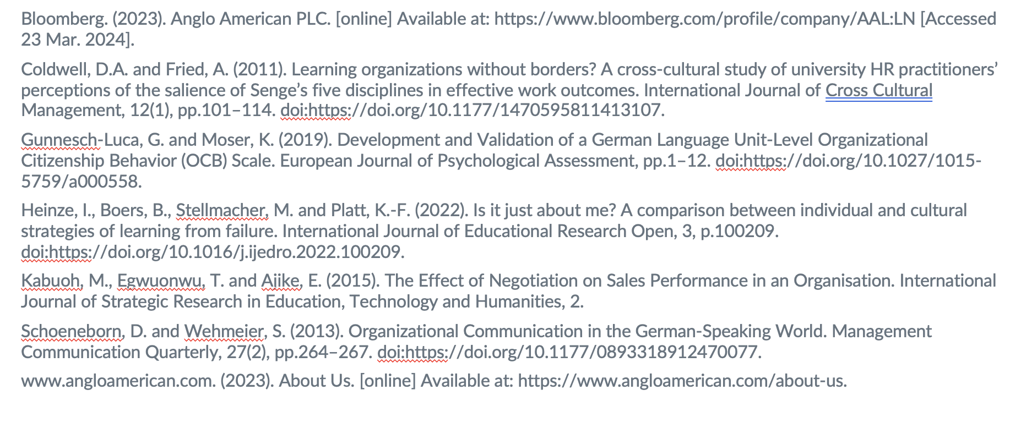
References

Slide 12
THANK YOU

