Slide 1

APA referencing
Navdeep Randhawa

Slide 2
Lesson Objectives/ Amcanion
Explain the APA Reference System
Be able to recognise Correct References using APA Referencing system

Slide 3
Citing
Your acknowledgement of an author's opinion either in general terms or though quotation in your main body of text will need to be referenced.

Slide 4

Paraphrasing
When you take someone else’s idea and put it into your own words.

Slide 5

Summarising
When you provide a brief overview of someone else’s idea.

Slide 6
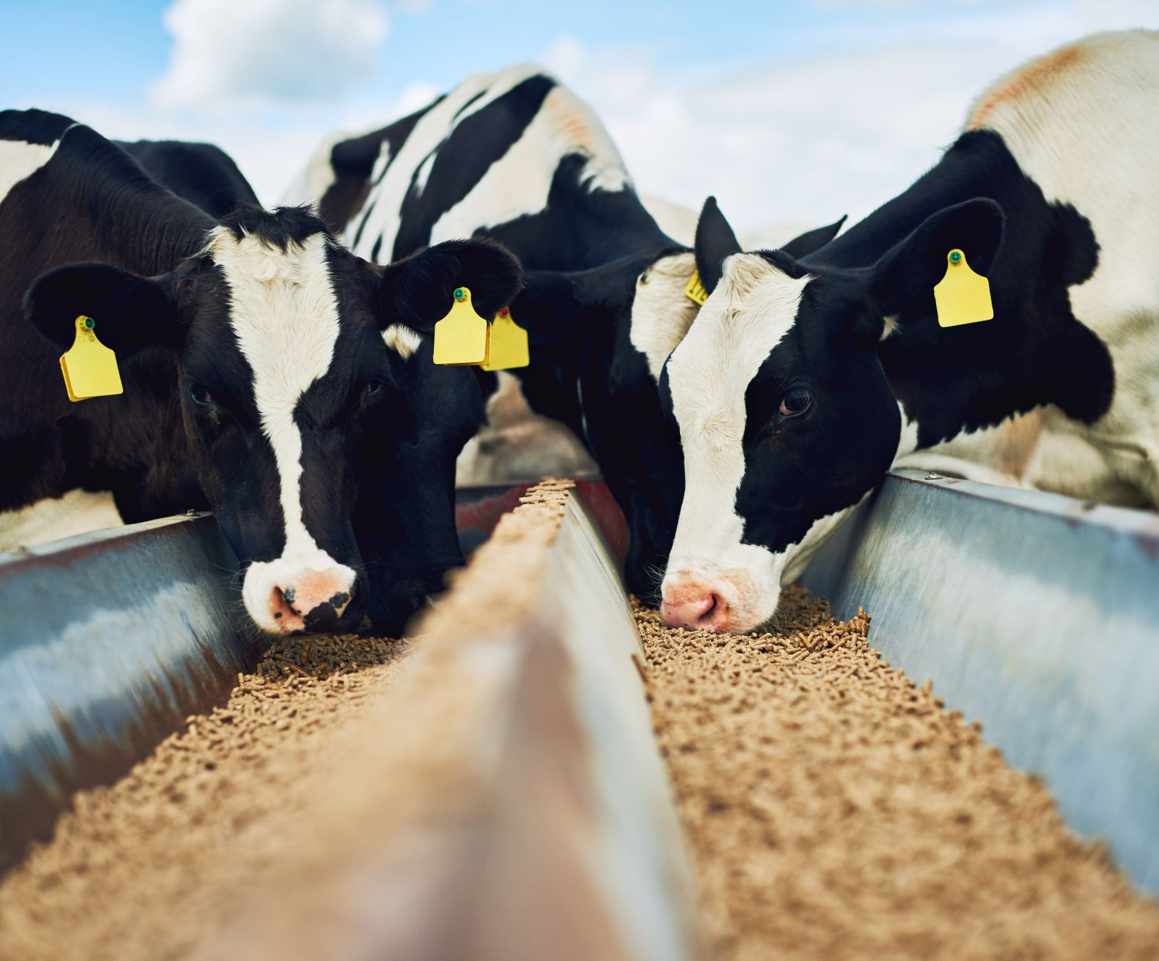
Is this Paraphrasing or Summarising?
On average each cow produces 10,900L/year and the farm sends 7m litres of milk a year, with the bulk of it being sent to Arla (Forde, 2015).

Slide 7

Quiz
APA Citation Practice Quiz! - Question 1 (proprofs.com)

Slide 8
You can cite a source directly (e.g. quoting verbatim from it) or indirectly (citing a source to show that you have used an author's ideas, but not quoted them).
Direct: '"Chocolate has an infinite variety of uses" (Davis, 2013, p.8).’
Indirect: 'As Davis (2013) notes, chocolate can be used in many different ways.'

Slide 9
Citations for books with one or two authors:
Last name, first initial. (Year). Title. Edition (if not the first edition of the book). City of publication: Publisher.
For example:
Davis, B. (2013). A History of Chocolate. Nottingham: Delectable Publications.
Davis, B. (2013). A History of Chocolate. 3rd ed. Nottingham: Delectable Publications.

Slide 10
Is this Citation Correct?
Jones, F. and Hughes, S. (2006). Eating Out: A Definitive Restaurant Handbook. Nottingham: Delectable Publications.

Slide 11

Yes it is Correct!

Slide 12
Citations for books with three or more authors:
Last name, first initial., Last name, first initial., and Last name, first initial. (Year). Title. City of publication: Publisher.
For example:
Evans, D., McDonald, F. and Jackson, T. (2008). Getting the best service. Nottingham: Delectable Publications.

Slide 13
Is this C itation Correct?
James, P., Croft, D., Levin, S. and Doe, A. (1998). How to Succeed in the Restaurant Industry. Nottingham: Delectable Publications.

Slide 14

No It’s Incorrect!

Slide 15
This is the Correct Answer- the title should be in italics.
James, P., Croft, D., Levin, S. and Doe, A. (1998). How to Succeed in the Restaurant Industry. Nottingham: Delectable Publications.

Slide 16

Citations for images/photographs – Print or Online:
Last name of artist/photographer, first initial). (Year of production). Title of image. [type of medium] City where image original can be found: Place/institution where image can be found.
For example:
Hewer, D. (1995). Women enjoying a cup of tea. [Photograph]. London: Food Photography Library.

Slide 17
Is this Correct?
Hewer, D. (1995). Women enjoying a cup of tea. [Photograph]. Retrieved from: www.foodiephotos.com/dhewerwomencupoftea

Slide 18
Yes it is Correct!

Slide 19
Citations for YouTube videos:
Username of contributor. (Year, Day Month). Video Title, Series Title (if relevant). [type of medium]. Retrieved from: URL.
For example:
Yummydishes. (2012, 30 January). Egg custard – simple recipe!, Baking 101. [YouTube video]. Available at: www.youtube.com/yummydisheseggcustard[Accessed 13 June 2016].

Slide 20
Citations for Journal Articles accessed on a website or database
Last name, First initial. (Year). Article Title. Journal name, Volume (Issue), Page/s. Retrieved from: URL
For example:
Jenkins, O. (1996). Unusual Recipes and Cantonese Cuisine. Culinary Research, Volume 5 (8), pp. 47-59. DOI: http://doi.org/ojenkinscantonesecuisine

Slide 21
Articles Citations for Print Journals
Last name, First initial. (Year). Article Title. Journal name, Volume (Issue), Page/s.
For example:
Jenkins, O. (1996). Unusual Recipes and Cantonese Cuisine. Culinary Research, Volume 5 (8), pp. 47-59.

Slide 22
Chris Kyriacou, 1998, Nelson Thornes, “Essential Teaching Skills”, Bath.
“Active Learning: 101 strategies to Teach Any Subject” Mel Sliberman, 1996, Allyn & Bacon, London.
“Teaching training and learning: a practical guide”. Ian Reece & Steven Walker, Sunderland, Business Education. 2003.
Correct the Bibliography

Slide 23
Was Your answer correct?
Kyriacou, C. (1998) Essential Teaching Skills. Bath: Nelson Thornes
Reece, I. & Walker, S. (2003) Teaching training and learning: a practical guide. Sunderland: Business Education.
Sliberman, M. (1996) Active Learning: 101 Strategies to Teach Any Subject. London: Allyn & Bacon.

Slide 24

For sources with three or more authors, all should be named on the first in-text citation. Subsequently, et al. can be used.
First citation: Dern, Geller and Lerner (2005)
Subsequent citations: Dern et al. (2005)
In the main body of the text, authors' names should be joined with the word 'and'. However, within parenthesis, an ampersand (&) should be used:
Main body: Dern, Geller and Lerner (2005) state that food is a source of great comfort to people.
Within parenthesis: Food can be considered a great source of comfort (Dern, Geller & Lerner, 2005).

Slide 25
Citations for Newspaper and Magazine Articles – Print or Online:
Last name, first initial. (Year). Article title. Newspaper name, Page/s.
For example:
Bell, Y. (2016). Man with unusual tastes eats chalk for breakfast. Healthy Lifestyles Magazine, p. 4.

Slide 26
Is this Correct?
Lees, P. 2015. Freaky eaters. The Weekly Herald, p 21. Retrieved from: www.theweeklyheraldonline.com/freakyeaters2015

Slide 27
No It’s Incorrect!

Slide 28
This is the Correct Answer- the brackets and full stop in the page number was missing!
Lees, P. (2015). Freaky eaters. The Weekly Herald, p.21. Retrieved from: www.theweeklyheraldonline.com/freakyeaters2015

Slide 29
Citations for presentations/lectures:
Last name of author, first initial. (Year). Presentation/lecture title [file format]. Retrieved from: URL (if accessed online).
For example:
Yates, R. (2008). The benefits of herbs [PowerPoint presentation].

Slide 30
Online sources Citations for websites:
Author/Source if no specific author (Year). Title of web document/page. Retrieved from: URL.
For example:
Proud, F. (2014, June 5). Food lovers group [Facebook]. Retrieved from: www.facebook.com/foodloversgroupproudf2014

Slide 31
Extension Activity- Have a Go
Go to the library catalogue
Find a business related E- book
Research and write a paragraph in your own words summarising some information your selected book is covering with correct citations and a reference list.

