Slide 1
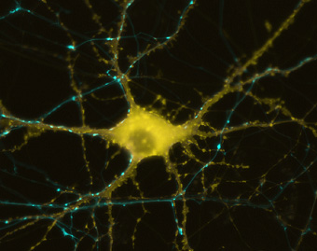
The Nervous System
Electrical
Communication

Slide 2

The Nervous System
Main Function:
This communication system controls and coordinates functions throughout the body and responds to internal and external stimuli.
Our nervous system allows us to feel pain.

Slide 3
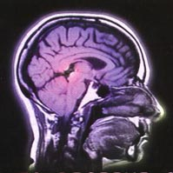
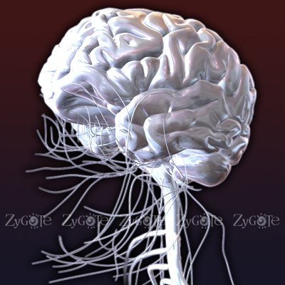
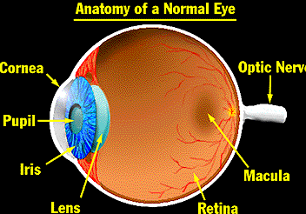
The Nervous System
Consists of: brain, spinal cord, nerves and sense organs
Sense Organs: Eyes, Skin, Ears, Nose & Tongue

Slide 4
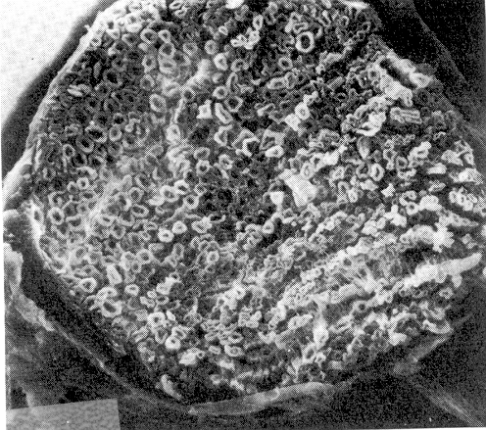
The Nerve
A nerve is an organ containing a bundle of nerve cells called neurons.
Neurons carry electrical messages called impulses throughout the body.
Picture shows hundreds of severed neuron axons

Slide 5
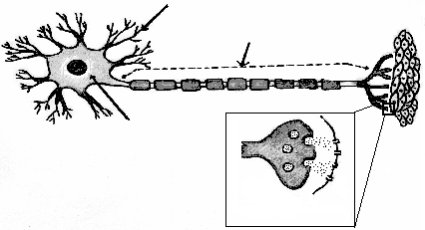
Impulse in a Neuron
dendrite
muscle tissue
Axon
cell body
cell
body
TYPICAL MOTOR NEURON
synapse

Slide 6
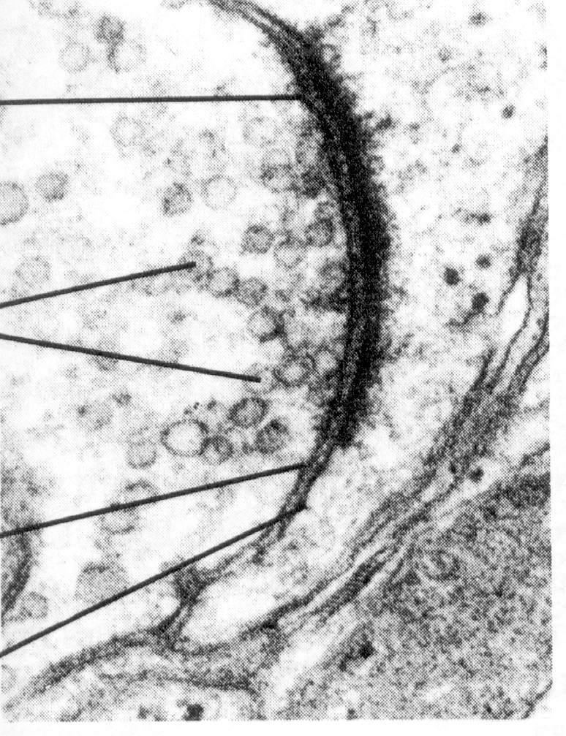
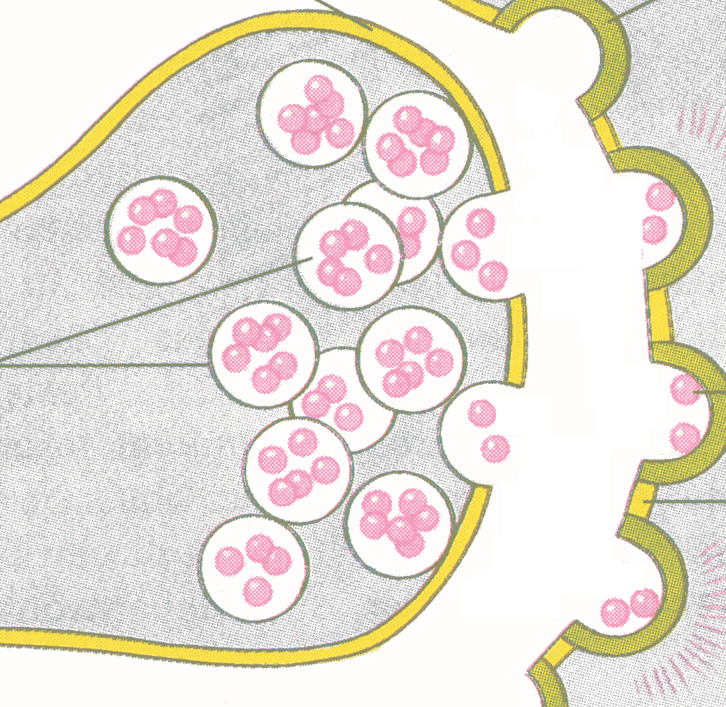

Because neurons never touch, chemical signalers called neurotransmitters must travel through the space called synapse between two neurons.
Neurotransmitters
(pink
spheres)
The message is transferred when RECEPTORS receive neurotrans-mitters.
Synapse (gap)

Slide 7
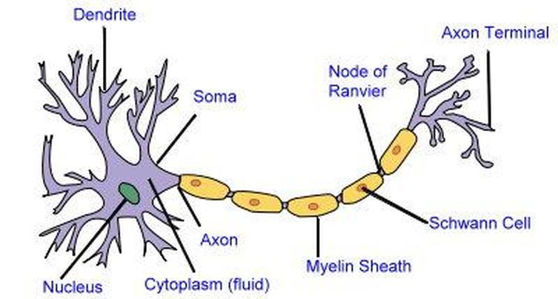
Parts of a Neuron
Cell body: contains nucleus & most of the cytoplasm
Dendrites: projections that bring impulses into the neuron to the cell body.
Axon: long projection that carries impulses away from cell body

Slide 8
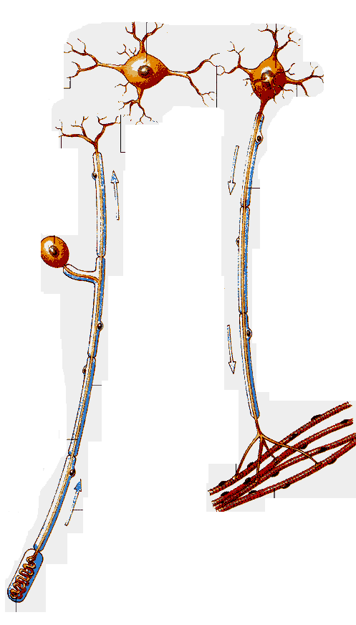
Types of Neurons
Sensory Neuron
Interneuron
Synapse
Synapse
Motor Neuron
Interneuron
Synapse
Motor Neuron
Muscle Contracts
Sensory Neuron

Slide 9
Sensory Neuron
carry impulses from sense organs to spinal cord & brain
Fun Fact:
Where can the largest cells in the world be found?
The giraffe’s sensory and motor neurons! Some must bring impulses from the bottom of their legs to their spinal cord several meters away!!

Slide 10
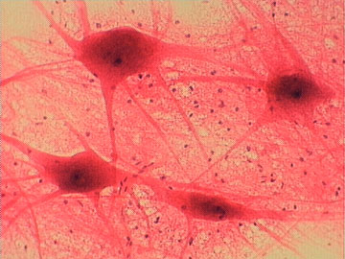
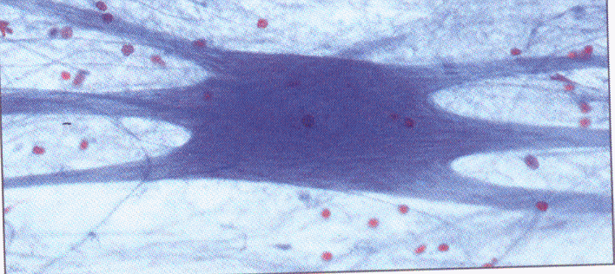
Interneuron
processes impulses in brain and spinal cord
- connect sensory and motor neurons

Slide 11
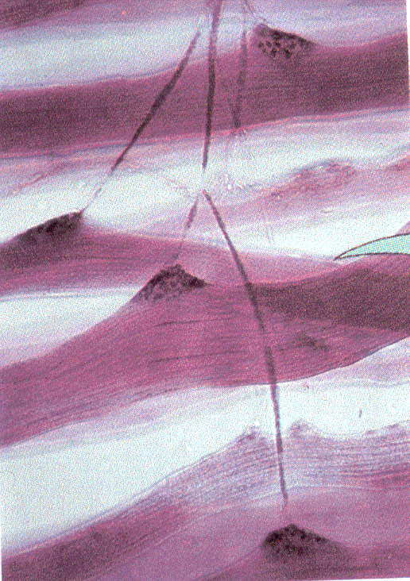
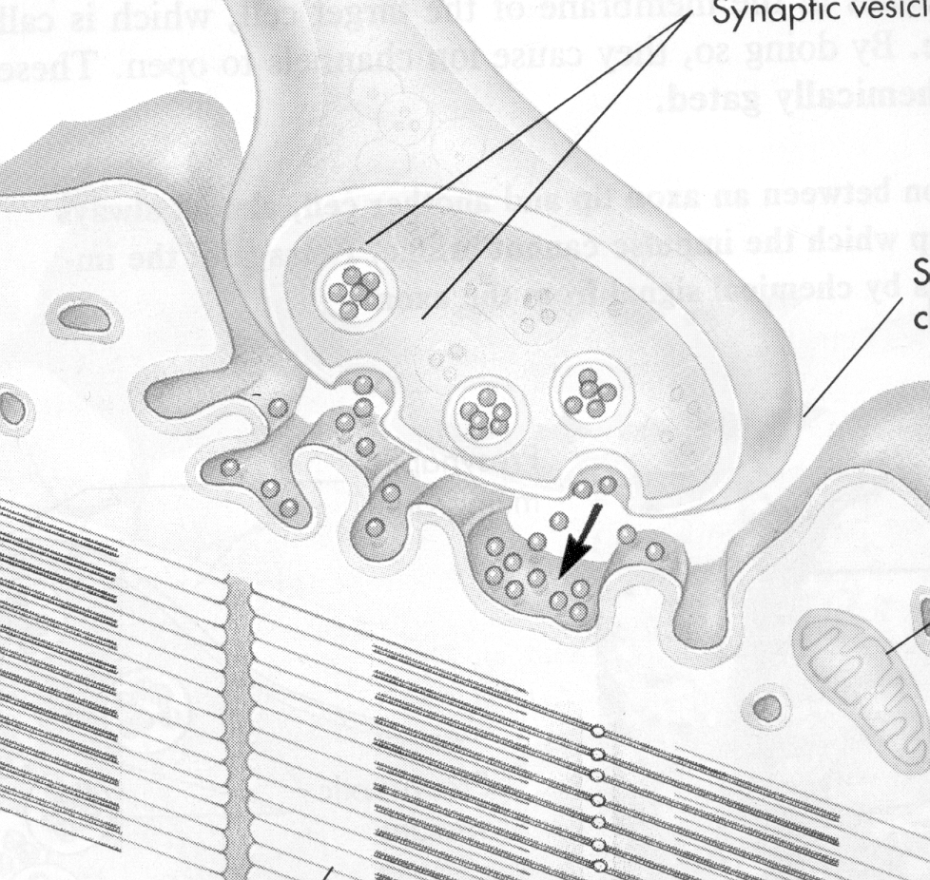
Motor Neurons
carry impulses from the brain & spinal cord to muscles & glands
Axon End
Axons branching out to muscle fibers

Slide 12
Communication with Neurons
Nerves work together with muscles for movement. An impulse begins when one neuron is stimulated by another neuron or by the sense organs.
The impulse travels down the axons of Sensory neurons to the brain cells called Interneurons.
The brain will then send an impulse through motor neurons to the necessary muscle or organs, telling it to contract.

Slide 13
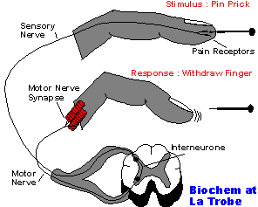
A reflex is an involuntary response that is processed in the spinal cord not the brain.
Reflexes protect the body before the brain knows what is going on.
Reflex Arc

Slide 14
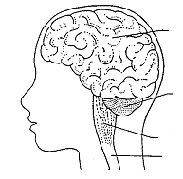
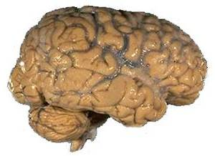
Central Nervous System
Consists of: Brain and Spinal Cord
Cerebrum
brain
Cerebellum
Medulla Oblongata
Spinal Cord

Slide 15
Central Nervous System
Cerebrum | Voluntary or conscious activities of the body-learning, judgment
Cerebellum | Coordinates and balances the actions of the muscles
Medulla Oblongata (Brain Stem) | Controls involuntary actions like blood pressure, heart rate, breathing, and swallowing
Spinal Cord | The main communications link between the brain and the rest of the body

Slide 16
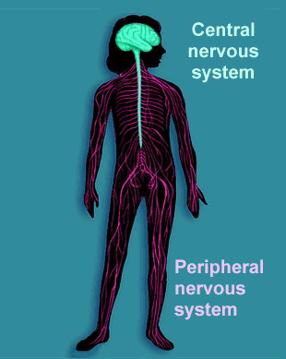
Peripheral Nervous System
Consists of: Sensory division and Motor division
-includes all sensory neurons, motor neurons, and sense organs

