Slide 1
LCHS4007
DIGITAL SKILLS & RESEARCH METHODS
Tayla ward 2513984
ASSESMENT 1
LECTURER ANIKA TAHSIN AHMED
STUDENT NUMBER 2513984
Tayla ward 2513984
LUCY, 2511519
HALEEMAH,2513985

Slide 2

CONTENT
lchs4007
introductions
strength and limitations of Ms Words
Strength and limitations of MS One drive

Slide 3

INTRODUCTION
SUNRISE RESIDENTIAL CARE (FOR OLDER AND DEMENTIA PATIENTS).
WE PLAN TO INTRODUCE DIGITAL TOOLS TO IMPROVE THE QUALITY AND EFFICIANCY OF CARE.
Care home has around 35 residents and a team of nurses, care workers, administrators and visiting health professionals.
Has recently begun introducing digital tools to help improve quality and efficiency of care.
(Carehome.co.uk,)
( 2025)

Slide 4
Tayla ward
2513984
lchs4007
Strength & limitations of Ms OneDrive
Pros. | Cons.
Centred care Ref: person centred software | Security issues Ref: Microsoft OneDrive security
Enhancing technology Ref: enhancing independence through technology | File and sync limitations Ref: 6 cons with using OneDrive
collaboration features Ref: collaborating with OneDrive | Elderly digital skills Ref: more than 1 in 30 lack basic skills to use the internet

Slide 5
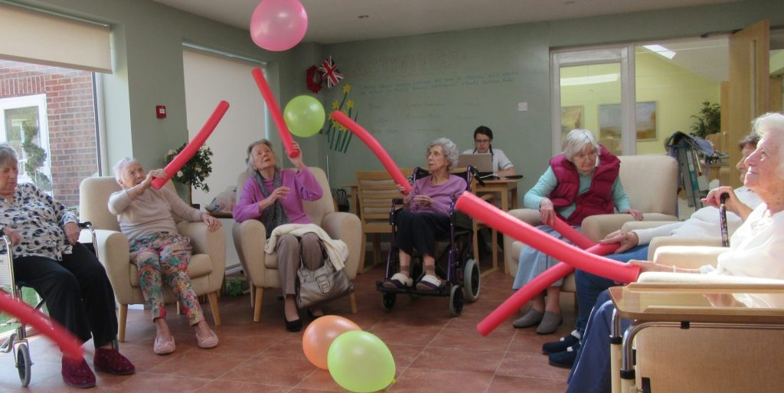
How to use OneDrive in a care home
Tayla ward 2513984
lchs4007
One drive is accessible through Microsoft identifying with a cloud icon.
Use one drive to make presentations within the care home.
Create work shift rotas within the care home for staff members.
Daily routine rotas for the elderly residents
Invite people to share presentations
Share residents' daily medication charts ( staff or residents' family upon request)
Interactive activities for residents such as quizzes

Slide 6
Pros of using one drive within the care home.
Tayla ward 2513984
lchs4007
OneDrive provides easily accessible access for staff members within sunrise residential freeing up more time to care for the residents as staff can access OneDrive quick and easy. one drive gives a much deeper understanding of each 35 residents needs at sunrise care home for the staff and nurses to understand more easily. Centred care provides emotional support, encourages collaborative decision making. Using one drive in residential care can also help involvement of family and friends enabling them to support their loved ones in their health care journey.
Better family connections, with families using one drive to connect with other family members staying at sunrise residential they can securely share photos and memories with each other, leaving the residence to feel more connected to the families that are not around everyday and helps elderly residence and residence suffering from dementia to not feel so isolated.
collaboration features, the team of carers and nurses within sunrise residential can share one drive files with each other, collaborate on files together ensuring all 35 residence that are either elderly or suffering from dementia, information, requirements are all met to standards, are up to date.

Slide 7
Cons with using one drive within the care home.
Tayla ward 2513984
lchs4007
The syncing feature with one drive can sometimes have issues such as files not syncing properly or conflicts between different versions of files. It states that OneDrive has limited storage space for free accounts possibly leading to a lot less storage than what is required in a care home, even for paid users' storage sizes might be limited, this could be a drawback for staff members with large amounts of resident's files and charts been stored possibly leading to lost files and medication charts been lost or unable to upload any files at all leading to security issues
File and sync limitations, one drive struggles with large numbers of files over (100,000)or files exceeding its size limit, so as sunrise residential has around 35 residence and a team of nurses etc there will be a lot of large files meaning it will be limited file space within the care home. May been left with residences files or information been lost.
Many of the residents in sunrise residential that suffer from been elderly will lack the basic knowledge and digital skills to be able to use OneDrive effectively, which would make it very difficult accessing digital tools creating problems not been able to access the OneDrive potentially leaving the resident felling unhappy and not satisfied.

Slide 8
Explain the Impact of limited digital skills (digital literacy)
Staff members lacking basic digital training may find it difficult using the digital tools needed to access things such as the internet, OneDrive, Microsoft systems making a negative impact on residents within sunrise residential care home, some older staff members may not be able to deliver to correct care as they won't be able to access things such as residents' medication charts, team presentations, daily routine charts etc. Nurses may need specific tailored training to suit their needs if circumstances differ or different learning styles are necessary this can also lead to some staff members left feeling anxious, stressed, even to be left feeling like they can't carry out digital tasks within the care home as they have lack of ability or skills.
(Jacqueline A De Leeuw) (Hetty Woltjer) (Rudolf B cool) august, 2020
Ref: identification of factors influencing the adaption of health information technology by nurses who are digitally lagging in depth interview study

Slide 9
.,
If staff members in sunrise residential are using a public staff computer, they must always remember to log out of their accounts so other staff members or even residents won't be able to access their personal emails, stopping residents' private information getting out to the. Staff members must not share personal details via email as it may get leaked. Staff members will make sure patients confidentiality is always kept safe working with what they know they can successfully fore fill correct care needed by knowing their limits of skills, always keeping records of their work for residents within sunrise residential , staff members at sunrise residential frequently check no unauthorised accounts are accessing files or important information within online accounts residents over 80 years old have different complex needs meaning they will need more frequent checks and with the help of digital technology tasks can be carried out with residents fast and suitable to their needs. Never discuss between staff members patient information that is private without consent from the resident within sunrise residential. Staff members should put their files and residents files in the highest security onedrive personal vault to keep everything secure and safe as it requires two step authentication steps
(Alex garner) (Jen Lewis) (Simon dixon) (Nancy Preston) https://pmc.ncbi.nlm.nih.gov/articles/PMC10861323/
(the NHS) https://www.lhhc.co.uk/pages/Confidentiality#:~:text=always%20endeavour%20to%20maintain%20patient,the%20information%20governance%20lead%20or
https://techsafety.ca/resources/toolkits/tips-for-a-secure-email-account (tech safety)
https://www.hcpc-uk.org/standards/meeting-our-standards/confidentiality/guidance-on-confidentiality/introduction-to-confidentiality/#:~:text=Confidentiality%20means%20protecting%20personal%20information,delegate%20appropriately
(micro

Slide 10
Referencing
Pros
((Microsoft) (no date) collaborating with one drive. Support.microsoft.com.https://support.microsoft.com/en-us/office/document-collaboration-and-co-authoring-ee1509b4-1f6e-401e-b04a-782d26f564a4#:~:text=With%20Microsoft%20365%20and%20OneDrive,co%2Dauthor%20Microsoft%20365%20documents:
(Person centred software) feb 4, 2019. role of technology in care homes, ttps://personcentredsoftware.com/resources/role-of-technology-in-care-homes#:~:text=More%20time%20to%20care%20with,collated%20into%20a%20hospital%20pack.
(The Porterbrook care home), 2025 .enhancing independence through technology. Theporterbrookcare.com/news.https://www.theporterbrookcare.com/news-events/the-role-of-technology-in-care-homes-promoting-independence-and-well-being/

Slide 11
Referencing
cons
(Age uk), 2024, more than 1 in 3 over 65s lack the skills to use the internet successfully. https://www.ageuk.org.uk/latest-press/articles/2024/more-than-1-in-3-over-65s-4.7-million-lack-the-basic-skills-to-use-the-internet-successfully/#:~:text=Civil%20Society%20Covenant-,More%20than%201%20in%203%20over%2065s%20(4.7%20million)%20lack,to%20use%20the%20internet%20successfully&text=New%20analysis%20by%20Age%20UK,to%20use%20the%20internet%20successfully.
(CrashPlan), 2025. 6 cons with using one drive, crashplan.com/blog/top-6-pros-and-cons-of-using-one-drive.https://www.crashplan.com/blog/top-6-pros-and-cons-of-using-onedrive/#:~:text=Cons%20of%20Using%20Microsoft%20OneDrive,File%20sharing
(Mikey molfessis) (Mimecast), September 02, 2024. Microsoft one drive security, mimecast.com/blog/microsoft-one-drive-security https://www.mimecast.com/blog/microsoft-one-drive-security/

