Slide 1
MODULE NAME: Problem Solving & Decision Making.
MODULE CODE: LCLM4004.
STUDENT NAME: Robert Ilie Rusnac.
STUDENT ID: 2435669.
LECTURER: Charles Oham.
Assignment 1: Presentation

Slide 2

OVERVIEW
Introduction:
Company background
Problem: nature and scope
PESTLE ANALYSIS: Green Haven Florists
Cause and effect analysis: Fishbone diagram
Conclusion
References

Slide 3
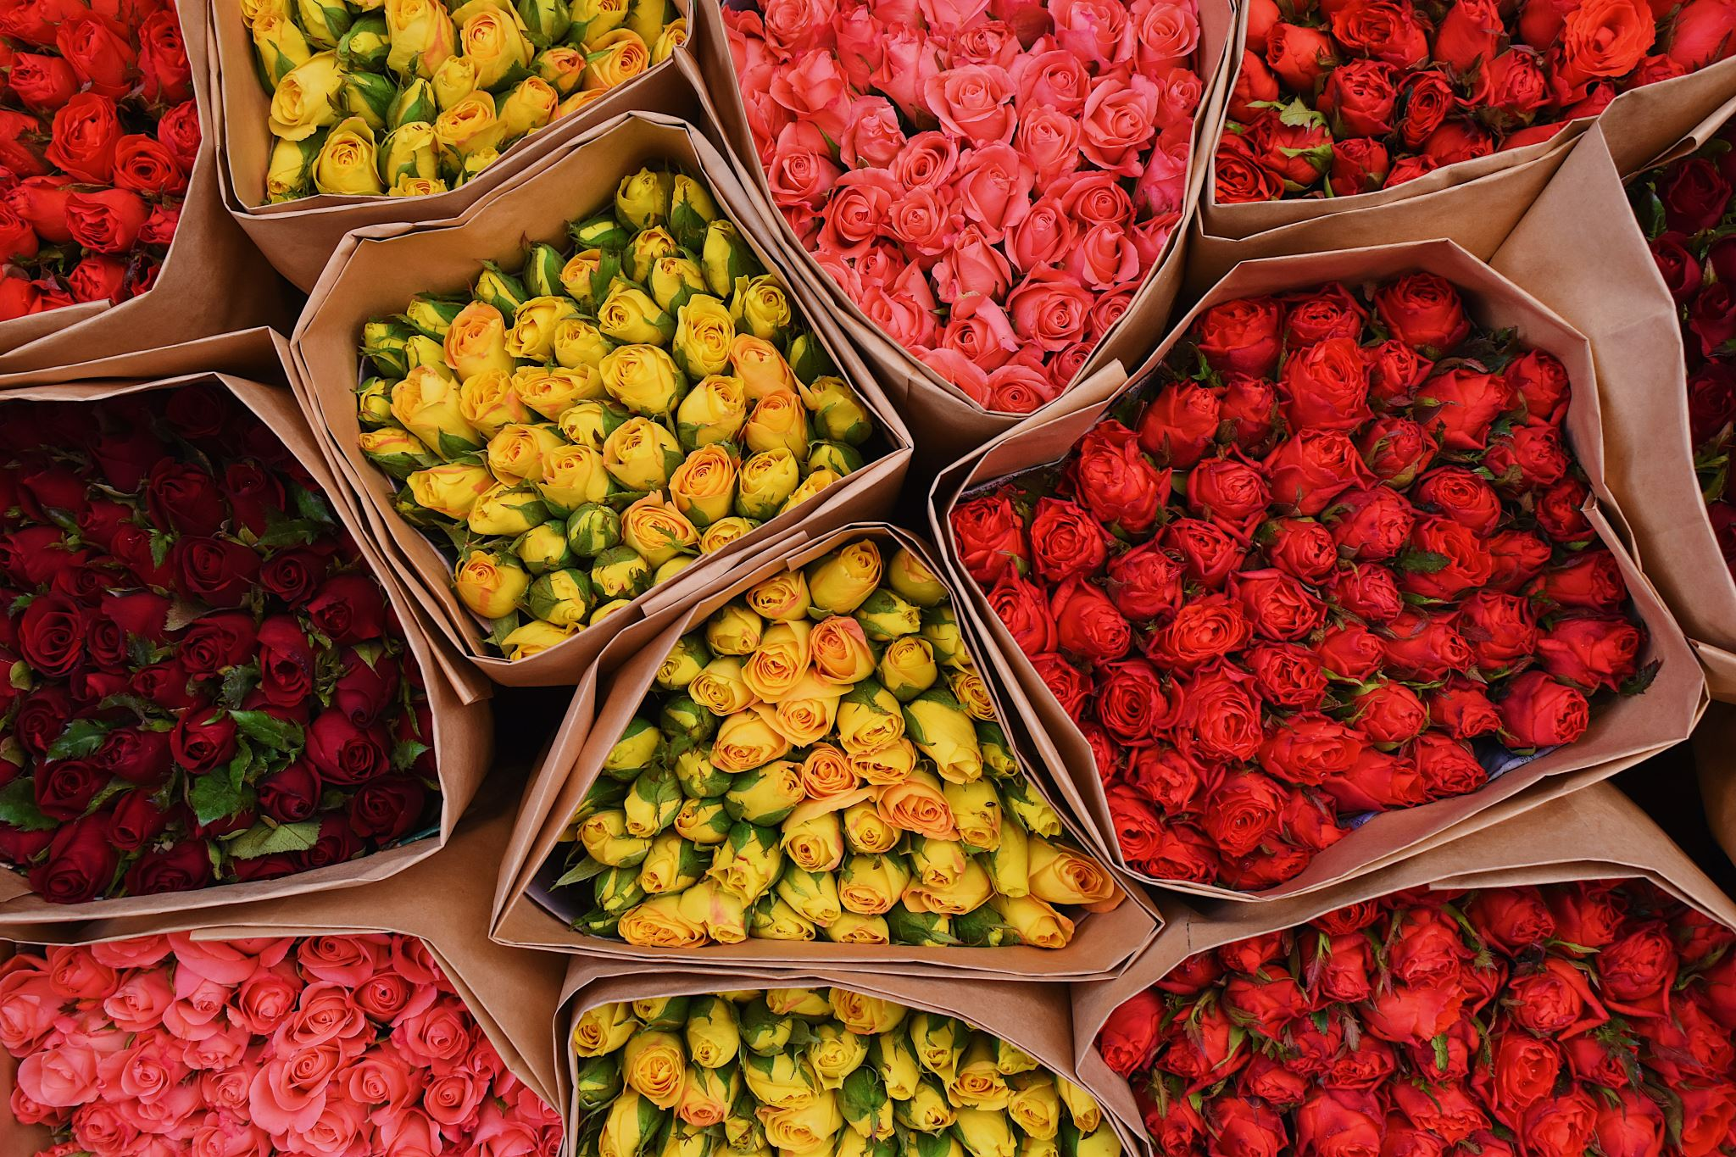
Introduction
DROP IN SALES- "decrease in the amount sold or revenue generated between two periods" ( calculator ultra, 2025)
Green haven florists is a long-established, family-run flower shop located on a once-bustling high street. Known for its creative floral arrangements and commitment to sustainable materials, the business has built a loyal local customer base over the years. However, in the past 12 months, the shop has faced significant challenges due to changing market dynamics and consumer behaviour. The rise of online shopping, coupled with declining foot traffic from the closure of nearby businesses, has led to a noticeable 30% drop in in-store sales.
Despite a modest increase in online orders, green haven florists has struggled to maintain its overall performance. Rising costs of imported flowers, supply chain disruptions, and inflation have further strained the business. Additionally, the shop’s outdated website and limited digital marketing presence have hindered its ability to compete with new entrants—both boutique florists leveraging social media and large national chains offering lower prices and broader delivery options.
This case study explores the key challenges faced by green haven florists and analyzes the external and internal factors contributing to its decline and provides strategic recommendations to reposition the business for long-term sustainability and growth.

Slide 4
Company background
Green Haven Florists
Founded in 2016.
Small independent flower shop located in Norwich, UK.
Owners: Liam and Priya.
Sells flowers and gained a reputation for their bespoke floral arrangements.
strong community ties.
Catered for a wide range of customers, from walk-in clients buying bouquets to corporate clients and weddings.

Slide 5
Problem: nature and scope
5W2H
What: Green Haven Florists is experiencing a 30% decline in their in-store sales due to reduced foot traffic, increased competition and rising operational costs. The business struggles to adapt to digital transformation and evolving consumer preferences towards online shopping and flexible delivery services.
Why: Shift in consumer behaviour towards online purchases and convenience, closure of nearby businesses leading to decreased local footfall, outdated website and weak digital marketing strategy
Who: Owners, Liam and Priya, customers, suppliers, competitors, employees.
Where: The business operates from a physical store on a high street, which has seen reduced activity due to nearby business closures. Online presence exists but is underdeveloped and outdated.
When: The issue has developed over the past 12 months, coinciding with economic pressures, supply disruptions and accelerated shifts towards digital retail channels.
How: Sales revenue has decreased sharply, costs of materials and operations have increased, customer satisfaction has been mixed due to website usability issues.
How Much: 30% decline in in-store sales, rising supply costs have eroded profit margins, online orders have increased only slightly failing to offset losses from reduced physical sales.

Slide 6
PESTLE ANALYSIS: Green Haven Florists
POLITICAL- Environmental regulations and sustainability standards require compliance with eco-friendly practices, such as using biodegradable wrapping materials.
- Local business policies and high street regeneration efforts may influence foot traffic and commercial rent costs.
ECONOMIC- Inflation has increased the cost of fresh flowers, packaging materials and logistics.
- Currency fluctuations impact the cost of imported flowers.
SOCIAL- Social media influence has shifted brand engagement towards digital platforms, favouring competitors with strong online presence.
- Customer expectations for flexible delivery options and subscription models are growing.

Slide 7
PESTLE ANALYSIS: Green Haven Florists
TECHNOLOGICAL- the company’s outdated website and limited digital marketing restrict its ability to attract and retain online customers.
LEGAL- Environmental regulations around packaging and waste disposal require continued use of biodegradable and recyclable materials.
ENVIRONMENTAL- climate change and extreme weather can disrupt global flower supplies, affecting availability and pricing.

Slide 8
Cause and effect analysis: Fishbone diagram
Digital Transformation: Redesign the website completely and implement a fully integrated e-commerce platform.
People: staff members exhibit limited digital skills and the company’s presence on social media is minimal, restricting its ability to engage modern customers.
Central Problem, over the past year, Green Haven Florists has experienced a roughly 30% drop in in-store sales, highlighting significant challenges in sustaining its traditional retail operations.
Operations: work closely with local suppliers to reduce costs while reinforcing sustainable partnerships that align with the shop’s eco-friendly philosophy.
Materials: The rising cost of imported flowers directly affects prices and squeezes profit margins, making financial sustainability more difficult.

Slide 9
Conclusion
Green Haven Florists must adapt to changing market trends and digital expectations.
By addressing cost challenges, enhancing online presence and offering flexible services.
They must introduce flexible delivery and subscription options to attract customers.
Continue sustainable practices while managing costs.
Modernize and re-design website for better user experience.

Slide 10
References
Calculator Ultra (2025) Find More Calculator Available at: Drop in Sales Calculator & Formula Online Calculator Ultra (Accessed: 8 November 2025).
https://asq.org/quality-resources/fishbone?srsltid=AfmBOoqZpAF4E1bIVyoLNceet1z6RedDEViC4Jt9MUbLkH5OLALfvG_P
https://www.cipd.org/uk/knowledge/factsheets/pestle-analysis-factsheet/
Studied/Used some information from the class powerpoint presentations, (week 2,3,4).

Slide 11

Questions

