Slide 1
PERCEPTION, COMMUNICATION AND EMOTIONAL INTELLIGENCE
5th december 2023

Slide 2

PERCEPTION
Perception is the root of our understanding, behaviour and actions
Managers need to understand importance of perception in guiding behaviour and
For effective personal and work relationships

Slide 3
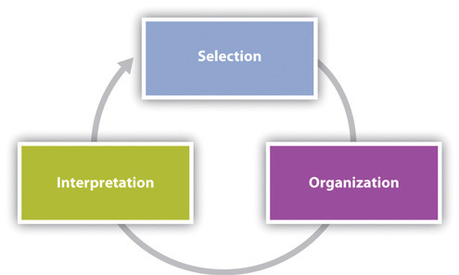
Definition
"Process of selection, organising, and interpretating information"

Slide 4
Selecting Information
We use all five senses
So many external stimuli – impossible to process them all
How do we decide what to select and what to leave out? (Fiske & Taylor, 1991)
Salience is the degree by which something attracts our attention
It will depend on aural, visual stimuli and things which meet our needs or interests

Slide 5
Organising Information
We sort and categorise information based on innate and learned patterns
We sort using proximity, similarity and difference (Coren, 1980)

Slide 6
Interpreting Information
Selecting and organising incoming information happens quickly.
Interpretation can be a much more deliberate and conscious step
We assign meaning to information based on mental structures known as schemata

Slide 7
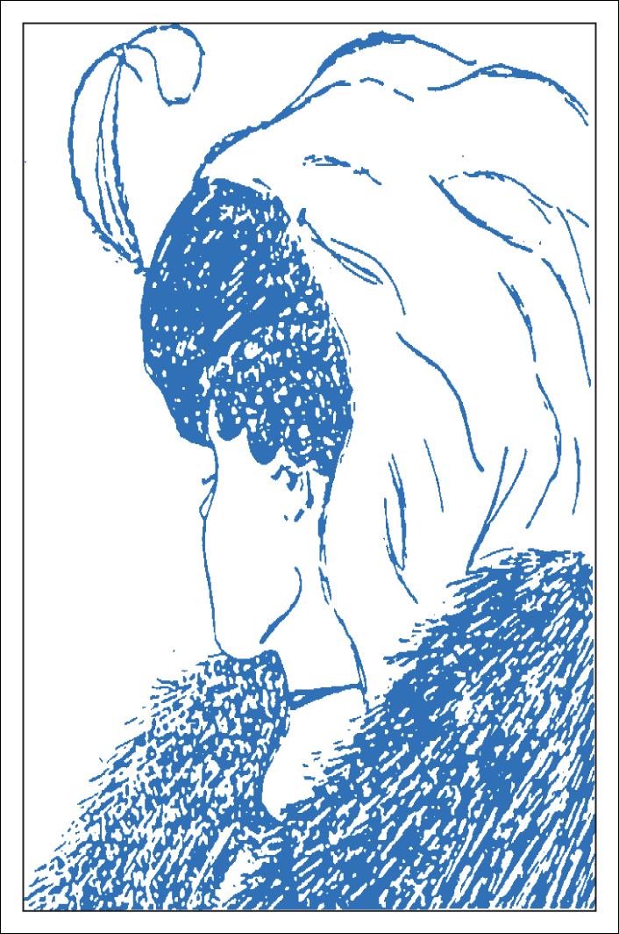
What do you see?
Perception v Reality
Research by Flinders University in 2018: the older you are the more likely you are to see an old woman

Slide 8

AND ANOTHER
WHAT DO YOU SEE?

Slide 9
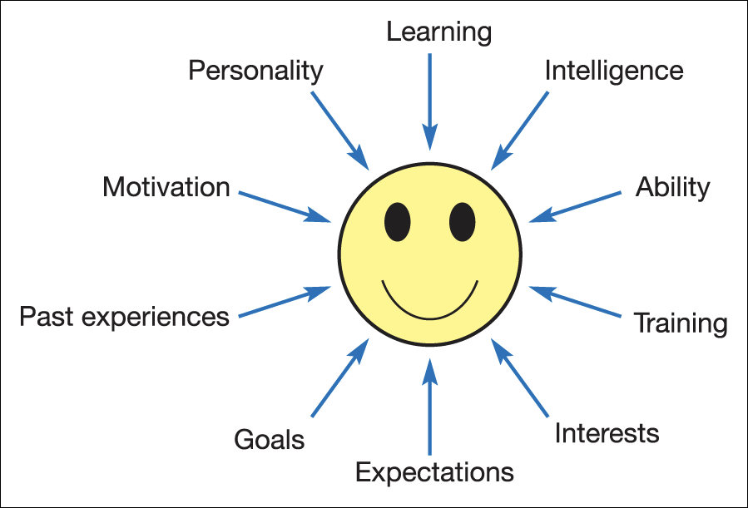
Factors affecting our perception

Slide 10

In work
Perception & stimuli can influence a manager's relationship with employees. This may impact on:
  Pay & reward
  Access to training & development
  Performance management
  Recruitment and selection decisions

Slide 11

Stereotypes
The tendency to ascribe positive or negative characteristics to others on the basis of general categorisations and perceived similarities.
A means of simplifying the process of perception and making judgements of other people, instead of dealing with a range of complex and alternative stimuli.

Slide 12

Common stereotypes – often:
Nationality
Occupation
Age
Physical attributes
Education
Social
Politics

Slide 13
The halo/rusty halo effects
The halo effect
A process whereby a person’s perception is formed on the basis of a single favourable trait or impression.
It tends to shut out other relevant characteristics of a person.
The rusty halo effect
Judgements made about a person are formed from the perception of negative characteristics.

Slide 14
Projection
The tendency to attribute or project one’s feeling, motives or characteristics to other people.
These can be positive, but are often negative and reflect our own undesirable traits.

Slide 15
Perceptual Defence
The tendency to avoid or screen out certain stimuli that are perceptually disturbing or threatening, and select information supportive of an existing point of view.

Slide 16
Unconscious Bias
Duke University: "mature-faced" people had a career advantage over "baby-faced" people
Yale University: male and female scientists are more likely to hire men, rate them higher than men and pay them more than women.
"the associations we hold, outside our conscious awareness and control...triggered by our brain automatically making quick judgements and assessments"

Slide 17
4 STRATEGIES FOR OVERCOMING UNCONSCIOUS BIAS
Be aware of the bias – and mitigate it
Improve cultural competency
Create safe spaces for learning
Take the Implicit Bias Test: https://implicit.harvard.edu/implicit/takeatest.html

Slide 18
COMMUNICATION
Leaders need to be able to communicate clearly and effectively
Most critical leadership skill?
  Be clear and concise
  Prepare ahead of time
  Be mindful of nonverbal communication
  Watch your tone
  Practice active listening
  Build your emotional intelligence
  Develop a workplace communication strategy
  Creative a positive culture

Slide 19
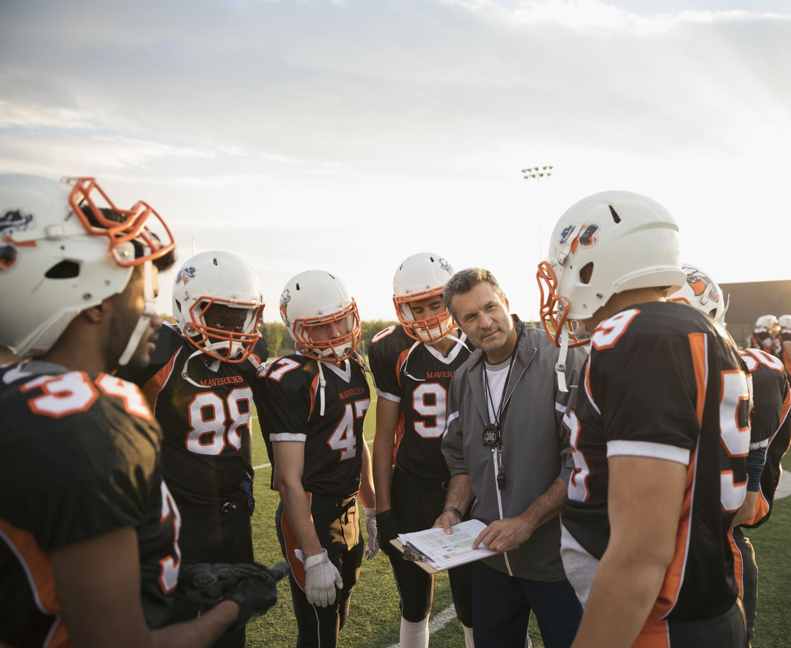
In your groups
Define and give some examples of non-verbal communication
What do we mean by active listening? Give some examples

Slide 20
Emotional Intelligence
Sought after interpersonal skills – valued by 71% of employers above technical skills
It's the ability to understand and manage your emotions, as well as recognise and influence the emotions of those around you
Daniel Goleman:
  "the most effective leaders are all alike in one crucial way: they all have a high degree of emotional intelligence."

Slide 21
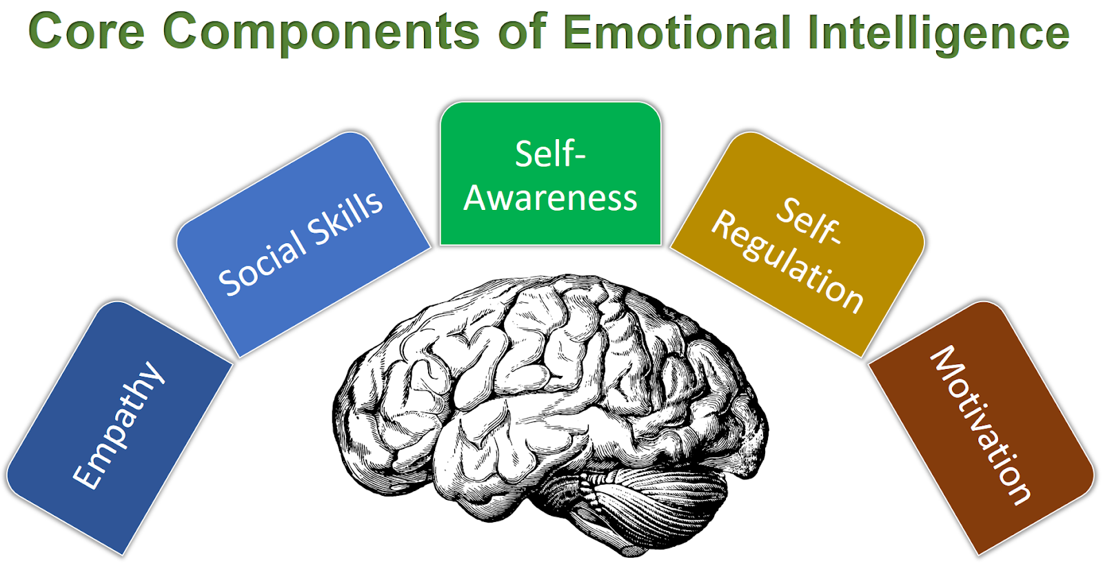
Five components of emotional intelligence
Empathy
Effective communication
Self-awareness
Self-regulation
Motivation

Slide 22
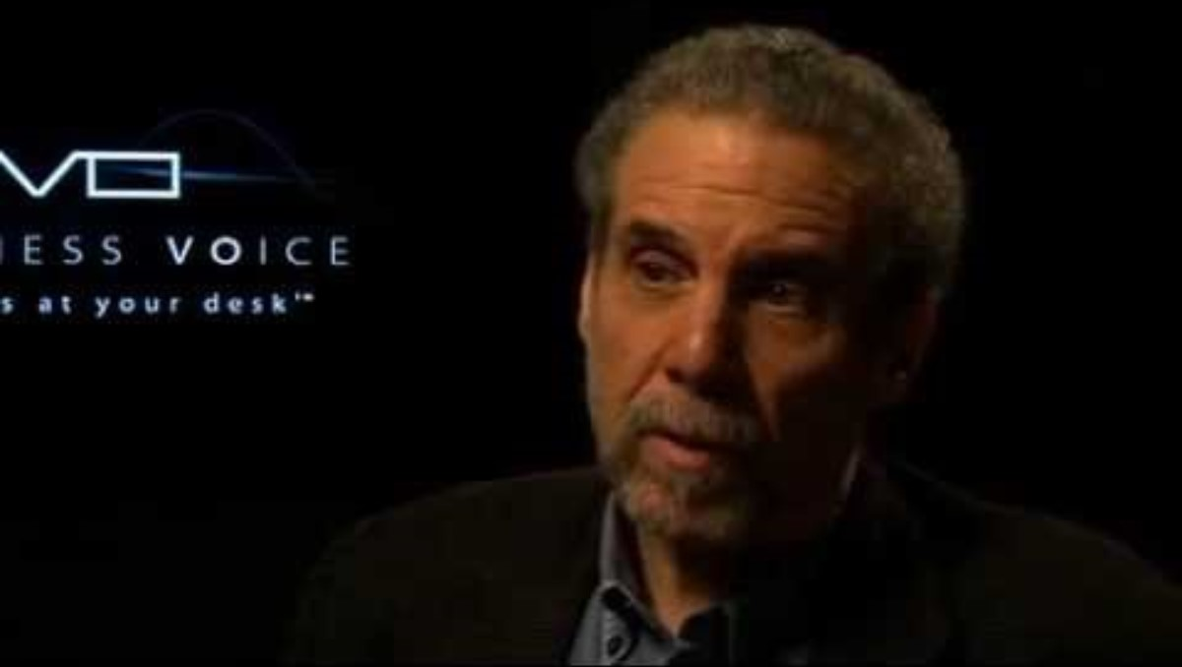
DANIEL GOLEMAN ON LEADERSHIP

Slide 23
How can you develop Emotional Intelligence?
Imagine you are preparing for an interview for a graduate scheme. Prepare a plan to improve your EQ – knowing that it is a sought after skill.
Lots of people have a personal development plan. Could you be one of them?

Slide 24
How to develop your EQ
Try journalling – reflecting on your day.
Undergo a 360-degree assessment
Practice active listening
Pay attention to your emotions
Take online courses
Read books
Recognise an emotional response
Recognise self-management strategies
Learn to identify others' values

