Slide 1


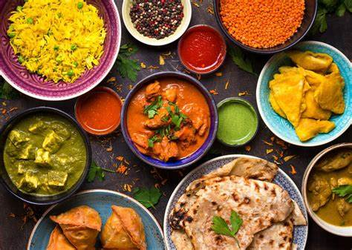
START-UP BUSINESS PLAN DEVELOPMENT:
ESTABLISH A FOOD OUTLET
Student name: Gindila Smaranda
Student ID number: 2216541
Module code: LCBB5001

Slide 2
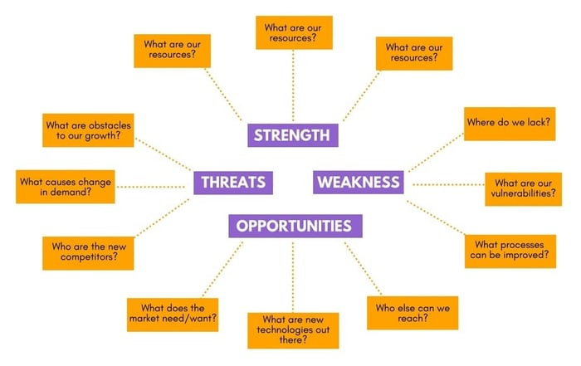
Introduction
A start-up business implementation needs to draw attention to agile and adaptable planning.
Here suggested business idea for developing an Indian Cuisine food outlet in the UK, namely Galland.
A strong leadership pattern, efficient communication platform, and transparent understanding of business goals are the main pillars of successful business planning.
Notes:
This presentation is involved in exploring the potentiality of business planning. Considering an efficient leadership pattern and strong agile planning developed here for implementing a startup food outlet development planning.

Slide 3
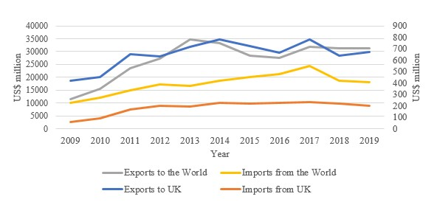
Overview of the business idea
Here the suggested business idea is to develop a food outlet in the UK.
Selling Indian traditional cuisine and a sustainable packaging strategy will be its USP to strengthen its competitive edge.
It has adopted a “customer-centric approach”.
The market size of Indian food in the UK has increased by 54% which signifies its potential to grow (Naylor et al., 2021).
Notes:
The main concern of this business plan is to develop an Indian cuisine food outlet in the UK food marketplace. As per the suggested planning, organic packaging of food and distinctive traditional food items with Indian fragrances, spices and aroma will be the unique USP for this business. This in turn protects it from an extensive competitive market.

Slide 4
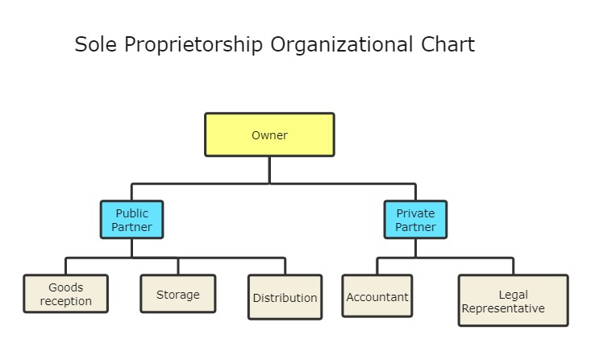
Legal Format of the Company and Ownership
Legal format development in a start-up business ensures an efficient risk management framework to cope with legal informalities-related issues (Carroll, 2021).
In this business case, the company will follow a “sole proprietorship”.
It signifies entire management system will be controlled by a single owner (Januarita, 2021).
Notes:
The legal format of a business provides a well-defined planned structure. Diverse organisational posts and any associated legal issues will be controlled under a certain legal format. This business will follow a sole ownership legal format.

Slide 5
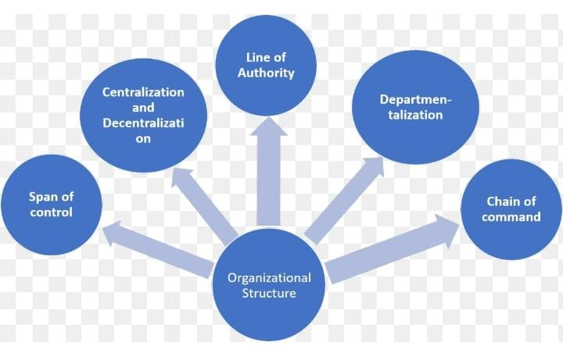
Management of the company
The management infrastructure of a company is developed based on the employee base (Andreas, 2022).
Beginning of this solely developed business idea has planned to implement with approx. 15 to 20 employees.
One head chef will be responsible for addressing the authenticity of the food items, while the maintenance crew will search for potential market opportunities to foster business innovation.
CEO, HR, SCM Officer, marketing managers and other staff will be the core of developing this business.
Notes:
This slide has presented the primary managerial structure of the proposed organisation, Galland. At the very beginning of this organisation, about 15 to 20 employees were included in the organisational structure. One accountant, Chef, SCM manager, and accountant will be the core of this framework.

Slide 6
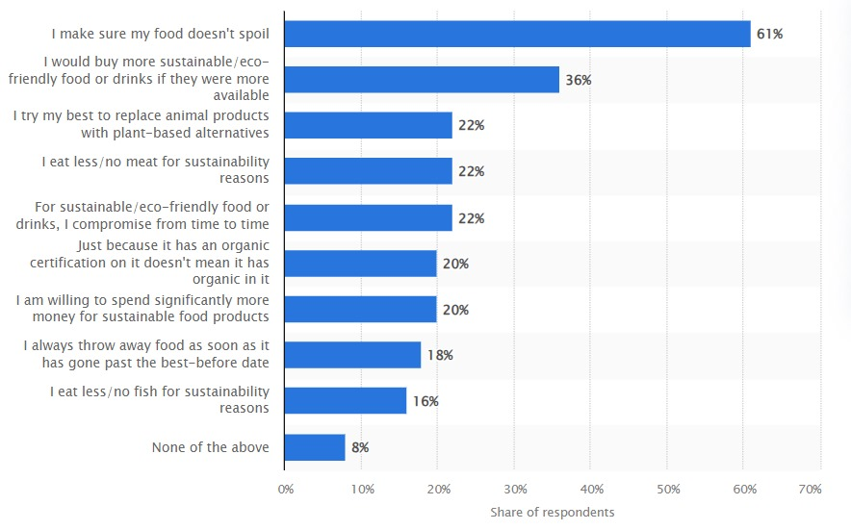
Evaluation of the Business Idea: SWOT
Distinct the business idea with innovative USP of selling Indian cuisine and using sustainable packaging.
Reduced brand recognition and market penetration are the common barriers to such startup planning.
Increased rate of events and catering globally is another market strength for this start-up idea.
Enhanced demand from an eco-conscious consumer base is another strength of this business idea (Statista.com, 2024).
Sole dependence on a single ownership indicates some threats to managing issues.
Notes:
The business concept of providing Indian food in eco-friendly packaging, is notable for its USP. The firm capitalises on the rising need for food service providers worldwide and growing enthusiasm from eco-conscious buyers, overcoming challenges including low visibility and market share. Sole proprietorship, however, may present management challenges.

Slide 7
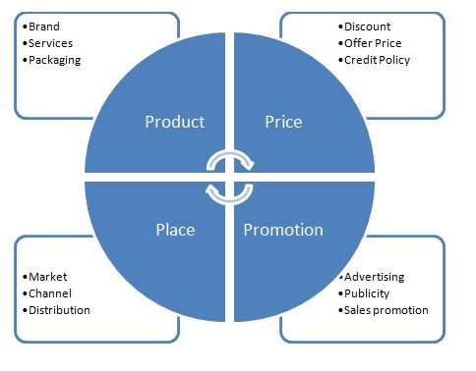
Evaluation of the Business Idea: 4P marketing mix
Product- A diverse product portfolio addressing traditional Indian cuisine will be offered delicately.
Pricing- In terms of coping with a highly competitive marketplace, it needs to adopt a competitive, value-based pricing strategy.
Place- business will be targeted in an area of the UK with highly dense or populated areas.
Promotion- It will adopt a mixed promotional strategy, conventional and digital media.
Notes:
The company targets the most populous regions of the UK. These regions will give a strong customer base. It will offer a variety of Indian cuisine, uses affordable prices, and has a mixed marketing plan.

Slide 8
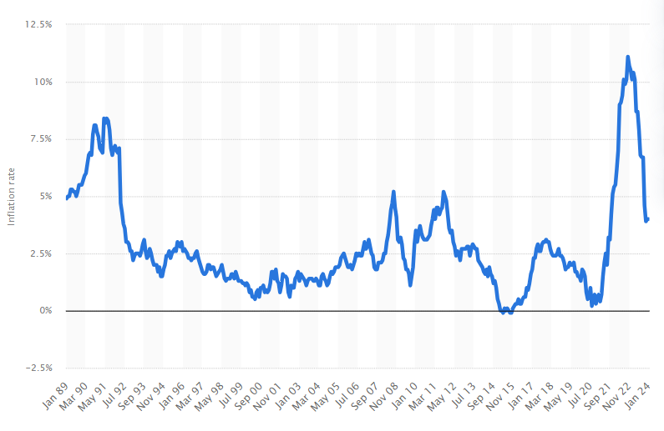
Evaluation of the Business Idea: PESTLE
Politically unstable conditions like Brexit cause significant economic constraints.
The increased inflation rate, in 2022, peaked at about rising 11.1%, becoming a contemporary business issue in the UK marketplace (Statista.com, 2024).
Its highly experienced and trained culinary team will strengthen its market structure.
Sociocultural trends towards the sustainable and standard-quality of food are a potential benefit for this business.
Notes:
The company has a competent culinary staff but also faces economic issues from growing inflation rates and political upheaval caused by Brexit. Trends in society toward sustainability could be advantageous to the company.

Slide 9
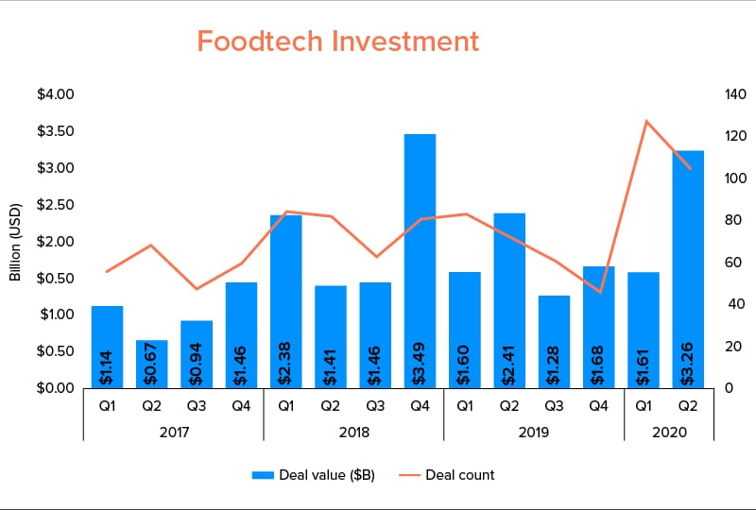
Evaluation of the Business Idea: PESTLE
The UK is providing a highly potent technological business landscape.
Regulatory and legal changes in the UK government body may hamper the management infrastructure of food sectors.
The “Organic Products Regulations 2009” protects the UK’s commitment towards satiable development.
Notes:
The UK's technologically advantageous environment contrasts with regulatory hazards and laws such as the "Organic Products Regulations 2009" promote sustainable growth.

Slide 10
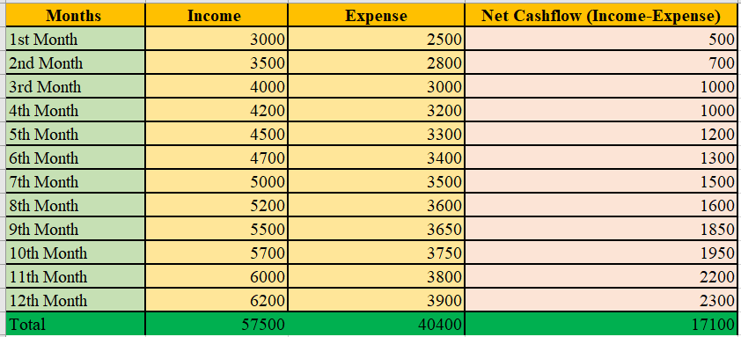
Cash flow forecast for the first 12 months
A £25,000 initial expenditure has been set aside for operating capital, culinary equipment, and launching expenses.
Rent, electricity bills, payroll, insurance coverage, marketing, and other incidentals are instances of monthly fixed expenditures.
Considering materials and package variable expenses per meal taken into account, a predicted "net cash flow" of about £17,100 over 12 months has been forecasted.
Notes:
This slide presents a forecast of cash flow for the initial 12 months. The starting £25,000 expenditure pays for necessary equipment, operations, and launching expenses. Utilities, rent, employment, coverage, advertising, and other expenses are among the fixed monthly costs, with a predicted "net cash flow" of £17,100.

Slide 11
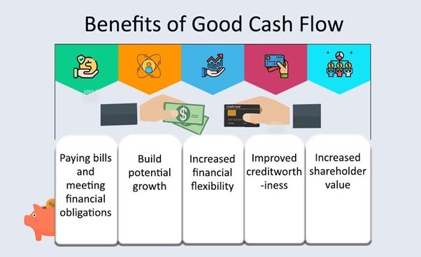
Conclusion
This study has critically defined how potent this business planning is in the UK business context.
Industrial analysis and cash flow management forecast help to protect the viability of this project.
Notes:
This presentation makes a comprehensive analysis of how this business planning will be successfully implemented in the UK-targeted regions. Considering the cash flow forecasts the financial stability of this project has also illustrated.

Slide 12
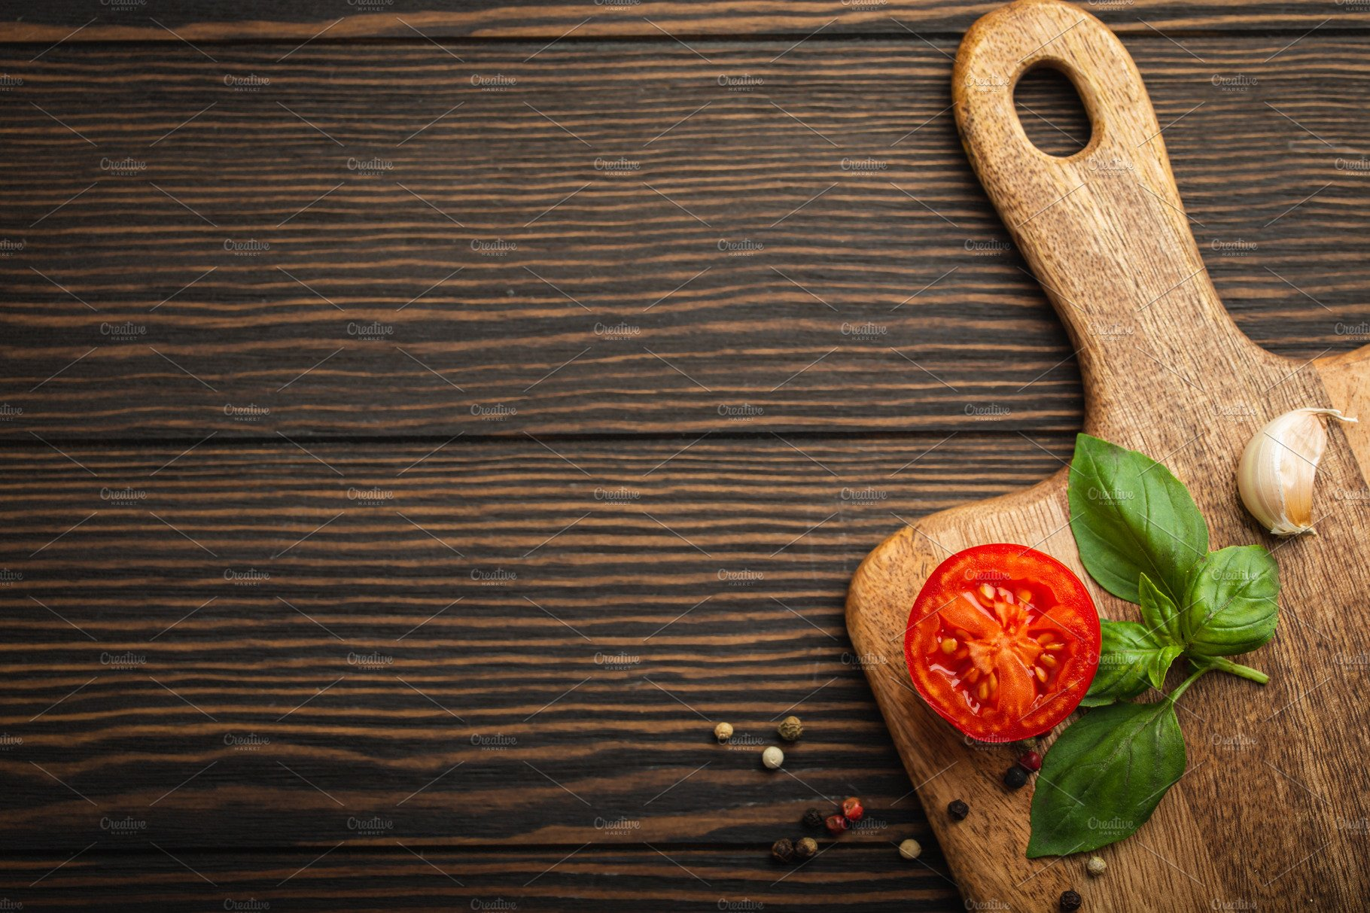
Reference List
Andreas, D., 2022. EMPLOYEE PERFORMANCE: The Effect Of Motivation And Job Satisfaction. PRODUKTIF: Jurnal Kepegawaian dan Organisasi, 1(1), pp.28-35.
Carroll, A.B., 2021. Corporate social responsibility: Perspectives on the CSR construct’s development and future. Business & Society, 60(6), pp.1258-1278.
Januarita, R., 2021. The Newly Sole Proprietorship as Limited Liability Company in Recent Indonesian Company Law. Jurnal Sosial dan Pembangunan, 37(1).
Naylor, R.L., Kishore, A., Sumaila, U.R., Issifu, I., Hunter, B.P., Belton, B., Bush, S.R., Cao, L., Gelcich, S., Gephart, J.A. and Golden, C.D., 2021. Blue food demand across geographic and temporal scales. Nature communications, 12(1), p.5413.
Statista.com, 2024, Attitudes towards sustainable nutrition in the United Kingdom as of June 2023, Available at: https://www.statista.com/statistics/1400522/uk-consumer-attitudes-towards-sustainable-nutrition/, [Accsessed On 4th March 2024]
Statista.com, 2024, Inflation rate for the Consumer Price Index (CPI) in the United Kingdom from January 1989 to January 2024, Available at: https://www.statista.com/statistics/306648/inflation-rate-consumer-price-index-cpi-united-kingdom-uk/#:~:text=Inflation%20rate%20in%20the%20UK%201989%2D2024&text=The%20UK%20inflation%20rate%20was,11.1%20percent%20in%20October%202022, [Accsessed On 4th March 2024]

Slide 13




