Slide 1
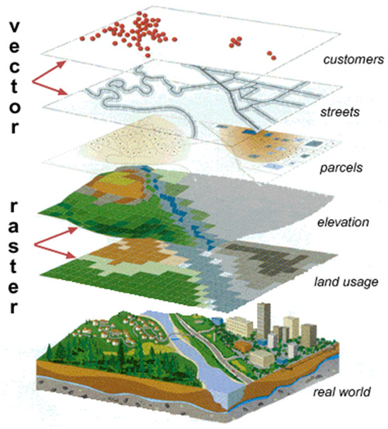
SOCIO-Demographic Data and GIS
A General Overview
By Hayley, Nicola, Ian and James

Slide 2
What is GIS?
“A GIS is designed for the collection,
storage, and analysis of objects and phenomena
where geographic location is an
important characteristic or critical to the
analysis.“’

Slide 3
Socio-Demographic Characteristics
Amongst other things, the analyses presented in this chapter show:
• Marriage was highly prevalent in the cohorts studied here, but at younger
ages, living with a partner became more common.
• Among people reported as having children, the most common number of
children was two, with the proportion of people who reported having one
child increasing with age.
• Only a small proportion of people in the population aged 50 or over have
one or more children living in the household. This proportion declined
with age.
• The prevalence of most socio-demographic characteristics covered in this
chapter showed differences by education and occupation. Men and women
in managerial and professional occupations, or who have attained higher
levels of education, were more likely to be married or to be living with a
partner, to have more children and to have parents who were still alive.
• In many of the socio-demographic aspects analysed, the differences
related to education and occupation were greater at younger ages.

Slide 4
What question can be expect a GIS to answer
Where are particular features found ?
What geographical patterns exist?
Where have changes occurred over a given period ?
Where do certain conditions apply?
What will the spatial implication be if an organisation takes certain actions?
Notes:
These are typical geographical question so whats new

Slide 5
Socio-Demographic Data, GIS and the Government
bY Lindsay, Martin,Woody

Slide 6
Government and GIS
GIS has been adopted by the Home Office for Policing programs, hoping to reduce crime rates.[5]
Usually the data comes from ‘population surveys and censuses’ [1].
GIS can be used for ‘policy making – Health, Pensions, Environment’[2] etc.
The socio-demographic data gathered can be placed onto a GIS to study the statistics.

Slide 7
Socio Demographic Data and Government use
Used to assess population changes
‘In the UK there has been a large expansion in the availability of spatially referenced socio-demographic data over the last few decades’ [3]
The areas looked at are an ‘ageing society, increased life expectancy, low fertility and teenage pregnancy’[3]
The Office of National Statistics gets socio-demographic information about business successes in different parts of the country or areas where there is a different language in use (e.g. Use of Welsh in Wales)[4] or economic change [6] or education for example the ONS website states that ‘4 in 5 of working age people have qualifications’[7].

Slide 8
The geographic used in china
GIS can be a spatial database management system(1)
GIS can be used in the analysis and evaluation of the simulation forecast
GIS is used in mapping in the topic map application

Slide 9
Application Type
According to the GIS applications in different areas can be divided into:
cadastral information system (CIS), image-based information system (IBIS), Land Information System (L IS), natural resources management information system (NR2MIS).
Market Analysis Information System (MAIS), Planning and Information System (PIS), Spatial Information System (SIS).
the decision-making space information system (SDIS), the City Information System (UIS) and transport geographic information system (GIS2T), and so on.(2)

Slide 10
Integration technology
GIS is comprehensive technology and have been integrated with each other technologies:
CIS-CAD
CIS-GPS
GIS-Internet(3)

Slide 11
References
EasyWeb, Accessed: 02 Dec 2008 [Online] http://easyweb.easynet.co.uk/~edp/esguide/eg-data/eg-data.htm
Esri UK , GIS for Central Government, Accessed: 02 Dec 2008 [Online],http://www.esriuk.com/industries/industry.asp?indid=6
GIS Development, Sociodemographic Spatial Change in UK: Data and Computational Issues and Solutions, [Online], http://www.gisdevelopment.net/magazine/years/2006/dec/30_3.htm
National Statistics, http://www.statistics.gov.uk/CCI/SearchRes.asp?term=Welsh+language
Public Technology, 37 police forces put crime on the map via GIS system, [Online],
http://www.publictechnology.net/modules.php?op=modload&name=News&file=article&sid=7133&mode=thread&order=0&thold=0
Office of National Statistics, Economy, [Online] http://www.statistics.gov.uk/instantfigures.asp
Office of National Statistics, Working Lives (Wales) , [Online] http://www.statistics.gov.uk/cci/nugget.asp?id=452

Slide 12
G.I.S. in business
Matt brooks, Matt Rees, Marc Lancey and Stacey Evans

Slide 13

Banking
Financial analysts employ GIS for targeting their markets by visualizing service needs. Companies including Metropolitan Life and Chase Manhattan Bank rely on GIS software to help them improve operational excellence and profitability.
A thorough knowledge of customers' needs and requirements gained from GIS analysis underlies the geographic advantage.

Slide 14

Insurance
Many insurance companies have made GIS a central component of their business, using it to visualize, analyze, and distribute risk. Companies such as CHUBB Insurance use GIS software for portfolio risk management.
Changes with what area you live in
Probably have their own GIS records
rather than going by post code to give
a good analysis of crime

Slide 15

Logistics
Logistics management requires planning the distribution fleet's activities, route locations, and schedules. Argentina's telephone company, Grupo Telefónica, uses the GIS logistics routing solution shown to the right to increase the number of daily deliveries without increasing resources.

Slide 16

Media
GIS is used by media bureaus for everything from analyzing circulation and attracting advertisers to creating the maps used in the material itself. The Associated Press (AP), USA TODAY, and National Geographic Society use GIS software to create accurate maps quickly for magazines, newspapers, and online news services. GIS maps can help the media keep the public informed about street closures or openings and other emergency services,
as in this map of lower Manhattan from
the AP.

Slide 17

Real Estate
From map-based contact management to sophisticated investment analysis in large real estate investment trusts, real estate agencies rely heavily on electronic mapping. Many realtors have found great success in using the Internet to market properties. Companies such as SSR Realty Advisors, Inc. use GIS in commercial real estate, while REALTOR.com uses GIS to bring maps online to 1.2 million people shopping for a new home. Learn more.

Slide 18
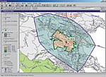
Retail Business
Businesses maintain information about sales, customers, inventory, demographic profiles, and mailing lists, all of which have geographic locations. Therefore, business managers, marketing strategists, financial analysts, and professional planners increasingly rely on GIS to organize, analyze, and present their business data.
Companies such as Sears have saved millions of dollars by managing deliveries with GIS.

Slide 19

Gym’s
Gold's Gym Enterprises uses GIS to study new franchise locations. Smaller companies, such as Ultra Marine Kayaking of Santa Cruz, California, find GIS useful and cost-effective for creating accurate and attractive maps for promotional materials.

Slide 20
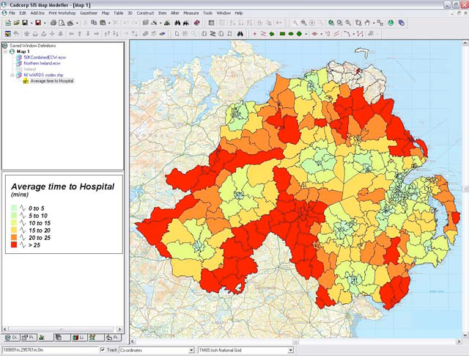
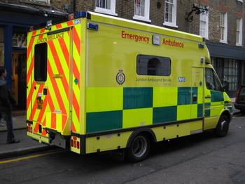
Ambulance
Slide 12 OSNI ‘GI in Health and Public Safety’ Seminar, 20 June 2007, Belfast
Cadcorp SIS® - Spatial Information System®
‘Location-based Health Services’
• Simple Site Location
exercises
• Point locations of hospitals,
GPs, pharmacists and
dentists
– Geocoded lists?
• Add
– Raster backdrop
– Ward boundaries
– etc.
• ‘What if?’ analysis
– New build etc.
– Compare with population
projections
• Decision support,
dissemination issues etc.
Cadcorp.com

Slide 21
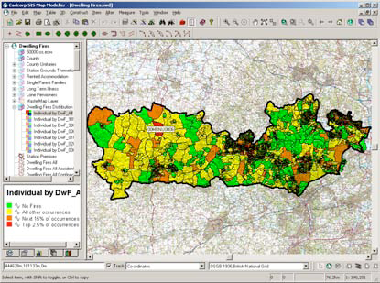
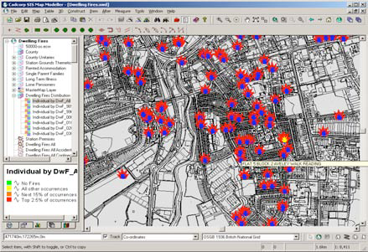
Fire service thematic mapping

Slide 22
ref
http://www.esri.com/industries/banking/index.html
http://www.gis.com/showcase/business.html
http://casweb.mimas.ac.uk/
http://www.caliper.com/Maptitude/Insurance/default.htm

Slide 23
How the NHS uses Socio – Demographic Data & GIS

Slide 24
Location Based GIS within the NHS
Consumers are turning to the internet in order to find –
  Hospitals
  Surgeries
  Dental Practice
  24 Hour Pharmacies

Slide 25
Case Study
There is the potential for using geographical information systems (GIS) to examine the provision of dental services in the UK. A major benefit of using GIS to examine socio demographic profiles of patients on a dental register is to inform policy makers.
A dental practice in swansea was examined and postKEY coded list of registered patients were analysed. To be of value in this context, the maintenance of up-to-date and fully postcoded information by practitioners is vital. Attention is taken to the advantages (and current limitations) of using deprivation indices in conjunction with such lists.
GIS has significant potential in analysing patterns of registration, and utilisation, of such services but, to date, there has been a relative dearth of studies that have developed such systems.

Slide 26
Case Study 2
Following a water contamination incident in Worchester 1994, the health authority proposed the establishment of a regional service based on GIS to assist in surveying environmental incidents and potential hazards.

Slide 27
Future of GIS within the NHS
Hospitals should soon be able to use GIS to produce real time maps in order to track movement of patients to better guarantee safety and security ie – Maternity Ward.
With over 230 diseases distributed throughout 200 countries it is difficult to track their spread, so therefore with GIS they will be able to publish the data immediately.

Slide 28
References
http://www.ingentaconnect.com/content/fgdp/pdc/2002/00000009/00000002/art00008?crawler=true
http://www.geog.ubc.ca/courses/geog471/notes/health/Overview_GIS_Health.htm
http://www.wmpho.org.uk/wmciu/GIS3.htm

