Slide 1
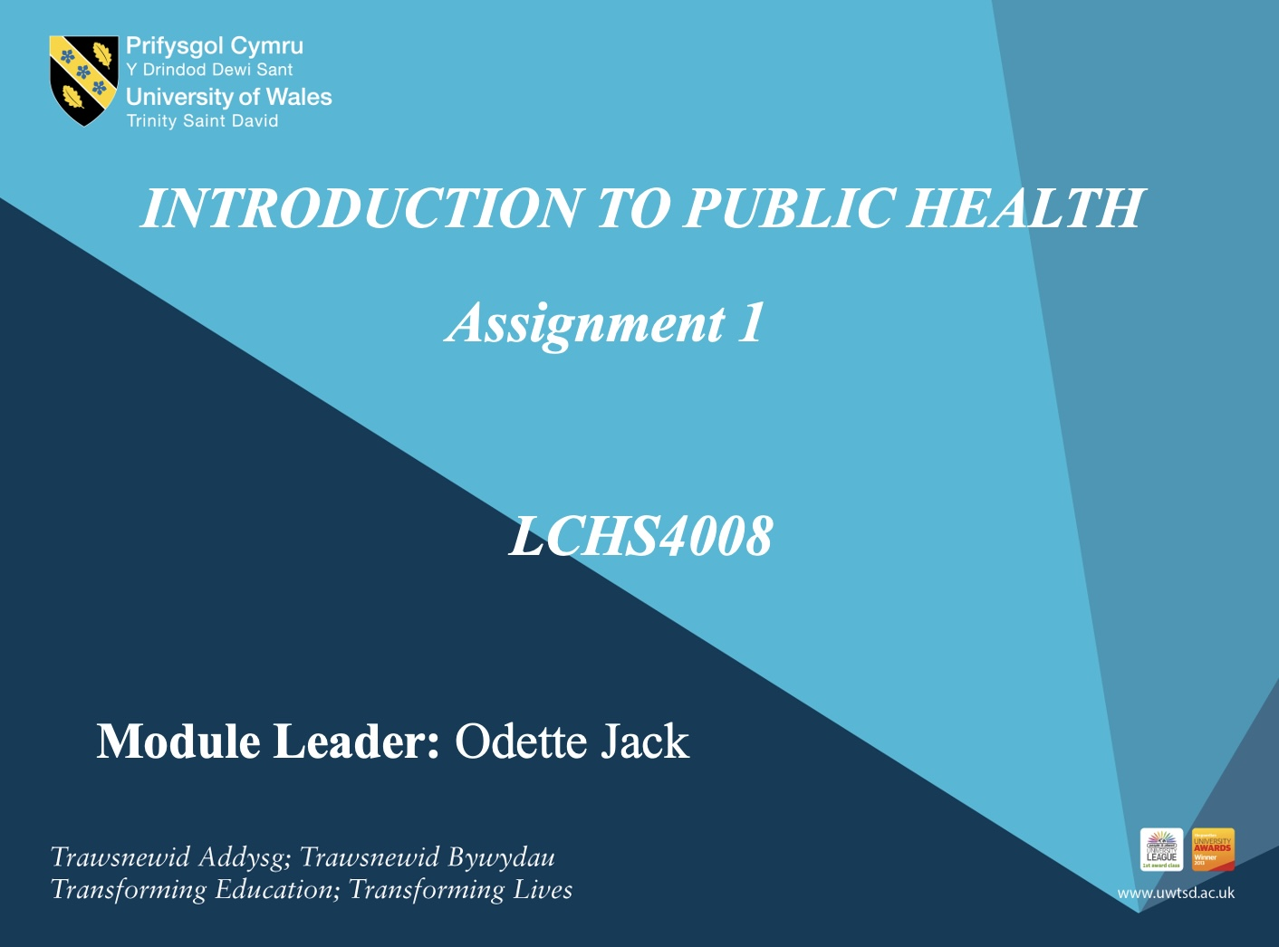

Slide 2
Group(POLIO)
Student Name | Student Number
NAZIA AZIMI | 2511889
RABEYA PAYEL | 2513891
OANA-ZLATITA ILICI | 2516914
HUMA IRFAN | 2513415

Slide 3

Presentation Overview
Introduction/Overview of (POLIO).
Methods And Strategies Used To Measure Polio.
Methods And Strategies Used To Monitor Polio.
Methods And Strategies Used To Control Polio.
Policy And Strategies That Are Available To The UK Government To Maintain Public Health.
Health Education And Prevention Strategies For College Management.

Slide 4
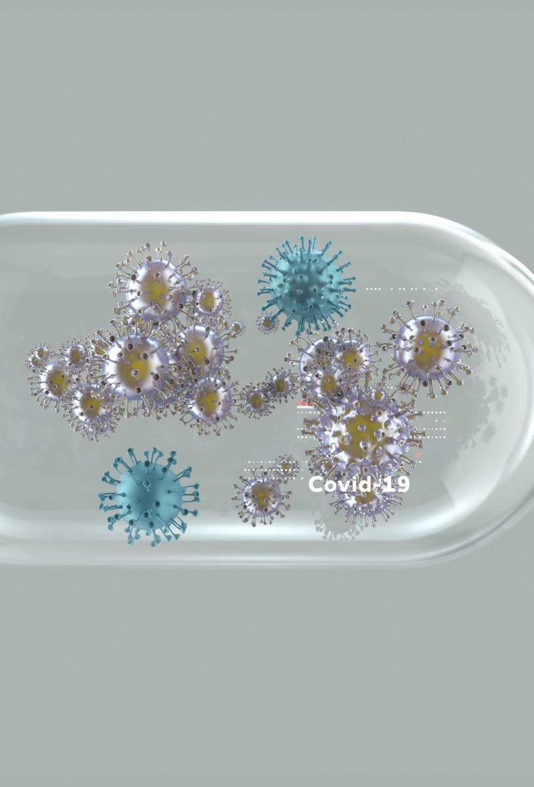
Introduction/Overview Of Polio Disease
Polio is an infectious disease caused by the poliovirus. It mainly spreads through the faecal-oral route, and it may spread through coughs or sneezes. The virus attacks the nervous system and can cause muscle weakness, including paralysis (WHO, 2025).
Most individuals infected with polio do not develop symptoms. However, symptoms can include fever, fatigue ,headaches. In severe cases it can affect the brain and nerves (NHS,2024).
Polio is extremely rare in the UK due to NHS vaccination programme and naturally occurring wild polio in the UK was recorded in 1984. Uk declared polio free in 2003.However the UK Health Security Agency (UKHSA) found poliovirus in sewage samples taken from the London Beckton Sewage Treatment Works in 2022. (UK Health Security Agency, 2022).
Morbidity refers to health complications caused by the disease. According to WHO, 1 in 200 individual who get infected with poliovirus will develop paralysis which can not be reversed or cured.
Mortality refers to death caused by the disease. Among the individuals who develop paralysis, 5-10% die because the paralysis affects the muscle that help them breath.( WHO, 2025).

Slide 5
strategies that could be used to Measure the Polio disease
Clinical Surveillance: The most direct way to measure the disease is by tracking its primary symptom: Acute Flaccid Paralysis (AFP).
Environmental Surveillance (ES)
Collecting wastewater samples to detect polioviruses in a population.
Aimed on community with lower vaccination rate (Department of health and social care 2019).

Slide 6
Measuring Population Immunity
To predict where an outbreak might occur, authorities measure how well-protected a population is. Vaccination Coverage, Serosurveys
Digital and Geospatial Mapping:
technology plays a major role in measuring the reach of the disease(WHO,2023).

Slide 7
Main approaches and strategies to Monitor Polio disease
Acute flaccid paralysis (AFP) Surveillance is the primary strategy for monitoring polio globally(WHO,2018).
Environmental and Laboratory Surveillance(WHO,2022)
Immunization monitoring and outbreak response monitoring vaccination coverage helps to prevent virus spread , identify immunity gap(WHO,2018).

Slide 8
Supplementary Strategies
Contact sampling: testing healthy children in the immediate circle of a suspected case.
Zero Reporting: requiring health facilities to submit a report every week even if they saw zero cases (this ensures they are (actually looking).
Community volunteers: utilizing local leaders and traditional healers to report rumors of paralyzed children In remote areas (World Health Organization, 2018).

Slide 9
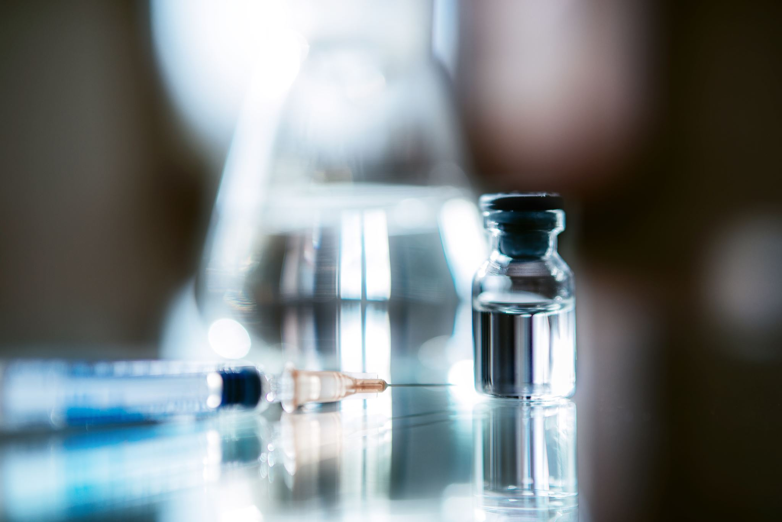
Strategies Used To Control Polio
Polio can be controlled by using safe and effective vaccination as there is no cure once a person get infected with the virus.
Targeted IPV Booster Campaign
After the detection of type 2 vaccine-derived poliovirus in sewage in London, the health authorities implemented a targeted IPV booster dose campaign.
This booster dose offered to all children between the ages of 1-9.
It also focused the areas where poliovirus has been detected and the communities with the lowest rate of vaccination.
Goal - To reduce paralysis and permanent disability caused by poliovirus infection.
To prevent further transmission of the virus ( UK Health Security agency,2022)

Slide 10
Polio Eradication Strategy
In 2020 , the Global Polio Eradication Initiative (GPEI) updated its strategy to eradicate polio worldwide.
The strategy aimed at faster response during polio outbreak.
Rising public awareness for poliovirus and making vaccination easier to access.
Improving the effectiveness of vaccination campaign (Global Polio Eradication Initiative, 2019).
Polio Surveillance Strategy
Sewage surveillance is a method to monitor wastewater to detect viruses and pathogens circulating in a community.
It acts as an early warning system for potential disease outbreaks.
By analysing sewage samples scientists can detect viruses even when infected individuals show no symptoms such as polio infection.
Goal- This data collection helps public health authorities to respond quickly.
It also helps with putting correct measures in place such as vaccination campaign and targeted (Inactivated Polio Vaccine) booster dose (Uk Health Security Agency,2026).

Slide 11
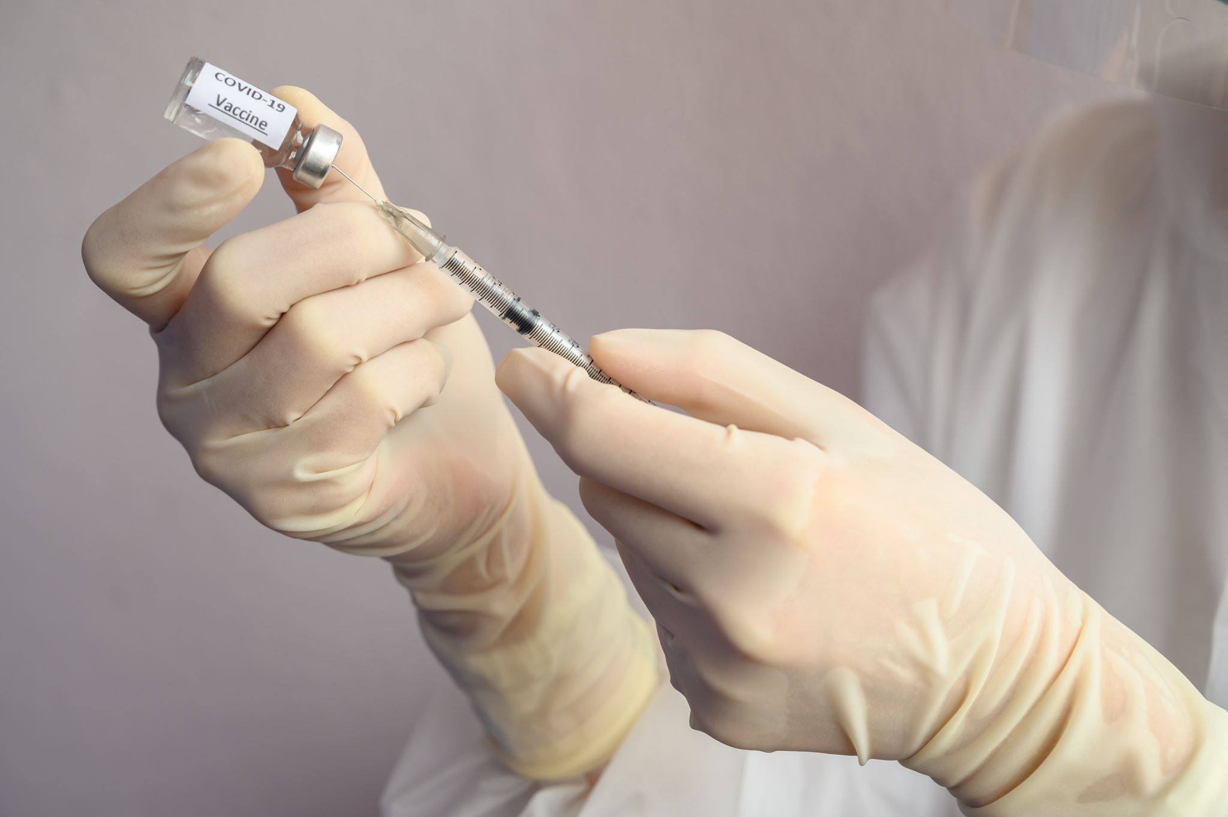
Polio Catch-Up Campaign
NHS offered vaccination to children between the ages of 1-11 who were unvaccinated or partially vaccinated during the summer term campaign.
Children has received other routine vaccination such as measles, mumps and rubella (MMR).
Vaccinations provided through primary schools and community clinics (Uk Health Security Agency,2023).

Slide 12
What policy and strategies are available to the UK government to maintain public health
NHS Long Term Plan The Uk’s poliomyelitis vaccination policy is a crucial component of its public health strategy, aiming to maintain a polio-free status since the last endemic case in 1984. (NHS,2026)
Policy and strategies
Polio Vaccination Schedule:
6in1 vaccine at 8,12 and 1,and 18 months old (protect against diphtheria, tetanus, pertussis, polio, influenze type B, and hepatitis B).
Booster Doses - 4in1 pre-school booster (diphtheria, tetanus, pertussis and polio).
3in1- teenage booster (tetanus, diphtheria and polio).
(NHS,2026)

Slide 13
Surveillance and Monitoring – vigilant monitoring for potential cases, focusing on imported infections or vaccine-derived outbreaks.
(Polio-NHS,2026)
Global Efforts The UK contributes financially and provides expertise to global polio eradication initiatives, aligning with the World Health Organizations’s (WHO) goals.
(House of Commons Library, 2026).

Slide 14
Health Education and Awareness Campaign
The aim of these campaigns are to increase awareness of how vaccine-derived polio virus (VDPV) or type 2 polio virus spreads to for students to be able to protect themselves by carrying out the necessary precautions.
As VDPV2 is spreading throughout north-east London through faecal contamination, it’s important for students, especially those in shared college accommodations, to be weary of hygiene.
There should be assemblies explaining what poliovirus is and how it spreads, e.g. primarily though faecal-oral route, especially in shared environments (World Health Organisation (WHO), 2023).
There should be posters in the bathrooms and around the college campus explaining how to maintain preventative hygiene measures.
Additionally, students may be provided with Q&A sessions with healthcare professionals.
Education is important as it improves the understanding of said diseases and encourages compliant behaviour. (Centers for Disease Control and Prevention (CDC), 2022)

Slide 15
Hand Hygiene
By taking care of hand hygiene, the transmission of infection is significantly reduced. (Aiello & Et Al, 2008)
Keeping hands clean are crucial to avoid the faecal-oral transmission of polio.
Install hand sanitizer dispensers at appropriate areas across the college, hang up hand washing posters, ensure soap and paper towels are always available in the toilets.

Slide 16
Sanitation and Environmental Hygiene
VDPV2 can survive in contaminated areas, such as shared toilets.
Poliovirus can persist in the environment for long periods of time, increasing the risk of transmitting the disease, therefore, increased sanitation reduces the survival chance of the virus. (World Health Organisation (WHO), 2023)
Increase the cleaning frequency of toilets, door handles, desks, chairs and equipment.
Use disinfectant sprays.
Conduct daily inspections of the toilets/environment.
Ensure that all waste is disposed appropriately, safely and effectively.

Slide 17
Health Monitoring and Symptom Screening
By identifying symptom early, a wider spread is prevented. (Heymann, 2015)
Educate the students and staff about the symptoms, which include:
  Fever
  Fatigue
  Headache
  Vomiting
  Stiff neck
  Limb weakness (NHS, 2026)
Encourage reporting symptoms as soon as possible and advise symptomatic individuals to stay at home and seek medical help.
Create a reporting system.

Slide 18
Conclusion
Overall, the control of polio depends on strong vaccination programmes, effective surveillance, and rapid public health responses. In the UK, high vaccination coverage, environmental monitoring and reliable laboratory data have helped maintain a polio-free status since 1984.
To prevent a re-emergence, these strategies must continue alongside public health education and good hygiene practices.

Slide 19
Reference List
Centers for Disease Control and Prevention (CDC) (2023) Polio surveillance and outbreak response. Available at: https://www.cdc.gov/polio (Accessed: 1 March 2026).
Duintjer Tebbens, R.J., Pallansch, M.A., Thompson, K.M., Wassilak, S.G.F., Cochi, S.L. and Kim, J.H. (2013) ‘Economic analysis of the global polio eradication initiative’, Vaccine, 31(7), pp. 1103–1109.
Fine, P. and Carneiro, I. (1999) ‘Transmissibility and persistence of oral polio vaccine viruses: implications for the global eradication initiative’, Bulletin of the World Health Organization, 77(3), pp. 170–177.
Global Polio Eradication Initiative (GPEI) (2023) Polio surveillance strategy 2022–2026. Available at: https://polioeradication.org. (Accessed: 1 March 2026).
World Health Organization (WHO) 2018 Polio surveillance: a field guide. Geneva: World Health Organization.
World Health Organization (WHO) (2022) Environmental surveillance for poliovirus circulation: guidelines. Geneva: World Health Organization.
Global Polio Eradication Initiative (2019) Polio Endgame Strategy 2019–2023. Available at: https://polioeradication.org/who-we-are/polio-endgame-strategy-2019-2023/ (Accessed: 10 March 2026).
NHS (2024) Polio. Available at: https://www.nhs.uk/conditions/polio/ (Accessed: 10 March 2026).
UK Health Security Agency (2022) All children aged 1 to 9 in London to be offered a dose of polio vaccine. Available at: https://www.gov.uk/government/news/all-children-aged-1-to-9-in-london-to-be-offered-a-dose-of-polio-vaccine (Accessed: 10 March 2026).
UK Health Security Agency (2022) Poliovirus detected in sewage from North and East London. Available at: https://www.gov.uk/government/news/poliovirus-detected-in-sewage-from-north-and-east-london (Accessed: 10 March 2026).
UK Health Security Agency (2026) Environmental surveillance for polio. Available at: https://www.gov.uk/government/publications/polio-global-eradication-nac-and-environmental-surveillance/environmental-surveillance-for-polio (Accessed: 10 March 2026).
World Health Organization (2025) Poliomyelitis (polio) fact sheet. Available at: https://www.who.int/news-room/fact-sheets/detail/poliomyelitis (Accessed: 10 March 2026).

Slide 20
UK Health Security Agency (2023) Polio vaccine catch-up campaign for London as sewage surveillance findings suggest reduced transmission. Available at: https://www.gov.uk/government/news/polio-vaccine-catch-up-campaign-for-london-as-sewage-surveillance-findings-suggest-reduced-transmission . (Accessed : 10 March,2026).
National Health Service. (2026). Polio vaccination in the Uk. Available at https://www.nhs.uk/conditions/polio/
(Accessed 8th March,2026)
House of Commons Library. (2026). UK Vaccination Policy
Available at https://www.vaccination.org.uk/polio-vaccination-in-the-uk/
(Accessed 8th March,2026)
Aiello & Et Al, 2008. Effect of hand hygience on infectious disease risk in the community setting: a meta-analysis. American joirnal of Public health, pp. 1371-1381.
Centers for Disease Control and Prevention (CDC), 2022. Polio: Transmission and prevention. [Online]
Available at: https://www.cdc.gov/polio
[Accessed 28 February 2026].
Heymann, 2015. Control of Communicable Diseases Manual. 20th ed. Washington DC: American Public Health Association .
NHS, 2026. Polio. [Online]
Available at: https://www.nhs.uk/conditions/polio/
[Accessed 4 March 2026].
World Health Organisation (WHO), 2023. Poliomyelitis fact sheet. [Online]
Available at: https://www.who.int/news-room/fact-sheets/detail/poliomyelitis
[Accessed 1 March 2026].

