Slide 1
BSc Ymchwiliad Proffesiynol
Trosolwg Cynnig Traethawd Hir
14.12.2022
BSc Professional Investigation
Dissertation proposal - Overview
14.12.2022

Slide 2
Deilliannau Dysgu/Learning outcomes
Ail-lunio gofynion cynnig traethawd hir
Ymgyfarwyddo a chynnwys y templed y cynnig
I nodi meysydd pwnc o ddiddordeb cynnar
To recap on the requirements of the dissertation proposal
To familiarise yourself with the contents of the proposal documents
To Identify early topic areas of interest

Slide 3
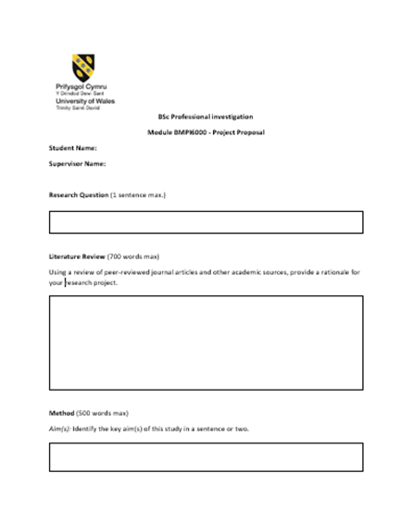
Y Templed cynnig
The Proposal Template
Available on Moodle

Slide 4
Proposal
Choose a subject/title
Background
Aim & Objectives
Research Method
Ethics
Referencing
Notes:
Assign your dissertation a working title
Provide some background information on the area that interests you, including a brief rationale
Identify the overall aim of your research (i.e. what you are trying to achieve)
Specify the individual objectives required to help you achieve your research aim
Outline how you will carry out your research
Indicate whether or not ethical issues arise from the proposal and if so how you are going to address them
List the literature referred to in producing the proposal ( Ref list/bibliography)

Slide 5

Why write a proposal ?
Part of the assessment process
Determine if your research meets academic standards
Provide support - named
Ethical considerations are addressed early on

Slide 6


The next steps
Choose a subject that you would like to research which is relevant to the course/professionally
Think of a draft title that you would give it

Slide 7
Do some background reading
Background reading – support why you want to research your chosen area
Not a comprehensive review of literature on your topic.
Be brief ; be focused
Basic background information supported by literature/sources to justify your proposal
Use Harvard!
BRIEFLY Explain the general topic area
Introduce the specific area that interests you
Explain why you have chosen to research the topic
Notes:
1.Background reading – support why you want to research your chosen area if asked by your supervisor. What have you found from your initial research? What are the gaps in literature/source material? How much information is there out there ?
This is not a comprehensive review of literature on your topic – that will come in your final document. You only have about 700 words here so be brief and focused about what you are saying and make sure that you reference your sources using Harvard. This is not a requirement to write about the history of your subject – be focused on what you want to research only. Remember to justify your proposal and the need to research your topic

Slide 8

What will be the AIM of your research?
What will it do/achieve?
What do you want it to do/achieve
What is its purpose?

Slide 9
What will your Research Objectives be?
The steps that you need to take to meet your research aim
Key words
Key words
Identify
Assess
Evaluate
Explore
Outline
Discuss
Analyse
Notes:
In order to realise or address your overall research aim , you have to list your objectives to show how you will get there
Important to consider the key words that you use as these will influence the depth of study that you propose to carry out.
e.g. Identify, evaluate, explore, formulate
Which of these words will require more work than others?
Go back to the handout I gave regarding ‘Directive words’ – you will have a longer list of Nouns that you can use.

Slide 10
Aim & Objectives - Example
Aim
A key aim within this study is to research and identify the core characteristics surrounding domestic abuse perpetrated by females and the reasons in which they commit such abuse. Moreover, a critical element of this study is to investigate why domestic abuse against male victims goes largely unreported in the UK and role society plays in the underdeveloped understanding of the crime itself.
Objectives
Distinguish core problems relating to the initial reporting to the police of female perpetrated domestic abuse and the prosecution of such crimes.
Examine the role society plays in the development of stereotypes and ideologies that surround abuse against male victims.
Analyse why females commit domestic abuse against their male partners and distinguish the common characteristics of female abusers by evaluating research material in the form of books, journals, articles, and websites.
Notes:
Here is an example of the Aim and Objectives for a dissertation referred to earlier
Note the Key words used in the objectives ( highlighted in blue) – how deep do you think the research had to be ?
Ask yourself are they ‘doable’ in the time that you have and the literature that is available to you in your chosen topic area?

Slide 11
Dissertation proposal – Research methods
Research methods = How will you do your research?
Outline briefly.
survey
questionnaires
interviews
Focus groups
other

Slide 12

Timeline – How long will it take?
Estimate of how long you believe each stage of your research will take
Look at the timeline provided – spread out between Feb and November.
Idea of time to give to each stage
Key submission dates
Overlaps
Not too detailed – can de-motivate you

Slide 13
Are there any ethical issues to consider?
Research Ethics
Transparency
Confidentiality
Voluntary
Do no harm
Impartial
Research Ethics:
‘Application of a code of conduct when human participants are the focus of empirical research’ (Biggam, 2015. p.73)
Design of empirical research : Research Ethics!
Ethics form – All to complete
Notes:
What do we mean by ‘Ethics’?
What about ‘Research Ethics’?

Slide 14
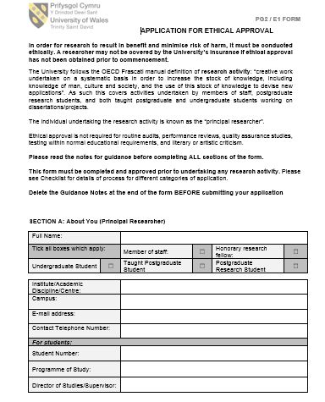
Ethics Form
Template on Moodle

Slide 15
Dissertation Proposal - Submission
Dissertation Proposal to be submitted by
23:59hrs on 27 February 2023
via Turnitin
Ethics form to be submitted by
23:59hrs on 27 February 2023
via Turnitin
**Turnitin portals are open now**.

Slide 16

Important!!!
Time management
(revisit lesson)

Slide 17
Key dates – plan around them
Course | Assignment | Submission date
01/22 | Workbook 1 | 12 January 2023
 | Proposal & Ethics | 27 February 2023
 | Workbook 2 | 12 May 2023
 | Dissertation | 3 November 2023

Slide 18


Task
Spend an hour listing:
All personal commitments (incl holidays/appointments etc.)
All professional commitments (courses/court etc.)
All study commitments (submission deadlines/classes)
Between 01.01.23 & 03.11.23

Slide 19

Cwestyniau/Questions?

