Slide 1

BUSINESS PLAN PRESENTATION
Certificate of Higher Education in Employability Skills Level 4
Module: Managing Enterprise (BMSW4011)
Student name: Soraya Conway
Student number: 2504779
Lecturer: Mel Squire

Slide 2
AI ACKNOWLEDGEMENT
I confirm that I have not presented any AI-generated text as my own work. I confirm I have copies of my drafts, notes, and other resources I used before and after the use of AI tools, which I may be asked to
provide in evidence.

Slide 3
Business Proposition: 1
The aim is to provide customisable products that appeal to all potential customers but mainly targeting religious or health reasons with sugar-free, vegan and halal options. Initially operating as an online home-run business using social media platforms, including TikTok (TikTok, 2016). Whatnot, Instagram and Facebook (Meta, 2021). There will also be a website launch to help with online sales.

Slide 4
DESCRIPTION AND
COMPANY NAME 1.1
Dabs Grabs Tasty Treats is a proposed confectionery business specialising in:
personalised sweet gift hampers
Halal pick and mix
Vegan pick and mix
Sugar-free pick and mix
American gift hampers
American snacks
wedding favours
Birthday party favours

Slide 5
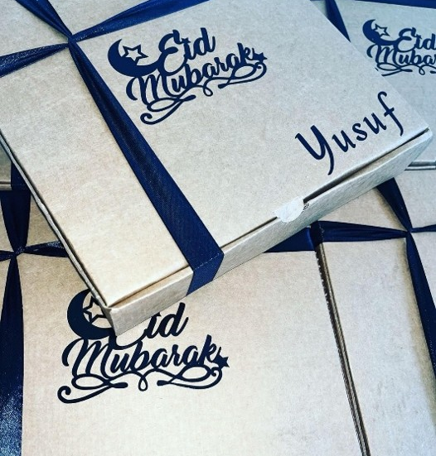
MY STORY 1.2
The idea of Dabs Grabs Tasty Treats was created out of the lack of dietary options available when I was shopping for gifts for friends and family for Eid.

Slide 6
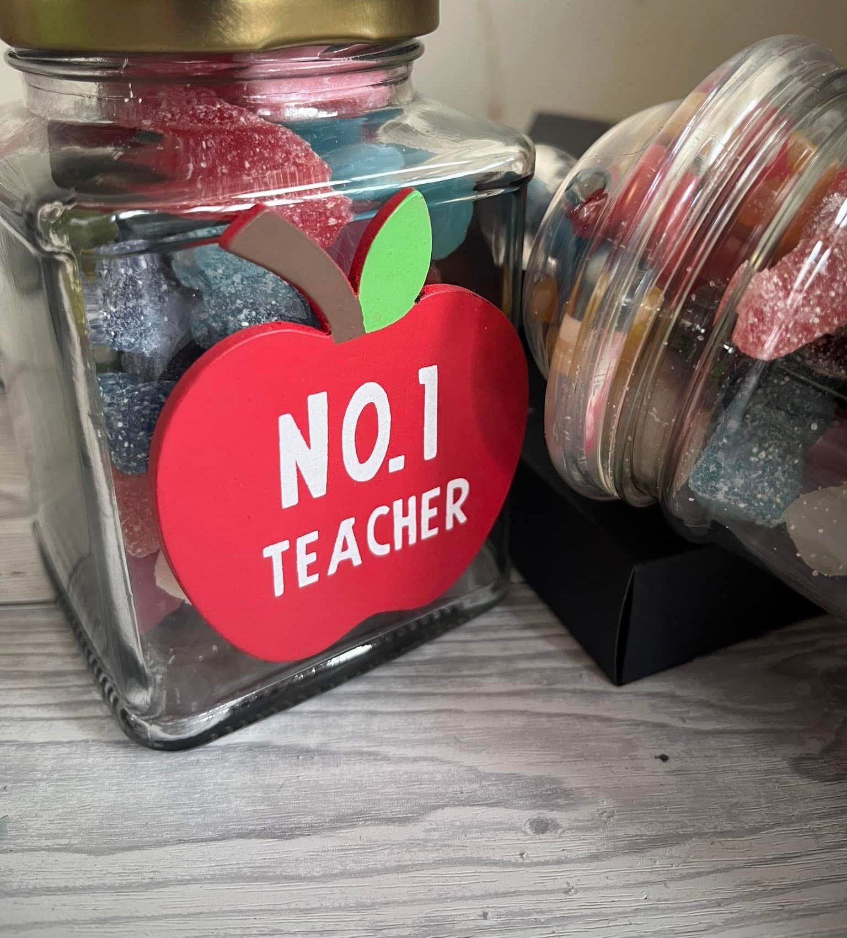
TEACHERS
GIFTS…

Slide 7
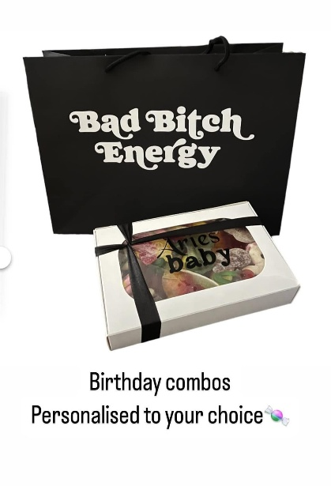
BIRTHDAY
GIFTS…

Slide 8
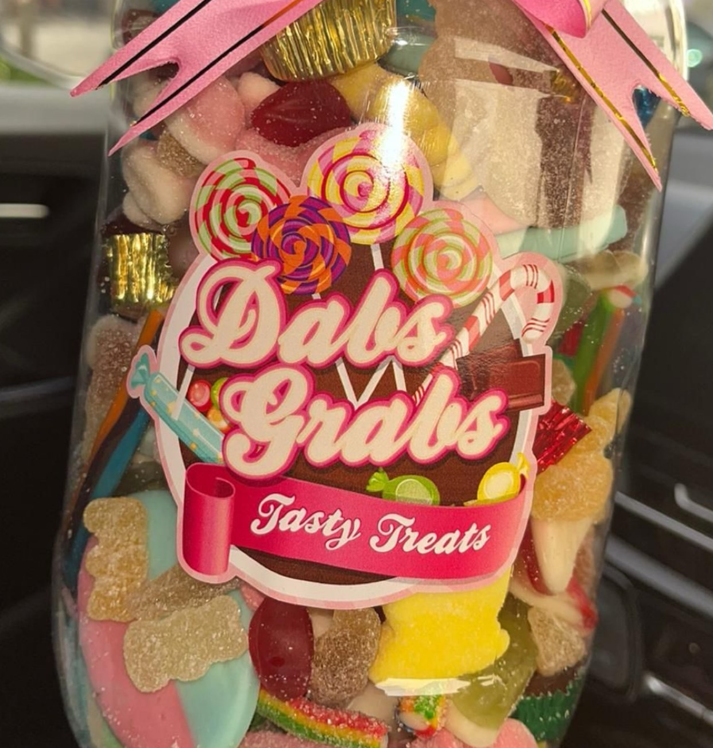
MISSION STATEMENT 1.3
Inclusive treats for guilt-free indulgence.

Slide 9
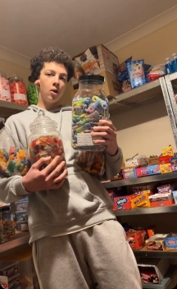
BUSINESS AIMS 1.4
Establish a profitable and recognisable family
confectionery brand.

Slide 10
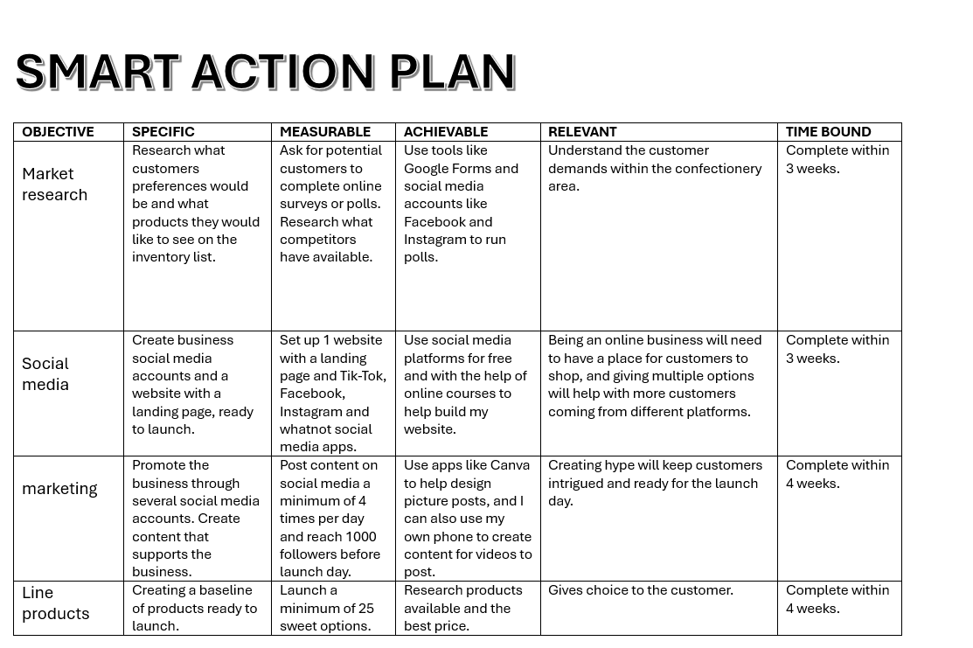
SMART OBJECTIVE 1.5

Slide 11

UNIQUE SELLING POINT 1.6
Products that are different to competitors
Focusing on a specific target market
Creating visually appealing products
Includes variety that’s inclusive of everyone

Slide 12
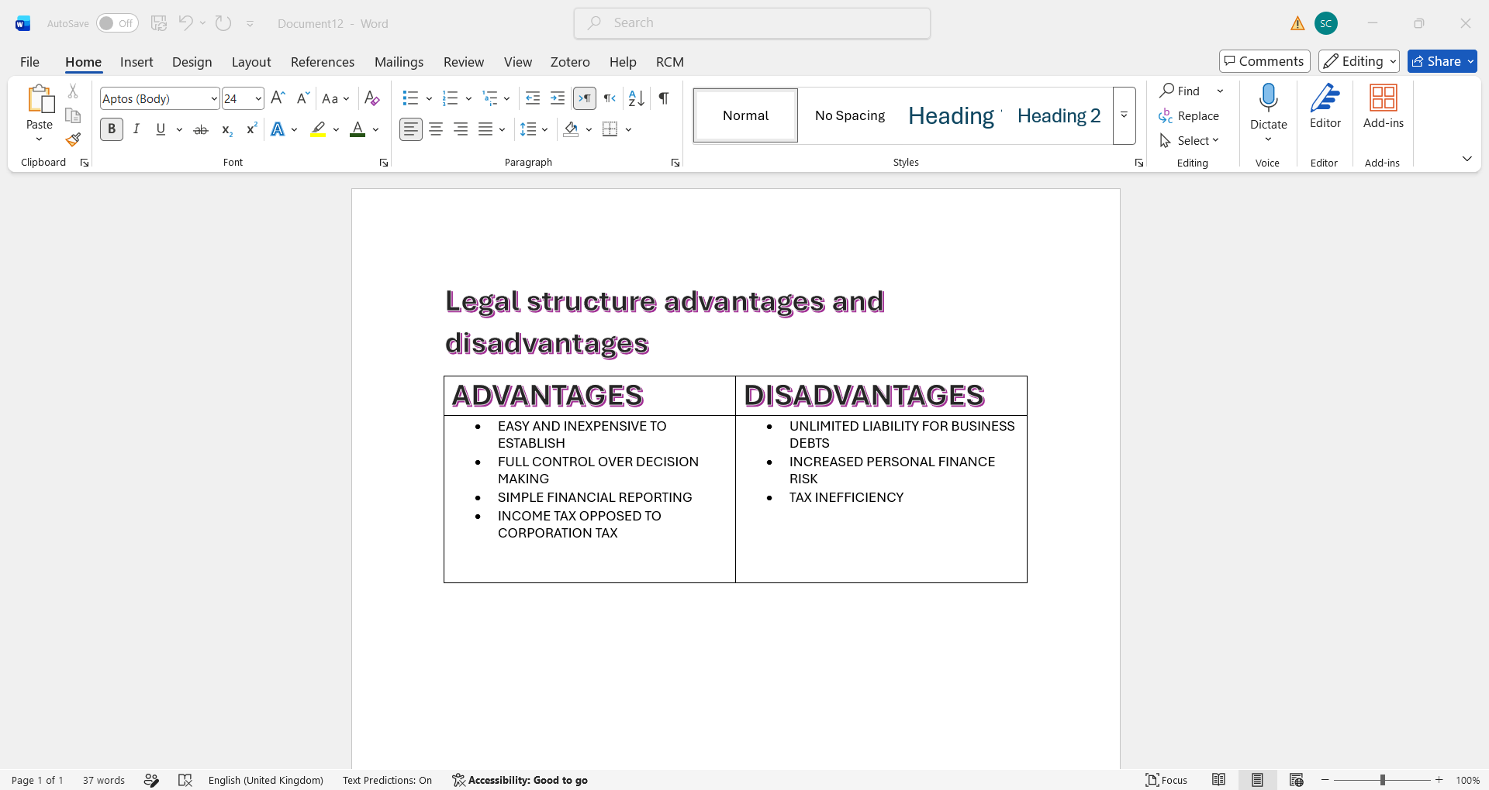
Legal Structure 1.7
Dabs Grabs Tasty Treats will be registered as a sole trader business (Gov.UK, “no date”).

Slide 13
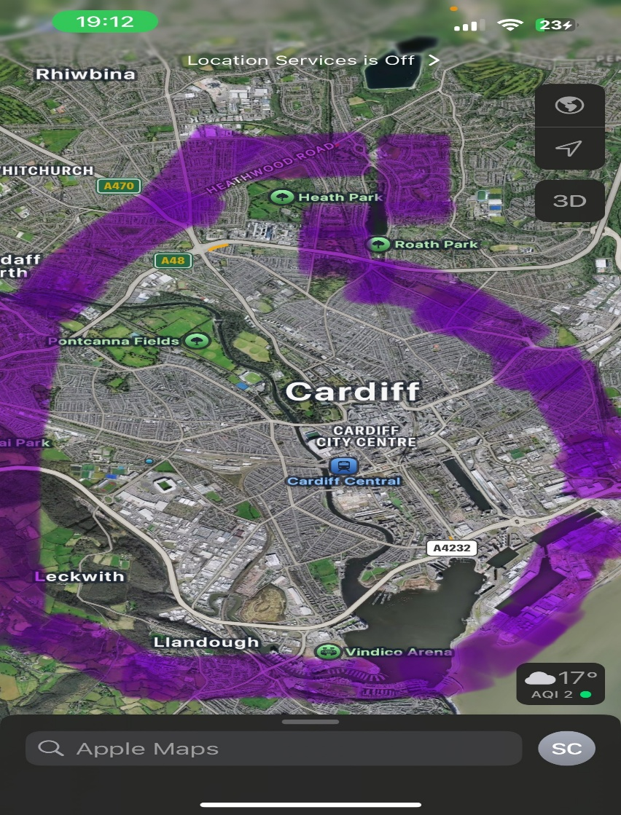
Location 1.8
Establishing the business from a home-based location in its early stages would reduce fixed operating costs and limit financial risk. Eliminating commercial rental payments would generate substantial savings, improving the business's financial stability.

Slide 14
Human resource strategy 1.9
Treating yourself as the most vital resource,
Knowing the business will be independently managed by me in the start-up phase, this reduces staffing costs and enables direct control over all departments of the business
Utilising resources early can help with clear crossover from a sole trader to Ltd company, like uk.gov/workplace.( Google Digital Garage 2016). Will help elevate your business, and LinkedIn Learning offers short courses (LinkedIn Learning, 2016).

Slide 15
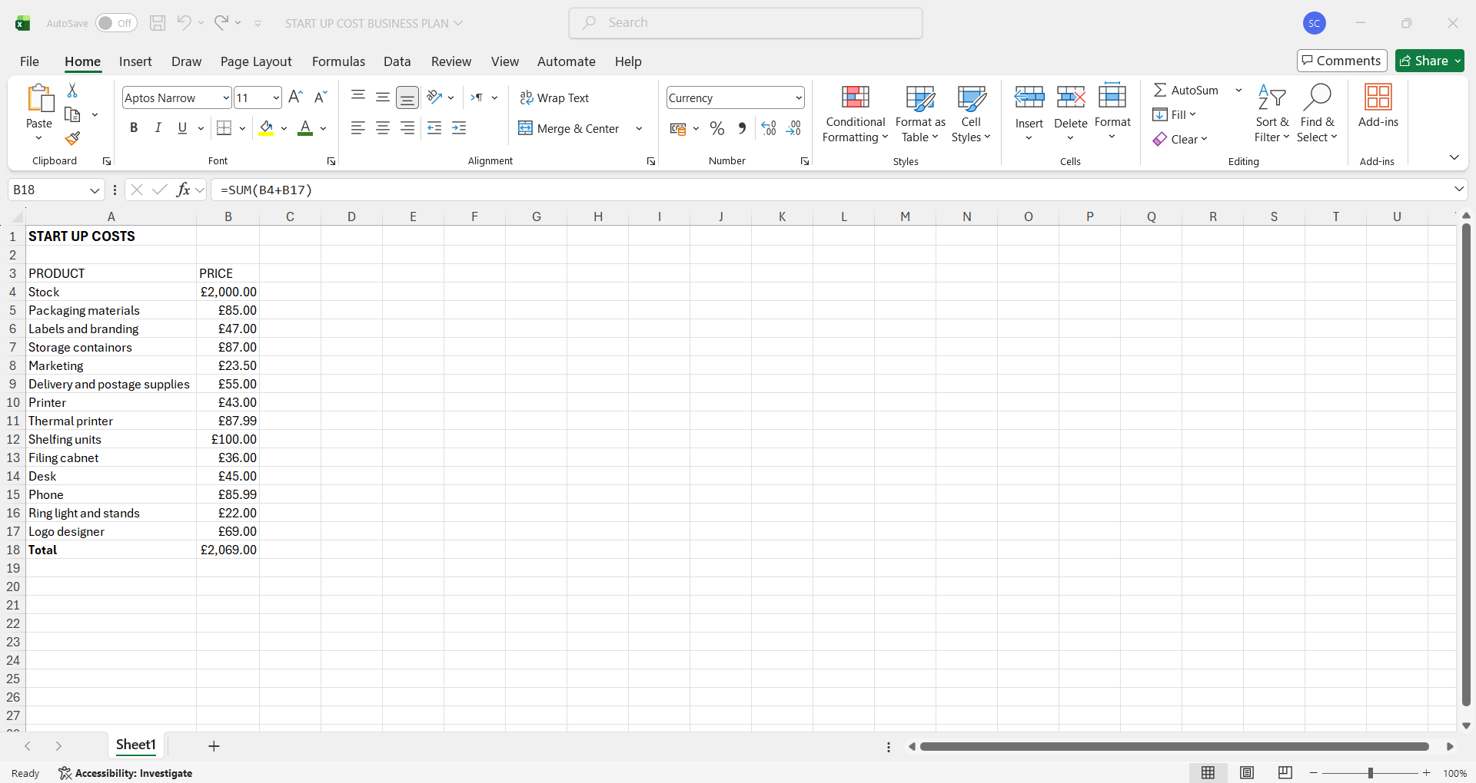
Financial Overview 1.10
Start-up costs: £2000.00
Making full use of Excel (Boogard, 2025). Will help keep financial records correct and up to date.

Slide 16
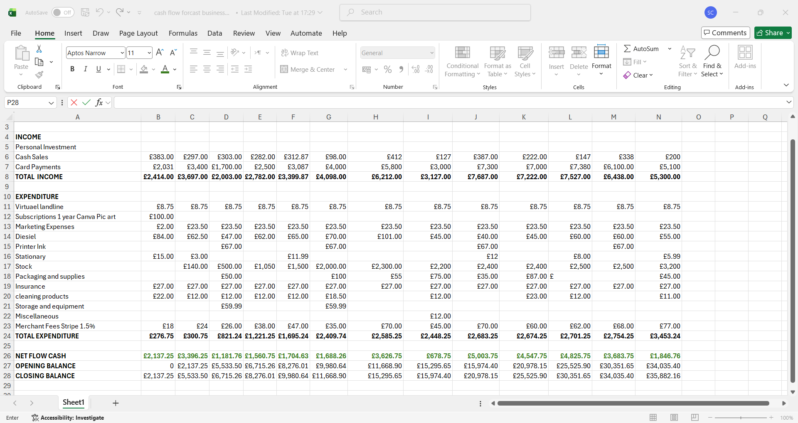
Cash Flow forecast 1.11

Slide 17
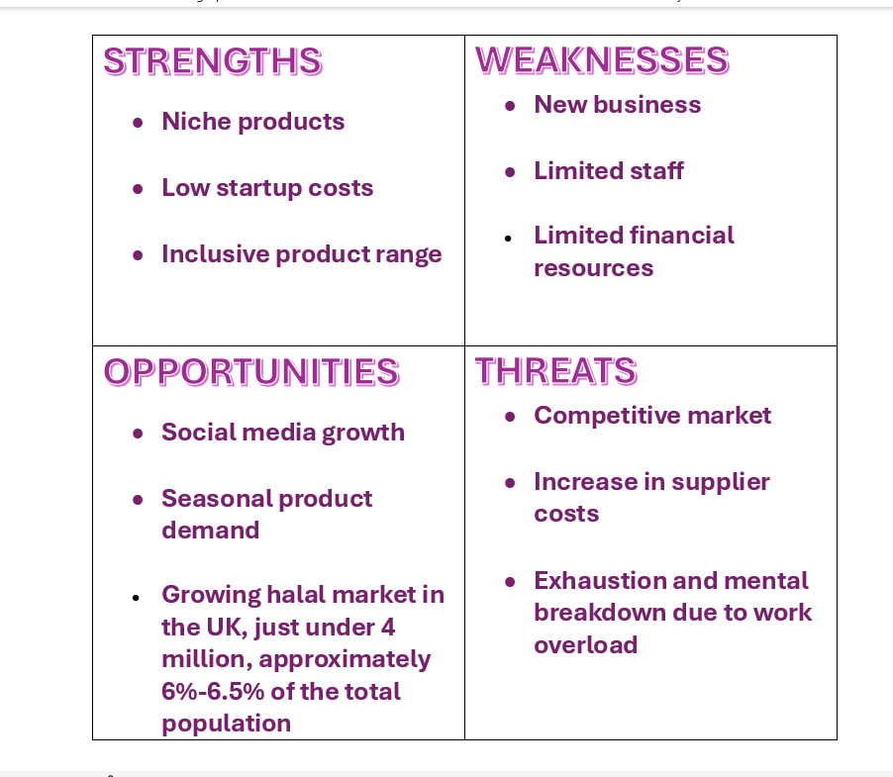
SWOT ANALYSIS
Breaking down the business plan and examining and evaluating the business’s validity, biases (Alam and Bhati, 2022).
SWOT Analysis. (n.d.). Helping businesses have a framework for strategic planning.

Slide 18
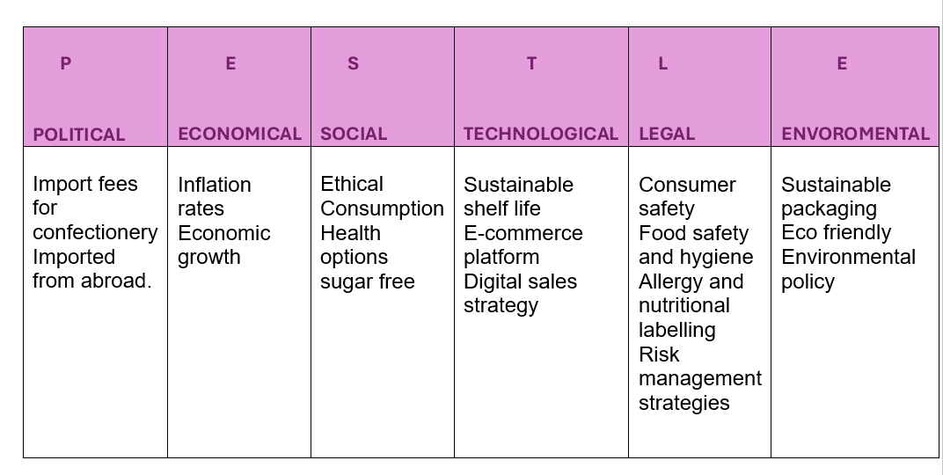
PESTLE ANALYSIS 1.12
Using a PESTLE analysis to create a framework. Marmol, “Et al.” (2015).

Slide 19
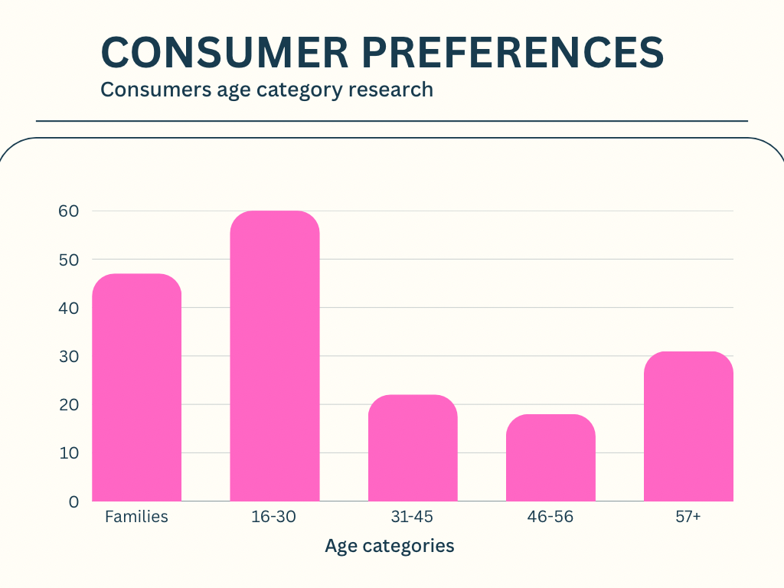
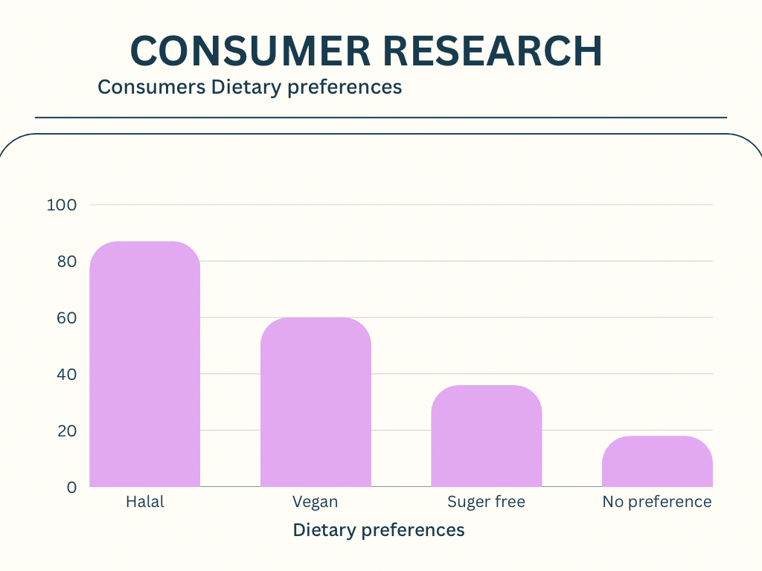
Market research 2
The confectionery market is currently worth over £5 billion (Interfax-Ukraine, 2026). It is an ongoing competitive market; having niche products can help keep customer retention and create brand differentiation.
From research, the target market (The Investopedia Team, 2026). seems to be aimed at families and the age group of 16-30, and halal and vegan dietary requirements show that this is what the consumer is looking for the most

Slide 20
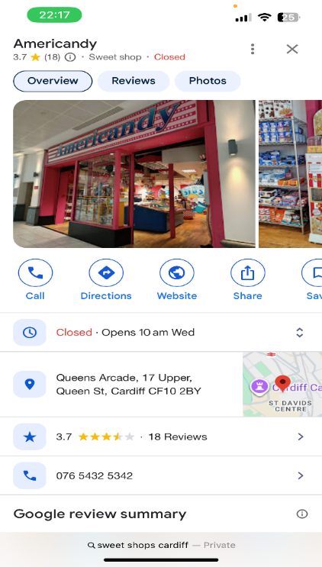
Market Research 2.1
Competition from businesses (American candy, 2018). are within a 15-mile radius: finding just one main shop.

Slide 21
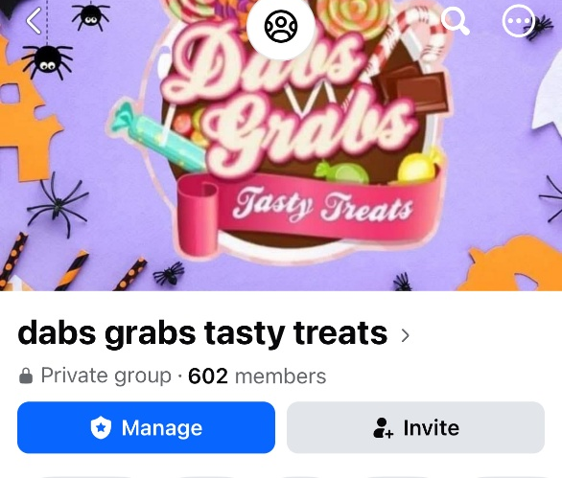
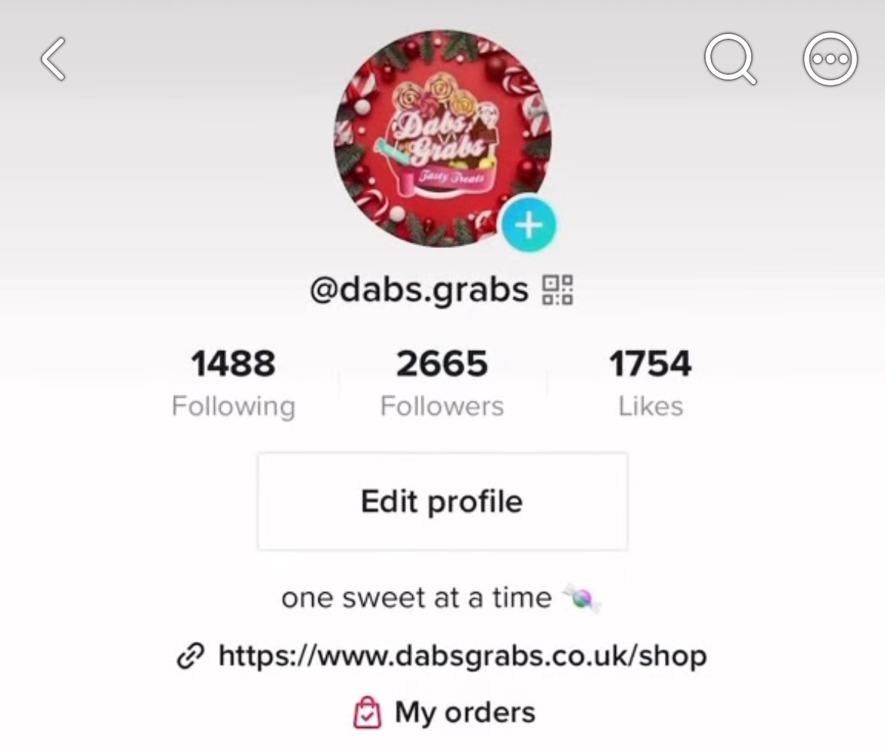
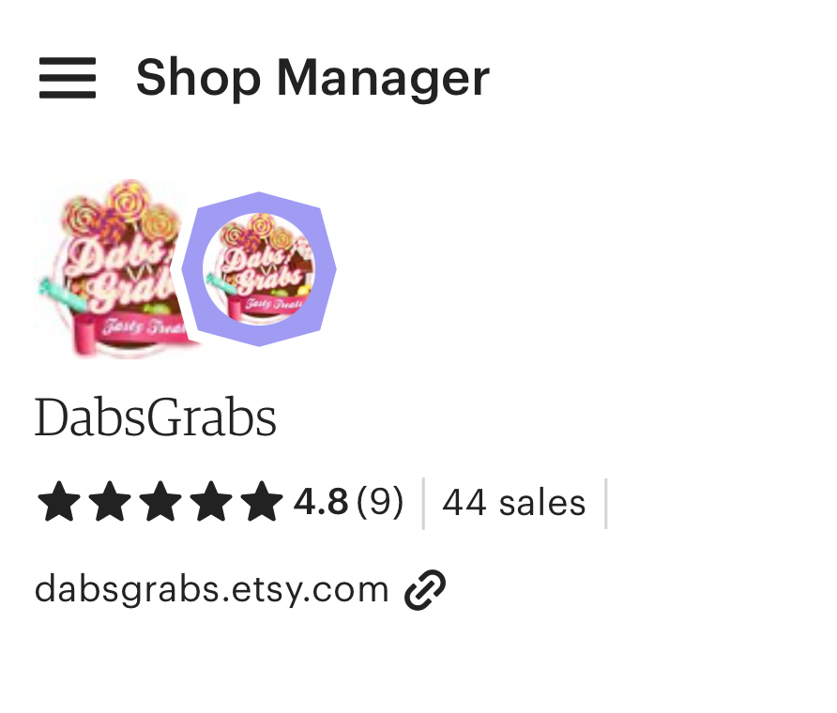
Market Examples 2.2
Using social media platforms like Etsy, TikTok, and Facebook
Will be used to promote and sell

Slide 22
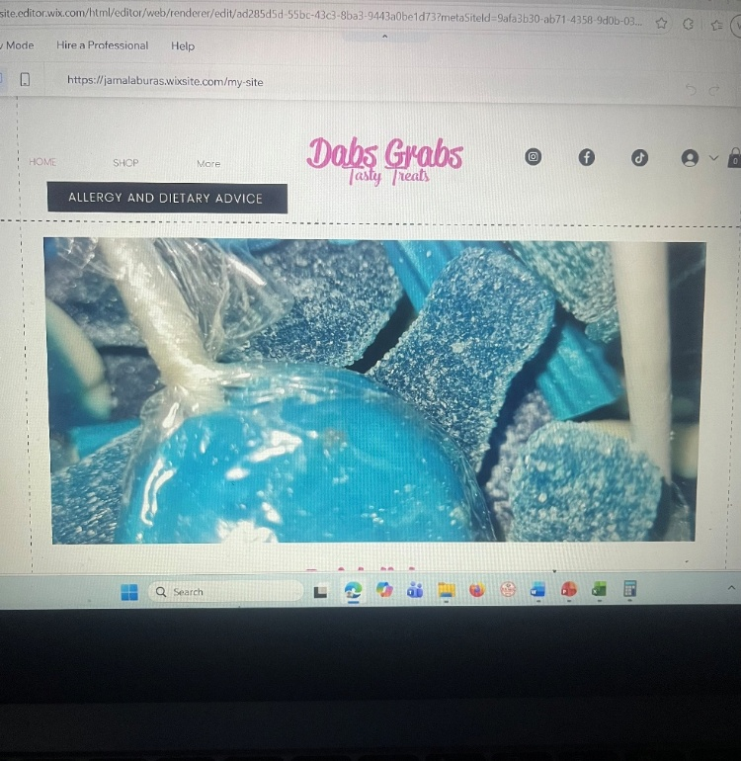
Market Examples 2.3
Digital marketing is the most effective method for Dabs Grabs Tasty Treats; this will also keep costs low and reach a global audience.

Slide 23
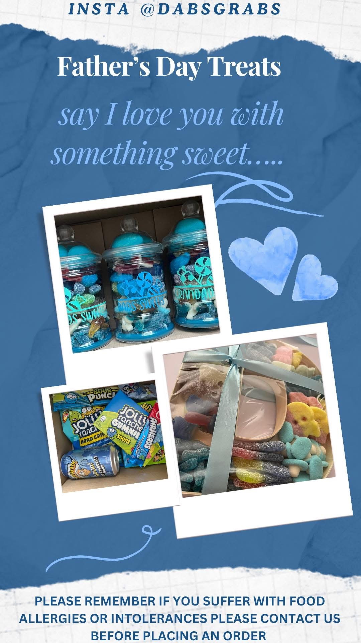
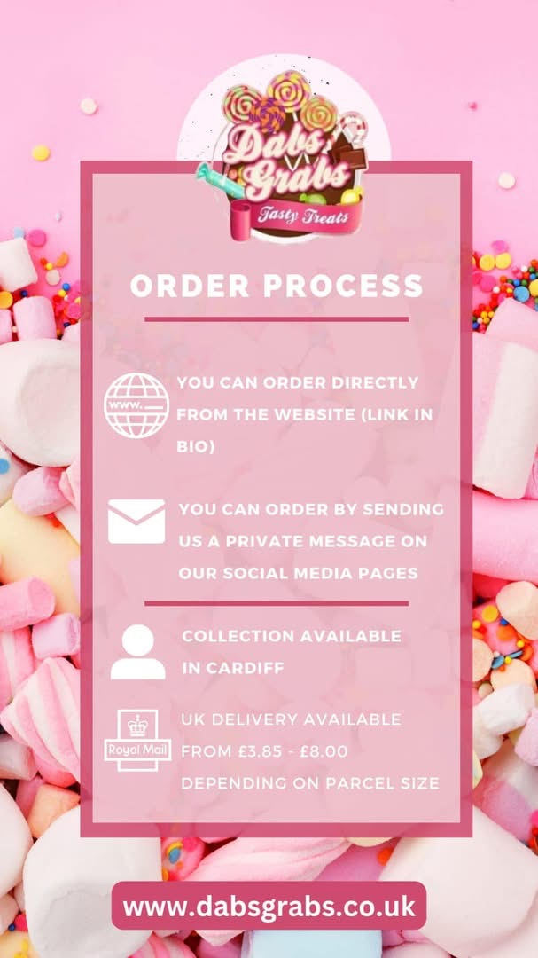
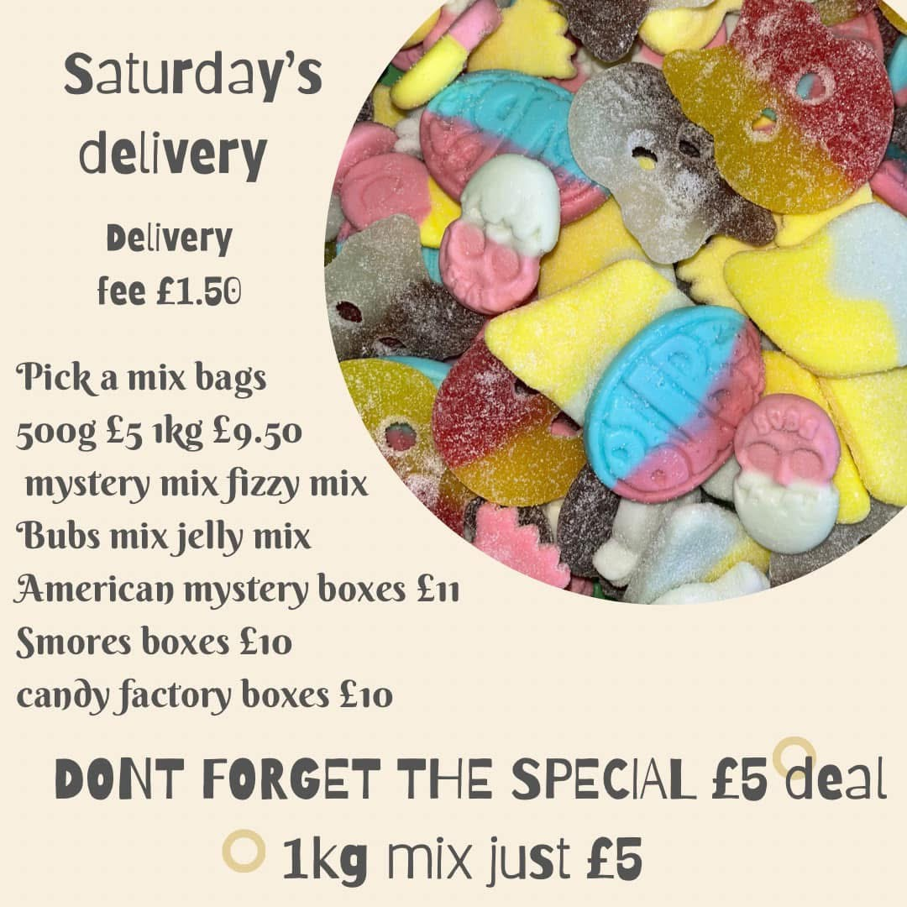
Market Examples 2.4

Slide 24
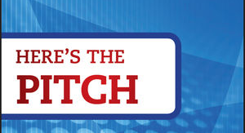
Angel Investor pitch 3.
I believe my home-run confectionery business is a worthwhile investment because it
Combines creativity
Quality and
Strong market demand
Consumers are LOOKING FOR INCLUSIVE, high-quality sweet treats, and my business is designed to meet that demand.

Slide 25
Strengths 3.1
Strong communication and customer service skills
I enjoy creating products that bring people together and make special occasions memorable.
This passion motivates me to maintain high standards, experiment with new ideas and ensure customer satisfaction.
Creative and innovative

Slide 26
Entrepreneurial Traits 3.2
I have demonstrated key entrepreneurial skills, including
creativity
Organisation
problem-solving
determination
researching my target market
analysed competitors
developed a marketing strategy
created realistic financial forecasts
These experiences have helped me understand what it takes to successfully launch and manage a sole trader company.

Slide 27
Achievements, Experience & Passion 3.2
Successfully Achieved
Designed a completed business concept
from idea to launch plan
Created branding, promotional materials and social media content
Developed realistic financial projections and growth objectives
Gained valuable business, marketing and entrepreneurial skills through this project.
Experienced
Developed confectionery and creativity skills through regular practice
Researched the confectionery market, customer needs and competitors
Created a full business plan, marketing strategy and financial forecasts for this venture

Slide 28
Passion
Passionate about giving customers the choice they deserve
Enjoy creating products that bring happiness and make celebrations special.
Motivated to turn a thought into a successful business

Slide 29
People don't just buy confectionery; they buy experiences, celebrations and moments of happiness.
My business delivers all three, and with your investment, I can bring those moments to even more customers

Slide 30
References
Alam, M. A., & Bhatti, O. K. (2022). Curtailing data biases in business research: Introducing a hybrid approach. Journal of Management &Organization, 28(4), 909-923. Available at: Curtailing data biases in business research: Introducing a hybrid approach - University of Wales Trinity Saint David (Accessed: 19 June 2026).
Boogard, K. (2025) 21 cool things you can make with Excel other than spreadsheets. Available at: 21 Important Uses of Excel in Business | GoSkills (Accessed: 19 June 2026)
Gov.UK (“no date”). Available at: Become a sole trader: What a sole trader is - GOV.UK (Accessed: 19 June 2026).
Google Digital Garage (2016). Available at: Google Digital Garage : Google (Accessed: 19 June 2026)
Interfax-Ukraine (2026). Roshens plans to enter UK confectionery market worth over £5 billion. Available at: Roshen plans to enter UK confectionery market worth over GBP 5 bln (Accessed: 19 June 2026).

Slide 31
LinkedIn Learning (2016). Available at: LinkedIn Learning: Online Training Courses & Skill Building (Accessed 19 June 2026)
Marmol, T. Del, Feys, B., Probert, C. (2016). Pestle analysis. Lemaitre Publishing. Available at: PESTLE analysis - University of Wales Trinity Saint David (Accessed 19 June 2026).
Meta (2021). Facebook. Available at: Facebook (Accessed: 19 June 2026).
SWOT Analysis. (n.d.). Datamonitor Plc. Available at: SWOT Analysis - University of Wales Trinity Saint David (Accessed: 19 June 2026).
TikTok (2016). Available at: TikTok - Make Your Day (Accessed: 19 June 2026).

