Slide 1
CertHE Skills for the Workplace
Module: BMSK4005
Professional Career Development
Session 4

Slide 2
Increasing self awareness
Myer Briggs Personality Profiling
VARK
Honey & Mumford
Implications for learning& for training
Overview of Workshop

Slide 3
Self Awareness
“Self awareness enables us to stand apart and examine even the way we “see” ourselves – our self-paradigm, the most fundamental paradigm of effectiveness. It affects not only our own attitudes and behaviours, but also how we see other people. It becomes our map of the basic nature of mankind.” Stephen Covey, 1999, P.66 -67
Notes:
Self awareness helps us to recognise and evaluate our own beliefs, values, motives, actions, reactions, biases and prejudices….and how we view others and their actions, etc.

Slide 4
Self Awareness
Self-awareness is vitally important as the foundation for maximizing our leadership and management skills.
Self-awareness can improve our judgement and help us identify opportunities for our professional development and personal growth, and the development and growth of others.

Slide 5
Increasing Self Awareness
According to a Harvard Business Review article in 2015, there are 5 ways to increase self awareness:-
Meditate
Write down your key plans and priorities
Undertake psychometric tests and profiling
Ask trusted friends
Get regular feedback at work
Tjan, A.K., February 2015, 5 Ways to Become More Self-Aware. [online] Available at: <https://hbr.org/2015/02/5-ways-to-become-more-self-aware> [Accessed 15 July 2017]

Slide 6
Writing down key plans and priorities
One of the best ways to increase self-awareness is to write down what you want to do and track your progress.
Warren Buffet, the famous investor and one of the world’s richest men, carefully records his reasons for making an investment at the time he makes it. These records help him assess whether or not future outcomes are down to his good judgment or just plain luck!

Slide 7
Write down your key plans and priorities
Benjamin Franklin kept a “balance sheet” of both the assets and liabilities of his personal traits.
By diarizing any new strength he believed he could learn from someone else, and marking down any self-perceived weaknesses, he could better assess whether the “net worth” of his character was growing over time.

Slide 8
Take Psychometric tests
Psychometric and profiling questionnaires are powerful tools for driving reflection, and subsequent discussion of the results
Among the best known of these tests are Myers-Briggs, Predictive Index and Insights Discovery, but all are aimed at serving as a data point towards greater self-awareness.
A common design point with all of them is that there are no particular right or wrong answers. Instead, they are designed to compel respondents to consider a set of traits or characteristics that most accurately describe them relative to other people.
Notes:
Discuss the merits of such profiling and the value of discussing and debating the results – it drives true reflection, especially if facilitated by a coaching approach. The Learning Styles questionnaires that have been undertaken by the group are also profiling tools that help increase our self awareness.
The MBTI Myers–Briggs Type Indicator is an introspective self-report questionnaire with the purpose of indicating differing psychological preferences in how people perceive the world around them and make decisions was constructed by Katharine Cook Briggs and her daughter Isabel Briggs Myers. It is based on the conceptual theory proposed by Carl Jung.
According to Carl G. Jung's theory of psychological types [Jung, 1971], people can be characterized by their preference of general attitude:
•Extraverted (E) vs. Introverted (I),
their preference of one of the two functions of perception:
•Sensing (S) vs. Intuition (N),
and their preference of one of the two functions of judging:
•Thinking (T) vs. Feeling (F)
The three areas of preferences introduced by Jung are dichotomies (i.e. bipolar dimensions where each pole represents a different preference). Jung also proposed that in a person one of the four functions above is dominant – either a function of perception or a function of judging. Isabel Briggs Myers, a researcher and practitioner of Jung’s theory, proposed to see the judging-perceiving relationship as a fourth dichotomy influencing personality type [Briggs Myers, 1980]:

Slide 9
Myer Briggs Psychometric Test
The first criterion, Extraversion – Introversion, signifies the source and direction of a person’s energy expression. An extravert’s source and direction of energy expression is mainly in the external world, while an introvert has a source of energy mainly in their own internal world.
The second criterion, Sensing – Intuition, represents the method by which someone perceives information. Sensing means that a person mainly believes information he or she receives directly from the external world. Intuition means that a person believes mainly information he or she receives from the internal or imaginative world.
The third criterion, Thinking – Feeling, represents how a person processes information. Feeling means that, as a rule, he or she makes a decision based on emotion, i.e. based on what they feel they should do. Thinking means that a person makes a decision mainly through logic.
The fourth criterion, Judging – Perceiving, reflects how a person implements the information he or she has processed. Judging means that a person organises all of his life events and, as a rule, sticks to his plans. Perceiving means that he or she is inclined to improvise and explore alternative options.
http://www.humanmetrics.com/personality/type

Slide 10
Get regular feedback at work
In addition to asking friends and family, use the formal processes and mechanisms at your workplace.
If these don’t exist, see if you can establish some formal feedback loops.
Provided it is done well, constructive, formalised feedback allows us to better see our own strengths and weaknesses.
The imperative here is to not wait around for things to happen, but to proactively seek out the feedback

Slide 11
Get regular feedback at work
The key to effective formal feedback is to have a process and manage it.
Once the feedback process is completed, it is important all involved to reflect on it by writing down their top takeaways. Note both any surprising strengths and any weaknesses or blind spots……and act upon them, where appropriate.

Slide 12
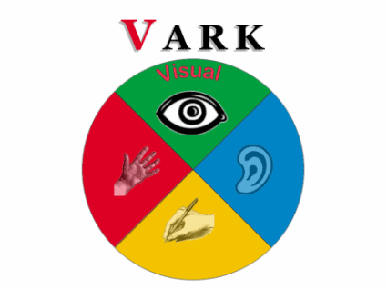
Learning Styles - VARK
Notes:
Model of learning style developed by Fleming and Mills (1992) and its basic idea is that the way we take information differs for each individual as some learn through (hearing / Auditory), others are Visual/ verbal, others through reading/ writing, and others through actively touching and experiencing or using information (kinaesthetic)

Slide 13
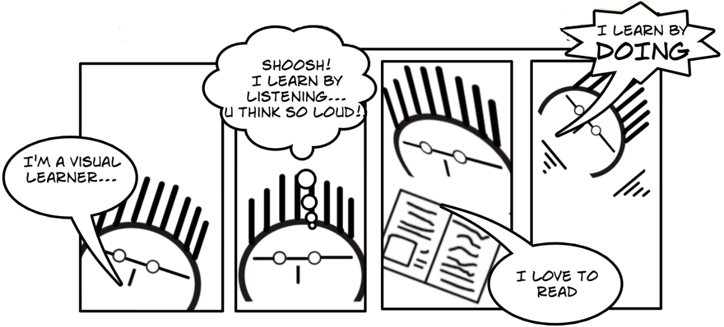
VARK- Questionnaire
Your scores will give an indication of your preference for some of the different ways of learning
V - by Visual Study Strategies
A - by Aural Study Strategies
R - by Read/Write Study Strategies
K - by Kinesthetic Study Strategies

Slide 14

Visual
Notice details
Observe rather than act or talk
Find verbal instructions difficult
Memorise by looking at pictures/videos

Slide 15
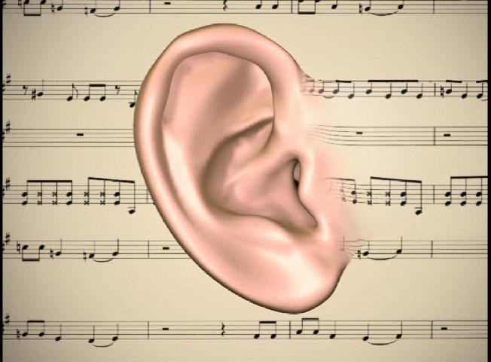
Auditory
Enjoy talking and listening to others
Like to try new things
Hum, sing and whisper or talk out loud
Easily distracted
Have difficulty with written instructions
Don’t like noisy environments

Slide 16

Read/Write
Like solitary activities
Learn best from reading & writing
Like reading and often good at spelling

Slide 17

Kinaesthetic
Like physical activities
Fidget with pens whilst studying
Like to try new things
Do not like reading and often poor at spelling
Use their hands whilst talking

Slide 18
Honey & Mumford (1992)
Activist/ Experience
Reflector/ Reflection and review of experience
Theorist/ conclusions
Pragmatist/ planning
Honey & Mumford (1986) suggest
that there are 4 types of learners:
Activist
Reflector
Theorist
Pragmatist
http://www.peterhoney.org/articles/who-are-honeymumford
Notes:
Honey and Mumpherd (1992) identified that people have different innate learning preferences closely related to Kolb's thinking/ reflective cycle.
Research conducted by Honey and Mumpherd Suggest that some people are better at learning experience (activist) other learn better by reflection (Reflectors), others by developing own ideas preferring theoretical input (theorist) and others like take information and plan for the future and asks ‘what ifs’ (Pragmatists).

Slide 19
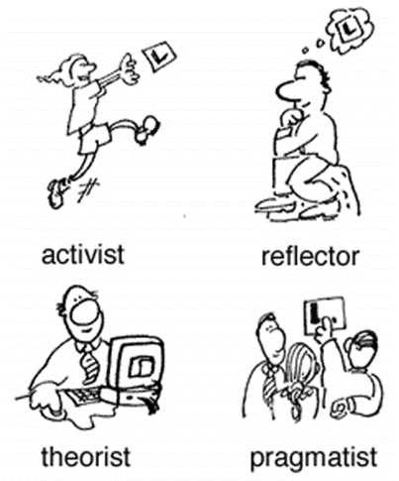
Honey & Mumford’s Learning Style
“Every student can learn, just not on the same day, or the same way.”
George Evans

Slide 20
Types of Learners
  Activist
Like to deal with new problems
Like new experiences
Like lots of activity's to keep them busy
They love challenges
  Pragmatist
Like to apply what they learnt to practical situations
They like logical reasons for doing something
They like to be hands on
They are enthusiastic

Slide 21
Types of Learners
Theorist
Reflector
Students need to take time to take in information
They prefer to read lots of materiel
They think about something before applying it
Students think deeply about what they are learning
They like things to be tried and tested
Tend to be reserved

Slide 22

If you were to set up a new television, What would you do?
Jump right in and press all the buttons (Activist)
Look briefly at the instructions and then have a go (Pragmatist)
Read the instructions, then think it through first (Theorist)
Read the full manual and consider ways of doing it (Reflector)

Slide 23
Application of learning styles to University
Activist (Active learning, workshops, exercises, Presentations, Group Works, Exams, Practice Assignments, Case Studies)
Reflector (Feedback lecturer/ Peers/ Work)
Theorist( Lectures, books, Tutorial, Discussions, Assignments, Journals, Mind-maps, research)
Pragmatist (Action Planning, Group Discussions, Project Assignments)

Slide 24
Discussion
Imagine yourself in the role of Manager. How would You address the individual development needs of your team. What different training methods could you use to address their different learning styles?
Notes:
Use syndicates or Buzz groups to address this. Different training approaches could include facilitated classroom/seminar experience, demonstrations, shadowing, project work, text books/procedure manuals/instruction books, coaching, mentoring, role-play, case-studies, joint problem solving, video/audio training resources. Games, etc. Draw out the different dynamics in the work environment – pressure on time versus training people properly…….Minimising cost versus addressing learning needs & styles appropriately……The Manager’s attitude towards training of their team? Etc.

Slide 25
Home work & Further Research
Complete the Big Five personality Test
Morgan, P. , 2017. The business student’s guide to study and employability. London: Sage Publications Ltd (Chapter 5)
Maund, A., Schriek, M., Tinkler, P., University of Wales Trinity Saint David, & Trinity College. (2017). Certificate in higher education : Skills for the workplace student yearbook. London: Sage. (Chapter 14)
Dowson, P., 2015. Personal and professional development for business students. London: Sage Publications Ltd.
Covey, S. R., 1999. The seven habits of highly effective people. London: Simon & Schuster UK Ltd.

