Slide 1
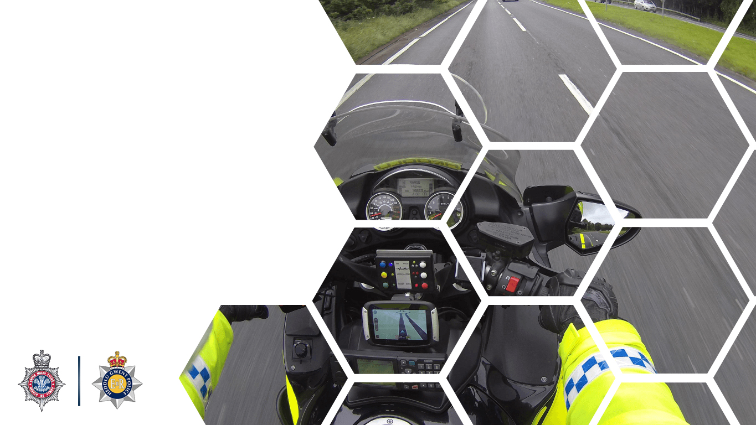

Vehicle Licencing and Registration

Slide 2

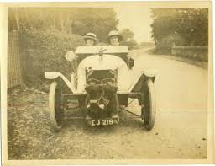
Vehicle Licencing and Registration
Vehicle Excise and Registration Act 1994
Notes:
The Vehicle Excise & Registration Act 1994 is the legislation that consolidates the law in relation to the registration of and excise duty payable in respect of motor vehicles.
Section 1 of the Vehicle Excise and Registration Act 1994 creates a vehicle licence which applies to a mechanically propelled vehicle kept/used on public roads (whether or not it is in working condition).

Slide 3
Vehicle Licencing and Registration
A duty of excise (vehicle excise duty) shall be charged in respect of every mechanically propelled vehicle that -
is registered under this Act ,
or
(b) is not so registered but is used, or kept, on a public road in the United Kingdom
Section 1 of the Vehicle Excise and Registration Act 1994
Notes:
. Section 1 of the Vehicle Excise and Registration Act 1994 creates a vehicle licence which applies to a mechanically propelled vehicle kept/used on public roads (whether or not it is in working condition). 1(1) A duty of excise (vehicle excise duty) shall be charged in respect of every mechanically propelled vehicle that -
(a) is registered under this Act (see section 21), or
(b) is not so registered but is used, or kept, on a public road in the United Kingdom.
1(1A) Vehicle excise duty shall also be charged in respect of every thing (whether or not it is a vehicle) that has been, but has ceased to be, a mechanically propelled vehicle and -
(a) is registered under this Act, or
(b) is not so registered but is used, or kept, on a public road in the United Kingdom.
1(1B) In the following provisions of this Act vehicle means -
(a) a mechanically propelled vehicle, or
(b) any thing (whether or not it is a vehicle) that has been, but has ceased to be, a mechanically propelled vehicle.
1(1C) Vehicle excise duty charged in respect of a vehicle by subsection (1)(a) or (1A)(a) shall be paid on a licence to be taken out -
(a) by the person in whose name the vehicle is registered under this Act, or
(b) if that person is not the person keeping the vehicle, by either of those persons.
1(1D) Vehicle excise duty charged in respect of a vehicle by subsection (1)(b) or (1A)(b) shall be paid on a licence to be taken out by the person keeping the vehicle.
1(2) A licence taken out for a vehicle is in this Act referred to as a vehicle licence.
Notes
(i) This means that vehicle excise duty will be charged in respect of every mechanically propelled vehicle used or kept on a public road (even if it has ceased to be such a vehicle to its condition) in the U.K. The keeper of the vehicle is responsible for paying the duty.
(ii) Furthermore, the keepers of motor vehicles 'off road' must notify D.V.L.C. (statutory off-road notification).
Whenever the Vehicle Excise & registration Act mentions ‘vehicle’ it means ‘mechanically propelled vehicle’
A mechanically propelled vehicle is defined under Sec 185(1) Road Traffic Act 1988 means a vehicle constructed so that it can be propelled mechanically, intended or adapted for use on a road.

Slide 4
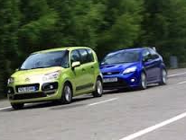
Vehicle Licencing and Registration
Uses
Keeps
Notes:
Firstly, it is worthwhile defining the general meaning of the word, 'use', as opposed to the more specialised meaning given to it for the purpose of road traffic law. It means 'to employ for some purpose; put into service'. So, before considering the different forms of 'use' to which the vehicle can be put (as described below), it is obviously necessary that the vehicle is being used in the general sense of the word.
Using a vehicle
the driver of a vehicle; and
the driver's employer if the driver is about his/her master's business (but see the last paragraph in this document for a variation in slightly differently worded legislation).
the owner of a vehicle when it is being driven by another person, but he/she is in the vehicle;
a vehicle steersman (e.g. where a broken down vehicle is being towed).
Keeping a vehicle
62(2) For the purposes of this Act and any other enactment relating to the keeping of vehicles on public roads, a person keeps a vehicle on a public road if he causes it to be on such a road for any period, however short, when it is not in use there.
The term is wide enough to cover the presence of the vehicle on a road when not in use, for any period of time. (Parked)
The keeper may be any person who parked it there while the vehicle remains under his or her control.
If one keeper surrenders control to another person, it is then that other person who keeps it there

Slide 5
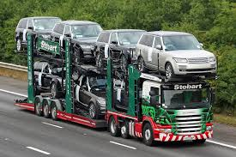
Example
A car transporter driver delivering vehicles to a garage parks the cars on the road while making the delivery.
The driver of the transporter ‘keeps’ the vehicles on the road.
When he or she hands over the keys/paperwork to someone at the garage, that person then becomes the keeper.
Notes:
So, whoever puts/causes the vehicle to be on a ‘public road’ and also retains possession or control over the vehicle, will be the keeper for the purpose of this legislation.
‘Owner’
The owner does not have to possess the vehicle documents or be registered as the owner of the vehicle.
It is the person who has authority over the control of the vehicle.
Taking the car transporter example -
It could be argued that the driver’s employers were the ‘owners’ of the vehicles.
And therefore would be liable until the vehicles were handed over to the garage.

Slide 6

Public Road
‘Public road’ can be defined as meaning:
‘any length of highway or of any other road to which the public has access and includes bridges over which a road passes.
Notes:
The term ‘public road’ indicates a road that is repairable at public expense.
‘Public road’ therefore can be defined as meaning ‘any length of highway or of any other road to which the public has access and includes bridges over which a road passes.

Slide 7
Vehicle Licencing and Registration
Owner
Notes:
‘Owner’
The owner does not have to possess the vehicle documents or be registered as the owner of the vehicle.
It is the person who has authority over the control of the vehicle

Slide 8
Example
Using the car transporter example –
It could be argued that the driver’s employers were the ‘owners’ of the vehicles as they had authority over the control of them
They would, therefore, be liable until the vehicles were handed over to the garage
Notes:
So, whoever puts/causes the vehicle to be on a ‘public road’ and also retains possession or control over the vehicle, will be the keeper for the purpose of this legislation.
‘Owner’
The owner does not have to possess the vehicle documents or be registered as the owner of the vehicle.
It is the person who has authority over the control of the vehicle.
Taking the car transporter example -
It could be argued that the driver’s employers were the ‘owners’ of the vehicles.
And therefore would be liable until the vehicles were handed over to the garage.

Slide 9
Vehicle Excise Licence - Offences
Using/keeping on a road an MPV for which a vehicle excise licence is not in force (Section 29 Vehicle Excise and Registration Act 1994).
Using a vehicle in a condition, manner or for a purpose for which a higher rate of duty was chargeable
(Sections 15 and 37 Vehicle Excise and Registration Act 1994)
Notes:
On 1st October 2014, changes were made under the Vehicle Licensing and Registration Act 1994.
No longer required to ‘display’ an excise licence (tax disc) on a vehicle – DVLA no longer issue ‘tax discs’
The vehicle excise licence (VEL) can no longer be transferred to the new keeper once a vehicle has been sold. It is the new keeper’s responsibility to tax the vehicle before it is used on a road.

Slide 10
Vehicle Excise Licence - Exemptions
Section 5 Vehicle Excise and Registration Act 1994 creates provisions which exempt certain vehicles from requiring a vehicle excise licence.
There are a large number of exemptions, and for convenience, these have been broken down into different groups.
Electric vehicles, vehicles not used for carriage (e.g. powered vehicles only used by pedestrians) & steam vehicles
Emergency vehicles and vehicles run by such bodies
Old vehicles and low emission passenger vehicles
Vehicles for disabled people
Agricultural vehicles, mowers and snow clearance vehicles
Vehicle testing
Vehicles for export and foreign armed forces imports
Notes:
Section 5 of the vehicle Excise and Registration Act 1994 creates provisions which exempt certain vehicles from the requirement for an excise license.
Schedule 2 to the Act specifies the description of the exempt vehicles.
There are a large number of exemptions in Schedule 2, which, for convenience have been broken down into the groups shown on the slide.
(Trainer to refer to ‘Vehicle Excise Licence Exemptions document for further information)

Slide 11
Vehicle Excise Licence
Statutory Off Road Notification (SORN)
The scheme applies to all motor vehicles that had a vehicle excise licence on or after 31 January 1998.
A person who fails to make the statutory off road notification when it is required commits an offence and may be fined up to £1,000.
Making a false declaration under this legislation is also an offence for which the penalty is a maximum of £5,000 or two years’ imprisonment
Notes:
The Road Vehicles (Registration and Licensing) Regulations 2002 create the rules for registration and licensing of vehicles. Regulation 26 brings Schedule 4 into effect which deals with statutory off-road notification.
Schedule 4 shall have effect for the purpose of prescribing, the particulars to be furnished and the declarations to be made, and the times at which and the circumstances and manner in which they are to be made, by a person who -
(a) omitted
(b) does not renew a vehicle licence on its expiration; or
(c) keeps an unlicensed vehicle.
- - - - - - - - - - - - - - - - - - - - - - - - - - - - - - - - - - - - - - - - - - - - - - - - - - - - - - -
the required declaration means a declaration made to the Secretary of State by the keeper of a relevant vehicle to the effect that (except for use under a trade licence) he does not for the time being intend to use or keep the vehicle on a public road and will not use or keep the vehicle on a public road without first taking out a vehicle licence (or if appropriate a nil licence) for the vehicle;
the required particulars in relation to a relevant vehicle are particulars of -
(a) the registration mark of the vehicle;
(b) the make and model of the vehicle; and
(c) the address of the premises at which the vehicle is kept; and
unlicensed vehicle means a relevant vehicle for which no vehicle licence is for the time being in force (and unlicensed shall be construed accordingly).
Paragraph 1(2)

Slide 12
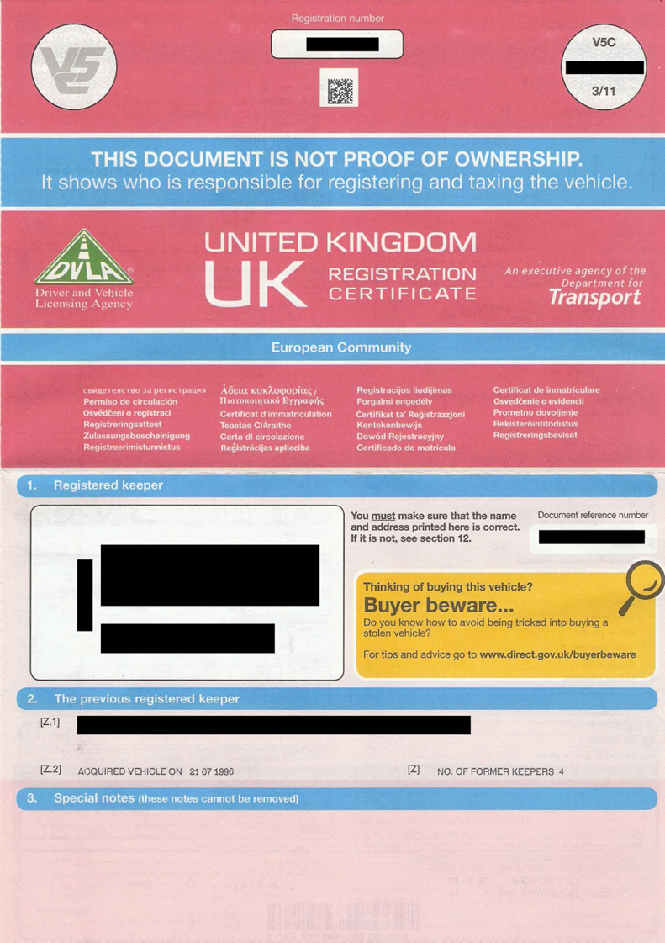
Vehicle Licencing and Registration
V5 Registration Documents
Notes:
The Vehicle Excise & Registration Act 1994 is the legislation that consolidates the law in relation to the registration of and excise duty payable in respect of motor vehicles.
Section 21 of the Vehicle Excise & Registration Act 1994 provides for the registration of a vehicle.
Before using or keeping a mechanically propelled vehicle on a public road the owner must have the vehicle registered with the Secretary of State for Transport.
Registration Documents
When a vehicle is first registered the licensing authority will issue the vehicle with;
A registration mark,
A registration document (V5).
Change of Ownership.
For a private sale.
Seller Fills in part 6 (Green) with new keeper details
Buyer and seller sign part 8 (Green)
Seller fills out part 10 (Green) with new keepers details
Buyer keeps part 10 until new V5 issued.
Seller sends off parts 1-8 to DVLA.
For a sale to a motor trader
Seller asks motor trader to complete section 9 (yellow)
Section 9 kept by seller and sent to DVLA
Rest of V5 handed to motor trader
Note that whilst the above process can still be complied with, notification of sale/change of ownership can be completed electronically.

Slide 13
Vehicle Licencing and Registration
V5 Registration Documents - Offences
Failing to notify DVLA of:
Acquisition of a vehicle
Disposal of a vehicle
Change of address (registered keeper)
Change of vehicle particulars (e.g. personal registration mark, colour)
Notes:
The Vehicle Excise & Registration Act 1994 is the legislation that consolidates the law in relation to the registration of and excise duty payable in respect of motor vehicles.
Section 21 of the Vehicle Excise & Registration Act 1994 provides for the registration of a vehicle.
Before using or keeping a mechanically propelled vehicle on a public road the owner must have the vehicle registered with the Secretary of State for Transport.
Registration Documents
When a vehicle is first registered the licensing authority will issue the vehicle with;
A registration mark,
A registration document (V5).
Change of Ownership.
For a private sale.
Seller Fills in part 6 (Green) with new keeper details
Buyer and seller sign part 8 (Green)
Seller fills out part 10 (Green) with new keepers details
Buyer keeps part 10 until new V5 issued.
Seller sends off parts 1-8 to DVLA.
For a sale to a motor trader
Seller asks motor trader to complete section 9 (yellow)
Section 9 kept by seller and sent to DVLA
Rest of V5 handed to motor trader
Note that whilst the above process can still be complied with, notification of sale/change of ownership can be completed electronically.

Slide 14

Vehicle Licencing and Registration
V5 Registration Documents - Offences
Failing to produce registration document when required:
A person using a vehicle in respect of which a registration document has been issued must produce the document for inspection on being so required by –
A constable or
An authorised person
A person is guilty of an offence if he fails to comply, unless
Sec 28A Vehicle Excise and Regulation Act 1994
Notes:
The Vehicle Excise & Registration Act 1994 is the legislation that consolidates the law in relation to the registration of and excise duty payable in respect of motor vehicles.
Section 28A of the Vehicle Excise & Registration Act 1994 provides for the offences in relation to failing to produce registration of a vehicle.
All genuine registration documents have a watermark, which is easily visible, when the document is held up to the light.

Slide 15
Vehicle Licencing and Registration
V5 Registration Documents - Offences
They produce it in person, at a police station specified by then at the time the request is made
and
They do so within 7 days after the date of which the request was made
or
As soon as is reasonably practicable
Sec 28A Vehicle Excise and Regulation Act 1994
Notes:
A person will NOT be guilty of an offence if the following conditions are satisfied:
The first condition is that -
the person produces the registration document, in person, at a police station specified by him at the time of the request, and
(b) he does so within 7 days after the date on which the request was made or as soon as is reasonably practicable.
The second condition is that -
(a) the vehicle is subject to a lease or hire agreement,
(b) the vehicle is not registered in the name of the lessee or hirer under that agreement and is not required to be so registered,
(c) the person produces appropriate evidence of the agreement to the constable or authorised person at the time of the request or he produces such evidence in person, at a police station specified by him at the time of the request:-
(i) within 7 days after the date of the request, or
(ii) as soon as is reasonably practicable, and
(d) the person has reasonable grounds for believing, or it is reasonable for him to expect, that the person from whom the vehicle has been leased or hired is able to produce, or require the production of, the registration document.
appropriate evidence means -
(a) a copy of the agreement, or
(b) such other documentary evidence of the agreement as is prescribed in regulations under this section.
The third condition is that any exception prescribed in regulations under this section is met.

Slide 16



Vehicle Licencing and Registration
Vehicle Registration Marks (VRM)
Notes:
Section 23 of the Vehicle Excise and Registration Act 1994 creates the mechanism for the creation of a registration mark.
23(1) Where the Secretary of State registers a vehicle under section 21(1) he shall assign to the vehicle a mark (a 'registration mark') indicating the registered number of the vehicle.
23(2) The Secretary of State may, in such circumstances as he may determine -
(a) assign a registration mark to a vehicle to which another registration mark has previously been assigned,
(b) assign to a vehicle (whether on its first registration or later) a registration mark previously assigned to another vehicle,
(c) (whether or not in connection with an assignment within paragraph (a) or (b)) withdraw any registration mark for the time being assigned to a vehicle, and
(d) re-assign to a vehicle a registration mark previously assigned to it but subsequently withdrawn.
23(3) The Secretary of State may by regulations provide that the registration mark for the time being assigned to a vehicle shall be fixed, in the manner prescribed by the regulations, on the vehicle, on any other vehicle drawn by the vehicle or on both.
23(4) The Secretary of State may by regulations prescribe -
(a) the size, shape and character of registration marks to be fixed on any vehicle, and
(b) the manner in which registration marks are to be displayed and rendered easily distinguishable (whether by day or by night).
23(5) The Secretary of State may by regulations -
(a) make provision for assigning general registration marks to persons holding trade licences and (in particular) prescribe the registration marks to be carried by vehicles the use of which is authorised by a trade licence, and
(b) make provision for the issue of trade plates to holders of trade licences and for the charging of a fee for the replacement of trade plates which are or may be lost, stolen, destroyed or damaged.

Slide 17
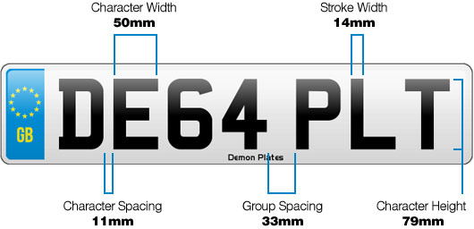

Vehicle Licencing and Registration -
Vehicle Registration Marks (VRM)
Must be of a certain size and type.
Displayed on a flat, rectangular surface, plate or area.
Be easily distinguishable and unobscured.
For vehicles registered after 1st January 1973:
The front marks should be black letters/figures on a white reflective background
The rear marks should be black letters/figures on a yellow reflective background
Notes:
Positioning of registration plates
Rear plates
Registration plate must be fixed on the rear of either:-
The vehicle, or
Where the vehicle is towing a trailer, the trailer, or
Where the vehicle is towing more than one trailer, the rearmost trailer
NB – There is no requirement for a plate between vehicle & trailer
Front plates
On front of vehicle in approved format

Slide 18
Vehicle Licencing and Registration -
Vehicle Registration Marks - Offences
It is an offence to:
Drive or keep a mechanically propelled vehicle on a public road when its vehicle registration mark:
Was not fixed as required,
or
Was obscured, rendered or allowed to become not easily distinguishable.
Section 43 Vehicle Excise and Registration Act 1994
Notes:
Section 23 of the Vehicle Excise and Registration Act 1994 creates the mechanism for the creation of a registration mark.
23(1) Where the Secretary of State registers a vehicle under section 21(1) he shall assign to the vehicle a mark (a 'registration mark') indicating the registered number of the vehicle.
23(2) The Secretary of State may, in such circumstances as he may determine -
(a) assign a registration mark to a vehicle to which another registration mark has previously been assigned,
(b) assign to a vehicle (whether on its first registration or later) a registration mark previously assigned to another vehicle,
(c) (whether or not in connection with an assignment within paragraph (a) or (b)) withdraw any registration mark for the time being assigned to a vehicle, and
(d) re-assign to a vehicle a registration mark previously assigned to it but subsequently withdrawn.
23(3) The Secretary of State may by regulations provide that the registration mark for the time being assigned to a vehicle shall be fixed, in the manner prescribed by the regulations, on the vehicle, on any other vehicle drawn by the vehicle or on both.
23(4) The Secretary of State may by regulations prescribe -
(a) the size, shape and character of registration marks to be fixed on any vehicle, and
(b) the manner in which registration marks are to be displayed and rendered easily distinguishable (whether by day or by night).
23(5) The Secretary of State may by regulations -
(a) make provision for assigning general registration marks to persons holding trade licences and (in particular) prescribe the registration marks to be carried by vehicles the use of which is authorised by a trade licence, and
(b) make provision for the issue of trade plates to holders of trade licences and for the charging of a fee for the replacement of trade plates which are or may be lost, stolen, destroyed or damaged.

Slide 19
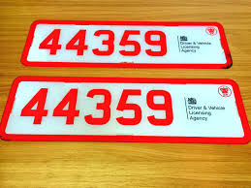
Vehicle Licencing and Registration
Trade Plates
Notes:
Trade (licence) plates are used by those in the motor industry, specifically motor traders and vehicle testers.
The plates are constructed in a similar way to normal registration plates, but with red letters and numbers on a white background.
Trade plates are only to be used when a vehicle is in the temporary possession of the trader or tester holding the licence, and they are using it in the course of their business.
Traders can use plates on occasions including demonstrating or delivering a vehicle to a customer, while vehicle testers use them while testing a vehicle on a public road.

Slide 20
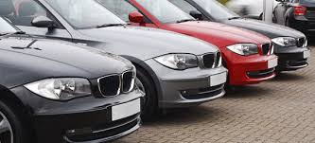
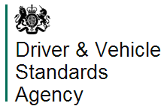
Vehicle Licencing and Registration
Trade Plates
Motor Traders
Vehicle Testers
Notes:
There is no automatic right to the issue of a trade licence and only those that can fully comply with the specified criteria will be eligible to become a trade licence holder. To be eligible to apply for a trade licence they must either be:
A motor trader, defined as:
A manufacturer or repairer of, or dealer in, mechanically propelled vehicles
A dealer in vehicles, if they carry on a business consisting wholly or mainly of collecting or delivering mechanically propelled vehicles and not including any other activities except those of a manufacturer or repairer of or dealer in such vehicles. This includes hire and leasing companies and also finance/HP companies.
Vehicle testers, defined as:
A person other than a motor trader who regularly in the course of their business engages in the testing on roads of mechanically propelled vehicles belonging to other people.

Slide 21
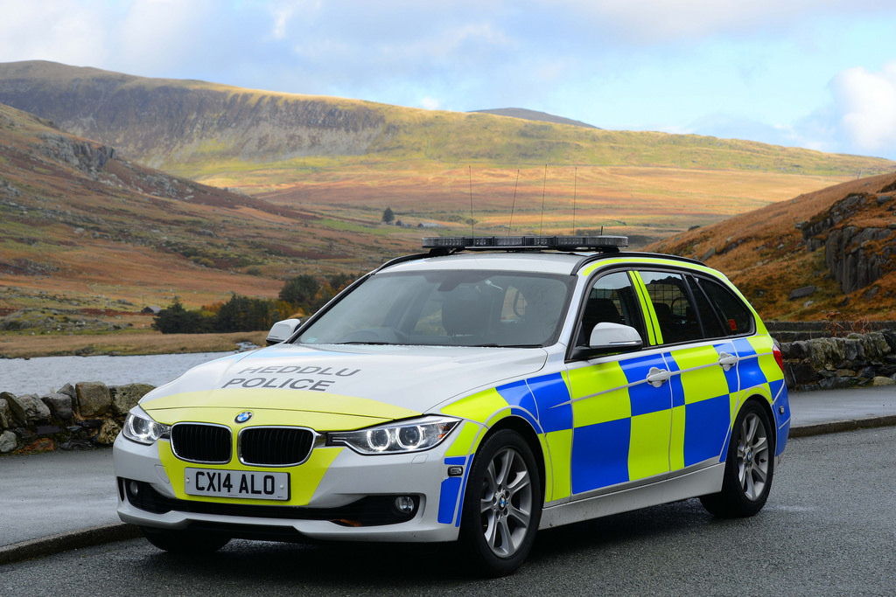
Vehicle Licencing and Registration
Any Questions?
Notes:
‘Owner’
The owner does not have to possess the vehicle documents or be registered as the owner of the vehicle.
It is the person who has authority over the control of the vehicle

