Slide 1

Digital Skills and Research Methods
GROUP 2
PRESENTATION
UBER TECHNOLOGY
BY
RHYAN ID: 2110751
ISAAC ID: 2111468
SHANTI ID;2109631
KEVIN ID: 2108739
LANDU MAHILU ID: 2109901

Slide 2
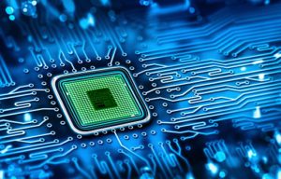
INTRODUCTION
Advances in technology have played an important role in the development of man, we now live in the world driven by technology.
Technological innovation provides ways to do work in smart ways.
Electronics, gadgets, faster modes of transportation have added to the comfort factor in our lives.
In this report, we will talk about how technologies have changed the world of transportation and we have chosen UBER TECHNOLOGY.

Slide 3
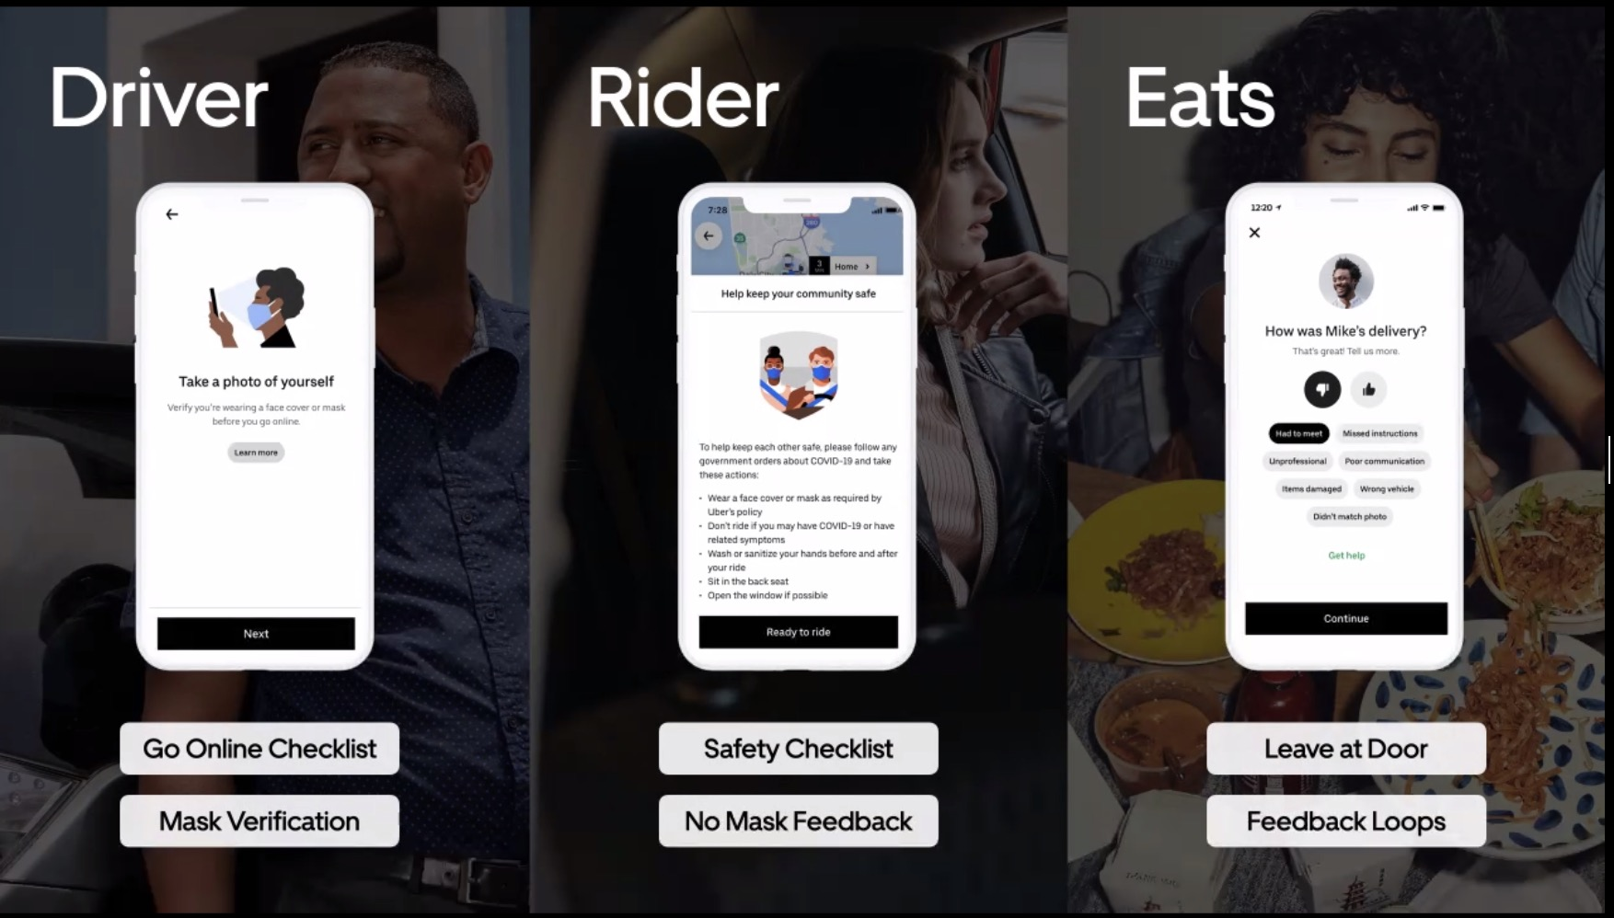
A Brief Introduction to Uber
Uber commonly as know by uber technologies, Uber is an American mobility as base in San Francisco is were the idea start, but the story began in Paris in 2008,with to friends, Travis Kalanick and Garrett camp,
The services provide include ride, food delivery (Uber Eats and Postmates), package delivery, couriers, freight transportation.

Slide 4
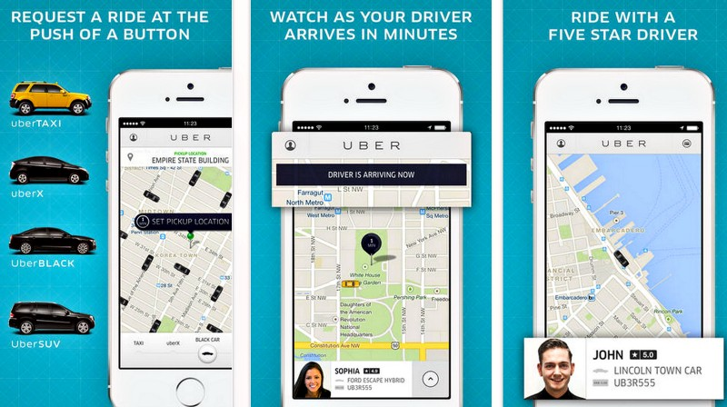
How uber works
Uber is a technology platform that uses a smartphone application to connect riders with the drivers.

Slide 5
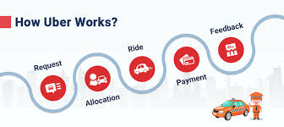
UBER HOW IT VWORKS
CREATE AN ACCOUNT
All you need is an email address and phone number.
You can request a trip from your browser
from the Uber app.
Enter your destination
Just open app and enter where you’re going in the Where to? box.
to confirm your pick-up location and tap Confirm again to be matched with a driver nearby.
Meet your driver
Check your trip
Payment
payment method such as a credit card or Uber Cash balance.

Slide 6
REFERENCES
www.uber.com
Google search
Technology-inovation/amazon
https://www.prospects.ac.uk/job-profiles/chartered-management-accountant

