Slide 1
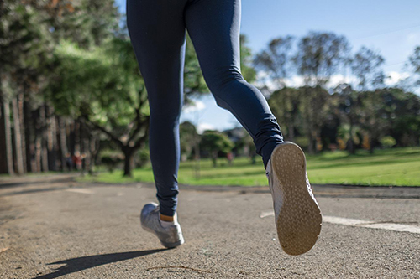

Name: Kanika Kanika
Id: 2229261
Module: practice based research code: LCHS7001_LON
Lecturer: Dr. Muhammed Afolabi
Prevalence of Running among students in a public university

Slide 2
Introduction
Physical activity should be a part of everyday's university routine for encouraging students to stay enthusiastic and energetic
This promotes both mental and physical health for all age of people
Students get inspiration for their studies by attending physical activity classes in their school (Grasdalsmoen et al. 2020).
Notes:
Universities are required to include physical activity and their syllabus for helping students improve their fitness by building strong bones and muscles, controlling weight, and reducing symptoms of anxiety and depression. This is also helpful to reduce the risk of developing health conditions such as cancer and other related health and cardiorespiratory diseases among students. In short, physical activity can uplift the standard of living for individuals. This study is going to develop a short proposal for understanding the prevalence of physical activity among students in the public universities. In this regard, the context of UK's public universities engaging their students in different physical activity sessions will be focused in the data collection process.

Slide 3
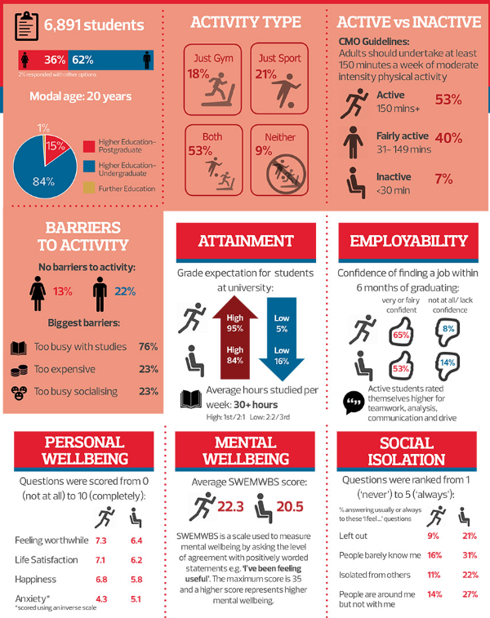
Background of the study
The literature research on the topic of the frequency with which college students engage in physical exercise yields contradictory results.
According to the statistics, nearly 64% of people aged 16 and over in England are physically fit and active.
In the UK, 44.6% of children and young people in school years meet the guidelines of taking part in sport and physical activity on an average (Gov.uk, 2022).
This reflects that UK schools and universities take good care of their students in taking part in physical activities.
Notes:
Physical activity is one of the most important activities that an educational institution needs to engage their students in for their better physical and mental conditions. At university level, students are seen to receive a limited scope of physical activity due to their study pressure and other reasons. Teachers must encourage students to take part in different sport activities and annual programs arranged by the University for increasing their interests in physical education. According to "UK chief medical officers' guidelines", each week students are required to stay engaged in 150 minutes of moderate intensity activity, 75 minutes of vigorous activity or a mixture of both on some days.

Slide 4
Research questions
RQ1. What is proportion and socio-demographic characteristics of students engaging in physical activity in Harvard University?
RQ2. What are the primary obstacles that impede students' ability to engage in regular physical activity, and what strategies can be employed to overcome them?
RQ3. To what degree does the perception of convenience and accessibility of campus recreation and sports facilities among students impact their utilisation of these resources and their engagement in physical activity?
Notes:
These research questions are adopted in this area to answer the prevalence of physical activity among students in the public university. The focus of this research will be provided in the UK-based public Universities engaging their students in different public activities. These research questions are developed to satisfy the demand of project objectives. Answering these questions will help the research team to find decent data on the utilisation of physical activity among students.

Slide 5
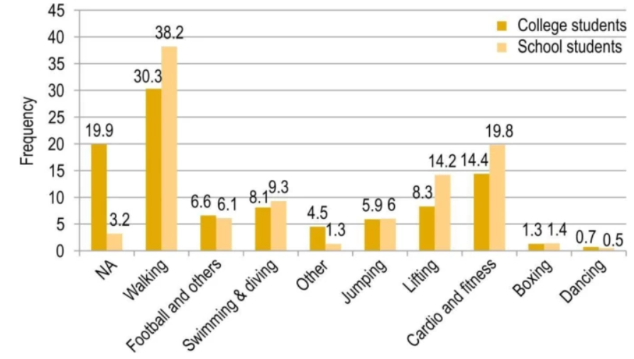
Rationale
The rationale is to assess student physical activity to assist Harvard University develop policies and services for active students.
The data collected in this portion will play a significant role in making the leaders understand the importance of engaging students with physical activity (Ethnicity-facts-figures.service.gov.uk, 2022).
The importance of physical activity along with the course curriculum will be expressed with primary data in this area.
Notes:
The rationale is to assess student physical activity to assist Harvard University develop policies and services for active students.
The data collected in this portion will play a significant role in making the leaders understand the importance of engaging students with physical activity (Ethnicity-facts-figures.service.gov.uk, 2022).
The importance of physical activity along with the course curriculum will be expressed with primary data in this area.

Slide 6
Methodology
Recruitment, sampling & study participants
This research will follow a "descriptive" design to collect and analyse datasets on this topic (Sileyew, 2019).
The sampling strategy of the participants will be random from Harvard University in the UK.
All the research participants will be students studying in Harvard University as they can share their experience of getting the scope they receive to stay engaged in the physical activities in their university.
One hundred students from different years of a public university will be picked to take part in this study (Nayak and Narayan, 2019).
The sample size of the research is 350.
Notes:
Ten close-ended questions will be asked of these participants. They are required to answer each of them according to their experience and knowledge. The strategy of this research is to describe the comprehensive plan of data collection and analysis based on the chosen topic. "Random probability sampling" will be used in the sampling strategy of this data collection. Students from different years of Harvard University will express their opinions and interests regarding physical activities. Two demographic questions will be included in the sample at first. Later, all eight questions will be either "yes-no" questions or "Likert-chart scale" questions. The study will involve hundred students to exchange their valuable opinions on this matter.
Research design offers a particular pattern of research. The research team will follow a specific structure of this research as a part of the methodological tool. The stool is helpful to maintain a detailed analysis of the gathered data sets based on this chosen topic. The descriptive design will guide researchers to describe each collected data on this topic. They can easily compare and contrast collected data sets so that the research can easily meet all adopted objectives. The target of choosing this Research design is to answer all the research questions by following a particular pattern or outline of the research.

Slide 7
Contd..
Data collection method
Conducting a survey in Excel format: A standardised questionnaire will gather socio-demographic, physical activity, and participation data from Harvard University undergraduate and graduate students.
Primary data collection from eligible and consenting students: Students from a wide range of majors and experiences will be recruited to fill out the survey in person by the research team.
Socio-demographic characteristics assessment: The questionnaire will include age, gender, residence, education, religion, marital status, employment, family income, and more.
Exploration of factors promoting physical activity: The questionnaire will also examine access to sports and leisure programming, academic stress, social support, and understanding of the health benefits of exercise(Braun et al. 2021).
Notes:
The data will be collected based on the ten survey questions in this area. Students will get five options in the "likert-chart format", while in case of the "yes-no" questions, they will get two options. They will pick one of the most suitable answers according to their point-of-view. Researchers will do all kind of cooperation with these human participants so that they do not feel any pressure to take part in this process. The selection of this research tool will be used to gather the most appropriate responses from the participants within a limited period of time. On the other hand, interview process will not be followed as taking permission from the university authority to interview some of their managerial staff can be hectic and time-consuming. The authorities may not allow that as well. Hence, students will be ideal participants for this study. The data will be collected from the participants where they will express different questions regarding both the scope of physical activity and loophole of opportunities in staying engaged in the physical activities. Each student will pick their preferable social media platforms, where they want to receive the set of questions of this study. The aim of this research is to collect maximum responses in the "positive" or "negative" categories that can justify the answer. Neutral responses will be remarked as confusing and diplomatic ones and a least priority will be given to these questions.

Slide 8
Contd..
Proposed data analysis technique
Utilization of SPSS statistical software: The data collected from the survey will be loaded into SPSS for streamlined data management and analysis.
Simple descriptive statistics: Descriptive statistics will be used extensively throughout the investigation to summarise and display the data in an understandable format.
Calculation of measures: In the case of numerical variables, the statistical measures that will be computed include means, modes, medians, and standard deviations. Conversely, for categorical data, proportions will be calculated.
Some graphs will be developed by the researchers by analysing the statistics of responses under each question sample (Breton et al. 2021).
Notes:
The data analysis will be based on the statistical analysis of the gathered responses. The students will share their experience of taking part in different sports or weekly exercises. The enjoyment of taking part in physical activities will be reviewed based on the participants' responses. Participants will share their interest in taking part in the physical activities in this area. The prevalence of physical activity as a part of university curriculum will be analysed in this area. The survey will include some recommendations from the students that will guide researchers to understand their requirements of physical activity. The process will follow a particular layout of conducting this task. The idea is to gain an in-depth knowledge of the chosen topic based on the real-life experiences of the students. This process will help the research team to strengthen their research by delivering decent quality and standard of the research. The rationale will be easily met in this way.

Slide 9
Contd..
Ethical considerations
The University of Bedfordshire's research Ethics Committee will review the study protocol to ensure compliance with all laws and rules.
Before participating, qualifying students will receive an informed consent form explaining the study's aims, methodology, risks, and benefits.
They may choose to participate or not.
Students may opt out of the study without consequence.
To protect participant privacy, all data will be de-identified, encrypted, and accessible only by approved researchers (Bloomfield and Fisher, 2019).
Notes:
The research will follow all ethical regulations of primary data collection. No research participant will be pressured to take part in this process. They will take they don't decisions about participating in this survey. No personal questions will be asked about from the gender and year of their university course. They are allowed to skip any of the questions in case they do not want to answer that. The research team will provide a brief objective of conducting this task so that they can understand the value of their responses. The data will be kept safe in the password-protected excel file. No one will get the access to see the responses apart from the research team. The anonymity of the data will be thoroughly maintained in this process.

Slide 10
Contd..
Implication of the research
This research may help create tailored strategies to improve student physical activity by reducing hurdles.
Knowing how widespread physical activity is at Harvard is a step towards improving students' health, happiness, and academic performance.
The importance of this data collection process will be based on the quality of the primary responses.
Notes:
The future researchers can use this work as a draft of their detailed research work. They will utilise these data to research further topic related to this one. Readers can gain knowledge of the prevalence of physical activity in the public universities of the UK. The loophole of infrastructure for the physical activity in different universities will also be clarified in this survey. The university authorities can also take decent steps to mitigate these areas by going through the outcomes of this quantitative data analysis.

Slide 11
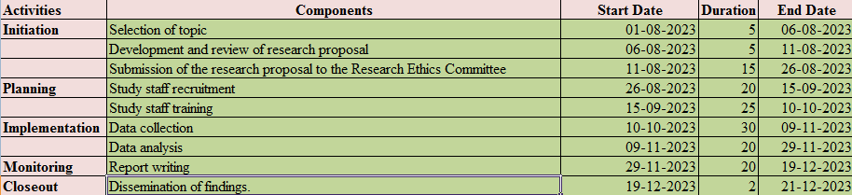
Contd..
Plan of work and time schedule
This data collection process will maintain a particular framework or plan for conducting this work (Mohajan, 2020).
This research will start from the first of August of this year.
The outline or the plan of work is made according to the requirement of each activity in this study.
Notes:
The maximum time will be taken by the team to select the primary participants for this research. Once the participants are selected the research team will send them survey questions via social media platforms. Not everyone has to answer the questions at a similar time and day. They can take part in the survey anytime they want according to their preferences and free time. The literature review will also take a decent time in this research.

Slide 12
References
Journals
Bloomfield, J. and Fisher, M.J., 2019. Quantitative research design. Journal of the Australasian Rehabilitation Nurses Association, 22(2), pp.27-30.
Braun, V., Clarke, V., Boulton, E., Davey, L. and McEvoy, C., 2021. The online survey as a qualitative research tool. International journal of social research methodology, 24(6), pp.641-654.
Breton, M., Gaboury, I., Sasseville, M., Beaulieu, C., Abou Malham, S., Hudon, C., Rodrigues, I., Maillet, L., Duhoux, A., Deville-Stoetzel, N. and Haggerty, J., 2021. Development of a self-reported reflective tool on advanced access to support primary healthcare providers: study protocol of a mixed-method research design using an e-Delphi survey. BMJ open, 11(11), p.e046411.
Grasdalsmoen, M., Eriksen, H.R., Lønning, K.J. and Sivertsen, B., 2020. Physical exercise, mental health problems, and suicide attempts in university students. BMC psychiatry, 20(1), pp.1-11.
Mohajan, H.K., 2020. Quantitative research: A successful investigation in natural and social sciences. Journal of Economic Development, Environment and People, 9(4), pp.50-79.
Nayak, M.S.D.P. and Narayan, K.A., 2019. Strengths and weaknesses of online surveys. technology, 6(7), pp.0837-2405053138.
Sileyew, K.J., 2019. Research design and methodology. Cyberspace, pp.1-12.
Websites
Ethnicity-facts-figures.service.gov.uk, 2022, Physical activity, viewed on 14th July, 2023, <https://www.ethnicity-facts-figures.service.gov.uk/health/diet-and-exercise/physical-activity/latest#:~:text=61.4%25%20of%20people%20aged%2016,for%20the%20last%206%20years>
Gov.uk, 2022, Physical activity data tool: statistical commentary, January 2022, viewed on 14th July, 2023, <https://www.gov.uk/government/statistics/physical-activity-data-tool-january-2022-update/physical-activity-data-tool-statistical-commentary-january-2022#:~:text=Main%20findings,-Activity%20levels%20remain&text=In%202020%20to%202021%2C%2044.6,minutes%20or%20more%20every%20day.>

Slide 13
Thank you

