Slide 1

Autumn Gale
1811212
SJS14012
(Image 1)

Slide 2

Discuss the concept of ‘Well-being’ referring to theory, policy and practice.
(Image 2)

Slide 3

Introduction
Image 3
What is well-being?
Definition of Wellbeing?
Theory
What is the government doing to promote well-being?
Ceredigion Local Well-being Plan 2018-2023
The Wheel of Well-being
Legislation
Practice
Conclusion
Image 3

Slide 4
The challenge of defining Well-being
What is Well-being?
Defining well-being has been an ongoing challenge for many years. The question ‘what is well-being?’ currently remains unanswered, leaving an unclear interpretation within todays society (Dodge, R., Daly, A., Huyton, J., & Sanders, L, 2012).
Well-being is essential to the quality of life. For example, relating to the satisfaction of material, biological, psychological, social, and cultural needs. Health and well-being impact on an individuals capability to meet their aspirations and overall quality of life (Zikmund, 2003).

Slide 5
Definition of Well-being
Shah and Marks (2004, p. 2) define wellbeing to be:
‘Well-being is more than just happiness. As well as feeling satisfied and happy,
well-being means developing as a person, being fulfilled, and making a
contribution to the community.’
The US Department for Health and Human Services (2018) defines well-being as follows:
‘There is no consensus around a single definition of well-being, but there is general agreement that at minimum, well-being includes the presence of positive emotions and moods (e.g., contentment, happiness), the absence of negative emotions (e.g., depression, anxiety), satisfaction with life, fulfilment and positive functioning.’

Slide 6
Theory
Definition of Theory: ‘A supposition or a system of ideas intended to explain something, especially one based on general principles independent of the thing to be explained’ (Oxford Living Dictionaries, 2017)
What does a child’s well-being consist off?
Attachment, role of a key person, exercise, good health, food and nutrition, physical care needs, factors affecting health.
Theoretical perspectives on well-being
Albert Bandura (Self-Efficacy)
John Bowlby (Attachment Theory)
Abraham Maslow (Hierarchy of Needs)
‘Children represent the future, and ensuring their physical, socio-emotional and language and cognitive development ought to be a priority for all societies. Children are particularly vulnerable to malnutrition and infectious diseases, many of which can be effectively prevented or treated.’ (WHO, 2018)

Slide 7
Maslow’s Hierarchy of needs
Self-actualization
Maslow recognised the importance of well-being when creating his hierarchy of needs
Esteem
Love/Belonging
Safety
Physiological

Slide 8
What is the government doing to promote wellbeing?
The aim for any government is to look after the public, listen to their concerns and interests. This would include roles such as actively developing and implementing policies and programmes that best contribute to help improve general standards of living.
The government has a position to promote the health and well-being of children and adults by encouraging a healthy lifestyle , e.g., by way of physical activity and sport (Wellard and Secker, 2017).

Slide 9

Ceredigion Local Well-being Plan 2018-2023
The Ceredigion public service board have put In to place the first ever Ceredigion local well-being plan.
The plan is to not just focus on the next five years but to focus on the future over a long term basis. The aim of the plan is to bring individuals and communities together.
It consists of two guiding principles and six well-being aims, which include improving the economic, social, environmental and cultural well-being of Ceredigion.
The plan does not represent a business minded approach, instead it is trying something new by reaching out to public sector organisations.
(Ceredigion County Council, 2018)

Slide 10
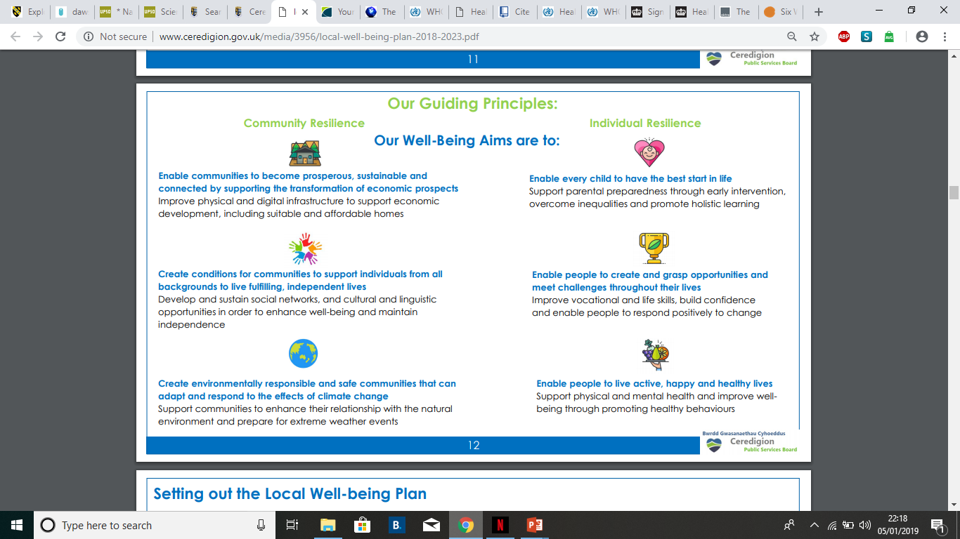
(Ceredigion county council 2018)
The plan aims to be as inclusive as possible although it does not guarantee all services and activities will be covered across the county.

Slide 11
The Wheel of Well-being
Body: be active
Mind: keep learning
Spirit: give
People: connect
Place: take notice
Planet: care
(Live Well Kent, 2018)

Slide 12
Legislation
Children act 1989, 2004 (Every Child Matters Framework)
Equality Act 2010
Human rights Act 1998
The wellbeing of future generations Act Wales 2015
Social services and well being Act 2014
Wellbeing policies in schools
Well being fundamental basic right – human rights acts
Universal credit

Slide 13
Practice
What Is actually happening in practice?
In 2017 changes to Child Tax Credits would have huge impacts on families with more than two children. For example entitlement for a third child would only be given under certain exceptions.
(UK GOV, 2018)

Slide 14
Conclusion
Taking a look at well-being we have established the terminology is still under sided. If we look at Maslow’s Hierarchy of basic need’s the UK government is failing to meet these basic standards of living for many people living in the UK, baring in mind these are the most vulnerable people in our society.
I conclude well-being is something that appears to be a low priority in our current political landscape. Policy makers need to reassess the distribution of wealth amongst some of the UKs poorest people for everyone to be able to meet a basic standard of life. And to achieve a state of well-being.

Slide 15
Reference list
Bandura, A. (1995) Self-Efficacy in Changing Societies. Cambridge Cambridge University Press.
Bowlby, J (1988) Clinical Applications of Attachment Theory. Bruner-Routledge. Taylor & Francis Group: Hove and New York. Google books (online). Available at. https://www.google.com/search?tbm=bks&q=scholar&oq=scholor (Accessed on 4th January 2019).
Ceredigion County Council. (2018) Ceredigion Local Well-being Plan. Available at. http://www.ceredigion.gov.uk/your-council/partnerships/ceredigion-public-services-board/health-social-care-wellbeing/ceredigion-local-well-being-plan/ (Accessed on 1st January 2019).
Charter for Compassion. (2017) Image 3. A Flourishing Life. Available at. https://charterforcompassion.org/a-flourishing-life (Accessed on 7th January 2019.
Dodge, R., Daly, A., Huyton, J., & Sanders, L. (2012). The challenge of defining wellbeing. International Journal of Wellbeing, 2(3), 222-235. doi:10.5502/ijw.v2i3.4
Equality and Human Rights Commission (2018) The Human Rights Act 1998. Available at. https://www.equalityhumanrights.com/en/human-rights/human-rights-act (Accessed on 5th January 2019).
Ian Wellard & Michelle Secker (2017) ‘visions’ for children’s health and well-being: eploring the complex and arbiritary processes of putting theory into practice, Sport, Education and Society.
Live Well Kent. (2018) The Six Ways to Well-being. Available at. https://livewellkent.org.uk/six-ways-wellbeing/ (Accessed on 1st January 2019).

Slide 16
Maslow, A. H. (2012) Towards a Psychology of Being. USA. Start Publishing LLC.
Oktra. (2019) Image 2. Available at. http://www.oktra.co.uk/insights/how-can-improving-mental-wellbeing-in-the-workplace-increase-productivity-and-commercial-success/ (Accessed on 7th January 2019).
Oxford Living Dictionaries. (2019) Definition of theory in English. Oxford University Press. Available at. https://en.oxforddictionaries.com/definition/theory (Accessed on 6th January 2019).
Pinsdaddy. (2019) Image 1. Happy People. Available at. http://www.pinsdaddy.com/happy-people_5fKnFupJlYwqqObkjNndwKP0UBxWYfR1YHi1rOJYjJ8/ (Accessed on 7th January 2019).
The National Archives. (2018,a) Children Act 1989. Available at. http://www.legislation.gov.uk/ukpga/1989/41/contents (Accessed on 5th January 2019).
Shah, H., & Marks, N. (2004). A well-being manifesto for a flourishing society. London: The New Economics Foundation.
The National Archives. (2018, b) Children Act 2004. Available at. http://www.legislation.gov.uk/ukpga/2004/31/contents (Accessed on 5th January 2019).
UK Government. (2018) Child Tax Credit: Support For A Maximum Of 2 Children. Available at. https://www.gov.uk/guidance/child-tax-credit-exceptions-to-the-2-child-limit

Slide 17
UK Government. (2015) Equality act 2010. Available at. https://www.gov.uk/guidance/equality-act-2010-guidance (Accessed on 5th January 2019).
UK Government. (2014) Social services and well being act 2014). Available at. http://www.legislation.gov.uk/anaw/2014/4/pdfs/anaw_20140004_en.pdf (Accessed on 5th January 2019).
US Department for Health and Human Services (2018) How is well-being defined? Available at. https://www.cdc.gov/hrqol/wellbeing.htm#three (Accessed on 6th January 2019).
Welsh Government. (2016) The well-being of future generations act Wales 2015. Available at. hhtps://gov.wales/topics/people-and-communities/people/future-generations-act/?lang=en(Accessed on 5^{th January 2019)}
World Health Organisation. (2019) Child Development. Available at. https://www.who.int/topics/child_development/en/ (Accessed on 6th January 2019).
Zikmund, V. (2003) Health
http://www.nel.edu/userfiles/articlesnew/NEL240603E03.pdf?route=pdf_/24_6/NEL240603E03_Zikmund_.pdf (Accessed on 6th January 2019).

