Slide 1
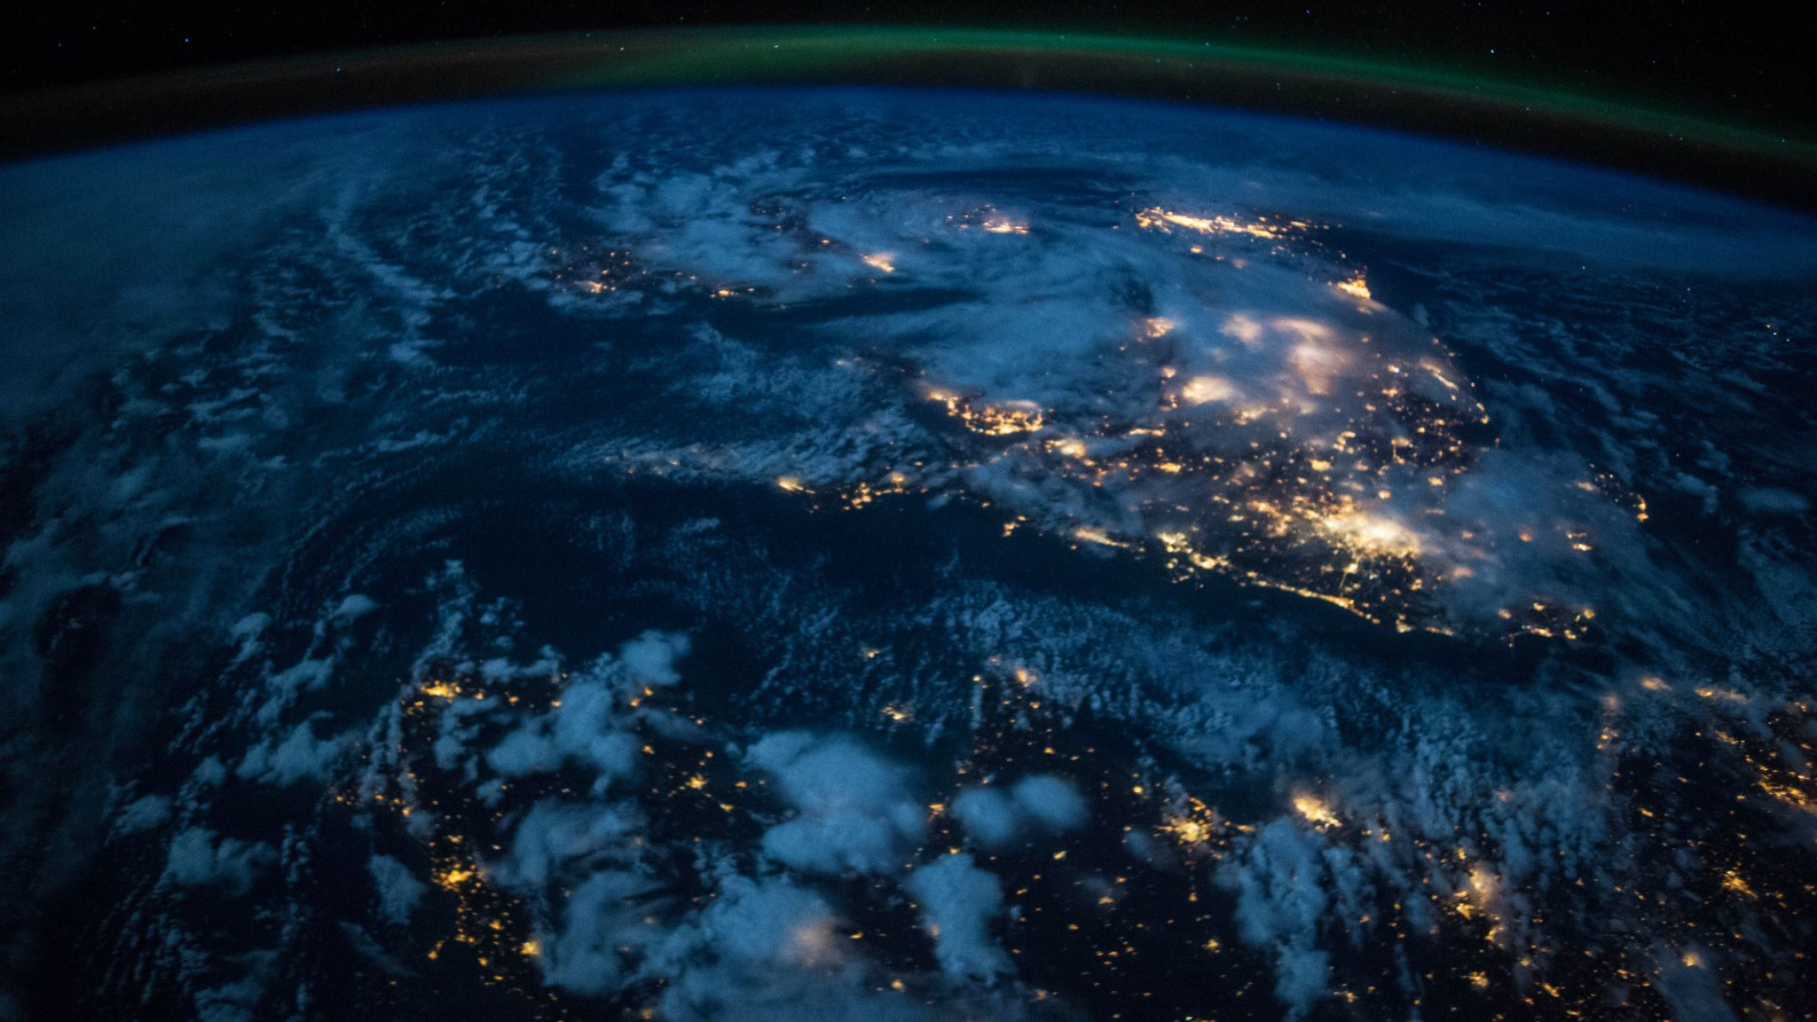
sustainability
The sustainability of coat coffee
Notes:
2016, we turned into the main espresso chain to transform our stores into reusing focuses. Thusly, we urged clients to reuse any dispensable takeaway cup by means of one of our 2,600+ hides away and down the nation. What's more, their not valuable about the brand of expendable cup you bring to us either. Regardless of whether it is anything but a Costa Coffee marked mug, we'll deal with it and guarantee it's reused.
They are not happy with halting there, only two years after the fact, they made a strong and aspiring duty – to turn into the main espresso anchor in the UK to reuse the same number of takeaway cups as we sell by 2020.
Inside its initial a half year, the plan reused more than 41 million cups and we are seeing an expansion in the quantity of spots individuals can reuse their takeaway cups, including workplaces, strip malls, colleges, transport center points, and nearby gatherings, altogether expanding reusing rates thus and importance we're well on our approach to accomplishing our 2020 objective!
t's assessed that the normal UK grown-up buys 3 plastic water bottles each week, so we've promised to give free drinking water on demand from the entirety of our stores the nation over, making more than 2,000 Refill stations and allowing everybody the chance to settle on progressively practical decisions.
Pay special mind to the Refill logo in our store windows as an update that they offer free drinking water!
They use plastic frosted beverage cups that are produced using 70% reused materials and can be discarded in any open blended reusing canister
Since June 2016, costa coffee has been working with clean innovation organization bio-bean to reuse costa coffee pre-owned espresso beans into biofuel. Through this association, bio-bean currently recoup more than 3,500 tons of espresso beans each year from around 900 Costa Coffee stores.

