Slide 1

PTSD, commonly known as post traumatic stress disorder
Mental health condition that develops following exposure to one or several traumatic events
Whilst now through psychological understanding it is known as PTSD.
Firstly known as shell shock from military soldiers during the First World War to describe severe psychological distress experienced by soldiers exposed to combat.
Notes:
Today’s presentation focuses on Post-traumatic stress Disorder, commonly known as PTSD, which is a mental health condition that develops following exposure to one or several traumatic events. Whilst now through psychological understanding it is known as PTSD, it was not always. First known as shell shock, which was used by military soldiers during the First World War to describe the severe psychological distress experienced by soldiers exposed to combat.

Slide 2
What this presentation will cover
How shell shock has evolved from medical and psychological and medical understanding to the modern diagnosis of Post traumatic stress disorder.
Exploring witnessing traumatic events, violence, and was can lead to PTSD, outline the key symptoms such as flashbacks, nightmares, triggers, and guilt, and discuss how PTSD symptoms can worsen or improve over time.
Cultural differences in the experience and understanding of PTSD will be considered.
Notes:
This presentation will cover what shell shock is, how it has evolved from medical and psychological understanding to the modern diagnosis of Post-traumatic stress disorder. It will explore how witnessing traumatic events, violence, and war can lead to PTSD, outlining the key symptoms such as flashbacks, nightmares, triggers, and guilt, and discuss how PTSD symptoms can worsen or improve over time. Finally, cultural differences in the experience and understanding of PTSD will be considered.

Slide 3
“Shell shock was first identified during World War I in 1915 by British physician Charles Myers. The term was used to describe soldiers who exhibited symptoms such as tremors, paralysis, mutism, confusion, nightmares, and emotional collapse following combat exposure ” (Myers, 1915).

Slide 4
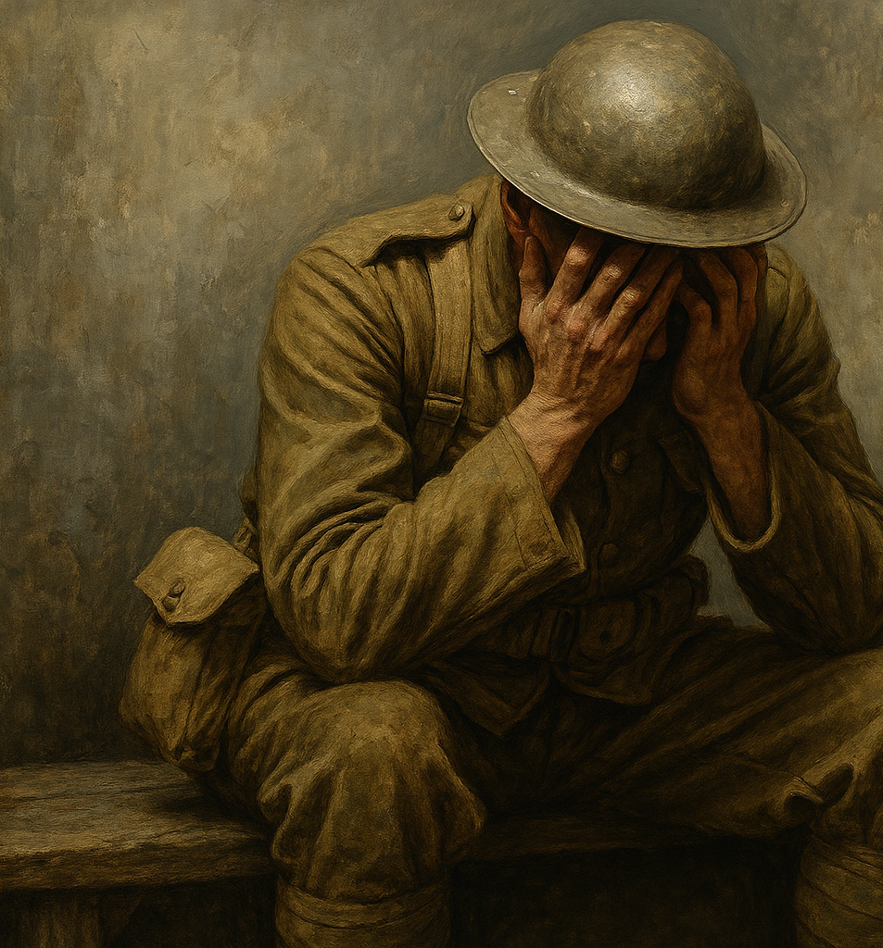
Symptoms were poorly understood, making it difficult for others to navigate why these soldiers were unable to function or cope.
Symptoms were unseen.
Shell shock challenged traditional beliefs that illness must have a clear cause.
Notes:
At that time, these symptoms were poorly understood, making it extremely difficult for others to navigate why these soldiers were unable to function or cope, as their symptoms were unseen and mental. Shell shock challenged traditional medical beliefs that illness must have a clear physical cause.

Slide 5
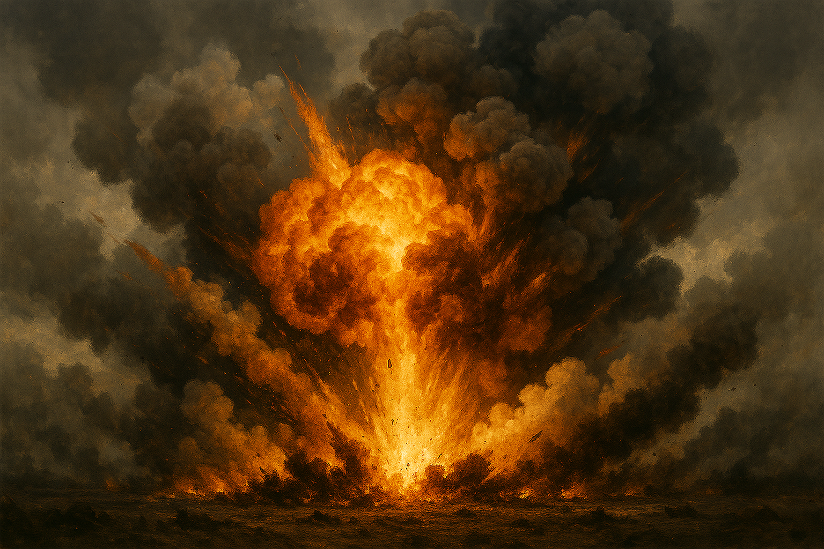
Shell shock was believed to be caused by physical injury to the brain resulting from exposure to exploding artillery shell.
It was thought that the pressure waves from these explosions damaged the nervous system, although there were no external wounds.
This theory aligned with medical models already existing that prioritized physical explanations for illness.
Although this explanation became increasingly insufficient as similar symptoms appeared in soldiers who has never been near explosions.
Notes:
“Initially, shell shock was believed to be caused by physical injury to the brain resulting from exposure to exploding artillery shells. It was thought that the pressure waves from explosions damaged the nervous system, even if no external wounds were visible” (Jones & Wessely, 2007).
“This theory aligned with existing medical models that prioritised physical explanations for illness. However, this explanation became increasingly inadequate as similar symptoms appeared in soldiers who had never been near explosions” (Myers, 1915).

Slide 6
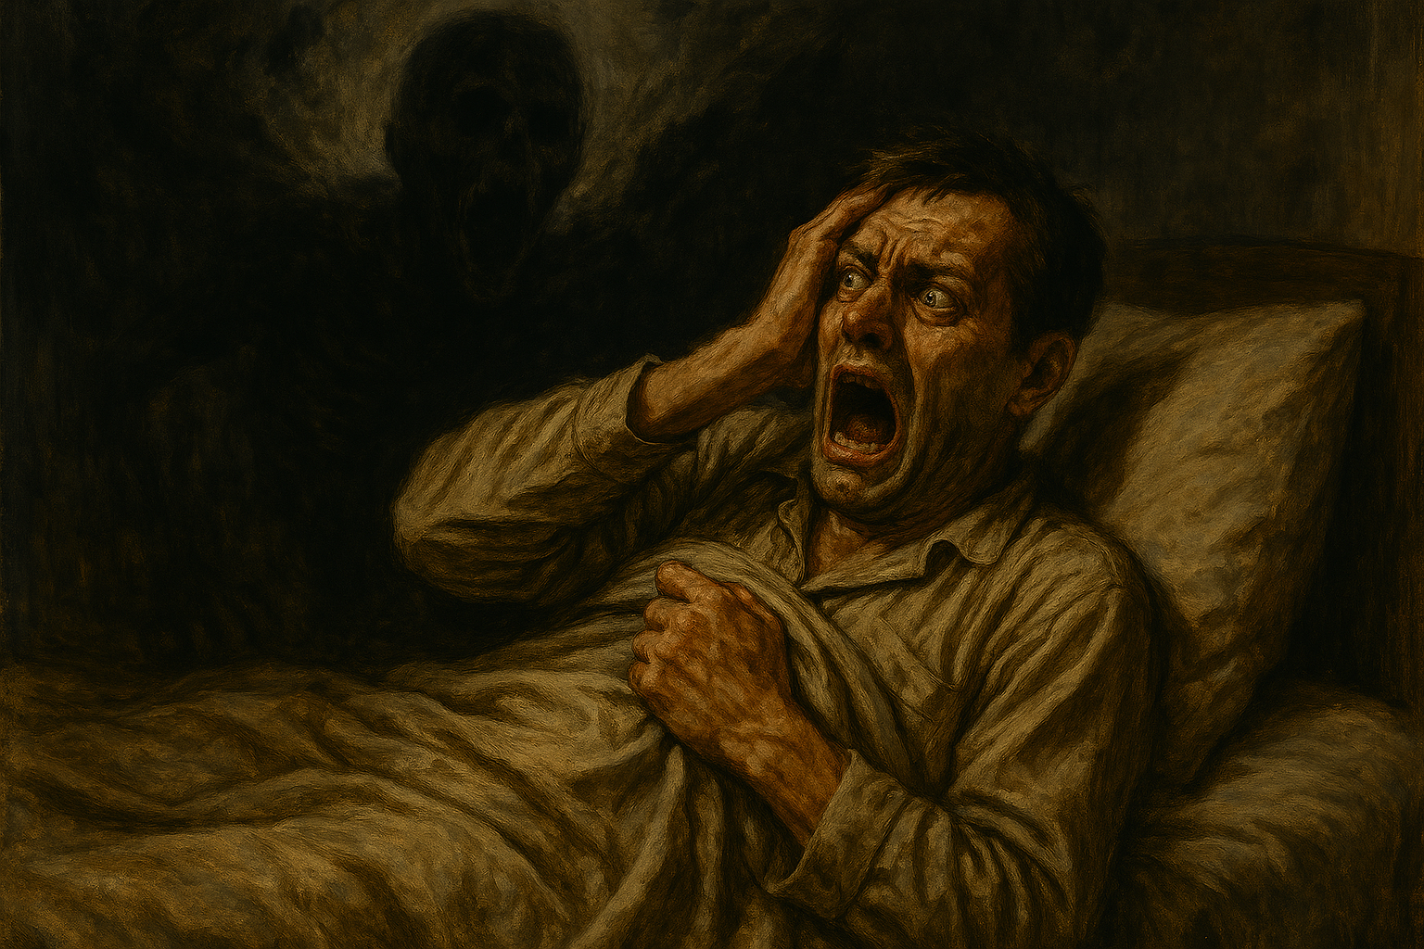
As war progressed, psychological explanations gained attention.
It was recognized that constant exposure to fear, death and the unpredicitibility overwhelmed soldiers’ mental coping mechanisms.
Early psychological theories suggested that trauma disrupted memory and emotional regulation, which led to symptoms such as
Flashbacks.
Nightmares.
Emotional numbness.
However, these terms were not yet formally defined.
Notes:
“As time went on and the war progressed, psychological explanations gained attention. Clinicians began to recognise that constant exposure to fear, death and the unpredictability overwhelmed soldiers’ mental coping mechanisms. Early psychological theories suggested that trauma disrupted memory and emotional regulation, leading to symptoms such as flashbacks, nightmares, and emotional numbness—although these terms were not yet formally defined” (Shephard, 2001).

Slide 7
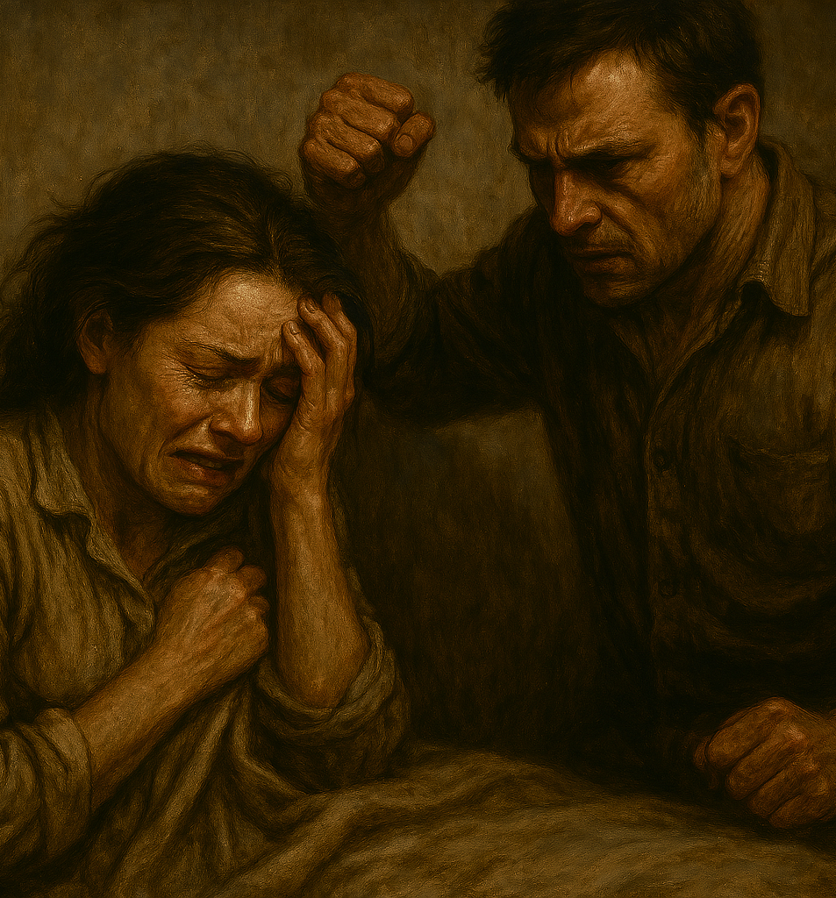
What causes PTSD
A multitude of factors and events can cause PTSD.
Near death experiences, a serious injury, witnessing violence, death or being on the receiving end of violence.
Witnessing something extremely distressing, have happened personally, or to hear of events taking place to somebody close.
Whilst it is common to experience flashbacks, have nightmares from the event, or be triggered by something, leading the person to recall that memory again.
Being diagnosed with PTSD, the person must show symptoms for over one month or it must effect their daily life.
PTSD is classed as a trauma and stressor disorder according to the DSM-5-TR.
Notes:
What causes PTSD can be a multitude of events, such as near-death experiences, a serious injury, witnessing violence or death or being on the receiving end of violence. Something extremely distressing to watch, have happened personally, or to hear of events taking place to somebody close. Whilst it is common to experience flashbacks, have nightmares about the event, or be triggered by something, leading the person to recall that memory again. To be diagnosed with PTSD, the person must show symptoms consistently for over one month or where it impacts the person’s daily life, making small tasks feel impossible. PTSD is classed as a trauma and stressor disorder according to the DSM-5 TR.

Slide 8
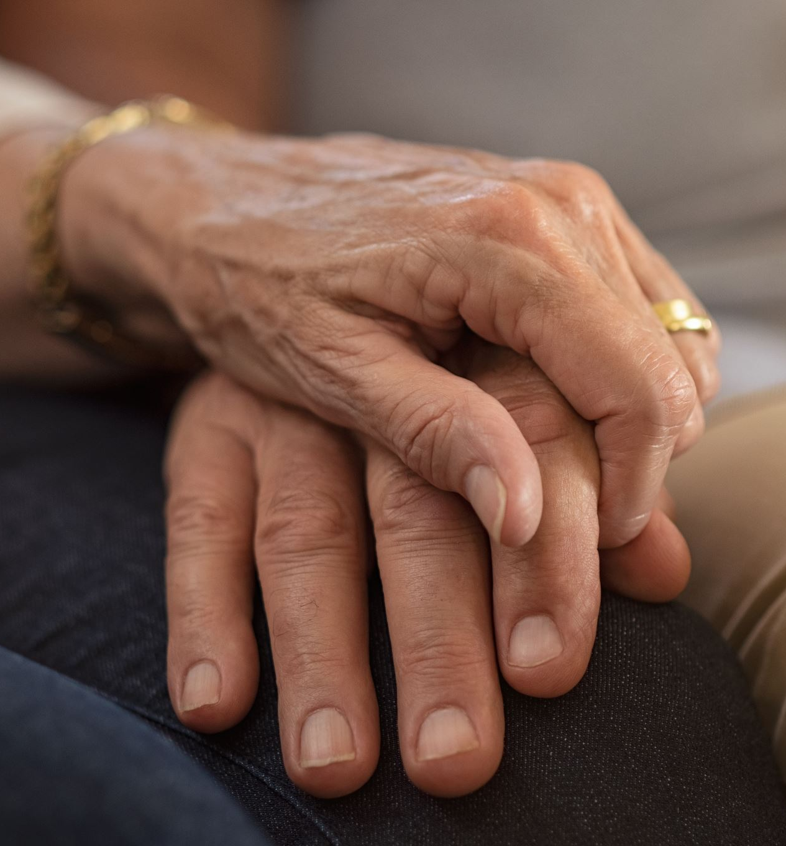
PTSD is not only caused by physical harm, but can also be caused by psychological trauma, such as domestic violence, having a serious injury or witnessing something horrifying like death.
This can sometimes have more of a significant impact when it comes to the psychological damage that goes hand in hand with it, as it is much more deeply rooted and much more complex.
Notes:
PTSD is not only caused by physical harm, but can also be caused by psychological trauma, such as domestic violence, having a serious injury or witnessing something horrifying like death. This can sometimes have more of a significant impact when it comes to the psychological damage that goes hand in hand with it, as it is more deeply rooted and much more complex.

Slide 9
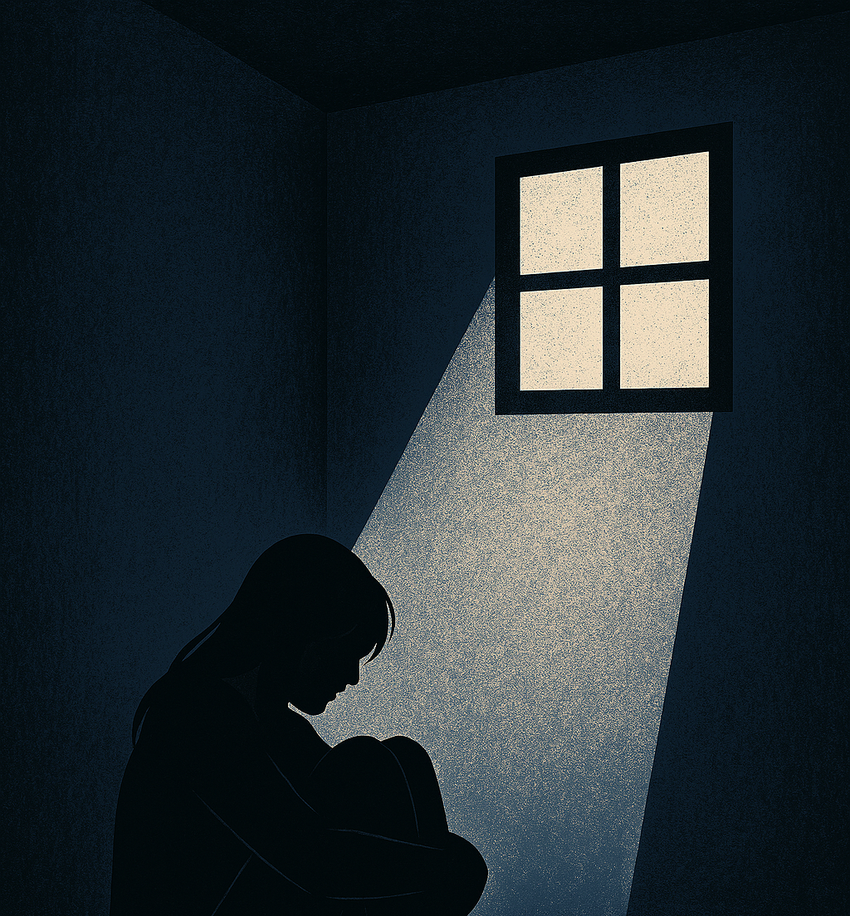
Traumatic experiences that lead to PTSD, often involves violence, interpersonal or collective.
Surviviors of physical assault, sexual assault, domestic abuse and childhood maltreatment are at particularly high risk.
These experiences are deeply personal and often involve betrayal, fear and loss of control, which can intensify psychological harm.
Notes:
“Traumatic experiences that lead to PTSD often involve violence, whether interpersonal or collective. Survivors of physical assault, sexual violence, domestic abuse, and childhood maltreatment are at particularly high risk. These experiences are deeply personal and often involve betrayal, fear, and loss of control, which can intensify psychological harm.” (Herman, 2015).

Slide 10

Research has shown that people from any background who have experienced or witnessed a traumatic event could show symptoms of PTSD regardless of cultural backgrounds, although in some countries, the cultural context has a huge part to play in how symptoms are portrayed and understood.
Some cultures believe that psychological distress is expressed through pain rather than through emotional language.
For some cultures, there is a still a stigma surrounding mental health, which discourages people from seeking help for traumas, whether it be community support or speaking to a therapist.
This makes it clear that cultural prospects do have a part to play in understanding and treating PTSD.
Notes:
Research has shown that people from any background who have experienced or witnessed a traumatic event could show symptoms of PTSD regardless of cultural backgrounds, although in some countries, the cultural context has a huge part to play in how symptoms are portrayed and understood. Some cultures believe that psychological distress is expressed through pain rather than through emotional language. For some cultures, there is still a stigma surrounding mental health, which discourages people from seeking help for traumas, whether it be community support or speaking to a therapist. This makes it clear that cultural prospects do have a part to play in understanding and treating PTSD.

Slide 11

Core symptoms of PTSD
Triggers
Flashbacks
Guilt
Shame
The person struggles with challenges that can last for some people for years even with professional help.
Visual reminders that make an event feel like it is happening all over again.
It is a reminder externally or internally that activates memories of the trauma.
People often blame themselves for the events that have happened even if it was out of their control, causing negative beliefs about themselves.
Notes:
Triggers, flashbacks, guilt, and shame are core symptoms of PTSD as the person struggles with challenges that can last for some people for years, even with professional help. These symptoms can cause a person to involuntarily react to smells, sounds or visual reminders that make the event feel like it is happening all over again. When triggered by something, it is a reminder, externally or internally, that activates memories of the trauma. “When triggered, the body responds as if the danger is present, activating the fight-or-flight response. This can result in rapid heartbeat, sweating, hypervigilance, and panic. Neurobiological research shows that PTSD involves heightened activity in the amygdala, the brain’s fear centre, and reduced regulation from the prefrontal cortex, which normally helps assess safety.” (van der Kolk, 2014).
Guilt and shame also play a huge part for the person, blaming themselves for the events that have happened, even if it was out of their control. Negative beliefs about themselves, believing they do not deserve to be happy, and are permanently damaged, are very common. A lot of people with PTSD also believe they are not safe even when they are.

Slide 12
Immediate help is key to recovering to improve symptoms of PTSD by professional help and a good support network.
However, if somebody does not seek the help they need, the outcome can be catastrophic to the person living with PTSD.
To conclude, PTSD highlights the lasting psychological effects that traumatic events leave on a person. It also highlights how critical it is for cultural movements to be empathetic to understanding the different ways this mental health condition is expressed. Recognising PTSD as a real and complex response to trauma is essential in reducing stigma and misunderstanding. Individuals affected by PTSD often navigate invisible struggles that are not immediately apparent to others, which can lead to isolation and delayed support. This can also cause symptoms to become unbearable to cope with. Acknowledging these experiences allows for greater empathy and more effective responses at both clinical and everyday levels.
Notes:
With immediate help for some, symptoms can massively improve if they have a good network around them, professional help and early intervention. For others, PTSD can become chronic if left untreated. Symptoms may worsen over time, leading to substance misuse, depression, or increased suicide risk. For others, PTSD can be delayed for months or years after the trauma by later stress or reminders.
To conclude, PTSD highlights the lasting psychological effects that traumatic events leave on a person. It also highlights how critical it is for cultural movements to be empathetic to understanding the different ways this mental health condition is expressed. Recognising PTSD as a real and complex response to trauma is essential in reducing stigma and misunderstanding. Individuals affected by PTSD often navigate invisible struggles that are not immediately apparent to others, which can lead to isolation and delayed support. This can also cause symptoms to become unbearable to cope with. Acknowledging these experiences allows for greater empathy and more effective responses at both clinical and everyday levels.

Slide 13
AI Acknowledgement
I confirm that I have not presented any AI-generated text as my own work. I confirm I have copies of my drafts, notes, and other sources I used before and after the use of AI tools, which I may be asked to provide in evidence.

Slide 14
PTSD
Today’s presentation focuses on Post-traumatic stress Disorder, commonly known as PTSD, which is a mental health condition that develops following exposure to one or several traumatic events. Whilst now through psychological understanding it is known as PTSD, it was not always. First known as shell shock, which was used by military soldiers during the First World War to describe the severe psychological distress experienced by soldiers exposed to combat.
This presentation will cover what shell shock is, how it has evolved from medical and psychological understanding to the modern diagnosis of Post-traumatic stress disorder. It will explore how witnessing traumatic events, violence, and war can lead to PTSD, outlining the key symptoms such as flashbacks, nightmares, triggers, and guilt, and discuss how PTSD symptoms can worsen or improve over time. Finally, cultural differences in the experience and understanding of PTSD will be considered.
“Shell shock was first identified during World War I in 1915 by British physician Charles Myers. The term was used to describe soldiers who exhibited symptoms such as tremors, paralysis, mutism, confusion, nightmares, and emotional collapse following combat exposure ” (Myers, 1915).
At that time, these symptoms were poorly understood, making it extremely difficult for others to navigate why these soldiers were unable to function or cope, as their symptoms were unseen and mental. Shell shock challenged traditional medical beliefs that illness must have a clear physical cause.

Slide 15
“Initially, shell shock was believed to be caused by physical injury to the brain resulting from exposure to exploding artillery shells. It was thought that the pressure waves from explosions damaged the nervous system, even if no external wounds were visible” (Jones & Wessely, 2007).
“This theory aligned with existing medical models that prioritised physical explanations for illness. However, this explanation became increasingly inadequate as similar symptoms appeared in soldiers who had never been near explosions” (Myers, 1915).
“As time went on and the war progressed, psychological explanations gained attention. Clinicians began to recognise that constant exposure to fear, death and the unpredictability overwhelmed soldiers’ mental coping mechanisms. Early psychological theories suggested that trauma disrupted memory and emotional regulation, leading to symptoms such as flashbacks, nightmares, and emotional numbness—although these terms were not yet formally defined” (Shephard, 2001).
What causes PTSD can be a multitude of events, such as near-death experiences, a serious injury, witnessing violence or death or being on the receiving end of violence. Something extremely distressing to watch, have happened personally, or to hear of events taking place to somebody close. Whilst it is common to experience flashbacks, have nightmares about the event, or be triggered by something, leading the individual to recall that memory again. To be diagnosed with PTSD, the person must show symptoms consistently for over one month or where it impacts the person’s daily life, making small tasks feel impossible. PTSD is classed as a trauma and stressor disorder according to the DSM-5 TR.

Slide 16
PTSD is not only caused by physical harm, but can also be caused by psychological trauma, such as domestic violence, having a serious injury or witnessing something horrifying like death. This can sometimes have more of a significant impact when it comes to the psychological damage that goes hand in hand with it, as it is more deeply rooted and much more complex.
“Traumatic experiences that lead to PTSD often involve violence, whether interpersonal or collective. Survivors of physical assault, sexual violence, domestic abuse, and childhood maltreatment are at particularly high risk. These experiences are deeply personal and often involve betrayal, fear, and loss of control, which can intensify psychological harm.” (Herman, 2015).
Research has shown that people from any background who have experienced or witnessed a traumatic event could show symptoms of PTSD regardless of cultural backgrounds, although in some countries, the cultural context has a huge part to play in how symptoms are portrayed and understood. Some cultures believe that psychological distress is expressed through pain rather than through emotional language. For some cultures, there is still a stigma surrounding mental health, which discourages people from seeking help for traumas, whether it be community support or speaking to a therapist. This makes it clear that cultural prospects do have a part to play in understanding and treating PTSD.
Triggers, flashbacks, guilt, and shame are core symptoms of PTSD as the person struggles with challenges that can last for some people for years, even with professional help. These symptoms can cause a person to involuntarily react to smells, sounds or visual reminders that make the event feel like it is happening all over again. When triggered by something, it is a reminder, externally or internally, that activates memories of the trauma. “When triggered, the body responds as if the danger is present, activating the fight-or-flight response. This can result in rapid heartbeat, sweating, hypervigilance, and panic. Neurobiological research shows that PTSD involves heightened activity in the amygdala, the brain’s fear centre, and reduced regulation from the prefrontal cortex, which normally helps assess safety.” (van der Kolk, 2014).

Slide 17
Guilt and shame also play a huge part for the person, blaming themselves for the events that have happened, even if it was out of their control. Negative beliefs about themselves, believing they do not deserve to be happy, and are permanently damaged, are very common. A lot of people with PTSD also believe they are not safe even when they are.
With immediate help for some, symptoms can massively improve if they have a good network around them, professional help and early intervention. For others, PTSD can become chronic if left untreated. Symptoms may worsen over time, leading to substance misuse, depression, or increased suicide risk. For others, PTSD can be delayed for months or years after the trauma by later stress or reminders.
To conclude, PTSD highlights the lasting psychological effects that traumatic events leave on a person. It also highlights how critical it is for cultural movements to be empathetic to understanding the different ways this mental health condition is expressed. Recognising PTSD as a real and complex response to trauma is essential in reducing stigma and misunderstanding. Individuals affected by PTSD often navigate invisible struggles that are not immediately apparent to others, which can lead to isolation and delayed support. This can also cause symptoms to become unbearable to cope with. Acknowledging these experiences allows for greater empathy and more effective responses at both clinical and everyday levels.

Slide 18
References
Myers, C. S. (1915). A contribution to the study of shell shock. The Lancet, 185(4772), 316–320.
Jones, E., & Wessely, S. (2007). Shell shock to PTSD: Military psychiatry from 1900 to the Gulf War. Psychology Press.
Shephard, B. (2001). A war of nerves. Harvard University Press.
Herman, J. L. (2015). Trauma and recovery: The aftermath of violence—from domestic abuse to political terror. Basic Books.
van der Kolk, B. (2014). The body keeps the score: Brain, mind, and body in the healing of trauma. Viking.

