Slide 1
ELECTRICAL AND ELECTRONIC PRINCIPLES
Circuit Theory Laws

Slide 2
Electrical Quantities
(SI units)
Quantity Symbol Unit Abr of unit
----------------------------------------------------------------------
Length l meter m
Mass m kilogram kg
Time t second sec
Energy E joule J
Force F newton N
Power P watt W
Charge Q coulomb C
Current I or i Ampere A
Potential V or v volt V
Resistance R ohm Ω
Capacitance C farad F
Inductance L henry H

Slide 3
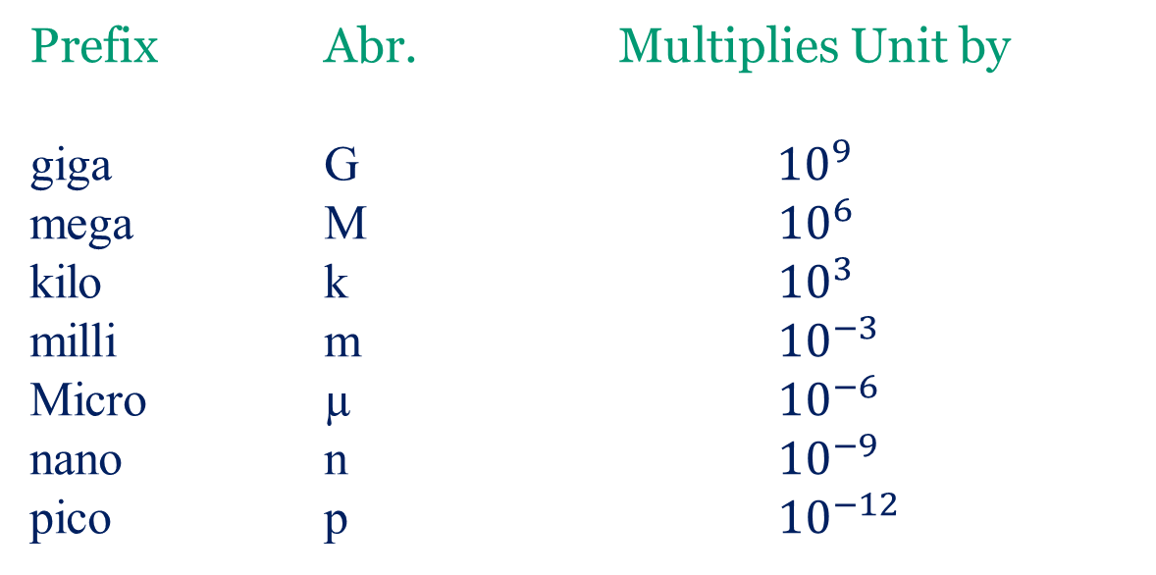
SI units may be made larger or smaller by using prefixes which denote multiplication or division by a particular amount. The six most common multiples, with their meaning are:

Slide 4
Electricity – The Basics
An understanding of the basics of electricity requires the understanding of three fundamental concepts.
Voltage
Current
Resistance
A direct mathematical relationship exists between voltage, resistance, and current in all electronic circuits.
Notes:
Introduction to the three basic elements of electricity/electronics

Slide 5
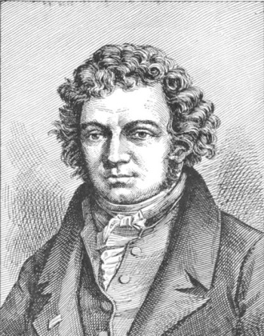
Voltage, Current, & Resistance
Current – Current is the flow of electrical charge through an electronic circuit. The direction of a current is opposite to the direction of electron flow. Current is measured in AMPERES (AMPS).
Andre Ampere
1775-1836
French Physicist
Notes:
The formal definition of current and the scientist that bears their name.
http://commons.wikimedia.org/wiki/Image:Andre-marie-ampere2.jpg

Slide 6
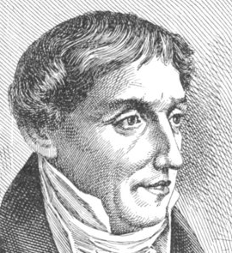
Voltage
Voltage – Voltage is the electrical force that causes current to flow in a circuit. It is measured in VOLTS.
Alessandro Volta
1745-1827
Italian Physicist
Notes:
The formal definition of voltage and the scientist that bears their name.
http://commons.wikimedia.org/wiki/Image:Alessandro_volta2.jpg

Slide 7
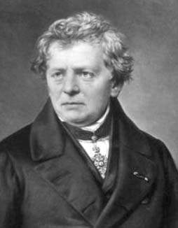
Resistance
Resistance – Resistance is a measure of opposition to current flow. It is measured in Ohms.
Georg Simon Ohm
1789-1854
German Physicist
Notes:
The formal definition of resistance and the scientist that bears their name.
http://commons.wikimedia.org/wiki/Image:Ohm3.gif

Slide 8

Resistors and Resistance
Georg Simon Ohm
Resistor – A circuit element with some specified value of resistance.
Resistance – the ability of a material to resist the flow of charge through it.
Resistors allow a circuit to deliver exactly the right amount of current, voltage, or power to a circuit or device (control current).
Notes:
A resistor is a linear device (unlike some other circuit components that are not linear)
Like diodes and transistors

Slide 9
Ohm’s Law:
Georg Simon Ohm established that there is an algebraic relationship between voltage and current for a resistor.
The following symbol is used for a resistor:
The unit of electric resistance is the ohm (Ω) where one ohm is one volt per ampere.

Slide 10

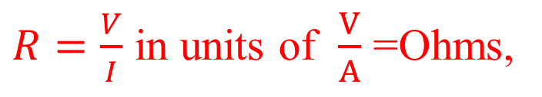
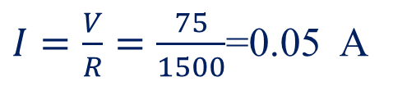

R is called the resistance (Ω) of the resistor.
Typical values:
Most resistance value in circuits are in the range 1Ω - 10 MΩ
A resistor is a passive device (it can only absorb energy)
Example: Calculate the current through the resistor shown below.
-
75V
+
I
1.5kΩ

Slide 11
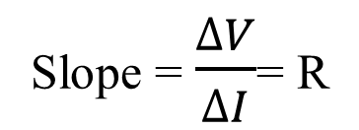
Resistor Characteristics and Ohm’s Law
Ohm’s Law is easily shown experimentally by varying the voltage across a resistor and measuring the current through it.
V
I
“characteristic of a resistor”

Slide 12
Review of V, I, and R
Voltage is
the amount of energy per charge available to
move electrons from one point to another in a circuit.
Current is
the rate of charge flow and is measured in
amperes.
Resistance is
the opposition to current and is measured
in ohms.

Slide 13
The most important fundamental law in electronics is Ohm’s law, which relates voltage, current, and resistance.
Georg Simon Ohm (1787-1854) studied the relationship between voltage, current, and resistance and formulated the equation that bears his name. In terms of current, Ohm’s law states
Question:
What is the current from a 12 V source if the resistance is 10 Ω?
1.2 A

Slide 14
Ohm’s law
If you need to solve for voltage, Ohm’s law is:
Question:
What is the voltage across a 680 Ω resistor if the current is 26.5 mA?
18 V

Slide 15
Ohm’s law
If you need to solve for resistance, Ohm’s law is:
Question:
What is the (hot) resistance of the bulb?
138 Ω
120 V

Slide 16
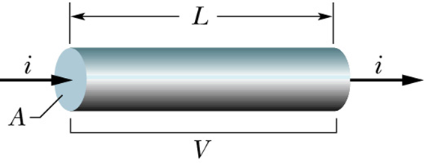

Resistors and Resistance
The amount of resistance does not depend on the voltage or the current.
The formula V=IR relates voltage to current. If you double the voltage, you will double the current, not change the resistance.
The resistance of an electrical conductor depends on following factors:
1-the length of the conductor,
2L

Slide 17
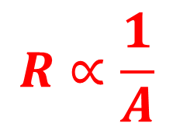

2-the cross section area of the conductor,
2A
3-the type of the material,
R_{copper}≠ R_{wood}≠ R_{sliver}≠ R_{carbon}

Slide 18
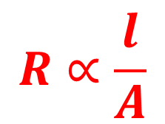
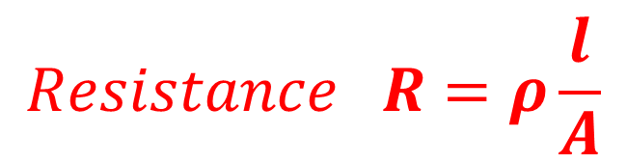
The constant of proportionality into this relationship is the type of the material used, and is known as the resistivity of the material and is given the symbol (rho) ρ, and measures how hard it is for current to flow through the material,
Where l is measured in m, A in m² and R in Ω (ohm). Hence ρ in Ωm (ohm meter)
Metals small resistivity (10x10⁻⁸ Ω m)
Insulators large resistivity (1x10¹⁵ Ω m)
Semi-conductors medium resistivity (0.5 Ω m)

Slide 19
Which one of the following types of materials exhibits the largest values of resistivity?
a) insulators
b) semiconductors
c) superconductors
d) metals

Slide 20
4-the temperature of the material.
Why do materials offer resistance?
Due to collision between electrons and vibrating atoms of the materials. The more the collision, more will be the resistance.
What is the relation between the resistance and the temperature of the material?
The resistance of the material increases with increase in temperature, because, as the temperature increases, the atoms of the material start vibrating with greater amplitude, thus increasing the chance of more collision.

Slide 21
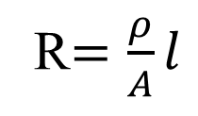
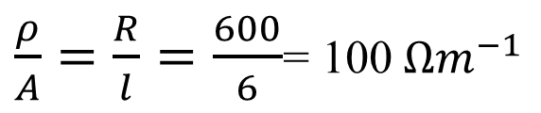
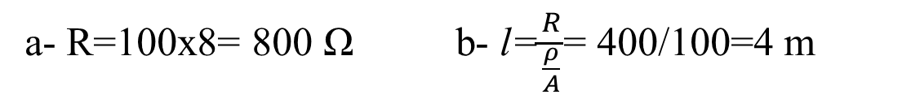
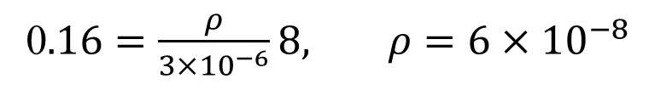

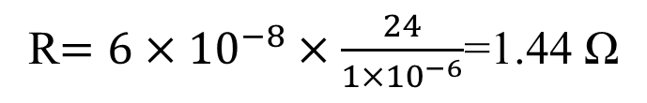
Excersise 1;
The resistance of 6 m length of wire is 600 Ω. Determine
the resistance of an 8 m length of the same wire and
the length of the same wire when the resistance is 400Ω.
Excersise 2;
A wire of length 8 m and cross-sectional area 3 mm² has a resistance of 0.16 Ω. If the wire is drawn out until its cross sectional area is 1 mm², determine the resistance of the wire.
If the cross- sectional area is reduced by 1/3, then the length be
must tripled to 3x8=24m

Slide 22
Energy and Power
In electrical work, the rate energy is dissipated can be determined from any of three forms of the power formula.
Together, the three forms are called
Watt’s law.
Power absorbed by resistors: Resistors are passive devices and can only absorb power.

Slide 23
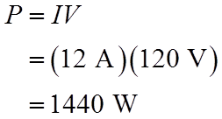
Example: What power is dissipated in a 27 Ω resistor if the current is 0.135 A?
Given that you know the resistance and current, substitute the values into P =I ²R.
Example: What power is dissipated by a heater that draws 12 A of current from a 120 V supply?

Slide 24
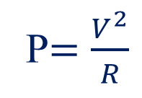
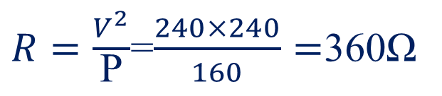
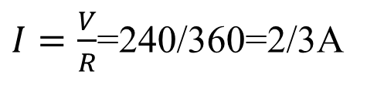
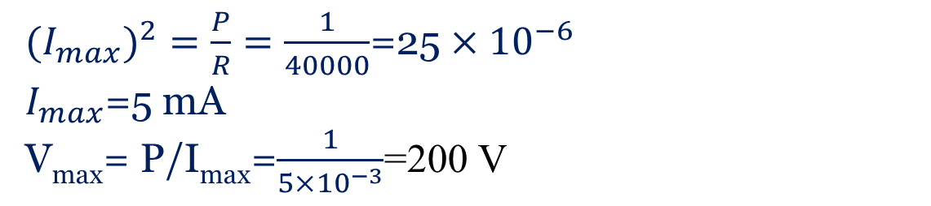
Example: A 160W light bulb operates using 240V. Determine R and I for the bulb.
P=VI I=P/V=160/240=2/3A
Example: Determine I_{max} and V_{max} for a 40 kΩ, 1 W resistor.

Slide 25
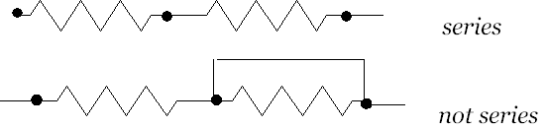
Series and Parallel networks
Series Circuit:
Two elements are in series if the current that flows through one must also flow through the other
All circuits have three common attributes. These are:
1. A source of voltage.
2. A load.
3. A complete path.

Slide 26
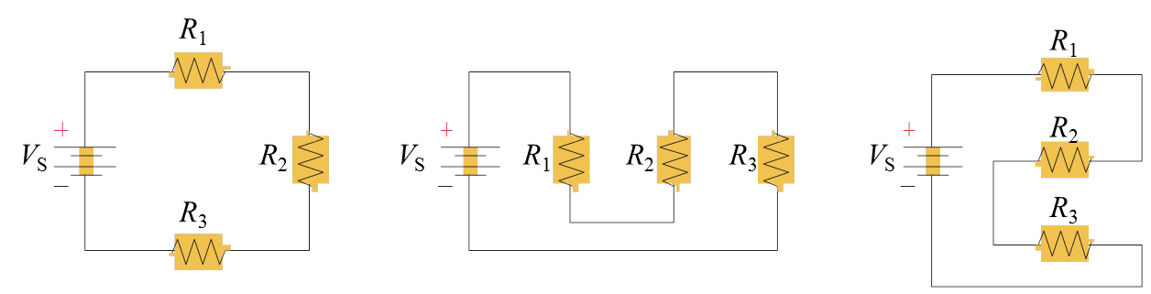
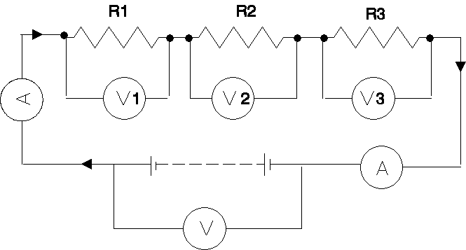
In a series circuit
a)- the current I is the same in all parts of the closed circuit and hence in series circuit is one that has only one current path.
b)- the sum of the voltages V1, V2 and V3 is equal to the total applied voltage, V.
V=V1+V2+V3

Slide 27
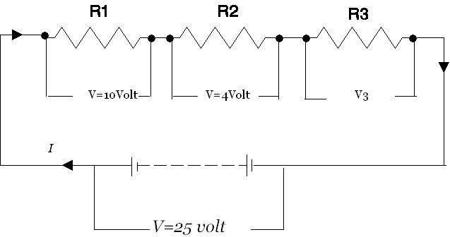
Exercise : For the circuit shown below, determine the potential difference across resistor R3. If the total resistance of the circuit is 100 Ω, determine the current flowing through R1. Find also the value of resistor R2.
the potential difference across resistor R3 is V3=25-(10+4)=11 V
current flowing through R1=current flowing in the circuit
I=V/R=25/100=.25 A
R2=4/.25=16 Ω R1=10/.25=40Ω R3=11/0.25=44 Ω
or R3=total resistance –(R1+R2)=100-(16+40)=44 Ω

Slide 28
Voltage sources in series
Voltage sources in series add algebraically. For example, the total voltage of the sources shown is
27 V
What is the total voltage if one battery is accidentally reversed?
9 V

Slide 29
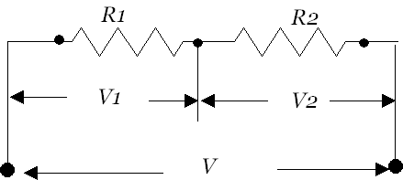
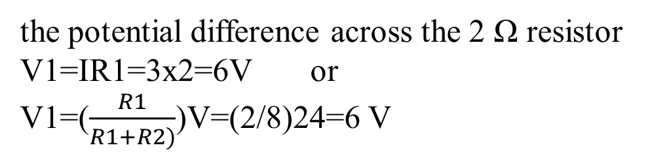
Exercise : Two resistors are connected in series across a 24 V supply and a current of 3 A flows in the circuit. If one of the resistors has resistance of 2 Ω, determine:
a) the value of the other resistor, and
b) the potential difference across the 2 Ω resistor, and
c) the energy consumed by the circuit when connected for 50 hours?
the total resistance R=V/I=24/3=8Ω
Value of the second resistor R2=8-2=6Ω
Energy consumed= I V t=3x24x50=3600 Wh=3.6 kWh

Slide 30

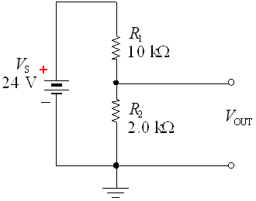
The output voltage from the voltage divider is
a. 2.0 V
b. 4.0 V
c. 12 V
d. 20 V

Slide 31
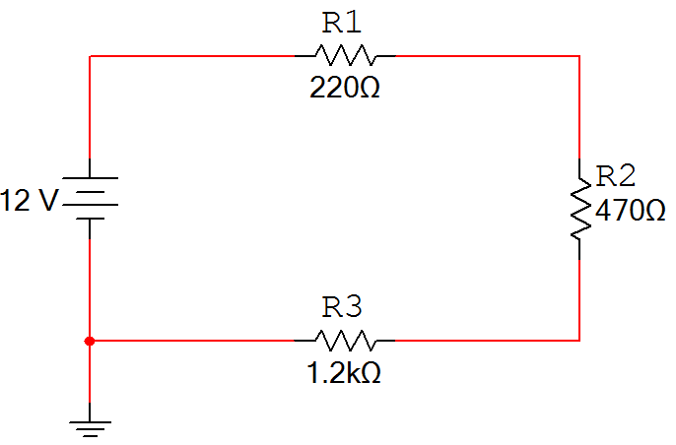
Series Circuits
Characteristics of a series circuit
The current flowing through every series component is equal.
The total resistance (R_{T}) is equal to the sum of all of the resistances (i.e., R₁ + R₂ + R₃).
The sum of all of the voltage drops (V_{R1} + V_{R2} + V_{R3}) is equal to the total applied voltage (V_{T}). This is called Kirchhoff’s Voltage Law.
V_{R1}
I_{T}
+
-
+
+
V_{T}
V_{R2}
-
-
R_{T}
-
+
V_{R3}
Notes:
Characteristics of a series circuit.

Slide 32
Example: Series Circuit
  For the series circuit shown, use the laws of circuit theory to calculate the following:
    The total resistance (R_{T})
    The current flowing through each component (I_{T}, I_{R1}, I_{R2}, & I_{R3})
    The voltage across each component (V_{T}, V_{R1}, V_{R2}, & V_{R3})
V_{R1}
I_{T}
+
-
+
I_{R1}
+
V_{T}
I_{R2}
V_{R2}
-
I_{R3}
-
R_{T}
-
+
V_{R3}
Notes:
Pause the presentation and allow the student to work on the example. The solution is on the next three slides.

Slide 33
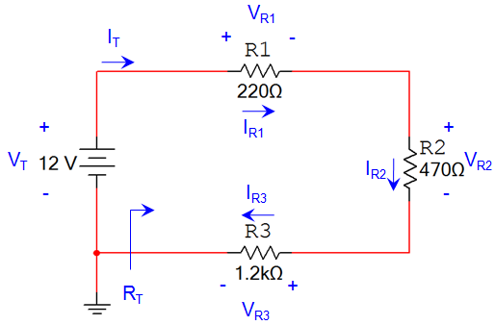
Example: Series Circuit
Solution:
Total Resistance:
Current Through Each Component:
V
I
R
Notes:
This slide provides the solution. If you print handouts, don’t print this page. (1 of 3)

Slide 34
Example: Series Circuit
Solution:
Voltage Across Each Component:
V
I
R
Notes:
This slide provides the solution. If you print handouts, don’t print this page. (2 of 3)

Slide 35
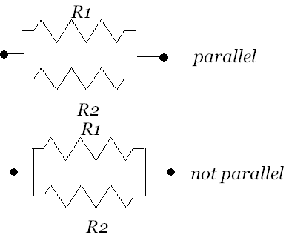
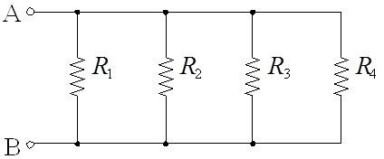
Parallel Networks
Two elements are in parallel if they are connected between
(share) the same two (distinct) end nodes.
A parallel circuit is identified by the fact that it has more than one current path (branch) connected to a common voltage source.

Slide 36
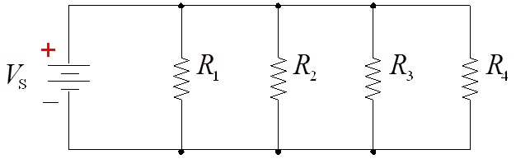
Parallel circuits have two big advantages over series circuits:
1. Each device in the circuit sees the full battery voltage.
2. Each device in the circuit may be turned off independently without stopping the current flowing to other devices in the circuit.

Slide 37
Parallel circuit rule for voltage
Because all components are connected across the same voltage source, the voltage across each is the same.

Slide 38
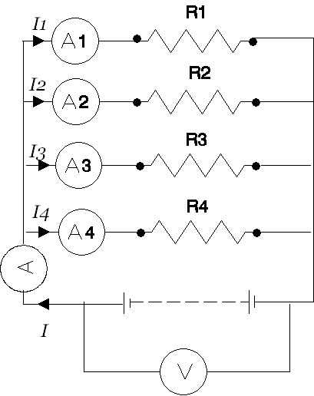
In a parallel circuit:
  a)- the sum of the currents I1, I2 ,I3 and I4 is equal to the total circuit current, I
  I=I1+I2+I3+I4
  b)- The potential difference, V volts, is the same across each of the resistors.

Slide 39
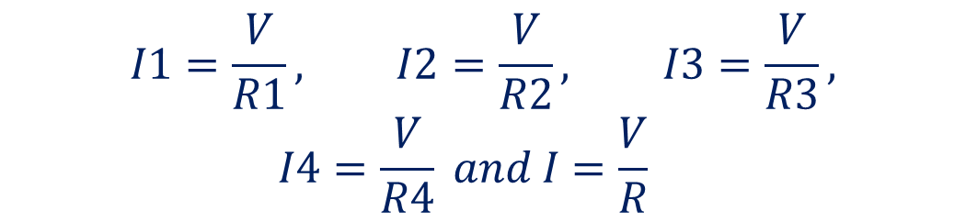
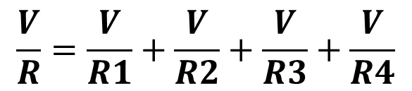
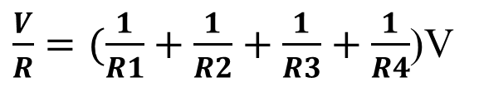
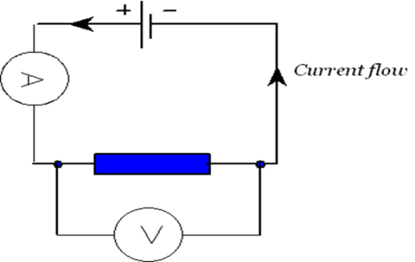
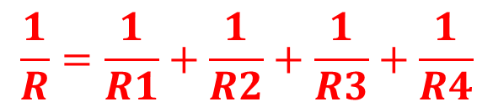
From ohm’s law:
Where R is the total circuit resistance.
Dividing throughout by V,
R

Slide 40
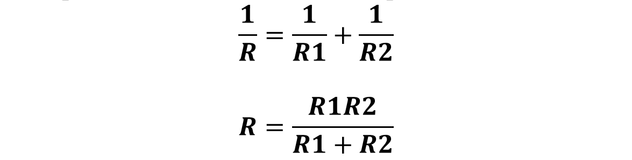
Special case for resistance of two parallel resistors
The resistance of two parallel resistors can be found by
What is the total resistance if R₁ = 27 kΩ and R₂ = 56 kΩ?
18.2 kΩ

Slide 41
Exercise 1:For the circuit above, R1=10 Ω and R3=5 Ω, if the reading on ammeter A is 12 A, ammeter 1 is 2 A, and ammeter 2 is 4 A determine,
a) the reading of ammeter 4, and
b) the value of the resistors R2 and R4.
The potential difference across R1 is the same as the supply voltage V
V=I1xR1 =2x10=20 Volt
The reading of ammeter 3 is equal to the current flowing through R3
I3=V/R3=20/5=4A
R2=V/I2=20/4=5 Ω
The reading of ammeter 4 is
I4=I-(I1+I2+I3)
I4=12-(2+4+4)=2 A
R4=V/I4=20/2=10 Ω

Slide 42
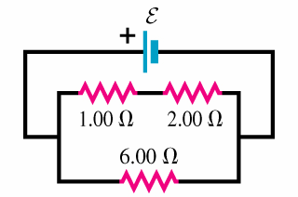
In the circuit shown, the voltage across the 2 Ω resistor is 12 volts .
1) What is the voltage E of the battery?
E
A) 6V
B) 12V
C) 18V
D) 24V
E) 120V
2) What is the current through the 6.00 ohm resistor?
A) 2A
B) 3A
C) 4A
D) 8A
E) 12A

Slide 43
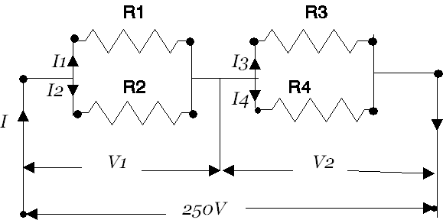
EX: For the circuit shown below, if R1=15 Ω, R2=10 Ω, and R3=38 Ω. Calculate a) the value of resistor R4 such that the total power dissipated in the circuit is 2.5kW.
Power dissipated P=VI
2500=250 I
I=10A
From Ohm’s law Rtotal=V/I=250/10=25Ω

Slide 44
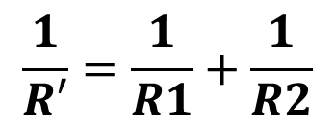
The equivalent resistance R’ of R1 & R2 in parallel is
R’=(10x15)/(10+15)=6 Ω
The equivalent resistance R’’ of R3 & R4 in parallel is
R’’=25-6=19 Ω
R’’=(R3xR4)/(R3+R4) 19=(38R4)/(38+R4)
19(38+R4)=38R4 R4=722/19=38 Ω

Slide 45
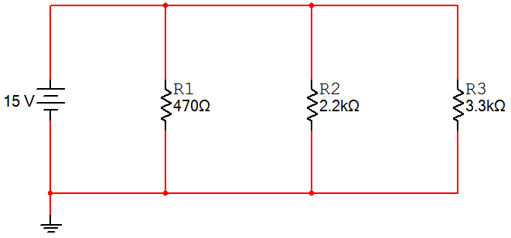
Example Parallel Circuits
  For the parallel circuit shown, use the laws of circuit theory to calculate the following:
    The total resistance (R_{T})
    The voltage across each component (V_{T}, V_{R1}, V_{R2}, & V_{R3})
    The current flowing through each component (I_{T}, I_{R1}, I_{R2}, & I_{R3}).
I_{T}
I_{R1}
I_{R2}
I_{R3}
+
+
+
+
V_{T}
V_{R1}
V_{R2}
V_{R3}
-
-
-
-
45
R_{T}
Notes:
Pause the presentation and allow the student to work on the example. The solution is on the next three slides.

Slide 46
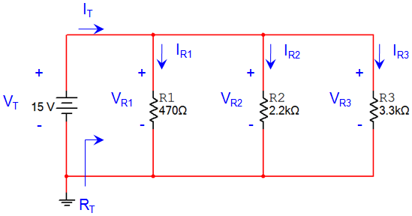
Example Parallel Circuits
Solution:
Total Resistance:
Voltage Across Each Component:
Notes:
This slide provides the solution. If you print handouts, don’t print this page. (1 of 3)

Slide 47
Example Parallel Circuits
Solution:
Current Through Each Component:
V
I
R
Notes:
This slide provides the solution. If you print handouts, don’t print this page. (2 of 3)

Slide 48
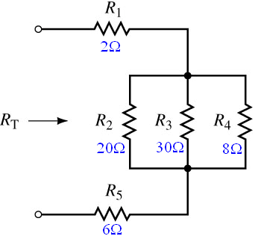
The Series-Parallel Network

Slide 49
The Series-Parallel Network
FIRST: Identify elements in series and elements in parallel
    20Ω, 30Ω, and 8Ω are in parallel
    This parallel combination is in series with 2Ω and 6Ω

Slide 50
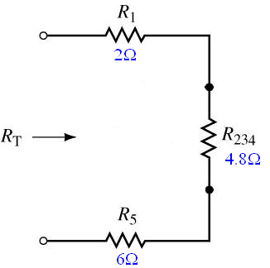
The Series-Parallel Network
SECOND: Simplify and redraw the circuit

Slide 51
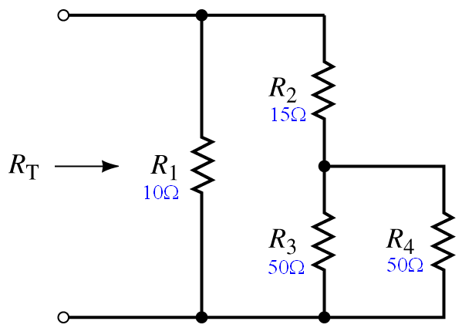
The Series-Parallel Network

Slide 52
The Series-Parallel Network
In this circuit
  R₃ and R₄ are in parallel
  Combination is in series with R₂
Entire combination is in parallel with R₁

Slide 53
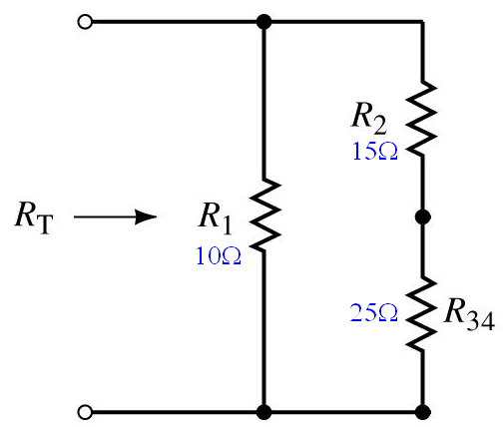
The Series-Parallel Network

Slide 54
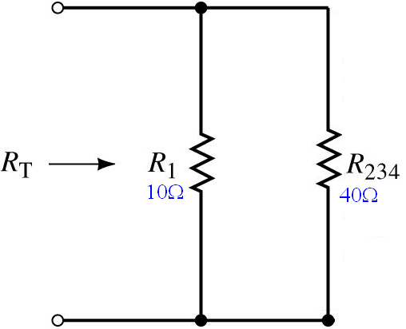
The Series-Parallel Network

Slide 55


Determine the currents and voltages indicated in the circuit below.

