Slide 1
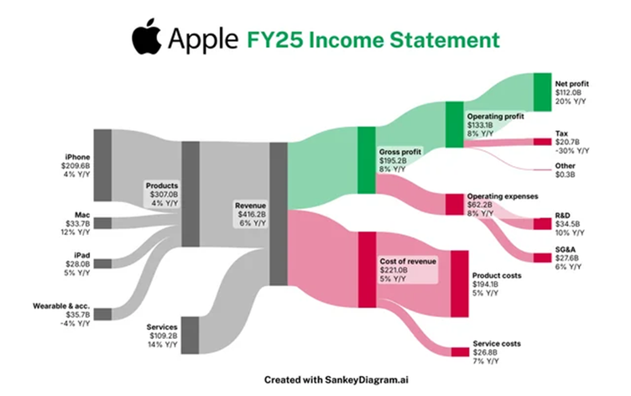
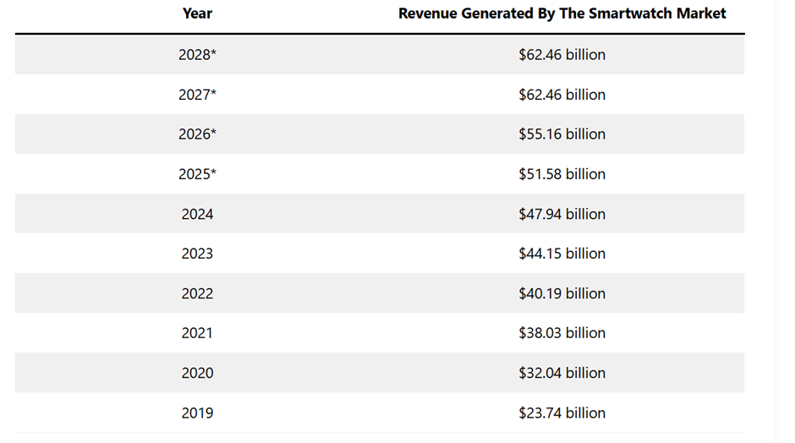
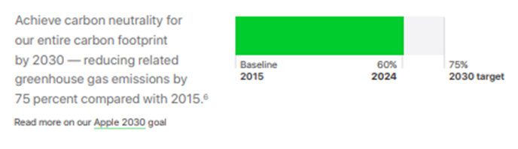
Apple Smart Health Ring: Expanding the Apple Health Ecosystem
INTRODUCTION
Apple Inc. is among the most successful technological companies in the world, where it achieved approximately 416 billion in revenue in 2025 and runs a strong ecosystem with iPhone, Apple Watch and iPad (Statista, 2024).
BRAND EXTENSION CONCEPT
The suggested product, Apple Smart Health Ring, is a small wearable that will expand the digital health ecosystem of Apple. The device would track heart rate, sleep cycles and exercise and be linked with Apple Health and other Apple gadgets so users can easily keep track of personal wellbeing through the Apple ecosystem.
MARKET APPEAL AND EMERGING TRENDS
The wearable health technology market is growing at a very high rate with the consumers being keen on digital health monitoring. The smartwatch and wearable market has a high potential to reach a market worth over 55 billion by 2026 as Apple Watch dominates the smartwatch market and has sold millions of products (Ruby, 2022).
SUSTAINABILITY ALIGNMENT
The key feature of this extension is sustainability. Since 2015, Apple has already cut down global greenhouse-gas emissions by more than 60 percent and hopes to be fully carbon-neutral in its products and supply chain by 2030 (Apple, 2025).
VALUE PROPOSITION
The Apple Smart Health Ring will be a strategic brand expansion, which integrates innovation, sustainable and the increasing consumer appetite of personalised health technology into the expanding Apple ecosystem.
REFERENCES
  Apple (2025). Environmental progress report. [online] Available at: https://www.apple.com/environment/pdf/Apple_Environmental_Progress_Report_2025.pdf.
  Ruby, D. (2022). Smartwatch Statistics 2023: How Many People Use Smartwatches? [online] Demand Sage. Available at: https://www.demandsage.com/smartwatch-statistics/ [Accessed 6 Mar. 2026].
  Statista (2024). Global Revenue of Apple from 2004 to 2024. [online] Statista. Available at: https://www.statista.com/statistics/265125/total-net-sales-of-apple-since-2004/ [Accessed 6 Mar. 2026].

