Slide 1

Critically discuss the impact the media has on UK policing
Tammy Morris-Puttock

Slide 2
Introduction
This presentation will cover how the police utilise social media as well as the impact social medias can have.
How social media can be used to communicate and report crimes.
Understanding the polices use of forces, as well as discussing policing and our human rights.
Understanding what cop culture is and police accountability.
Discussing policing protocols such as the code of ethics and the policing principles.
Discussing the positive and negative impact the media can have on the police.
Notes:
2

Slide 3
How is social media used by the police?
The police use a range of different social media platforms such as online or printed. This could be the use of platforms such as snapchat, Instagram, Facebook and twitter as well as printed and online newspapers.
Social media has given a way to improve openness, transparency and citizen participation within policing (Bullock 2017).
(Burger 2013)
Builds relationships and community
Control over reputation
Engagement and communication
Gives information – help/ warnings, suspects/ wanted and missing persons
Notes:
Social media can be used for a range of things for example sharing information such as reports on missing persons and wanted people. It allows the information to be viewed by a large group of people and so it needs to be accurate. BBC news (2012) states that social media is more effective than the traditional printed media when it comes to communicating with young people. This is due to the fact that most young people use a form of social media daily. Utilising the relevant platforms can help increase involvement with certain generations, this may help reduce crime but may also help circulate what is or has happened. This could be a report on knife crime, drug use or an explosion.
3

Slide 4
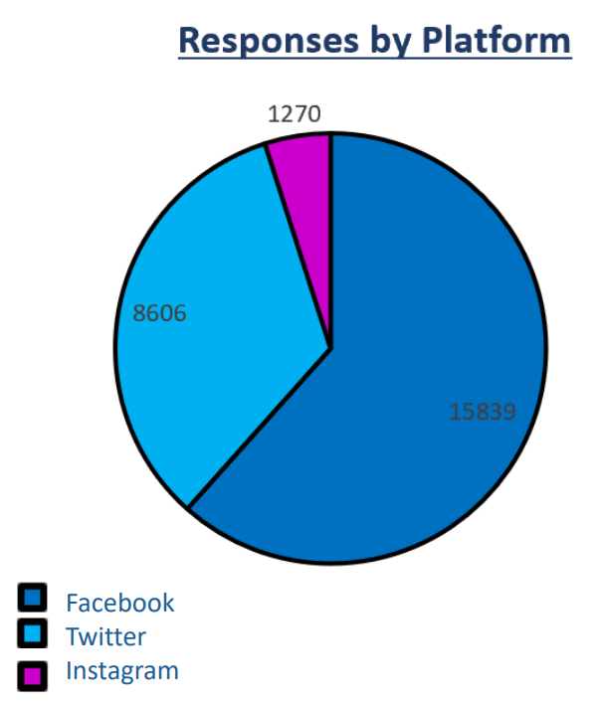
How does the police communicate with the public ?
Who do the police communicate with
Community equality advisors
Fritsvold (2023) states that an important aspect of police and media relations is the quickness and accuracy of the news being spread.
Partner agencies
Force press office and media advisors
Local community leaders/ representatives
Crime reduction advisors
LGBTQ+ society
Community groups and forums
Neighbourhood policing
Youth leaders and social services department
(Bailey and York 2018)
(College of Policing 2013)
Notes:
With any incident involving the police it is important to ensure that not only the public know what’s happened but also everyone in the organisations they are working with. Ensuring that information about an incident is correct and sent out quickly is important since we can access everything at a click of a button and many people may have recorded the incident and given their opinions on what has happened. Due to the vast number of groups within the police information sometimes is not passed on; having the correct information is important as everyone needs to be on the same page especially if the media is involved. As this prevents incorrect information being shared and rumours to be stopped ensuring that the public don’t panic with out cause. High profile cases such as serial killers and terrorist attacks need to be shared due to people needing to take precautions.
Bailey and York (2018) research into the number of responses given to the public based upon the different platforms used, their findings showed that pout of tree forms of media Instagram was the platform with the least number of responses and Facebook having the most. This could be due to the older generation being more aware of the police presence online and wanting to know what is happening compared to the younger generation who may be more likely to use Instagram. While social media maybe helpful it may also be a down fall as many now video incidents and post them, this leads to the police having no control over what is shared.
4

Slide 5
Reporting crime
There are many ways you can get in touch with the police to report a crime such as via calling 999 or visiting a police website.
On most media platforms you can privately messaging police organisations or post in a public forum if it’s a neighbourhood issue, or you can report someone or a post if it is deemed offensive or a crime.
The CPS (2023) states that you can report a crime anonymously through Crimestoppers on their website or via phone on 0800555111.
Notes:
Bailey and York (2018) said that around 812 people who took a survey had tried to report a crime or incident via Facebook. The idea that many people are using this form of media to report a crime means that the police are able to reach a wider range of people. Reporting crimes via social media will help to open up phone lines for emergencies and allows the police to react more effectively. Reporting a crime shouldn’t be made to feel like a chore therefore using Facebook or other platforms to report is often helpful as you can do it from the com fort of your own home.
5

Slide 6
Use of force and human rights
Eric Garner- July 2014
  His death happened due to a New York police officer having him in a choke- hold.
  Eric’s words “I can’t breathe” became a rallying cry for protests police brutality.
  (BBC news 2019)
George Floyd
May 2020
  He died after being arrested by a police officer in Minneapolis. The officer had his knee on Mr Floyd’s neck.
  The plead he couldn’t breathe. After his death, many protests broke out spreading across the world.
  (BBC 2020)
Notes:
Over the years there have been many incidents that have been report by the media based on the polices actions against black people and other races. Two cases that sparked up a riot was Eric Garner and George Floyd, both gentlemen were restrained and died due to having their airways restricted. Both cases show a predominant use of force against black males, although both American sources they show that there is an idea of the police being institutionally racist.
Force should only be used when necessary to mitigate an incident, make an arrest or protect themselves from harm (National Institute of Justice 2020).
United Nations (2023) says that the ‘international human rights act is the legal framework that regulates the use of force by the police, it prevents arbitrary, excessive or discriminatory uses of force and ensures accountability in cases of abuse’. The idea that this act is designed to control the way force is used is great however in the cases above it is clear to see that the act was not taken into account regardless of the outcome of the police officers involved. One of their basic human rights was violated and this was the right to life.
6

Slide 7
Cop/police culture
What is it? – cop culture is a comprehensive term that encompasses a system of values and attitudes that define the normative social world of police (Campeau 2015).
There are different types of cultures within the police such as ‘street cops’, ‘beat cops’ and ‘canteen cops’ (Coliandris et al 2015).
Notes:
Police culture can take many forms and can be shown in many ways. Police are human just like us and are prone to making mistakes however due to the authority they have they are under pressure to be role models and to not make mistakes. Sometimes cop culture may make police officers feel as though they cannot do any wrong and that they can do what they want.
7

Slide 8
Code of ethics for policing
It sets out and defines the exemplary standards of behavior for everyone who works in the police (college of policing 2023).
Home office (2014) ethical behavior comes from the values and beliefs, attitudes and knowledge the guide the judgements of each individual.
These can be set out in the principles of policing as well as the standards of behavior that a police officer should have.
Notes:
Everyone ethical behaviours may be slightly different depending on our background and up bringing. There are principles and standards the police have to follow.
8

Slide 9
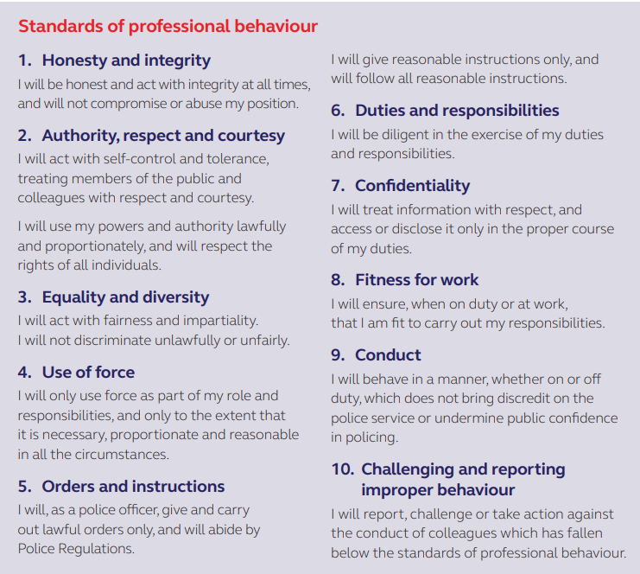
Standards of professional behaviour
(College of Policing 2014)
Notes:
Most of the behaviours above are see as the behaviours you must have in life and work. In the police confidentiality means not sharing information about cases you are working on with family and friends. The idea that you must challenge behaviour may be difficult due to the fact that the police are often see as a second family as they work together so much and have to go through potential life-threatening situations together.
9

Slide 10
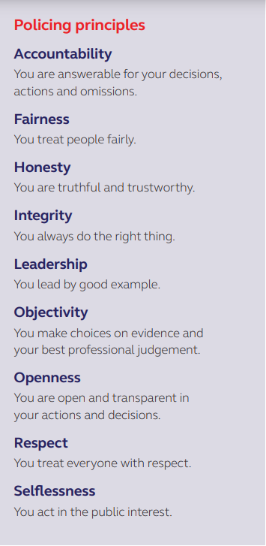
Principles of policing -
(College of Policing 2014)
Notes:
Having principles is apart of life while these are similar to the code of ethics there are a few difference such as openness and selflessness. These are both good qualities to have as a police officer due to the fact that they will help you to work with other as well as those you are sworn to protect eg the public.
10

Slide 11
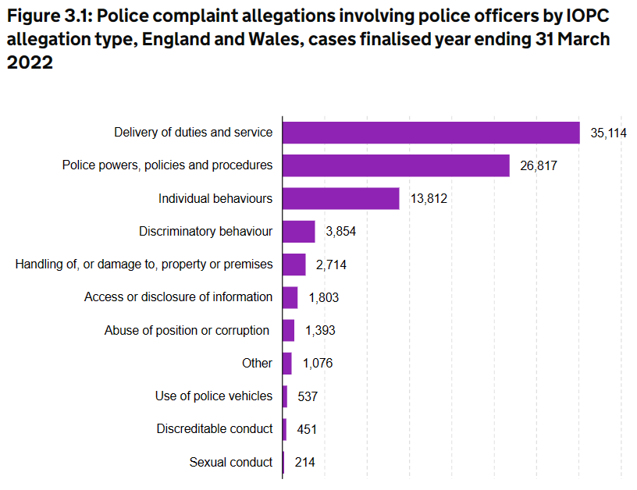
Police misconduct
A well-known case of police misconduct was the death of Sarah Everard was committed by a met police officer who kidnapped her the killed her (BBC news 2021).
(Home office 2023)
Notes:
Just like everyone else the police is known to have issues with the way officers act. They have to deal with theses issues and have to make sure that the officers who were involved are held accountable. In the Sarah Everard case, the officer was sentence to prison sentence which doesn’t usually happen.
The Government acknowledges that fact the police are prone to misconduct and show that in March 2022 there were 35,114 complaints about there delivery of duties and service and other issues such as complaints about sexual conduct having only been reported 214 times which can be seen by the graph above.
The idea that the police misuse their powers and authority to cause harm or do display behaviours such as those listed on the screen means that the public won't trust them. However, this is why the police are monitored and investigated if something like this happens.
The idea that police can misbehave may make the public question what else they are doing. The media is situations like this may report what the know even if it is not yet the full story.
Cases such as Sarah’s may cause mistrust within the female part of the population as the people, we are meant to trust caused harm. This would bring great trust issues with the police especially females as we often find our selves feeling uncomfortable in many situations.
11

Slide 12
Police accountability
There are many organizations involved in holding the police accountable and ensuring they follow protocol and procedures.
Independent Office for Police conduct – they over see the police complaints system.
Parliament – sets out laws and acts that the police must use and follow when policing.
Police and crime commissioners
His Majesty’s Inspectorate of Constabulary and Fire & Rescue services– they assess the effectiveness and efficiency of the police force as well as fire and rescue services, working in the publics interest (HMICFERS 2023) .
Notes:
The IOPC (2023) states that it investigates into every aspect of the force, on issue such as complaints, misconduct and if someone has died due to direct or indirect contact with the police. Having organisations such as the IOPC means that the police cannot just brush people's complaints aside, it means that they are dealt with and they will get to the source of this issue. This ensures that in cases such as the Sarah Everard case the police officer is punished and dealt with correctly.
12

Slide 13
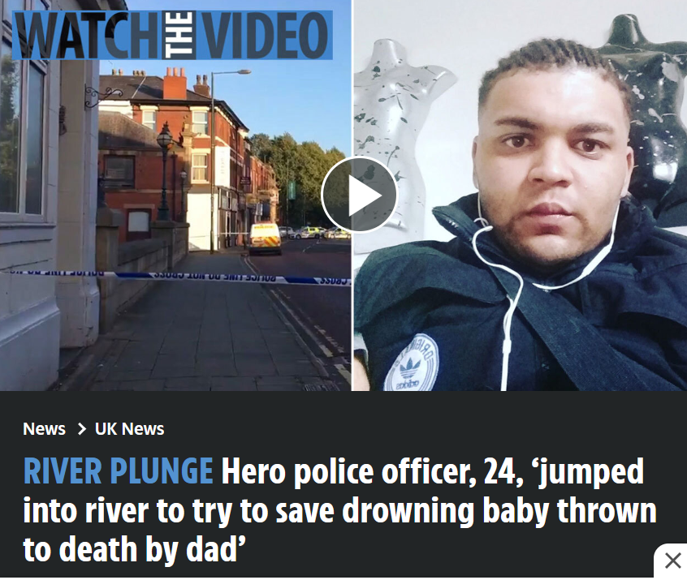
Positive impact of police in the media
(Burrows 2019)
Notes:
Hero police officer, 24, 'jumped into river to try and save drowning baby thrown to death by dad' (thesun.co.uk)
There are not many cases online that paint the police in a good light, on case that I found was about a 24-year-old female police officer who risked her own life to jump into a river after a baby. Police officers are often risking their lives to help use. The issue with the media is they like to twist and change the way we see the police. The officer who rescued the baby although not gaining the desired outcome still did what she could to rescue the child, and managed to get justice by arresting the person who threw the child into the river.
13

Slide 14
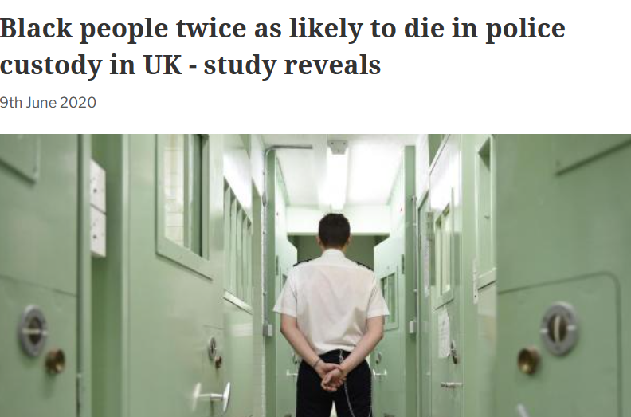
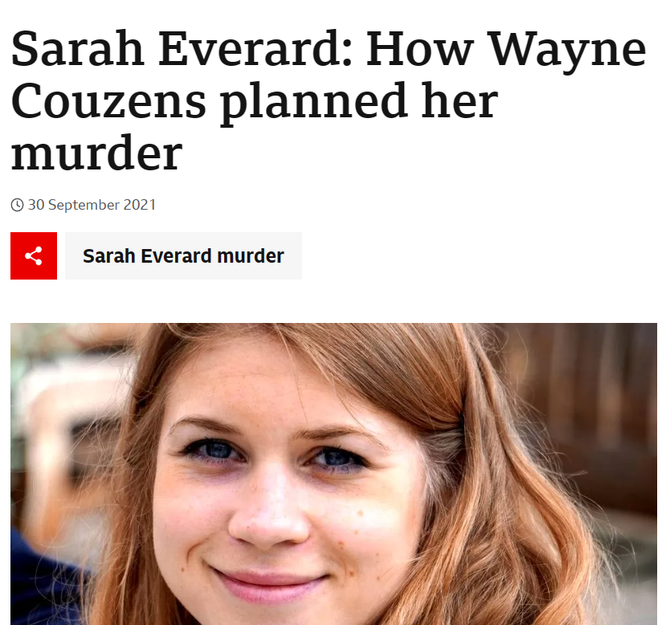
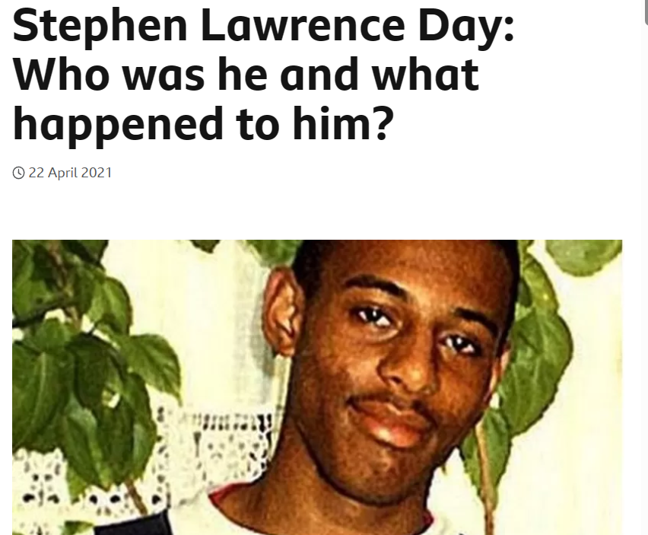
Negative impact of police in the media
Notes:
Shown on the slide are a few news reports of people who have been mistreated by the police Sarah Everard is a perfect case to show the misconduct that the media portrays within the police against females. Mark duggan august 2014 - He was suspected of carrying a firearm and was shot twice later dying from these injuries (Siddique 2020). This is a perfect example of racism within the police as it was shot first ask questions later and he died as a result of it.
14

Slide 15
Thank you for listening

Slide 16
Reference list in note section of this slide.
Notes:
Bailey, D, York, R (2018) social media survey findings [online] Available at: NPCC_SMSurvey_2018.pdf (Accessed 21/04/2023)
Bailey, D. York, R (2018) responses by platform [diagram] available at: NPCC_SMSurvey_2018.pdf (accessed 21/04/2023)
BBC news (2012) social media benefits to police investigations [online] Available at: Social media benefits to police investigated - BBC News (accessed25/04/2023)
BBC news (2019) Eric Garner: NY officer in ‘I can’t breathe’ death fired. [online] Available at: Eric Garner: NY officer in 'I can't breathe' death fired - BBC News(Accessed 25/04/2023)
BBC news (2020) George Floyd: what happened in the final moments of his life [online] Available at: George Floyd: What happened in the final moments of his life - BBC News(accessed 22/04/2023)
BBC news (2021) Sarah Everard murder: Wayne Couzensindep given whole-life sentence [online] Available at: Sarah Everard murder: Wayne Couzens given whole-life sentence - BBC News (Accessed 22/04/2023)
Bullock, K (2017) ‘The police use of social media: transformation or normalisation?’ Social policy and society. vol 17 issue 2. Doi: https://doi.org/10.1017/S1474746417000112 (Accessed 24/04/2023)
Burger, L (2013) 4 ways social media can help police departments. [online] available at: 4 ways social media can help police departments (police1.com) (accessed 26/04/2023)
Burrows, T (2019) river Plunge hero police officer, 24, ‘jumped into river to try to save a drowning baby thrown to death by dad’ [online] Available at: Hero police officer, 24, 'jumped into river to try and save drowning baby thrown to death by dad' | The Sun (accessed 15/04/2023)
Campeau, H (2015) ‘’police culture’ at work: making sense of police oversight’ the British journal of criminology. Vol 15 issue 4. DOI: https://doi.org/10.1093/bjc/azu093
Coliandris, G. Rogers, C. Gravelle, J (2015) ‘Smoke and Mirrors, or a real attempt at reform?’ Policing: A journal of policy and practice. Vol 5 issue 3. DOI: https://doi.org/10.1093/police/par033 (Accessed 26/04/2023)
College of Policing (2014) Code of ethics. Coventry, College of policing Ltd. Available at: code_of_ethics.pdf (college.police.uk) (Accessed 22/04/2023)
HMICFERS (2023) His Majesty’s Inspectorate of Constabulary and Fire & Rescue services [online] Available at: His Majesty’s Inspectorate of Constabulary and Fire & Rescue Services - His Majesty’s Inspectorate of Constabulary and Fire & Rescue Services (HMICFRS) – Home | His Majesty’s Inspectorate of Constabulary and Fire & Rescue Services (HMICFRS) – Home (justiceinspectorates.gov.uk) (Accessed 26/04/2023)
Home office (2014) Code of ethics: policing professionalism. [online] Available at: Code of ethics: policing professionalism - GOV.UK (www.gov.uk) (accessed 26/04/2023)
Home office (2023) Police complaint allegations involving police officers by IOPC allegation type, England and Wales, cases finalised year ending 31 March 2022 [graph] Available at: Police misconduct, England and Wales year ending 31 March 2022 - GOV.UK (www.gov.uk) (Accessed 25/04/2023)
Independent Office for Police Conduct (2023) what we investigate and next steps [online] Available at: What we investigate and next steps | Independent Office for Police Conduct (Accessed 26/04/2023)
National institute of justice (2020) overview of police use of force [online] available at: Overview of Police Use of Force | National Institute of Justice (ojp.gov) (Accessed 25/04/2023)
Siddique, H (2020) Mark Duggan police shooting: can forensic tech cast doubt on official report? [online] Available at: Mark Duggan shooting: can forensic tech cast doubt on official report? | UK news | The Guardian (accessed 26/04/2023)
The Crown Prosecution service (2023) Reporting a crime [online] Available at: Reporting a crime | The Crown Prosecution Service (cps.gov.uk) (accessed 25/04/2023)
United nations (2023) OHCHR: law enforcement and human rights [online] Available at: OHCHR: Law enforcement and human rights | OHCHR (Accessed 25/04/2023)
16

