Slide 1
BLUESTONE DEVELOPMENTS
Leisure Attraction Management

Slide 2
2013 New Ownership Deal
Publically announced as Mgt Buyout
No figures given
Reality Admiral Buyout for £10m
Acquired from majority equity holders Finance Wales and Lloyds Bank Group
Provides working capital for next stage of development
500 staff to benefit from Employee Benefit Trust to be launched end of 2013….
Gambit and Acuity Legal oversaw deal and took a share in the project…..
Attracted a number of Bidders……including Center Parcs and Aspro….

Slide 3
Gambit Statement
Keeps ownership of the Business in Wales
Protects the supply chain in Pembrokeshire and South Wales
If it had gone to a larger player then this vitally economically important indigenous supply chain would have been compromised

Slide 4
Attraction Description in 2013
Nearly 300 lodges
Spa, private village, shops and restaurant
Audited accounts 2012
Bank Debt = £64m
Finance Wales Debt £6m rest owed to RBS/Lloyds Bank Group
Repayment was extended to October 2013

Slide 5
2016 New Ownership Deal
Multi Million £ Investment
Workers 30% Share
New Developments Planned
£7m investment in Eden Project-Style Sky Dome for 2018 opening…designs being drawn up…early stage
£2.5m refurb of Blackpool Mill to Victorian Themed Attraction subject to planning
300 new jobs
Barclays Debt Finance Deal
Majority Share ownership pass to Mgt and staff

Slide 6
Recent Developments
2013 Admiral Group buyout for £10m!
2016 Exit of Admiral – 25% minority share
2016 Secondary Management Buyout
Deal overseen by Gambit and Acuity Legal….
Key Shareholders now – William and Pamela McNamara
30% Employee Benefit Trust
Based on staff increasing to 1,000 in 3 years all eligible for EBT Dividends

Slide 7
Statistics
Visitor Numbers
2013 95k
2016 130k
Occupancy
2013-6 averaged over 95%
25% increase in capacity since 2013
Turnover
Increased by 50% 2013-2016
2013 £14.5m
2016 £22m
Visitors
3% of visitors from overseas
53% from other parts of UK
Aprox 2/3^{rds} of visitors visit other attractions…….

Slide 8
Vision
“Our original vision for Bluestone began some 2 decades ago, has been realised over the past 3 years”
William McNamara, Bluestone CEO, 2016
3rd phase of development has taken the resort to 300+ 5 star lodges, cottages and apartments……..

Slide 9
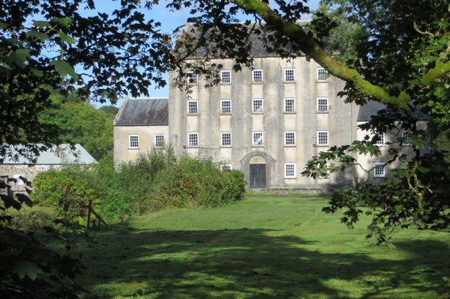
Blackpool Mill Development

Slide 10
Blackpool Mill - Aims
Historic Integrity
Preserve, Manage and Improve in it’s entirety
Experts – Heritage, Ecology and Bio Diversity
Disused watermill – Grade 2 Listed Building
To be brought back to life as a Tourist Attraction
Celebrate local life in Victorian Times
19th century building into 21st century purpose
Preservation for future generations
Public Consultation
SSSI – Site of Special Scientific Interest
SAC – Special Area of Conservation

Slide 11
Plans
Develop 5 floors including tea room (existing)
Milling Experience, History and Discovery, Creative crafts Workshop and Victorian Themed Escape Room
Two ancillary buildings including the millers cottage will be brought back to life
Exhibition and Events Barn
Narrow Gauge Steam Railway with Platform and Station
Transport back in time, sights, sounds and smells
Riverside Meadow – Events Venue
Bluestone Guests and Public
Subject to planning work to start 2017
Expected opening Spring 2018

Slide 12
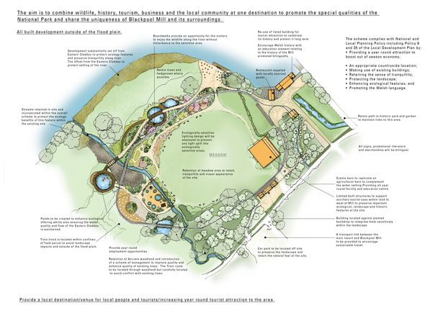
Development Plans

Slide 13
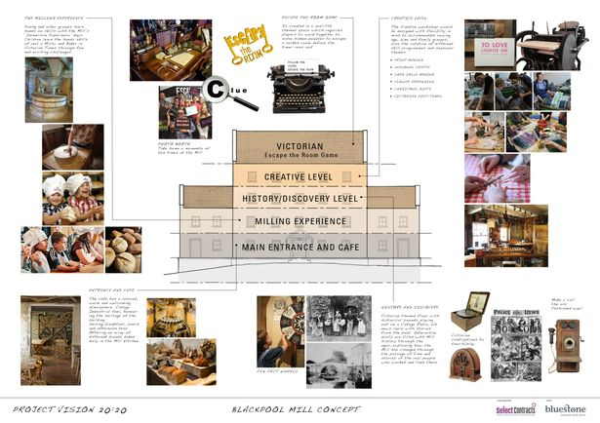
Attraction Development

