Slide 1

Global Business Environment
Week 2
Globalisation: Impact, Theories and Major Forces

Slide 2
By the end of this session, students should be aware of:
The impact of globalisation
Theories of globalisation from the firm's perspective
Current forces shaping the global business environment

Slide 3
Go through your assignment brief and discuss with your lecturer

Slide 4


Slide 5
Globalisation
Globalisation refers to the increased interconnectedness and interdependence of different countries in terms of trade, culture, and politics.
The growth of international trade has led to many businesses becoming multinational corporations. These organisations operate in multiple countries, leveraging global markets for growth and profitability.
Technological advances, such as the internet, have fuelled globalisation by enabling real-time communication and e-commerce across borders.
Globalization can positively and negatively impact society.

Slide 6
Positive Impact of Globalisation on Business Operations
Market reach. Globalisation allows businesses to expand their market reach. By selling products and services in multiple countries, organisations can gain a larger customer base and increased revenues.
Resources and talent. Globalisation enables access to international resources and talent. Companies can source raw materials from countries where they are abundant and cost-effective, and recruit skilled workers from around the world.
Outsourcing has become more common due to globalisation. Businesses can outsource certain tasks or functions to countries where labour is cheaper, which helps reduce operating costs.

Slide 7
Positive impact of globalisation on business operations
Increased global cooperation. For a globalized economy to exist, nations must be willing to put their differences aside and work together. Therefore, increased globalization has been linked to a reduction—though not an elimination—of conflict.
The ability for nations to “specialize. Global and regional cooperation allow nations to heavily lean into their economic strengths, knowing they can trade products for other resources. An example is a tropical nation that specializes in exporting a certain fruit. it’s been shown that when nations specialize in the production of goods or services in which they have an advantage, trade benefits both parties.

Slide 8
Positive impact of globalisation on business operations
Increased Cross-Border Investment. At the macroeconomic level, this international investment has been shown to enhance welfare on both sides of the equation:
The country that’s the source of the capital benefits because it can often earn a higher return abroad than domestically. The country that receives the inflow of capital benefits because that capital contributes to investment and, therefore, to productivity.
Foreign investment also often comes with, or in the form of, technology, know-how, or access to distribution channels that can help the recipient nation.

Slide 9
Negative impact of globalisation on business operations
Increased Competition. When viewed as a whole, global free trade is beneficial to the entire system. Individual companies, organizations, and workers can be disadvantaged, however, by global competition. This is similar to how these parties might be disadvantaged by domestic competition: The pool has simply widened.
Some firms, industries, and citizens may elect governments to pursue protectionist policies designed to buffer domestic firms or workers from foreign competition. Protectionism often takes the form of tariffs, quotas, or non-tariff barriers, such as quality or sanitation requirements that make it more difficult for a competing nation or business to justify doing business in the country.

Slide 10
Negative impact of globalisation on business operations
Disproportionate Growth. Globalization can introduce disproportionate growth both between and within nations. These effects must be carefully managed economically and morally.
Within countries, globalization often has the effect of increasing immigration. Macroeconomically, immigration increases gross domestic product (GDP), which can be an economic boon to the recipient nation. Immigration may, however, reduce GDP per capita in the short run if immigrants’ income is lower than the average income of those already living in the country.
Additionally, as with competition, immigration can benefit the country as a whole while imposing costs on people who may want their government to restrict immigration to protect them from those costs. These sentiments are often tied to and motivated—at least in part—by racism and xenophobia.

Slide 11
Negative impact of globalisation on business operations
Environmental concerns
One of the primary results of globalization is that it opens businesses up to new markets in which they can sell goods and source labor, raw materials, and components. Both of these realities mean finished products travel farther now than ever before—potentially halfway around the globe. In the past, products were more likely to be produced, sold, and consumed locally. This increased transport of goods can impact the environment in several ways, including:
Increased emissions
Habitat destruction
Invasive species
Decreased Biodiversity
Increased greenhouse gas emissions, ocean acidification, deforestation (and other forms of habitat loss or destruction), climate change, and the introduction of invasive species all work to reduce biodiversity around the globe.

Slide 12
Environmental concerns
One often-overlooked side effect of globalization is that it allows nations and geographical regions to focus on their economic strengths while relying on trading partners for goods they don’t produce themselves. This economic specialization often boosts productivity and efficiency.
Unfortunately, overspecialization can threaten forest health and lead to serious environmental issues, often in the form of habitat loss, deforestation, or natural resource overuse. A few examples include:
Illegal deforestation in Brazil due to an increase in the country’s cattle ranching operations, which requires significant land for grazing

Slide 13
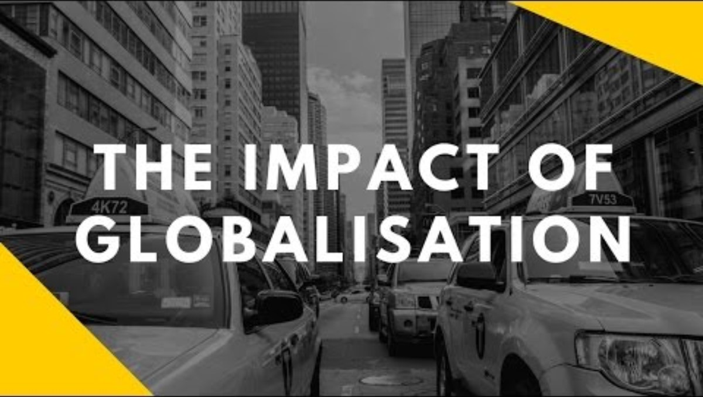

Slide 14
World system theory
The World-System Theory of globalization was developed by sociologist Immanuel Wallerstein. World-systems theory emphasises the significance of the entire globe as a whole instead of individual nations. According to this theory, the world is divided into three regions
Core nations. Countries in Western West Europe and the United States of America are examples of core countries.
These countries have a powerful central government that is well-funded through taxes.
They are economically diverse, industrialised, and largely self-sufficient. They have a sizable middle and working class, and they prioritise the manufacture of finished commodities above raw materials.

Slide 15
World system theory
Periphery countries generally refer to nations in Latin America and Africa that have unstable governments.
They often rely on a single economic activity, which is more often than not, raw material extraction.
There is a large proportion of impoverished and illiterate individuals, as well as a small elite class that controls the majority of the economy. As a result, there is a significant disparity in the population.
Core nations and transnational firms have a significant impact on these countries. This has the potential to impair the peripheral nations’ future economic prospects.

Slide 16
World system theory
Semi-periphery states such as India and Brazil fill the gap between the Core and the Periphery.
They are not always influential in international commerce, but their economies are broad and advanced.
These semi-periphery countries might arise from either Periphery countries climbing up to the modernised Core countries or Core countries descending to Periphery status.
The World-Systems Theory is a fluid model, but it has been criticised for being overly focused on the economy and the Core nations, overlooking culture and even class conflicts inside individual countries.

Slide 17
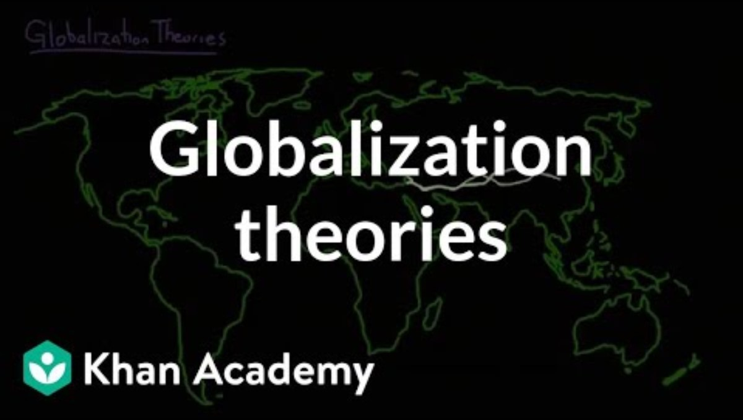

Slide 18
Activity
Watch the video on the next slide and answer the following questions.
Why did walmart expand globally
What made its expansion successful in some countries and not in some.

Slide 19
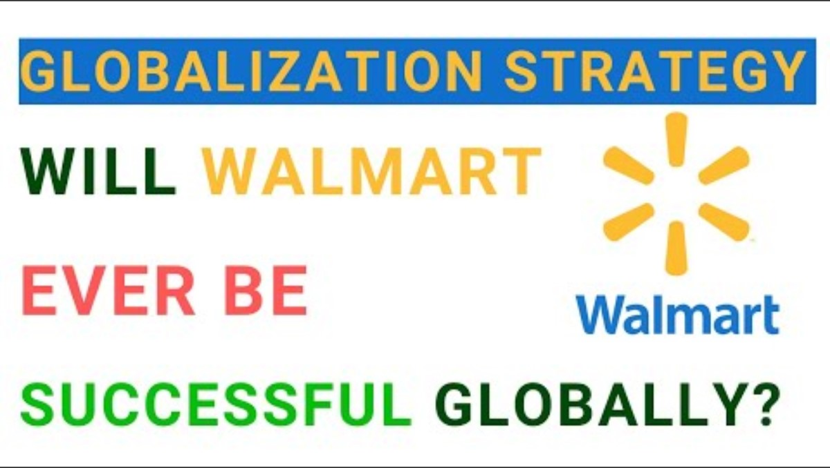

Slide 20


Slide 21
Forces shaping the global business landscape
Conflict in Ukraine and Middle East
The Russia-Ukraine frontline in the conflict has remained static in the last year. No cease-fire negotiations are in sight. There are signs of eroding support among foreign governments on both sides of the Atlantic
Tensions in the Middle East have been high, with global attention focused on the war in Gaza. Recent developments in Lebanon and the Red Sea have heightened concerns for broader regional conflict and disruption.
DISCOVER

Slide 22
Higher interest rates
Even though inflation, triggered by the COVID-19 pandemic and the Ukraine war, is showing signs of cooling in the United States and EU, it’s uncertain when central bankers will significantly reduce rates.
Recent high rates have raised hurdles for capital investments and reduced mergers and acquisitions, private equity and venture capital activity.
On the positive side, interest rates remain modest in some nations. And unlike previously, higher US rates have not triggered systemic debt crises in emerging markets.
DISCOVER

Slide 23
China dynamics
Geopolitical tensions, shifting government policies, a slowing economy and concerns over supply-chain resilience have complicated China’s business environment. Even assuming a slower growth rate of around 3%, however, China’s GDP in 2030 is projected to be around $5 trillion greater than in 2022.
This would surpass the expected combined economic growth of the EU, the Association of Southeast Asian Nations (ASEAN), South Korea and Japan combined. Chinese markets have unique needs and regulations and fierce domestic competition. Companies need to consider carefully the role China will play in their portfolios.

Slide 24
Election year 2024
Voters in nations accounting for more than half the world's population will go to the polls to elect leaders this year.
The impacts will be far-reaching. Results in Indonesia, for example, are likely to have implications for climate policies and results in Mexico may shape location decisions by foreign manufacturers.
New leadership in the United States could result in major changes in foreign, economic and climate policy. Parliamentary elections in the EU could impact the bloc’s net-zero commitments. Moreover, developments in generative AI and other digital technologies could make elections acutely vulnerable to interference.

Slide 25
Asia’s economic acceleration
Asia, the most economically integrated region besides Europe, is well-positioned for growth in the coming years. Boston Consulting Group’s global trade model projects that over the coming decade, India’s and ASEAN’s trade will grow by 6.3% and 4.1% per year, compared with global trade growth of 2.8%.
These trends result from growing domestic markets, shifting cost structures and a desire for increased supply chain resilience. Both markets are attractive investment locations for companies following a “China +1” approach of diversifying manufacturing footprints and supply chains beyond a China base.

Slide 26
The geopolitics of AI
The massive expansion in the capability and use of AI – for civilian and military purposes – is fueling a race for global supremacy. At the same time, different regulatory approaches are emerging around the world. For example, the EU, with its AI Act, prioritizes a centralized, risk-based approach covering consumer protection and product safety, while the United States is taking a more decentralized approach, focusing on national security.
Navigating an increasing patchwork of AI regulations across borders will be challenging for global companies. They must engage regulators to ensure adequate safeguards while allowing experimentation and innovation.

Slide 27
Rise of (green) industrial policy
Governments are taking increasingly bold action to develop low-carbon industries to fight climate change, strengthen domestic manufacturing and reduce reliance on offshore suppliers of components and critical minerals.
There is significant money on the table. The EU’s Green Deal Industrial Plan dedicates EUR 357 billion through 2030 to support the green transition with state funding and broader funding support for environmental targets
Climate policies are influencing company decisions. Because they often come with conditions attached, such policies will likely reshape global supply chains.

Slide 28
8. BRICS Expansion
BRICS, initially a moniker for the high-growth markets Brazil, Russia, India, China and South Africa, has evolved into BRICS+, an organized grouping of emerging markets. In 2023, the grouping expanded to include Saudi Arabia, Egypt, the United Arab Emirates, Iran and Ethiopia.
This expansion led to incremental increases in the share of global GDP and population. But it has dramatically increased the group’s weight in oil. BRICS+ countries now control 43% of global oil production up from the 20% of the original group. BRICS+ also announced plans to establish institutions such as a new development bank.
It remains to be seen how a group of countries with some fundamental differences can remain unified. But if these institutions take shape and exert influence, they could offer an interesting counterbalance to the West.

Slide 29
The race for global talent
Entrepreneurs, engineers and researchers are fast becoming new geo-strategic assets that fuel countries’ ambitions to reach AI leadership, shore up their tax base and drive green industrial policy.
That’s why many nations are now playing a dual game regarding migration: they are trying to contain irregular migration movements while actively attracting top talent.
Major reforms are underway in Australia, Germany and the Middle East. In 2024 and beyond, countries, cities and firms will need to articulate new narratives and develop new value propositions to attract and retain the citizens of tomorrow.

Slide 30
Home work
Watch the video on the next slide and outline the major forces shaping the global business environment.
We will discuss your answer in our next class.

Slide 31


Slide 32
Summary
What is globalisation
Outline the impact of globalisation on business operation
Which current major forces are shaping the business environment

Slide 33
References
Stobierski . T (2024)4 EFFECTS OF GLOBALIZATION ON THE ENVIRONMENT. Available at Effects of Globalization on the Environment (hbs.edu) (Accessed 12th April 2024)
Morrison, J. (2017). The Global Business Environment Challenges and Responsibilities. 4th ed. London: Palgrave.

