Slide 1
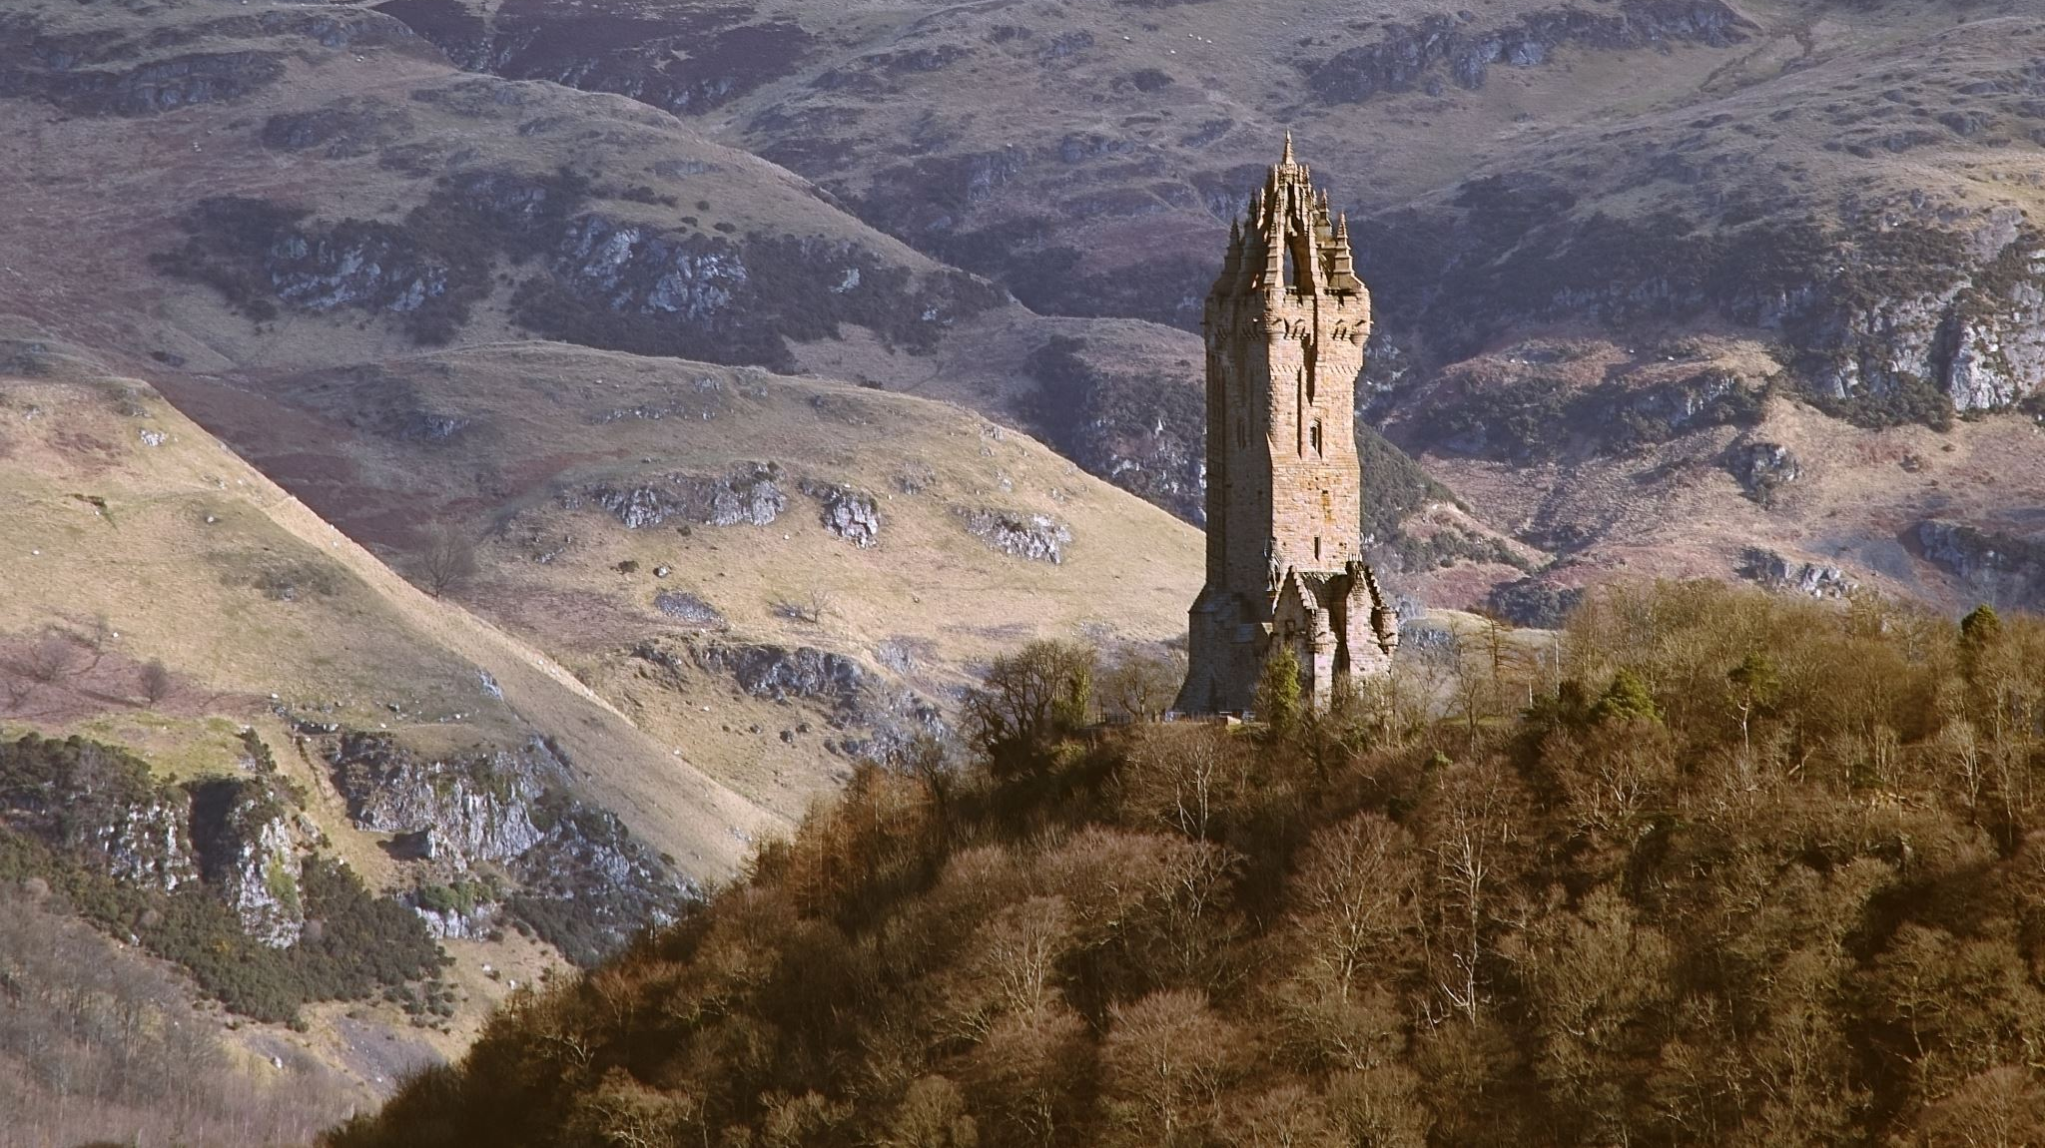
History of Counselling
Women and madness

Slide 2
Aims
To explore society's understanding of medieval madness, looking at Margery Kempe's story.
To begin to explore our understanding of women, madness and society.
To understand the idea of the medieval witch and wise woman.

Slide 3
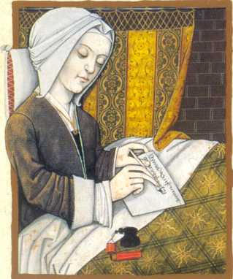
Margery Kempe c. 1373 – after 1438
Married, with 14 children.
She resisted domestic and religious roles and instead sought to develop a spiritual, mystic role within the community.
She heard voices, she conversed with Christ and went on many pilgrimages across Europe

Slide 4
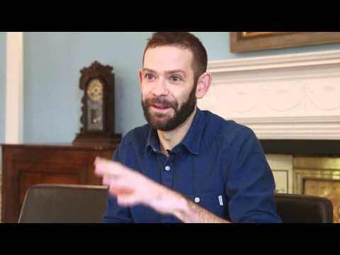
Who was Margery kempe?

Slide 5
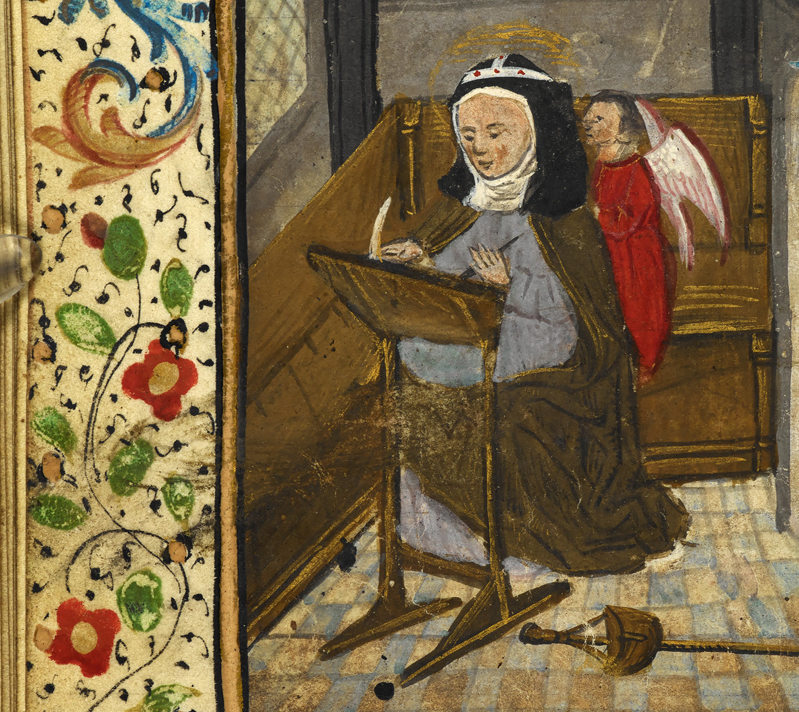
Margery Kempe
She was both hated and adored, with the Steward of the Court of Leicester stating, "Either you are a right good woman, or else a right wicked woman".
She was charged with heresy on many occasions and brought to caught, where she was often threatened with being burned at the stake.
She was a contentious figure and remains so to this day.

Slide 6
Margery Kempe
Why does she still remain contentious?
Academics still look at her autobiography and try to reflect on whether she was a medieval mystic or whether it is an early recording of an individual with psychosis.
We continue with this struggle today, although we perhaps have different names: Schizophrenia and Psychosis.

Slide 7
Women and Madness
We still have a greater amount of women diagnosed with mental illness, than men.
These earliest stories of madness in women continue to evoke questions.
In small groups I'd like you to discuss the following questions:

Slide 8
Women and madness
Knowing the little that you do know about Margery Kempe, why do you think she might have stirred up both hatred and adoration?
Why do you think more women might be diagnosed with mental illness today?

Slide 9

Witchcraft in the Middle Ages
From around the late 15th century

Slide 10
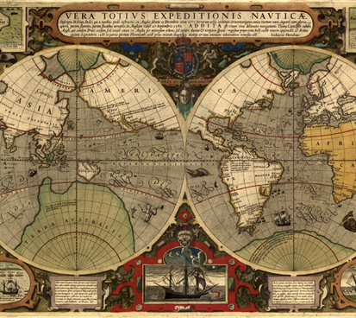
Early modern era (late 15th to the dawn of the 16th century)
This was a time of great change
Feudal system was falling apart
The rise of the nation state – extension of trade and markets in Europe
Circumnavigation of the globe

Slide 11
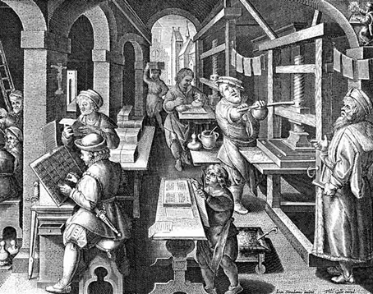
Time of change
Manifestations of protestant reformation and the Catholic Church losing power in places across Europe.
Renaissance
Classical learning
Print Culture (pamphlets etc)
Creativity within architecture, music, art, drama
Birth of the scientific revolution

Slide 12
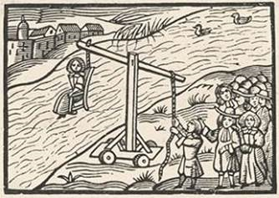
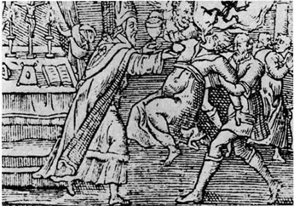
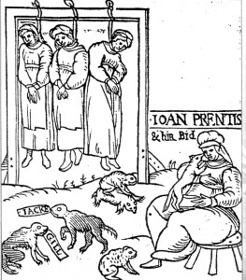
Witch hunts
Witch-hunts across Europe
Trials, tortures, executions
Agonizing deaths

Slide 13
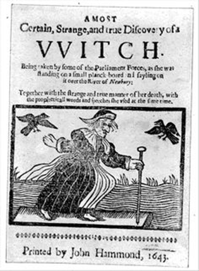
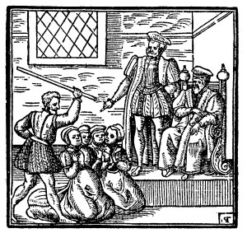
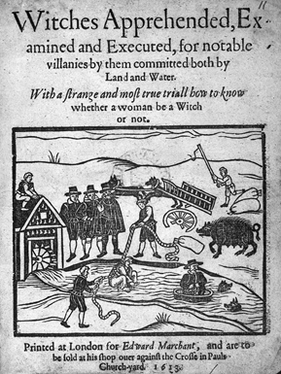
Witch hunts across europe
Intense and in some places long-lasting
Both Catholics and Protestants were engaged in the seeking, finding and torturing of witches. Both were engaged in shocking and gruesome brutality.

Slide 14
Witches and torture
Witches were said to be in league with the devil
Under torture they admitted to this, often stating that they were possessed by devils, even agreeing that they had copulated with the Devil.
These confessions led to the witches receiving further torment and cruelty – the aim being to kill them.
Witches were blamed for all manner of misfortunes
Somewhere in the region of 50,000 – 100,000 witches were said to have been killed during the witch-hunts, until the craze dissipated.

Slide 15
Possession and madness
The idea that mad people were possessed by evil spirits and demons had been around for a while
Satan, the devil, was around us all the time. Looking out for unwary souls to trap and seduce.
Death was always around people at this time, but so was Satan.
Some modern theorists, including David Hume (1711-76) and Voltaire believed that witches were merely another name for the mentally ill. They brought the two together to try to explain what had happened.

Slide 16
Women, madness and witchcraft
So many of the people who were persecuted for being for witches were older women who were perhaps traditional healers or midwives. Why do you think society chose to torment these women in particular?
Film : Witch Hunts: A century of murder
Notes:
https://www.my5.tv/witches-a-century-of-murder/season-1/episode-1

Slide 17
Thoughts about this week’s themes?

