Slide 1


Sexual Offences Involving Children
Notes:
On successful completion of this module, learners will be able to:
Outline the relevant ages of consent as stated in the SOA 2003
Describe the offence of Sexual activity with a child as stipulated in S9 of the SOA 2003
Explain the offence of causing or inciting a child to engage in sexual activity as stipulated by S10 of the SOA 2003
Outline the offence of engaging in in sexual activity in the presence of a child as stipulated in S11 of the SOA 2003
Summarise the offence of causing a child to watch a sexual act as stipulated in S12 of the SOA 2003
During this session you will cover offences under the Sexual Offences Act 2003. These offences against children are split into 2 areas –
S5-8 where the victim is aged under 13
S9-12 where the victim is aged between 13 and 16.
The differences are around CONSENT. And we will go into this through the lesson.

Slide 2

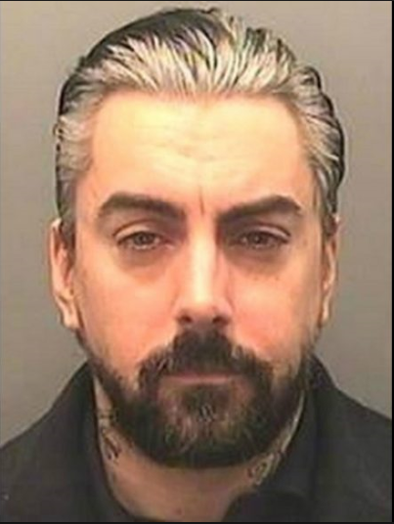
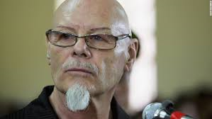
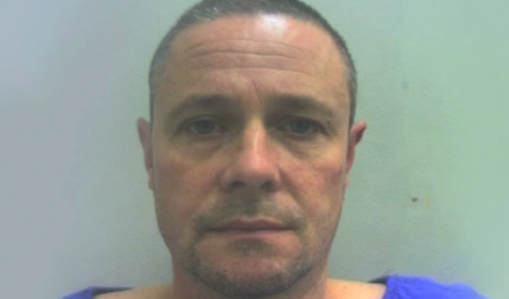
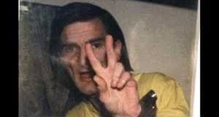
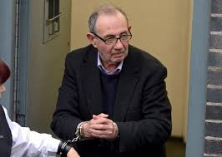
Notes:
QTS – what is the age f consent for a person to be able to legally engage in sexual activity in the UK? (16 years of age, between 16 and 13 possible defence, under 13, no defence)
From Top Left, then bottom photos from left
Jonathan King (born Kenneth George King; 6 December 1944) is an English seinger-songwriter, record producer, music entrepreneur and former TV and radio presenter. King was sentenced to seven years in prison in 2001 for sexually abusing 5 boys aged 14 and 15 during the 1980s.
Ian David Karslake Watkins (born 30 July 1977) is a Welsh musician and convicted paedophile. Watkins achieved prominence as a founder member, lead singer and lyricist of the Lostprophets. Lostprophets disbanded in 2013 after Wakins was charged with sexual offences in late 2012. In November 2013, he pleaded guilty to 13 charges, included the attempted rape and sexual assault of a child under 13; these offences were committed against the infant children of two fans who were also convicted. He was subsequently sentenced to 29 years imprisonment and six years on extended licence.
Gary Glitter
On the 19th January 2015 Glitter appeared at Southwark Crown Court accused of seven counts of indecent assault, one count of attempted rape, and two other sexual offences, against three girls between 1975 and 1980. The trial lasted two and a half weeks.
On 5th February 2015 he was convicted of attempted rape, four counts of indecent assault and one of having sex with a girl under 13. He was acquitted of the three other counts. He was sentenced to 16 years in prison.
Mark Bridger – The trial of Mark Bridger began on the 29th April 2013. On the 29th May the judge concluded his summing up and ordered the jury to consider it’s verdicts. On 20th May Bridger was found guilty of abduction, murder and perverting the course of justice. He was sentenced to life imprisonment.
Howard Hughes was born in Llandudno, Wales. Along with a sex chromosome abnormality which caused him to grow at an increased velocity he also had behavioural problems, learning differences and dyslexia. Hughes abducted 7 year old Sophie Hook from a tent in her relative’s garden in Llandudno. In July 1996 he was sentenced to life imprisonment for the double rape and murder of Sophie. In November 2002, Home Secretary David Blunkett set Hughes’ minimum term to 50 years.
John Allen, 73 was convicted in 2014 at Mold Crown Court after a seven week trial of abusing 18 boys and one girl aged between seven and 15, at the children’s homes in the Wrexham area run by Bryn Alyn Community, a company set up and run by Allen.
He was described as a formidable force, regarded as God by many of the children, and he would drag youngsters from their beds while on night duty and abuse them. He denied 40 charges of historic abuse between 1969 and 1990 but was convicted after a seven week trial.

Slide 3
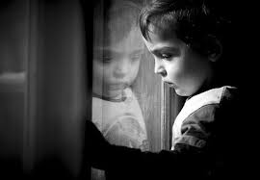
Offences Involving Children Under 13
Sections 5 – 8 Sexual Offences Act 2003
Notes:
QTS – what is deemed as sexual activity for the purposes of the SOA?
QTS _ we have discussed the age of consent, so what if a 12 year old child consents to sexual activity?
Firstly we will look at offences under Sections 5 – 8 which relate to sexual abuse of children under the age of 13.
These offences mirror that of S1-4 of the sexual offences act that you covered in the Rape and Serious Sexual offences lesson but the victim in each case is under 13. The definitions of terms will mirror the S1-4 offences.
For the purpose of the offences in these sections it is immaterial whether the child consents or not.
A child under 13 is unable to give legal consent and therefore the defendant’s belief in consent will not be relevant.
These offences are ones of strict liability as to age, and investigators only have to prove:
the intentional sexual activity, and
the age of the complainant at the date of the sexual activity,
e.g. a certified copy of a birth certificate together with evidence of identity.
Not even a reasonable belief that B was 13 or over will excuse A.
As already stated - A child under 13 is unable to give legal consent and therefore the defendant’s belief in consent will not be relevant.

Slide 4
Rape of a Child under 13
Section 5 Sexual Offences Act 2003
A person commits an offence if:
He intentionally penetrates the vagina, anus or mouth of another person with his penis
AND
The person is under 13
Version 1 2017
Notes:
Indictable only offence – Life Imprisonment
This offence and section 1 (rape) are the only offences that can only be committed by a male, because they relate to penile penetration.

Slide 5
Sexual Assault of a Child under 13 by Penetration
Section 6 Sexual Offences Act 2003
A person commits an offence if:
He intentionally penetrates the vagina, anus of another person with a part of his body or anything else
The penetration is sexual
The person is under 13
Version 1 2017
Notes:
Indictable only offence – Life Imprisonment

Slide 6
Sexual Assault of a Child under 13 by Touching
Section 7 Sexual Offences Act 2003
A person commits an offence if:
He intentionally touches another person
The touching is sexual
The person is under 13
Version 1 2017
Notes:
Either Way offence – 14 years imprisonment
Whether or not a child consented to the act is irrelevant.
Note
Whilst offences between adults and children are always to be viewed as extremely serious, these offences apply to acts between children. Account should also be taken of article 8 of the European Convention on Human Rights (respect for private life) - the criminalisation of consenting children aged 13 - 18 may breach their rights. For example, where B, aged 12, willingly kisses her 12 year old boyfriend's genitals, both commit offences.

Slide 7
Causing or Inciting a Child under 13 to engage in Sexual Activity
Section 8 Sexual Offences Act 2003
A person commits an offence if:
If he intentionally causes or incites another to engage in a sexual activity & the child in under 13
Version 1 2017
Notes:
This offence covers the same situations as does the offence under section 4 except that, for this offence, whether or not the child consented to engaging in the sexual activity is irrelevant.
This section also covers the situation where incitement takes place but the sexual activity itself does not. For example, a person may incite a child to engage in sexual activity with him (for example, where a person incites the child to masturbate him), or on the child himself (for example, where a person incites the child to strip) or with a third person (for example, where someone incites the child to have sexual intercourse with his friend). This offence can be committed by a male or female against a male or female .
An offence of intentionally inciting a child under 13 to engage in sexual activity can be committed even though it is not possible to identify any specific or identifiable child to whom the incitement was addressed. It does not matter whether the incitement was directed at a particular child, a very large group of children or whether they could be identified or not.
Examples of an adult causing or inciting a child to engage in sexual activity could be promising a reward, persuading the child that it is perfectly acceptable behaviour that other children engage in all the time and he/she would be abnormal not to agree, or saying that it was necessary to check the child's body for bruises, lice etc, or to try on clothes.
The offence can be charged where the adult incites the child to take part in sexual activity, even where the activity itself does not take place, for example because a parent intervenes.
If the permutations involve penetration , the chances are that it carries a life sentence otherwise triable either way max 14 yrs.

Slide 8
Offences Involving Children
Sections 9 -12 Sexual Offences Act 2003
Notes:
QTS – so what is the differences in offences if the child is between 16 and 13 years of age?
Sections 9 – 12 relate to sexual abuse of children.
Sexual activity between an adult and a child under the age of 16 in unlawful. As already stated where the victim is under 13 years old the law considers that they CANNOT CONSENT in any sense.
Where an adult (aged 18 or over) engages in sexual activity with a child between ages of 13 and 16, where a lack of consent does not feature offences S9-12 of the SOA 2003 apply and have been created to ciminalise such conduct. Again there is no need to prove that consent was not given. The adult may be able use a defence of reasonable belief that the child is 16 or over, except where the child is in fact aged under 13 years. Where the child is aged 13 or over but under 16, the prosecution must prove that the defendant did not reasonably believe that the child was 16 or over.
So for example if a 15 year old was in a pub, wearing make up, the defendant may be able to argue that he/she reasonably believed that the child was over 16 – and this could be a defence to the offences under these sections.
A reasonable person would not believe that a 12 year old was over 16 – so this defence is not available for offences under S5-8.
The purpose of the offences under Sections 9-12 is to provide a means of prosecuting a person who secures the consent of a child through pressure but stops short of coercion so that a non-consensual offence cannot be proved.
If a victim was between the age of 13-15 there are no specific offences of Rape, assault by penetration or sexual assault. It may be more appropriate to charge with the adult offences under S1-3 of the Sexual Offences Act ( where a lack of consent would need to be proven)
Where the lack of consent is difficult to prove, or the circumstances reveal willing participation then S9-12 could be considered.

Slide 9
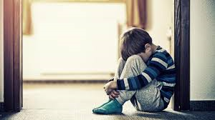

Sexual Activity with a Child
Section 9 Sexual Offences Act 2003
Triable on indictment
Power of arrest without warrant – constables/ other persons
Notes:
These are committed by an adult 18 years or over.
Whilst investigating remember proof that the adult knew that the victim was under 16 years… consider seizing any photos offender may have of victim in school uniform, etc
Also consider the birth certificate of the victim.

Slide 10
Section 9 (1)
A person aged 18 or over (A) commits an offence if:
a) He intentionally touches another person (B)
b) The touching is sexual, &
Either
i. B is under 16 & A does not reasonably believe that B is 16 or over, or
ii. B is under 13
Notes:
Section 9 (1) – Assault with no penetration
If the victim is under 13 years it is much more likely that the suspect will be charged with a S6 or 7 offence.
Proof of age required that victim is under 16
Defence available of reasonable belief that the victim was over 16.
Either way offence – max penalty of 14 years on indictment or 6 months summary

Slide 11
Section 9 (2)
A person is guilty of an offence under this section if the touching involved:
(a) penetration of B’s anus or vagina with a part of A’s body or anything else
(b) penetration of B’s mouth with A’s penis
(c) penetration of A’s anus or vagina with a part of B’s body, or
(d) penetration of A’s mouth with B’s penis
Notes:
If the sexual activity involves penetration the more serious offence of S9(2) will apply.
Indictment only – 14 years max

Slide 12
To summarise …..
Section 9 of the Sexual Offences Act 2003 makes it an offence for……
….a person aged 18 or over to intentionally engage in sexual touching of a child under 16 years
Notes:
Where the child is 13 years or over but is under 16 years, the prosecution must prove that the defendant did not reasonably believe that the child was 16 years or over.
This offence can be committed by male or female offender against a male or female victim.
It is expected that where the child is under 13, one of the under 13 offences (S5 – 8), E.g rape of a child under 13, rather than the offence of sexual activity with a child would normally be charged. These offences have higher penalties to reflect the fact that a child under 13 can not legally consent to sexual activity.
However, this offence might be used where a child is under 13. An example would be where a person was charged with the offence of sexual activity with a child, all parties believing that the child to be 13 or over, and it the became known during the course of the trial that the child was actually under 13. The extension of this offence to under 13s means that the trial could continue with the original charge where necessary. This closes a potential loophole in the law. Decisions about whether to charge someone with this offence will be made in accordance with the principles set out in the Code for Crown Prosecutors. In deciding whether it is in the public interest to prosecute for this offence, where there is enough evidence to provide a realistic prospect of conviction, prosecutors may take into account factors which include the age and emotional maturity of the parties, whether they entered into a sexual relationship willingly, any coercion or corruption by a person, the relationship between the parties and whether there was any existence of a duty of care or breach of trust. The discretion of the CPS not to charge where it is not in the public interest would be partially relevant where the two parties were close in age. For instance an 18 year old and a 15 year old had engaged in mutually agreed sexual activity.

Slide 13
Causing or Inciting a Child to Engage in Sexual Activity
Section 10 Sexual Offences Act 2003
Where Penetration Involved – Indictment only
otherwise either way.
Power of arrest without warrant – constables/ other persons.
Notes:
QTS – what is the difference between the words, “cause” and, “incite?”
Committed by an adult 18 years or over

Slide 14
Section 10(1)
A person aged 18 or over (A) commits an offence if:
a) He intentionally causes or incites another person (B) to engage in an activity
b) The activity is sexual, &
Either
i. B is under 16 & A does not reasonably believe that B is 16 or over, or
ii. B is under 13
Notes:
Similar to S8 offence but appropriate if the victim is between 13-15.
Triable either way – 14 years max
Where the child is aged 13 or over, but under 16, the prosecution must prove that the defendant did not reasonably believe that they were 16 or over. The sexual activity which is caused, encouraged or assisted may be activity with the victim (for example, where the defendant causes, encourages or assists the child to have sexual intercourse with him), on the child himself (for example, where the defendant causes, encourages or assists the child to strip for the defendant's sexual gratification) or with a third person (for example, where the defendant causes, encourages or assists the child to have sexual intercourse with the victim's friend).
The encouragement and assistance constitutes an offence whether or not the activity encouraged or assisted actually takes place (Eg, because a parent intervenes) Whether or not the child consented to the activity caused, encouraged or assisted, or to the encouragement or assistance, is irrelevant.
This offence can be committed by a male or female offender against a male or female victim. Examples of an adult causing, encouraging or assisting a child to engage in sexual activity could be promising a reward, persuading the child that it is perfectly acceptable behaviour that other children engage in all the time and he/she would be abnormal not to agree, or saying that it was necessary to check the child's body for bruises, lice etc., or to try on clothes. It is not intended to cover health professionals, or anyone providing sex education, advice or contraception to
children.

Slide 15
Section 10(2)
A person is guilty of an offence under this section if the activity caused or incited involved:
(a) penetration of B’s anus or vagina
(b) penetration of B’s mouth with person’s penis
(c) penetration of a person’s anus or vagina with a part of B’s body, or by B with anything else, or
(d) penetration of a person’s mouth with B’s penis
Notes:
Again more serious offence under S10(2) if the act involves penetration
Indictment only – 14 years max

Slide 16
To summarise …..
Section 10 of the Sexual Offences Act 2003 makes it an offence for a person ages 18 or over
intentionally to cause, encourage or assist a child under 16 years to engage in sexual activity
Notes:
Where the child is under 13, it is expected that the adult would normally be charged with the offence of causing or inciting a child under 13 to engage in sexual activity at section 8. However, occasionally the offence at section 10 might be used where the child is under 13 (as with S9 previously discussed)
An example would be where a person was charged with causing or inciting a child to engage in sexual activity, all parties believing the child to be 13 or over, and it then became known in the course of the trial that the child was actually under 13. The extension of section 10 to under 13s means that the trial could continue with the original charge where necessary. This closes a potential loophole in the law.

Slide 17
Engaging in Sexual Activity in the Presence of a Child
Section 11 Sexual Offences Act 2003
Triable either way
Power of arrest without warrant – constable / other persons
Notes:
QTS – What examples can you think of when adults engage in sexual activity in front of a child?
Committed by an adult 18 years or over

Slide 18
Section 11(1)
A person ages 18 or over (A) commits and offence if:
a) He intentionally engages in an activity
b) The activity is sexual
c) For the purpose of obtaining sexual gratification, he engages in it.
i. When another person (B) is present or in a place from which A can be observed &
ii. Knowing or believing that B is aware, or intending that B should be aware, that he is engaging in it &
iii. B is under 16 & A does not reasonably believe that B is 16 or over, or B is under 13
Notes:
The offence is committed if the defendant knows or believes that the child is aware that he is engaging in the activity or intends that the child should be aware of this. This offence would cover, for example, the defendant masturbating himself in front of a child, or the defendant masturbating himself in the presence of the child to whom he is describing what he is doing, perhaps because the child is covering his face.
It would also cover the situation where the defendant performs a sexual act in a place where he knows that he can be seen by a child, for example via a webcam. The offence does not require the victim to witness the activity. The offence would therefore still be committed if, for example, the defendant intended the victim to witness the activity, and believed that the victim was witnessing the activity, but the victim had fallen asleep or was busy with an activity which meant that A was being wholly ignored, unbeknown to the defendant (it must 'unbeknown' since otherwise the specified purpose cannot be proven in 11 (1)(c)(ii).
But if B leaves the position where observation of A is possible to a place where it is not possible, and does so before any sexual activity begins, then the offence has not been committed; if B leaves half way through the sexual activity, then the offence has been committed up to that point. If A arranges for B to be present in a place of observation in order to observe sexual activity and then begins the activity in the belief and with the purpose that B is present but in fact B has left before commencement or has never turned up at the appointed time, then an attempt may have been committed

Slide 19
To summarise …..
Section 11 of the Sexual Offences Act 2003 makes it an offence for a person ages 18 or over intentionally to engage in sexual activity in order to gain sexual gratification
when a child under 16 is present or in a place from which the defendant can be observed
Notes:
To summarise, Section 11 of the Sexual Offences Act 2003 makes it an offence for a person aged 18 or over intentionally to engage in sexual activity in order to gain sexual gratification from the child watching (or presumed watching by the defendant), when a child aged under 16 is present or in a place from which the defendant can be observed.
When the child is aged 13 or over but under 16, the prosecution must prove that the defendant did not reasonably believe that he was 16 or over.
The offence is intended to cover the situation where someone seeks sexual gratification not from the sexual act itself but rather from the fact that he is performing that act in the presence or intended presence of a child.
This offence can be committed by a male or female offender against a male or female victim.
The motive of sexual gratification is a necessary safeguard intended to avoid capturing those who engage in sexual activity in front of a
child for a legitimate reason. For example, a teacher who sexually kisses his partner just outside the school gates, could be deemed to
be engaging in sexual activity intentionally in front of a child and might otherwise be caught by the offence. But whether a "kiss“ (lips to lips) can be viewed as "sexual" within section 78 may be doubted; therefore, even if the teacher is sexually gratified by such exhibitionism, it is not within section 11 unless the activities involve a sexual act.The same would excuse someone who is sexually gratified by some kind of normal non-sexual activity (e.g. washing a car, mowing the grass).

Slide 20
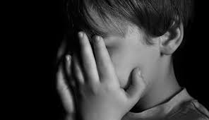
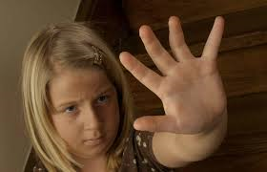
Causing a Child to Watch a Sexual Act
Section 12 Sexual Offences Act 2003
Triable either way
Power of arrest without warrant – constables/ other persons
Notes:
QTS – what types of examples can you think of when a child watches a sexual act?

Slide 21
Section 12(1)
A person aged 18 or over (A) commits an offence if:
a) For the purpose of obtaining sexual gratification, he intentionally causes another person (B) to watch a 3rd person engaging in an activity, or to look at an image of any person engaging in an activity
b) The activity is sexual, &
Either
i. B is under 16 & A does not reasonably believe that B is 16 or over, or
ii. B is under 13
Notes:
The offence is intended to cover the situation where someone seeks sexual gratification not from the sexual act itself but rather from causing the child to watch a third party involved in a sexual activity (live or recorded).
The motive of sexual gratification is a necessary safeguard intended to avoid capturing those who engage in sexual activity in front of a child for a legitimate reason. For example, a teacher who sexually kisses his partner just outside the school gates, could be deemed to be engaging in sexual activity intentionally in front of a child and might otherwise be caught by the offence. But whether a "kiss"
(lips to lips) can be viewed as "sexual" within section 78 may be doubted; therefore, even if the teacher is sexually gratified by such
exhibitionism, it is not within section 11 unless the activities involve a sexual act.
The same would excuse someone who is sexually gratified by some kind of normal non-sexual activity (e.g. washing a car, mowing the
grass).

Slide 22
To summarise …..
Section 12 of the Sexual Offences Act 2003 makes it an offence for a person intentionally to cause a child aged under 16, for the purpose of obtaining the sexual gratification themselves, to watch a third person engaging in sexual activity or to look at an image of a person engaging in sexual activity
Notes:
Definition of ‘image’
79(4) "Image" means a moving or still image and includes an image produced by any means and, where the context permits, a three-dimensional image. 79(5) References to an image of a person include references to an image of an imaginary person.
Where the child is aged 13 or over but under 16, the prosecution must prove that the defendant did not reasonably believe that they
were 16 or over. The definition of sexual activity is explained in section 78. A person who, for his own sexual gratification, forces a child to watch two people have sex, or who forces a child to watch a pornographic film, would commit this offence. This offence does not require any element of coercion, the child may even agree this is irrelevant. The offence is committed even where the child apparently consents to watching a sexual act.
In order for an offence to be committed, the adult must act for their own sexual gratification. This ensures that adults showing children sex education material, either in a school or other setting, will not be liable for this offence.
The sexual gratification does not need to be at the same time as showing the child the material. Therefore you could show the child sexualized material with the intention of gaining sexual gratification some hours later.
Activity 1 to follow this PPT slide

Slide 23


