Slide 1
Group presentation
Course: Professional policing
Module : Evidence Based Policing
Code: BMPL4016
Assignment title:
Discuss how community engagement strategies can be used to improve trust and legitimacy when policing the public.
Cerys Williams (2416044)
Harriet Cope (2305803)
Erin Davies (2404320)
MORGAN JONES (2421509)

Slide 2

Discussing how community engagement strategies can be used to improve trust and legitimacy when policing the public
Cerys Williams, 2416044, Professional Policing

Slide 3
An introduction to Youth engagement programmes
Youth engagement is a key strategy used by police to prevent crime and build positive relationships with younger generations. The police often work with partner agencies like such to help reduce crime in communities (Wood et al, 2024).
Examples of youth engagement programmes:
Police Cadets – For ages 13-18, aimed to assist in the implementation of community-based policing strategies (Gloucestershire Constabulary, 2025).
Mini Police – Designed for year 5 and 6 pupils (age 8-11) to develop skills (Police and Crime Commissioner for Wiltshire and Swindon, 2023).
Night Challenge – Targeted at youths who view the police in a negative manner (Humberside Police, 2024).
Youth Boot Camps – Focuses on demanding physical activity with the aim of developing mental toughness.

Slide 4
The effectiveness of youth engagement programmes
Positive statistics
Research from the University of South Wales highlights that police cadet programmes play a vital role when enhancing public trust and confidence (Police Professional, 2022).
Linx Youth Project, Middlesbrough – Involved detached youth work and contributed to a 79% reduction in first time entrants to the youth justice system between 2016 and 2020 (National Youth Agency, 2023).
Sure start programme – Helped lead to a 20% decrease in custodial sentences by age 16 (Institute for Fiscal Studies, 2024).
Contrasting statistics
Youth boot camps have led to a 6% increase in future crime (Youth Endowment Fund, 2025).
Youths who engage in programmes involving physical activity are more likely to consume high levels of alcohol (Eccles & Barber, 1999).

Slide 5
street and arrow (developed by the Scottish violence reduction unit)
The Scottish Violence Reduction unit was launched in 2005,focusing on violence and violence prevention.
The SVRU aims to pinpoint the root causes of youth violence and resolve its key factors (Scottish Violence Reduction Unit, 2022) A way the SVRU connects with young people is through their Street and Arrow scheme.
The Street and Arrow scheme engages with youths who have a history of or are vulnerable to violence, supporting them with a year of paid work experience in a café located in Glasgow (Relationships Project, 2025).
Effectiveness of Street and Arrow
Led to a 58% decrease in knife carrying
A 73% decrease in gang fighting
Over all 85% reduction in weapon carrying
(Relationships Project, 2025)

Slide 6

Conclusion
To conclude, data and case studies have shown that youth engagement programmes are an effective strategy that can be used to improve public trust within a policing context. By involving young people in shaping initiatives such as educational reform (Checkoway and Gutierrez, 2012), helps create positive relationships while reducing the negative perceptions of policing. Although there are many benefits to youth engagement programmes, there is still room for improvement. By making youth programmes more inclusive and consistent, this will create long-term, positive impacts on society. When done routinely, youth engagement can then play a key role in strengthening police-community relations.

Slide 7
References
Checkoway, B.N., Gutierrez, L.M. (2012) Youth participation and community change. 1st edn. Taylor & Francis. P.1. (Accessed 7th April 2025).
Eccles, J. S., Barber, B. L. (1999) Student Council, volunteering, Basketball, or Marching Band: What Kind of Extracurricular involvement Matters? P.29. Available at: https://deepblue.lib.umich.edu/bitstream/handle/2027.42/67473/10.1177_0743558499141003.pdf?sequence=2&isAllowed=y (Accessed 3rd April 2025).
Gloucestershire Constabulary (2025) Police cadets. Available online at: https://www.gloucestershire.police.uk/police-forces/gloucestershire-constabulary/areas/gloucestershire/ca/careers/police-cadets/ (Accessed 28th March 2025).
Humberside Police (2024) Night Challenge. Available online at: https://www.humberside.police.uk/police-forces/humberside-police/areas/about-us/about-us/youth-engagement/night-challenge/ (Accessed 28th March 2025).
Institute for Fiscal Studies (2024) Sure Start reduced likelihood of ending up in youth custody by a fifth. Available online at: https://ifs.org.uk/publications/effect-sure-start-youth-misbehaviour-crime-and-contacts-childrens-social-care#:~:text=Key%20Findings,-1.&text=Living%20within%202.5%20kilometres%20of,to%20access%20to%20Sure%20Start. (Accessed 1st April 2025).
National Youth Agency (2023) Youth centre closures linked to greater risk of young people entering criminal justice system. Available online at: https://nya.org.uk/youth-centre-closures-linked-to-greater-risk-of-young-people-entering-criminal-justice-system/ (Accessed 1st April 2025).
Police and Crime Commissioner for Wiltshire and Swindon (2023) Mini Police. Available online at: https://www.wiltshire-pcc.gov.uk/Youth-zone/policing-and-you/mini-police/ (Accessed 28th March 2025).
Police Professional (2022) Research highlights 'invaluable' benefits of cadets to policing and the wider community. Available online at: https://policeprofessional.com/news/research-highlights-invaluable-benefits-of-cadets-to-policing-and-the-wider-community/#:~:text=A%20new%20study%20shows%20that,people%2C%20policing%20and%20their%20communities.&text=Researchers%20at%20the%20University%20of,specifically%20volunteer%20police%20cadet%20leaders. (Accessed 3rd April 2025).

Slide 8
References (2)
Relationships Project (2025) Case Study: Scottish Violence Reduction Unit (SVRU) A public health approach to ending violence. Available online at: https://relationshipsproject.org/project/48771/ (Accessed 4th April 2025).
Scottish Violence Reduction Unit (2022) Violence is preventable. Available online at: https://www.svru.co.uk/ (Accessed 4th April 2025).
Wood, D., Bradshaw, S., Dickens, T., Parker-McLeod, J., Davies, C. (2024) Blackstone’s Handbook for Policing Students. 18th edn. Oxford University Press. P.203. (Accessed 4th April 2025).
Youth Endowment Fund (2025) Boot Camps. Available online at: https://youthendowmentfund.org.uk/toolkit/boot-camps/ (Accessed 3rd April 2025).

Slide 9
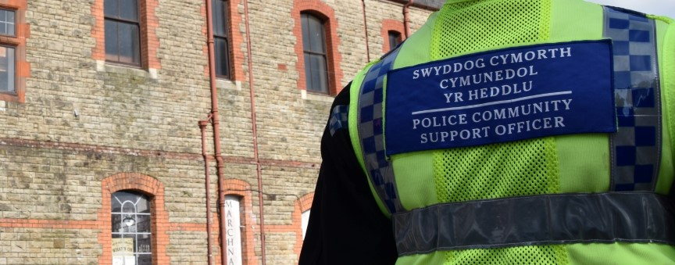
Building Trust & Legitimacy Through Community Engagement in Neighbourhood Policing
Harriet Cope
BMPL4016
MISHELLE HILL
(South Wales Police, 2025)

Slide 10

Introduction to neighbourhood policing
EFFECTIVENESS OF CURRENT STRATEGIES
NEIGHBOURHOOD Policing Teams (NPT's) build visibility & familiarity
Community partnerships lead to shared problem-solving
Social media proves transparency & responsiveness
Increased trust leads to better cooperation
(Myhill, A. 2012)

Slide 11
EVIDENCE OF EFFECTIVENESS
COLLEGE OF POLICING 2020 REPORTS THAT VISIBLE AND ENGAGING LOCAL OFFICERS IMPROVE PUBLIC CONFIDENCE, ESPECIALLY WHEN COMMUNITIES FEEL OFFICERS UNDERSTAND LOCAL ISSUES.
ACCORDING TO OFFICE FOR NATIONAL STATISTICS (2023) THE CRIME SURVEY FOR ENGLAND AND WALES states that PEOPLE WHO FEEL THEIR LOCAL POLICE ARE DOING A GOOD JOB ARE MORE LIKELY TO REPORT CRIME AND COOPERATE WITH INVESTIGATIONS.

Slide 12

Challenges of EBP in Community Policing
Cultural resistance within police
Lack of training/resources
EBP Favours long-term outcomes, but police face short-term demands
Misuse or misunderstanding of data can harm trust
Lum, C., Koper, C.S. et al (2011) , Sherman, L.W. (2013) , College of Policing (2015)

Slide 13
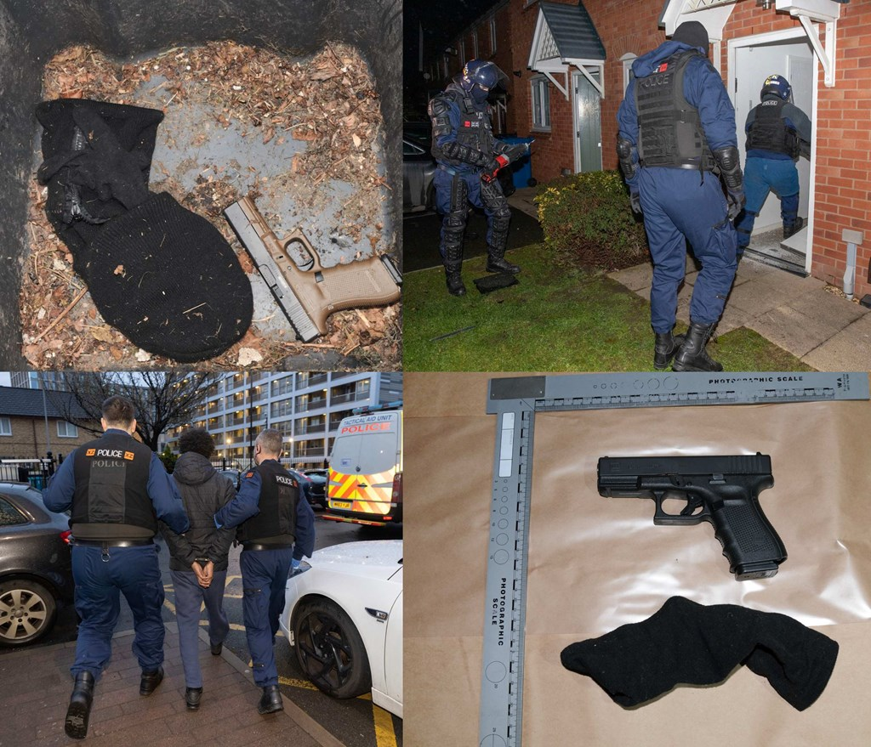
Case Study
Operation Shield (Manchester)
What Happened
Operation Shield is a community-led initiative by Greater Manchester Police aimed at reducing gun crime and enhancing public trust.
The strategy focuses on proactive engagement with at-risk individuals, community partnerships, and intelligence-led policing.
Key Eliments of this case
Community Collaboration: GMP collaborated with local organisations to identify and support individuals most at risk of involvement in gun violence.
Youth Engagement: Programs were implemented to provide alternatives to gang involvement, focusing on education, employment, and mentorship opportunities.
Data-Driven Policing: Utilisation of crime data to identify hotspots and allocate resources effectively.
Manchester Police Department (n.d.),National Institute of Justice (2023)

Slide 14
Outcomes of this case
A significant reduction in firearms discharges, with a reported 64% decrease over three years from April 2020 to March 2023.
Improved community relations and increased public confidence in local policing efforts.
Lessons Learned:
Sustainable reductions in gun crime require a holistic approach that combines policing with community engagement and support services.
Greater Manchester Police (2023)

Slide 15
Conclusion
To conclude by analysing data and a case study it shows enough evidence that Neighbourhood policing is a successful strategy To improve TRUST AND LEGITIMACY THROUGH COMMUNITY ENGAGEMENT within the police so far.
according to London assembly (2005) the Neighbourhood policing initiative, crime decreased 3.1% in areas with dedicated neighbourhood teams compared to 1.9% in areas without such strategies in place. In just four months, the installation of Safer Neighbourhood Teams in Tower Hamlets led to a 28% decrease in theft/handling offences and a 20% reduction in criminal damage.
Therefore, to prioritise engagement in communication. Police work closely with residents to improve understanding of concerns in the community and to collaborate on the best solutions to resolve them.

Slide 16
Reference List
College of Policing (2015) Why evidence matters. Available at: https://www.college.police.uk/research/evidence-based-policing-EBPAccessed: 12 April 2025).
College of Policing (2020) Neighbourhood policing guidelines. Available at: https://www.college.police.uk/guidance/neighbourhood-policing (Accessed: 09 April 2025).
Government Events (2024). Police-Community Relationships: Importance & Strategies Government Events. [online] Government Events. Available at: https://www.governmentevents.co.uk/ge-insights/the-importance-of-police-community-relationships-strategies/ (Accessed: 11 April 2025).
Greater Manchester Police (2023) GMP continue action to clamp down on gun crime as firearms discharges decrease by 64% over three years from April 2020. Available at: https://www.gmp.police.uk/news/greater-manchester/news/news/2023/may/gmp-continue-action-to-clamp-down-on-gun-crime-as-firearms-discharges-decrease-by-64-over-three-years-from-april-2020/ (Accessed: 7 April 2025).
Lum, C., Koper, C.S. et al (2011) ‘The evidence-based policing matrix’, Journal of Experimental Criminology, 7(1), pp. 3–26.
MANCHESTER POLICE DEPARTMENT (N.D.) GUN VIOLENCE REDUCTION STRATEGY. AVAILABLE AT: HTTPS://WWW.MANCHESTERNH.GOV/DEPARTMENTS/POLICE/INVESTIGATIONS/GUN-VIOLENCE-REDUCTION-STRATEGY (ACCESSED: 21 APRIL 2025).
Myhill, A. (2012) ‘Community engagement in policing: Lessons from the literature’, Home Office Research Report 73. London: Home Office. (Accessed: 6 April 2025).

Slide 17
Additional References
Office for National Statistics (2023) Crime Survey for England and Wales. Available at: https://www.ons.gov.uk (Accessed: 20 April 2025).
Sherman, L.W. (2013) ‘The rise of evidence-based policing: Targeting, testing, and tracking’, Crime and Justice, 42(1), pp. 377–451.
South Wales Police (2025). Neighbourhood Policing. [online] Neighbourhood Policing SWP. Available at: https://www.heddlu-de-cymru.police.uk/police-forces/south-wales-police/areas/about-us/about-us/neighbourhood-policing/ [Accessed 16 Mar. 2025].
Weisburd, D. and Neyroud, P. (2011) Police science: Toward a new paradigm. Washington, DC: U.S. Department of Justice.
NATIONAL INSTITUTE OF JUSTICE (2023) POLICE USE SCIENCE AND COMMUNITY PARTNERSHIPS TO REDUCE GUN VIOLENCE. AVAILABLE AT: HTTPS://NIJ.OJP.GOV/TOPICS/ARTICLES/POLICE-USE-SCIENCE-AND-COMMUNITY-PARTNERSHIPS-REDUCE-GUN-VIOLENCE (ACCESSED: 21 APRIL 2025).

Slide 18
Building trust and legitimacy through community meetings
Erin Davies
2404320

Slide 19
What is community meetings?
• Community meetings are collaborative events where individuals from a community gather to address significant issues, exchange ideas and collaborate on solutions. ( Hosting Communtiymeetings that’s POPS, n.d.)
• British Transport Police (2023) says the object is to cultivate an open and respectful environment where all participants can contribute to making the community a safer and more vibrant place.

Slide 20
Effectiveness of having community meetings
Community meetings with the police is effective in various ways by:
Building community relations
(Government Events, 2024)
Lowers fear of crime and boots confidence
(Myhill, 2012)
Share problems
(www.westlancs.gov.uk. N.d)

Slide 21
Challenges of having community meetings
On the other hand, community meetings have some challenges which include:
•Small amount of people turn up to the meetings
(Lister & Platts- Fowler, 2014)
•Language barriers
(Hunter et al, 2022)
•Lack of trust
(Vulnerability & policing futures research centre, 2024)

Slide 22

Case study Tottenham Riots, London (2011)
Tottenham Riots took place on Saturday 6th of August 2011. London was overwhelmed by fire and violence for five nights. By the end of the riots, five people had lost their lives, including a 68 year old man who was attacked while trying to put out a fire in a litter bin in Ealing. Many people were left without homes, and over 200 individuals
After the riots, police aim was to improve relationship
with Tottenham residents.Met police did this through:
ØPublic community meetings
ØYouth outreach programs
ØPartnership with local organisations.
were injured, mostly police officers.
https://www.google.com/url?sa=i&url=https%3A%2F%2Fwww.channel4.com%2Fnews%2Fthe-tottenham-residents-burned-out-by-the-riots&psig=AOvVaw1ARPttkI4el2QU_GTjz9ER&ust=1745599509471000&source=images&cd=vfe&opi=89978449&ved=0CBcQjhxqFwoTCKCl4q6P8YwDFQAAAAAdAAAAABAE

Slide 23
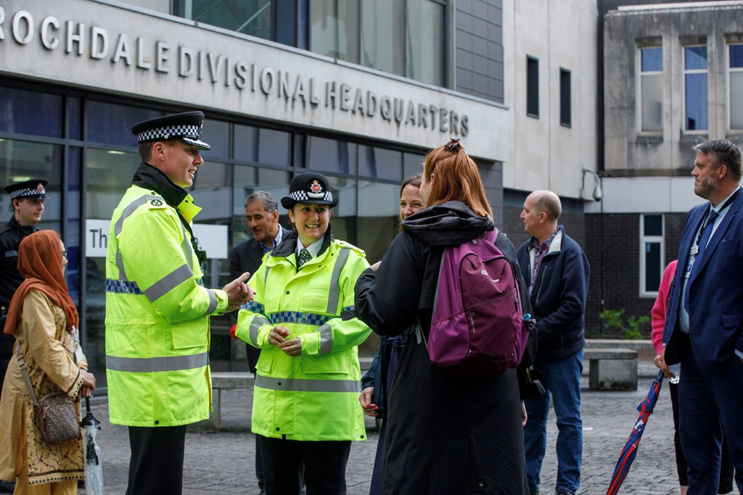
Case Study
Greater Manchester Police has faced a range of difficult issues for a long time, such as gang violence, drug related crime and social unrest in it’s various communities.
In order to tackle this, Greater Manchester Police set up neighborhood policing teams that worked in local areas and attended community meetings.
https://www.google.com/url?sa=i&url=https%3A%2F%2Fwww.gmp.police.uk%2Fnews%2Fgreater-manchester%2Fnews%2Fnews%2F2023%2Fjuly%2Fgmp-host-community-engagement-session-to-discuss-progress-on-tackling-violence-against-women-and-girls-in-rochdale%2F&psig=AOvVaw2B68daY5gCDCL7oAF9K0FP&ust=1745599726937000&source=images&cd=vfe&opi=89978449&ved=0CBcQjhxqFwoTCOif6f2P8YwDFQAAAAAdAAAAABAE
(Greater Manchester Serious Violance Action Plan Providing an effective response to violence and its causes. 1. n.d.)

Slide 24
Refrence List
Bell, B. (2021). Riots 10 years on: The five nights when London burned. BBC News. (online) Available at: https://www.bbc.co.uk/news/uk-england-london-58058031
British Transport Police (2023). PACT meetings. (online) www.btp.police.uk. Available at: https://www.btp.police.uk/police-forces/british-transport-police/areas/about-us/about-us/in-the-community/pact-meetings/#:~:text=Your%20local%20Neighbourhood%20Policing%20Team,area%20can%20best%20be%20tackled.
Government Events (2024). Police- community relationships: Importance & strategies. Government Events. (online) Government Events. Available at: https://www.governmentevents.co.uk/ge-insights/the-importance-of-police-community-relationships-strategies/#:~:text=Cultural%20Competency%20Training%3A%20Ensuring%20officers,public%20trust%20and%20ensuring%20accountability.
Greater Manchester Serious Violance Action Plan Providing an effective response to violence and its causes. 1. (n.d.) Available at: https://www.greatermanchester-ca.gov.uk/media/4811/gm_violence_reduction_plan_final_amends_final_accessible.pdf
Hosting a Community Meeting That POPS. (n.d.). Available at: https://www.cityofws.org/DocumentCenter/View/491/Hosting-a-Community-Meeting-Purpose-Outcome-Process-Strategy-POPS-PDF#:~:text=A%20community%20meeting%20is%20the,plans%20are%20set%20and%20assigned.
Hunter, G., Bhardwa, B., Dinisman, T., Moroz, A., Anastassiou, A. and Lynall, A. (2022). Language barriers in the criminal justice system. (online) Available at: https://www.bell-foundation.org.uk/app/uploads/2022/03/Language-barriers-in-the-criminal-justice-system.pdf

Slide 25
(2)
Lister, S. and Platts- Fowler, D. (2014). N8 policing research partnership community engagement: Evidence Review. (Online) Available at: https://www.n8research.org.uk/media/CommunityEngagement_EvidenceReview.pdf
Myhill, A. (2012). Community engangement in policing lessons from the literature. (online) Available at: https://web.archive.org/web/20160306011218id_/http://www.nhwa.com.au/wp-content/uploads/Research_community-engagement-lit-rev-myhill.pdf
Science, L.S. of E and P. (2014) LSE research into the causes of the 2011 riots leads to reform of police ‘stop and search’ powers. (online) London School of Economics and Political science. Available at: https://www.lse.ac.uk/Research/research-impact-case-studies/lse-research-causes-2011-riots-reform-police-stop-search-powers
Vulnerability & policing futures research Centre. (2024). Police are failing to meet the public’s minimum standards of service, researchers find – vulnerability & policing futures research Centre. (online) Available at: https://vulnerabilitypolicing.org.uk/news/police-are-failing-to-meet-the-publics-minimum-standards-of-service-researchers-find/#:~:text=This%20lack%20of%20confidence%20is,people%20experience%20in%20their%20communities.
www.westlancs.gov.uk. (n.d.) Police and communities together – West Lancashire Borough Council. (Online) Available at: https://www.westlancs.gov.uk/more/community-safety/police-and-communities-together.aspx

Slide 26
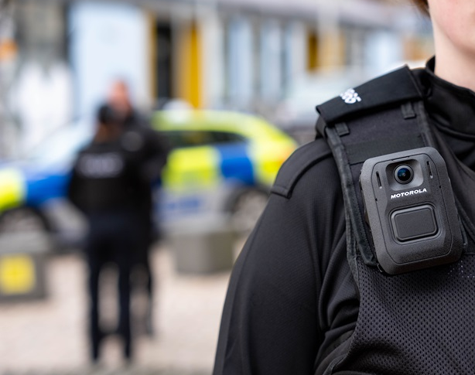
Body worn cameras having an impact on UK policing

Slide 27
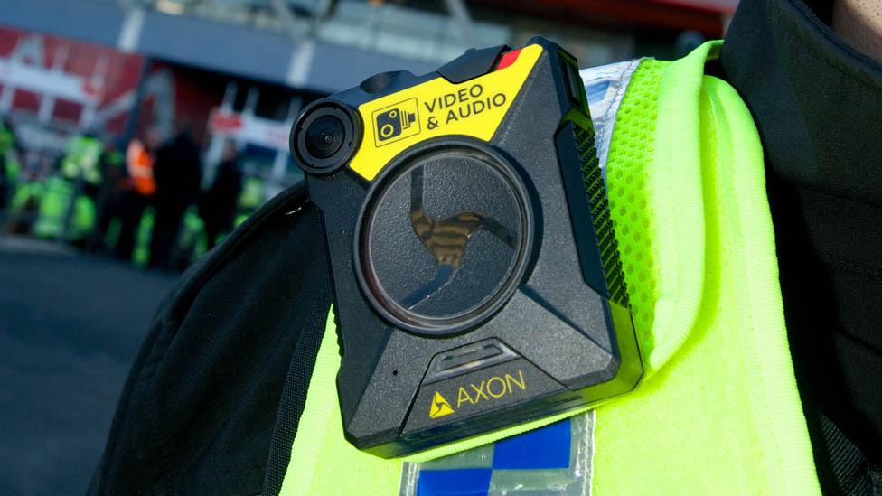
What is Body worn cameras?
Body warn are smalll cameras worn by officers to record audio and visual evidance
The body worn is usally worn on the officers chest on their uniform
The police activate them at the start of an icident and they record until it is no longer necceserry
The footage is stored on the camera then uploaded on to the files for futher investigation
(BWV) continues to represent a significant advancement in our ability to document interactions between the police and the public (NPCC 2024)
(South Wales 2017)

Slide 28
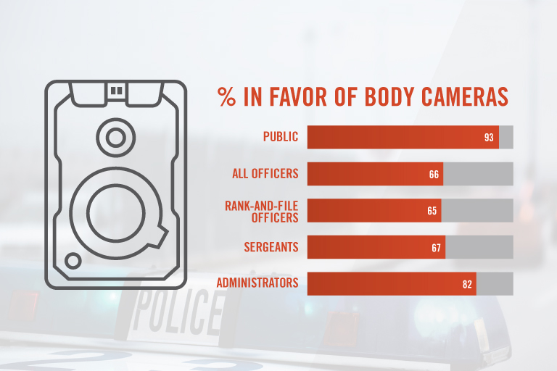
Benefits of body worn cameras
Evidance gathering- All camera footage recorded provide a record for review and possible use in court
Accountability- Body worn can reduce the force of officers and decrease complaints
Transparancy- The pubic can see that they are being recorded during their interactions making trust and transparancy
Training- Footage can be used to train other officers and improve their practises
They also aim to deter misconduct, build community trust (metropolitan police 2021)
(Gatec 2024)

Slide 29
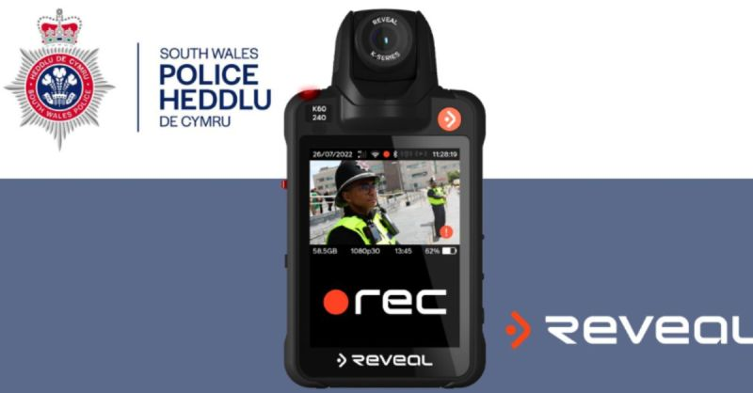
The negatives of body worn cameras
Invasion of privacy- Body worn can be intrusive, individuals who are unaware of recording can cliam an invasion on their privacy
Technical and practical- Body worn can malfunction or be damaged meaning potential loss of evidance if the footage is not transferred
Missuse of footage- Recording without proper justifcation to or not activating the camera where it should be used
Research suggests that the presence of BWCs in domestic abuse cases may have unintended impacts on the victim, such as increasing their fear of further abuse if the perpetrator is aware they are being filmed (Titeheradge 2023)
(Media 2025)

Slide 30

Statistics
Reported by 15 studies, and the meta-analysis found a small (15.9%) increase in assaults or resistance against officers wearing BWCs. (college of policing 2021)
Outcome measures on complaints against police were reported by 22 of the 30 studies. A significant reduction of 16.6% was found in those wearing BWCs compared to the control groups without BWCs. (college of policing 2021)
a 50% reduction in the odds of force being used was recorded when body worn cameras are present compared to control conditions (Henstock 2015)

Slide 31
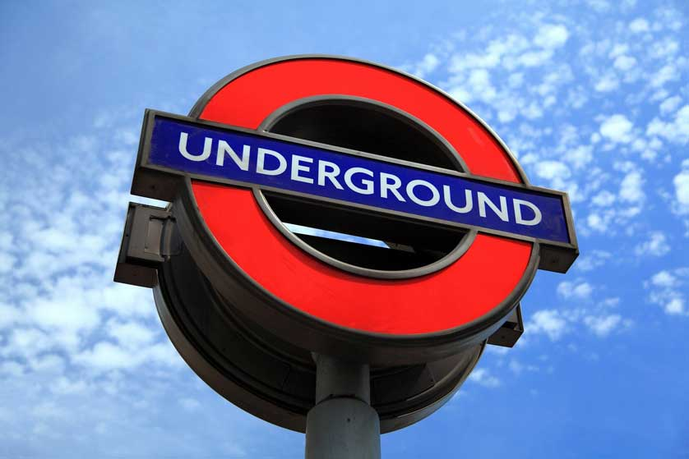
Case study
Use of body worn
Officers recordered the whole inicdent using their body worn cameras
The footage gathered aggressive behaviour and physcial assualt from the man in question
Outcome
Video eveidnce led the man to plead guilty and was sentenced to 12 weeks imprisoment for each assualt
Impact of the body worn
Provided clear, objective evidence for prosecution.
Helped protect officers and support swift justice.
Encouraged TfL to expand body camera use
(Matters 2020)
A case study on a man who verbally abused and assaulted two london tube station staff in baker street in 2020
Brittan visitor 2021

Slide 32

Conclusion
Body-worn cameras have improved transparency, reduced complaints, and decreased use-of-force incidents in UK policing. They provide crucial evidence in legal cases, speeding up prosecutions and increasing conviction rates. The cameras also act as a deterrent, promoting better behavior from both officers and the public. While challenges like privacy concerns remain, BWCs have significantly enhanced officer safety and public trust, shaping the future of policing in the UK.
(South Wales Police 2021)

Slide 33
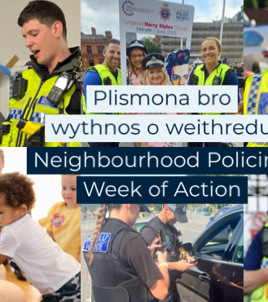
Overall conclusion
The introduction of body-worn cameras, youth engagement initiatives, neighbourhood policing, and community meetings has had a major positive impact on UK policing.
Body-worn cameras have improved transparency and trust, while youth engagement has helped build early positive relationships between young people and the police. Neighbourhood policing teams have strengthened local connections and increased community safety, and regular community meetings have given the public a stronger voice, improving cooperation and confidence. Together, these strategies have made policing more accountable, more visible, and more community-focused across the UK.

Slide 34
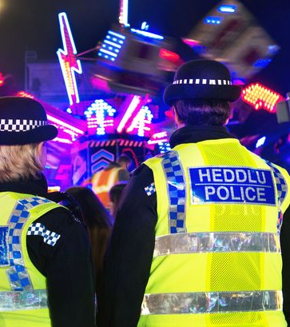
Reference list
bbc (2017). Frontline South Wales Police officers get body cameras. BBC News. [online] 17 May. Available at: https://www.bbc.co.uk/news/uk-wales-39949232.
Britain Visitor - Travel Guide To Britain. (2021). London Underground Logo. [online] Available at: https://www.britain-visitor.com/britain-images/britain-image-7 [Accessed 27 Apr. 2025].
College of Policing (2021). Body-worn Cameras. [online] College of Policing. Available at: https://www.college.police.uk/research/crime-reduction-toolkit/body-worn-cameras.
getac (2024). Seven Ways Police Body Camera Technology is Beneficial for Everyone. [online] Getac. Available at: https://www.getac.com/us/blog/seven-ways-police-body-camera-technology-is-beneficial-for-everyone/# [Accessed 27 Apr. 2025].
Henstock, D. (2015). Testing the Effects of Body Worn Video on Police Use of Force during Arrest: A Randomised Controlled Trial Submitted in part fulfilment of the Requirements for the Masters Degree in Applied Criminology and Police Management Number of words: 17,994 MSt in Applied Criminology and Police Management 2015. [online] Available at: https://www.crim.cam.ac.uk/system/files/documents/darren-henstock.pdf.
Matters, T. for L. | E.J. (2020). Body worn camera evidence again plays a key role in securing a conviction for assault against TfL officers. [online] Transport for London. Available at: https://tfl.gov.uk/info-for/media/press-releases/2021/november/body-worn-camera-evidence-again-plays-a-key-role-in-securing-a-conviction-for-assault-against-tfl-officers.
Media, R. (2025). [online] Linkedin.com. Available at: https://www.linkedin.com/posts/reveal-media-ltd_the-ability-to-maximize-your-evidence-management-activity-7308910098091761664-dRxC [Accessed 27 Apr. 2025].
Metropolitan Police (2021). How and when BWV cameras are used. [online] Metropolitan Police. Available at: https://www.met.police.uk/advice/advice-and-information/bwv/body-worn-video-bwv/how-and-when-bwv-cameras-are-used/.
NPCC (2024). BODY-WORN VIDEO GUIDANCE 2024. [online] Available at: https://www.npcc.police.uk/SysSiteAssets/media/downloads/publications/publications-log/local-policing-coordination-committee/2024/npcc-bwv-guidance-2024.pdf.
Titheradge, N. (2023). Police officers widely misusing body-worn cameras. BBC News. [online] 27 Sep. Available at: https://www.bbc.co.uk/news/uk-66809642.
Wikipedia. (2022). South Wales Police. [online] Available at: https://en.wikipedia.org/wiki/South_Wales_Police.

