Slide 1

DIGITAL PORTFOLIO AND REFLECTION
STUDENT NAME: Sorin-Marius Pandelea
STUDENT ID: 2537441

Slide 2
INTRODUCTION
The portfolio includes an overview of different activities; I have completed in this portfolio.
A reflection on my development and challenges faced.
An Overview of the ways these skills will help me in study, work and daily life.
Notes:
Through this audio recording, I am going to explain to you my journey across the Digital Skills Module. Throughout this module, I had to engage in various type of tasks, of which I am going to describe three of them. These tasks were extremely helpful and allowed me to develop essential academic and digital skills. However, I did faced several challenges and complications throughout the process. But in the end, I was able to complete the tasks successfully, develop confidence in my digital skillset and ability to use them carefully in my daily, study and work life.

Slide 3
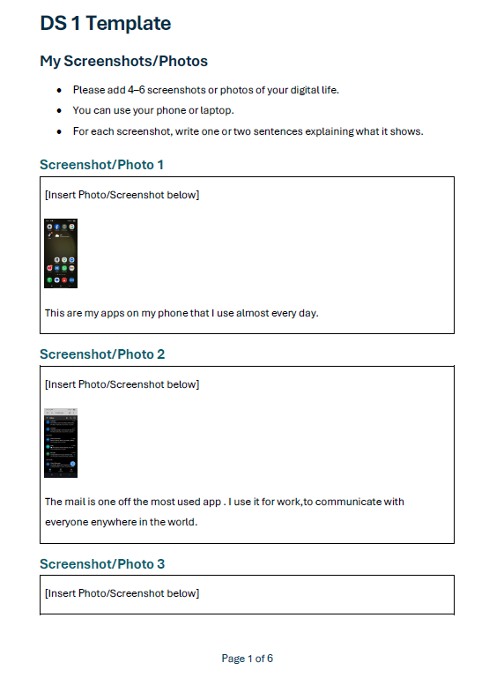
MY PORTFOLIO AND WORKS: WORK 1: WORD DOCUMENT
Task involved adding screenshots pertaining to my digital life.
It included adding an explanation relating to the screenshots.
I also had to edit the pictures within the table and add page numbers.
Notes:
This task required me to add screenshot of 4-6 pictures that was represented of my digital life. I added the screenshots within the table, and included a small line explaining the meaning of the screenshot used. I also added page numbers.

Slide 4
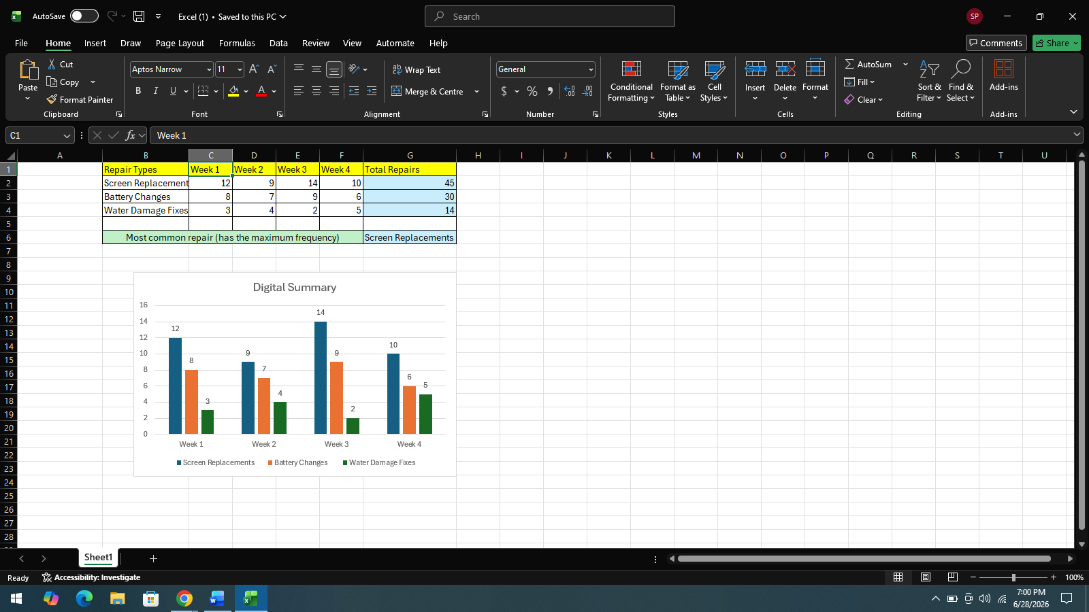
WORK 2: EXCEL TASK
Organizing a set of information in Excel in a table format.
Applying Excel formulae to calculate total and identify the most common replacement type.
Inserted a chart in the Excel Sheet.
Notes:
For this task, I was required to organise a set of information in MS Excel. I added the information, in a logical table format. I applied SUM formula to calculate the total and used the MAX function to calculate the most common replacement type. Furthermore, I also illustrated the information using a well-labelled chart.

Slide 5
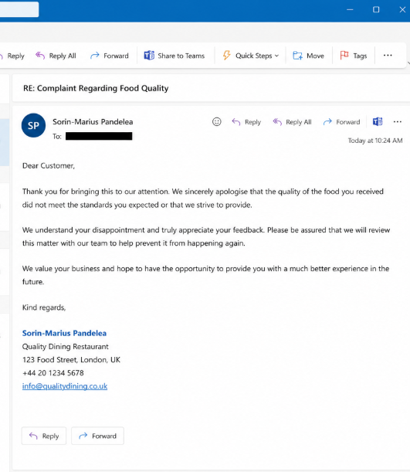
WORK 3: SENDING AND CHECKING E-MAIL
I created an email as part of Week 7 Activity.
The email involved writing a response to a customer complaint.
This helped me improve my ability to write professional email.
Notes:
I created a email, as a part of the Week 7 activity of Sending and Checking an Email. The email required us to write a clear and polite response to a customer complaint.

Slide 6
MY DEVELOPMENT
Initially I faced challenges of applying correct format in the word documents, using proper MS Excel formulae and producing clear charts.
I also found it difficult to maintain a professional tone, while communicating using e-mail.
I lacked sufficient confidence in using the digital techniques and tools.
With practice and regular feedback from my tutor, I developed my confidence.
Notes:
In this module of Digital Skills I had to meet a number of challenges, such as correct formatting into Word documents, accurate input of formulas into Excel spreadsheets, producing clear charts and having a professional tone for emails. I did not have confidence in using some of the digital tools at first and required more practice to carry out the tasks appropriately. But, overcoming these difficulties gave me better proficiency in word processing, spreadsheets and communicating with e-mail. I also developed my digitisation skills, professional communication and attention to detail, problem solving abilities.

Slide 7
REFLECTION
Through this module, I have Improved my MS Word organisation, formatting, and document presentation skills.
I developed Excel data management, formulas, tables, and chart skills.
I also learned ways to frame professional, polite, and empathetic digital email communication.
This module has strengthened my problem-solving abilities through practice and correcting mistakes.
It increased my digital literacy, confidence, and independent learning skills.
Notes:
On reflection, the three tasks done in the Digital Skills module have taught me quite a bit and had given me some valuable skills that have given me increased confidence in myself using digital technologies. The Word task has helped me develop essential organisational skills, while arranging visual information taught to me, ways to insert and format screenshots, use tables in Class Actions, how to add page numbers and how to present content clearly and structure it. By a lot of practice and carefully following instructions, I was able to develop my skill to navigate through MS Word.
The Excel task allowed me to get good at arranging data, using functions like 'SUM' and 'MAX'. I also learned how to correctly format tables, create labels and charts to visually communicate information. To get better and better with Excel data, I was able to practice other functions and also fix my errors.
Finally, the email task revealed the importance of communicating professionally through digital means, especially when dealing with a customer complaint. It demonstrated the use of a polite, straightforward and compassionate voice.
I gained good overall digital literacy, communication skills, problem solving skills alongside an increase of confidence through feedback, practice and through self-directed activities.

Slide 8

CONCLUSION
Developed confidence using Word, Excel, and Outlook effectively.
The module improved my academic skills for assignments, data organisation, and analysis.
I learned to create professional documents, charts, and presentations.
The module strengthened my professional communication with customers, colleagues, and lecturers.
The module enhanced my ability to perform everyday tasks such as digital organisation, email management, and technology confidence.
Notes:
Completing this portfolio has been a great learning opportunity and has enabled me to get a variety of digital skills. The various activities gave me the opportunity to learn and become confident using these office applications (word, excel, outlook emails) effectively. The skills will help me in my studies whilst preparing assignments, organising data, analysing it, making charts and communicating with lecturers and other students in the class. I am able to apply these skills in the workplace to create professional documents, handle information, interpret simple information and interact professionally with customers and colleagues. Digital skills can help me to organise personal information, manage email and to become more comfortable and responsible with technology, in my everyday life.

Slide 9
THANK YOU

