Slide 1
Sesiwn 8
Damcaniaethau Arweinyddiaeth a Rheolaeth mewn Arfer
Session 8
Leadership and Management Theories in Practice

Slide 2
Cynnwys
Contents
Cyflwyniad;
Hunaniaeth arweinyddiaeth;
Damcaniaethau arweinyddiaeth;
Diwylliant sefydliadol;
Arweinyddiaeth foesegol;
Arloesedd a newid;
Cymorth ar gyfer yr asesiad.
Introduction;
Leadership identity;
Leadership theories;
Organisational culture;
Ethical leadership;
Innovation and change;
Assessment support.

Slide 3
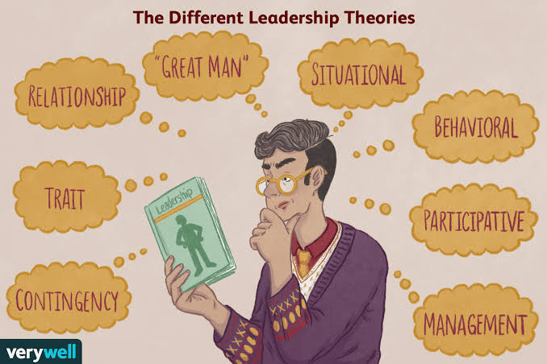
Adran 1
Section 1
Cyflwyniad
Introduction
(Source: Verywell Mind, 2025)

Slide 4
Deilliannau dysgu
Learning outcomes
Uned 406
DD1 – Deall dulliau damcaniaethol
Uned 407
DD3 – Deall dulliau, sgiliau a rhinweddau ar gyfer arweinyddiaeth a rheolaeth effeithiol.
Unit 406
LO1 – Understand theoretical approaches
Unit 407
LO3 – Understand approaches, skills and qualities for effective leadership and management.

Slide 5
Nod y sesiwn
Aim of session
Gwerthuso damcaniaethau ac arddulliau arweinyddiaeth;
Archwilio diwylliant sefydliadol ac arweinyddiaeth foesegol;
Cymharu dulliau arloesi a rheoli newid;
Cymhwyso damcaniaethau arweinyddiaeth i arfer yn y gweithle;
Myfyrio ar hunaniaeth arweinyddiaeth sy'n datblygu a pharatoi ar gyfer Patch 5.
Evaluate leadership theories and styles;
Explore organisational culture and ethical leadership;
Compare approaches to innovation and change management;
Apply leadership theories to workplace practice;
Reflect on developing leadership identity and prepare for Patch 5.

Slide 6
Asesiad
Assessment
Patch 5
Damcaniaethau Arweinyddiaeth mewn Arfer
Patch 5
Leadership Theory in Practice

Slide 7
Hunaniaeth arweinyddiaeth
Leadership identity
Pa arddull arweinyddiaeth yr wyf yn ei defnyddio fel arfer?
Pa dystiolaeth sy'n cefnogi hyn?
Sut byddai cydweithwyr yn fy nisgrifio?
Pa ddamcaniaeth arweinyddiaeth sy'n adlewyrchu fy ngwerthoedd orau?
• What leadership style do I naturally adopt?
• What evidence supports this?
• How would colleagues describe me?
• What leadership theory best reflects my values?

Slide 8

Cwis hunaniaeth arweinyddiaeth
Leadership identity quiz
https://www.teamazing.com/leadership-style-quiz/
(Source: Merriam-Webster, 2026)

Slide 9
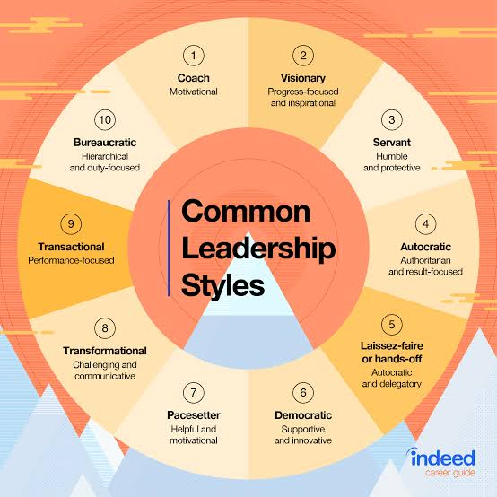
Adran 2
Section 2
Damcaniaethau arweinyddiaeth
Leadership theory
(Source: Indeed, 2026)

Slide 10
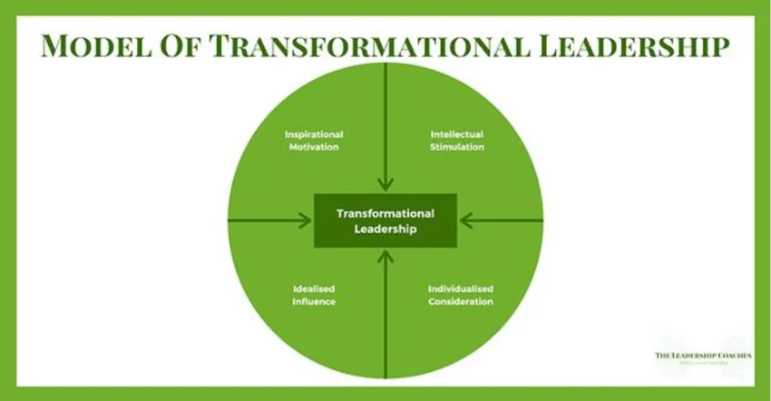
Arweinyddiaeth Drawsnewidiol
Transformational Leadership
“Transformational leaders seek to create significant change in the life of both organisations and the people in them through developing a vision for the future, to which all can enthusiastically commit. Transformational leadership is needed when rapid and radical change is being experienced.”
(Lindon and Lindon, 2012, page 55).
(Bass, 1985; Burns, 1978)

Slide 11
Arweinyddiaeth Drawsnewidiol
Transformational Leadership
Arweinwyr gweledigaethol;​
Yn symud ymlaen yn barhaol​;
Ehangu sgiliau a gwybodaeth;​
Y gallu i ddatblygu a newid arfer​.
Visionary leaders​;
Moving forward continuously​;
Expanding skills and knowledge​;
Ability to develop and change practice​.
(Davis et al., 2022)

Slide 12
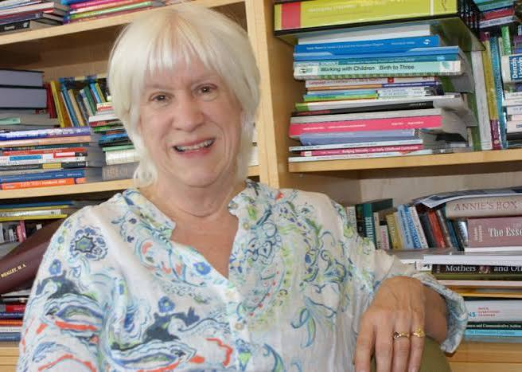
Dr Margy Whalley
Hyrwyddo partneriaeth â rhieni;
Datblygu ymchwil gan ymarferwyr;
Creu diwylliant o arfer myfyriol;
Grymuso staff i ddod yn arweinwyr ac ymchwilwyr.
Championed partnership with parents;
Developed practitioner research;
Created a culture of reflective practice;
Empowered staff to become leaders and researchers.
(Source: Northamptonshire Telegraph, 2016)

Slide 13
Esiampl ar sail arfer
Practice-based example
Mae arweinydd meithrinfa yn datblygu gweledigaeth i wella dysgu yn yr awyr agored ar draws y lleoliad. Mae'n rhannu ei frwdfrydedd gyda'r staff, yn cynnwys pawb wrth gynllunio'r newidiadau, yn annog syniadau newydd, ac yn darparu cyfleoedd hyfforddi. Dros amser, mae ymarferwyr yn dod yn fwy hyderus, yn cymryd perchnogaeth o'r prosiect, ac yn creu profiadau dysgu arloesol yn yr awyr agored i blant.
A nursery leader develops a vision to improve outdoor learning across the setting. They share their enthusiasm with staff, involve everyone in planning changes, encourage new ideas, and provide training opportunities. Over time, practitioners become more confident, take ownership of the project, and create innovative outdoor experiences for children.

Slide 14
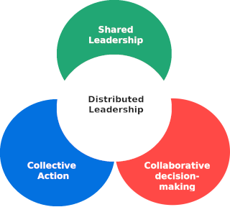
Arweinyddiaeth Wasgaredig
Distributed Leadership
“Distributed leadership is a deliberate organisational strategy in which aspects of leadership behaviour and actions are shared with some, not necessarily all, staff throughout an organisation.”
(Lindon and Lindon, 2012, page 119).
(Spillane,2006)

Slide 15
Arweinyddiaeth Wasgaredig
Distributed Leadership
Mae hyn yn edrych yn bellach na UN math o arweinydd.​
Rhannu​;
Gwasgaru​;
Democratig​;
Cynhywsol​.
This looks beyond the leadership of ONE leader.​
Shared​;
Dispersed​;
Democratic​;
Inclusive. ​

Slide 16
Esiampl ar sail arfer
Practice-based example
Mae arweinydd Cylch Meithrin yn cydnabod cryfderau gwahanol ymarferwyr. Mae un ymarferydd yn arwain datblygiad y Gymraeg, mae un arall yn cydlynu dysgu awyr agored, ac mae trydydd yn gyfrifol am ymgysylltu â theuluoedd. Mae staff yn rhannu syniadau'n rheolaidd ac yn cyfrannu at wneud penderfyniadau. Mae'r arweinydd yn cydlynu ac yn cefnogi'r rolau hyn ond nid yw'n gwneud pob penderfyniad ar ei ben ei hun.
A Cylch Meithrin leader recognises the strengths of different practitioners. One practitioner leads Welsh language development, another coordinates outdoor learning, and another takes responsibility for family engagement. Staff regularly share ideas and contribute to decision-making. The leader coordinates and supports these roles but does not make all decisions alone.

Slide 17
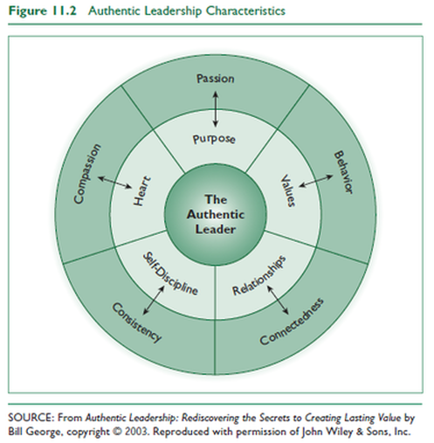
Arweinyddiaeth Ddilys
Authentic Leadership
“People of the highest integrity, committed to building enduring organizations…who have a deep sense of purpose and are true to their core values, who have the courage to build their companies to meet the needs of all their stakeholders, and who recognize the importance of their service to society.”
(George, 2015, page 1).
(George, 2003)

Slide 18
Arweinyddiaeth Ddilys
Authentic Leadership
Mae arweinydd dilys yn aml yn cael ei nodweddu gan:
Bod yn ddiffuant;
Cael ei arwain gan werthoedd;
Bod yn dryloyw;
Bod yn hunanymwybodol;
Bod yn foesegol.
An authentic leader are often characterised as being:
Genuine;
Values-driven;
Transparent;
Self-aware;
Ethical.

Slide 19
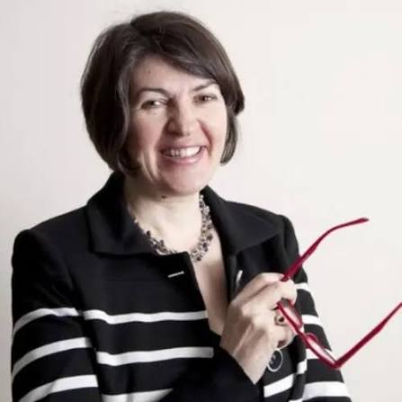
June O’Sullivan OBE
Gwella deilliannau plant a theuluoedd;
Arwain drwy werthoedd clir;
Hyrwyddo cyfathrebu agored;
Annog arfer myfyriol;
Meithrin ymddiriedaeth gyda staff a rhieni.
Improves outcomes for children and families;
Clear values;
Promotes open communication;
Encourages staff to reflect on their practice;
Builds trusting relationships with colleagues and parents.
(Source: Family, 2021)

Slide 20
Esiampl ar sail arfer
Practice-based example
Mewn lleoliad BC, gallai arweinydd dilys rannu ei werthoedd a'i weledigaeth ar gyfer dysgu plant yn agored, cyfaddef pan fydd wedi gwneud camgymeriad, ceisio adborth gan staff a rhieni, a sicrhau bod penderfyniadau'n gyson ag anghenion plant a theuluoedd. Drwy weithredu gydag uniondeb a thryloywder, mae'n meithrin ymddiriedaeth ac yn annog eraill i wneud yr un fath.
In an EY setting, an authentic leader might openly share their values and vision for children's learning, admit when they have made mistakes, seek feedback from staff and parents, and ensure that decisions are consistent with the needs of children and families. By acting with integrity and transparency, they build trust and encourage others to do the same.

Slide 21
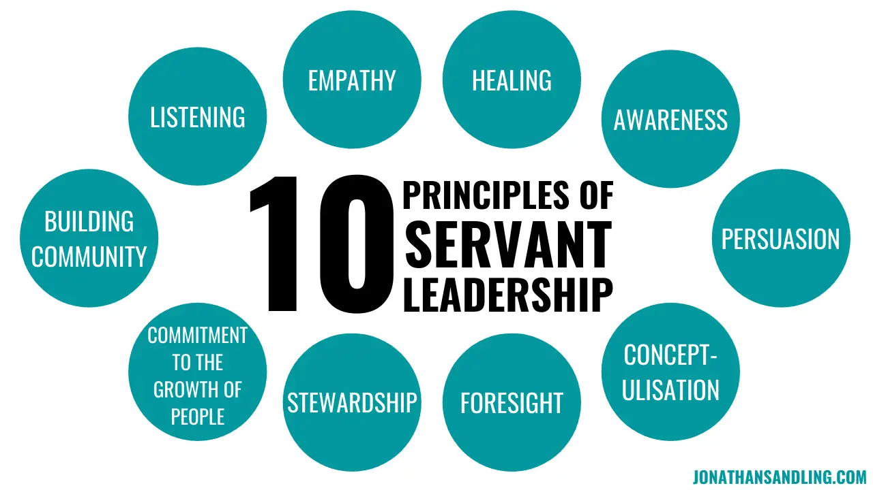
Arweinyddiaeth Wasanaethol
Servant Leadership
“The servant-leader is servant first. It begins with a natural feeling that one wants to serve…as opposed to wanting power, influence, fame or wealth.”
“Good leaders must first become good servants.”
(Greenleaf, 1998)
(Greenleaf, 1970,1977)

Slide 22
Arweinyddiaeth Wasanaethol
Servant Leadership
Blaenoriaethu llesiant plant, teuluoedd a staff;
Cefnogi datblygiad proffesiynol ymarferwyr;
Creu amgylchedd cynhwysol a gofalgar;
Annog gwaith tîm a chydweithio;
Gwrando ar farn plant, rhieni a chydweithwyr;
Arwain drwy wasanaeth yn hytrach nag awdurdod.
Prioritises the wellbeing of children, families, and staff;
Supports practitioners' professional development;
Creates an inclusive and caring environment;
Encourages teamwork and collaboration;
Listens to the views of children, parents, and colleagues;
Leads through service rather than authority.

Slide 23
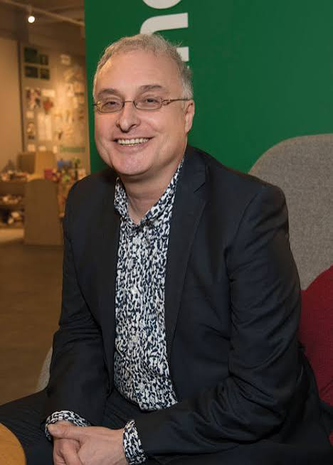
Jan Dubiel
Cefnogi ymarferwyr;
Datblygu gallu proffesiynol;
Rhoi anghenion plant wrth wraidd y broses o wneud penderfyniadau.
Supports practitioners;
Develops professional capacity;
Places children’s needs at centre of decision-making.
“One of the most influential people in British education” (Times Educational Supplement).
(Source: Schools Week, 2026)

Slide 24
Esiampl ar sail arfer
Practice-based example
Mewn lleoliad BC, gall arweinydd gwasanaethol dreulio amser yn cefnogi llesiant staff, mentora ymarferwyr newydd, gwrando ar bryderon rhieni, a sicrhau bod penderfyniadau'n cael eu gwneud er budd gorau plant. Mae'r arweinydd yn canolbwyntio ar helpu eraill i lwyddo yn hytrach na cheisio statws neu reolaeth.
In an EY setting, a servant leader may spend time supporting staff wellbeing, mentoring new practitioners, listening to parents' concerns, and ensuring that decisions are made in the best interests of children. The leader focuses on helping others succeed rather than seeking status or control.

Slide 25
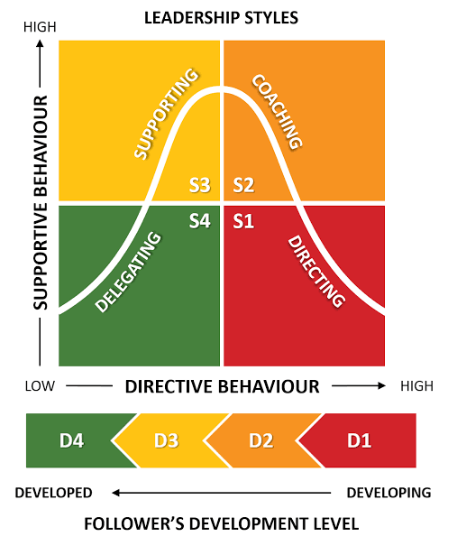
Arweinyddiaeth Sefyllfaol
Situational Leadership
“…successful leaders must tailor their approach to the maturity of the followers and the situation, or details and environment, of the assignment. To achieve the organization's goals, leaders must evaluate the specifics of the work involved and the emotional or relational support the followers seem to require.”
(Campbell, 2022, page 1).
(Hersey and Blanchard, 1969)

Slide 26
Arweinyddiaeth Sefyllfaol
Situational Leadership
Yn addasu eu harddull arwain i wahanol sefyllfaoedd;
Yn darparu lefelau gwahanol o gefnogaeth yn ôl anghenion staff;
Yn ymateb yn hyblyg i heriau a chyfleoedd;
Yn datblygu ymarferwyr yn ôl eu profiad a'u hyder;
Yn canolbwyntio ar sicrhau'r deilliannau gorau i blant.
Adapt their leadership style to different situations;
Provide different levels of support depending on staff needs;
Respond flexibly to challenges and opportunities;
Develop practitioners according to their experience and confidence;
Focus on achieving the best outcomes for children.

Slide 27
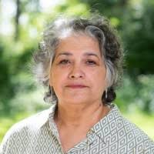
Dr Iram Siraj
Wedi arwain astudiaethau REPEY ac EPPE;
Addasu dulliau arwain i wahanol gyd-destunau;
Hyrwyddo arweinyddiaeth addysgegol mewn lleoliadau Blynyddoedd Cynnar;
Cefnogi datblygiad proffesiynol wedi'i deilwra i ymarferwyr;
Annog arfer wedi'i seilio ar dystiolaeth ac arfer myfyriol;
Ymateb yn hyblyg i anghenion amrywiol plant, teuluoedd a staff.
Lead the REPEY and EPPE studies;
Adapted leadership approaches to different contexts;
Supported tailored professional development for practitioners;
Encouraged evidence-informed and reflective practice;
Responded flexibly to the diverse needs of children, families, and staff.
(Source: LinkedIn, 2026 )

Slide 28
Esiampl ar sail arfer
Practice-based example
Mae arweinydd BC yn cefnogi dau ymarferydd. Mae un newydd gymhwyso ac angen arweiniad manwl wrth gynllunio gweithgareddau, tra bod y llall yn brofiadol ac yn hyderus wrth arwain profiadau dysgu. Mae'r arweinydd yn darparu cefnogaeth a hyfforddiant agos i'r ymarferydd newydd ond yn rhoi mwy o annibyniaeth i'r ymarferydd profiadol. Drwy addasu ei ddull yn unol ag anghenion pob unigolyn, mae'r arweinydd yn dangos arweinyddiaeth sefyllfaol.
An EY leader is supporting two practitioners. One is newly qualified and requires detailed guidance when planning activities, while the other is experienced and confident in leading learning experiences. The leader provides close support and coaching to the new practitioner but gives the experienced practitioner greater autonomy. By adapting their approach to each individual's needs, the leader demonstrates situational leadership.

Slide 29

Arweinyddiaeth Dosturiol
Compassionate Leadership
“Compassionate leadership involves attending to every person we lead, understanding their challenges, empathising with them, and helping them. It is quintessentially inclusive. It implies our ability to be equally present will all team members; to have frequent positive contact and develop our understanding and empathy; to respond differentially in a supportive way with team members based on differences between them; and to support, help and mentor all team members, including managing the inevitable team conflicts in a way that is respectful and inclusive.”
(West, 2021, page 132).
(West and Chowla, 2017)

Slide 30
Arweinyddiaeth Dosturiol
Compassionate Leadership
Empathi a dealltwriaeth;
Gwrando gweithredol;
Cefnogi llesiant;
Meithrin ymddiriedaeth a pherthnasoedd cadarnhaol;
Arwain gyda charedigrwydd a pharch.
Empathy and understanding;
Active listening;
Supporting wellbeing;
Building trust and positive relationships;
Leading with kindness and respect.

Slide 31
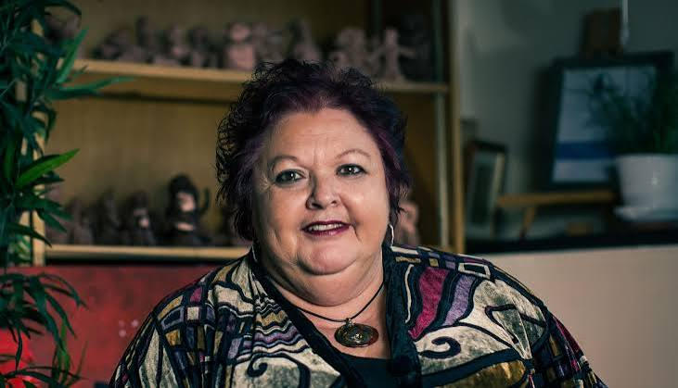
Dr Cathy Nutbrown
Hyrwyddo cefnogaeth o ansawdd uchel i'r gweithlu Blynyddoedd Cynnar;
Eirioli dros hawliau a llesiant plant;
Hyrwyddo arfer cynhwysol a pharchus;
Gwerthfawrogi a datblygu ymarferwyr drwy ddysgu proffesiynol;
Annog perthnasoedd gofalgar wrth wraidd y ddarpariaeth.
Championed high-quality support for the Early Years workforce;
Advocated for children's rights and wellbeing;
Promoted inclusive and respectful practice;
Valued and developed practitioners through professional Learning;
Encouraged caring relationships at the heart of Provision.
(Source: Early Education, 2021 )

Slide 32
Esiampl ar sail arfer
Practice-based example
Mae arweinydd BC yn sylwi bod ymarferydd yn cael trafferth gyda phwysau gwaith. Yn hytrach na beirniadu perfformiad, mae'r arweinydd yn trefnu trafodaeth gefnogol, yn gwrando ar bryderon, yn cynnig mentora, ac yn addasu cyfrifoldebau lle bo modd. Trwy flaenoriaethu llesiant wrth gynnal safonau uchel i blant, mae'r arweinydd yn dangos arweinyddiaeth dosturiol.
An EY leader notices that a practitioner is struggling with workload pressures. Rather than criticising performance, the leader arranges a supportive discussion, listens to concerns, offers mentoring, and adjusts responsibilities where possible. By prioritising wellbeing while maintaining high standards for children, the leader demonstrates compassionate leadership.

Slide 33
Trafodwch
Discuss
Pa ddamcaniaeth arweinyddiaeth sy’n adfyfyrio eich arfer chi orau?
Trawsnewidiol;
Gwasgaredig;
Dilys;
Gwasanaethol;
Sefyllfaol;
Tosturiol.
Which leadership theory best reflects your current practice?
Transformational;
Distributed;
Authentic;
Servant;
Situational;
- Compassionate.

Slide 34

Adran 3
Section 3
Diwylliant sefydliadol
Organisational culture
(Source: DDI, 2026)

Slide 35
Diffiniad
Definition
“…organisational culture varies between organisations, which have their own values, beliefs, history, ways of using language, and generally accepted ways of doing things. What people do is significantly influenced by the organisational culture of the setting.
Organisational culture is sometimes referred to in simple terms as ‘the way we do things around here’, a description first made popular by Deal and Kennedy (1982).”
(Radford, 2024, page 124).

Slide 36
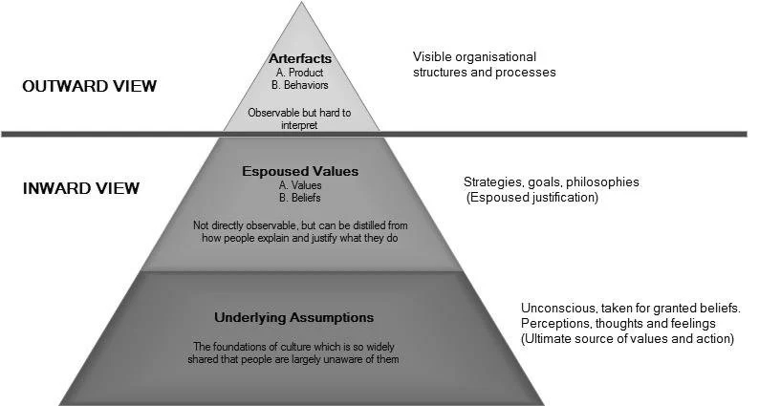
Model Schein
Schein’s model

Slide 37
Esiampl
Example
Schein’s Level | Example in a Cylch Meithrin
Artefacts | Welsh language displays Outdoor learning environments Welcoming environment
Espoused values | Commitment to Welsh-medium education Play-based learning
Underlying assumptions | Belief that children learn best through play and immersion in the Welsh language

Slide 38
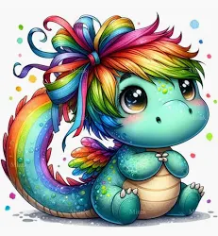
Senario
Scenario
Mae gan Feithrinfa Ddraig yr Enfys datganiad sydd yn pwysleisio:
Parch; 2. Cynhwysiant; 3. Arfer plentyn-ganolog.
Fodd bynnag, ymddengys mewn adroddiadau diweddar bod:
Trosiant staff uchel;
Cynnych mewn cwynion o rhieni;
Darpariaeth wan o’r Gymraeg;
Staff yn adrodd nad ydynt yn teimlo eu bod yn cael cefnogaeth o arweinwyr.
Rainbow Dragon Nursery has a mission statement that emphasises:
Respect; 2.Inclusion; 3. Child-centred practice.
However, recent reports show that:
Staff turnover is high;
Parents complaints are increasing;
Welsh language provision is weak;
Staff report feeling unsupported by leaders.

Slide 39
Trafodwch
Discuss
Ystyriwch sut mae cysylltu’r senario gyda model Schein.
Arteffactau – yr hyn gallwn ei weld;
Gwerthoedd datganedig – yr hyn mae’r feithrinfa’n dweud ei bod yn ei gredu;
Rhagdybiaethau sylfaenol – yr hyn mae pobl yn ei gredu go iawn.
Consider how this scenario could relate to Schein’s model.
Artefacts – what we can see;
Espoused values – what the nursery says it believes;
Underlying assumptions – what people really believe.

Slide 40
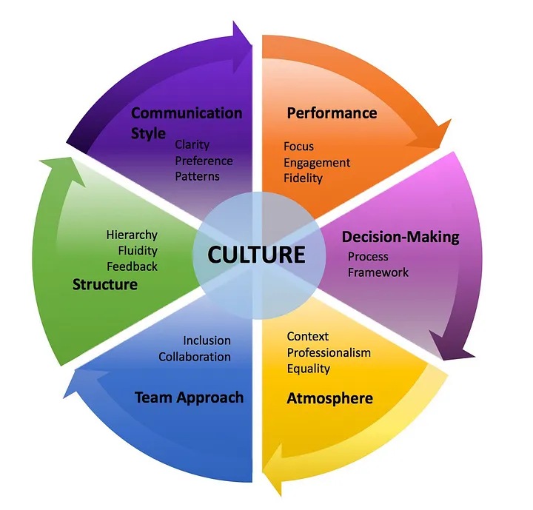
Pwysigrwydd diwylliant sefydliadol
The importance of organisational culture
“An organization’s culture is only as good as the leadership that is demonstrated. By establishing trust and an ethical standard for codes of conduct within the organization, subordinates will feel empowered and obtain faith and confidence within the organization. The impact of trust within an organization allows for better productivity and a positive work environment. Without establishing trust in the organization, each employee will be in it for themselves, as opposed to working for one another.”
(Vasquez, 2022, page 1).

Slide 41
Dyfyniad
Quotation
“Organizational culture can significantly influence the performance and effectiveness of a company; the morale and productivity of its employees; and its ability to attract, motivate, and retain talented people. Unfortunately, many leaders are either unaware of the significant impact culture can have, are aware but overwhelmed by the extensive and sometimes conflicting information available on culture, or are not well informed about how to build and sustain cultures effectively.”
(Warrick, 2017, page 1).

Slide 42
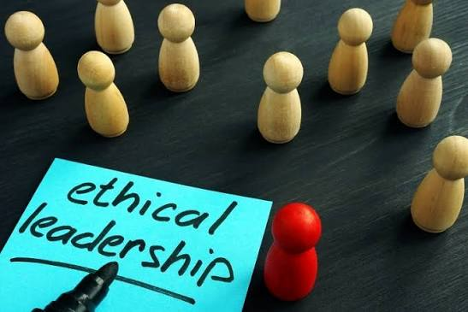
Adran 4
Section 4
Arweinyddiaeth foesegol
Ethical leadership
(Source: Thomas International, 2026)

Slide 43
Trafodwch
Discuss
Sut allai arweinyddiaeth foesegol edrych?
What might ethical leadership look like?

Slide 44
Diffiniad
Definition
Mae arweinyddiaeth foesegol yn golygu bod arweinwyr yn gweithredu mewn ffordd deg, onest a moesol briodol, tra'n annog eraill i ymddwyn yn foesegol drwy gyfathrebu, gwneud penderfyniadau a bod yn fodelau rôl cadarnhaol.
Ethical leadership involves leaders acting in ways that are fair, honest, and morally appropriate, while encouraging others to behave ethically through communication, decision-making, and positive role modelling.
(Pletz et al., 2025).

Slide 45
Ymchwil
Research
Mae canfyddiadau ymchwil yn dangos bod arweinwyr moesegol yn hyrwyddo:
Ymgysylltiad uwch gan weithwyr;
Perfformiad tîm cryfach;
Mwy o lwyddiant sefydliadol.
Yn ogystal, ceir:
Mwy o ymddiriedaeth gan weithwyr a rhanddeiliaid;
Mwy o deyrngarwch a chynhyrchiant;
Cyfraddau is o ymddygiad ac ymddygiad amhriodol anfoesegol.
Research findings demonstrate that ethical leaders drive:
Higher employee engagement;
Stronger team performance;
Greater organisational success.
There is also:
Greater trust from employees and stakeholders;
Increased loyalty and productivity;
Lower rates of unethical behaviour and misconduct.

Slide 46
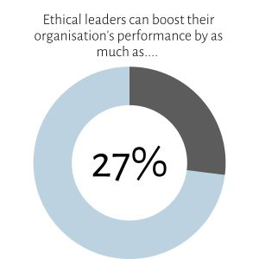
Damcaniaethau allweddol
Arweinyddiaeth Drawsnewidiol (Bass ac Avolio, 1994) - Mae arweinyddiaeth foesegol yn cyd-fynd yn agos ag arweinyddiaeth drawsnewidiol, lle mae arweinwyr yn gweithredu fel modelau rôl, yn ysbrydoli gweledigaeth, ac yn grymuso timau.
Arweinyddiaeth Wasanaethol (Greenleaf, 1977) - Mae arweinydd gwasanaethol yn blaenoriaethu anghenion ei dîm, gan sicrhau bod penderfyniadau moesegol o fudd i weithwyr a'r gymuned ehangach.
Damcaniaeth Rhanddeiliaid (Freeman, 1984) - Mae arweinyddiaeth foesegol yn gofyn am ystyried buddiannau pob rhanddeiliad, nid cyfranddalwyr yn unig, gan sicrhau arferion sefydliadol cynaliadwy.
Damcaniaeth Datblygiad Moesol (Kohlberg, 1973) - Mae'n rhaid i arweinwyr weithredu ar y lefelau uchaf o resymu moesol, gan flaenoriaethu egwyddorion moesegol cyffredinol yn hytrach na buddiannau personol.

Slide 47
Key theories
Transformational Leadership (Bass & Avolio, 1994) - Ethical leadership aligns closely with transformational leadership, where leaders act as role models, inspire vision, and empower teams.
Servant Leadership (Green leaf, 1977) - A servant leader prioritises the needs of their team, ensuring ethical decision-making benefits employees and the wider community.
Stakeholder Theory (Freeman, 1984) - Ethical leadership requires considering the interests of all stakeholders, not just shareholders, ensuring sustainable business practices.
Moral Development Theory (Kohlberg, 1973) - Leaders must operate at the highest stages of moral reasoning, prioritising universal ethical principles over self-interest.

Slide 48
Astudiaeth Achos 1
Case Study 1
Mae ymarferydd sy’n cael ei werthfawrogi’n fawr yn methu’n gyson herio iaith wahaniaethol.
Sut fyddech chi’n gymhwyso arweinyddiaeth foesegol yma?
Pa ddeddfwriaeth allech ddefnyddio?
Ydych chi’n medru cyfiawnhau eich penderfyniadau?
A highly valued practitioner is repeatedly failing to challenge discriminatory language.
How would you apply ethical leadership here?
Which legislation would you use?
Can you justify your decisions?

Slide 49
Astudiaeth Achos 2
Case Study 2
Dim ond cyllid ar gyfer un aelod staff sydd ar gael iddynt fynychu hyfforddiant ar arweinyddiaeth.
Sut fyddech chi’n gymhwyso arweinyddiaeth foesegol yma?
Pa ddeddfwriaeth allech ddefnyddio?
Ydych chi’n medru cyfiawnhau eich penderfyniadau?
There is funding for only one member of staff to attend leadership training.
How would you apply ethical leadership here?
Which legislation would you use?
Can you justify your decisions?

Slide 50
Astudiaeth Achos 3
Case Study 3
Mae teuluoedd yn herio adnoddau Cymru Wrth-hiliol
Sut fyddech chi’n gymhwyso arweinyddiaeth foesegol yma?
Pa ddeddfwriaeth allech ddefnyddio?
Ydych chi’n medru cyfiawnhau eich penderfyniadau?
Families challenge Anti-Racist Wales resources.
How would you apply ethical leadership here?
Which legislation would you use?
Can you justify your decisions?

Slide 51
Negeseuon allweddol
Key messages
Mae arweinwyr moesegol yn cydbwyso tegwch, cynhwysiant a barn broffesiynol;
Dylai penderfyniadau gael eu llywio gan ddeddfwriaeth, gwerthoedd a hawliau plant;
Mae tryloywder a chysondeb yn meithrin ymddiriedaeth;
Dylid cyfiawnhau penderfyniadau anodd drwy ddefnyddio tystiolaeth ac egwyddorion moesegol;
Dylai budd gorau'r plentyn fod wrth wraidd pob penderfyniad.
Ethical leaders balance fairness, inclusion, and professional judgement;
Decisions should be guided by legislation, values, and children's rights;
Transparency and consistency build trust;
Difficult decisions should be justified using evidence and ethical principles;
The best interests of children should remain at the centre of decision-making.

Slide 52
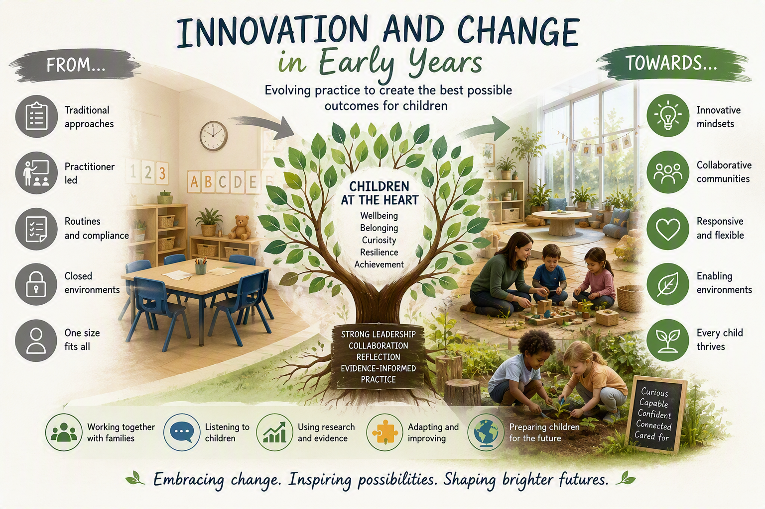
Adran 5
Section 5
Arloesedd a newid
Innovation and change

Slide 53
Trafodwch
Discuss
Beth yw arloesedd?
Pam fod arloesedd yn bwysig mewn arfer blynyddoedd cynnar?
What is innovation?
Why is innovation important in early years practice?

Slide 54
Dyfyniadau
Quotations
“Innovation is the specific instrument of entrepreneurship. The act that endows resources with a new capacity to create wealth.”
(Drucker, 1985, Page 30).
“Change is a journey, not a blueprint”
(Fullan, 1993/1994).

Slide 55
Myth neu Realiti?
Myth or Reality?
Mae arloesedd bob amser yn cynnwys technoleg;
Rhaid i arloesedd fod yn ddrud;
Mae arloesedd bob amser yn llwyddo.
Innovation always involves technology.
Innovation must be expensive.
Innovation always succeeds.

Slide 56
Arloesedd
Innovation
Mae anghenion plant yn newid;
Mae tystiolaeth ymchwil yn esblygu;
Mae cymdeithas a thechnoleg yn newid;
Mae diwygiadau'r cwricwlwm yn gofyn am ddulliau newydd;
Mae gwelliant parhaus yn ddisgwyliad proffesiynol.
Children's needs change;
Research evidence evolves;
Society and technology change;
Curriculum reforms require new approaches;
Continuous improvement is a professional expectation.

Slide 57
Trafodwch
Discuss
Meddyliwch am un peth arloesol rydych wedi'i brofi yn eich lleoliad.
Beth newidiodd?
Pam y cafodd ei gyflwyno?
Beth weithiodd yn dda?
Pa heriau a gododd?
Sut wnaeth y plant elwa?
Think of one innovation you have experienced in your setting.
What changed?
Why was it introduced?
What worked well?
What challenges arose?
How did children benefit?

Slide 58
Astudiaethau Achos
Case Studies
Disodlwyd arsylwadau traddodiadol gan gyfnodolion dysgu digidol.
Daeth dysgu awyr agored yn brif amgylchedd dysgu.
Daeth rhieni yn gyd-addysgwyr drwy weithdai rheolaidd ac ymgysylltu ar-lein.
Pa beth arloesol fyddai'n cael yr effaith fwyaf yn eich lleoliad chi, a pham?
Traditional observations replaced with digital learning journals.
Outdoor learning becomes the primary learning environment.
Parents become co-educators through regular workshops and online engagement.
Which innovation would have the greatest impact in your setting and why?

Slide 59
Damcaniaeth Lledaeniad Arloesedd
Diffusion of Innovation Theory
Arloeswyr;
Mabwysiadwyr Cynnar;
Y Mwyafrif Cynnar;
Y Mwyafrif Hwyr;
Yr Ôl-ddilynwyr.
Innovators;
Early adopters;
Early majority;
Late majority;
Laggards.
(Rogers, 2003)

Slide 60
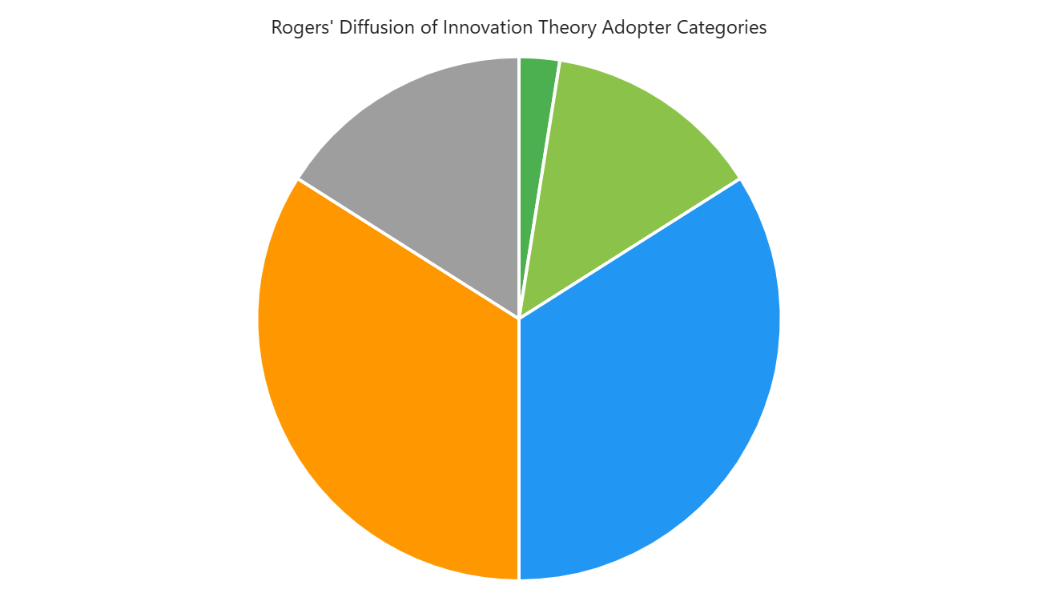
Innovators – 2.5%
Laggards – 16%
Early Adopters – 13.5%
Late Majority – 34%
Early Majority – 34%

Slide 61

Cwis
Quiz
Go to vevox.app
Enter the session ID: 112-916-703
Or scan the QR code

Slide 62
Myfyriad olaf
Final reflection
Y ddamcaniaeth arweinyddiaeth sy'n adlewyrchu fi orau yw...
Y ddamcaniaeth arweinyddiaeth yr hoffwn ei datblygu yw...
Y newid yr hoffwn ei arwain yw...
The leadership theory that best reflects me is...
The leadership theory I want to develop is...
The change I would like to lead is...

Slide 63

Adran 6
Section 6
Cymorth ar gyfer Asesiad Patch 5
Patch 5 Assessment Support
(Source: Access Creative, 2025)

Slide 64
Trosolwg
Overview
Hyd y patch: tua 500 o eiriau;
Sesiynau Perthnasol: Sesiynau 8 a 9;
Pwynt Cyflwyno: Cyflwyniad Portffolio Ffurfiannol;
Cod Lliw y Portffolio: Porffor;
Cysylltiadau AWLIF: Adran 2 DDau 1-3.
Patch Length: 500 words (approx.);
Related Sessions: Sessions 8 and 9;
Submission Point: Formative Portfolio Submission;
Portfolio Colour Code: Purple;
AWLIF Links: Section 2 LOs 1-3.

Slide 65
Tasg asesiad
Assessment task
“Pa ddull arweinyddiaeth sy'n cyd-fynd orau â'm harfer arweinyddiaeth datblygiadol, a pham?”
“Which leadership approach best reflects my developing practice and why?"

Slide 66
Deilliannau dysgu
Learning outcomes
Damcaniaethau arweinyddiaeth;
Damcaniaethau rheolaeth;
Arddulliau arweinyddiaeth;
Diwylliant sefydliadol;
Arloesedd a newid;
Hunaniaeth arweinyddiaeth;
Gwneud penderfyniadau;
Datblygu tîm.
Leadership theories;
Management theories;
Leadership styles;
Organisational culture;
Innovation and change;
Leadership identity;
Decision-making;
Team development.

Slide 67
Damcaniaethau arweinyddiaeth a rheolaeth mewn arfer
Leadership and management theories in practice
Themâu allweddol:
Arweinyddiaeth drawsnewidiol;
Arweinyddiaeth wasgaredig;
Arweinyddiaeth ddilys;
Arweinyddiaeth wasanaethol;
Arweinyddiaeth sefyllfaol;
Arweinyddiaeth dosturiol.
Key themes:
Transformational leadership;
Distributed leadership;
Authentic leadership;
Servant leadership;
Situational leadership;
Compassionate leadership.

Slide 68
Strwythur awgrymedig
Suggested structure
500 gair;
Cyflwyniad – tua 75 gair;
Cyflwynwch:
- Damcaniaethau arweinyddiaeth;
- Eich dewis o ddamcaniaeth/au;
- Perthnasedd i arfer.
500 words;
Introduction – approx. 75 words;
Introduce:
Leadership theory;
Your chosen theory/theories;
Relevance to practice.

Slide 69
Prif gorff
Main discussion
Trosolwg o’r ddamcaniaeth – tua 100 o eiriau;
Esboniwch:
Prif nodweddion;
Egwyddorion craidd;
Nodweddion allweddol.
Overview of theory – approx. 100 words;
Explain:
- Main characteristics;
- Core principles;
- Key features.

Slide 70
Prif gorff
Main discussion
Gwerthusiad feirniadol – tua 175 o eiriau;
Cryfderau;
Cyfyngiadau;
Perthnasedd i arfer arweinyddiaeth;
Addasrwydd ar gyfer Addysg a Gofal Gynnar.
Critical evaluation – approx. 175 words;
- Strengths;
Limitations;
Relevance to leadership practice;
Suitability for Early Education and Care.

Slide 71
Prif gorff
Main discussion
Cymhwyso i’ch hunaniaeth fel arweinydd – tua 100 o eiriau;
Myfyriwch ar:
Gwerthoedd personol;
Cryfderau arweinyddiaeth;
Dyheadau ar gyfer y dyfodol.
Application to leadership identity – approx. 100 words;
Reflect upon:
Personal values;
Leadership strengths;
Future aspirations.

Slide 72
Strwythur awgrymedig
Suggested structure
Casgliad – tua 75 gair;
Crynhowch:
Dysgu allweddol;
Dull arweinyddiaeth sydd orau gennych;
Blaenoriaethau ar gyfer y dyfodol.
Conclusion – approx. 75 words;
Summarise:
Key learning;
Preferred leadership approach;
Future development priorities.

Slide 73
Awgrymiadau defnyddiol
Top tips
Defnyddiwch enghreifftiau o'ch arfer eich hun;
Defnyddiwch enghreifftiau o'ch lleoliad;
Cyfeiriwch at ddeddfwriaeth, polisïau a fframweithiau;
Myfyriwch ar eich rôl fel arweinydd;
Nodwch gamau gweithredu ar gyfer gwelliant yn y dyfodol.
Link theory to your own practice;
Use examples from your setting;
Refer to legislation, policy and frameworks;
Reflect on your role as a leader;
Identify future actions for improvement.

Slide 74
Cyfeirnodi
Referencing
Campbell, J. (2022) Situational leadership theory. Available at: https://www.ebsco.com/research-starters/social-sciences-and-humanities/situational-leadership-theory [Accessed: August 21 2026].
Davis, J., McBrayer, J.S., Miller, S.B. and Fallon, K. (2022) Transformational Leadership and Organizational Citizenship Behavior Motives in Teachers, Journal of Organizational and Educational Leadership, 8(1), p.1. Available at: https://files.eric.ed.gov/fulltext/EJ1364226.pdf [Accessed: August 24 2026].
Drucker, P.F. (1985) Entrepreneurial strategies, California Management Review (pre-1986), 27(000002), p.9. Available at: https://www.proquest.com/docview/206313115?pq-origsite=gscholar&fromopenview=true&sourcetype=Scholarly%20Journals [Accessed: August 24 2026].
Fullan, M. (1993) Change forces: Probing the depths of educational reform (Vol. 10). Psychology Press.
George, B. (2015) Harvard Business School: Authentic leadership rediscovered. Available at: https://billgeorge.org/article/harvard-business-school-authentic-leadership-rediscovered/ [Accessed: August 21 2026].
Greenleaf, R.K. (1998) The power of servant-leadership. Berrett-Koehler Publishers.

Slide 75
Cyfeirnodi
Referencing
Lindon, J. and Lindon, L. (2012) Leadership and early years professionalism. Hodder.
Pletz, V., Tiberius, V. and Meyer, N. (2025 )Ethical leadership: a bibliometric review and research framework with methodological implications. Business Ethics, the Environment & Responsibility, 34(4), pp.2173-2186. Available at: https://onlinelibrary.wiley.com/doi/pdf/10.1111/beer.12754 [Accessed: August 24 2026].
Radford, S. (2024) Survive or thrive? Readiness to teach in early childhood centres through the lens of organisational culture. He Kupu, 8(2), p.110. Available at: https://www.hekupu.ac.nz/sites/default/files/2024-10/12%20Radford.pdf [Accessed: August 20 2026].
Rogers. E.M. (2003) Diffusion of innovations. Free Press.
Vasquez, H. (2022) The importance of organizational culture. Available at: https://medium.com/illumination/the-importance-of-organizational-culture-57d344e6a16f [Accessed: August 20 2026].
Warrick, D.D. (2017) What leaders need to know about organizational culture. Business horizons, 60(3), pp.395-404. Available at: https://doi.org/10.1016/j.bushor.2017.01.011
West, M.A. (2021) Compassionate leadership: Sustaining wisdom, humanity and presence in health and social care. Swirling Leaf Press.

Slide 76
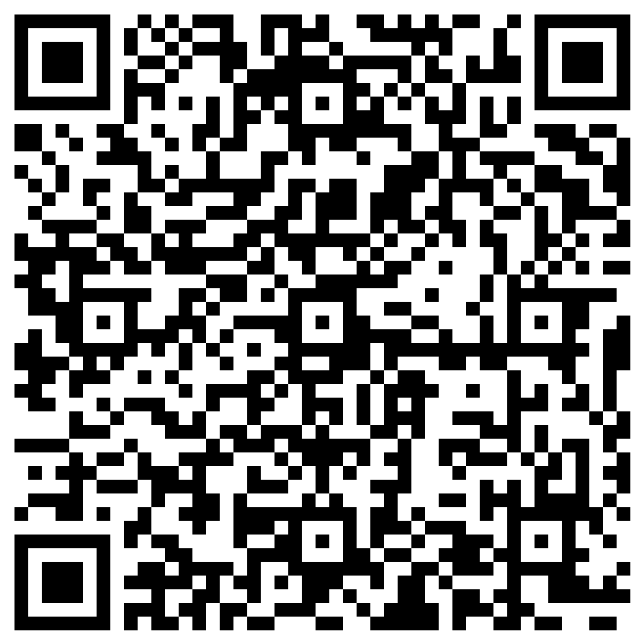
Diolch am eich cyfranogiad
Thank you for your participation
Unrhyw gwestiynau neu fyfyrdodau?
Cwblhewch y ffurflen gwerthusiad os gwelwch yn dda.
Any questions or reflections?
Please complete the evaluation form.

