Slide 1
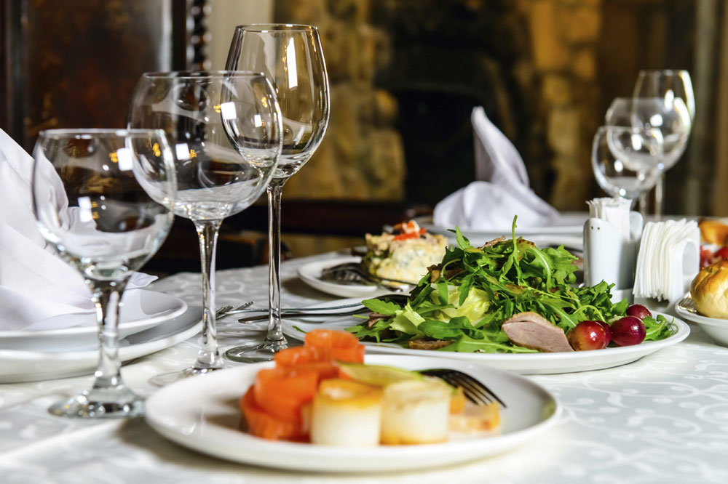
Operational issue from the Food and Beverage department
Name: Theodor-Andrei Bidoianu
Student number: 1816338

Slide 2

What are operational issues?
Operational issues drain business energy and resources, causing the business to be less profitable. They affect operational performance impact strategy execution and are anti-growth.

Slide 3
Operational issues in the Food and Beverage industry
As any other department, the Food and Beverage industry is constantly facing operational issues. Some of the most common ones, worth mentioning, are: choosing the right menu, hiring and training the right staff, dealing with customer service, controlling waste, etc.

Slide 4
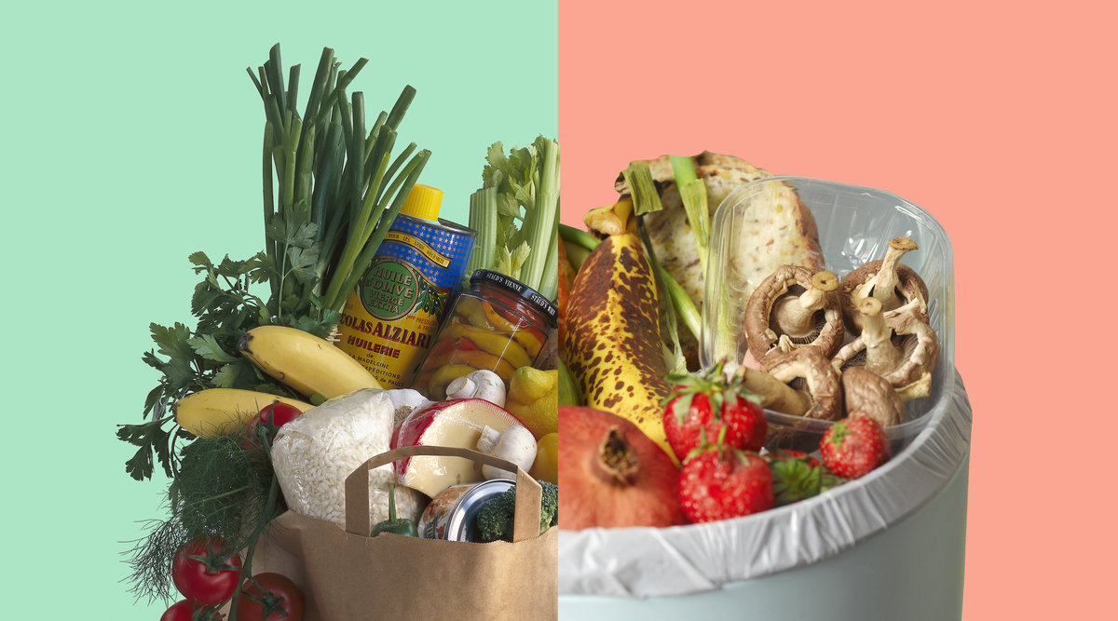
Reducing waste in the Food and Beverage department
I chose to approach this issue because I consider that a significant percent of all food is discarded or spoiled prior to consummation. Hotels are not immune to this issue of food waste. During my experience, I have noticed the problem of food wasting. There are lots of ways we could reduce this and manage the hotel's food production.

Slide 5

Efficient ways to reduce food waste
Inspect the deliveries
Keep a stock inventory
Proper storage
Keep track of the use-by dates
Portion control
Compost food waste

Slide 6

Inspect the deliveries
At every arriving transport at the hotel, you should always check and accept only the items that you ordered, to prevent excess. Also, you should reject products delivered at the incorrect storage temperature, or anything presenting visible damage or spoilage. Fortunately, during my time here, I have noticed that the employers are always proper checking all the goods-in.

Slide 7
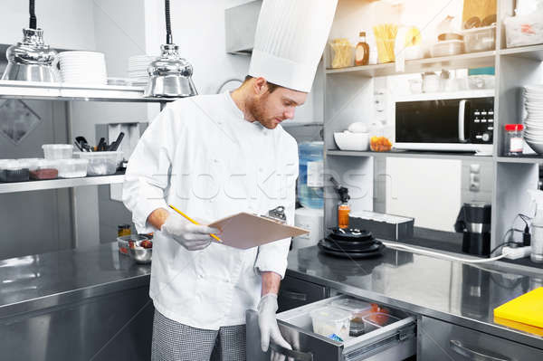
Keeping a stock inventory & tracking the use-by dates
In order to prevent waste, you should be aware of the exact stock you have at all times. Keeping detailed list of the food in all of your storage areas, including their use-by/best-before dates, helps avoiding food getting forgotten and going to waste.

Slide 8
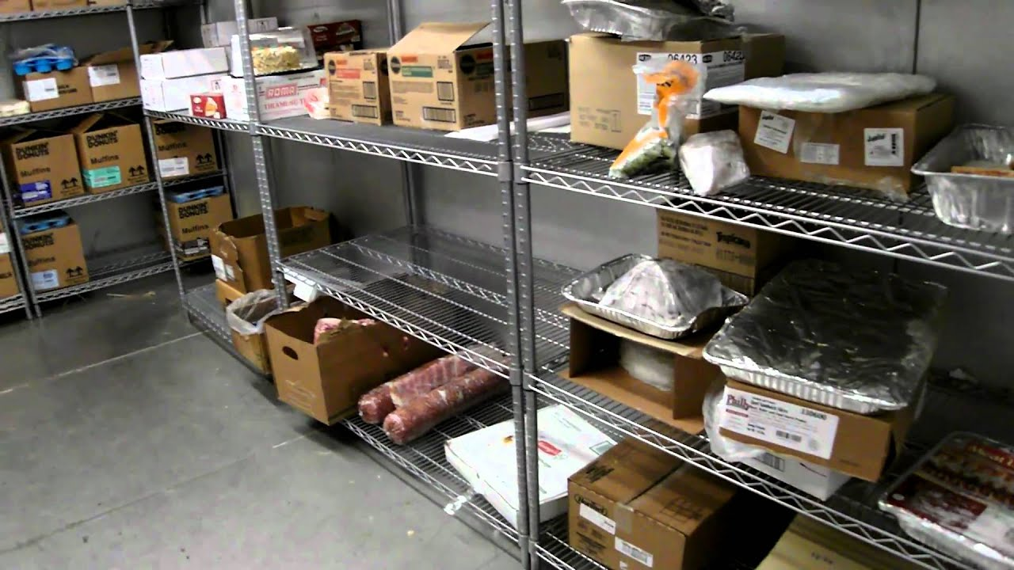
Proper storage
Storing foods under the correct conditions is important for preserving their quality and preventing spoilage. Always make sure that the fridges and freezers are running at the correct temperatures and the products are placed in the right shelves.

Slide 9
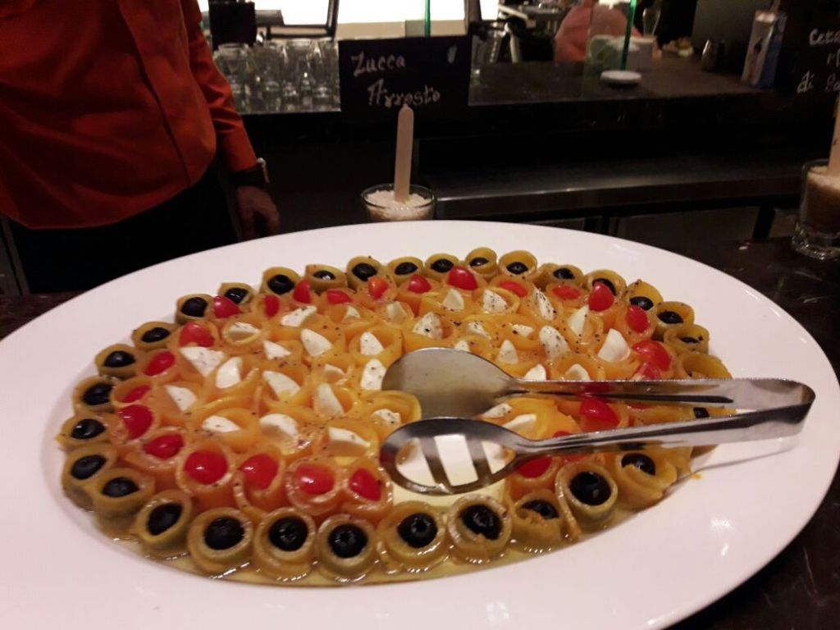
Portion control
The quality of the served food in the hotel's restaurant and the room-service is much more preferable to the quantity. The size of the dishes should be kept to a reasonable proportion. Fulfill customer's expectations by preparing and serving the dishes as describe on the menu. I have learned how to correctly portion and distribute the dishes.

Slide 10
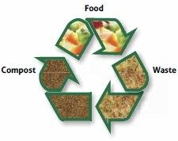
Compost food waste
A great way of reducing the food waste is to choose to put it into a compost bin, so it can be used for other purposes. During my experience in the Food and Beverage department, I have noticed lots of food being thrown away. For example, stuff like fruit and vegetable peelings could be used as fertilizers.

