Slide 1

Social inclusion, Victimisation and Welfare
Week 1- Introduction
BMLC5014
Michelle Hill
m.hill@uwtsd.ac.uk

Slide 2

Aims for the session
Introductions
Module learning outcomes
House keeping
Assessments
Scheme of work
Question and Answer
Short break
Definitions

Slide 3

Introductions
Name-
A little about you -

Slide 4

Learning outcomes
Upon the successful completion of this module, the student should be able to:
• critically analyse the sub-discipline of victimology, its strengths and weaknesses, and
alternative sources of data as a basis for understanding people’s experiences;
• demonstrate knowledge and a critical understanding of the nature and extent of crime,
and its impact and critically evaluate the efficacy of the concept of the victim and
victim-oriented policies within the contemporary cultural context;
• engage in debate concerning a broad range of issues surrounding the theory and
practice of securing human rights, equality, and social justice.

Slide 5
Roles
Roles
My role
Provide a safe and engaging learning environment
Answer any questions and provide support
Provide constructive and supportive feedback
Respect for all
Your role
To attend and engage
Show courtesy and respect to yourselves and others
Explore beyond what is provided here
Inform me via email if unable to attend
If you need support, ask me!
Enjoy! Ask questions! Be inquisitive!

Slide 8

Any Questions?

Slide 9

Short break 10 minutes

Slide 10


Slide 11

“Any fool can know. The point is to understand.”
― Albert Einstein

Slide 12

Task
Find and simplify these terms
Victimology
Vulnerable
Victim
Victimise
Social inclusion
Victimisation
Inequality
Equity

Slide 13
Key terms
Victimology-
The study of victims of crime, their experiences, and the factors that can make people or groups more susceptible to being victimised. It also explores how the CJS accommodates and assists victims.
Vulnerable–
Capable of being physically or emotionally wounded.
In need of special care, support or protection for reasons e.g. age (children are always vulnerable), disability, at risk of abuse or neglect. It can vary depending on the context it is used in.
Victim-
Is someone or something that has been damaged, injured, hurt or has suffered harm because of an action of someone or something else
Victimise-
To make someone into a victim by harming or taking advantage of them in some way

Slide 14
Victimisation-
Takes place when one person treats another less favourably (this can depend on context/circumstances also)
Social inclusion-
The process of ensuring that everyone has the opportunity and ability to fully participate in society to promote a sense of belonging for individuals
Inequality-
The state of not being equal, especially in status, rights and opportunities
Equity–
Fairness in providing different people with the resources they need to achieve an equal outcome to others

Slide 15
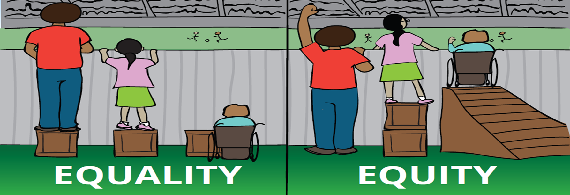

Slide 16

Who is considered vulnerable?

Slide 17
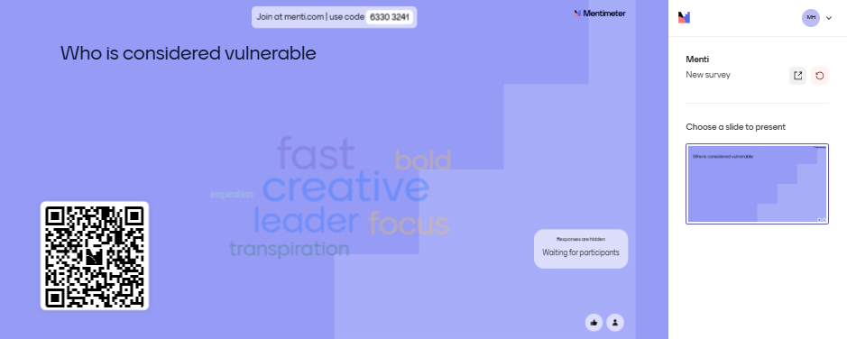

Slide 18
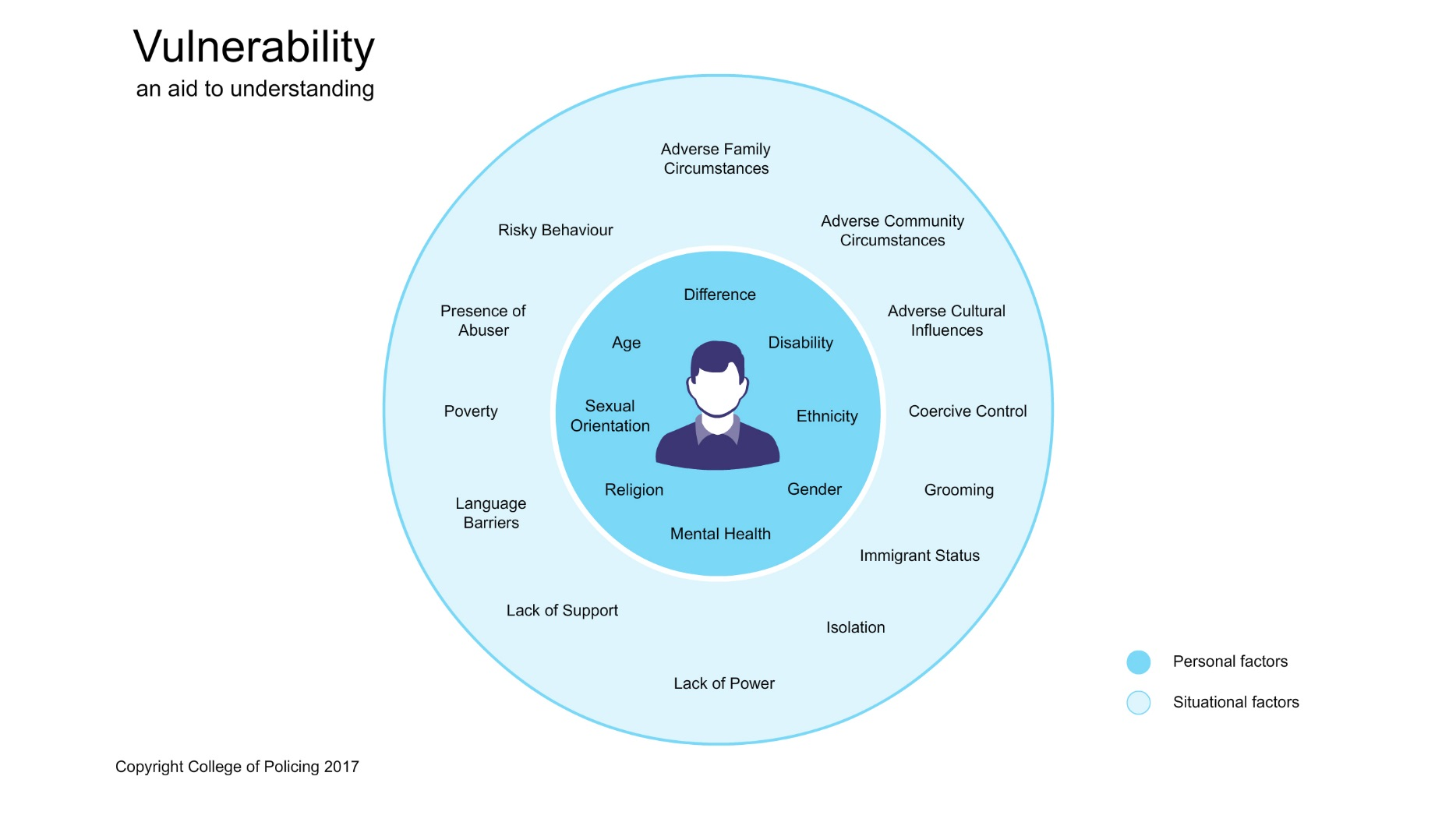

Slide 19

Any Questions?

Slide 20

Definition of Vulnerability

Slide 21
Definition of Vulnerability-
College of Policing
‘A person is vulnerable if, as a result of their situation or circumstances, they are unable to take care or protect themselves, or others, from harm or exploitation.’

Slide 22

NSPCC
‘If a child is considered to be suffering, or likely to suffer, significant harm the local authority will make them the subject of a child protection plan (in England) or add them to a child protection register (in Northern Ireland, Scotland and Wales)’
Notes:
National society for the protection of cruelty to children

Slide 23

vulnerable adult is a patient who is or may be for any reason unable to take care of him or herself, or unable to protect him or herself against significant harm or exploitation.

Slide 24

Adult Social Services
A person who is 18 years of age or over, and who is or may be in need of community care services by reason of mental or other disability, age or illness and who is or may be unable to take care of him/herself, or unable to protect him/herself against significant harm or serious exploitation.

Slide 25

Outside agencies/businesses
Solicitors – ‘a vulnerable person is either a minor or someone who, for physical or mental reasons, is unable to look after themselves or their finances.’
Financial – ‘vulnerable person has a specific technical definition and is either: A disabled person or a bereaved disabled person or a bereaved minor.’

Slide 26

Psychology Services
A vulnerable adult, or an adult at risk, is a person over the age of 18 person who is at risk of harm or who lacks the most basic human life skills. A vulnerable adult is unable, rather than unwilling, to properly learn or properly maintain these skills and is usually completely without, and unable to obtain, any family, friends, acquaintances or other assistive persons in their lives to offer education or assistance in these areas. To be classed as vulnerable, the adult's circumstances must be unable to be altered or improved by the adult's own individual actions without direct assistance from a more capable adult. The vulnerable adult must also be shown to be, on some significant level, a risk to themselves if assistance is not provided.

Slide 27
Why do you think there are so many different definitions of Vulnerable or vulnerability?
Why can’t they all work towards using the same definition?

Slide 28
Different agencies use different definitions because these are referenced within other pieces of legislation that are relevant to their working context.
Different organisations must work to their own organisation’s principles or constitution
e.g. Police have 9 principles that they must follow
e.g. NHS have 7 constitutions
Their own principles or constitutions set the appropriate course of help / action / demands
Each organisation will face different levels of vulnerability
However, they all have a duty to protect and safeguard

Slide 29

What is a victim in the Criminal Justice system

Slide 30
The Victims Code acknowledges that the terms ‘complainant’ and ‘survivor’ are often used in the criminal justice system to describe a person who has made a criminal allegation to the police.
Definitions – Harm or loss caused by a criminal offence
A close relative of a person whose death was directly caused by a criminal offence.
Under Victims Code if you are the parent of the victim if the victim is under 18 years of age.
Parent or family member have rights if a victim has a mental impairment or badly injured due to criminal offence – cannot communicate / lacks the capacity to do so.
All service providers must have the victim’s best interests as their primary consideration and take the victim’s age, maturity, views, needs and concerns fully into account.

Slide 31
Victims in CJS
Victims have shifted within the Criminal Justice System from being passive and excluded to being more active participants with rights
Policing today has regular contact with victims of crime
The definitions of who is considered a victim has expanded to acknowledge the wider impact of crime e.g., witnesses
Courts and Probation Services have further contact with some victims
The scope of victimhood has expanded to included ‘criminal conduct’ so to allow people to access services at an earlier point
Less focus on Victim responsibility
Nature of policing has changed in the last 20 years – more focus on mental health, vulnerability and risks

Slide 32

What are your thoughts?

Slide 33
Next
Criminal Justice system
Ideal victim

