Slide 1

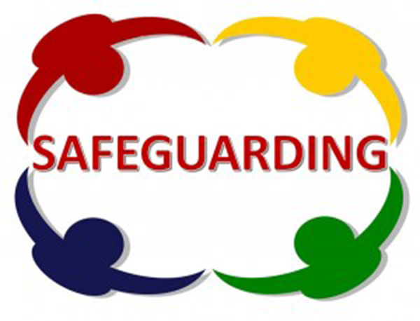


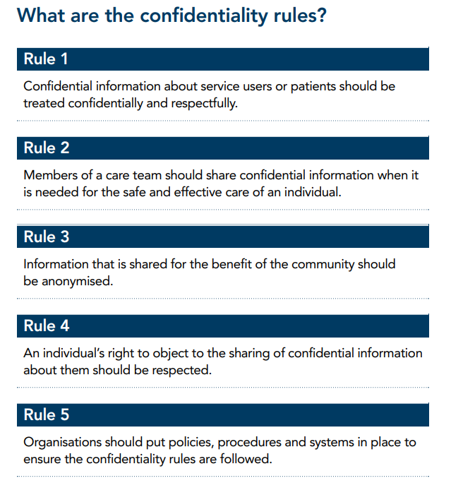

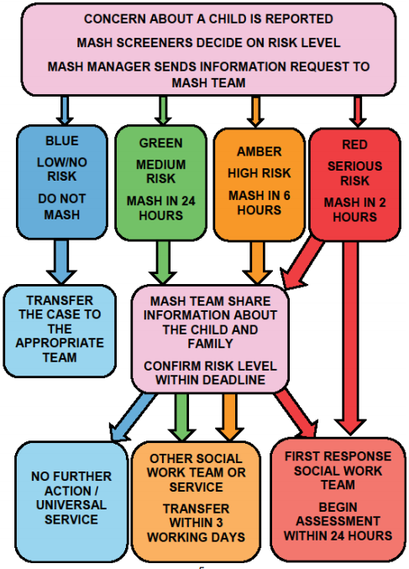
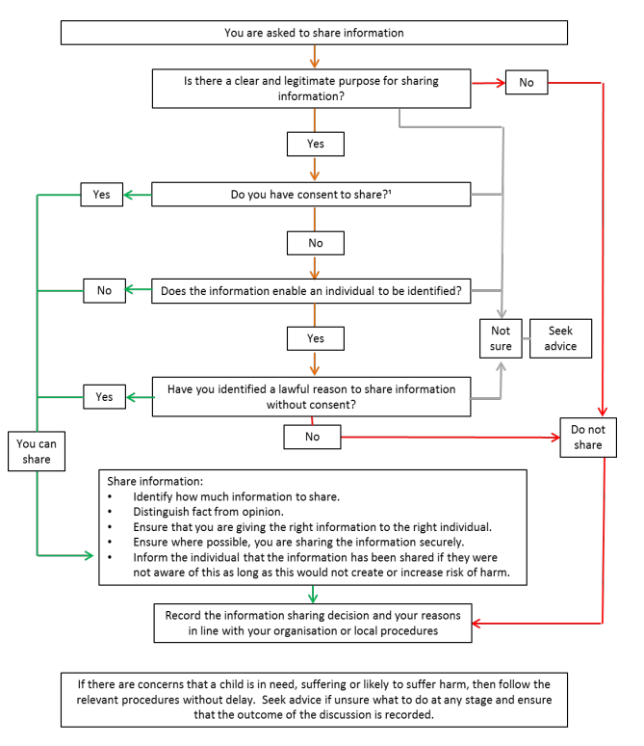
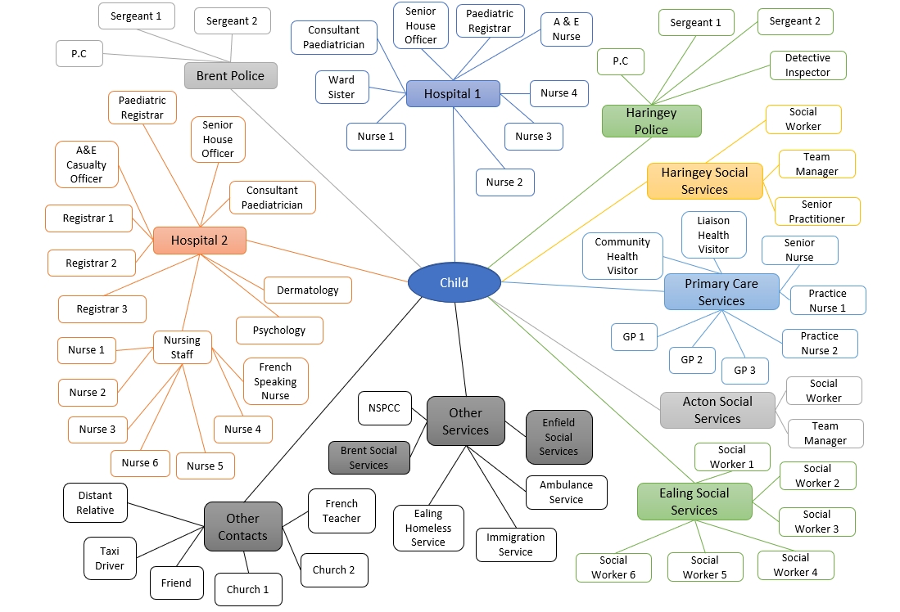
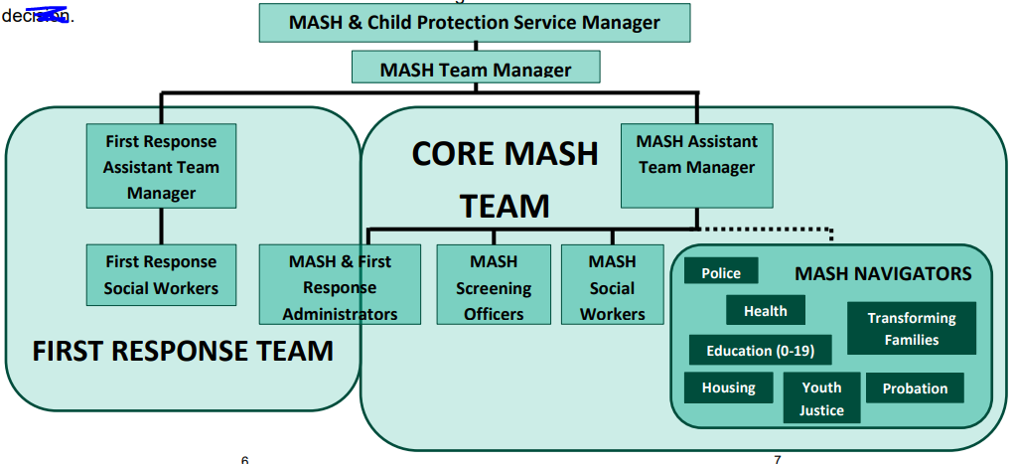
Balancing Safeguarding Responsibilities with the need for Confidentiality
Claire Thomson 1603261
Why Multi agency working?
Legislation for safeguarding
Sharing information is an intrinsic part of any frontline practitioners’ job when working with in social care or with children. The decisions about how much information to share, with whom and when, can have a profound impact on individuals’ lives. Information sharing helps to ensure that an individual receives the right services at the right time and prevents a need from becoming more acute
(H.M. Government, 2018)
All organisations should have arrangements in place, which set out clearly the processes and the principles for sharing information (HSCIC, 2013).
The failure of agencies to work together effectively to safeguard children and young people has been highlighted in numerous serious case reviews of child protection cases (Laming Enquiry 2003; Gov.uk, 2007). The Laming child protection progress report (2009) & the Munro Review of Child Protection (Parton, 2012) recognised the key role of the Local Safeguarding Children Boards in fostering multi agency working (Crockett et al, 2013).
“Multi-agency working is key to effective safeguarding and child protection”.
(Sidebotham et al, 2016)
The safeguarding vulnerable groups Act 2006
Social Services and wellbeing (Wales) Act 2014
All-Wales Child Protection Policy and
Procedures 2008
The Care Standards Act 2000
(Social Care Wales, n.d.)
Clauses allow for sharing information when there is a requirement to safeguard.
Working together to Safeguard Children (2018) sets out how agencies should co-operate and share information in order to safeguard.
When a safeguarding concern is raised
The Multi-Agency Safeguarding Hub (MASH) is the single
point of contact for all safeguarding concerns regarding
children and young people. It brings together expert professionals, called “navigators”, from services that have contact with children, young people and families, making the best possible use of their combined knowledge to keep children safe from harm.
(HSCIC, 2013)
When should information be shared?
Confidentiality Legislation
Human Rights Act 1998 - personal information held in confidence unless safeguarding concerns.
The Care Act 2014 - importance of sharing information at early stage for safeguarding.
The Health and Social Care (Safety and Quality) Act 2015 –integration of information sharing.
The Data Protection Act 2018 and the GDPR
personal information must be:
-Processed lawfully, fairly, and transparently.
-Collected for specified, explicit and legitimate purposes.
-Adequate, relevant, and limited to what’s necessary for the purposes of why it was collected.
-Accurate and up to date.
-Not be kept for longer than is necessary.
-Processed in a manner with appropriate security.
(Collier, 2019)
This means more complexity around individuals.
(Merton Council, 2020)
(Dicks, 2019)
(H.M. Government, 2018)

Slide 2




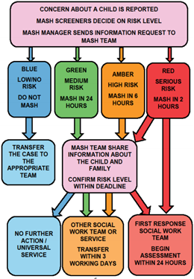
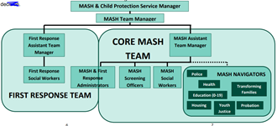
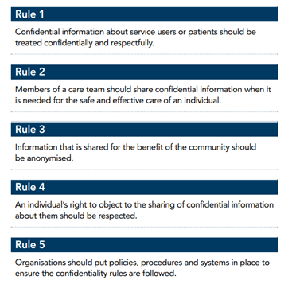
Picture References
Lewis, J. (2017). How to build a better multi-agency leadership team through group coaching. Available: https://cmdeltaconsulting.com/tag/multi-agency-working/.Last accessed 10th Jan 2020.
Southsea Tennis Club. (2020). Safeguarding. Available: https://www.southseatennis.co.uk/safeguarding.html. Last accessed 10th Jan 2020.
H.M. Governmnet. (2018). Information sharing Advice for practitioners providing safeguarding services to children, young people, parents and carers. Available: https://assets.publishing.service.gov.uk/government/uploads/system/uploads/attachment_data/file/721581/Information_sharing_advice_practitioners_safeguarding_services.pdf. Last accessed 22nd Jan 2020.
Dicks, K. (2019). Lecture Notes from University of Wales Trinity St David. Advocacy Undergraduate.
Merton Council . (2020). MASH Multi-Agency Safeguarding Hub Guide for Professionals. Available: https://www.merton.gov.uk/assets/Documents/0403%20merton_mash_leaflet__professional.pdf.Last accessed 23rd Jan 2020.
Merton Council . (2020). MASH Multi-Agency Safeguarding Hub Guide for Professionals. Available: https://www.merton.gov.uk/assets/Documents/0403%20merton_mash_leaflet__professional.pdf. Last accessed 23rd Jan 2020.
HSCIC. (2013). A guide to confidentiality in health and social care. Available: http://static.ukcgc.uk/docs/HSCIC-guide-to-confidentiality.pdf. Last accessed 23rd Jan 2020.
References
Care Quality Commission. (2014). Safeguarding adults Roles and responsibilities in health and care services . Available: https://www.cqc.org.uk/sites/default/files/20140416_safeguarding_adults_-_roles_and_responsibilities_-_revised_draf....pdf. Last accessed 22nd Jan 2020.
Collier, E. (2019). A Guide to Confidentiality in Health and Social Care. Available: https://www.highspeedtraining.co.uk/hub/confidentiality-in-health-and-social-care/. Last accessed 10th Jan 2020.
Crockett, R., Gilchrist, G., Davies, J., Henshall, A., Hoggart, L., Chandler, V., Sims, D. and Webb, J., (2013). Assessing the early impact of multi agency safeguarding hubs (MASH) in London.
DfE. (2010). HARINGEY LOCAL SAFEGUARDING CHILDREN BOARD SERIOUS CASE REVIEW ‘CHILD A’ . Available: https://assets.publishing.service.gov.uk/government/uploads/system/uploads/attachment_data/file/182527/first_serious_case_review_overview_report_relating_to_peter_connelly_dated_november_2008.pdf. Last accessed 10th Jan 2020.
H.M. Governmnet. (2018). Information sharing Advice for practitioners providing safeguarding services to children, young people, parents and carers. Available: https://assets.publishing.service.gov.uk/government/uploads/system/uploads/attachment_data/file/721581/Information_sharing_advice_practitioners_safeguarding_services.pdf. Last accessed 22nd Jan 2020.
H.M. Government. (2018). Working Together to Safeguard Children A guide to inter-agency working to safeguard and promote the welfare of children . Available: https://assets.publishing.service.gov.uk/government/uploads/system/uploads/attachment_data/file/779401/Working_Together_to_Safeguard-Children.pdf. Last accessed 23rd Jan 2020.
HSCIC. (2013). A guide to confidentiality in health and social care. Available: http://static.ukcgc.uk/docs/HSCIC-guide-to-confidentiality.pdf. Last accessed 23rd Jan 2020.
Laming, L. (2003) The Victoria Climbié Inquiry Report. TSO, London.
Laming, H. (2009). The Protection of Children in England: a Progress Report. London, House of Commons.
Merton Council . (2020). MASH Multi-Agency Safeguarding Hub Guide for Professionals. Available: https://www.merton.gov.uk/assets/Documents/0403%20merton_mash_leaflet__professional.pdf. Last accessed 23rd Jan 2020.
Parton, N., 2012. The Munro review of child protection: An appraisal. Children & Society, 26(2), pp.150-162.
Sidebotham, P., Brandon, M., Bailey, S., Belderson, P., Dodsworth, J., Garstang, J., Harrison, E., Retzer, A. and Sorensen, P., (2016). Pathways to harm, pathways to protection: a triennial analysis of serious case reviews 2011 to 2014. Department for Education.
Social Care Wales. (n.d.). Hand-outs All Wales Basic Safeguarding Awareness Training Version 2. Available: https://socialcare.wales/cms_assets/file-uploads/7-All-Wales-Basic-Safeguarding-Awareness-Training-Legislation-and-guidance-summary.pdf. Last accessed 23rd Jan 2020.

