Slide 1
The writing process: practical concerns
Advancing, retreating and disciplinarity

Slide 2

So far
We looked at generating ideas, gaining momentum and planning for criticality in the literature in the academic writing process.
This is what academic writing theorists have termed ‘advancing’.
Today we shall look at the last step of ‘advancing’ in your writing: engaging creatively with your written text via using ‘checks and balances’.
Next, the final stage of academic writing, ‘retreating’, will be explored in more detail.

Slide 3

Checks, balances and retreating
Without the checks and balances associated with revisiting, reconceptualising, revising and reworking your writing, you may start to work in a vacuum, uninformed or untested by useful ideas.
In becoming determined to advance your work, also guard against a sort of overconfident isolation (Blanton et al., 2001) that could be countered by stepping back – a phase of writing named ‘retreating’.

Slide 4
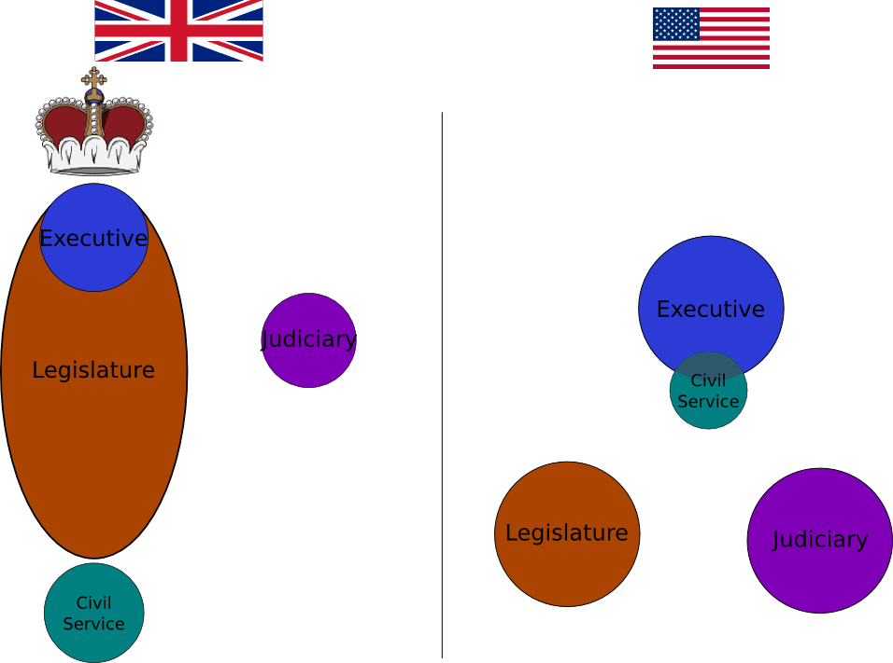
What are checks and balances?
‘Checks and Balances’ can be defined as the abilities and powers that are exclusively given to one branch of government in order to ‘check’ the actions of the other branches. These powers are often constitutionally protected.
‘Checks and Balances’ are often given in the form of powers that are reserved exclusively to that branch. They came to exist after the process of ‘separation of powers’ in Western societies.

Slide 5

in academic writing
‘Checks and balances’ in academic writing come in the form of a checklist of strategies that you can apply to help you control, check and balance your own writing.

Slide 6
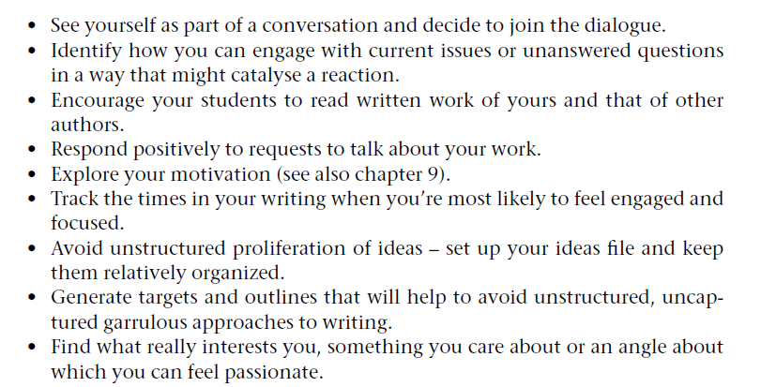
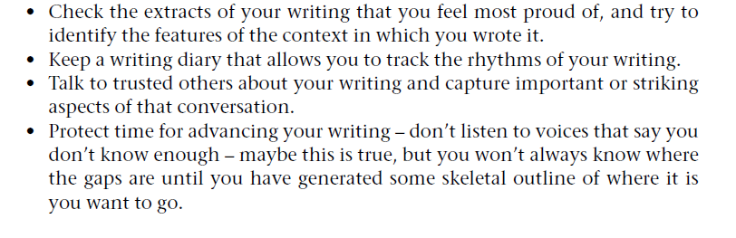
The list
We will now explore some of them in a bit more detail.
Let us look at the next couple of slides.
Murray & Moore (2006: 34-35)

Slide 7
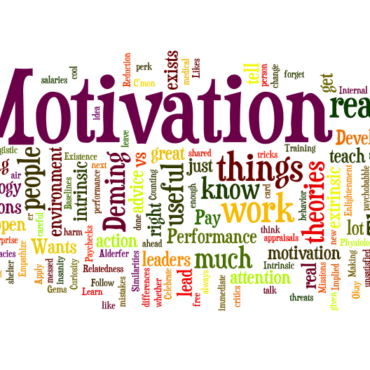
Exploring your motivation
Some points from the list suggest that you should explore your motivation for engaging with your writing.
What motivates you to write and what hinders that motivation?
So, take 5 mins to think about and make a list of 5 motivators specific to you, and add a challenge to each motivator.
In your breakout rooms, discuss them for 10 mins and choose a speaker to feedback to the rest of the class.
Class discussion for 10 mins.

Slide 8

Talking about your writing
Some points form the list encourage you to engage in a conversation about your writing with readers of your work.
In your breakout rooms, you have 10 mins to consider why talking about your writing with others might be useful and even important.
Consider your emotional response to, i.e., the feelings you experience, when discussing your written work with others and getting feedback, especially negative feedback.
Now, let us talk about this as a group.

Slide 9
So, from our discussion of checks and balances…
Writing requires listening to and being guided by the voices of others, but also it demands confidence, motivation and willingness to present your own voice, your own perspectives and your own interpretations.
Writing often involves an intimate familiarity with the small details of a specific piece of work, but it also demands that we position these specifics on a broader stage, identifying and explaining connections and comparisons in a wider theoretical context.
Writing is not just influenced by what we know and what we have discovered about a particular phenomenon, it is also influenced by what we feel, and more particularly, what we feel about ourselves.
The creative part of writing requires chaos, luck and coincidence; but in order to shape and craft our writing effectively, it needs the imposition of at least some order and discipline. The implications of these paradoxes are important and worth exploring in some more detail.

Slide 10
The importance of ‘retreating’
Now we shall focus on the importance of ‘retreating’ or stepping back from your academic writing.
We will think about how to prepare to engage in this less active, more reflective, objective but essential phase of the academic writing process.
Academic writers can benefit from the deliberate adoption of a retreat strategy at various key stages in their writing.
We will also highlight the importance of balancing regular and successive phases of progress and revision.

Slide 11
Defining the retreat phase: reviewing and recharging
Retreating from your writing represents a change of gear and can involve a range of different dynamics: a rest phase after a period of active writing; the development of and reflection on ideas that have already been at least partly formed; the ‘handing over’ of your writing to someone else and allowing your writing to be viewed through another lens.
Retreating or stepping back means stopping, resting, thinking, reflecting, re-evaluating, revising and re-orientating your writing. All of these may be important things to do in order to produce a publishable, coherent piece of work.
The importance of retreating reflects the need for you to be cautious about becoming so immersed or locked into your work that you can’t cast a more objective eye over what you have done.
Some of the key practical advice includes guidelines for handing your writing to someone else; listening to or reading feedback and achieving relaxation and detachment in the context of even the most stressful and demanding writing projects.

Slide 12

Retreating in order to rest
Make your breaks complete.
Make your breaks timed – know when your next writing period is going to be.
Write a list of what needs to be done next before leaving your writing task.
Do something completely different: exercise, entertainment, socialising, meditating, massage, yoga, swimming, etc.
Don’t actively try to think about your writing project – but bring a notebook with you – just in case.

Slide 13

Retreating to get feedback from others
Negative feedback.
Positive feedback.
Potential blocks to effective feedback.
In your breakout rooms, take 10 mins to discuss the effects of negative and positive feedback on the writer.
Also, consider what might be some of the potential blocks to effective feedback for academic writers.
Be ready to share your views.

Slide 14

Let’s talk feedback
Some of the functional approaches to getting feedback on your writing are:
  Understanding the importance of audience.
  The beauty of criticism.
  The utility of receptivity: becoming a receptive listener.
  Staying in charge: asking for specific feedback.
  A focus on professional development and learning.
  Letting other people play a role in your writing.
  Coping with unhelpful or destructive feedback.
  Setting up writing partnerships and getting a ‘critical friend’.

Slide 15
Some practical ideas (1)
Contextualise your work to enhance the feedback process.
When working with a writing mentor or partner, try contextualising your work to help your critical friend give you useful feedback.
Prompts that might be useful in initiating feedback might sound like this:
  ‘Before you give me feedback on this piece, this is what you need to know’: e.g. the evolution and stage of my writing (first draft, redraft, revisited after a long time, unstructured, polished).
  ‘These are the reasons I wrote this piece.’
  ‘I have received feedback about a previous draft that advised me to . . . and these are the ways in which I have tried to integrate that advice.’
Adapted from Murray & Moore (2006: 50)

Slide 16

Some practical ideas (2)
Give your feedback givers instructions about what exactly you would want them to focus on and pay attention to when giving you feedback.
What might be some of the instructions you would give to a critical friend who is about to read your work?
Write a short list of instructions – you have 5 mins for this task.
Let us discuss your thoughts as a group.

Slide 17
Some instructions for specific feedback might include:
  Highlight the essential, central messages in my writing.
  Invite me to elaborate on particular aspects of my writing.
  Tell me what you know/think/feel about the topic.
  Tell me how much ‘voice’ you hear in my writing.
  Be my writing champion: tell me what is good in my writing.
  Be my devil’s advocate: tell me what is weak and needs improvement.
  Summarise my writing to help me clarify things.
  Give me specific feedback on aspects of my writing: Is this clear enough? Is my writing simple enough to convey these central ideas? Is this section too short/too long? Do you feel I’ve justified my assertions in this section? Could you read this piece with a view to picking up misspellings, typos or grammatical mistakes?
(Adapted from Elbow and Belanoff, 2000)

Slide 18
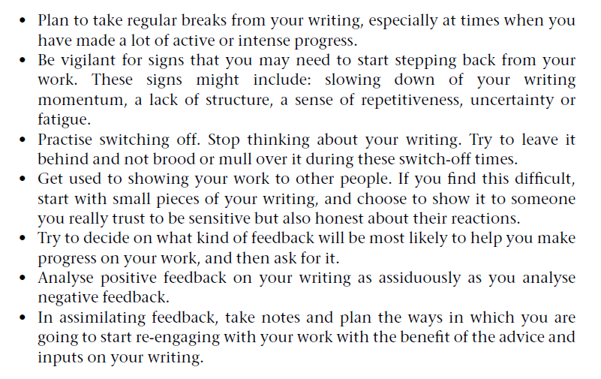
Checklist and strategy for retreating from your writing
Murray & Moore (2006: 52)

Slide 19
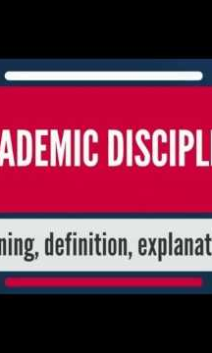
Disciplinarity in academic writing
Disciplinarity is often held up as one of the most important features of academic study, research and writing.
This suggests that, if you want to write within a specific discipline, you need to establish what constitutes ‘disciplinarity’ in your area and, more specifically, how that is represented in published academic writing in your field at this time.
This approach to disciplinarity is rhetorical, in the sense that it involves analysing features of texts and considering the audiences and purposes of academic writing.
This links back to the idea of critical reading that we explored last week.
The aim of analysis of published papers is to identify characteristics of academic writing in the sub-set of a discipline represented by any given journal.
While you will undoubtedly learn from discipline-specific analysis, you may find that you can learn generic lessons from looking at how academic writing is produced in other disciplines.

Slide 20
Practical tips
You can begin your analysis of published papers by focusing on specific characteristics:
  Structure.
  Statement claiming ‘contribution’.
  Case made for sufficiency of evidence for contribution.
You can begin your analysis by looking at and evaluating journal article abstracts.
  How is the rationale/problematic established?
  As far as you can tell from the abstract, how is the paper structured?
  How is methodology defined and justified?
  How is contribution ‘branded’?

Slide 21
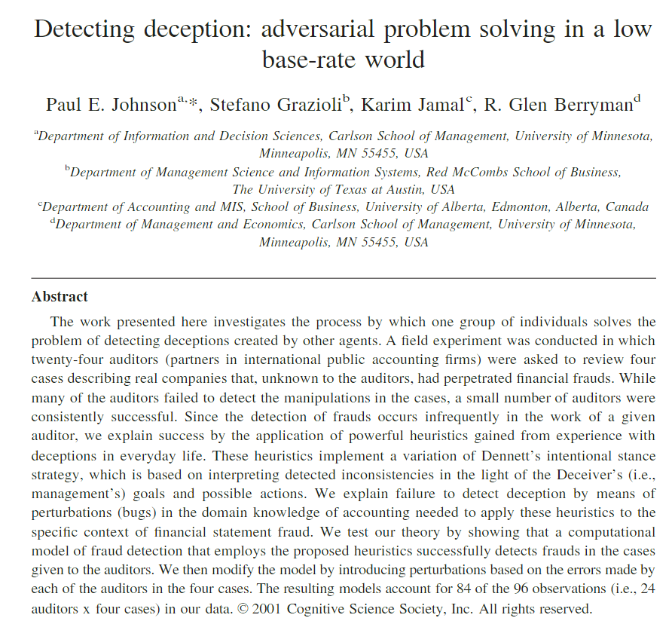
Example abstract
How is the rationale / problem established?
How is the paper structured?
How is methodology defined and justified?
How is contribution ‘branded’?
Can you use this abstract as a model? Why/why not?

Slide 22
Possible comments
These authors choose an impersonal style: ‘The work . . . investigates’. The problem that this research addresses is defined earlier and more concisely than in other examples. Here the authors get much more quickly to the point of the research, providing less in the way of context and rationale for the work at this point in the abstract, though presumably there would be more of that in the paper itself.
The next sentence summarises the results. The main line of argument is articulated, using the personal pronoun ‘we’ this time: developing an explanation, testing it, modifying it and testing it again.
A linking device is the use of ‘we’, at the start of three consecutive sentences, showing stages in the research: ‘explain’, ‘test’ and ‘modify’, although, interestingly, the last sentence does not begin with ‘we’, perhaps suggesting a more objective interpretation of the data?
It might also be possible to map your writing over this model using this structure:
  X . . . is/are needed for . . .
  Many models/approaches have been developed to . . .
  However, none of these accounts for/can predict/tell us about . . .
  We/This paper proposes a . . . that accounts for/predicts/provides information on . . .
  We apply this model/This model is applied/This paper describes the application . . .
  We argue that this/This strengthens the interpretation of/approach to . . .

Slide 23

Developing your own writer’s voice
It is common for academic writers to worry that they are losing their own voice, or wonder if they are ever going to develop one.
They spend so long reading and analysing other people’s writing that they feel they lose sight of what they want to say and how they want to write.
How would you define ‘voice’ in subject-specific academic writing?
Is the issue of ‘voice’ associated with finding your own position in the debate and articulating that distinctiveness in conceptual/intellectual, discipline-specific terms?
Does the search for a voice originate in a fear of loss of identity in the discipline? Or compromising of values in order to get something published?
While the question of ‘voice’ in writing may take us into a discussion of style, perhaps we could more usefully focus on ‘voice’ in the sense of ‘contribution’?
Perhaps writers who fear losing their voice could reconceptualise ‘voice’ as ‘contribution’; academic writing in your discipline does, presumably, require you to articulate your view of the field and your own contribution to it.
In a sense, this is your ‘voice’.

Slide 24
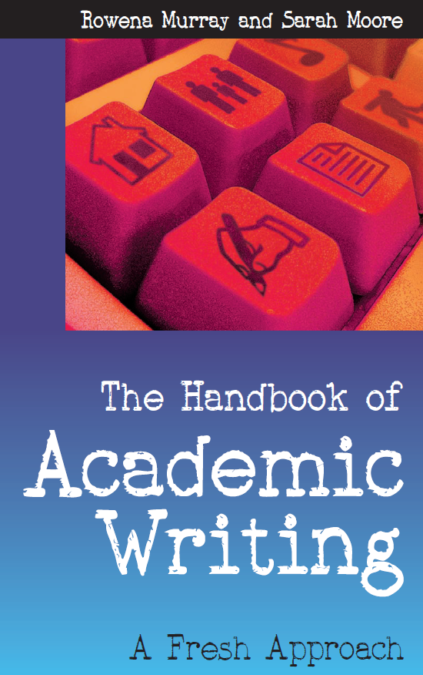
Today’s materials are sourced from:

