Slide 1
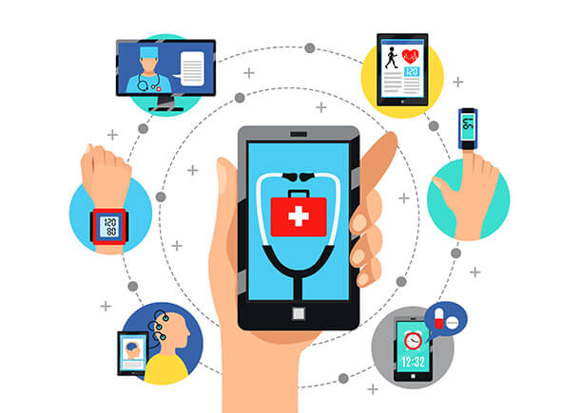
Digital Innovation Presentation
ASSIGNMENT NAME: DIGITAL INNOVATION.
MODULE NAME: DIGITAL TRANSFORMATION.IN HEALTH AND PROFESSIONS.
MODULE CODE: BMHP 6026
STUDENT NAME: LUCRESHA LEWIS
STUDENT: 2315413
LECTURER NAME: MARTIN SVEJDA
https://meditechinsights.com/wp-content/uploads/2024/01/Global-mHealth-Solutions-Market.jpg

Slide 2
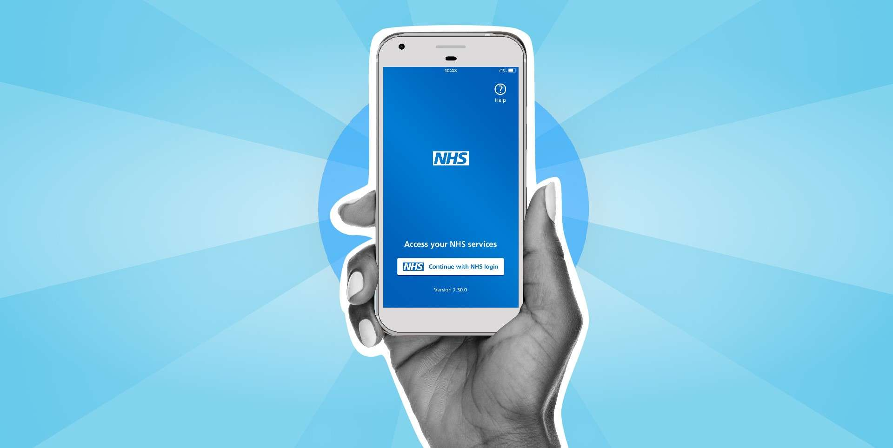
Introduction
Digital innovation reshaping UK healthcare
Focus
  NHS App as case study in transformation
Analysis Across
  Workforce, service delivery, patients, community
Aim
  Evaluate true impact — benefits & challenges
Lens
  Equity, ethics, systems thinking
https://tavistockandportman.nhs.uk/wp-content/uploads/2025/09/NHS-app.jpg

Slide 3
Overview of the innovation
Launched Jan 2019 – “digital front door” to NHS (NHS Long Term Plan, 2019)
Functions: GP booking, repeat prescriptions, medical records, NHS 111, vaccination services
Expanded role: COVID-19 pass & vaccine verification
By 2023: 33.6m users, 500m logins, 42m prescriptions (NHS England, 2023)
Integral to NHS Long Term Plan and Topol Review (2019)
33.6 million users
500 million logins
By 2023
42 million subscriptions
mHealth technology

Slide 4
Digital Transformation & Systems Thinking
Concept: Digital transformation ≠ technology alone — it’s systemic change.
Theoretical lens: Sociotechnical Systems Theory (STS) — success occurs when technology and people adapt together (Cao et al., 2025).
The NHS App reflects this balance between technical efficiency and human adaptation.
Technology
Effective Transformation
Human Systems
Integration requires
  Leadership
  Training
  Digital readiness
  Ethical governance

Slide 5
Impact on the Workforce
Positive
  5.7 million staff hours saved, £622 million operational savings (DHSC, 2025).
  Reduced administrative load → more “time to care.”
  Decrease in manual errors (Camacho et al., 2024).
  Enhanced digital roles and professional development.
Negative
  38% of NHS staff feel digitally underprepared (Hammerton et al., 2022).
  Increased “hidden labour” – supporting digitally excluded patients (BMA, 2023).
  Cybersecurity risks: NHS among most targeted sectors (Security Breaches Survey, 2024).

Slide 6
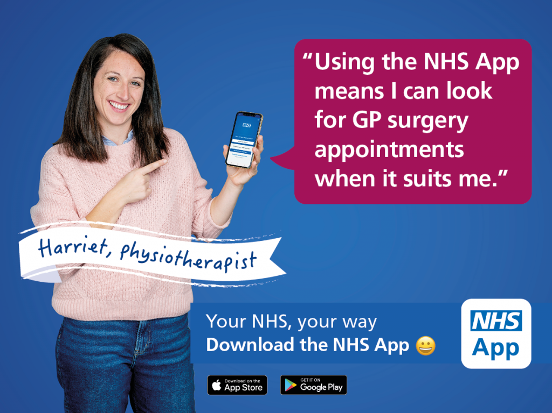
Impact on Service Delivery
Achievements:
  84% of GP practices integrated (NHS England, 2024).
  30 million monthly prescription requests and 1.7 million bookings.
  Improved patient flow, continuity, and administrative efficiency.
  During COVID-19: 29 million digital vaccination passes issued (Kendal et al., 2023).
Challenges:
  69% fully integrated → fragmentation persists
  Rural/deprived uptake lower (Sukriti et al., 2023)
  Broadband access: 98% overall, rural gaps remain (Ofcom, 2024)
  Risk of “two-tier NHS” (Litchfield et al., 2025)
  Poor interoperability across primary–secondary care (Trane et al., 2022)
https://www.choose.co.uk/img/editorial/700x464/img217552.jpg

Slide 7

Impact on Patients and Service Users
  72% satisfaction (NHS Digital, 2024).
  Greater autonomy and self-management (NMC, 2018).
  Improved access for chronic condition patients via reminders and record access.
Benefits
  11 million UK adults lack digital skills (Good Things Foundation, 2024).
  28% express data privacy fears (Rajput et al., 2025).
  Misinterpretation of clinical data → anxiety (Kuppanda & Jenkins, 2023).
Concerns
https://www.nutgrovevillasurgery.nhs.uk/media/General%20Images/NHS-App-generic-social_screens_Generic%20social%20-%20instagram_1080x1080_B.jpg

Slide 8
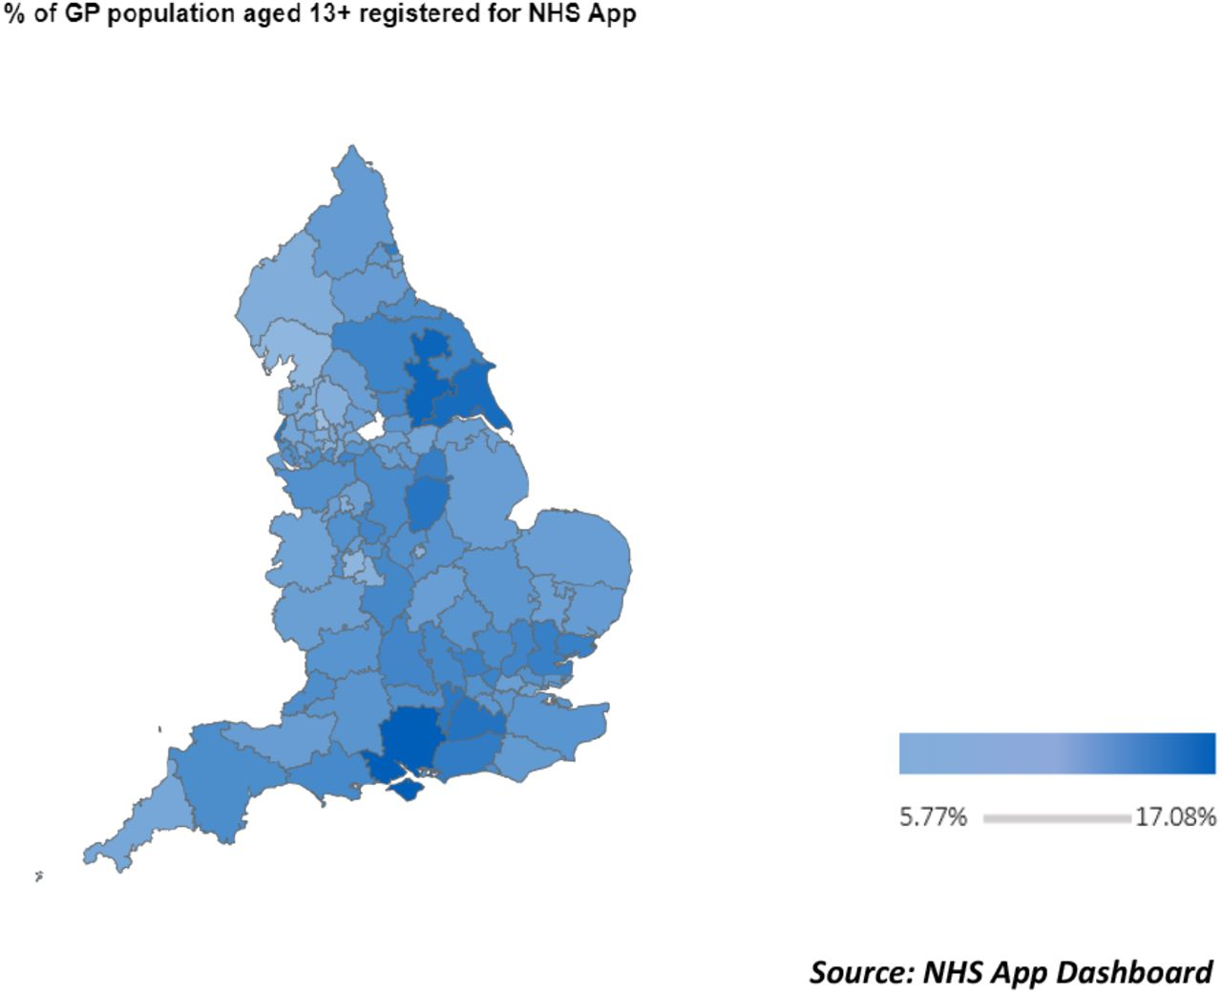
Impact on Communities and Population Health
Positive outcomes
  21 million vaccination bookings, organ donation, public health messaging (Reidy et al., 2025).
  Strengthened preventive care through health campaigns.
  Family co-production — younger users assisting older relatives (Greenhalgh et al., 2022).
Negative elements
  Digital poverty linked to deprivation (Marmot, 2020)
  Rural & low-income areas least likely to benefit
  Risks exclusion of vulnerable populations
  Family support may compromise confidentiality
  Need hybrid (digital + face-to-face) models

Slide 9
Conclusion and recommendations
NHS App = milestone in digital transformation
Delivers efficiency, empowerment, public health gains
Exposes gaps in equity, training, infrastructure, governance
Build digital competence across workforce
Invest in inclusive infrastructure & offline options
Strengthen data transparency & engagement

Slide 10
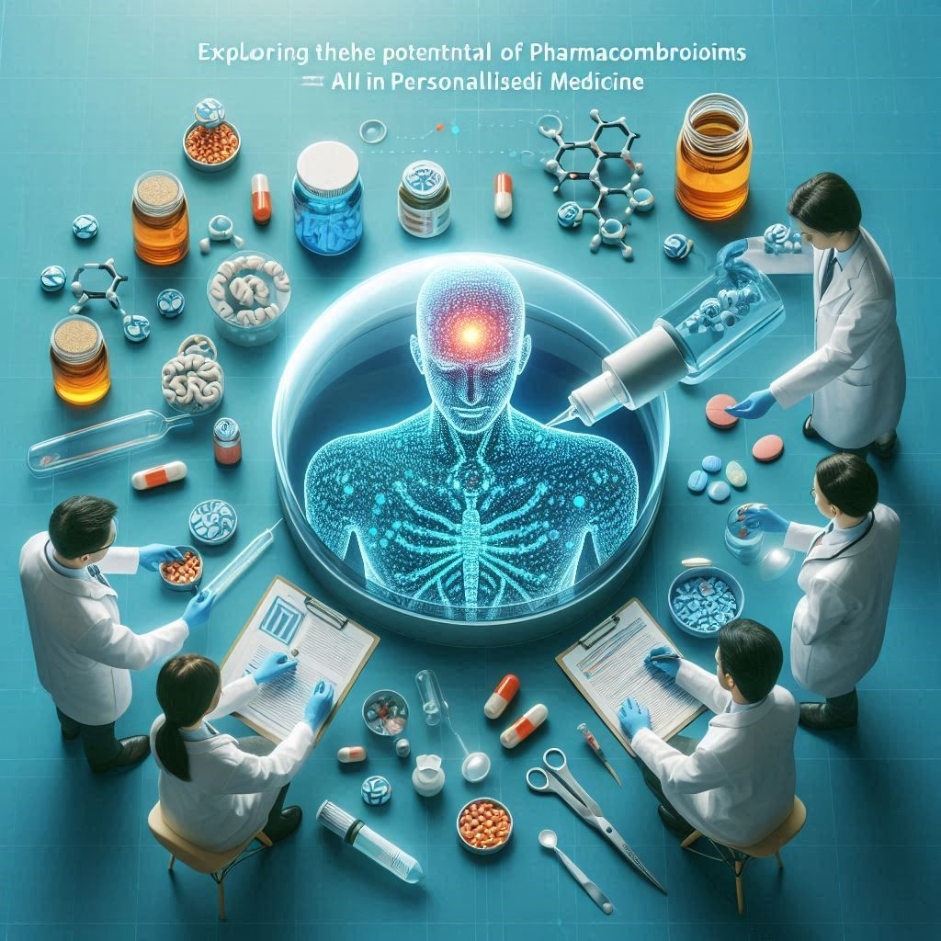
The Future — Genomics, AI & Integration
The NHS App provides a foundation for precision medicine.
Integration with 100,000 Genomes Project could deliver personalised risk profiles.
AI could enable predictive analytics and earlier intervention (Alowais et al., 2023).
Challenges: consent, data bias, algorithmic transparency.

Slide 11
References
Allmann, K., 2022. UK Digital Poverty Evidence Review 2022. Digital Poverty Alliance. [pdf] Available at: https://digitalpovertyalliance.org/wp-content/uploads/2022/06/UK-Digital-Poverty-Evidence-Review-2022-v1.0-compressed.pdf [Accessed 2 Oct. 2025].
Alowais, S.A., Alghamdi, S.S., Alsuhebany, N., Alqahtani, T., Alshaya, A.I., Almohareb, S.N., Aldairem, A., Alrashed, M., Bin Saleh, K., Badreldin, H.A. and Al Yami, M.S., 2023. Revolutionising healthcare: the role of artificial intelligence in clinical practice. BMC medical education, 23(1), p.689. https://doi.org/10.1186/s12909-023-04698-z
British Medical Association (BMA). 2023. Digital transformation in general practice: workforce perspectives. London: BMA. Available at: https://www.bma.org.uk/media/6578/bma-infrastructure-2-report-getting-it-right-dec-2022.pdf
Brown, M. (ed.), 2022. The Digital Divide: Reducing inequalities for better health. Public Policy Projects. [pdf] Available at: https://publicpolicyprojects.com/wp-content/uploads/2023/07/PPP-Digital-Divide-report-22.pdf [Accessed 2 Oct. 2025].
Camacho, E.M., Gavan, S., Keers, R.N., Chuter, A. and Elliott, R.A., 2024. Estimating the impact on patient safety of enabling the digital transfer of patients’ prescription information in the English NHS. BMJ quality & safety, 33(11), pp.726-737. https://doi.org/10.1136/bmjqs-2023-016675
Carini, E., Villani, L., Pezzullo, A.M., Gentili, A., Barbara, A., Ricciardi, W. and Boccia, S., 2021. The impact of digital patient portals on health outcomes, system efficiency, and patient attitudes: updated systematic literature review. Journal of Medical Internet Research, 23(9), p.e26189. https://doi.org/10.2196/26189
Department of Health and Social Care (2025) Major NHS App expansion cuts waiting times. GOV.UK, 28 April. Available at: https://www.gov.uk/government/news/major-nhs-app-expansion-cuts-waiting-times (Accessed: 2 October 2025).
Department of Health and Social Care (DHSC). 2025. Major NHS App expansion cuts waiting times. London: DHSC. Available at: https://www.gov.uk/government/news/major-nhs-app-expansion-cuts-waiting-times [Accessed 1 October 2025].
Department of Health and Social Care (DHSC). 2025. Patients to receive reminders and test results via the NHS App. London: DHSC. Available at: https://www.gov.uk/government/news/patients-to-receive-reminders-and-test-results-via-the-nhs-app [Accessed 1 October 2025].
Department of Health and Social Care, NHS England & NHS Digital (2024) NHS App hits over 30 million sign-ups. GOV.UK, 31 December. Available at: https://www.gov.uk/government/news/nhs-app-hits-over-30-million-sign-ups (Accessed: 2 October 2025).

Slide 12
References
Genomics England, 2025. 100,000 Genomes Project. [online] Available at: https://www.genomicsengland.co.uk/initiatives/100000-genomes-project
Good Things Foundation (2024) An evaluation of the Widening Digital Participation in Health programme. London: Good Things Foundation. Available at: https://www.goodthingsfoundation.org/policy-and-research/research-and-evidence/research-2024/health-and-digital-evaluation-widening-participation-programme (Accessed: 3 October 2025).
Greenhalgh, T., Clarke, A., Byng, R., Dakin, F., Faulkner, S., Hemmings, N., Hughes, G., Husain, L., Kalin, A., Ladds, E. and MacIver, E., 2025. After the disruptive innovation: How remote and digital services were embedded, blended and abandoned in UK general practice-longitudinal study. Health and Social Care Delivery Research, pp.1-37. https://www.ncbi.nlm.nih.gov/books/NBK615506/
Hammerton, M., Benson, T. and Sibley, A., 2022. Readiness for five digital technologies in general practice: perceptions of staff in one part of southern England. BMJ Open Quality, 11(2), p.e001865. https://doi.org/10.1136/bmjoq-2022-001865
Jayasinghe, S., 2025. People-centred care: a systems view of a new paradigm. Discover Health Systems, 4(1), p.43. https://link.springer.com/article/10.1007/s44250-025-00215-9
Jeilani, A. and Hussein, A., 2025. Impact of digital health technologies adoption on healthcare workers’ performance and workload: perspective with DOI and TOE models. BMC Health Services Research, 25(1), p.271. https://doi.org/10.1186/s12913-025-12414-4
Kendall, M., Tsallis, D., Wymant, C., Di Francia, A., Balogun, Y., Didelot, X., Ferretti, L. and Fraser, C., 2023. Epidemiological impacts of the NHS COVID-19 app in England and Wales throughout its first year. Nature Communications, 14(1), p.858. https://doi.org/10.1038/s41467-023-36495-z
Khalil, F.G., 2024. Socio-technical platforms for care transformation: An integrative synthesis and conceptualization. Technology in Society, 77, p.102532.
Kuppanda, P.M. and Jenkins, J., 2023. Evaluation of experiences and attitudes of patients towards patient portal–enabled access to their health information or medical records: a qualitative grounded theory study. Qualitative Health Research, 33(12), pp.1080-1090.
Litchfield, I., Gale, N.K., Greenfield, S., Shukla, D. and Burrows, M., 2025. Enhancing access to primary care is critical to the future of an equitable health service: using process visualisation to understand the impact of national policy in the UK. Frontiers in Health Services, 4, p.1499847. https://doi.org/10.3389/frhs.2024.1499847
Livieri, G., Mangina, E., Protopapadakis, E.D. and Panayiotou, A.G., 2025. The gaps and challenges in digital health technology use as perceived by patients: a scoping review and narrative meta-synthesis. Frontiers in Digital Health, 7, p.1474956. https://doi.org/10.3389/fdgth.2025.1474956
Marmot, M., Allen, J., Boyce, T., Goldblatt, P. & Morrison, J., 2020. Health Equity in England: The Marmot Review 10 Years On. Institute of Health Equity; The Health Foundation.
NHS England Digital. 2024. Public attitudes to data in the NHS and social care. London: NHS England. Available at: https://digital.nhs.uk/data-and-information/keeping-data-safe-and-benefitting-the-public/public-attitudes-to-data-in-the-nhs-and-social-care (Accessed: 2 October 2025).
NHS England, 2023. NHS App reaches record users on fifth anniversary. [online] 27 December. Available at: https://www.england.nhs.uk/2023/12/nhs-app-reaches-record-users-on-fifth-anniversary/ [Accessed 2 Oct. 2025].
Nuffield Trust, 2022. The impact of digital technology on the NHS workforce. [online] Nuffield Trust. Available at: https://www.nuffieldtrust.org.uk/research/the-impact-of-covid-19-on-the-use-of-digital-technology-in-the-nhs

Slide 13
References
Nursing and Midwifery Council (NMC). (2018) The Code: Professional Standards of Practice and Behaviour for Nurses, Midwives and Nursing Associates. London: NMC. [online]. Available at: https://www.nmc.org.uk/globalassets/sitedocuments/nmc-publications/nmc-code.pdf (Accessed: 2 October 2025).
Ocean, N. and Meyer, C., 2023. Satisfaction and attrition in the UK healthcare sector over the past decade. PLoS One, 18(4), p.e0284516. https://doi.org/10.1371/journal.pone.0284516
Ofcom, 2025. Barriers to household connectivity. [online] 15 September. Available at: https://www.ofcom.org.uk/internet-based-services/technology/barriers-to-household-connectivity
Rajput, K., Darzi, A. and Ghafur, S., 2025. Overlooked and under-reported: the impact of cyberattacks on primary care in the UK National Health Service. The Lancet Digital Health. https://doi.org/10.1016/j.landig.2025.100879
Reidy, C., Papoutsi, C., Kc, S., Gudgin, B., Laverty, A.A., Greaves, F. and Powell, J., 2025. Qualitative evaluation of the implementation and national roll-out of the NHS App in England. BMC medicine, 23(1), p.20. https://bmcmedicine.biomedcentral.com/articles/10.1186/s12916-024-03842-w
Sukriti, K.C., Tewolde, S., Laverty, A.A., Costelloe, C., Papoutsi, C., Reidy, C., Gudgin, B., Shenton, C., Majeed, A., Powell, J. and Greaves, F., 2023. Uptake and adoption of the NHS App in England: an observational study. British Journal of General Practice. https://doi.org/10.3399/BJGP.2022.0150
Topol, E., 2019. The Topol Review: Preparing the healthcare workforce to deliver the digital future. London: NHS Health Education England. https://www.voced.edu.au/content/ngv:100521
Trane, K., Aasbrenn, K., Rønningen, M., Odden, S., Lexén, A. and Landheim, A., 2022. Integration of care in complex and fragmented service systems: experiences of staff in flexible assertive community treatment teams. International Journal of Integrated Care, 22(2), p.17. https://doi.org/10.5334/ijic.6011
Waldman, S.A. and Terzic, A., 2019. Healthcare evolves from reactive to proactive. Clinical pharmacology and therapeutics, 105(1), p.10. https://pmc.ncbi.nlm.nih.gov/articles/PMC6314203/

Slide 14
References
Livieri, G., Mangina, E., Protopapadakis, E.D. and Panayiotou, A.G., 2025. The gaps and challenges in digital health technology use as perceived by patients: a scoping review and narrative meta-synthesis. Frontiers in Digital Health, 7, p.1474956. https://doi.org/10.3389/fdgth.2025.1474956
Marmot, M., Allen, J., Boyce, T., Goldblatt, P. & Morrison, J., 2020. Health Equity in England: The Marmot Review 10 Years On. Institute of Health Equity; The Health Foundation.
NHS England Digital. 2024. Public attitudes to data in the NHS and social care. London: NHS England. Available at: https://digital.nhs.uk/data-and-information/keeping-data-safe-and-benefitting-the-public/public-attitudes-to-data-in-the-nhs-and-social-care (Accessed: 2 October 2025).
NHS England, 2023. NHS App reaches record users on fifth anniversary. [online] 27 December. Available at: https://www.england.nhs.uk/2023/12/nhs-app-reaches-record-users-on-fifth-anniversary/ [Accessed 2 Oct. 2025].
Nursing and Midwifery Council (NMC). (2018) The Code: Professional Standards of Practice and Behaviour for Nurses, Midwives and Nursing Associates. London: NMC. [online]. Available at: https://www.nmc.org.uk/globalassets/sitedocuments/nmc-publications/nmc-code.pdf Ofcom, 2025. Barriers to household connectivity. [online] 15 September. Available at: https://www.ofcom.org.uk/internet-based-services/technology/barriers-to-household-connectivity
Rajput, K., Darzi, A. and Ghafur, S., 2025. Overlooked and under-reported: the impact of cyberattacks on primary care in the UK National Health Service. The Lancet Digital Health. https://doi.org/10.1016/j.landig.2025.100879
Reidy, C., Papoutsi, C., Kc, S., Gudgin, B., Laverty, A.A., Greaves, F. and Powell, J., 2025. Qualitative evaluation of the implementation and national roll-out of the NHS App in England. BMC medicine, 23(1), p.20. https://bmcmedicine.biomedcentral.com/articles/10.1186/s12916-024-03842-w
Sukriti, K.C., Tewolde, S., Laverty, A.A., Costelloe, C., Papoutsi, C., Reidy, C., Gudgin, B., Shenton, C., Majeed, A., Powell, J. and Greaves, F., 2023. Uptake and adoption of the NHS App in England: an observational study. British Journal of General Practice. Topol, E., 2019. The Topol Review: Preparing the healthcare workforce to deliver the digital future. London: NHS Health Education England. https://www.voced.edu.au/content/ngv:100521
Trane, K., Aasbrenn, K., Rønningen, M., Odden, S., Lexén, A. and Landheim, A., 2022. Integration of care in complex and fragmented service systems: experiences of staff in flexible assertive community treatment teams. International Journal of Integrated Care, 22(2), p.17. https://doi.org/10.5334/ijic.6011

