Slide 1

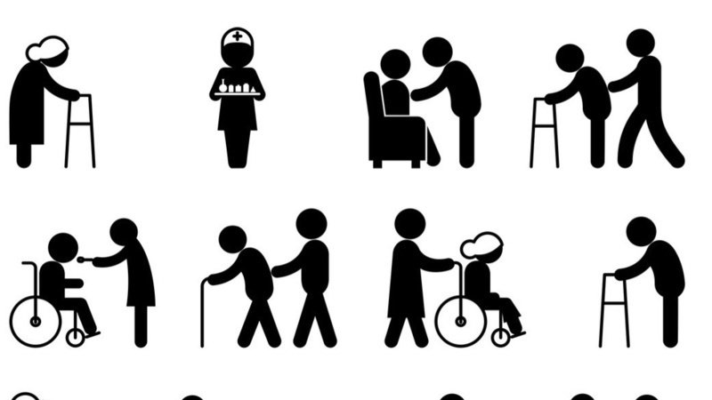
Assessment 1
Community Development
Promote the Social and Healthcare needs of Seniors in Leeds.
Student Name:​Winfred Nakanjako Diane
Student ID: 1905864​
Module Name: Community Care and Development
Module Code: BMHP6022
Lecturer Name: Chizoba Esio-Bassey
Date: 05/08/2022

Slide 2


Introduction
The term community is used as a shorthand for bonds, relations and identities joining people together. Zevallos (2013) defines a community as a social group following a social structure in a society either in terms of culture, status, values and norms. Belonging in a community has been linked to self rated health at all ages.
A weak sense of belonging in a community is associated with poorer mental and general health as Michalski et al. (2020) found out. Community development is all about a social group working towards positive change to improve themselves.
It is for these reasons that this work explores how communities can be developed in the sector of care, health and old people now and in the future in the City of Leeds. In addition, this work will also explore the rights and needs of these people as well as the power of digital communication in developing the developed communities.

Slide 3
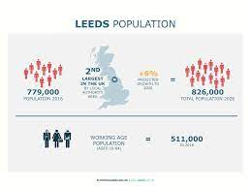
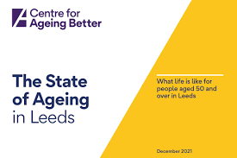
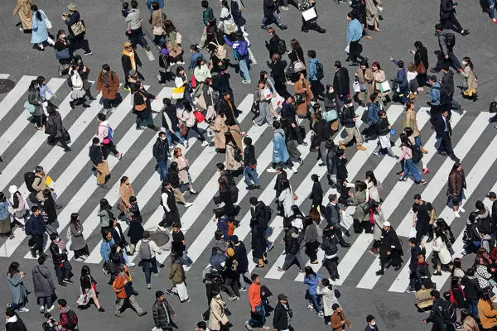
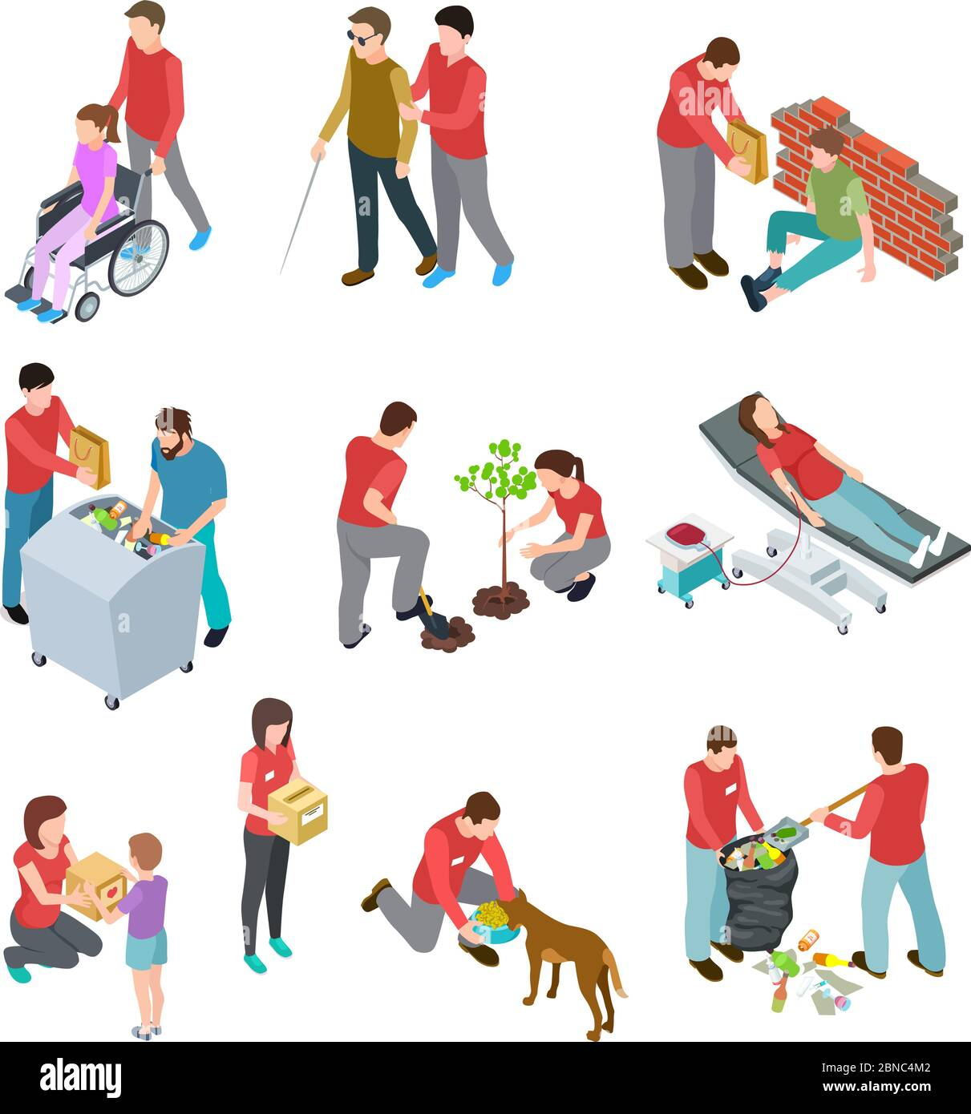
Demography and diversity
This is the third largest city in the UK with 812,000 people by 2021 and 1 in every person in Leeds is considered a senior citizen. These are individuals with rich knowledge and experience that can be employed to better the community, but they are facing challenges brought about by old age.(Canter for Ageing Better, 2021).
There is a strong sense of community in Leeds, and people are very supportive of each other. The city has a number of community groups and organizations that work to improve the health and wellbeing of residents, but this is not quite enough (Leeds, 2022).
Leeds is a very diverse city with more than 140 ethnic groups and 18% of its population is made up of minority ethnicities. There are Whites, Asians, Blacks, Mixed, Arabs and other ethnicities too (World Population Review, 2022). The community of older people in Leeds is comprised of different people and they all need to be treated with equality.

Slide 4

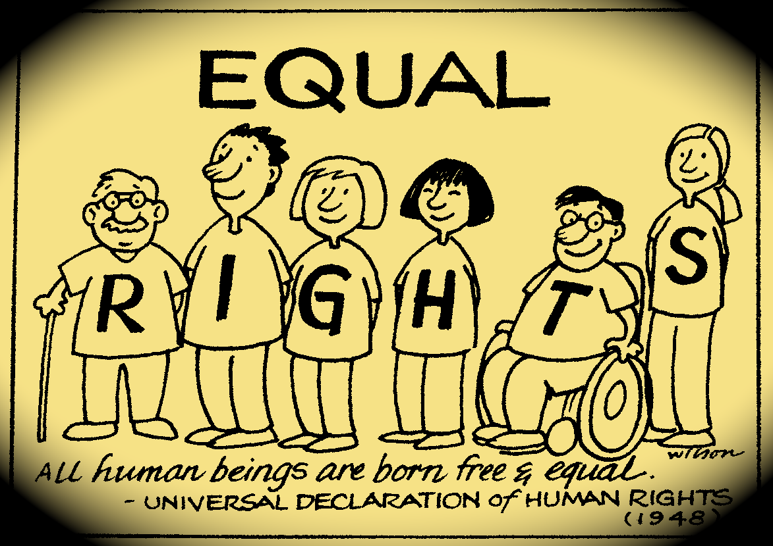
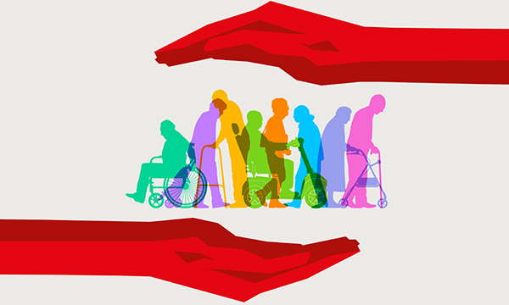

Key legislations
Equality Act 2010
This act is put in place to ensure that individuals are not discriminated against. For older people, it ensures that they are not being discriminated against just because of their age but instead they get access to social amenities (Gov.UK, 2010).
Safeguarding Vulnerable Groups Act 2006
This law sets out the process to be followed in vetting individuals who will work with vulnerable people, in this the elders in the community. In a new article in the Evening Post (2020) it was discovered that many are the seniors who are being abused by their care givers more so their relatives. This legislation will ensure that those dealing with seniors are suitable to offer health and social care services.
Care Act 2014
The local authorities have a role to play in safeguarding and promoting the wellbeing of people especially them who are considered to be vulnerable against neglect and abuse (DHSC, 2016).

Slide 5
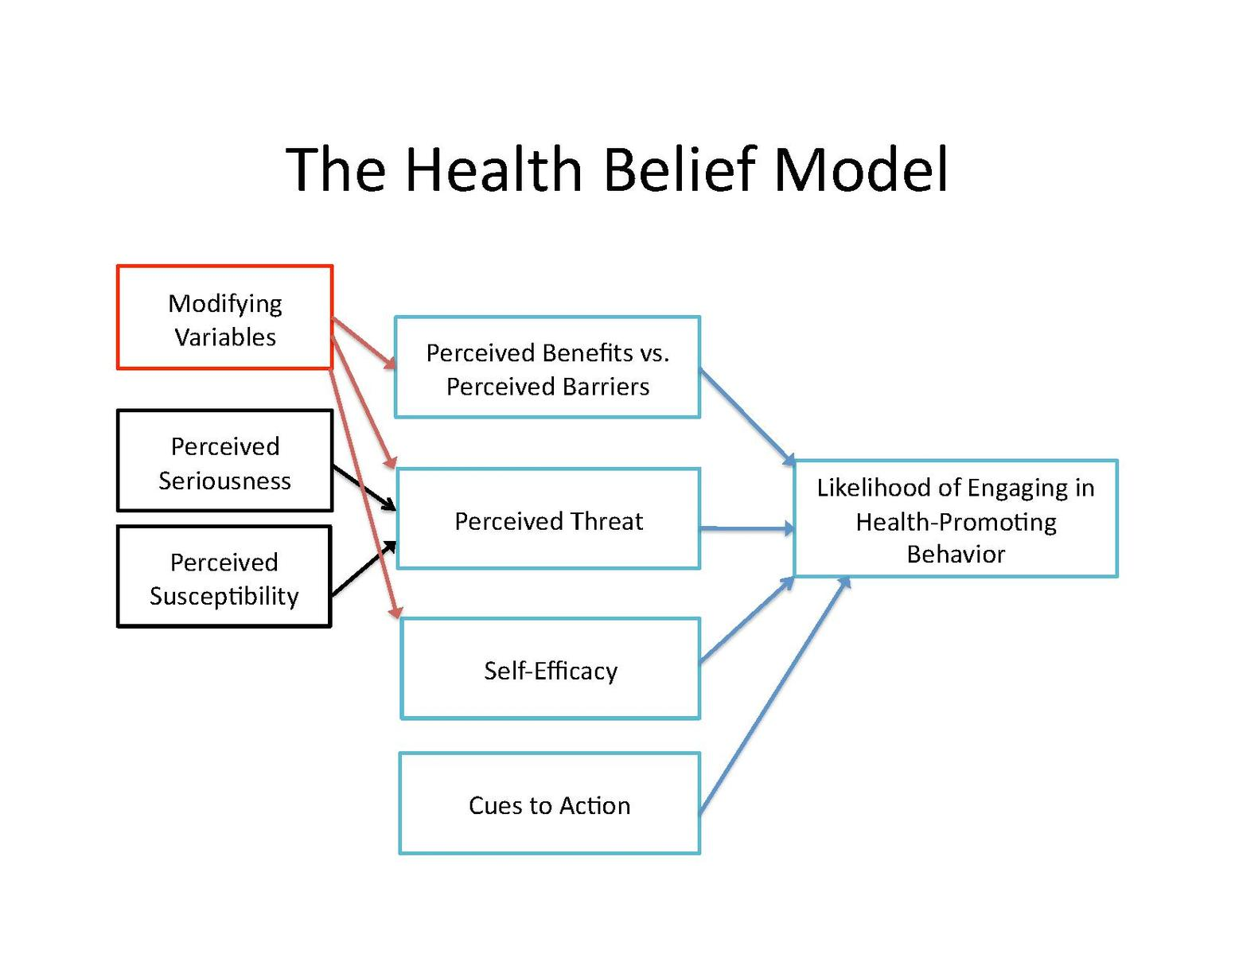
Theories of community development in Leeds Community
It posits that seniors in Leeds will take action to avoid or reduce a health threat if they believe that the threat is real and that they are personally susceptible to it.
The model suggests that seniors in Leeds are more likely to take action if they believe that the benefits of taking action outweigh the costs. Neglecting seniors is more costly at the end of the day since the cost of attending to chronic ailments will fall on the community financially and even in terms of services.(Jones et al., 2014).
The health belief model can be used to understand the repercussions of not attending to seniors, leaving them to wallow in poverty and ailments. By understanding the perceived risks and benefits of participating in such activities, community developers can design programs that are more likely to be successful in engaging seniors. (Urich, 2017).
Community development efforts that focus on increasing seniors in Leeds to be awareness of health risks and providing resources to help them make healthy choices could potentially reduce health disparities among this population.
The community is more likely to take action towards attending to seniors if they perceive that there is an imminent danger lurking if they are left alone to feel lonely and isolated.
(Urich, 2017)

Slide 6
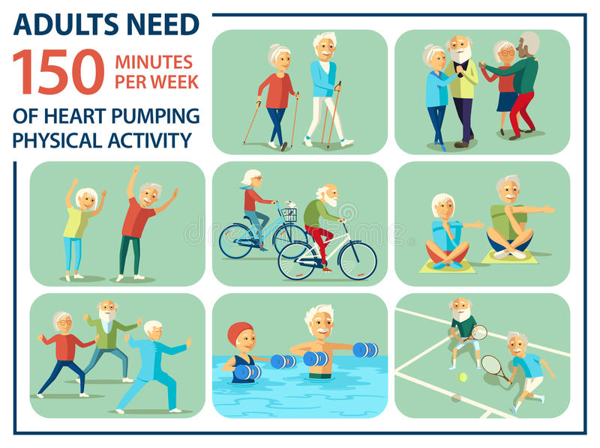
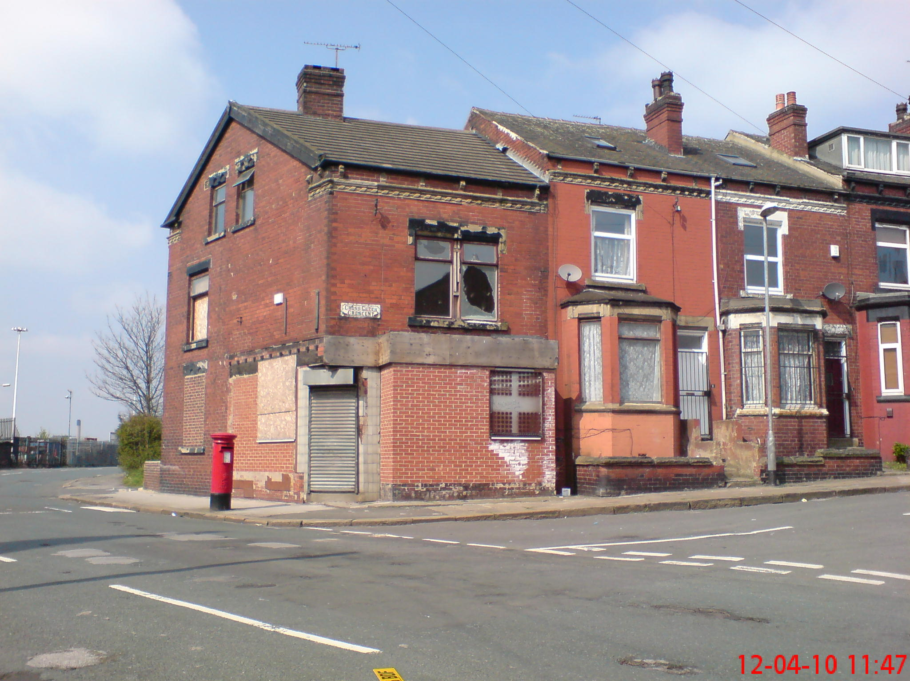
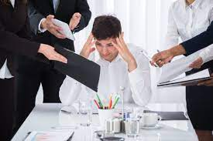

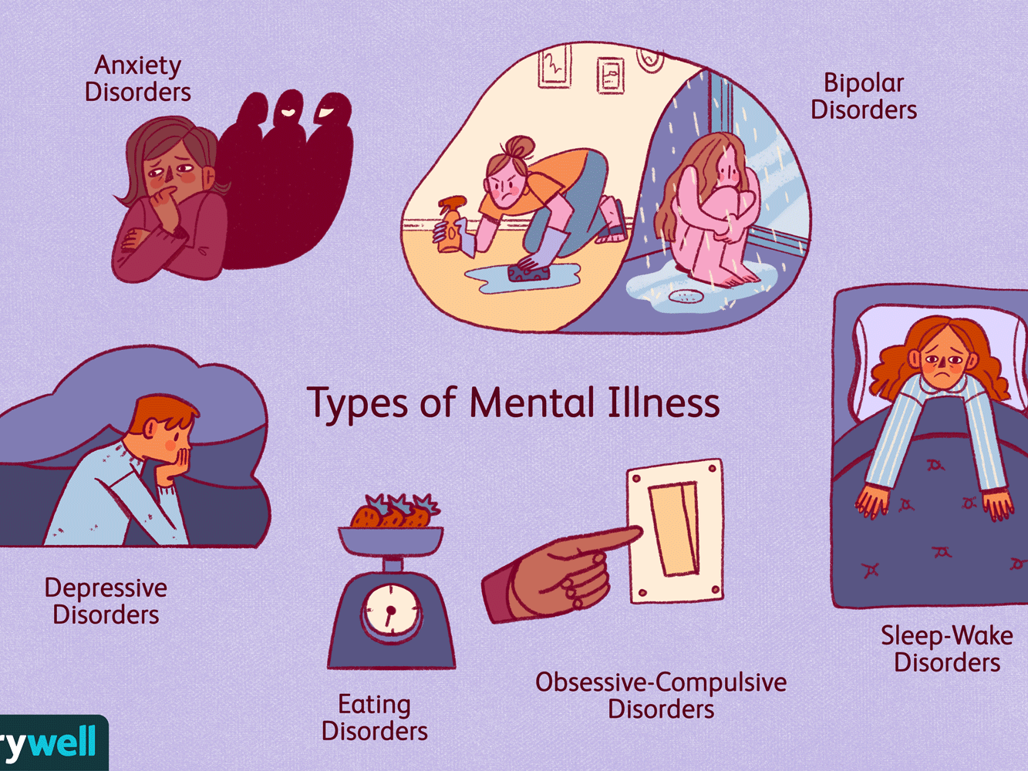
Needs of senior people in Leeds
Housing Standards most houses in Leeds are old 60% build before 1965(Center for Ageing Better, 2021).
Poor communication from service providers.
(Abdi et al., 2019):
The most deprived areas of Leeds are more likely to suffer from poor health, E.g. mental health problems, obesity etc(Lea, 2014)
Limited professional advice on self-care
e.g., engage more in exercises
50-64 who are unemployed is as a result of ill-health. 1 in every 8 households in Leeds have a person aged 65 and over living alone. This is the main reason for loneliness and social isolation

Slide 7
Challenges
To develop a community requires extensive research and evaluation of the current situation. It has been ascertained that the needs of senior citizens in Leeds are being overlooked and there is the need to ensure that the present communities are developed in order to use their assets towards the improvement of this group. The aim is to promote the social and healthcare needs of seniors in Leeds.
The following are steps to follow when developing a community (Towe et al., 2015):
Assessing community resources and strengths
Leeds has a strong sense of community which can be capitalized on as people always desire to see themselves advancing. The residents will be willing to participate in this promotion.
Ascertain community weaknesses
Leeds has of late been short of investments in key areas, a lack of jobs as well as an ageing population that requires to be attended to (Hatch, 2021).
Evaluate community risks
There is high crime rate in Leeds as a result of unemployment and deprivation. At 151% of national crime rate (Plumplot, 2022).
Reviewing high risk populace
The senior citizens in this city are prone to inequalities due to their age, they get vulnerable and majority of them languish in poverty after retirement (Center for Ageing Better, 2021).

Slide 8
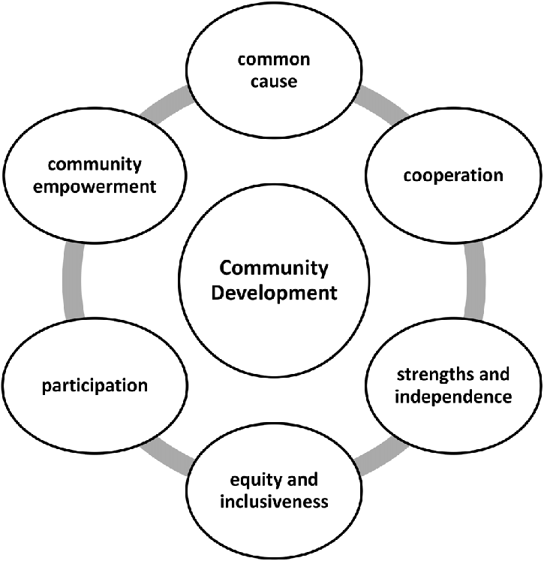
Impact of community development
Community development is not all about eliminating the problems in a community, it is about lessening them (Straza, 2018). In developing a community that will attend to the needs of older citizens in Leeds the following will be observed as outcomes:
Attitudes and perceptions are changed
Empowered individuals for instance access to healthcare
Lessened disparity among the residents
Better facilities and increased opportunities at life chances
Continued motivation (Straza, 2018).
Elements of community development
Elements of community development (Bordun, 2018)

Slide 9

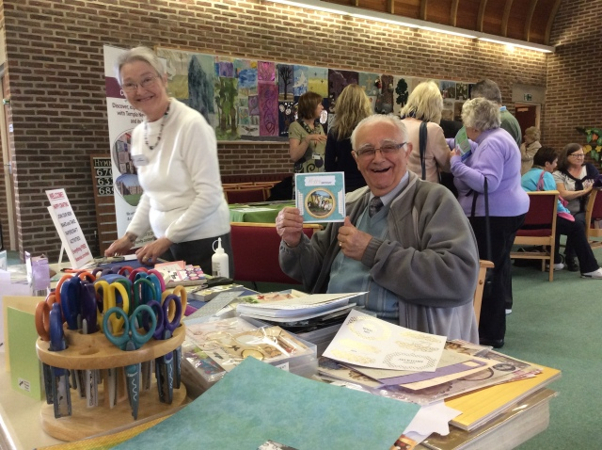

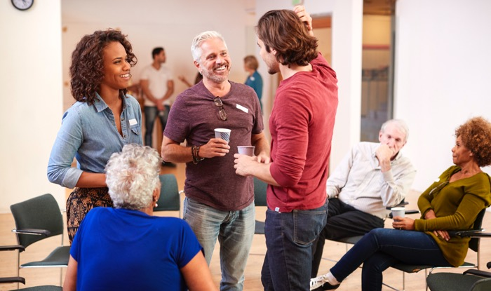
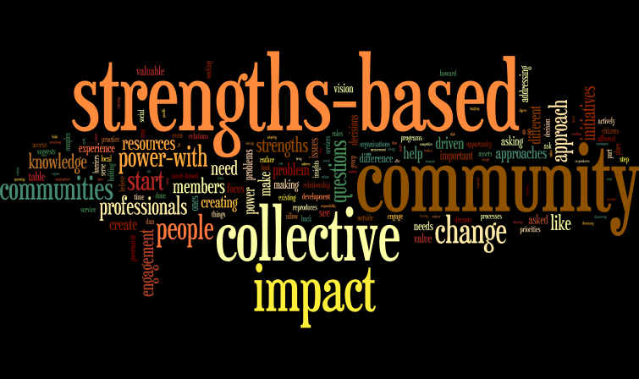
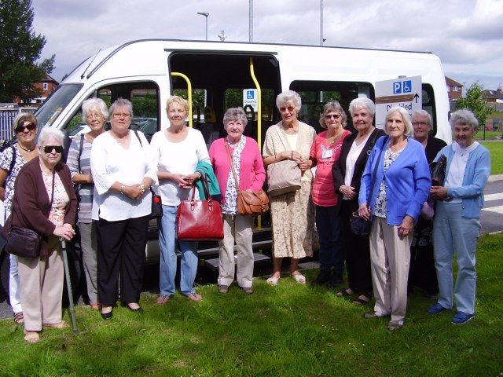
Sustainability of future community in Leeds(betterlivesleed2016)
Learning and working together
Self-determination: Make their own decisions
volunteers bring energy and enthusiasm
Card Making session
Planning Trips / Outing
Collective impact: By coming together people can have a stronger and greater impact on what they desire to change.
Trip to Tong

Slide 10


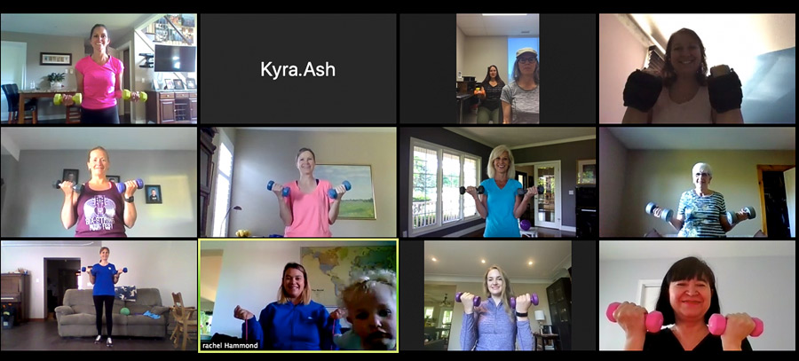
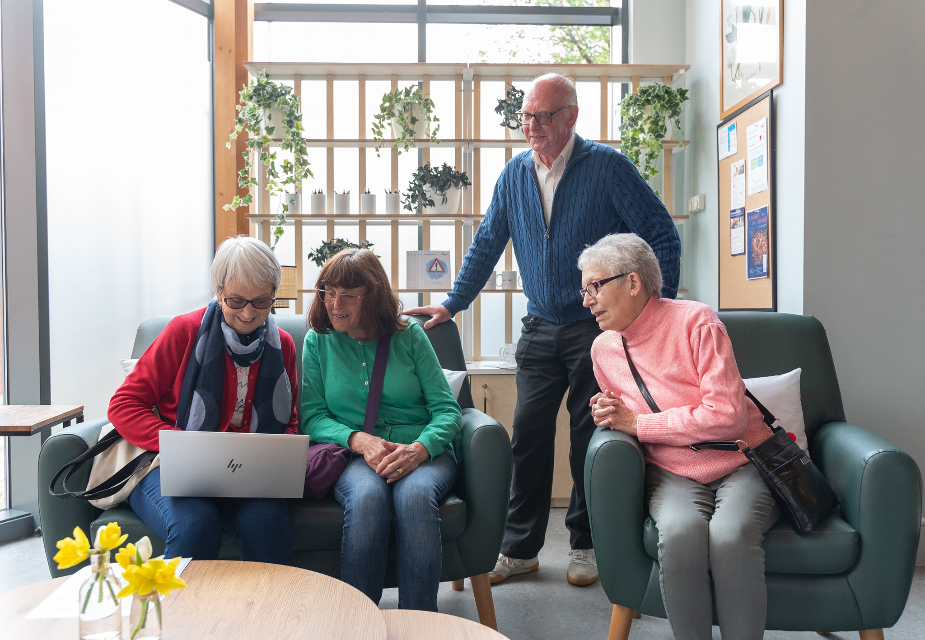

Digital communication
Timing of session;Community Hub
Neighbourhood Network Scheme go online to keep its weekly get-togethers going. which supports older people to live independently, has been working with 100% Digital Leeds to deliver weekly coffee mornings.(NHSLeeds,2022)
The organisation has developed a programme of Zoom sessions, offering a different session
Laptops have helped the community to identify and address problems and to develop and implement solutions.(Age,Uk 2022
Decision-making processes(Josh at al..,2013)

Slide 11
Barriers to community development.
There are many potential barriers to community development in Leeds, but some of the most common are as below (Cooper, 2022):
A lack of resources is often the most significant barrier to community development. Without adequate funding, it can be difficult to implement community development initiatives. One way to overcome this barrier is to seek out grant opportunities or other forms of financial assistance. Another is to develop creative funding strategies, such as crowdfunding or partnering with local businesses.
A lack of community involvement can also be a barrier to community development. Without buy-in from residents, it can be difficult to get projects off the ground. One way to overcome this is to ensure that community members are involved in the planning process from the start. Another is to develop programs that directly engage residents, such as volunteer opportunities or community events.
A lack of planning and coordination can also be a barrier. This can make it difficult to identify community development priorities and to develop and implement effective community development strategies. Evaluation and planning before starting the process is fundamental.
A lack of government support can be a barrier. Without government backing, it can be difficult to secure funding or other forms of support. One way to overcome this is to advocate for government support at the local, state and federal levels. Another is to build partnerships with government agencies and other organizations.

Slide 12
Conclusion
In this work the plan on developing communities in Leeds to ensure that seniors are being taken care of and their wellbeing prioritized.
It has been noted that majority of ageing people get to face immense challenges brought about by old age, this makes them vulnerable and impacts their access to social amenities resulting in poor life quality.
Developing a community ensures that their assets are employed in making them better.
The strengths of these communities are used in improving the society for the sake of this population.
Empowering a community such that the ageing individuals still receive care either in their homes or care institutions will go a long way in ensuring that they lead a comfortable life in retirement.

Slide 13
Reference list
Abdi, S., Spann, A., Borilovic, J., de Witte, L. and Hawley, M. (2019). Understanding the care and support needs of older people: a scoping review and categorisation using the WHO international classification of functioning, disability and health framework (ICF). BMC Geriatrics, 19(1). doi:10.1186/s12877-019-1189-9.
Bordun, O. (2018). TOURIST DESTINATION AND KEY INDICATORS OF ITS SUSTAINABILITY. Current Issues of Tourism Research, 4(2).
Casla, K. (2020). Ending Child Poverty: Twenty Years On An essay collection. [online] Available at: https://www.unison.org.uk/content/uploads/2020/03/26024-1.pdf.
Center for Ageing Better (2019). Age Friendly Leeds Strategy and action plan 2019 - 2022.
Center for Ageing Better (2021). The State of Ageing in Leeds. [online] Available at: https://ageing-better.org.uk/sites/default/files/2021-12/the-state-of-ageing-in-leeds.pdf.
Cooper, C. (2022). 5 barriers to community engagement: and how to overcome them! [online] www.commonplace.is. Available at: https://www.commonplace.is/blog/barriers-to-community-engagement.
DHSC (2016). Care Act Factsheets. [online] GOV.UK. Available at: https://www.gov.uk/government/publications/care-act-2014-part-1-factsheets/care-act-factsheets.
Ettekal, A. and Mahoney, J.L. (2017). Ecological Systems Theory. The SAGE Encyclopedia of Out-of-School Learning, [online] pp.239–241. doi:10.4135/9781483385198.n94.
Evening Post (2020). Domestic abuse can take many forms, including a family member financially abusing an elderly relative. [online] www.yorkshireeveningpost.co.uk. Available at: https://www.yorkshireeveningpost.co.uk/news/crime/police-bid-help-stop-domestic-abuse-elderly-3054742 [Accessed 12 Jul. 2022].
Falconer, K. (2019). The 4 types of discrimination: what every employer needs to know. [online] HR Solutions. Available at: https://www.hrsolutions-uk.com/4-types-of-discrimination/.
Gov.UK (2010). Equality Act 2010. [online] Legislation.gov.uk. Available at: https://www.legislation.gov.uk/ukpga/2010/15/part/2/chapter/1.
Guy-Evans, O. (2020). Bronfenbrenner’s Ecological Systems Theory. [online] www.simplypsychology.org. Available at: https://www.simplypsychology.org/Bronfenbrenner.html.
Hatch (2021). Leeds City Region Strategic Employment Evidence - Land and Property.
Jones, C.L., Jensen, J.D., Scherr, C.L., Brown, N.R., Christy, K. and Weaver, J. (2014). The Health Belief Model as an Explanatory Framework in Communication Research: Exploring Parallel, Serial, and Moderated Mediation. Health Communication, 30(6), pp.566–576. doi:10.1080/10410236.2013.873363.
Joshi, A., Meza, J., Costa, S., Perin, D.M.P., Trout, K. and Rayamajih, A. (2013). The role of information and communication technology in community outreach, academic and research collaboration, and education and support services (IT-CARES). Perspectives in health information management, 10(Fall).
Lea, W. (2014). Consultation on setting the 2020 persistent child poverty target. [online] Available at: https://assets.publishing.service.gov.uk/government/uploads/system/uploads/attachment_data/file/323979/Persistent_child_poverty_consultation_-_print-ready_version.pdf.

Slide 14
Reference list
Leeds (2022). Community Led Local Development in Leeds. [online] Leeds.gov.uk. Available at: https://www.leeds.gov.uk/clld [Accessed 11 Jul. 2022].
Maziashvili, M., Pleśniak, A. and Kowalik, I. (2022). The digital communication tools and citizens’ relationship with local governments: a comparison of Georgian and Polish cities. International Review of Administrative Sciences, p.002085232210797. doi:10.1177/00208523221079746.
McLeod, S. (2022). Maslow’s Hierarchy of Needs. [online] Simply Psychology. Available at: https://www.simplypsychology.org/maslow.html.
Michalski, C.A., Diemert, L.M., Helliwell, J.F., Goel, V. and Rosella, L.C. (2020). Relationship between sense of community belonging and self-rated health across life stages. SSM - Population Health, 12, p.100676. doi:10.1016/j.ssmph.2020.100676.
ONS (2022). How the population changed in Leeds, Census 2021 - ONS. [online] www.ons.gov.uk. Available at: https://www.ons.gov.uk/visualisations/censuspopulationchange/E08000035/ [Accessed 11 Jul. 2022].
Plumplot (2022). Leeds violent crime statistics in maps and graphs. [online] www.plumplot.co.uk. Available at: https://www.plumplot.co.uk/Leeds-violent-crime-statistics.html.
SCDC (2019). SCDC - We believe communities matter. [online] SCDC - We believe communities matter. Available at: https://www.scdc.org.uk/who/what-is-community-development.
Straza, M. (2018). Community Development: What it is, its Importance, and How to Contribute in Your City. [online] Straza Consulting. Available at: https://www.consultstraza.com/community-development-what-it-is-its-importance-and-how-to-contribute-in-your-city [Accessed 11 Jul. 2022].
Towe, V.L., Chandra, A., Acosta, J.D., Chari, R., Uscher-Pines, L. and Sellers, C. (2015). Getting to Know the Community. [online] Resilience in Communities. Available at: http://resilienceincommunities.com/program/plan/know-the-community/.
Urich, A. (2017). The Health Belief Model. In: Methods for Stress Management. Pressbooks.
World Population Review (2022). Leeds Population 2020 (Demographics, Maps, Graphs). [online] worldpopulationreview.com. Available at: https://worldpopulationreview.com/world-cities/leeds-population.
Zevallos, D.Z. (2013). Sociology of Community. [online] The Other Sociologist. Available at: https://othersociologist.com/2013/11/20/sociology-of-community/.

