Slide 1

DBA CRITICAL LITERATURE REVIEW FOR DOCTORAL RESEARCH
DR CAROLINE JAWAD 2022

Slide 2

Please note
This presentation will introduce you to some aspects of research methods – but it is NOT intended to replace key reading, such as Bryman, Crotty, Creswell, Maxwell, Denscombe, Denzin, Guba and Lincoln, Easterby-Smith et al, Collis and Hussey and Cohen.
You must read key texts and beyond at doctoral level that cover the method and for this you may have to go beyond your modules reading list.
Again some slides will not be focused on and you are expected at this doctoral level to be motivated, engaged and understand the areas you need to explore.
Notes:
For him is Paradise packed with bounties, pleasure and delight and spiritual sustenance and comforts

Slide 3

This presentation uses ….

Slide 4
In a single slide…
Identifying studies to include is a key stage of any literature review.
A systematic literature search is an essential component of any systematic review.
Having developed a structured review question, this chapter helps you to translate that question into an appropriate search strategy.
Tools and exercises can assist you to devise a search strategy and identify appropriate sources of information to be searched.
Several techniques exist to make your literature search more systematic, and to review and refine it as necessary.

Slide 5
Start with a scoping search (1 of 2)
A quick search of one or two sources, scoping searches have three main objectives:
  identify any existing reviews around the topic (to avoid duplicating work)
  assess the nature and scale of the literature (to ensure that you can complete the review you are planning within the time and resource available)
  identify key publications with which to familiarise yourself with the topic and inform your subsequent searches (sometimes described as pearl growing).

Slide 6
Start with a scoping search (2 of 2)
These are essential at the stage where you are developing your protocol (see chapter 4). A scoping search can also help you choose sources and terminology to use for your systematic search.

Slide 7
Systematic searching: 1. Selecting Sources
Identify a selection of bibliographic databases that will cover all the disciplines likely to be relevant to your topic.
  These might include broad multidisciplinary sources (Web of Science, Scopus) as well as subject-specific databases like MEDLINE, PsycINFO or ERIC.
Consider what types of grey (unpublished) literature may be relevant and how you will obtain them
  Eg, would you be interested in reports from government organisations? Preliminary results from ongoing studies? Dissertations and theses? These types of material may be difficult to obtain but for some topics they may be essential.

Slide 8
Systematic search 2:
Developing your search strategy
Make a list of terms relating to each of the key concepts of your review question (see chapter 4).
Search one concept at a time, using thesaurus searching (where databases offer subject headings) in addition to free text searching of titles and abstracts
Consider alternative spellings, and use truncation (*) to find different word endings (eg, vaccin* to find vaccine, vaccines, vaccination)
Combine searches relating to the same concept with OR
Combine searches relating to different concepts with AND
Use search filters to limit your search to specific types of study

Slide 9
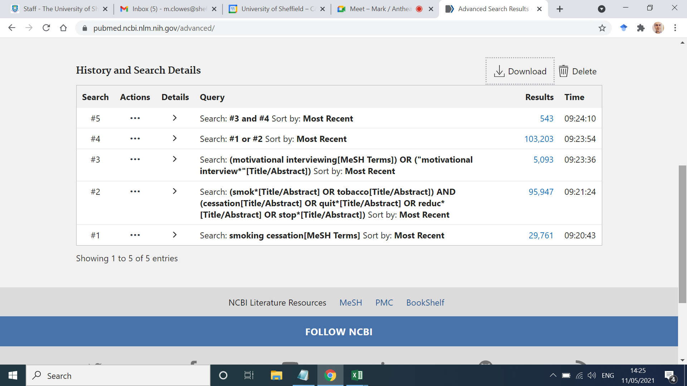
Example search string (PubMed)
In this simple search, concepts are searched one at a time (lines 1-2 smoking cessation, line 3 motivational interviewing).
Each concept is searched in MeSH (subject headings) and title/abstract.
Similar lines (1&2) are combined with OR; different concepts (3&4) with AND.
More examples of search strings can be found in chapter 5.

Slide 10
Supplementary searching
To minimise the likelihood of missing relevant material:
  Check reference lists of included papers
  Use citation searching to find more recent papers which cite those you have included
  If time allows, consider contacting key authors in case they have work in progress and are able to share early findings with you, or suggest others you might have missed.

Slide 11
Reporting your searches
Keep notes throughout the process
Save your searches wherever possible, allowing you to edit and re-run as required
Provide a prose description of your searches in the Methods section of your review
Reproduce at least one database search string in full as an appendix/supplementary material
Follow the PRISMA-S guidance on reporting searches

Slide 12
‘Take homes’ (1 of 2)
Pre-plan your search and conduct a scoping search.
Select the most appropriate sources to search.
Take into account limitations of the literature, such as inconsistent terminology and problematic indexing, and include alternative search terms (including those used in known papers).
Select the most appropriate search techniques for the sources that you have chosen. Consider whether it is appropriate to use search filters.

Slide 13
‘Take homes’ (2 of 2)
Employ supplementary search approaches (for example citation searching as well as traditional database searching).
Evaluate your search results, modify your search strategies accordingly and be sure to document the search process to allow you to report it accurately when you write up your review.

Slide 14
Now read:
Chapter 5 of the Sage Book: Searching The Evidence. In: Systematic Approaches to a Successful Literature Review, 3rd ed, 2021.
You might also find the following useful:
Levay, P. & Craven, J. (eds). 2019. Systematic Searching: Practical Ideas for Improving Results. Facet: London. ISBN 9781783303731

