Slide 1
Welcome to Marketing & Promoting Restaurant Facilities – BMGM6002
I will begin the Lecture at 9:30am, so use this as an opportunity to grab a beverage, access required documents or ask me any questions that you have. Please ensure that once we begin the lecture you have access to Moodle with your module handbook open.
Please ensure that during this lecture your camera remains on at all times.

Slide 2
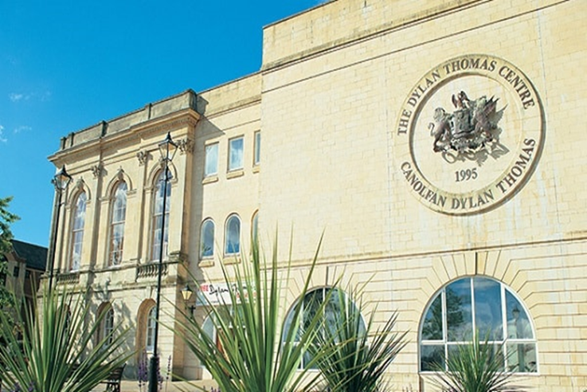
International Gastronomy Management
BMGM6002 Marketing & Promoting
Restaurant Facilities
Week 5 – Tactics, Action and Control

Slide 3
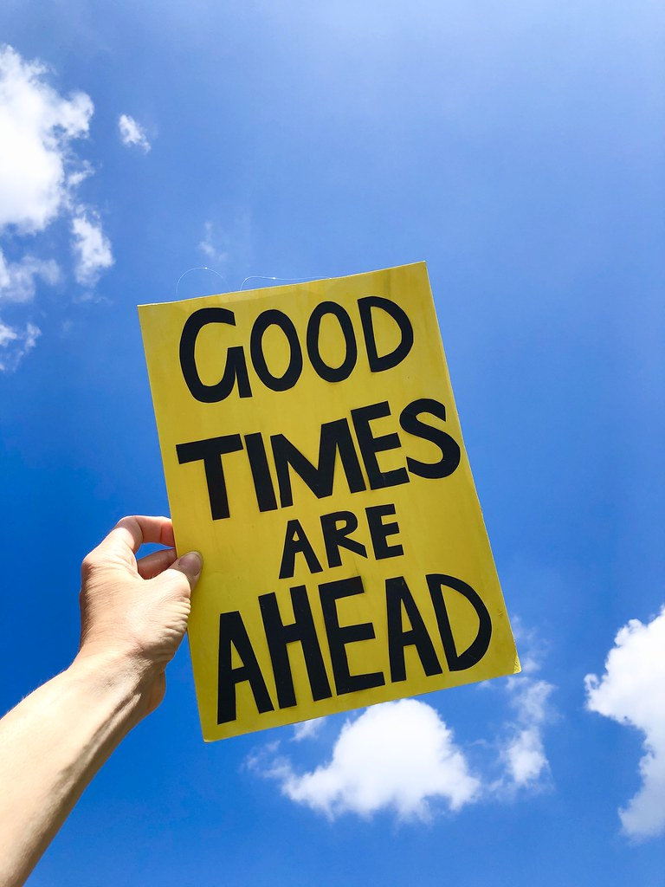
Aims for today
What is Social Media/Digital Marketing
Communication & promotional Mix

Slide 4
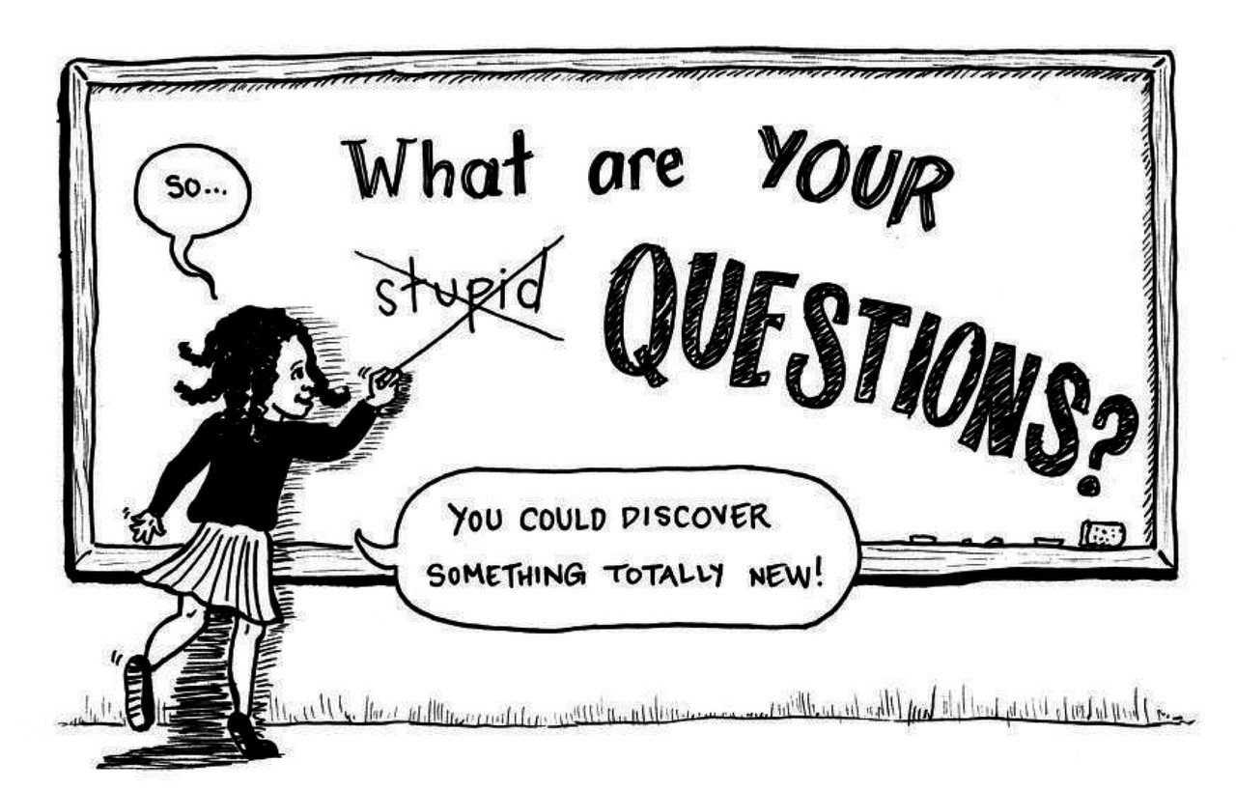
Any Questions?

Slide 5
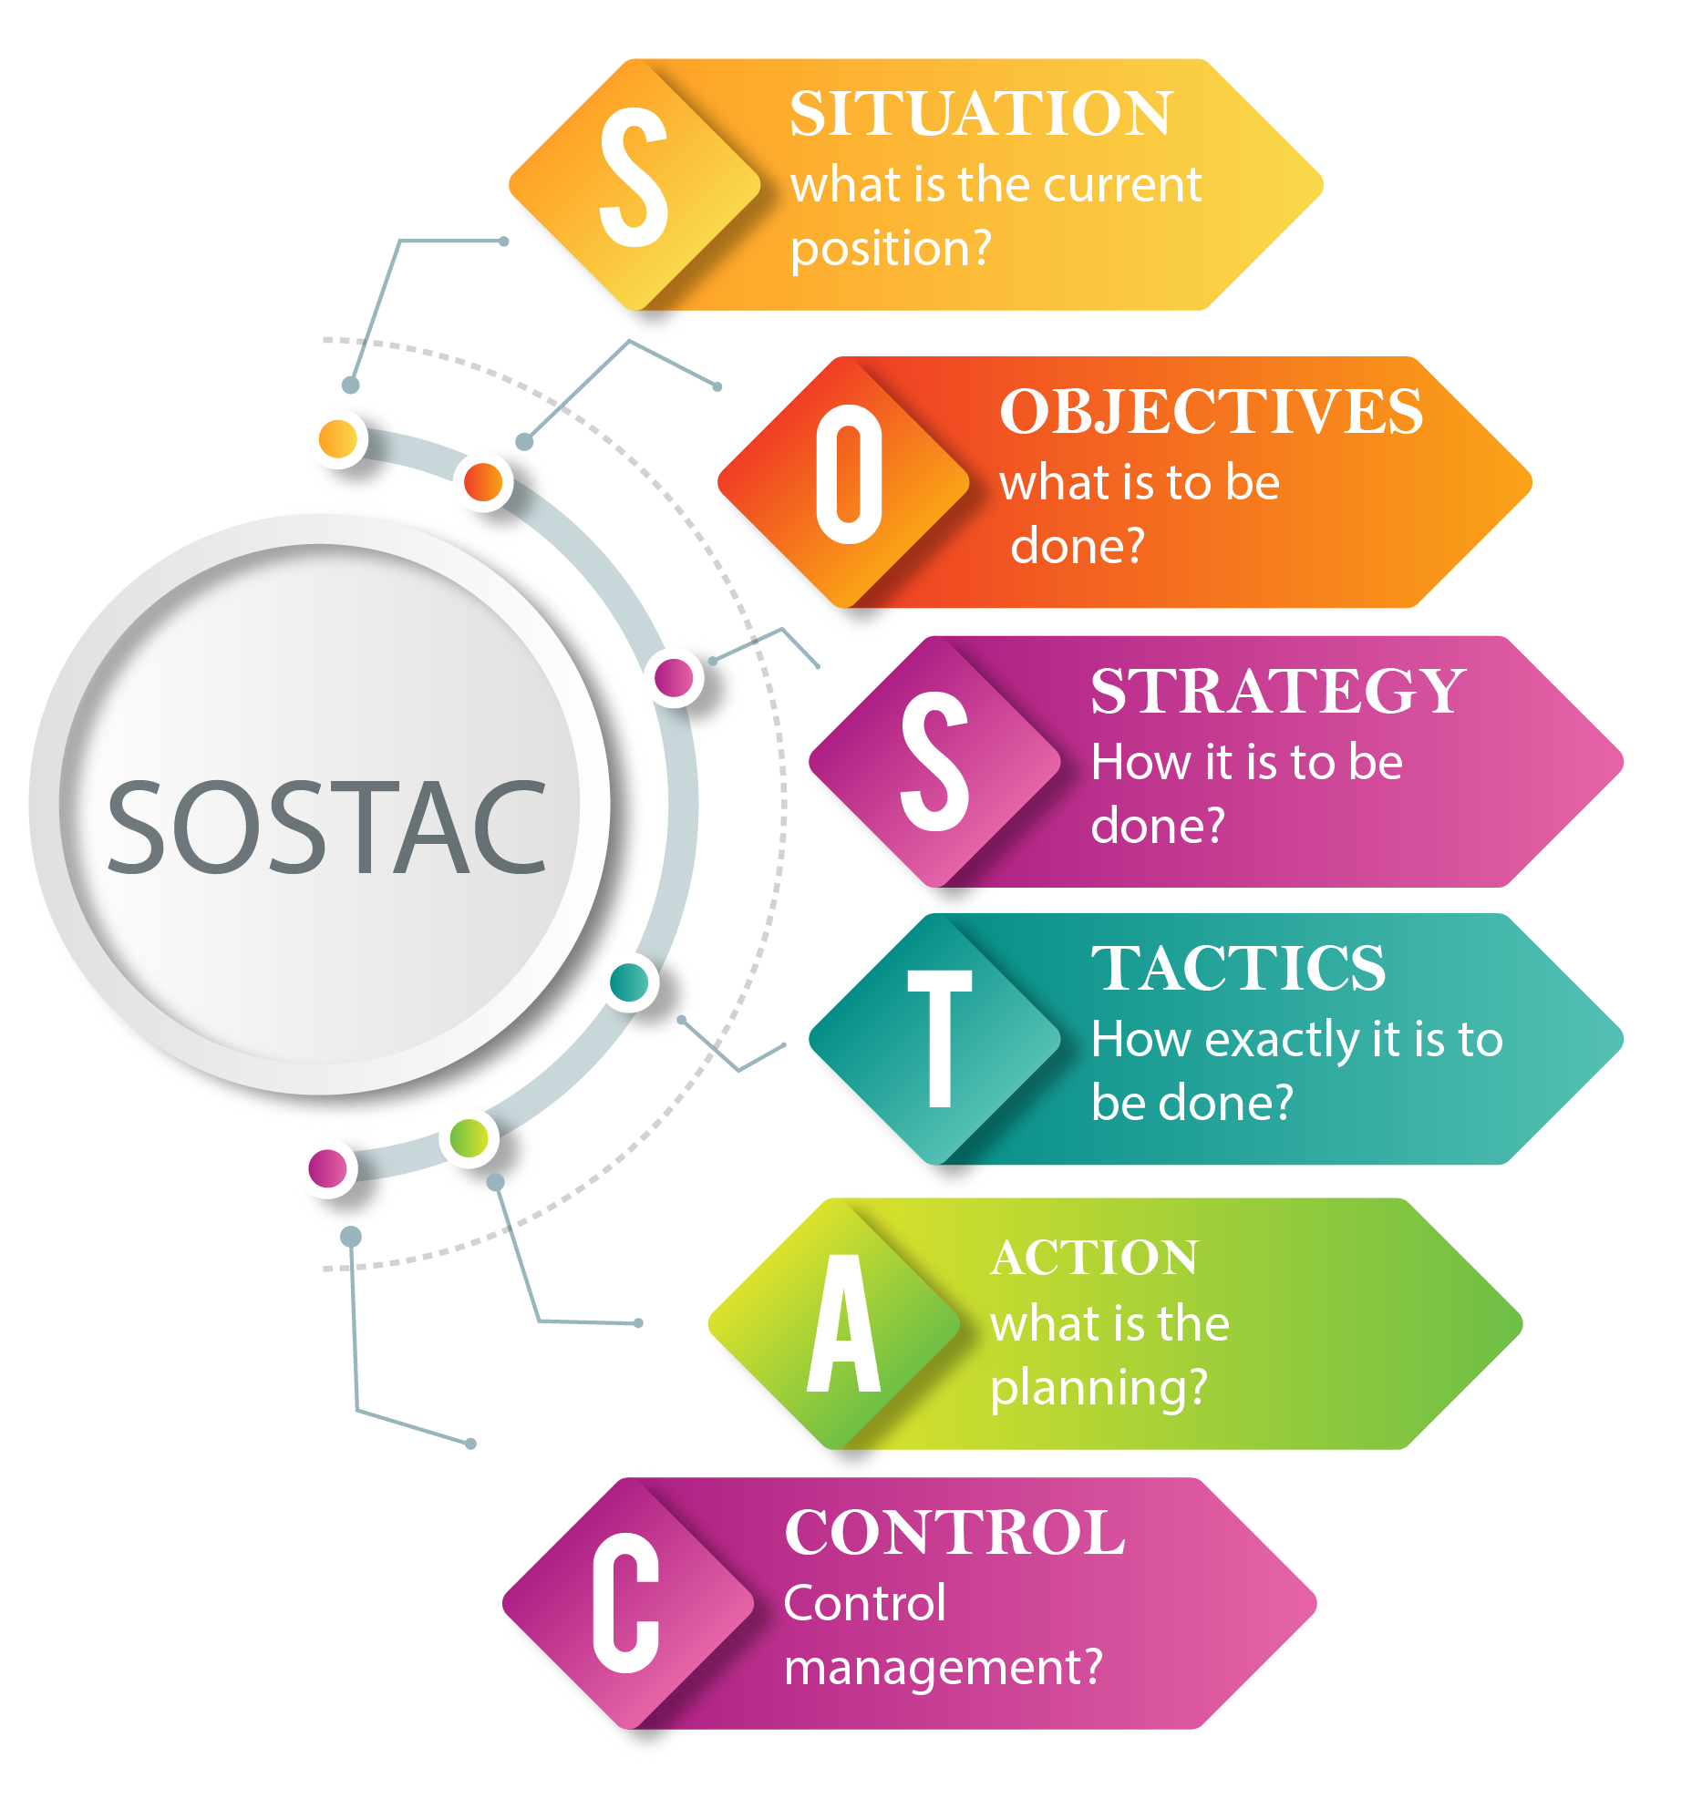
Tactics
Action
Control

Slide 6
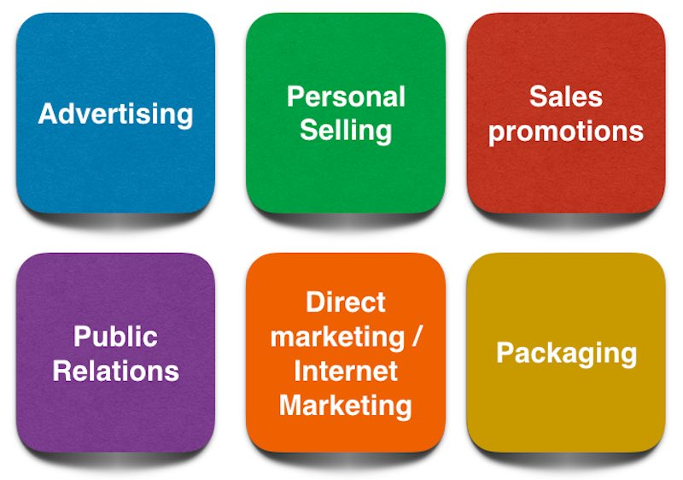
Communications Mix
A company’s overall marketing communication strategy is called the “Communications” or “Promotional” mix.
“The specific blend of advertising, public relations, personal selling, and direct-marketing tools that the company uses to persuasively communicate customer value and build customer relationships.” (Kotler & Armstrong, 2018)
In the era of mass communications and emerging mobile technologies, an organization must build an adequate mix of marketing communications (Todorova, 2015)
Notes:
the Communications Mix defines the ways you communicate with your customers,
i.e. the tools you use.
Advertising: This tool of IMC refers to any paid form of non personal promotions of products and services by a public figure and identified sponsor. The various forms of media used are print, broadcast, network, electronic and display. Advertising form of communication reached geographically dispersed consumers.
Sales Promotions: Sales promotions are a variety of short-term incentive to encourage trial or purchase of product or service. This usually includes consumer promotions- such as distribution of free samples, coupons on purchase of higher quantity, discounts and premiums or trade promotions, focusing on retailers, such as display and merchandising allowances, volume discounts, pay for performance incentives and incentives on salespersons.
Personal Selling: This tool of marketing is done through face-to-face interaction with consumers. The whole purpose of personal selling is making presentations, answering questions and taking orders. Personal selling helps in maintaining long term relations with the customer. The main advantage is that the message can be customized as per the needs of the customer.
Public Relations: PR is a two way communication process which is directed towards improving the relationship between the organization and the public. This method of communication monitors the feedback of the customers and adjusts its message for providing maximum benefits to them.
Direct Marketing: This method of communication includes the usage of mail, telephones, fax or internet to communicate with or respond back to the customers or prospects. Companies usually have a database of contact details of consumer through which they directly contact the customers to send catalogues and other marketing material making it easier for the consumer to purchase online.

Slide 7
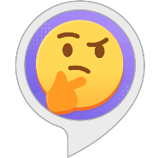
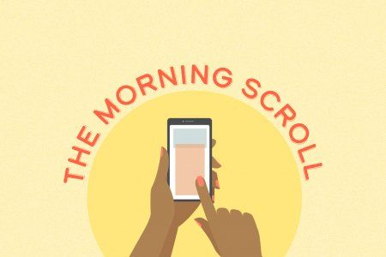
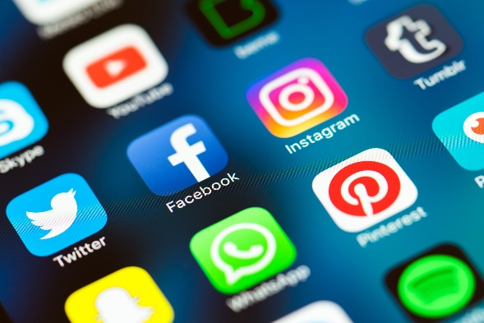
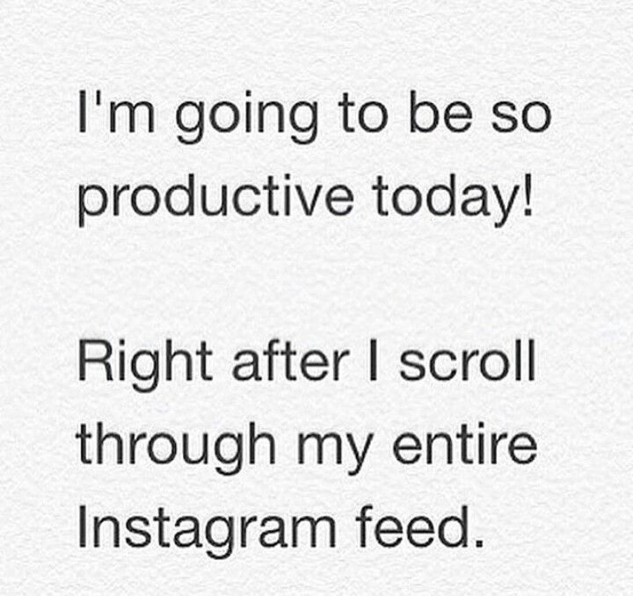

Its a social World
What was the first thing you did when you woke up this morning?
What time of day is best to post on social media?
You wouldn't be alone one survey of people from 31 countries reported that 96% of them use their smartphone within an hour of waking up often before they get out of bed
(Lee & Calugar-Pop 2016)
Notes:
Checked your mobile?
Maybe set up a snapchat story?
Scrolled through a few Tweets
or checked out WhatsApp
Instagram lunchtime =2/3 times more engagement

Slide 8
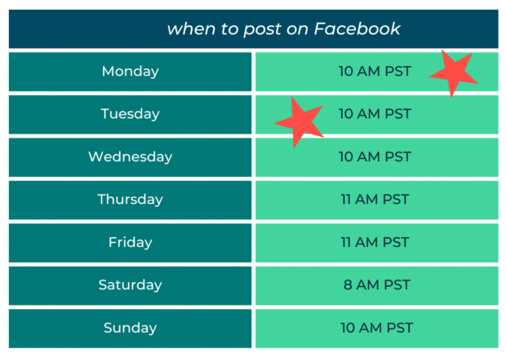
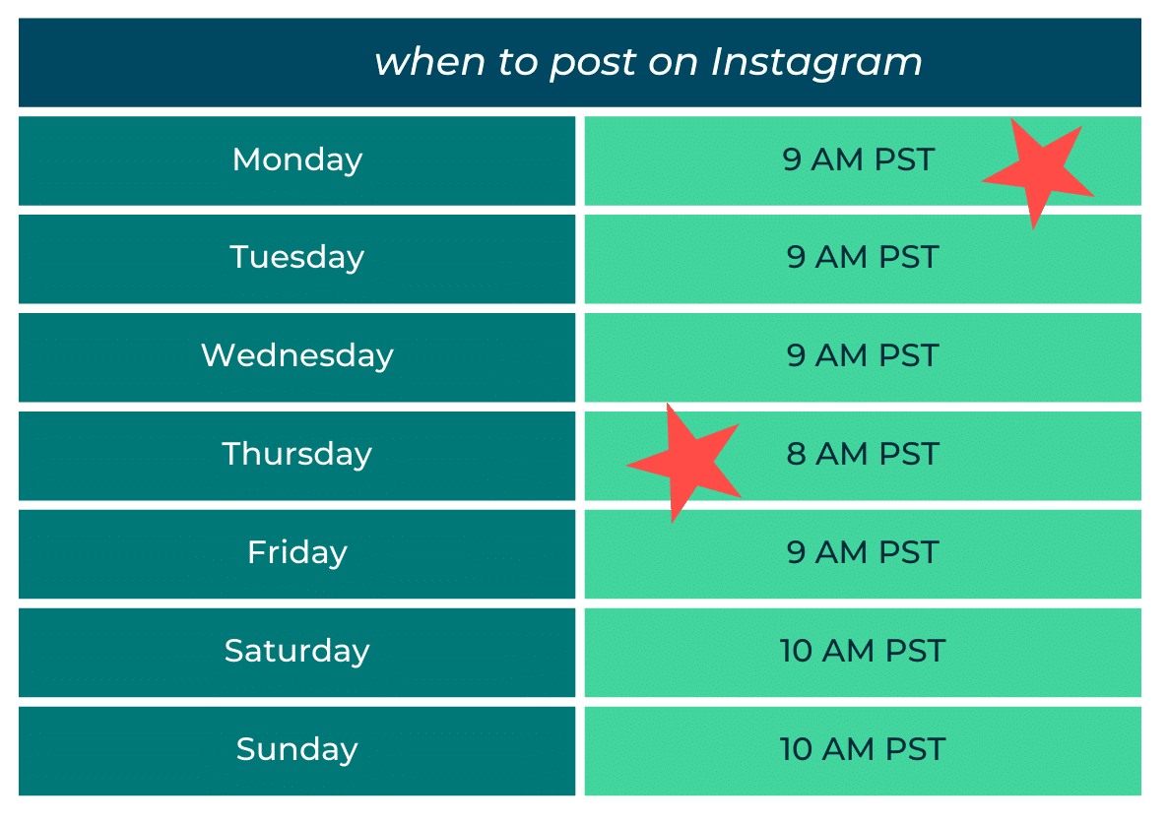
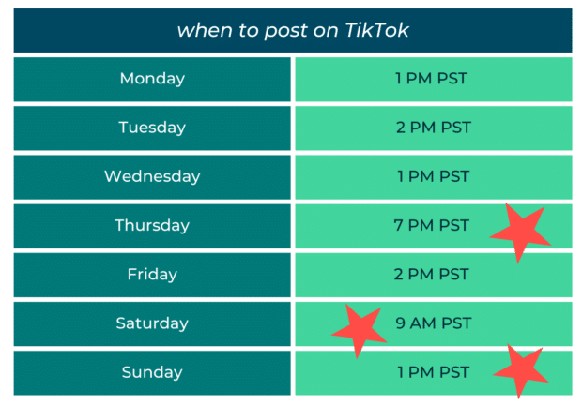
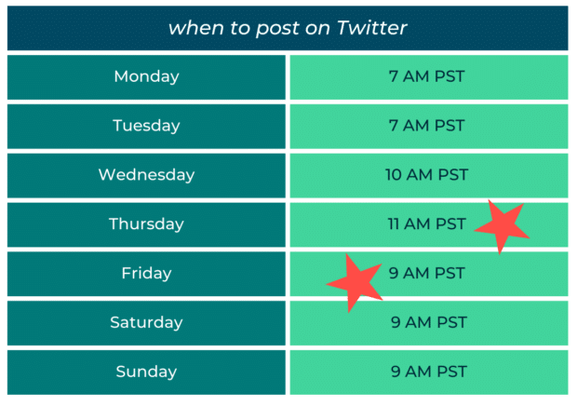
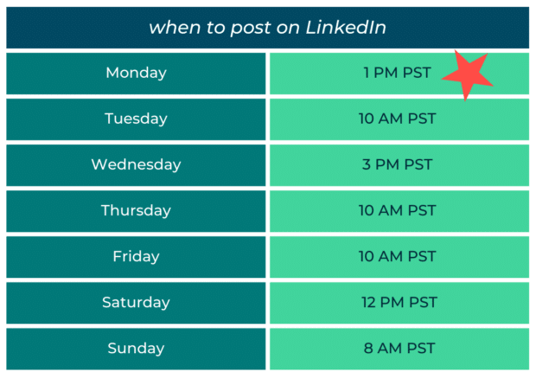
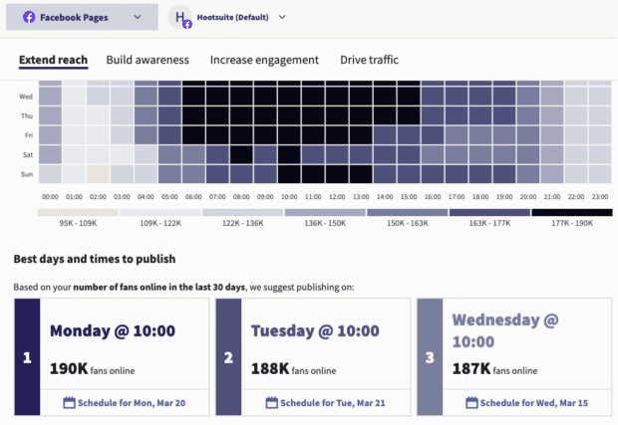
When?
Generally, the best time to post on social media overall is 9:00 AM PST (12:00 PM EST) on Mondays. But every network has its own sweet spot.
Best Time to Publish in Hootsuite Analytics (vidyard.com)

Slide 9
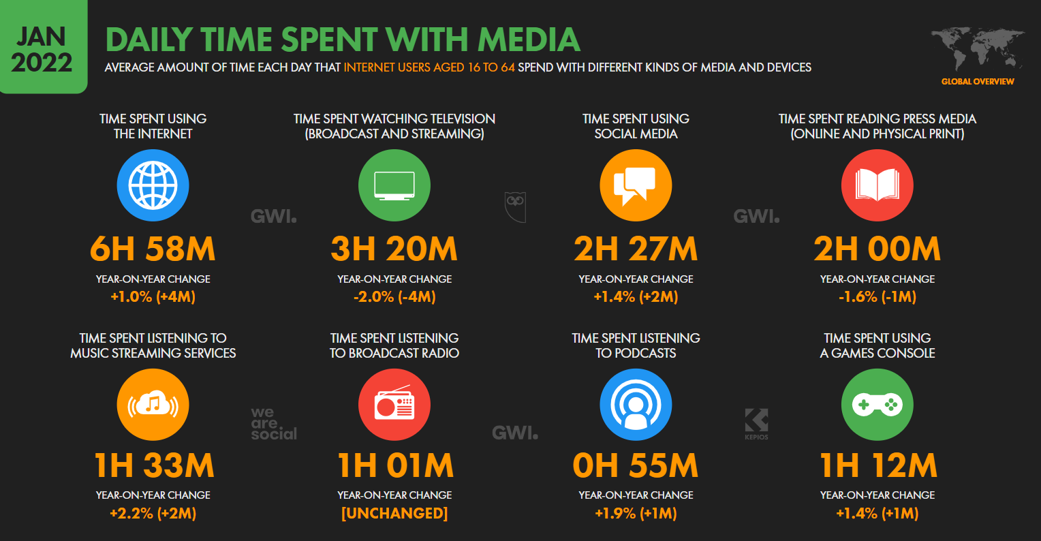
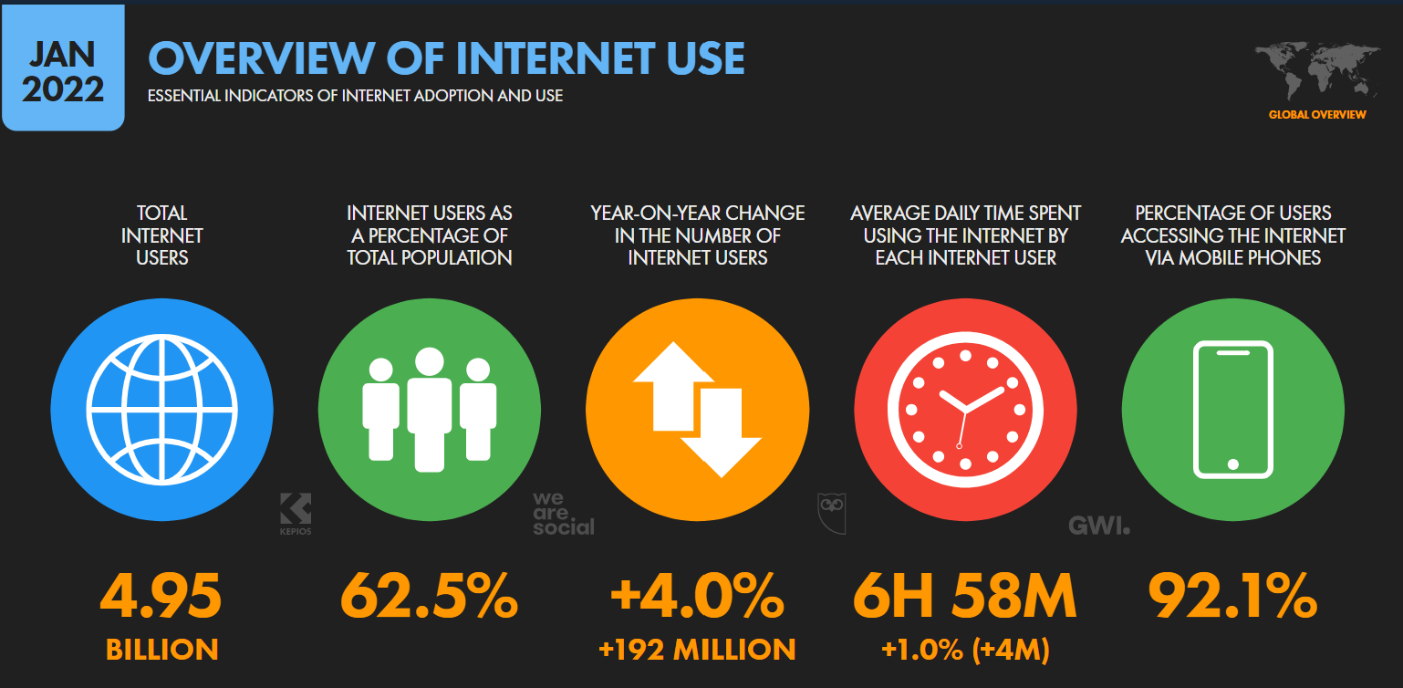
So how connected are our customers?

Slide 10

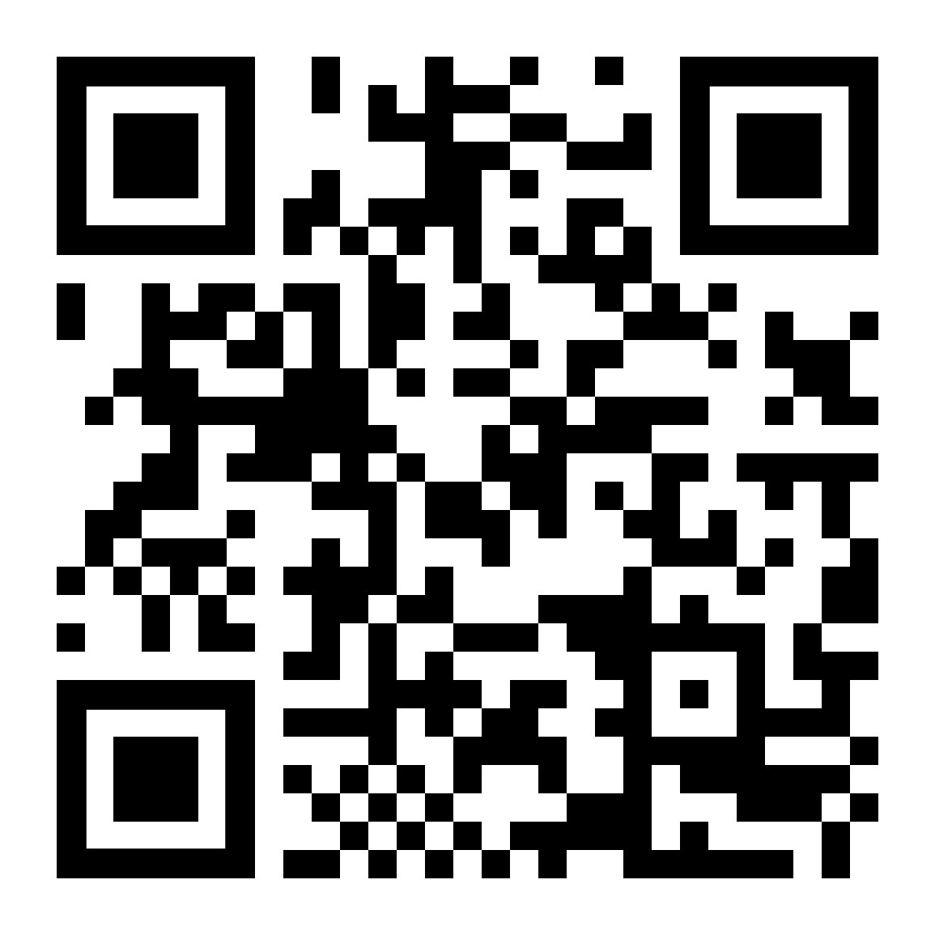
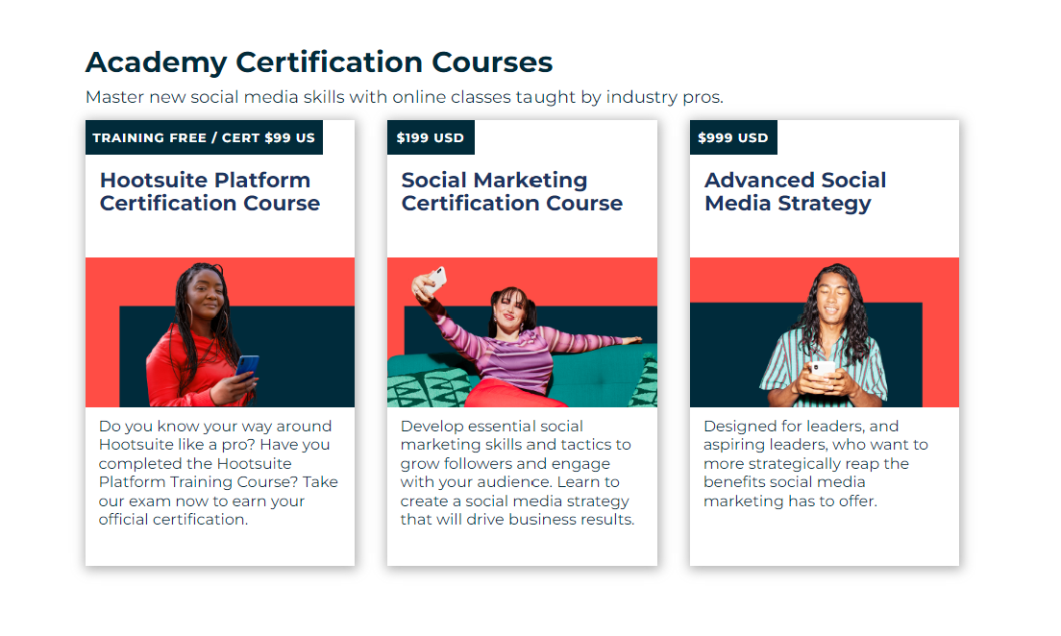
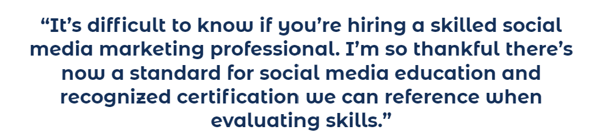

Social Media Marketing & Platform Courseware - Hootsuite Academy
45 mins to get as far as you can in Hootsuite academy?
Complete in your own time to get certificate

Slide 11
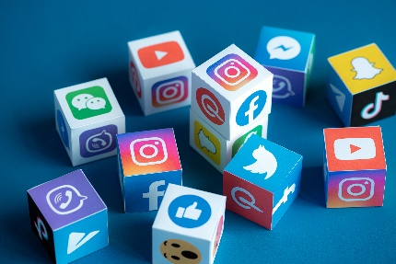
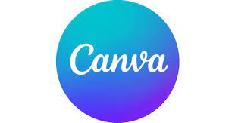


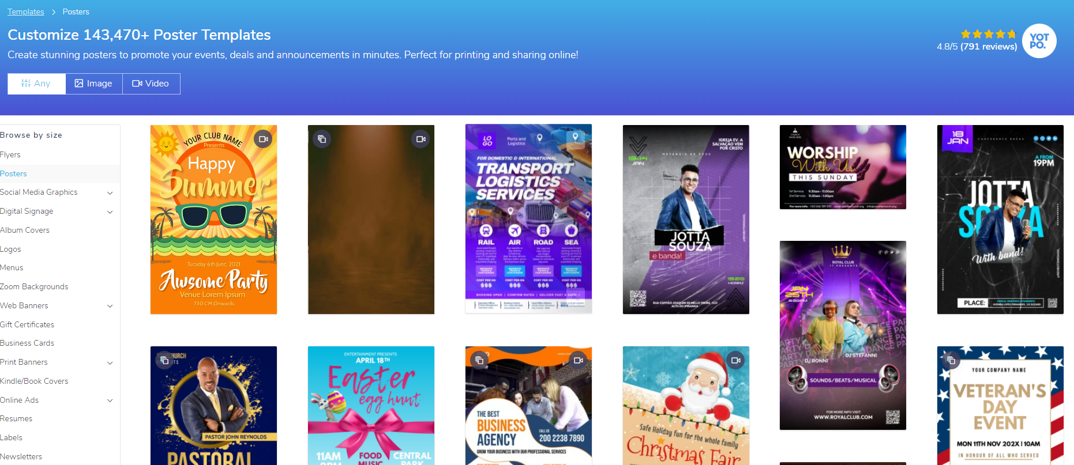

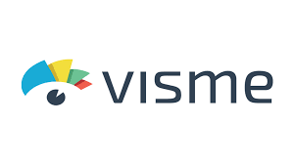

Show me your marketing art!
Create content designed to get customers to ‘Act’ for the opening of your business.
Think about who you are making it for, which social media channel‘s’ you would use.
Be prepared to discuss
45 mins!
Notes:
A great tool for posters leaflets, social media posts animated videos, web banners and other marketing content.
You guys will need to create your own accounts and set a submissions box, ideally one for each of your sessions.
Copy and paste the student instructions (I will show you how ☺)

Slide 12
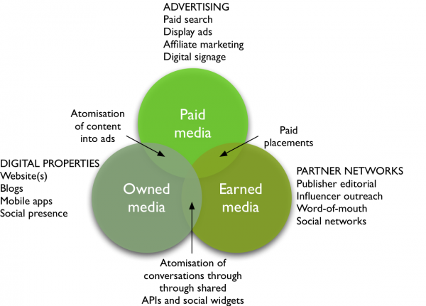
Types of Media
Notes:
PGC & UGC
Professionally Generated content / User Generated Content
1. What is paid media?
Defining paid media is the most simple. Paid or bought media are media where there is investment to pay for visitors, reach or conversions through search, display ad networks or affiliate marketing.
Offline traditional paid media like print and TV advertising and direct mail remain important accounting for a large share of paid media spend.
Digital diffusion means we are seeing more and more opportunities for targeted digital paid media such as online streaming and in-app ads.
What is earned media?
Traditionally, earned media has been the name given to publicity generated through PR invested in targeting influencers to increase awareness about a brand.
Of course, it’s still an investment - whether time or money, or both. But this type of investment, when done well, has the most potential to instill customer trust through recommendations/advocacy.
Earned media also includes word-of-mouth that can be stimulated through viral and social media marketing and includes conversations in social networks, blogs and other communities.
It’s useful to think of earned media as developed through different types of partners such as publishers, bloggers and other influencers including customer advocates. Think of earned media as different forms of conversations occurring both online and offline.
API’s = Application programming interfaces
Widget = media/social plugins for use on personal sites
3. What is owned media?
This is media owned by the brand. Online this includes a company’s own websites, blogs, mobile apps or their social presence on Facebook, Linked In or Twitter. Offline owned media may include brochures or retails stores.
It’s useful to think of a company’s own presence as media in the sense that they are an alternative investment to other media and they offer opportunities to promote products using similar ad or editorial formats to other media. It emphasizes the need for all organizations to become multi-channel publishers.

Slide 13
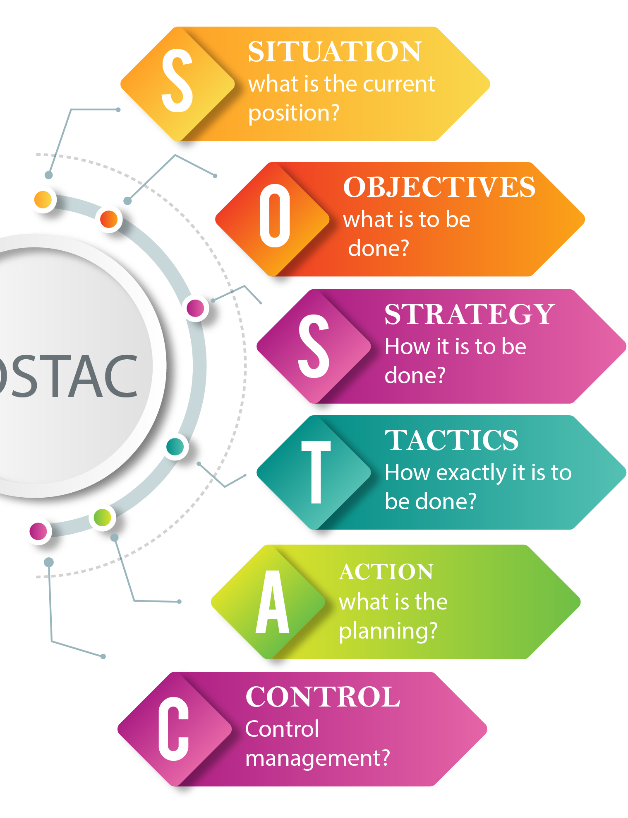
Action

Slide 14
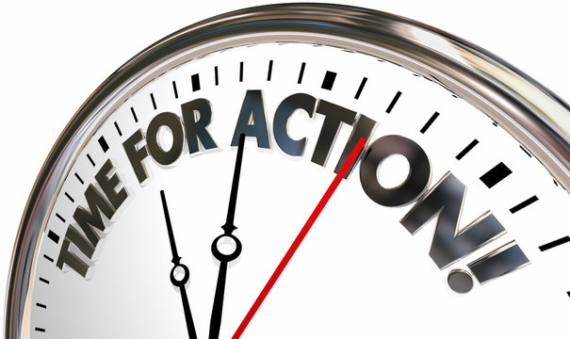
Action!
Now you have an idea of what your audience wants and what channels they use and thought about the types of communications we want to send ‘RACE’ now we have to deliver!
Now we must create a timeline of our communications (Just the communications!)
Think about at what time of year we should release what types of messages for our brand?
E.g if we are a beach resort in Spain, should we use promotions in summer or winter?...
What channels would you use for a beach resort in Spain when targeting promotions to British holiday makers?
Is a ‘Promotion’ likely to be Reach, Act, Convert or Engage?

Slide 15
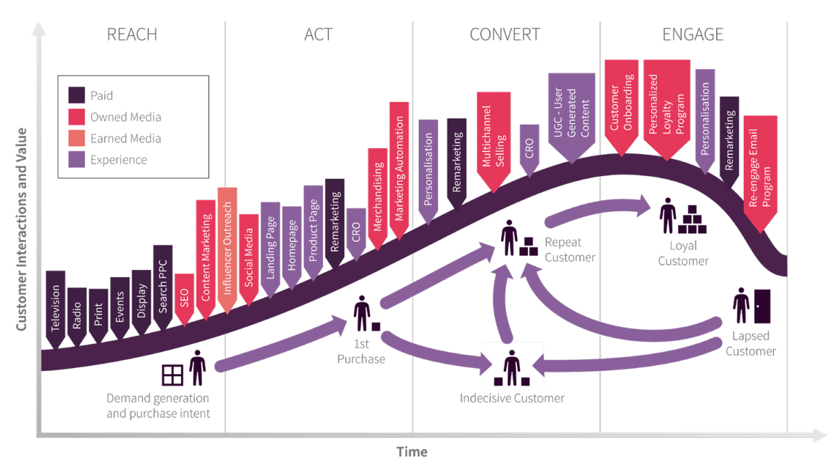
Action!
In groups make a Gannt chart of marketing activities and channels for the case study. Gannt chart template is in the learning materials on Moodle- You must use this template for your assessment.
Consider the issues this organization is facing? How will you structure their communications to be the most effective?
Case study –
The Cosy cottage
In late 2022, The Jones family purchased the Cosy Cottage Hotel in South Devon coast (An existing hotel that had gone out of business during the Covid lockdown). The Hotel has a basic website and a little used social media page with a good number of followers from the previous owners (400), The hotel is a 15 mins walk from the beach and a 20 min drive to Torquay which has many attractions, The Jones family are keen to get their hotel started on the right foot and have asked you to design a communications plan for next year January to December that will attract new users to their website and social media and increase bookings in the quieter autumn and winter months and reach out to the customers who have been to the hotel under the previous owners.
-Consider RACE (what is the aim of the message)/ and what Channels you will use for which groups of new and existing customers?
-What times of year will need which kinds of strategies?
Notes:
Reach and Act to gain interest and interactions, (e.g sharing interesting stories on social media/ creating content, stories of local events etc..) PR, Email/Direct marketing, Advertising)
Convert - promotions discounts, (personal selling, sales promotion etc..
Engage – keep the customers interested, build relationships – email marketing, encouraging social media stories, remarketing – personalised messages, reminders of previous holidays etc..

Slide 16
Control

Slide 17
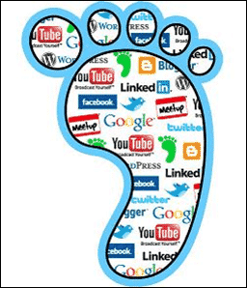
Big Data, Social footprints &
The Goldmine!
This is the impression or mark that we make when we visit sites.
When we visit websites and web communities, we leave a digital trail behind… your footprints become a source of Big data
Much research on what can be revealed about you by the footprints that you leave has been carried out, one notably by Dong (2015) who found that personal traits are clear including whether your parents were divorced could be established!
Notes:
Big Data – Where does it come from? Everywhere, everything you do online is recorded and logged.. In 2020 44 trillion gigabytes of big data had been collected by marketers of consumer habits, behaviours and purchases.
In 2018 Google spent 3 billion on Big data management and capture, Facebook 1 Billion (Jay Parikh - Vp of engineering at Facebook Said “everything we do is a Big data problem”
CIA paid Amazon web services 600 million Dollars to build private cloud infrastructure to manage Big Data. (Ira Hunt – CTO at the CIA said “Our mission is to collect everything and hang on to it forever!”
Big Issues – much of the data gathered is unstructured and fragmented lacking cohesion of databases. only 12% on average of this data is ever analysed, with so much data humans simply cant keep up, The advent of the AI marketeer, now a 40 billion a year industry and needed to make sense of vast quantities of data produced.

Slide 18
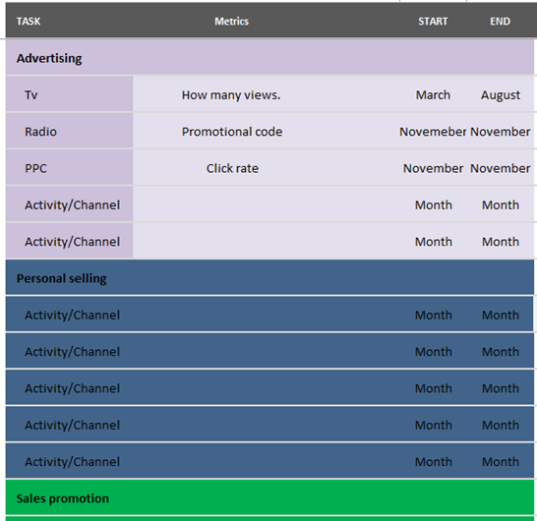
Control
Plans should include control systems – performance must be monitored, measured and controlled (how will we measure success? Think about your SMART target and what was identified)
Identify USP, Features and Benefits
On your Gannt there is a space for “Metrics/KPI’s” for each channel you use, this is what you will measure to know that the process is working, consider what can be measured and how
Discuss how we will measure success? Why?
What is the objective-New customers, positive attitudes towards brand, Increase profits etc..
In this section you will discuss your use of metrics and justify your choices,
e.g
“Promotional discount codes have been used to measure radio communications effectiveness as each time a promotional code is used this can be traced to a successful engagement of the channel.”

Slide 19
REFERENCES
Kotler, P., Keller, K. and Chernev, A., 2021. Marketing management. 16th ed. Pearson.
Lee, P. and Calugar-Pop, C., 2021. The home-based worker. [online] Deloitte Insights. Available at: <https://www2.deloitte.com/us/en/insights/industry/telecommunications/global-mobile-consumer-survey.html> [Accessed 15 May 2022].
Solis, B., 2013. The Ultimate Moment of Truth and The Art of Digital Engagement - Brian Solis. [online] Brian Solis. Available at: <https://www.briansolis.com/2013/11/the-ultimate-moment-of-truth-and-the-art-of-engagement/> [Accessed 15 May 2022].
Todorova, G., 2015. Marketing communication mix. Trakia Journal of Science, 13(Suppl.1), pp.368-374.

