Slide 1
Applying Attachment Theory to understand and Support Isaac's Development
Student name : Abibat Bamidele
Student Number: 2513925
Module: Psychology in Health and Social Care

Slide 2
Introducing Isaac's Case
Isaac is a four year old child attending a Children's Centre in London. Staff have observed that he becomes distressed when separated from his mother, struggles to participate in group activities, appears withdrawn during play and shows delays in language development.
This presentation uses Bowlby's attachment Theory to explore how Isaac's early experiences may have influenced his emotional, social and language development. It will also propose practical strategies that can be used by practitioners to support his wellbeing and development.

Slide 3

Attachment Theory
Attachment Theory was developed by John Bowlby(1969). Bowlby argued that children are biologically programmed to form close emotional bonds with their primary caregiver. These early relationships provide children with security, protection and emotional support.
According to Bowlby, a secure attachment develops when caregivers respond consistently and sensitively to a child's needs. Children who experience secure attachment are more likely to feel confident exploring their enviroment and forming positive relationships with others.
Secure attachments are formed when caregivers respond consistently and sensitively to childrens needs (Howe, 2011)
Early attachment relationships can influence later emotional and social development (Sroufe,2005).
Mary Ainsworth later expanded the theory through her strange situation study and identified different attachment styles, including secure and insecure attachment (Ainsworth et al., 1978).
Bowlby also proposed that early attachment relationships create an “internal working model” that influences how children view themselves, others and future relationships (Bowlby, 1969).
Image (Pixabay,2026).

Slide 4
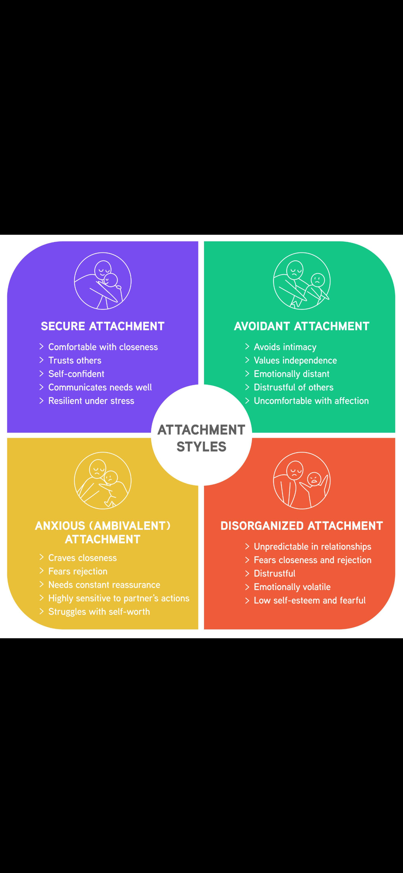
Applying Attachment Theory to Isaac
Attachment theory helps explain several aspects of Isaac's behaviour.
Isaac's mother is experiencing post-natal depression. Research suggests that parental depression can affect a caregiver's emotional availability and responsiveness, making it more difficult for children to develop a secure attachment. (Howe, 2011)
Isaac has also experienced disrupted childcare arragments and a recent move to London. Frequent changes in caregivers and environments may reduce a child's sense of stability and security. (Bowlby, 1969)
These experiences may contribute to Isaac's clinginess, seperation anxiety and reluctance to engage with unfamiliar people and activities.(Sroufe, 2005)
Isaac’s distress when separated from his mother may indicate an insecure attachment pattern. Ainsworth et al. (1978) found that children with insecure attachments often demonstrate heightened anxiety during separation and reduced confidence when exploring unfamiliar environments.
Figure 2: Attachment Theory model (Simply Psychology, 2024).

Slide 5

Nature and Nurture
Isaac's development is likely influenced by both biological and enviromental factors.
Nature factors include
-Temperament,
-Genetic influences
-Early brain development
Nurture factors include:
-Maternal mental health
-Quality of caregiving
-Disrupted childcare arrangements
-Limited social opportunities
-Moving to a new enviroment
Although Attachment Theory focuses strongly on enviromental influences, development is generally understood as the interaction between nature and nurture (Gross,2020).
Children's development is influenced by both biological predispositions and enviromental experiences(Shaffer and Kipp, 2014).

Slide 6
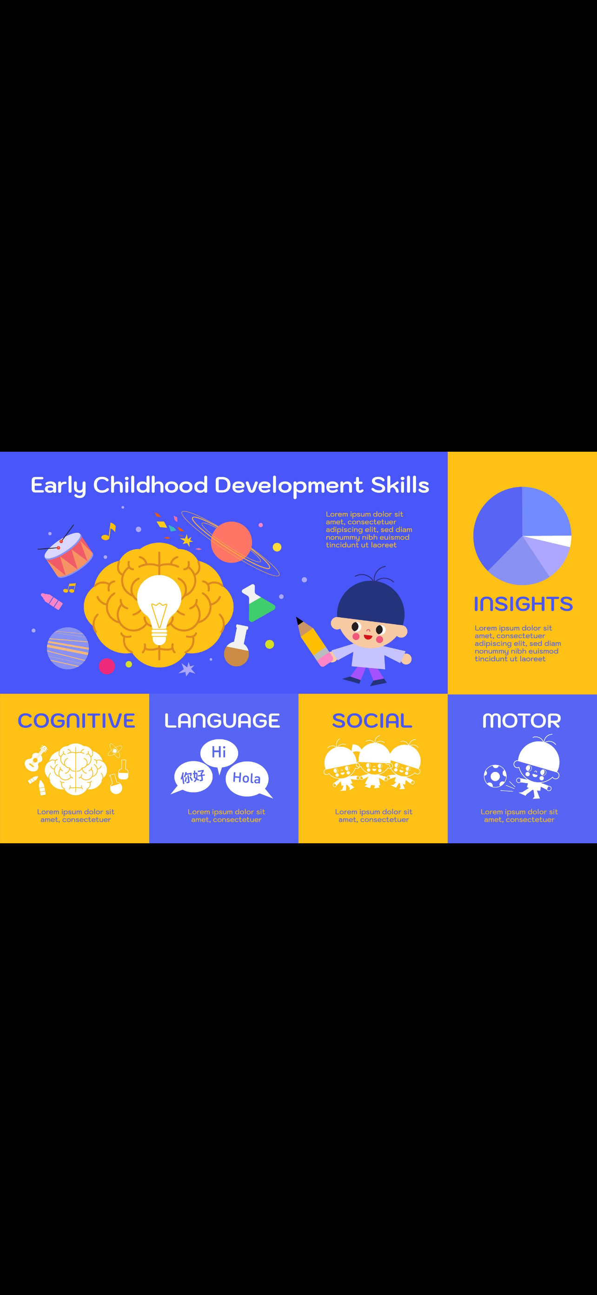
Impact on Development
Isaac’s early experiences may affect several areas of development.
Emotional Development:
• Separation anxiety
• Clinginess
• Difficulty regulating emotions
Social Development:
• Withdrawal from peers
• Difficulty joining group activities
• Reduced confidence
Language Development:
• Delayed communication skills
• Fewer opportunities for social interaction and conversation
Limited caregiver responsiveness may reduce opportunities for language modelling and communication.
Sleep Difficulties:
• Emotional insecurity may contribute to problems settling and sleeping independently.
Attachment difficulties can influence emotional regulation, social competence and communication development (Howe, 2011). Longitudinal research suggests that early attachment experiences can have lasting effects on development if support is not provided (Sroufe, 2005).

Slide 7

Theory-Informed Support Plan
Attachment-Based Support:
• Assign a consistent key person within the setting.
• Establish predictable daily routines.
• Use gradual separation strategies to reduce anxiety.
Language and Social Development:
• Provide small-group play opportunities.
• Use storytelling, songs and conversations throughout the day.
• Encourage peer interaction through supported play activities.
Supporting the Parent:
• Maintain regular communication with Isaac’s mother.
• Signpost mental health and parenting support services.
• Encourage positive parent-child interactions.
Multi-Agency Working:
• Speech and Language Therapist
• Health Visitor
• Family Support Worker
• Early Years Practitioners
These strategies reflect Bowlby’s emphasis on secure relationships and emotional security (Bowlby, 1969). The key person approach is also consistent with guidance within early years practice (Department for Education, 2024).

Slide 8
Critical Evaluation and conclusions
Strengths of Attachment Theory
Explains children’s emotional development.
• Widely used within early years practice.
• Supported by extensive research evidence.
• Helps practitioners understand children’s behaviour. (Howe,2010).
Limitations
• Places significant emphasis on the mother-child relationship.
• May underestimate wider social and economic influences.
• Cultural differences in caregiving are not always fully considered. (Gross, 2020)
Conclusion
Attachment Theory provides a useful framework for understanding Isaac’s difficulties. His experiences of disrupted care, maternal mental health challenges and major life transitions may have affected his sense of security. Early intervention and multi-agency support can promote positive outcomes and improve his emotional, social and language development.

Slide 9
REFRENCE LIST
Ainsworth, M.D.S., Blehar, M.C., Waters, E. and Wall, S. (1978) Patterns of Attachment. Hillsdale: Lawrence Erlbaum.
Bowlby, J. (1969) Attachment and Loss: Volume 1: Attachment. London: Penguin.
Gross, R. (2020) Psychology: The Science of Mind and Behaviour. 8th edn. London: Hodder Education.
Howe, D. (2011) Attachment Across the Lifecourse. Basingstoke: Palgrave Macmillan.
Shaffer, D.R. and Kipp, K. (2014) Developmental Psychology: Childhood and Adolescence. 9th edn. Belmont: Wadsworth.
Sroufe, L.A. (2005) ‘Attachment and development: A prospective, longitudinal study from birth to adulthood’, Attachment and Human Development, 7(4), pp. 349–367.
CDC (2024) Developmental milestones. Available at: https://www.cdc.gov (Accessed: 11 June 2026).
Department for Education (2024) Early Years Foundation Stage Framework. London: DfE.
iStock (2026) Separation anxiety in young children. Available at: https://www.istockphoto.com (Accessed: 11 June 2026).
Pixabay (2026) Parent and child image. Available at: https://pixabay.com (Accessed: 11 June 2026).
Pixabay (2026) Balance scale image. Available at: https://pixabay.com (Accessed: 11 June 2026).
Pixabay (2026) Children playing together. Available at: https://pixabay.com (Accessed: 11 June 2026).
Simply Psychology (2024) Attachment Theory. Available at: https://www.simplypsychology.org/attachment.html (Accessed: 11 June 2026).
Verywell Mind (2024) Nature vs Nurture Debate. Available at: https://www.verywellmind.com (Accessed: 11 June 2026).

