Slide 1

Module code: LCHS4010 Module name: Professional development within health and social care
Student: Rihana Khanam
Teacher: Prabjob Sahota

Slide 2

Introduction:
A nursery practitioner provides care, learning, and wellbeing support to children aged 0-5 years. Practice must adhere to the statutory standards for early childhood development, health, and safety as outlined in the Early Years Foundation Stage framework (Department for Education, 2026). The Coventry-area nursery practitioner vacancy requires applicants with safeguarding awareness, play-based activity planning skills, and excellent working abilities.

Slide 3
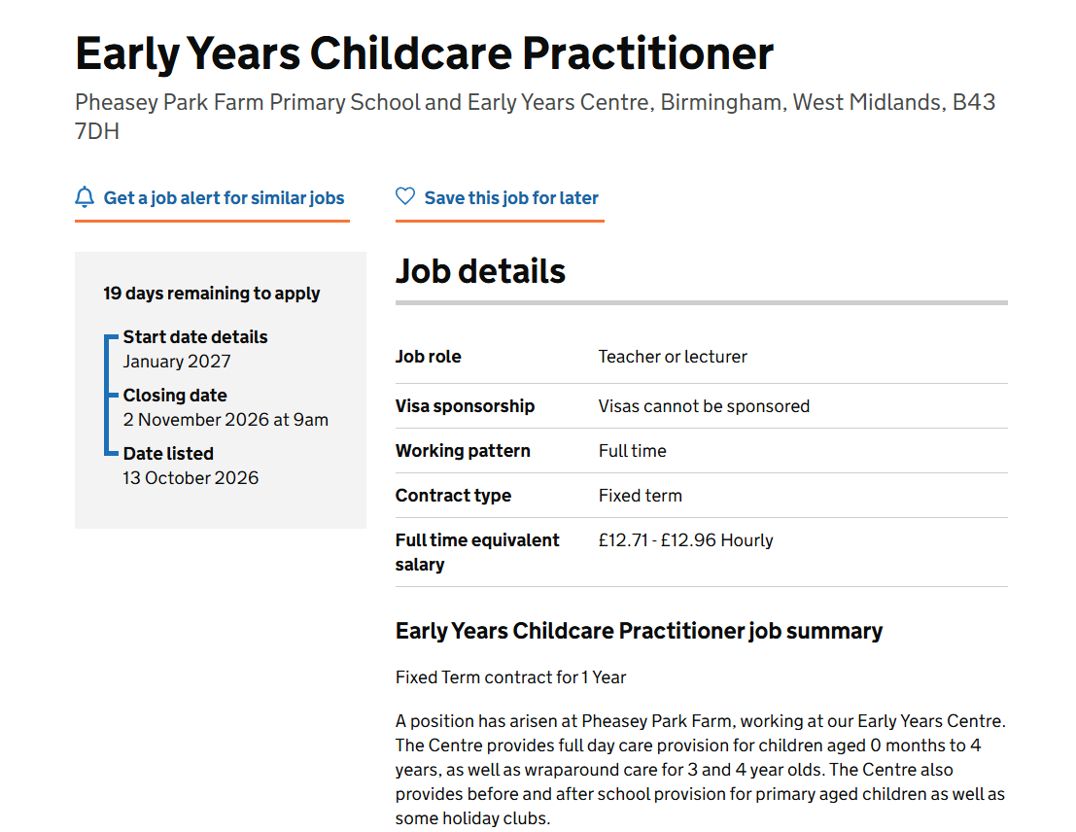

Job role:

Slide 4

Personal SWOT analysis for the nursery practitioner role:
Strengths:
I enjoy time with young children.
I am a calm and patient person.
I pay close attention to children and adults.
I have experience assisting younger family members.
Weaknesses: ​
Limited formal nursery experience.​
I get nervous speaking in front of groups.​
I am still learning about EYFS requirements (Department of Education, 2026).​
Opportunities:
Early childhood education courses available locally.
Volunteer placements in nurseries.
Free official child safety training.
Shadowing opportunities for work experience.
Threats:
Early childhood education courses available locally.
Volunteer placements in nurseries.
Free official child safety training.
Shadowing opportunities for work experience.

Slide 5

Using strengths to address weaknesses & reduce threats
I can lead small play sessions using patience and listening skills, gaining confidence and practical knowledge of EYFS guidelines (Department for Education, 2026). Volunteering at a nursery will help me stand out from other applicants, while regular short training sessions will improve my safeguarding and framework knowledge and reduce qualification-related risks.

Slide 6

Making use of available opportunities
I intend to pursue relevant early-years education, apply for volunteer nursery placements, and complete safeguarding training. These steps will assist in implementing EYFS standards (Department for Education, 2026) and developing a job-ready profile.

Slide 7
Reference list:
Department for Education. (2026). Early Years Foundation Stage (EYFS) Statutory Framework. GOV.UK. Available from: https://www.gov.uk/government/publications/early‑years‑foundation‑stage‑framework‑‑2 (Accessed 10 October 2026)
Live Advert - https://teaching-vacancies.service.gov.uk/jobs/early-years-childcare-practitioner-712427fd-64ea-4463-9cb8-76ead312253a?utm_campaign=google_jobs_apply&utm_source=google_jobs_apply&utm_medium=organic
Picture: https://www.dreamstime.com/illustration/childcare-teacher.html

