Slide 1

Project Management Plan
Module: Managing Projects in the Workplace
Module code: BMSW5104
Student name: David Marian Beltic Student ID: 2020289
Student name: Vladislav Erhan Student ID:2111920
Student name: Vailica Madalin Iliuta Student ID: 2007277
Student name: Vitalie Erhan Student ID:2111917
Lecturer name: Abel Agoba

Slide 2

Project management plan for opening Bumblebee nursery in Coventry

Slide 3

Introduction
One of the essential characteristics of the project is uniqueness, and each project varies by size and complexity, hence it is tough to establish the project's success by comparing it with other projects. The success of this project plan will be shown when the program will fulfil stakeholders' requirements and needs.
Creating and completing any project requires a team with specific and defined roles and responsibilities. Therefore, this project plan has four members to form a team to complete the project

Slide 4

Project Description and Scope
Life started to go back to normality, and many businesses decided to ask their employees to return to the office. This factor will boost the crises already existing regarding what parents should do with their children when they need to go to work. In Coventry, for example, there are around 7,174 places in nursery registered in Coventry when there are approximately 23,300 children under five .Therefore, there is a real need for more nurseries in the Coventry area.
This project will:
1. Tackle the needs of nursery spaces in Coventry.
2. Helps parents to return to work and solve their childcare issue
3. Provided a safe and comforting environment with passionate teachers that will help children to learn in an active learning environment.

Slide 5

Stakeholders Analysis
Parents are an important stakeholder group since they are the service's main customers and so directly benefit from it
Children despite the possibility that children would not directly affect the decisions that are made about the project, children constitute an important category of stakeholders.
Members of the staff, such as teachers and administrators, are included in this category of workers.
Regulatory agencies: Both governmental and professional regulatory agencies are in charge of determining the rules and norms that nurseries must follow in order to be considered legitimate businesses
Surrounding Community: The surrounding community's acceptance and support of the project may be crucial to the business's successful operation because factors like increased traffic and noise may have a negative impact on them.
Suppliers: These stakeholders provide the nursery with the required resources for its functioning, such as food, instructional materials, and furnishings. They are also considered stakeholders.

Slide 6

PESTEL analysis is an important strategy framework used to analyse the external factors of a business (Johnson et al., 2008). There are six factors that may affect the performance and the environment of the business, Political, Economic, Social, Technological, Environmental and Legal (Alanzi, 2018). It is important to identify these factors, which may affect the performance of the business.

Slide 7
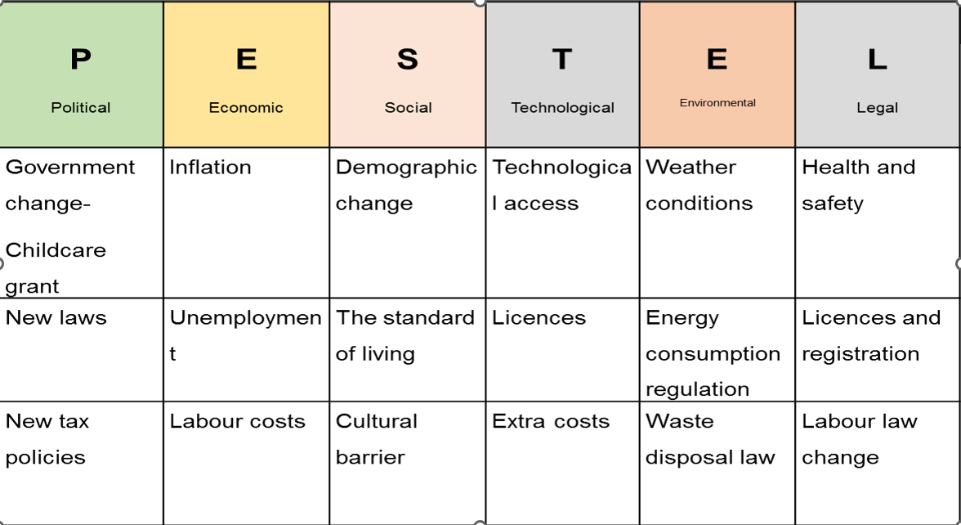

Slide 8
Political factors are Government change - Childcare grant and New laws that offers paid childcare for parents, which is a very favourable factor for businesses financial situation. New tax policies that may be implemented by the government may affect negatively, as the nursery will have to pay more taxes to run the business, which may lead to extra financial involvement.
Economic factors as Inflation may lead to people Unemployment, so as a result people may take care of their children at home, and don’t spent money on nurseries. Higher Labour costs can influence Bumblebee nursery negatively, so it will be too expensive to keep more teachers working more hours.
Social factors as Demographic change may lead to less children in nursery’s care. Cultural barrier is an important aspect as well, as parents of different cultures and religious may take their children in an appropriate care, which speak their language, and teach their culture.

Slide 9
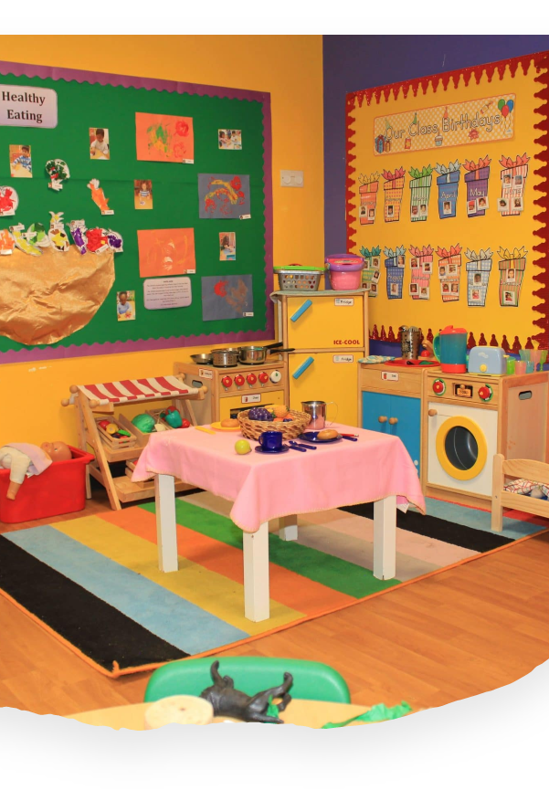
Technological aspect, which in this Century is present in every type of business, may introduce Technological access to children that are in Bumblebee care, which involve Extra costs (for ex: to buy tablets, Smart tv, other appliances). Licences needed to run the business can take a lot of time and money, so this can cause problems to the nursery.
Environmental factors as Weather conditions, cold or warm weather can prevent parents from taking their children to the nursery. In conclusion, less children, less profit. Waste disposal law has a positive effect on nursery and the environment. The nursery has enough waste disposal bins, to respect the imposed law.
Legal factors Health and safety regulation influence positively the business. Every employee will feel secure and protected in the working environment and will be happier and more productive in the nursery. Licences and registration are time and money consuming. Can stop the nursery from its activity till any of the licence or registration is received.

Slide 10
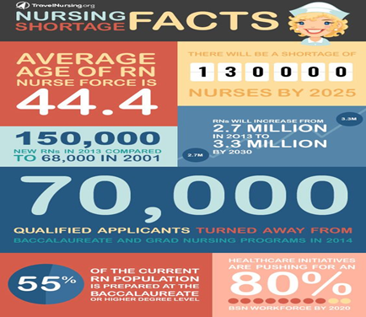
Quad Chart
Immediately Following Steps and a Provisional Timeline
Fundraising (August–September 2023): We will begin fundraising to obtain grants, loans, and private funding.
Putting the Finishing Touches on the Location (October–November 2023): We want to make sure the nursery's location meets all safety and zoning requirements and is accessible to a large portion of the population.
Safe, Comfortable, and Engaging Our Young Learners (December 2023–April 2024): After finding cash and a place, we'll start building and planning the nursery. Our young pupils will be secure, comfortable, and stimulated.
We will recruit and educate a team of devoted and experienced educators and administrators in May and June 2024. Our staff will be credentialed and screened.
Compliance with legislation (July–August 2024): We will ensure that all of our actions, from health and safety to educational standards, comply with legislation.
Opening (September 2024): After finishing all preparations, we will open the nursery and welcome our first students.
This timeline is a guideline and may change based on money, regulatory approval time, and other issues. To ensure transparency and promote involvement, we will regularly inform all relevant parties.

Slide 11
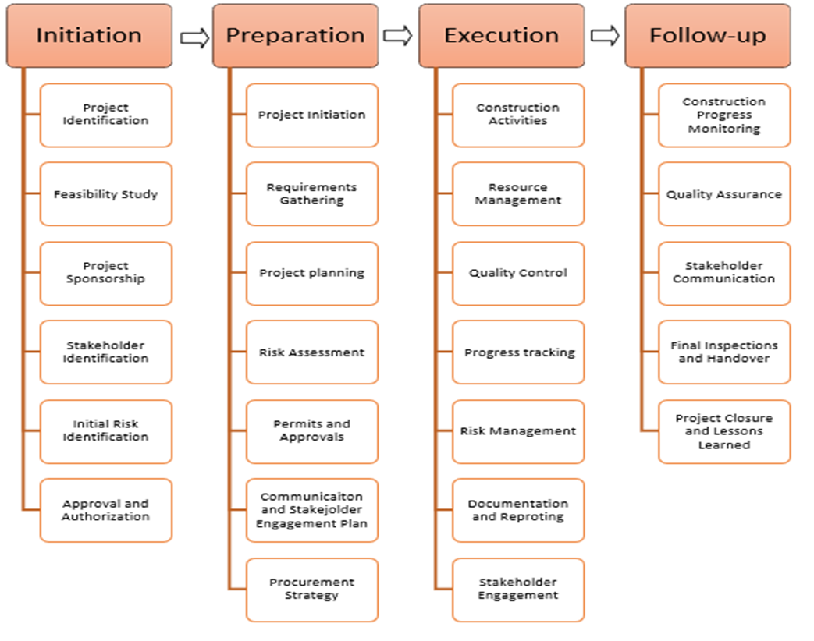
Work Breakdown structure

Slide 12
Cost Accounts estimation

Slide 13
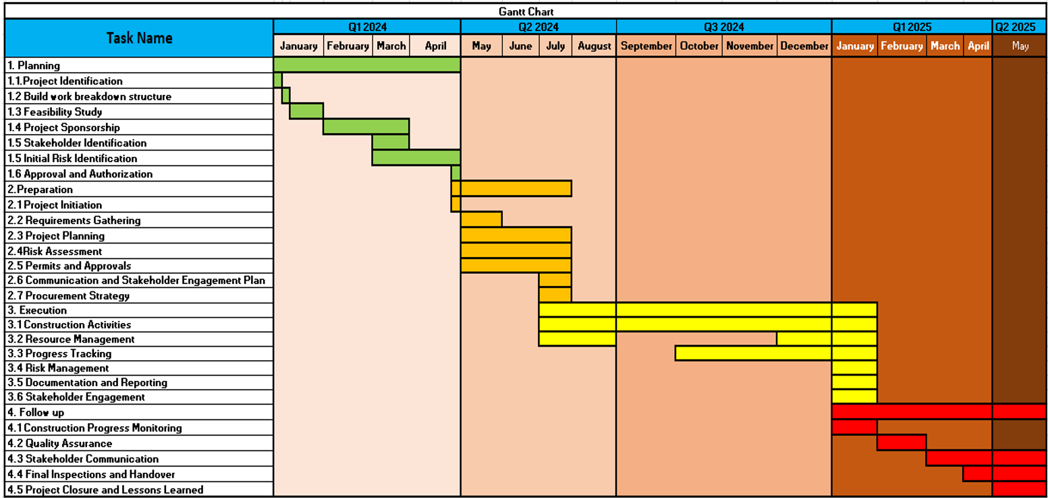
Gantt Chart

Slide 14

Risk Assessment
The planning process for a project must always include a risk assessment. However, it provides the teams working on the project with the ability to foresee possible issues that might have a negative effect on the project and prepare for ways to address such issues (Chapman, 2001).
The potential risks associated with regulatory measures. The potential for non-adherence to the regulations governing childcare services may lead to legal consequences and damage to our reputation (Hillson and Murray-Webster, 2007). The Perils of Recruitment. The acquisition of competent and devoted staff members is imperative for the nursery's success. The potential hazards and threats to the well-being and physical integrity of individuals. A health and safety risk refers to any potential hazard that has the potential to jeopardise the well-being and safety of children, employees, or visitors (Kerzner, 2017).

Slide 15
Conclusion
The nursery construction project aims to create a safe and stimulating environment for children's growth and development. It involves careful planning, designing, and execution of infrastructure, incorporating child-friendly facilities, ensuring regulatory compliance, and emphasizing security measures. The project contributes to fostering a nurturing and educational setting for young learners.
The success of this project plan will be shown when the program will fulfil stakeholders' requirements and needs. Once the project will be completed the team will conduct a research analysis and identify the main points of how will impact all project stakeholders.

Slide 16
References
Alanzi, S. (2018) ‘PESTEL analysis’, Project Management.
Bryson, J. M. (2004). What to do when stakeholders matter. Public management review, 6(1), 21-53.
Chapman, R. J. (2001). The controlling influences on effective risk identification and assessment for construction design management. International journal of project management, 19(3), 147-160.
Drury, C. (2018). Management and Cost Accounting. 10th ed. Andover: Cengage Learning.
Freeman, R. E. (2010). Strategic management: A stakeholder approach. Cambridge university press.
Gouk, A. and Hallam, K. (2018). There are more children than childcare places in Coventry. (online) CoventryLive. Available at: https://www.coventrytelegraph.net/news/coventry-news/more-children-childcare-places-coventry-15055275 (Accessed: 26 June 2023).
Hillson, D., & Murray-Webster, R. (2007). Understanding and Managing Risk Attitude. Gower Publishing, Ltd.
Iconic. (n.d.). Pricing | Iconic - How much will my construction project cost? (online) Available at: https://www.iconicprojectmanagement.com/pricing (Accessed 8 Jul. 2023)
Johnson, G., Whittington, R. and Scholes, K. (2008) Exploring corporate strategy. Text and cases. Prentice Hall Higher Education.
Kerzner, H. (2017). Project management: a systems approach to planning, scheduling, and controlling. John Wiley & Sons.
Matovic, I.M. (2020) ‘PESTEL analysis of external environment as a success factor of startup business’, ConScienS, pp. 96.
Mir, & Pinnington, A. H. (2014). Exploring the value of project management: Linking Project Management Performance and Project Success. International Journal of Project Management, 32(2), 202–217. https://doi.org/10.1016/j.ijproman.2013.05.012
Romanova, O. (2022). Average Building Costs in the UK. [online] PlanRadar. Available at: https://www.planradar.com/gb/calculating-construction-costs-in-the-uk/.
Shatskaya, E., Samarina, M. and Nekhorosheva, K. (2016) ‘PESTEL Analysis as a tool of strategic analysis in international markets’, Scope academic house B&M publishing, pp. 47.
The education hub (2023) Free childcare: How we are tackling the cost of childcare. Available at: https://educationhub.blog.gov.uk/2023/06/01/free-childcare-how-we-tackling-the-cost-of-childcare/ (Accessed: 23 June 2023)

