Slide 1
Explore barriers to wellbeing and inclusion for informal carers. Refer to theory, policy and practice.
By Libby Jenkins 1700284 SJSS4002

Slide 2
Meaning of an informal carer
An informal carer has many definitions including:
‘An informal carer includes any person, such as a family member, friend or neighbour, who is giving regular, ongoing assistance to another person without payment for the care given’ (Australian Government, 2014).
‘Carers are persons who provide care (usually unpaid) to someone with a chronic illness, disability or other long lasting health or care need, outside a professional or formal employment framework’ (Smart Care, 2014).

Slide 3
Statistics involving informal carers
‘An estimated 6.5 million people in the UK provide unpaid care’ (Tinder Foundation, 2014).
‘20% of carers consider themselves to have a mental health condition’ (Tinder Foundation, 2014).
‘89% say caring limits their capacity for paid employment’ (Tinder Foundation, 2014).
‘40% of carers say they rarely or never feel optimistic about the future, and parent carers worry especially about the future care of their children’ (Tinder Foundation, 2014).
These statistics convey that informal carers are suffering from mental health problems and a high percentage of carers feel they do not have enough support (Mental Health Foundation, 2018).

Slide 4
Employment prospects can be affected
‘Caregiving is associated with a significant reduction in employment and hours of work’ (OECD, 2011).
Some informal carers have to give up some of their working hours or quit their job in order to look after the individual that needs the care (Health Knowledge, 2007).
This will result in the informal carers’ wellbeing being affected as the amount of money they are earning will reduce and this can affect other areas of life such as, health due to healthy foods needed for nutrients that may cost more and they can no longer purchase them (Carers Trust, 2015).

Slide 5
Health can be affected
‘The State of Caring Report 2013 of Carers UK states that 84% of carers said that caring has a negative impact on health’ (Smart Care, 2014).
Being a carer can be exhausting and many informal carers will do as much as possible to help support their friend, family member or neighbour (New Policy Institute, 2016).
Looking after an individual can result in the carer’s health being overlooked and their wellbeing being affected, if this does happen it will affect both the individual and the carer (Carers UK, 2014).

Slide 6
Dealing with the health and social care systems
Informal carers may need help from the necessary services to have some help with looking after their friend, family member or neighbour (NHS Choices, 2015).
‘Carer has to fit this into a logical pattern of successive visits and integrating the outcomes into a care scheme that is viable for carer and cared-for person’ (Smart Care, 2014).
Sometimes informal carers do not get the assistance they need therefore this is not very inclusive and will affect their wellbeing due to the stress of contacting these services and getting their request rejected will result in the carer having a large work load (Disability and Carers, 2014).
The Care Act 2014 puts ‘people and their carers in control of their care and support’ suggesting that individuals are suppose to have power over their care but it is not always granted (GOV.UK, 2010).

Slide 7
Ethnicity and informal carers
‘Black children are more likely to be in formal childcare than others; Bangladeshi and Pakistani children are much less likely’ (Equality and Human Rights Commission, 2016).
‘Meanwhile, Bangladeshi and Pakistani people are significantly more likely than average to provide informal paid care (more than twice as likely as White people)’ (Equality and Human Rights Commission, 2016).
This conveys that ethnicity can affect who is more likely to be in care and ethnic minorities are more likely to be informal carers (PRIAE, 2014).

Slide 8
What are young carers?
‘The BBC estimates that there are about 700,000 young carers in the UK’ (Young Minds, 2018).
‘Young carers miss an average of 48 days of school because of their role and 68% have been bullied at some point directly because of having to care for someone’ (Young Minds, 2018).
This suggests that being a young carer can affect inclusion and their wellbeing due to their studies being affected which can have long term effects such as dropping out of school or not gaining any qualifications (Office for National Statistics, 2016).

Slide 9
Social and medical model of disability
The medical model of disability believes that ‘disabled people are viewed as medical problems, who if not curable, needed to be ‘helped’ and were dependent on medical care and the medical profession’ (Hughes 1998, cited in, Larkin, 2009).
The social model of disability ‘argues that disability is not the problem of an individual’s impairment but rather it is the attitudinal and physical constraints imposed by a society geared towards a norm of able-bodiedness that oppress disabled people’ (Hughes 1998, cited in, Larkin, 2009).
Therefore, informal carers would be affected by the medical model as the disabled person may become dependent on them and this can affect their wellbeing due to the workload (Which, 2018).
The individual being cared for would be affected by the social model of disability as they will be made to feel inferior to others and this could have a strain on informal carers too as they need to look out for the mental health of the person they are caring for (Carers UK, 2014).

Slide 10
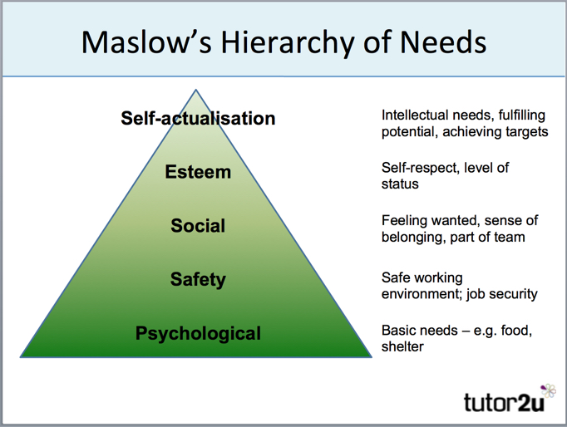
Maslow’s Hierarchy of Needs
Maslow believes that to have complete wellbeing an individual needs to gain all Psychological needs before they can move along the pyramid (Pursuit of Happiness, 2016).
An informal carer would be affected by this theory as they would only reach the second tier before their wellbeing became affected (Carers UK, 2014).
However, in theory an informal carer should be able to gain the esteem level and self-actualisation due to them helping care for an individual, this would allow them to feel socially included (SCIE, 2014).
(Tutor2u, 2015).

Slide 11
Conclusion
To Conclude, informal carers have many barriers to inclusion and wellbeing including their income being affected, job security and trying to get government funding to help support them while they care for the individual who needs it.
Informal carers do have the problem of not having enough time for themselves and then their health can be affected by being a carer, this is a problem.
Finally, Maslow’s Hierarchy of Needs suggests that individuals need all stages of the pyramid to have their wellbeing fulfilled, this conveys that informal carers do not have complete wellbeing.

Slide 12
Reference list
Australian Government,. (2014) Informal carer—relationship to care recipient http://meteor.aihw.gov.au/content/index.phtml/itemId/269485 (Accessed: 8th January 2018).
Carers Trust,. (2015) Key facts about carers and the people they care for https://carers.org/key-facts-about-carers-and-people-they-care (Accessed: 8th January 2018).
Carers UK,. (2014) Help & advice https://www.carersuk.org/help-and-advice (Accessed: 11th January 2018).
Carers UK,. (2014) New rights for carers from April 2015 https://www.carersuk.org/help-and-advice/health/looking-after-your-health/13-help-advice/practical-support (Accessed: 9th January 2018).
Carers UK,. (2014) New rights for carers from April 2015 ­­https://www.carersuk.org/help-and-advic\e/financial-support/help-with-benefits/13-help-advice/index.php (Accessed: 11th January 2018).
Disability and Carers,. (2014) Review of the respite and information services for young carers program Final Report – Stakeholder Summary https://www.dss.gov.au/our-responsibilities/disability-and-carers/publications-articles/review-of-the-respite-and-information-services-for-young-carers-program-final-report-stakeholder-summary?HTML (Accessed: 9th January 2018).

Slide 13
Reference list
Equality and Human Rights Commission,. (2016) Key areas: Care and support https://www.equalityhumanrights.com/en/how-fair-britain/online-summary/key-areas-care-and-support (Accessed: 11th January 2018).
GOV.UK,. (2010) Care Bill becomes Care Act 2014 https://www.gov.uk/government/speeches/care-bill-becomes-care-act-2014 (Accessed: 11th January 2018).
Health Knowledge,. (2007) Section 2. The Role of Informal Carers in Community Care https://www.healthknowledge.org.uk/public-health-textbook/medical-sociology-policy-economics/4b-health-care/section9 (Accessed: 8th January 2018).
Larkin, M,. (2009) Vulnerable Groups in Health and Social Care, SAGE Publications: London.
Mental Health Foundation,. (2018) Statistics https://www.mentalhealth.org.uk/statistics (Accessed: 11th January 2018).
New Policy Institute,. (2016) Informal carers & poverty in the UK An analysis of the Family Resources Survey http://www.npi.org.uk/files/2114/6411/1359/Carers_and_poverty_in_the_UK_-_full_report.pdf (Accessed: 9th January 2018).
NHS Choices,. (2015) Carers' assessments https://www.nhs.uk/conditions/social-care-and-support/carers-assessment/? (Accessed: 9th January 2018).
OECD,. (2014) The Impact of Caring on Family Carers http://www.oecd.org/els/health-systems/47884865.pdf (Accessed: 8th January 2018).
Office for National Statistics,. (2016) Measuring national well-being: Life in the UK: 2016 https://www.ons.gov.uk/peoplepopulationandcommunity/wellbeing/articles/measuringnationalwellbeing/2016 (Accessed: 11th January 2018).

Slide 14
Reference list
PRIAE,. (2014) Ethnicity, Older People and Palliative Care http://www.priae.org/assets/palcope/National_Council_for_Palliative_Care.PDF (Accessed: 11th January 2018).
Pursuit of Happiness,. (2016) Abraham Maslow http://www.pursuit-of-happiness.org/history-of-happiness/abraham-maslow/ (Accessed: 11th January 2018).
SCIE,. (2014) Dignity in care https://www.scie.org.uk/publications/guides/guide15/factors/choice/ (Accessed: 11th January 2018).
Smart Care,. (2014) Informal carers- Challenges faced and needs to be addressed http://pilotsmartcare.eu/topics/service-requirements/informal-carers.html (Accessed: 8th January 2018).
Tinder Foundation,. (2014) The Health and Wellbeing of Unpaid Carers https://www.carersuk.org/for-professionals/policy/policy-library/the-health-and-wellbeing-of-unpaid-carers (Accessed: 8th January 2018).
Which,. (2018) Being a carer https://www.which.co.uk/elderly-care/for-carers/being-a-carer?msclkid=883dead269c31e752e94b08c66558e09&utm_source=bing&utm_medium=cpc&utm_campaign=Elderly%20Care%20-%20EC%20Care-Being%20A%20Carer-Generic-Broad&utm_term=%2Binformal%20%2Bcarer&utm_content=informal%20carer (Accessed: 11th January 2018).
Young Minds,. (2018) What are young carers? https://youngminds.org.uk/find-help/looking-after-yourself/young-carers/ (Accessed: 11th January 2018).

