Slide 1

The role and importance of quality service, hospitality, and guest services within the hotel Industry
Loredana-Marina Pal
Student ID:2222512
22 October 2023
Hospitality and Guest Services-BMIH4003
Lecturer: Charlotte Joyner

Slide 2
Content table
Hotel Indigo………………………………………………………………..3
What we have?.…………………………………………………..………4
Customers and expectations……………………………………….5
Why is hospitality important? ……………………………………6
Examples of hospitality for everyone……………………………7
What is missing?...............................................................8
What is the role of a guest service representative?……...9
Conclusion…………………………………….……………………………10

Slide 3

Hotel Indigo is an Boutique type hotel that is focus on making sure that their guest experience “the heart of the neighborhood” even if they never leave the hotel. (Hotel Indigo, 2023)
The first Indigo Hotel was open in 2004 in Atlanta Georgian, today having more then 130 locations all around the world. (King, 2012)
. (Hotel Indigo, 2023)

Slide 4
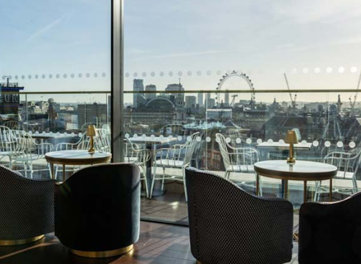
What we have?
Attracting for the London location is that they have the restaurant on the rooftop so everybody can enjoy breakfast lunch and dinner while watching the incredible view.
As they know most of their guest are traveling around the world The Indigo Hotel implemented a “Points System” for their members. (Hotel Indigo, 2023)
The rooftop Guide, 2015)

Slide 5


Customers and their expectation
This hotel brand is focus on attracting business and leisure customers as the brand knows that those are two major segments in hotel industry. (International Journal of hospitability Management, 2005)
Jain,2021)
In this case the customers are expecting cozy environment and to feel welcome.
(Sanctifly, 2020)

Slide 6

Why is hospitality important ?
The hospitality is extremely important in services industry as it is the biggest component that makes the difference between providing just a shelter and providing an incredible experience that the guests want to repeat.
(L, 2022)
It is important to go beyond the customers expectation and build up the trust with them.
Giving them the woow factor whenever is possible.
(Raub,2023)

Slide 7

Examples of hospitality for everyone
For example The Indigo Hotel London is making sure that everybody has access to their facilities :
Accessible Guest Room
-Emergency Cord/Button in the room
-Guest Room Furniture Can Be Rearranged
-Built-in Shower
-Lift Access to All Floors
-Ramp Access
Hearing Accessibility
Visual Alarms or Alerts
Vision Accessibility
On-Site Restaurant Menus in Braille or Available Reader
Audible Alarms in Hallways
(Hotel Indigo, 2023)
(ILO,2023)

Slide 8


What is missing?
Facilities for families with small kids to avoid any hazard
Or even better
Child care as everyone knows how hard is to travel with small children
(mmihelp, 2023)
(Fodors Travel, 2023)

Slide 9


What's the role of the guest service representative?
Consider that the first person that a guest sees is the receptioner ,the Indigo Hotel is making sure that their staff is helpful and polite, proof being their review page.
The role of an guest service representative is to ensure the correct information is provided during the check-in/ check-out.
Offering assistance with what the customer needs and also paying attention if something else can be added to make their stay more exclusive.
(Ayres Hotels, 2023)
. (Hotel Indigo, 2023)
(Dreams time, 2023)

Slide 10
Conclusion
The entire hotelier industry is based on hospitality, basically making sure that the guest feel at home and that their expectations are exited by getting something extra or by staff being able to fix unpredicted issues.

Slide 11
Reference list
(2015). Retrieved from The rooftop Guide: https://www.therooftopguide.com/rooftop-bars-in-london/lsq-rooftop.html
(2020, Jan 27). Retrieved from Sanctifly: https://www.sanctifly.club/sblog/the-effects-of-business-vs-leisure-travel
(2023). Retrieved from Hotel Indigo: https://www.ihg.com/hotelindigo/hotels/gb/en/reservation
(2023). Retrieved from Ayres Hotels: https://www.ayreshotels.com/guest-service-agent
(2023). Retrieved from ILO: https://www.ilo.org/infostories/en-GB/Stories/Employment/The-win-win-of-disability-inclusion#starting-your-disability-inclusion-journey
(2023). Retrieved from Dreams time: https://www.dreamstime.com/people-hotel-square-concept-professional-workers-providing-top-quality-services-vector-illustration-image213254527
(2023). Retrieved from mmihelp: https://www.immihelp.com/your-kids-arent-safe-in-the-hotel-save-them-from-these-hazards/
(2023). Retrieved from Fodors Travel: https://www.fodors.com/news/photos/these-hotel-brands-have-the-best-babysitting-services
International Jurnal of hospitability Management. Tom Baum (2005).
Jain, A. (2021, Dec 10). Retrieved from Darwinbox: https://blog.darwinbox.com/welcome-messages-for-new-employees
King, D. (2012, Jun 12). Retrieved from Travel Weekly: https://www.travelweekly.com/Travel-News/Hotel-News/Atlantas-second-Hotel-Indigo-opens-near-airport
L, N. (2022, Dec 26). Linkedin. Retrieved from https://www.linkedin.com/pulse/importance-hospitality-service-industry-nadir-ashurbeyov-a%C5%9Furb%C9%99yov-
Raub, D. S. (2023). Retrieved from EHL Insights: https://hospitalityinsights.ehl.edu/how-do-hospitality-students-see-their-future-in-the-industry

