Slide 1
Online gaming - children and adolescents
Week 5 – 2026

Slide 2
Prevalence of gaming
According to the latest online gaming statistics for 2022, roughly 40% of the world’s population are online gamers.
Progressed over the years to online multiplayer gaming across multiple countries and continents.
UK online gaming statistics
According to online gaming research by Ofcom, 60% of UK adults aged 16+ stated that they played games on some form of console, desktop, or smartphone device (either online or offline). Comparatively, the figure for 3-15-year-olds was 91%.
In addition, research from UK Safer Internet Centre also discovered that:
65% of 8-17-year-olds found online gaming an important part of their lives.
70% of young people admitted that playing online games in 2021 was more enjoyable than in previous years.

Slide 3
UK online gaming revenue statistics
Revenue for online gaming in the UK is over £21 billion (2022).
Between 2022 and 2027, the annual growth rate is forecast to reach almost 7%, resulting in an expected market value of £29.4 billion by 2027.
In 2021, the UK video game market was around £7.16 billion—up nearly 2% from 2020.
Game hardware sales in 2021 totalled £2.66 billion—a 17.4% increase from the previous year.
The main cause of this was the sale of console hardware, which rose by almost a third (32.9%) from 2020, to reach a record high of £1.13 billion.
This was driven largely by 2021 being the first full calendar year for Sony’s PS5 and Microsoft’s Xbox Series consoles.
There was also substantial growth in Virtual Reality (VR) hardware sales, generating around £183 million in revenue—nearly 42% more than 2020 sales.

Slide 4
Gaming disorder – addicted to gaming
https://www.youtube.com/watch?v=WhqJpFtBGqc
2-11mins

Slide 5
Problems caused by excessive gaming…
Task:
What are the issues?

Slide 6
Allison, von Wahlde, Shockley and Gabbard
(2006)
– N = 1 male adolescent playing computer games excessively (age = 18)
– Participant underwent multidisciplinary assessment for 3 days at a psychiatric clinic
Addiction criteria, symptoms and
prevalence
“Game addiction”
– No specific diagnostic tool used
– 12–16 h gameplay/day
– No sleep, limited real-life social contacts
– Escapism motivation, obsession with gaming
– Symptoms: gaming “overshadowed” participant’s life, continuously missed classes at school, diminished energy, poor concentration, fatigue, muscle tension

Slide 7
Batthyány, Müller, Benker and Wölfling
(2009)
N = 1,231 students (grades 3–5 - primary/lower secondary age) in Vienna (46% female)
– Survey
Assessment of Computer Game Addiction in Children – Revised (CSVK-R)
(Thalemann, Albrecht & Grüsser, 2004)
“Excessive computer game play” found in 12% (n = 1,068; 10% abusive, 3% dependent behaviour)
– Based on criteria of substance dependence (DSM IV-TR and ICD-10)

Slide 8
Bear, Bogusz and Green (2011)
N = 102 adolescents (age range = 11–17 years) from out-patient psychiatric clinics in Canada
– Surveys completed by children and their parents
Addiction score significantly correlated with:
  Higher difficulties,
  Less prosocial behaviour in both child and parent reports i.e., positive correlations with emotional, conduct, and peer problems, and hyperactivity
  Negative correlation with prosocial behaviour, and functional impairment (i.e., family, learning, life skills, self-concept, and social activity)
  Fights with parents over video games, getting little sleep, being late for school, decrease in social contacts, neglect of self-care, relying on friends for homework

Slide 9
Choo, Gentile, Sim, Li, Khoo and Liau (2010)
N = 2,998 primary and secondary school children in Singapore (73% males; mean age = 11 years, SD = 2 years)
– Survey questionnaire
Prevalence of pathological gaming:
8.7% (12.6% boys, 4.7% girls)
– Compared to non-pathological gamers, pathological gamers
  Play 2× more,
  Significantly more likely to have video-game system in bedroom,
  Receive poorer grades,
  More impulse control problems,
  Poorer social competence,
  Greater hostile cognitions,
  More video-gaming related problems.

Slide 10
Links to gambling…Loot boxes
What are these, and why are they a problem?
Loot boxes are rewards within computer games that can be bought with virtual currencies or real-world money.
Concerns have been raised about whether they encourage gambling-like behaviours, particularly among children.
In July 2022, Boris Johnson’s government published its response to a consultation on loot boxes. It decided not to legislate to bring loot boxes within the scope of the Gambling Act 2005.
Look into this issue in pairs / small groups…
https://www.theguardian.com/society/2022/jul/17/uk-will-not-ban-video-games-loot-boxes-despite-problem-gambling-findings
https://metro.co.uk/2022/06/01/fifa-22-loot-boxes-condemned-for-needing-11500-to-get-just-one-card-16748412/

Slide 11
Loot boxes in video games: update on improvements to industry-led protections – Dept for Culture, Media and Sport.
18th July, 2023.
The government undertook an extensive call for evidence on loot boxes, and published its response in July 2022. This found an association between loot box purchases and problem gambling, but evidence has not established whether a causal relationship exists. In response the government set out its view that:
purchases of loot boxes should be unavailable to all children and young people unless and until they are enabled by a parent or guardian
all players should have access to, and be aware of, spending controls and transparent information to support safe and responsible gameplay
better evidence and research, enabled by improved access to data, should be developed to inform future policy making on loot boxes and video games more broadly
Correlation not causation???

Slide 12
Young gaming addicts can now get NHS treatment - so what are the warning signs to look out for?
Video
https://www.itv.com/news/2019-10-08/young-gaming-addicts-can-now-get-nhs-treatment-so-what-are-the-warning-signs-to-look-out-for
What is the way forward for this issue?

Slide 13
Technology used in a positive way…
Exergaming

Slide 14
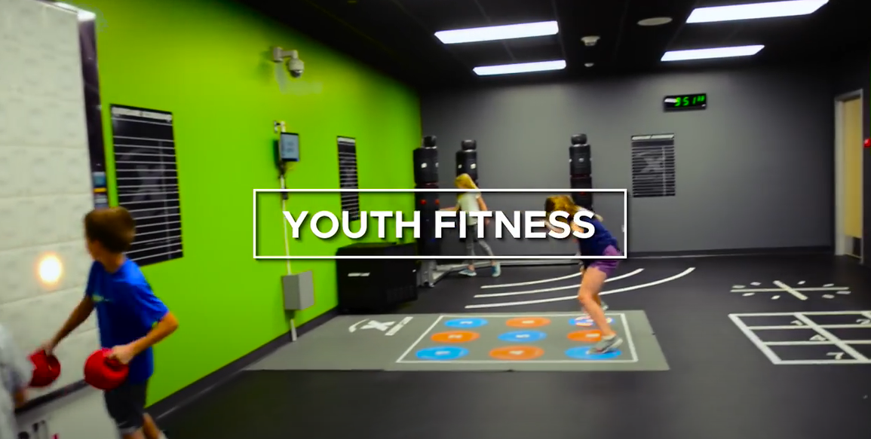
Technology used in a positive way…
Exergaming
Example of an exergaming facility within a community.
https://www.youtube.com/watch?v=K-Oy3IGTj9Q
Myths of Exergaming interview - EDUCA 2021 (Researchers from Finland - with subtitles)
https://www.youtube.com/watch?v=izNXUzAqca8
MIRA Rehab | NHS
https://www.youtube.com/watch?v=Qv_NChcS29Q
Thoughts on this?

Slide 15
Fitness apps – gamification of exercise?
What is out there?
Do you use any of these?

Slide 16
Online Safety Act 2026 – changes?
What did this bring in terms of changes / protections for under 18’s?

