Slide 1

Check Point CERTIFIED SECURITY ADMINISTRATOR
CCSA

Slide 2
Chapter 7
Check Point NAT
Notes:
Originally, the Network Address Translation (NAT) method was used by IT administrators to prevent the need to designate a new address to every host when a network was moved, or when the upstream Internet service provider was replaced, but could not direct the network’s address space. Today, NAT is an essential and popular tool in
preserving global address space considering IPv4 address exhaustion. In this chapter, how NAT affects traffic and how to configure manual and automatic NAT is covered.

Slide 3
Learning Objectives
Discuss how NAT (Network Address Translation) affects traffic.
Describe how to configure manual and automatic NAT.

Slide 4

Check Point NAT Overview
NAT is a method of mapping an IP address to another IP address.
From IETF:
A method by which IP addresses are mapped from one realm to another in an attempt to provide transparent routing to hosts.
Notes:
In computer networking, NAT (Network Address Translation) refers to a method of mapping an IP address to another one. The Internet Engineering
Task Force (IETF) defines NAT as "a method by which IP addresses are mapped from one realm to another, in an attempt to provide transparent
routing to hosts." See datatracker.ietf.org/doc/rfc2663.
In the Check Point environment, NAT refers to a Check Point feature included
with the Firewall Software Blade to protect the identity of a network.
Using Check Point NAT, the Security Gateway can change:
• Source IP address in a packet
• Destination IP address in a packet
• TCP / UDP port in a packet

Slide 5
Example Flow Using NAT
Internal computer sends a packet to an external computer.
Security Gateway translates the source IP address to a new IP address.
External computer returns a packet to the Security Gateway.
Security Gateway translates the new IP address back to the original IP address.
Packet from the external computer is routed to the correct internal computer.
Notes:
1. An internal computer sends a packet to an external computer.
2. The Security Gateway translates the source IP address to a new address.
3. The external computer returns the packet to the Security Gateway.
4. The Security Gateway translates the new IP address back to the original IP
address.
5. The packet from the external computer is routed to the correct internal computer.

Slide 6
Translation Methods
Static NAT:
One-to-one relationship between private and public IP addresses.
Useful for servers or hosts that require a consistent address accessible from the Internet.
Hide NAT:
Many-to-one translation that hides many source IP addresses behind one or a few IP addresses.
Useful when fewer IP addresses are available.
Notes:
The Security Gateway uses the following methods to translate IP addresses in your network.
The method used depends on the network configuration and an organization's translation needs.
Static NAT:
Establishes a one-to-one relationship between private and public IP addresses.
It is useful for servers or hosts that require a consistent address that is accessible from the Internet.
Hide NAT:
Is a many-to-one translation that hides many source IP addresses behind one or a few IP addresses.
It is useful when fewer addresses are available than the actual number of hosts to be translated.• It is useful when fewer addresses are available than the actual number
of hosts to be translated.

Slide 7
For protocols where the port number cannot be changed, Hide NAT cannot be used.
To distinguish between connections, the source port of the connection must be also changed. For this process, port allocation with the Global NAT (GNAT) feature is used.
GNAT is discussed in the CCTE course. For further information, see SecureKnowledge article sk26202 - Changing the kernel global parameters for Check Point Security Gateway.

Slide 8
Check Point NAT Rules
Two types of NAT rules:
  Automatic
  Manual
Part of the NAT Policy.
Generally viewed and configured with SmartConsole.
Notes:
There are two types of rules that Check Point NAT supports for address translation: the automatic and manual. These rules are part of the NAT Policy. Rules are generally viewed and configured with SmartConsole.

Slide 9
Automatic NAT Rules
Automatic NAT Rules
In most cases, the NAT Policy is automatically populated with the necessary rules.
The Security Gateway creates the rules automatically, based on the defined network object proper.
Notes:
There are two types of rules that Check Point NAT supports for address translation: the automatic and manual. These rules are part of the NAT Policy. Rules are generally viewed and configured with SmartConsole.

Slide 10
Manual NAT Rules - Example Uses
Specified IP addresses (destination and source) or services (ports)
Static NAT in only one direction
Translation of source and destination IP addresses in the same packet
Translation of services (destination ports)
Translation of IP addresses for dynamic objects
Notes:
In some situations, manual rules are useful are; for example:
Specified IP addresses (destination and source) or services (ports)
Static NAT in only one direction
Translation of source and destination IP addresses in the same packet
Translation of services (destination ports)
Translation of IP addresses for dynamic objects

Slide 11
When using manual NAT rules, Proxy ARP is required.

Slide 12
Rule Enforcement
Manual Rule Enforcement:
First manual NAT rule that matches connection is enforced.
Automatic Rule Enforcement:
Two automatic NAT rules that match a connection can be enforced:
  One rule for the source
  One rule for the destination.
Notes:
Manual Rule Enforcement
With manual rule enforcement, the first manual NAT rule that matches a connection is enforced. The Firewall does not enforce a different NAT rule that can be more applicable.
Automatic Rule Enforcement
With automatic rule enforcement, two automatic NAT rules that match a connection can be enforced:
One rule for the source
One rule for the destination
When a connection matches two automatic rules, those rules are enforced. When a connection matches two automatic rules, those rules are enforced.

Slide 13
You can enable automatic NAT rules for these SmartConsole objects:
• Security Gateways
• Hosts
• Networks
• Address Ranges

Slide 14
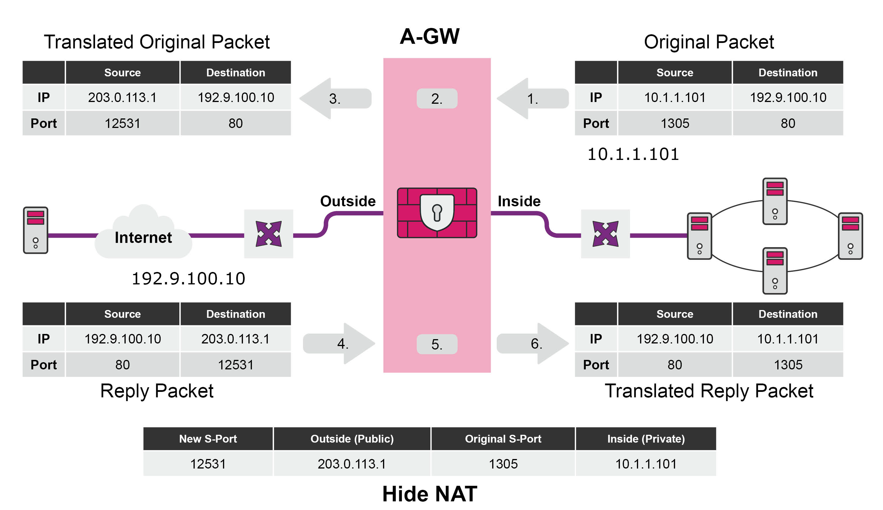
Hide NAT
Translation occurs on the server side.
Notes:
With Hide NAT, the source is translated, the source port is modified, and translation occurs on the server side. In the illustration below, notice the source packet with address 10.1.1.101 going to destination 192.9.100.10.
The Firewall modifies the source port and adds the port information to a state table. The packet translates as it leaves the Security Gateway.

Slide 15
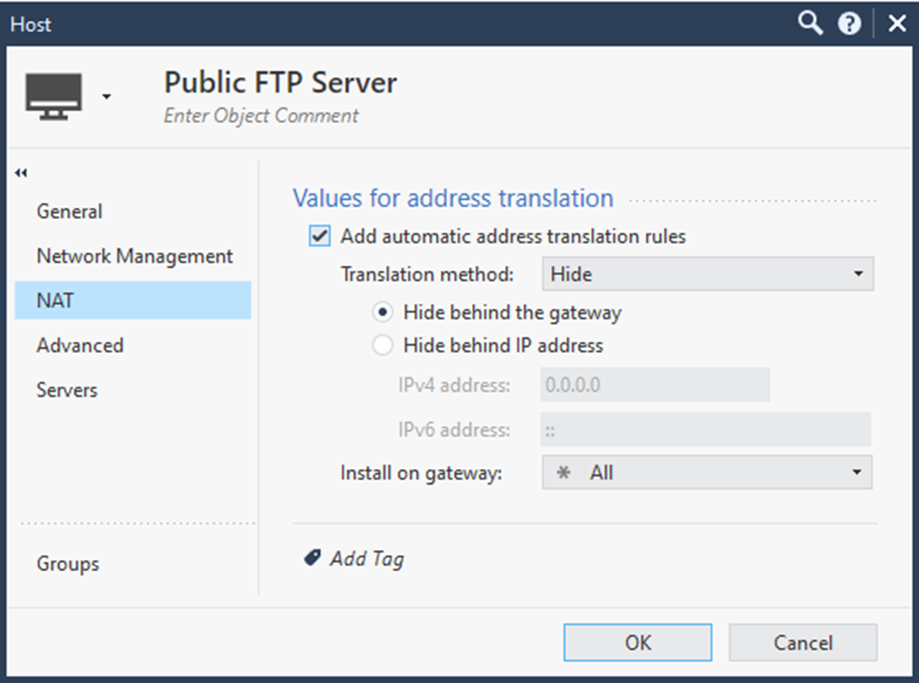
Hide NAT Configuration
Configured by manually creating rules in the NAT policy or by enabling NAT on the desired network object.
Notes:
Hide NAT is configured by manually creating rules in the NAT policy or by enabling NAT on the desired network object.

Slide 16
Configuring Hide NAT Rules
Two rules are created automatically.
  The first rule prevents the translation of packets traveling from the translated object to itself.
  The second rule instructs the Security Gateway to translate packets whose source IP address is part of the company’s network. This rule translates packets from private addresses to the IP address of the exiting interface of the Security Gateway.
Modify IP address information associated with traffic packets as they pass through Security Gateway.
Notes:
Two rules are created automatically.
The first rule prevents the translation of packets traveling from the translated object to itself.
The second rule instructs the Security Gateway to translate packets whose source IP address is part of the company’s network. This rule translates packets from private addresses to the IP address of the exiting interface of the Security Gateway.
Modify IP address information associated with traffic packets as they pass through Security Gateway.
The expected behavior of Security Gateway is based on the type of NAT rule configured and how the rule is applied within the flow of traffic.

Slide 17
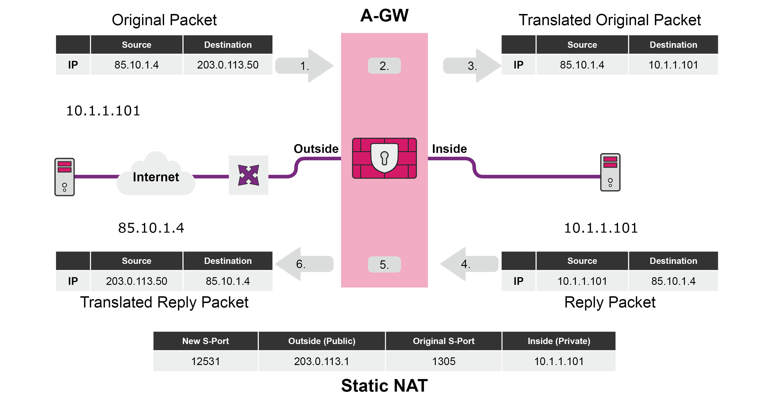
Static NAT
Assigned to a server that needs to be accessed directly from outside the Security Gateway.
Notes:
Static translation is assigned to a server that needs to be accessed directly from outside the Security Gateway. The packet is typically initiated from a host outside the Firewall. When the client initiates traffic to the Static NAT address, the destination of the packet is translated.
In the example below, the Security Gateway changes the source address from a private address to the public address.

Slide 18
Configuring Static NAT Rules
Configuring a Security Gateway to perform Static NAT for a host is like to configuring a Security Gateway to perform Hide NAT using another externally accessible IP address.
Configuring an object for automatic creation of Static NAT rules adds two rules to the Address Translation policy. Both rules are translating rules.
  For routing to work properly, Translate to IP Address configuration must be on the same subnet as the Security Gateway’s IP address.
  When Automatic NAT rule creation is used, it makes the necessary adjustments to the ARP configuration.

Slide 19
Proxy ARP for Manual NAT
Technique by which a proxy server on a given network answers the Address Resolution Protocol (ARP) queries for an IP address that is not on that network.
The proxy is aware of the location of the destination and offers its own MAC address as the destination.
Traffic directed to the proxy address is typically routed by the proxy to the intended destination using another interface or tunnel.
https://en.wikipedia.org/wiki/Proxy_ARP
Notes:
Proxy ARP is a technique by which a proxy server on a given network answers the Address Resolution Protocol (ARP) queries for an IP address that is not on
that network.
The proxy is aware of the location of the traffic's destination and offers its own MAC address as the destination. The traffic directed to the proxy address is
then typically routed by the proxy to the intended destination via another interface or via a tunnel. See en.wikipedia.org/wiki/Proxy_ARP.

Slide 20
Proxy ARP Configuration
Two-part process:
  Configure Layer 2-to-Layer 3 matching on Security Gateway / each cluster member.
  Create relevant Manual NAT rules and install the policy.
Layer 2-to-Layer 3 matching is used to match IP addresses of the relevant hosts on the Internal network (where the hosts are located) to the MAC address of the Security Gateway on the External network (where the IP addresses of these hosts should be published).
Notes:
Configuration of Proxy ARP is a two-part process:
Configure Layer 2-to-Layer 3 matching on Security Gateway/each cluster member.
Create relevant Manual NAT rules and install the policy.
Layer 2-to-Layer 3 matching is used to match IP addresses of the relevant hosts on the Internal network (where the hosts are located) to the MAC address of the Security Gateway on the External network (where the IP addresses of these hosts should be published).

Slide 21
Check Point supports the Automatic Creation of Proxy ARP for Manual NAT rules on the Security Gateway. This streamlines the process.
See sk114395 - Automatic creation of Proxy ARP for Manual NAT rules on Security Gateway.

Slide 22
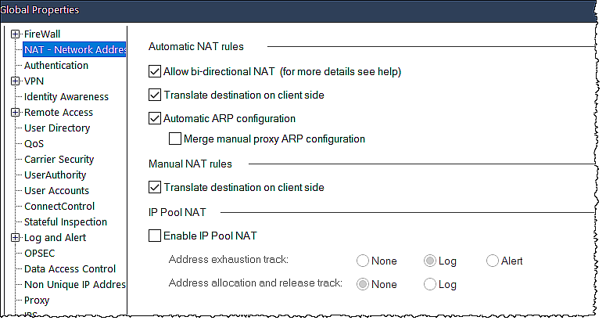
NAT Global Properties
Influence how NAT is handled by a Security Gateway.
Notes:
Several Global Properties influence how NAT is handled by a Security Gateway. The figure below shows the default Global Properties for NAT.
From the SmartConsole:
On the applications drop-down menu, select Global Properties.
Within the Firewall list, select NAT - Network Address Translation.

Slide 23
Automatic NAT Rules
Allow Bi-directional NAT:
  Applies to automatic NAT rules in the NAT Rule Base.
  Allows two automatic NAT rules to match a connection.
Translate Destination on Client Side:
  Applies to packets originating at the client with the server as the destination.
Notes:
In most cases, the Security Gateway automatically creates NAT rules based on information derived from object properties. The following parameters can be modified to adjust the behavior of Automatic NAT rules on a global level.
Allow Bi-directional NAT
Allow Bi-directional NAT applies to automatic NAT rules in the NAT Rule Base, and allows two automatic NAT rules to match a connection. Without
Bidirectional NAT, only one automatic NAT rule can match a connection.
When NAT is defined for a network object, an automatic NAT rule is generated that does the required translation. If NAT is defined on two objects (Host, address range or network) and the first object represents the source address of the connection and second object the destination address, two automatic NAT rules are created.
Without Bi-directional NAT only the first NAT rule will match the connection. The second rule is be ignored. With Bi-directional NAT, both rules are matched and the connection translated correctly.
Translate Destination on Client Side
Translate destination on client side applies to packets originating at the client, with the server as its destination. Static NAT for the server is performed on the client side. It is enabled by default.

Slide 24
Automatic NAT Rules (Continued)
Automatic ARP Configuration:
  Ensures that ARP requests are answered by the Check Point Security Gateway.
Merge Manual Proxy ARP:
  Merges the automatic and manual ARP configurations.
Notes:
Automatic ARP Configuration
Automatic ARP configuration ensures that ARP requests for a translated (NATed) machine, network or address range are answered by the Check Point Security Gateway.
Select this option to automatically update ARP tables on Security Gateways. For NAT to function properly, a Security Gateway must accept packets whose destination addresses differ from the addresses configured on its interfaces. Automatic ARP configuration adds the ARP entries needed to accomplish this task. This property applies to automatically created NAT rules only.
Merge Manual Proxy ARP
Merge manual proxy ARP configuration merges the automatic and manual ARP configurations.
Manual proxy ARP configuration is required for manual Static NAT rules. If a manual ARP configuration is defined in the local.arp file and Automatic ARP configuration is enabled, both definitions are maintained. If there is a conflict between the definitions (the same NAT IP address appears in both), then the manual configuration is used. If this options is not enabled and Automatic ARP configuration is enabled, the Security Gateway ignores the entries in the local.arp file.
ARP can be configured through the Gaia portal or Clish.

Slide 25
Manual NAT Rules
Firewall rulebase rule that handles connections from the Internet to the object on which NAT is performed - Use the real (untranslated) address for the NATed object.
Connections that are not sent to a security server - Use the NATed (fake) address for the NATed object.
Notes:
Manual NAT Rules
The Translate destination on client side option applies to packets originating at a client, with the server as its destination. By default, Static NAT for the server is performed on the client side.
If using Manual NAT for connections that are sent to a security server and Translate destination on client side is selected, take care to create the Firewall rulebase rule as follows:
• For the Firewall rulebase rule that handles connections from the Internet to the object on which NAT is performed, you must use the real (untranslated) address for the NATed object.
• For connections that are not sent to a security server, use the NATed (fake) address for the NATed object.

Slide 26
List the two types of rules that Check Point NAT supports for address translation.
What is the difference between Hide NAT and Static NAT?
Review Questions
Notes:
Answers:
Question 1:
Automatic
Manual
Question 2:
Hide NAT is a solution that only allows outgoing connections. It involves translating many private addresses to one public address. Using Hide NAT, the defined hosts and networks share the same address when their traffic is routed by the gateway. Different source port numbers are used to identify internal IP addresses on the one shared IP address. The source IP Address is changed to the shared address and the source port is modified to the identifier port. Hide NAT is most often used to allow internal users access to external resources.
Static NAT allows both incoming and outgoing connections. It involves the translation of one private IP address to a unique public IP address and from that unique public IP address to the private address. Static NAT allows a host with a private IP address to be translated to a unique public address. This method of translation is often used for Internet Web Servers and Check Point Security Management Servers. Any application that requires both inbound and outbound connectivity, or the ability for external hosts to connect to the servers requires a Static NAT configuration.

Slide 27

Lab 7A
Configuring Network Address Translation Policy
LAB
BREAK

Slide 28
Chapter 8
Security elevation
Notes:
This chapter discusses ways to elevate the environments security posture with Application Control and URL Filtering and Autonomous Threat Prevention.

Slide 29
Learning Objectives
Demonstrate an understanding of Application Control & URL Filtering and Autonomous Threat Prevention capabilities and how to configure these solutions to meet an organization's security requirements.

Slide 30



Application Control & URL Filtering
Granular control of social networks
Applications and application features
Identify, allow, block, or limit usage
Controls access to millions of websites by category, users, groups, and machines
Provides application security and identify control
Notes:
Check Point's Firewall innovation provides the industry’s strongest Application Control and URL Filtering for businesses of all sizes. Policies that detect or block thousands of applications and Internet sites can easily be created.

Slide 31
Application Control & URL Filtering Use Cases
Use Case | Solution
Learn About Applications | Use Check Point comprehensive AppWiki to understand what applications are used for and to determine risk levels.
Create a Granular Policy | Make rules to allow or block applications or Internet sites by individual application, application or URL categories, or risk levels.
Track Employees Online Usage | Based on traffic results, change policies to be more effective.
Keep Policies Updated | Application and URL Filtering Database is updated regularly with applications and site categories to help keep policies current.
Custom Applications, Sites, Categories, and Groups | Applications, websites, categories, and groups that are not in the Application and URL Filtering Database can be created for use in the Policy.
Notes:
Administrators use Application Control and URL Filtering Blades for the use cases listed in the table shown in your Student Guide.

Slide 32
Main Features of Application Control & URL Filtering
Granular Application Control
Largest application library with AppWiki
Integrated into Security Gateways
Central Management
SmartEvent Analysis
Notes:
Granular Application Control – Identify, allow, or block thousands of applications and Internet sites. This provides protection against the
increasing threat vectors and malware introduced by Internet applications and sites.
Largest application library with AppWiki – Comprehensive Application Control that uses the industry’s largest application library. It scans for and
detects more than 4,500 applications and more than 100,000 Web 2.0 widgets and categories.
Integrated into Security Gateways - Activate Application Control and URL Filtering on Security Gateways, including UTM-1, Power-1, IP Appliances,
and IAS Appliances.
Central Management – Lets you centrally manage security Policies for Application Control and URL Filtering from one user-friendly console for
easy administration.
SmartEvent Analysis - Use SmartEvent advanced analysis capabilities to understand your application and site traffic with filtering, charts, reporting,
statistics, and more, of all events that pass through enabled Security Gateways.

Slide 33
Application Control
Provides the industry’s strongest application security and identity control.
Lets IT teams create granular polices based on users or groups.
    Identify, block, or limit usage of Web 2.0 applications and social networking widgets.
Notes:
Provides the industry’s strongest application security and identity control.
Lets IT teams create granular polices based on users or groups.
Identify, block, or limit usage of Web 2.0 applications and social networking widgets.

Slide 34

Application Control
The Check Point Secure Web Gateway solution protects an organization from online security threats and infections by enforcing company policy and filtering Internet-bound traffic.
It is available as an on-premise or cloud-delivered network security service.
For additional information, refer to:
https://www.checkpoint.com/cyber-hub/network-security/what-issecure-web-gateway
Notes:
Check Point provides the industry's strongest application security and identity control to organizations of all sizes. It lets IT teams easily create granular policies based on users or groups to identify, block, or limit usage of over 4,800 Web 2.0 applications and 300,000 widgets. The Application Control Software Blade is a key component of the Secure Web Gateway Appliance.

Slide 35

Benefits of Application Control
Identify and control applications in an IT environment.
Automatically identify trusted software that has the authorization to run.
Prevent all other unauthorized applications from executing.
Eliminate unknown and unwanted applications.
Reduce the risks and costs associated with malware.
Improve overall network stability.
Identify applications running within endpoint environment.
Protect against exploits of unpatched OS and third-party application vulnerabilities.
Notes:
Companies have grown increasingly dependent on applications in day-to-day business operations. With web-based, cloud-based, and third-party
applications at the core of today’s business processes, companies are faced with the challenge of monitoring and controlling data security threats while operating efficiently and productively.
Most Application Control solutions include allow list and block list capabilities to show organizations which applications to trust and allow to execute and which to stop. With Application Control, companies of all sizes can eliminate the risks posed by malicious, illegal, and unauthorized software and network access.

Slide 36
Better Understanding of Data Environments with Application Control
Application Control:
Provides knowledge about key areas of applications, web traffic, threats, and data patterns.
Provides users a better understanding of applications or threats, behavioral characteristics, and usage.
Organizations gain knowledge about:
Traffic source and destination
Security rules and zones
Notes:
Most Application Control solutions also allow for visibility into applications, users, and content. This is helpful to understand the data your enterprise owns
and controls, its storage locations, which users have access to it, the access points, and the data transmission process. These steps are required for data
discovery and classification for risk management and regulatory compliance.
Application Control supports these processes and lets organizations be aware of what is happening within their network.
Application Control gives companies and organizations knowledge about key areas of applications, web traffic, threats, and data patterns. Users also benefit
from Application Control by gaining a better understanding of applications or threats, behavioral characteristics, and usage details.
Organizations also gain knowledge about traffic source and destination, security rules, and zones to get a complete picture of application usage
patterns, which in turn lets them make more informed decisions on how to secure applications and identify risky behavior. While they are making those
decisions, the Application Control solution is automatically protecting the network with allow list and block list capabilities.

Slide 37
URL Filtering
URL (Uniform Resource Locator) filtering restricts the online content that individuals can access.
Users are prevented from going to specific web sites and prohibited from using corporate resources in any way that could harmfully affect the organization.
Controls access to millions of web sites by category, users, groups, and machines.
Protects users from malicious sites.
Enables safe use of the Internet.
Educates users on Web Usage Policy in real time with UserCheck.
Notes:
Uniform Resource Locator (URL) filtering is a process that lets establishments restrict the online content that individuals can access. Users are prevented from going to specific web sites and prohibited from using corporate resources, such as bandwidth or devices, or in any way that could harmfully affect the organization.
Check Point URL Filtering controls access to millions of web sites by category, users, groups, and machines to protect users from malicious sites and enable safe use of the Internet. URL Filtering employs UserCheck technology, which educates users on Web Usage Policy in real time.

Slide 38
How URL Filtering Works
Compares web traffic against URL filters.
URL filter categories or groups include:
  Blocked sites
  Allowed sites
  Defined IT Policies
  Blocked or Allowed URL Filtering
Notes:
URL filtering works by comparing all web traffic against URL filters, which are typically contained in a database of sites that users are permitted to access or denied from accessing.
Each site in the database is assigned to a specific URL filter, which could be a category or group.

Slide 39

Need for URL Filtering
Control employee Internet access to inappropriate and illicit websites.
Control bandwidth issues.
Decrease legal liability.
Improve organizational security.
Notes:
As with Application Control, access to the Internet and non-work-related website browsing can open networks to a variety of security threats and have a negative effect on employee productivity.
URL Filtering can be used to:
• Control employee Internet access to inappropriate and illicit websites.
• Control bandwidth issues.
• Decrease legal liability.
• Improve organizational security.
When URL Filtering is set, employee data is kept private when attempting to determine a site category. Only the host part of the URL is sent to the Check Point Online Web Service. This data is also encrypted.

Slide 40
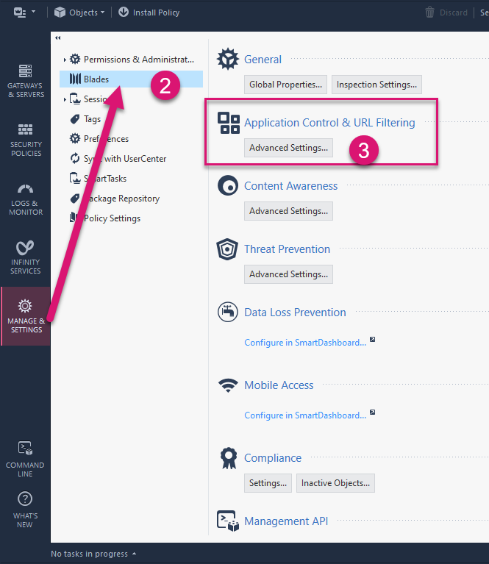
Configuring Application Control and URL Filtering
Connect to SmartConsole
From Manage & Settings, select Blades.
Under Application Control & URL Filtering, click Advanced Settings.

Slide 41
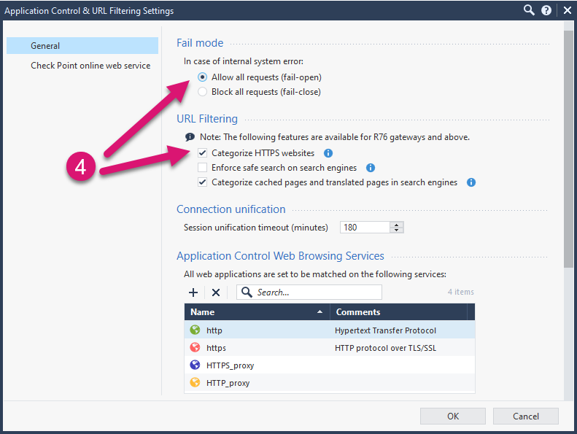
Configuring Application Control and URL Filtering (Continued)
From General, under Fail mode, enable Allow all requests (fail-open) and under URL Filtering, enable Categorize HTTPs websites.

Slide 42
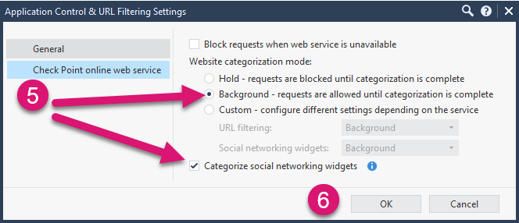
Configuring Application Control and URL Filtering (Continued)
From Check Point online web service, select Background and select Categorize social networking widgets.
Click Ok.
Install the policy.

Slide 43
Autonomous Threat Prevention
Provides out-of-the-box Threat Prevention, which reduces administrative overhead.
Single Click Configuration
Streamlined Configuration and Deployment
Automatic Configuration Updates
Optional Customization
The Threat Prevention configuration is always up-to-date without the need for manual labor.
Notes:
With R81 and higher, Autonomous Threat Prevention provides out-of-the-box Threat Prevention. This reduces administrative overhead. The major features of this new way of managing Threat Prevention Security Gateways are as follows:
• Single Click Configuration - The administrator just needs to choose one of the predefined network types for the Security Gateways to protect
(Perimeter, Cloud/Data Center, Internal Network, Guest Network, Strict Security).
• Automatic Configuration Updates - Check Point automatically updates the profile and the customers automatically enjoy new features, advanced
protections enabled (based on research and ongoing attacks), and other best practices.
• Streamlines configuration and deployment of policy profiles across your Security Gateways.
• Provides simple and powerful customization to serve your organization’s needs.
• Zero day-to-day maintenance is required from the administrator, while maintaining optimal security.
Your Threat Prevention configuration is always up-to-date, without the need for manual intervention. For example, assume a new and ongoing attack performs lateral movement in internal networks with a specific file type. Check Point updates its best practices so these files are blocked immediately on all relevant Security Gateways managed by Autonomous Threat Prevention Management.

Slide 44
Autonomous Threat Prevention Profiles
Recommended for Perimeter Profile (Default):
  Provides optimized security for the perimeter Gateway and protection for users browsing the web, data centers, incoming emails, and FTP.
  Recommended for multiple protections on the same Gateway.
  Most like the Custom Threat Prevention Optimized profile.
Data Center East/West Profile:
  Optimized security to prevent cyberattacks on data centers. Includes extensive protection over servers and east–west traffic.
Notes:
Autonomous Threat Prevention includes the following preconfigured Threat Prevention profiles to give the organization the exact level of protection it needs.
Recommended for Perimeter Profile (Default)
This profile provides optimized security for the perimeter Gateway and protection for users browsing the web, data centers, incoming emails, and FTP. It is recommended for multiple protections on the same Gateway; for example, when perimeter and Internal network protection are needed. It is like the Custom Threat Prevention Optimized profile.
Data Center East/West Profile
This profile provides optimized security to prevent cyberattacks on data centers. Includes extensive protection over servers and east–west traffic.

Slide 45
Autonomous Threat Prevention Profiles (Continued)
Internal Network Profile:
  Provides maximum security to prevent cyberattacks over internal traffic between internal users and internal servers.
Strict Security for Perimeter Profile:
  Provides maximum security to prevent cyberattacks over internal traffic between internal users and internal servers.
Recommended for Guest Network Profile:
  Detect mode profile to monitor cyberattacks attempts through a guest network (Wi-Fi) non-intrusively.
Notes:
Internal Network Profile
This profile provides maximum security to prevent cyberattacks over internal traffic between internal users and internal servers.
Strict Security for Perimeter Profile
This profile provides maximum security for perimeter Gateways. It includes protection for users browsing the web, data centers, incoming emails, and FTP.
Recommended for Guest Network Profile
This is a Detect mode profile to monitor cyberattacks attempts through a guest network (Wi-Fi) non-intrusively.

Slide 46
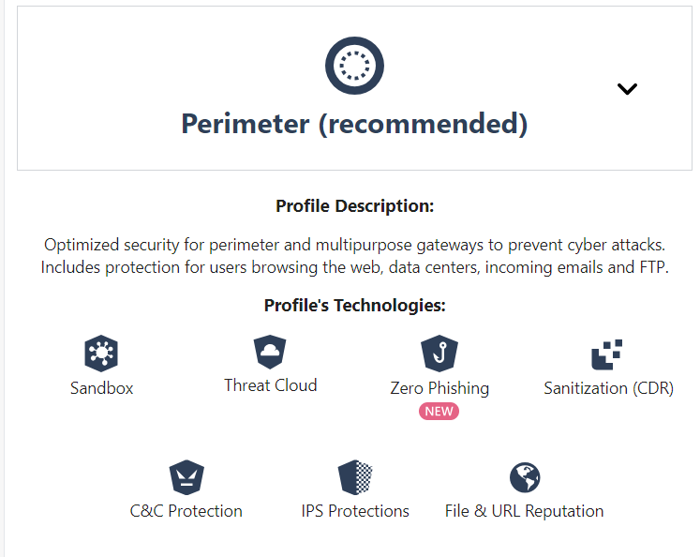
Technologies Used by Autonomous Threat Prevention Profiles
Each Autonomous Threat Prevention profile consists of a wide range of industry-leading protections, as shown in the figure.
Notes:
Each Autonomous Threat Prevention profile consists of a wide range of industry-leading protections, as shown in the figure. See the following section for additional information about each technology.

Slide 47
Technologies Used by Each Profile
Autonomous Profile | Description
Sandbox | Prevents unknown, zero-day and advanced polymorphic attacks by executing suspicious files in evasion-resistant sandbox and applying advanced AI techniques. It is used in all Autonomous Threat Prevention profiles.
ThreatCloud | ThreatCloud is cloud-based real-time global threat intelligence using Check Point worldwide network of threat sensors. It is used in all Autonomous Threat Prevention profiles.

Slide 48
Technologies Used by Each Profile (Continued)
Autonomous Profile | Description
Zero Phishing (R81.20 and higher) | Prevents unknown zero-day and known phishing attacks on websites in real-time, by utilizing industry-leading, Machine-Learning algorithms and patented inspection technologies. URL-based Zero Phishing is used in the Recommended for Perimeter and Strict Security for Perimeter profiles. In-browser Zero Phishing is not used in any profile.

Slide 49
Technologies Used by Each Profile (Continued)
Autonomous Profile | Description
Sanitization (CDR) | Provides proactive prevention of unknown attacks from day zero, by sanitizing incoming files before delivering them to users. It is used in the following Autonomous Threat Prevention profiles: Recommended for Perimeter profile Strict Security for Perimeter profile
C&C Protection | Detects infected and compromised devices on the network. It blocks attacks and prevents damage by blocking malware C&C communications. It is used in all Autonomous Threat Prevention profiles.

Slide 50
Technologies Used by Each Profile (Continued)
Autonomous Profile | Description
IPS Protections | Implements advanced protections from network-based attacks and protects all IT systems, including servers, endpoints, industrial systems, and IoT. It is used in all Autonomous Threat Prevention profiles.
File & URL Reputation | Examines files and URLs through the ThreatCloud repository for reputation. It is used in all Autonomous Threat Prevention profiles.

Slide 51
Customized Profiles
Autonomous Threat Prevention profiles can also be customized for an organization’s specific needs using exceptions and advanced settings to mold policies in accordance with the requirements of a company's network environment.
Notes:
Autonomous Threat Prevention profiles can also be customized for an organization’s specific needs using exceptions and advanced settings to mold
policies in accordance with the requirements of a company's network environment.

Slide 52
Monitoring Threat Prevention
Log Sessions - Consolidated logs based on sessions.
Packet Captures - Greater insight into traffic that generated the log
Advanced Forensic Details - Additional fields that hold information that can be used for advanced forensic analysis of the traffic that triggered a protection.
Notes:
Check Point's Threat Prevention system can provide significant data on past attacks. This crucial data informs administrators on the origins of attacks and how to defeat future attacks. When the Gateway generates a log, you have many options for what is included in them.

Slide 53

Log Sessions
To manage log volume, Threat Prevention logs are consolidated based on sessions.
  This is the default.
  Session starts when a user first accesses an application or site.
During a session:
Gateway records one log for each application or site accessed by the user.
All user activity included in the log.
View the Suppressed Logs field to determine the number of connections made during the session.
Notes:
Log Sessions
Security Gateways generate a large amount of traffic logs based on traffic volume. In an attempt to ensure a manageable volume of logs, many Threat Prevention logs are consolidated based on sessions by default. A session is a period that starts when the user first accesses an application or site.
During a session, the Gateway records one log for each application or site the user accesses. All of the user activity within the session is included in that log.
The number of connections made during the session is logged in the Suppressed Logs field of the log in the Logs & Monitor view of SmartConsole.

Slide 54

Packet Captures
With the packet capture feature activated,
  The Security Gateway sends a packet capture file with the log to the Log Server.
  Packet captures can be opened from the log or saved for later review.
Notes:
Packet Captures
Many protections in the Threat Prevention solution have the option to collect a
network traffic capture when a threat is detected. The content of the capture
provides greater insight into the traffic that generated the log. In some cases,
packet captures are collected by default, but in others the feature must be
activated on each protection for which it is desired.
With the packet capture feature activated, the Security Gateway sends a
packet capture file with the log to the Log Server. The packet captures can be
opened from the log or saved to a file location for later review.

Slide 55

Advanced Forensic Details
Support the following protocols:
  DNS
  FTP
  HTTP
  HTTPS
  SMTP
Notes:
Advanced Forensic Details
Some logs contain additional fields that hold information that can be used for advanced forensic analysis of the traffic that triggered a protection. These Advanced Forensic Details support the following protocols:
• DNS
• FTP
• HTTP
• HTTPS
• SMTP
The additional information can be used by Check Point researchers to analyze
attacks and improve protections.

Slide 56
List at least two use cases for Application Control.
How does URL filtering work?
What is the recommended profile supported by Autonomous Threat Prevention?
Review Questions
Notes:
Answers:
Question 1:
Learn about applications
Create a granular policy
Track employees online usage
Keep policies updated
Customize applications, sites, categories, and groups
Question 2:
URL filtering works by comparing all web traffic against URL filters, which are typically contained in a database of sites that users are permitted to access or denied from accessing.
Question 3:
Perimeter

Slide 57
Lab 8A
Integrating Security with a Unified Policy
LAB
BREAK

Slide 58
Lab 8B
Elevating Security with Autonomous Threat Prevention
LAB
BREAK

