Slide 1

PROFESSIONAL DEVELOPMENT WITHIN HEALTH AND SOCIAL CARE LCHS4005
STUDENT: JAVARIA REHMAN 2128580
LECTURER: FOUZIYA FARHEEN

Slide 2
Contents
Introduction…………………………………………………………….Slide 3
What is Communication………………………………………………Slide 4
Categories of Communication………………………………..……..Slide 5
Transactional Model of Communication.…………………………...Slide 6
Why is Communication Relevant in Health and Social Care…….Slide 7
Example of How Communication Can Be Used in Health Care…Slide8
Effects of Poor Communication..…………………………………....Slide 9
Patients Discharge……………………………….………………......Slide 10
Conclusion……………………………………………………………..Slide 11
References…………………………………………………………….Slide 12 -14

Slide 3

Introduction
The purpose of this presentation is to describe why communication is relevant to working within health and social care and how I will apply this skill as a health care assistant.
Source, 123rf.com,(2023).

Slide 4
What is Communication?
The process of conveying knowledge and understanding from one person to another is known as communication.
The Latin word communis, means common. The word communication is derived from this Latin word. The term emphasises the point that there can be no communication until there is an understanding that arises from the transfer of information
There are three components to a communication: the sender, the message, and the recipient.
The transfer of information is only one aspect of communication. It requires some degree of success to transmit or convey a message, as any breakdown can prevent the understanding from being transferred.
Effective communication involves actively listening (Lunenburg, F.C. 2010)

Slide 5
  Categories of Communication
There are many different ways in which we can communicate. These methods can be used within the health and social care sector, such as GP surgeries, hospitals, nursing homes and social care support facilities.
Communication is a combination of:
Verbal - oral and written language.
Nonverbal - gestures, posture, mimics, appearance and movement.
Paraverbal - words accompanied by voice attributes for example tone, rhythm, flow of speech (Chichirez, Purcărea 2018).
Written communication includes emails, letters, magazines, the internet, social media, handbooks etc (Lunenburg, F.C. 2010)

Slide 6
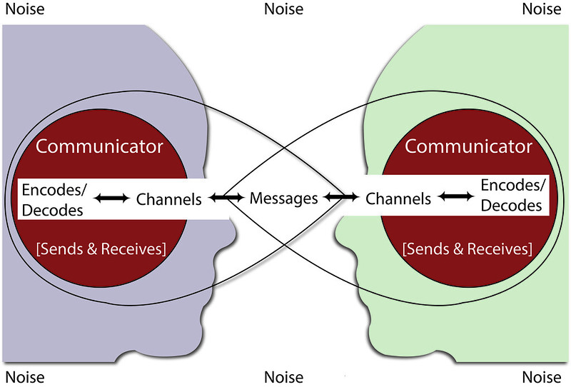
Transactional Model of Communication
The transactional model of communication was created by Dean C. Barnlund in 1970 (Wrench, Punyanunt-Carter, Thweat. 2022).
The Transaction Model of communication has notably different sender and recipient roles than the other models Participants in a communication encounter are considered as communicators rather than senders and receivers. According to the Transaction Model, you are both a sender and a receiver simultaneously (Lapum, J. et al. n.d).
Source. Wrench, Punyanunt-Carter, Thweat. 2022.

Slide 7
Why is Communication Relevant in Health and Social Care
Communication takes on many different forms and occurs in a variety of contexts in healthcare.
A relationship of trust can be built between the medical staff and the patient/service user when communication is carried out effectively and properly
The most crucial kind of communication in medicine, is that between patient and medical staff which offers much of the information required to establish a diagnosis
A performance-enhancing factor is how medical staff responds to the needs of service users. This enhances the medical facility's reputation and increases patients' and clients' interest in it (Chichirez. Purcărea, 2018).

Slide 8
Example of How Communication can be used in Health and Social Care
As a health care assistant, it is vital to have good communication skills to provide
Emotional support to patients,
Protect their privacy.
Discuss any treatment plans with other health care professionals and patients.
Listen to concerns and address any issues for the best possible outcome for patients.
If there are any language barriers, then these need to be addressed appropriately.
Patients and their families as partners in their health care, can feel empowered when their healthcare information has been effectively communicated to them.
Effective communication is also vital in safe transitions in healthcare
When transitioning from one health care setting to another, these all present chances to overlook critical aspects of healthcare communication, as well as patient and family satisfaction. If information is not communicated effectively between care providers then this can lead to poor transitions. Therefore, it is vital that effective communication takes place (Mansukhani, R.P., Candelario, D. and Eckert, L.J. 2015).

Slide 9
Poor Communication
Examples of the negative effects of inadequate communication on healthcare costs:
Unnecessary hospital admissions
Readmissions
Needless testing
Repeated referrals
(Vermeir, P. et al. 2015).

Slide 10
Patients Discharge
Communication interventions at the time of patients being discharged are significantly related to greater patient satisfaction, less hospital readmissions, and more adherence to treatment.
As patients are discharged, medical professionals need to integrate their conditions, perceptions, and needs with important information, such as the patient's diagnosis and course of treatment (Becker, C. et al. (2021).
When patients leave the hospital, sending discharge letters as a way of communicating the information to both them and their doctors could significantly improve patient outcomes (Warwick.ac.uk, 2020).

Slide 11
Conclusion
Effective communication is essential in health and social care as it can ensure the most safe and effective delivery of care, it can also aid in building meaningful relationships with service users, carers and everyone involved.

Slide 12
References
Becker, C. et al. (2021) Interventions to improve communication at hospital discharge and rates of readmission: A systematic review and meta-analysis, JAMA network open. U.S. National Library of Medicine. Available at: https://www.ncbi.nlm.nih.gov/pmc/articles/PMC8397933 (Accessed: March 8, 2023).
Chichirez, C.-M. and Purcărea, V.L. (2018) Interpersonal Communication in Healthcare, Journal of medicine and life. U.S. National Library of Medicine. Available at: http://www.ncbi.nlm.nih.gov/pmc/articles/PMC6101690/ (Accessed: March 7, 2023).
Including patients in hospital discharge communication would improve outcomes of care (2020) Warwick News & Events. University of Warwick. Available at: https://warwick.ac.uk/newsandevents/pressreleases/including_patients_in/ (Accessed: March 12, 2023).

Slide 13
References Continued
Lapum, J. et al. (no date) Transaction model of communication, Introduction to Communication in Nursing. Available at: https://pressbooks.library.torontomu.ca/communicationnursing/chapter/transaction-model-of-communication/ (Accessed: March 6, 2023).
Lunenburg, F.C. (2010) Communication: The process, barriers, and improving effectiveness, Schooling. Sam Houston State University. Available at: https://www.mcgill.ca/engage/files/engage/communication_lunenburg_2010.pdf (Accessed: March 12, 2023).
Mansukhani, R.P., Candelario, D. and Eckert, L.J. (2015) Exploring transitional care: Evidence-based strategies for improving provider Communication and Reducing Readmissions, P & T : a peer-reviewed journal for formulary management. U.S. National Library of Medicine. Available at: https://www.ncbi.nlm.nih.gov/pmc/articles/PMC4606859/#b2-ptj4010690 (Accessed: March 11, 2023).

Slide 14
References Continued
Vermeir, P. et al. (2015) “Communication in healthcare: A narrative review of the literature and practical recommendations,” International Journal of Clinical Practice, 69(11), pp. 1257–1267. Available at: https://doi.org/10.1111/ijcp.12686
Word cloud with communication related tags (2023) 123RF. Available at: https://www.123rf.com/photo_29959064_word-cloud-with-communication-related-tags.html (Accessed: March 5, 2023).
Wrench, J.S., Punyanunt-Carter, N.M. and Thweatt, K.S. (2022) 2.4: Models of Interpersonal Communication, Social Sci LibreTexts. Libretexts. Available at: https://socialsci.libretexts.org/Bookshelves/Communication/Interpersonal_Communication/Book (Accessed: March 6, 2023).

