Slide 1
Contents page
Introduction
Case Study -Overview of chosen family
Mother- concerns and difficulties
Child- concerns and difficulties
Action plan
Behavioural, referrals and community's
Crisis line – Maslow's Safeguarding measures
Pros and cons
Additional factors/concerns both (pos/neg)
Legislations ad policy's
Future resources and recommendations.
Assessment/ steps moving forward
Ensuring safeguarding
Safeguarding plan
Housing needs
Additional Agencies of support
Positive and challenges within support services
Potential outcome
Conclusion
References

Slide 2

Introduction
Our aim is to analyse and evaluate UK legislation laws and policies, such as the Mental Capacity Act 2010 and The human rights act 2007 to understand the best methods and resources available to help support and care for families (parents and children).
Looking at relevant health and social care services and agency's that can offer support care and advice in many other areas for families. Looking at a case study Identify the possible causes behind the concerns of Family C.
What teams and services they could benefit from working with, and what could be recommended for improvements to be made, we have explored possible contributing factors that could be the reasoning behind the families' complications such as;
The housing repair concerns / recommendations or support.
The psychological health concerns of the mother.
The behavioural problems of the children.
Environmental and social factors.
Possible preventions for the children.
Unknown situation with farther.

Slide 3
Case Study- Family C
Our chosen study is based on a family that is experiencing some neurological and behavioural Problems.
Some issues regarding the family are:
Mom who suffers with psychological health issues.
6 children from the ages 1 to 17/+ (Oldest two daughter live independently)
One of two boys is presenting behavioural problems
Housing repairs are a concern to the family

Slide 4
Mothers Concerns / Difficulties
Mother has psychological difficulties this could be anything from acute to long term such as;
Either internal or external, many different contributing factors that could cause the mother to have difficulties in her life daily, and this could affect her parenting ability’s Behavioral or emotionally
-Causing other issues such as:
Anxiety disorder
depression
Bipolar
schizophrenia
Possible factors
Lack of parental support for farther.
Childhood abuse, trauma or neglect.
Social disadvantages, such as poverty or debt.
Lack of local interaction (isolation) loneliness.
Discrimination and stigma, including racism .
Server or long-term stress.
Physical or psychological health condition.

Slide 5
Childrens Concerns and Difficulties
One of the young boys is displaying traits of behaviour that is deemed as concerning – this may be because he is fighting for attention off his mom – she doesn’t give him enough due to having multiple children and her psychological difficulties.
Some children have several different types of behavioral disorders such as attention deficit hyperactivity disorder or emotional disorders like anxiety or depression, developmental disorders such as autism, all either internal or external, (Ogundele, 2018).
It is very common for children of preschool and school age children to be defiant being disruptive, having temper tantrums and ADHD.
Lack of routine/ parental supervision
Low self esteem
Learning disabilities
Behavioural/ disruptive disorders
Emotional disorder
Abuse/neglect

Slide 6
Professional intervention
As the family are under child in need plan a social worker will be present to see the family and support in the needs and requirements of their health and home. This will ensure that the plan of action table will have a greater impact on organisation on the mind of the mother allow communication, rules and chores are met and completed local authority provision helps the service of health, education, and police. This states in children act 2000. (Thoborn, J,. 2023).
Early intervention is very important to getting the correct support, from the right services, using systematic reviews and meta-analysis of a person's conditions, CBT and family intervention is always a core recommendation when trying to help support those who have behavioural and emotional disorders

Slide 7

Behavioural, Referrals & Community
It has been hypothesised that emotion plays a vital role in social work assessment (Ingram, 2015) and that Emotional Intelligence (EI) - the capacity to identify, manage and respond to emotion – is key to effective professional judgement and practice (Morrison, 2007).
Influencing each other through meetings as a family, by this the family can develop emotional balance as the communication between the family members can all voice. This will help the change in structure of the family for stronger mentally and physically. (Calatrava, M. et al, 2023).
This can also develop by meeting at community centres where other parents can meet and children and can help with how every family is different, by how they raise their children. As every family is uniquely different through socially, economically, and emotionally. (Anderson, J,.2014).
For the son with behavioural problems, a one-to-one session will commence to help underline the issues of how his behaviour started. Cognitive behavioural therapy will help the young boy as well as help the mother and possibly the other 2 children, this could occur for them in later life. (Creswell, C. al et,. 2019).
A family can struggle with the services the Barclay Committee acknowledgment helps families, non-accidental injuries, some mental health cases and juvenile delinquents. (Alber, j,.1995).

Slide 8
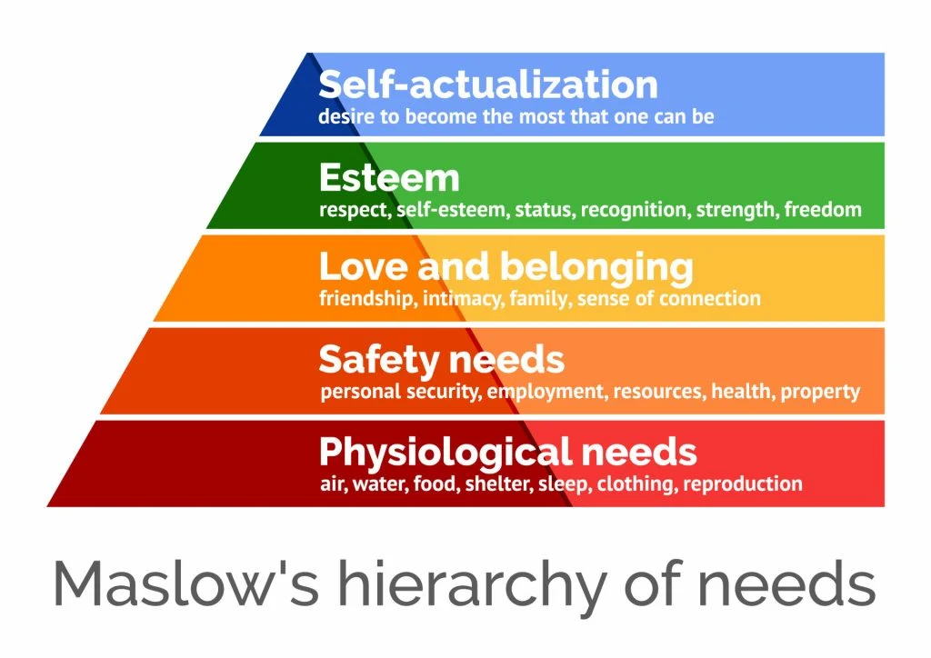
HSC Support model
(McLeod , 2023)
https://youtu.be/c5OJ18NggH0
Notes:
People are driven by motivation and need
Human needs
Physiological needs - needs vital to survival - food water shelter
Safety needs - order and predictivity and control needs are filled by society
Love and belonging needs - friendships and social interactions need for acceptance, romantic desire
Esteem -efforts recognised, accomplishment ,team participation
Self-actualization - concerned with personal growth , fulfilling own potential

Slide 9

Maslow Hierarchy
Maslow hierarchy explains how keeping positive mind, happiness, so with the family attending a 6-week course of 1-hour sessions starting with interacting with each family members feelings to understand this will help increase their minds leading them to positive minds. (Maslow, A., 2023). This could help the healthy minds overcome the psychological issues, helping to lead the family forwards a brighter future.
Self-actualization comes with the plan of action. This shows the activities to potentially create creativity within the minds. Team working and building skills as a family helps the family understand communication also helping the self-esteem of everyone within the household. (Poston, B., 2009).
Crisis line
In 2000 England was the first to introduce home treatment crisis team. (Khalifeh, H,. al el. 2019). This is to help the family comfortable; this helps if an emergency. The council for repairs helps within 24 hours according to government website. The social and mom will apply for help from her local council, as she can apply for garage/storage unit, (Shobiye, L. and Parker, S,.2023). to accumulate the belongings from her home whilst she renovates the damaged rooms.
Action planning
Though many different services that can be offered and accessed by the family, to help the parent keep a good health structure in the household (and publicly), introducing an action plan that will help each one of the family have a routine, that will benefit them for the suture, helping them develop better cognitive skills , having a specific time to go to bed and wake up for their day-to-day tasks , this overall will help the family create a good balance, (Mechelen and Bradshaw, 2009)

Slide 10
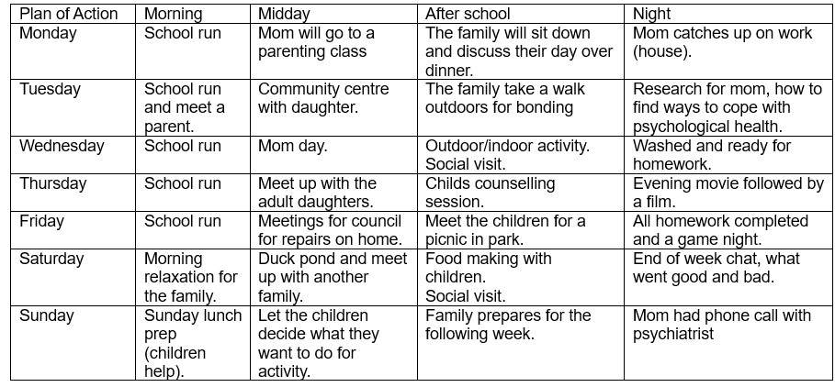
Action plan
This care plan was created to help the family to commit to a routine and know what the plan of action is, this is shown as over whelming for the mother so it was suggested and agreed that the adult daughters will split the week for the first month of helping mom and family adjust to a schedule, this also shows that mom thought if she was to split the table into two weeks will help mom identify what to do fortnightly.

Slide 11
Young adults' perception of well- being
How might and individuals' perception of health affect their behaviour and well-being?
Depending on family's, peers' perceptions.
How its betrayed in the media,
Previous experience such as being ill or having a disease (Chronic conditions)
A persons environment, such as our location (distance) to access the services
Implications
Society's view means that being beautiful mean being healthy
the price of health food compared to unhealthy food
Access to some services, others are hard to access, easier to access through private services.

Slide 12

Additional information and moving forward
Therapy for the family is trust, mutual understanding, social support and self- efficacy, with this therapy the family will improve within these factors. (Street, Jr., al et 2009).
Education and health. This is a 5-week course that will help the family emerge qualitive evident of what progress and challenges the family face. This service helps underline psycho-social development, such as self-esteem, self-awareness and self-perception. (Feinstein, L,. Al et. 2006).
In 2015, behavioural therapy became more into the community rather than schools, this helps ensures the home requirements are sustainable for the child as well as the school setting. Multi-disciplinary team comes within the services of adaptive skills that support skills, nursing and medication, this is beneficial for the children of the family as this can be performed and assessed when outdoors participating in family activities or even at home. (Bowring, D. L,. 2020).
Family and friend support, young adults tend to find it more comfortable to be around family and friends when undergoing therapies, treatments, health, education and home. Children are more influential and motivated to participate if their peers are. (Sheehan, H,. 2023).
Once the family have attended and stated committed to the courses, the family will have assessments starting with 6 weeks then 6 months and followed by a year review. This is to ensure the family will move forward together, with these steps the family will be able to move forward once the family and the team worked together to give independency back into their lives. (Huston, R,. And CLASP. 2004).

Slide 13

Everyone is different
As every family culture and how they parent is different. Mom will attend a parenting class, this will help the attitudes from the children, help with boundaries and discipline methods, this course will also help entice structure of the family and help mom understand the feelings of her children and how to understand the support each child needs and how to continue to become a stronger and healthier family. Support and welfare division will continue to support mom and family throughout the children's academical years within school. This will help support mom throughout the forthcoming years. This will be helpful as the schools offer additional support to children and parents when struggling with health and safety. (Harris, K. M,.1996).

Slide 14

Safeguarding Policy's
What is safeguarding?
The term 'Safeguarding' means to protect , i.e., preventing or avoiding a person from risk or harm and neglect. Understanding your safeguarding duties is key for any organisation to develop better safeguarding practices,(Scie, 2017)
Six principles of child safeguarding are;
Empowerment, people being supported to make their own decisions and informed consent.
Prevention. Acting before harm occurs
Protection, keeping them away from harm
Proportionality, mindfulness and appropriation when responding to the presented risk.
Partnership. Working collaborative with other professional bodies and services to ensure safeguarding.
Accountability, being responsible for your own roles and duties when supporting others, being self-aware
Typically, In this cases, is there are would have been some reports made from the school as it would be their duty of care to firstly speak with parents,
if the school still see the family dynamic as concerning meaning they think the mother may need more support.
A further report will be made to CBT which will be beneficial for the family and for a Parenting capacity assessment to be done, to see if the parent is capable to look after herself mentally and physically, to be able to care for the children,(Scie, 2017)

Slide 15
UK Legislations and Policy and Standards
Legislations are set the laws, procedures or standards that people and organizations must follow, set of laws to protect businesses, employers and consumers, set by the UK parliament. The ones that protect patients receiving support from primary and secondary services are as follows;
Legislations
Safeguarding vulnerable groups act 2006 and the protection of freedoms bill.
The Human Rights Act 2000 (equality and human rights 2007)
Sexual offence Act.
Care Act 2014.
Ill treatment or Wilful neglect.
Equality act 200
GDPR
Advocacy.
Data Protection Act.
Mental capacity act (to promote a person centred, rights-based approach to supporting people ).
DoLS - (Deprivation of liberty safeguarding).
NICE- Quality standards on child abuse and neglect.
Policies and Procedures
Accident and incident reporting
Care planning and needs assessments
Diversity and equality policy
Confidentiality policy
Health and safety
Informed consent
Mental capacity act policy
Supervision and appraisal
Power of attorney policy
Privacy and dignity
Managing challenging behaviour accidents and incidents reporting
Complaints and whistleblowing
Safeguarding policy
Data protection policy

Slide 16
Future resources and recommendations
Many resources are available today under government funding, depending on the area, As a recommendation the family is to undergo an ‘family needs assessment’ this will help better understanding the probing complications and how best to support the mother and children or worst case, a child protection plan (Scie, 2017)
Access to charities and voluntary services that offer free help and advice.
CBT (cognitive behavioural therapy)
CAMHS
Childline
Therapies, counselling.
Youth organisations (Young Minds, The Children’s society, NSPCC)
SFPC – Eighteen local authorities working In partnership supported to reduce the number of children entering care homes, by improving support and care for children and families using new innovating programmes

Slide 17

References
Scie, (2020). Legislation relating to safeguarding adults | Overview for social care | SCIE. [online] scie.org.uk. Available at: https://www.scie.org.uk/key-social-care-legislation/safeguarding-adults [Accessed 1 Jan. 1970].
SFPC, (2023)| Strengthening Families, Protecting Children (SFPC). [online]. Available at: https://www.scie.org.uk/strengthening-families/about..
Children and Social Work Act 2017. [online] legislation.gov.uk. Available at: https://www.legislation.gov.uk/ukpga/2017/16/contents/enacted [Accessed 1 Jan. 1970].
Mind, ()What causes mental health problems? - Mind. [online]. Available at: https://www.mind.org.uk/information-support/types-of-mental-health-problems/mental-health-problems-introduction/causes/..
Ogundele, M. (2018). Behavioural and emotional disorders in childhood: A brief overview for paediatricians - PMC. [online]. Available at: https://www.ncbi.nlm.nih.gov/pmc/articles/PMC5803568/. [Accessed 1 Jan. 1970].
Child protection - Family Rights Group. [online]. Available at: https://frg.org.uk/get-help-and-advice/what/child-protection/?gclid=CjwKCAjwv8qkBhAnEiwAkY-ahoBTaWacUWAvUcuIEEZ466NTXLb1-XB15XQt5g3kiTDUddtneiUG8hoC6qsQAvD_BwE..
Herring S, Gray K, Taffe J, Tonge B, Sweeney D, Einfeld S. Behaviour and emotional problems in toddlers with pervasive developmental disorders and developmental delay: associations with parental mental health and family functioning. J Intellect Disabil Res. 2006 Dec;50(Pt 12):874-82. doi: 10.1111/j.1365-2788.2006.00904.x. PMID: 17100948.
McLeod , S. (2023). Maslow's Hierarchy of Needs. [online]. Available at: https://www.simplypsychology.org/maslow.html. [Accessed 1 Jan. 1970].
Mechelen, N. and Bradshaw, J. (2009). Child Poverty as a Government Priority: Child Benefit Packages for Working Families, 1992–2009 | SpringerLink. [online]. Available at: https://link.springer.com/chapter/10.1057/9781137291844_4. [Accessed 1 Jan. 1970].

Slide 18

Anderson, J., (2014). The impact of family structure on the health of children: Effects of divorce. The Linacre Quarterly, 81(4), pp.378-387. [accessed date 01/6/23],
Bowring, D.L., Totsika, V., Hastings, R.P. and Toogood, S., (2020). Outcomes from a community‐based Positive Behavioural Support team for children and adults with developmental disabilities. Journal of Applied Research in Intellectual Disabilities, 33(2), pp.193-203. [accessed date 22/6/23].
Calatrava, M., Swords, L. and Spratt, T., (2023). Socio-emotional adjustment in children attending family centres: The role of the parent–child relationship. The British Journal of Social Work. [accessed date 29/5/23].
Creswell, C., Parkinson, M., Thirlwall, K. and Willetts, L., (2019). Parent-led CBT for child anxiety: Helping parents help their kids. Guilford Publications. [accessed date 11/6/23].
Feinstein, L., Sabates, R., Anderson, T.M., Sorhaindo, A. and Hammond, C., (2006), March. What are the effects of education on health. In Measuring the effects of education on health and civic engagement: Proceedings of the Copenhagen symposium (pp. 171-354). Paris, France: Organisation for Economic Co-operation and Development. [accessed date 22/6/23].
Harris, K.M., 1996. Life after welfare: Women, work, and repeat dependency. American Sociological Review, pp.407-426.
Hutson, R.Q. and CLASP, (2004). Providing Comprehensive, Integrated Social Services to Vulnerable Children and Families: Are There Legal Barriers at the Federal Level to Moving Forward?. Center for Law and Social Policy. [accessed date 22/6/23].
Ingram. R., (2015). Understanding Emotions in Social Work: Theory, Practice and Reflection. McGraw-Hill Education (UK). [accessed date 29/5/23].

Slide 19

Khalifeh, H., Murgatroyd, C., Freeman, M., Johnson, S. and Killaspy, H., (2009). Home treatment as an alternative to hospital admission for mothers in a mental health crisis: a qualitative study. Psychiatric Services, 60(5), pp.634-639.
Kuppens, S. ceulemans, E.,(2019). Parenting Styles: A Closer look at a Well-Known concept. https://www.ncbi.nlm.nih.gov/pmc/articles/PMC6323136/. [Accessed date 01/06/23].
Maslow, A., (2023). APPLICATIONS OF POSITIVE PSYCHOLOGY: FROM SURVEYS TO INTENTIONS. Positive Psychology for Healthcare Professionals: A Toolkit for Improving Wellbeing, p.109.
Morrison, T., (2007). Emotional intelligence, emotion and social work: Contexts, characteristics, complications and contribution. British Journal of Social Work, 37, 245-263. [accessed date 26/5/23].
Poston, B., (2009). Maslow’s hierarchy of needs. The surgical technologist, 41(8), pp.347-353. [accessed date 20/6/23].
Sheehan, H., (2023). Bring your support team with you: The role of family and friends in supporting the motivation of international secondary students. International Journal of Educational Development, 97, p.102713. [accessed date 22/6/23].
Shobiye, L. and Parker, S., (2023). Narratives of coercive precarity experienced by mothers seeking asylum in the UK (Wales). Ethnic and Racial Studies, 46(2), pp.358-377.
Street Jr, R.L., Makoul, G., Arora, N.K. and Epstein, R.M., (2009). How does communication heal? Pathways linking clinician–patient communication to health outcomes. Patient education and counseling, 74(3), pp.295-301. [accessed date 22/6/23].
Thoburn, J., (2023). Child welfare and child protection services in England. Oxford Handbook of Child Protection Systems, p.135. [accessed date 02/06/23].
Vismara, L.A. and Rogers, S.J., (2010). Behavioral treatments in autism spectrum disorder: what do we know?. Annual review of clinical psychology, 6, pp.447-468. [accessed date 26/5/23].

